Slide 1
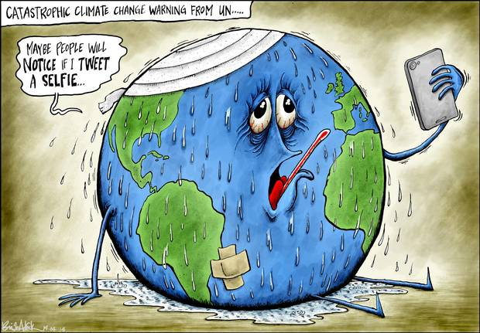
Econ 275 – Environmental Economics
Chapter 17 Lecture - Climate Change

Slide 2
The Science of Climate Change
Greenhouse gases absorb infrared radiation, trapping heat that would otherwise radiate into space.
  Carbon dioxide: most abundant
  Emissions of these gases increasing over time
Intergovernmental Panel on Climate change (IPCC) reported in 2007 that most warming over last 250 years can be attributed to human activity.
https://www.un.org/en/climatechange/reports?gad_source=1&gclid=EAIaIQobChMIqIyW4OHViQMVjmZHAR2GAhiSEAAYASAAEgIENfD_BwE

Slide 3
The Science of Climate Change
With respect to projected climatic changes, the report found the following:
CO₂ increases due to use of fossil fuels and land-use change, methane/NO₂ due to agriculture.
The global increases in carbon dioxide concentration are due primarily to fossil-fuel use and land-use change, while those of methane and nitrous oxide are due primarily to agriculture.
Warming of the climate system is unequivocal, as is now evident from observations of increases in global average air and ocean temperatures, widespread melting of snow and ice, and rising global average sea level.

Slide 4
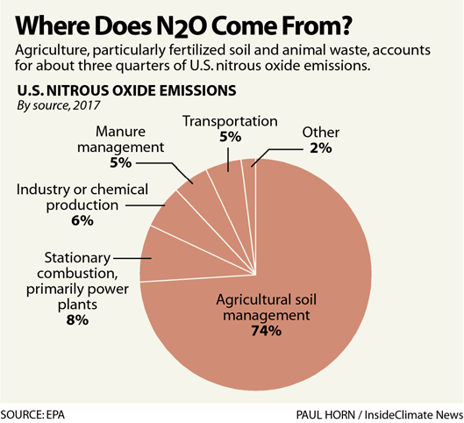

Slide 5
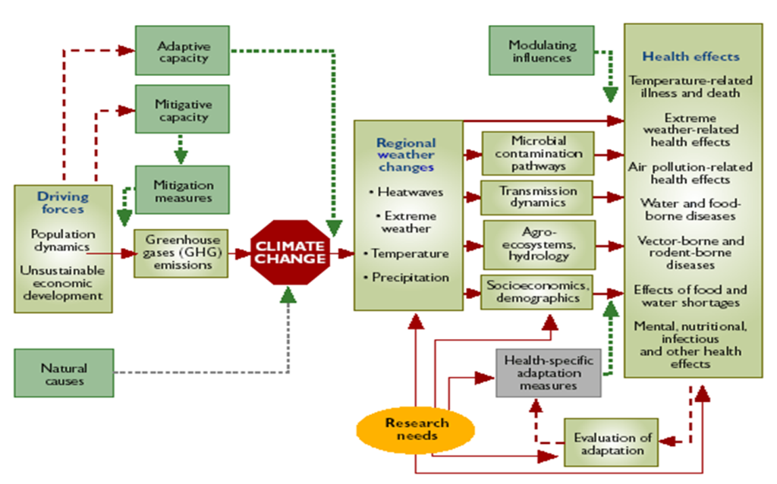
Climate Change and Health
https://www.who.int/globalchange/climate/summary/en/index12.html

Slide 6
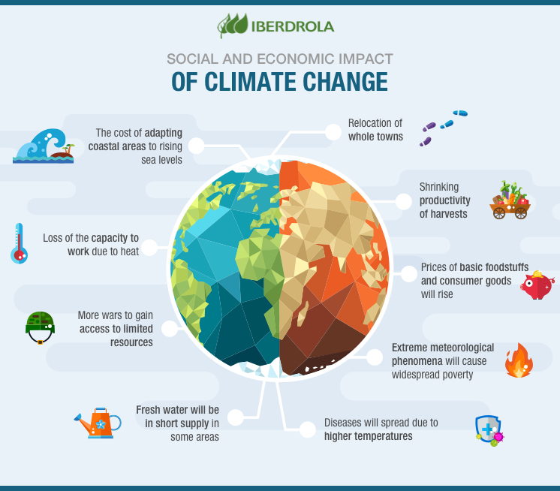

Slide 7
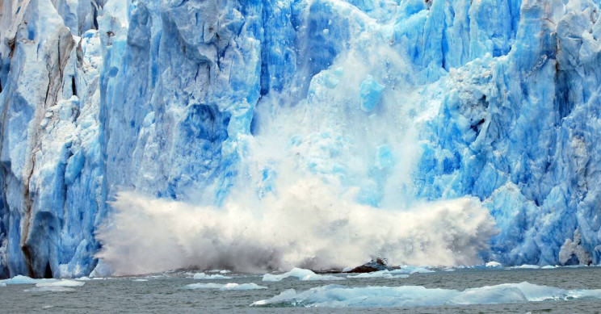
The Science of Climate Change
Human-induced warming and sea-level rise would continue for centuries due to the timescales associated with the climate processes and feedbacks, even if greenhouse gases were to be stabilized.
Projected impacts of the warming include contracting snow cover, shrinking sea ice in the Arctic and Antarctic regions, and increasing weather events such as extreme heat, heavy precipitation and intense storms.

Slide 8
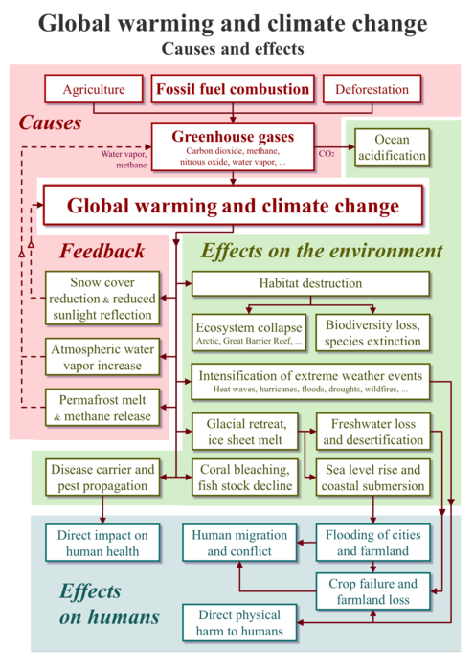

Slide 9
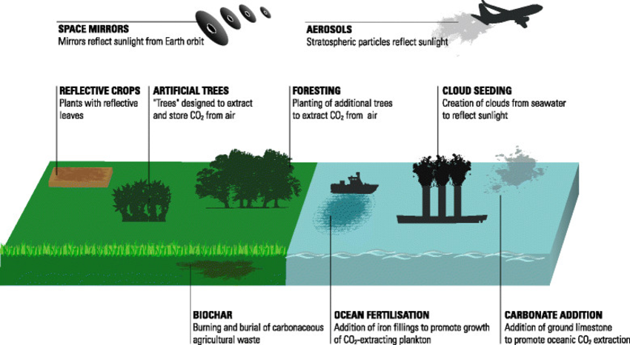
Negotiations over Climate Change Policy
Characterizing the Broad Strategies
  Climate engineering (geoengineering): two categories
    Carbon dioxide removal—air capture, ocean fertilization
    Solar-radiation management-injecting stratospheric
    aerosols
  Adaptation: modify natural or human systems to minimize harm
  Mitigation: attempts to moderate the temperature rise by reducing emissions, increase planet’s capacity to absorb greenhouse gases

Slide 10
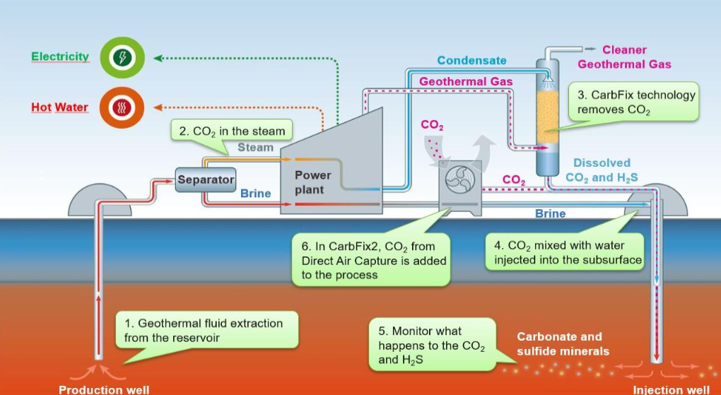
Carbon Capture

Slide 11
Negotiations over Climate Change Policy
Game Theory as a Window on Climate Negotiations
  Game theory has been used to study participation in agreements with public good problems.
  “Issue linkage” is a strategy where countries simultaneously negotiate a climate change agreement and another economic agreement on a linked issue, e.g. trade.
  A final strategy involves transfers from gainers to losers or a redistribution of net benefits.
  Choosing cost-effective policies can positively affect the level of participation.

Slide 12
Game Theory Example
The decision at the negotiations table for both Rich and Poor countries is whether they act now (before climate change) or act later (wait for climate change to happen and then act).
The 4-box matrix on the next slide shows the four potential scenarios that could have come out of the mid-1990s climate change negotiations:
Green growth – all countries act now, no change in global distribution of wealth.
Green equity – rich act first, poor act later, most of climate change is avoided (since rich countries have the majority of emissions) but poor countries are able to catch-up on global development
Carbon colonialism – poor countries act now, rich act later. Much of climate change still occurs and rich get richer.
Carbon wasteland – no countries act until later. Catastrophic climate change occurs, world economy suffers, no change in distribution of wealth.

Slide 13
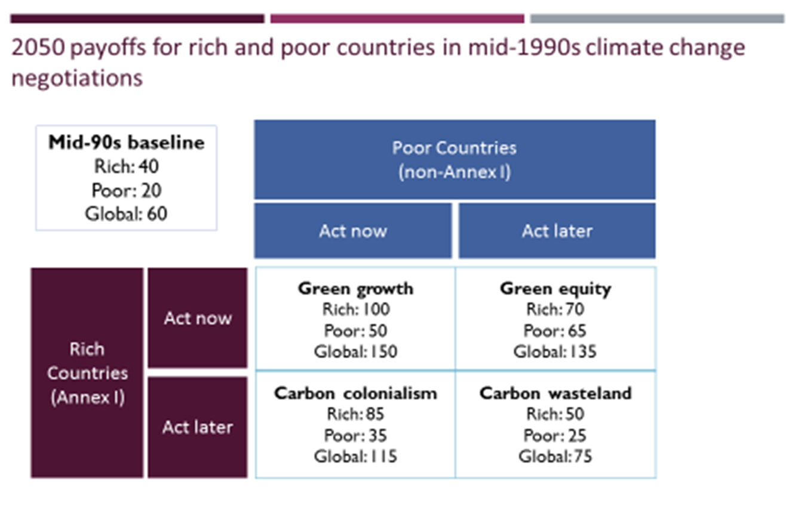
http://essaydocs.org/game-theory-and-international-climate-change-negotiations.html

Slide 14
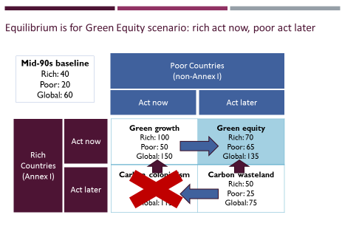
Dominant strategy for rich countries: act now
Poor countries will push for green equity
http://essaydocs.org/game-theory-and-international-climate-change-negotiations.html

Slide 15
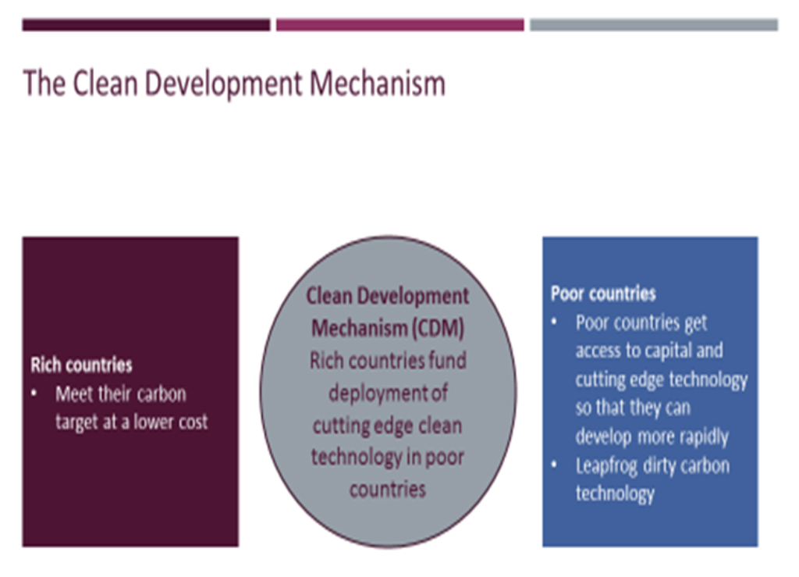
http://essaydocs.org/game-theory-and-international-climate-change-negotiations.html

Slide 16
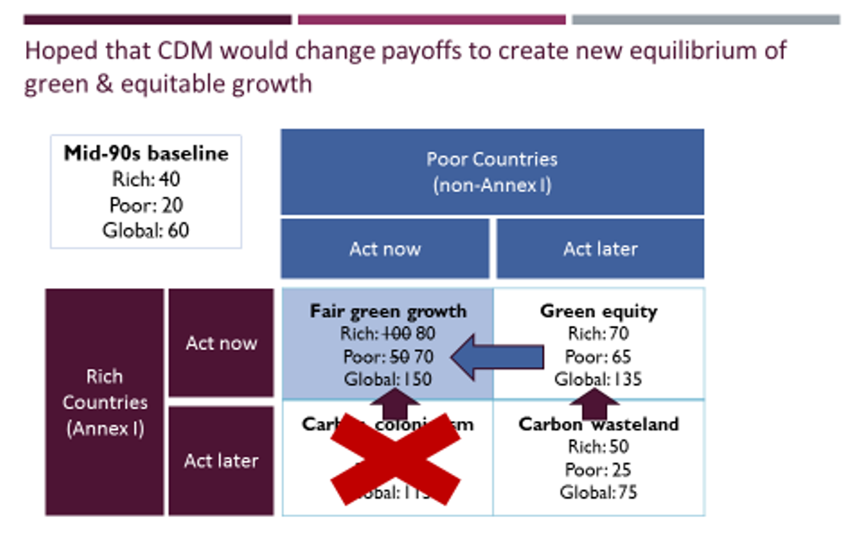
http://essaydocs.org/game-theory-and-international-climate-change-negotiations.html

Slide 17
Some Things to Consider
A main difficulty in constructing self-enforcing agreements is the free-rider effect.
Climate change involves a global pollutant and the effects of emissions reductions are a public good. All nations receive the benefits of emissions reductions whether those nations contributed to those reductions or not.
Individual nations therefore bear all of the costs of their reductions, but gain only a portion of the resulting benefits.
This means the private marginal benefit for any nation’s reduction effort is lower than the social marginal benefit, which is the sum of the marginal benefits received by all nations.
Therefore when an individual nation reduces emissions until its private marginal cost of reduction is equal to its private marginal benefit, this private optimum results in too little reduction.

Slide 18
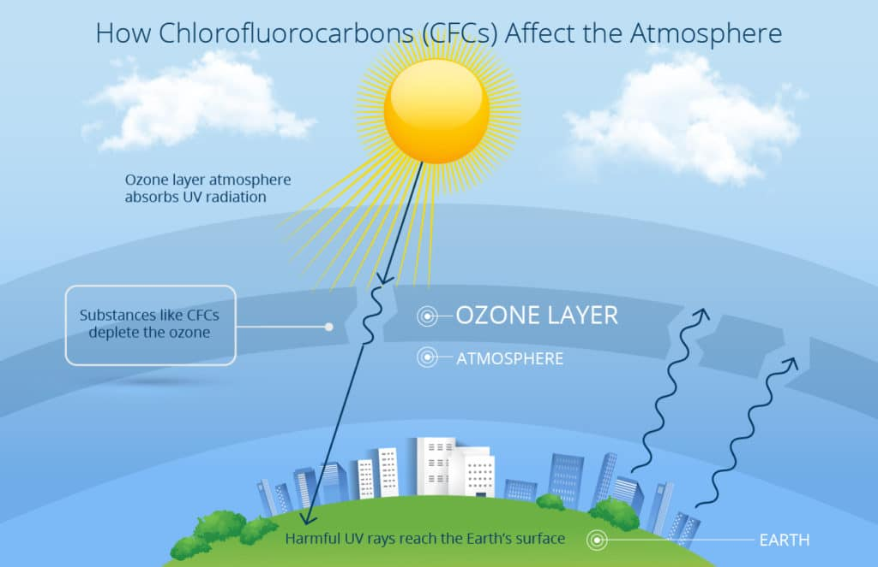
The Precedent: Reducing Ozone-Depleting Gases
Stratospheric ozone shields earth from harmful radiation and factors in determining climate.
The use of cholorofluorocarbons (CFCs) for aerosol propellants, packing materials, and refrigeration has been a large factor in the depletion of the stratospheric ozone shield.
Major known effect of ozone depletion: increase in nonmelanoma skin cancer.

Slide 19
Economics and the Mitigation Policy Choice
Providing Context: A Brief Look at Three Illustrative Carbon Pricing Programs
  The British Columbia Carbon Tax
  The European Union’s Emissions Trading System
  The Australian Hybrid System

Slide 20
Economics and the Mitigation Policy Choice
British Columbia Carbon Tax Program
British Columbia has imposed a carbon tax on each metric ton of carbon dioxide equivalent (CO2-e) emissions from the combustion of fuel.
The carbon tax is applied and collected at the wholesale level, using the administrative channels established earlier for collecting motor fuel taxes.
The cost of the tax is ultimately passed forward to consumers via higher prices.
The carbon tax is revenue neutral.
  With a revenue-neutral tax, the government keeps none of the money collected from the levy. Instead, it redistributes all of it back to taxpayers in the form of tax cuts.

Slide 21
Economics and the Mitigation Policy Choice
European Union Emissions Trading System (E.U. ETS)
The program establishes a cap on the total amount of certain GHGs.
Under this cap, companies receive emission allowances (EUAs), which they can sell to, or buy from, one another as needed. At the end of the year each company must surrender enough allowances to cover all its emissions or pay penalties on any excess.
Companies can bank any spare allowances for future sale or for covering their future needs.

Slide 22
Economics and the Mitigation Policy Choice
Australian Hybrid System
In the first stage emitters face a fixed price for each metric ton of carbon emitted. The price started at $A23 (US$23.8) per metric ton and rises at 2.5 percent per annum in real terms.
In the second stage, which began in 2014, the fixed carbon price regime transitions to a fully flexible price regime, with the price determined by an emissions trading market.

Slide 23
Economics and the Mitigation Policy Choice
Three Carbon Pricing Program Design Issues: Using the Revenue, Offsets, and Price Volatility
  Revenue
    Revenues could be used to reduce the financial burden of the policy on low-income populations, to boost the economy, to increase the magnitude of the emissions reductions, to aid workers displaced by the policy, and even to increase the likelihood that a carbon-pricing policy might be enacted in the first place.

Slide 24
Economics and the Mitigation
Policy Choice
    Various strategies include:
    giving the revenue back to households in the form of a lump-sum rebate on a per capita basis,
    lowering various taxes such as the corporate tax, the income tax, the capital gains tax, the payroll tax, etc.,
    using the revenue to subsidize further emissions reductions, or
    helping workers who are displaced by the shift to a lower carbon energy supply.

Slide 25
Mitigation Policy: Timing
There are enormous uncertainties associated with climate changes.
Benefits from control are received in the distant future, while costs occur now.
Uncertainties about the costs and benefits are also problematic. Governments must make decisions without complete information.

Slide 26
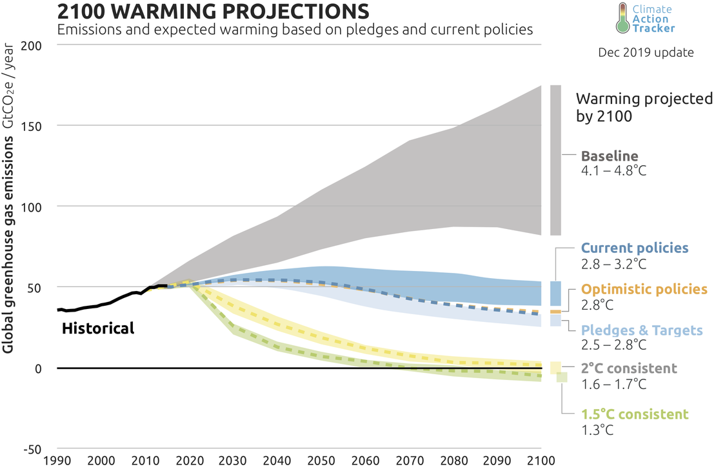

Slide 27
The Role of Adaptation Policy
Whereas mitigation strategies try to limit damage by limiting the emissions that cause the impacts, adaptation tends to limit damage by reducing the damage caused by the impacts that do occur.
The two strategies are complements in the sense that the optimal policy response contains both adaptation and mitigation.
Since the marginal cost function for each strategy is upward-sloping, this normally means that an optimal strategy would employ both mitigation and adaptation.
Deviating from this optimum necessarily means that costs would be higher than necessary.

Slide 28
The Role of Adaptation Policy
Property rights matter. Because they would incur the losses caused by property damages, renters also have lower incentives than owners to invest in adaptation. In general ambiguous or compromised property rights can be a barrier to effective private action.
Effective private action depends on good information on both the nature of risks and options for adapting to them.
Much of this information about future risks is a public good, which means that it will be undersupplied unless the government supplies it or participates in its supply.

Slide 29
The Role of Adaptation Policy
Adaptation choices can also be limited by affordability, including how a low income diminishes the ability to borrow.
Much of the adaptation would involve public capital like roads, or public transportation systems and the desirability of many private adaptation responses would be affected by those public adaptation responses.

Slide 30
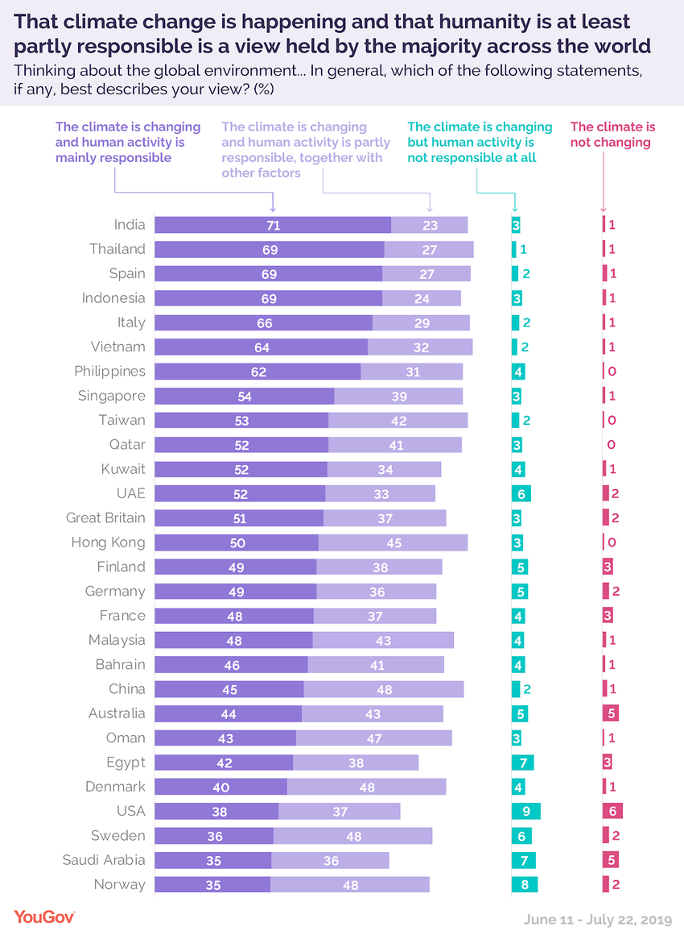

Slide 31
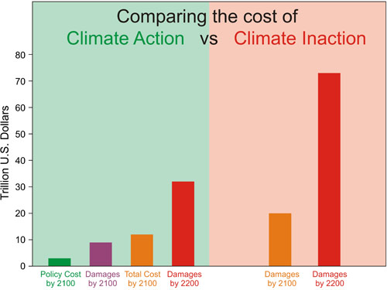
https://www.globalissues.org/article/233/climate-change-and-global-warming-introduction

Slide 32
