Slide 1
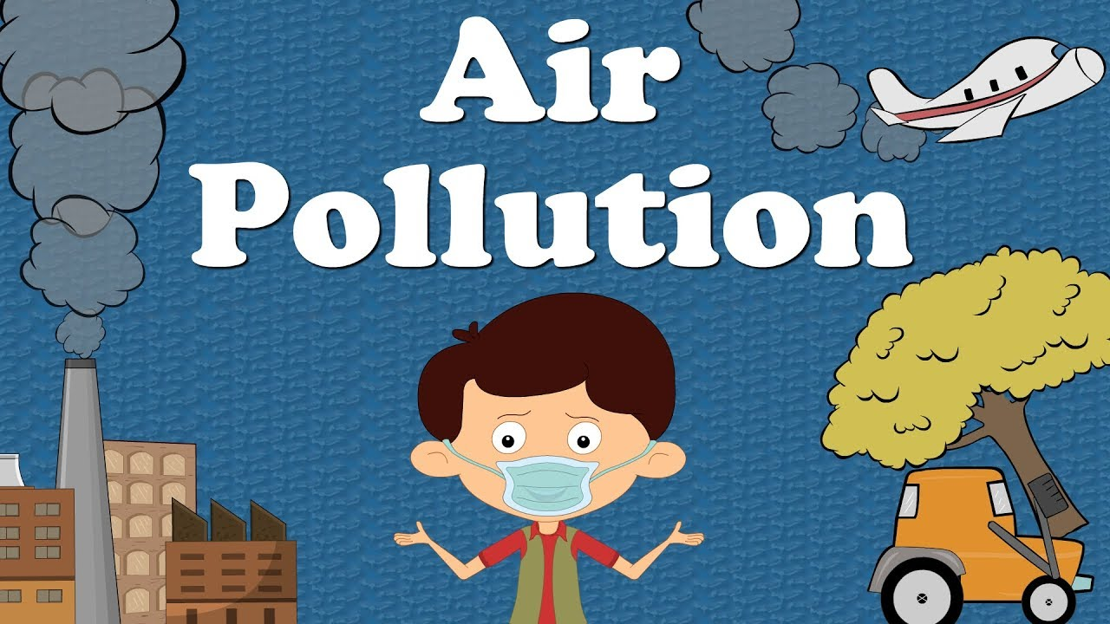
Econ 275 – Environmental Economics
Chapter 15 Lecture - Stationary-Source Local and Regional Air Pollution

Slide 2
Conventional Pollutants
The Command-and-Control Policy Framework
  Conventional or “criteria” pollutants are common substances such as sulfur oxides, particulates, carbon monoxide, ozone, nitrogen dioxide, and lead. They are thought to be dangerous only at high concentrations.
  The historical approach to air pollution control has been known as the command-and-control approach based on emissions standards.

Slide 3
Conventional Pollutants
  In the USA, Sate governments are responsible for ensuring the standards are met. States must design state implementation plans (SIPs) that must be approved by the Environmental Protection Agency (EPA).
  The EPA has also established national uniform emission standards for new sources of criteria pollutants. Standards governing new and modified sources of criteria pollutants are called the New Source Performance Standards (NSPS). These serve as minimum standards.

Slide 4
Conventional Pollutants
The Efficiency of the Command-and-Control Approach
  The threshold concept suggests that the standard is set using a health threshold.
  The level of the ambient standard is set on some other basis.
  Standards tend to be uniform across all of the country.
  The timing of emission flows is important since concentrations are important for criteria pollutants.
  Most standards are defined in terms of pollutant concentration, but typically health effects are more closely related to exposure.

Slide 5
Conventional Pollutants
Cost-Effectiveness of the Command-and-Control Approach
  Command and control is typically not cost-effective. See example on next slide.
  CAC will be close to cost-effective only if a high degree of control is necessary such that all sources are forced to abate as much as is economically feasible.
  While inefficient, CAC policies have resulted in better air quality in developed countries. Developing countries, however, need to find cost-effective ways to improve air quality.

Slide 6
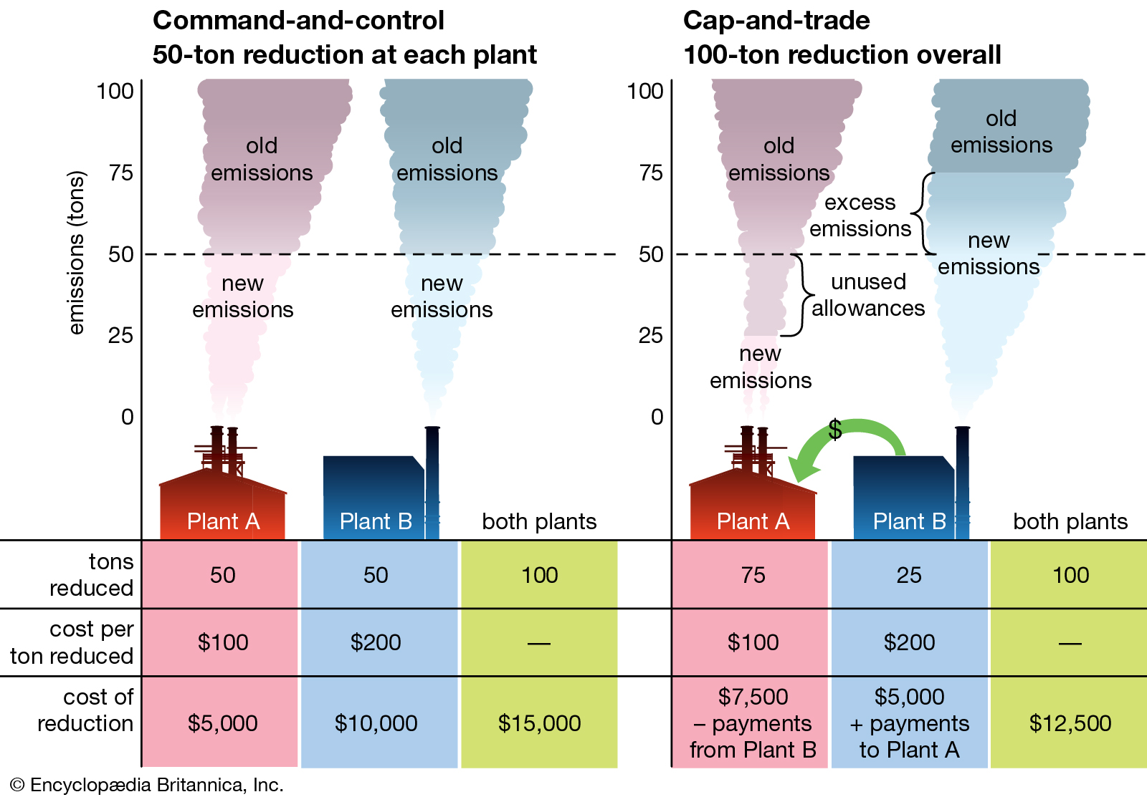

Slide 7
Market-Based Approaches
Emissions Charges
  Economists usually suggest one of two types of emissions charges.
    An efficiency charge is set up to achieve an efficient outcome by forcing the polluter to compensate completely for all damage.
    A cost-effective charge is designed to achieve an ambient standard at the lowest possible cost.
  Emissions charges must be set by an administrative process.

Slide 8
Market-Based Approaches
Damages from regional pollutants can travel further in the air.
The same substances can be both local pollutants and regional pollutants, for example, sulfur oxides.
The approach of “Dilution is the solution.”
Crafting a Policy
  Set up an emission trading system—the sulfur allowance trading program
Emission Trading
  Establish an auction market for the allowances.
  The auction made allowance prices publicly transparent.

