Slide 1
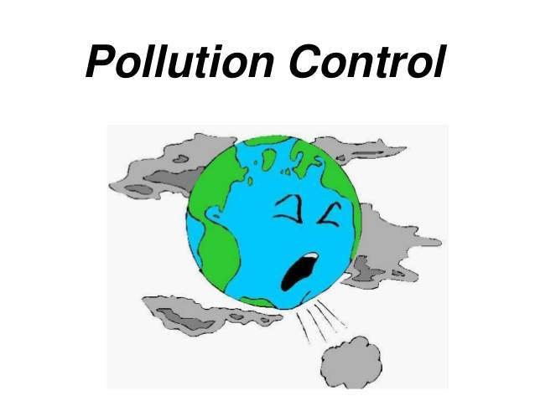
Econ 275 – Environmental Economics
Chapter 14 Lecture - Economics of Pollution Control: An Overview

Slide 2
Identifying Major Air Pollutants
Criteria pollutants are substances known to be hazardous to health and welfare, characterized as harmful by criteria documents. They are particulate matter (often referred to as particle pollution), ground-level ozone, carbon monoxide, sulfur dioxide, nitrogen dioxide, and lead.
Hazardous air pollutants are noncriteria pollutants that may cause or contribute to irreversible illness or increased mortality. Examples of HAPs include benzene, which is found in gasoline; perchloroethylene, which is emitted from some dry cleaning facilities; and methylene chloride, which is used as a solvent and paint stripper by a number of industries. Other examples are dioxins, asbestos, toluene, and metals such as cadmium, mercury, chromium, and lead compounds.
Greenhouse gas (GHG) pollutants are those collectively responsible for the absorption process that naturally warms the earth

Slide 3
A Pollutant Taxonomy
The ability of the environment to absorb pollutants is called its absorptive capacity.
Stock pollutants are pollutants for which the environment has little or no absorptive capacity. Examples of stock pollutants include non-biodegradable bottles tossed by the roadside; heavy metals, such as lead, that accumulate in the soils near the emissions source.
Fund pollutants are pollutants for which the environment has some absorptive capacity. An example is carbon dioxide.
Local pollutants cause damage near the source of emissions while regional pollutants cause damage at greater distances. Particulate matter (PM10 and PM2.5) and nitrogen dioxide (NO2) are the most important components of local air pollution.

Slide 4
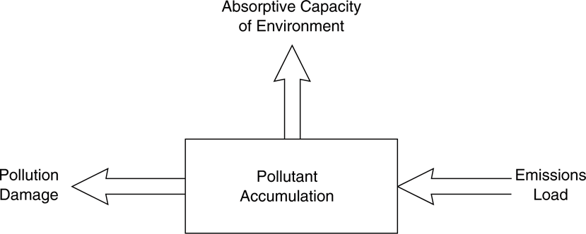
Relationship Between Emissions and Pollution Damage

Slide 5
A Pollutant Taxonomy
Local and regional pollutants make up the horizontal dimension of damage or horizontal zone of influence.
The vertical zone of damage refers to whether the pollution damages are mostly at ground level or if they accumulate in the upper atmosphere.
Surface pollutants (water pollution) cause damage near the earth’s surface, while global pollutants (carbon dioxide and chlorofluorocarbons) cause damage in the upper atmosphere.

Slide 6
Defining the Efficient Allocation of Pollution
Stock Pollutants
  Damage rises as the pollutant accumulates.
    Damage can take many forms.
  The optimal allocation of a stock pollutant is the one that maximizes the present value of benefits from consuming the good whose production causes the pollution minus the cost of damage to the environment caused by the pollutant.
  Stock pollutants create burdens for future generations.

Slide 7
Defining the Efficient Allocation of Pollution
Fund Pollutants
  Pollution control is most easily analyzed from the perspective of minimizing cost.
    Damage costs
    Pollution control or avoidance costs.
  Marginal damage costs generally increase with the amount of pollution.
  Marginal control costs typically increase with the amount of pollution that is controlled or abated.
  The cost-minimizing solution is found by equating marginal damage costs to marginal control costs (see next slide).

Slide 8
Efficient Allocation of a Fund Pollutant

Slide 9
Market Allocation of Pollution
Damage costs are externalities.
Control costs are not externalities.
Therefore what is cheapest for the firm is not always what is cheapest for society as a whole.
Firms that attempt to control pollution unilaterally are placed at a competitive disadvantage.
The market fails to generate the efficient level of pollution control and penalizes firms that attempt to control pollution.

Slide 10
Efficient Policy Responses
Efficiency is achieved when the marginal cost of control is equal to the marginal damage caused by the pollution for each emitter.
One policy option for achieving efficiency would be to impose a legal limit on the amount of pollution allowed by each emitter.
Another approach would be to internalize the marginal damage caused by each unit of emissions by means of a tax or charge per unit of emissions.
Knowing the level of pollution at which these two curves cross is the difficulty.

Slide 11
Cost-Effective Policies for Uniformly Mixed Fund Pollutants
Defining a Cost-Effective Allocation
  The cost-effective allocation is found by equating the marginal control costs of the two sources.
  Since total cost is the area under the marginal control cost curve, total costs across the two firms is minimized by minimizing the two areas and is found by equating the two marginal costs.
  Any other allocation would result in higher total cost.

Slide 12
Cost-Effective Allocation of a Uniformly Mixed Pollutant

Slide 13

Cost-Effective Policies for Uniformly Mixed Fund Pollutants
Cost-Effective Pollution Control Policies
  Emissions Standards
    An emission standard is a legal limit on the amount of the pollutant an individual source is allowed to emit.
    This approach is referred to as command-and-control.

Slide 14
Cost-Effective Policies for Uniformly Mixed Fund Pollutants
  Emissions Charges
    An emission charge is a per-unit of pollutant fee, collected by the government.
    Charges are economic incentives.
    Each firm will independently reduce emissions until its marginal control cost equals the emission charge.
    This yields a cost-effective allocation.
    A difficulty with this approach is determining how high the charge should be set in order to ensure that the resulting emission reduction is at the desired level.

Slide 15
Cost-Minimizing Control of Pollution with an Emissions Charge
T = Emission charge per unit
OTBC = amount firm would pay with uncontrolled emissions
If company decides to control emissions it would do so if MC<T
Thus, it will clean up 10 units at cost of OAD and pay tax of DABC
We can see OAD + DABC < OTBC

Slide 16
Cost Savings from Technological Change: Charges versus Standards (MC₀ to MC₁)

Slide 17
Cost-Effective Policies for Uniformly Mixed Fund Pollutants
  Cap-and-Trade
    All sources are allocated allowances to emit either on the basis of some criterion or by auctioning. The allowances are freely transferable.
    The equilibrium price will be the price at which the marginal control costs are equal for both (or across all) firms.
    The market equilibrium for an emission allowance system is the cost-effective allocation, but it is easier said than done.

Slide 18
Cost-Effectiveness and
Emission Trading
Total units of pollution allocated is 15 units. Source 1 allocated 7 units – must clean up 8. Source 2 allocated 8 units – must clean up 7
Is there an incentive
to trade?
Source 1 firm would
sell 2 units
End up at B

Slide 19
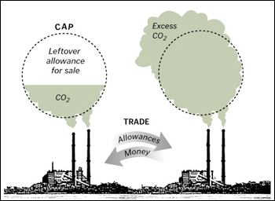
Cap and Trade

Slide 20
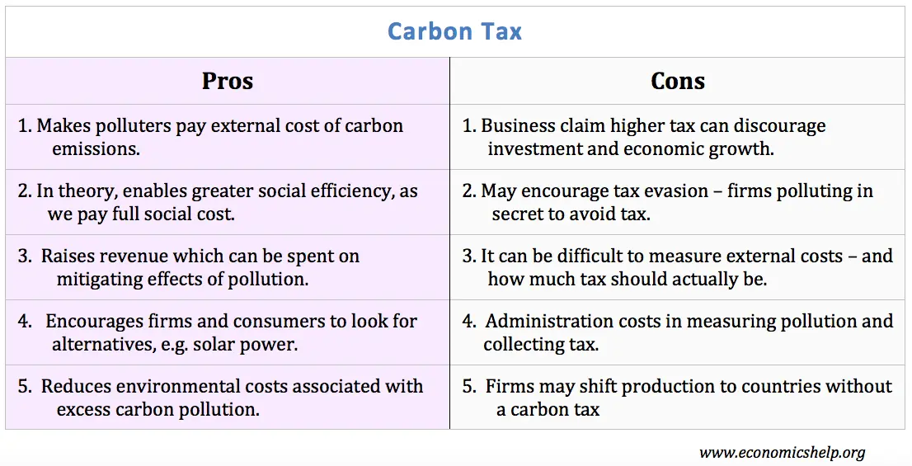

Slide 21
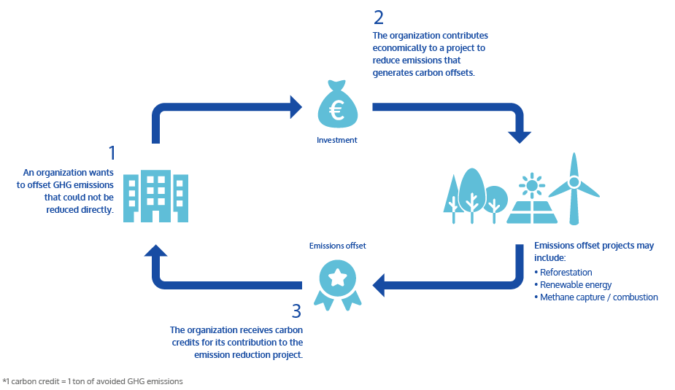
Carbon Offsetting
https://clean-co2.com/en/carbon-offsetting/

Slide 22
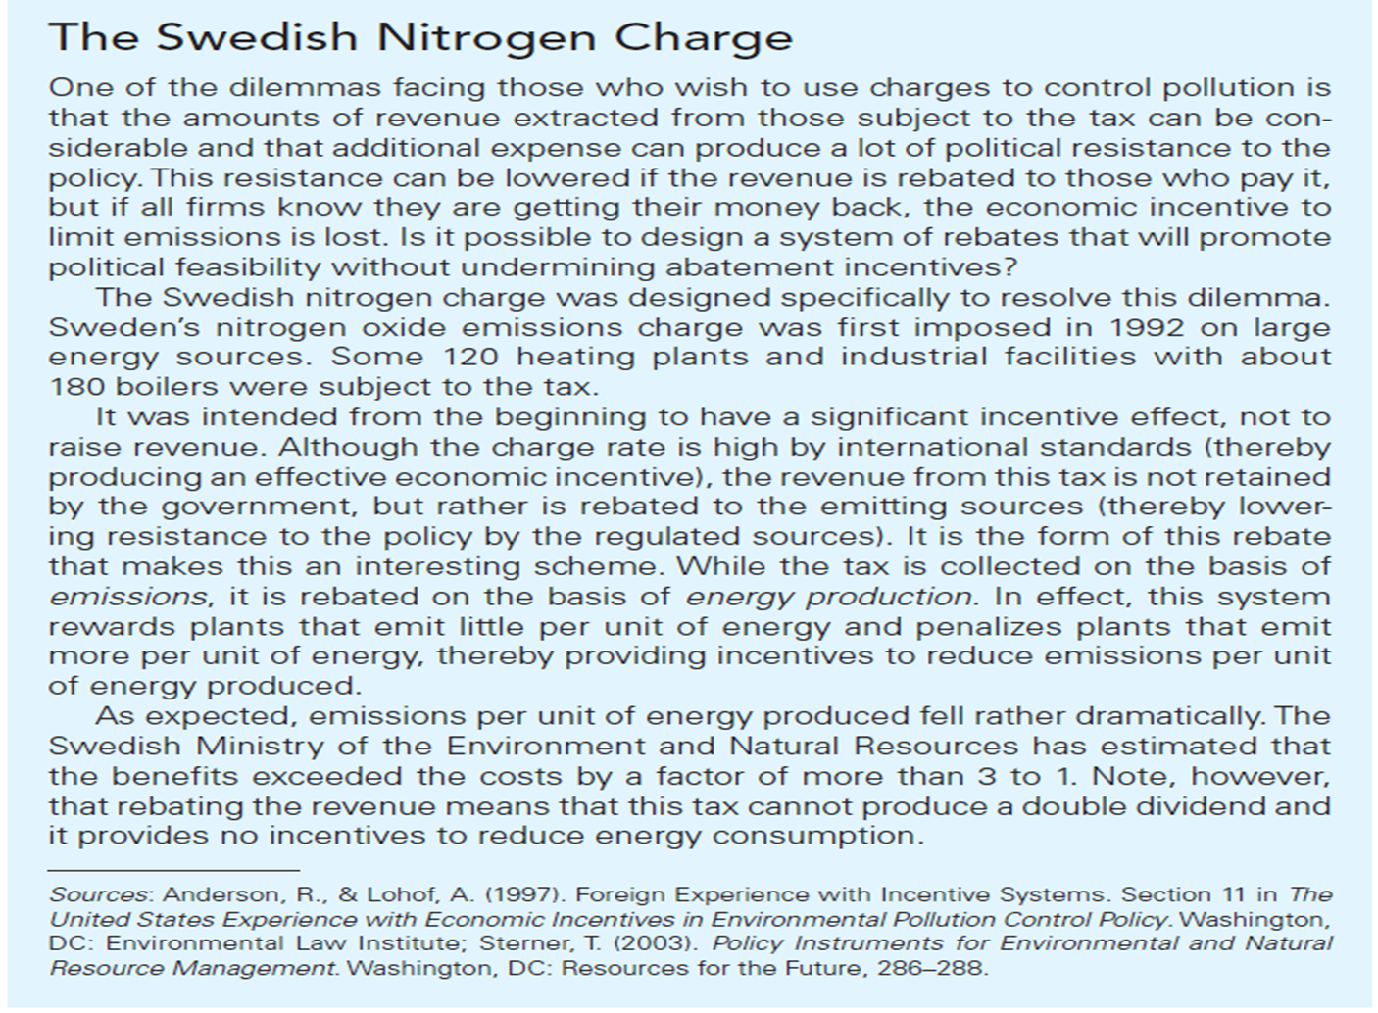

Slide 23
Other Policy Dimensions
Responses to Changes in the Regulatory Environment
  With charges, an increase in emitters will raise total levels of pollution.
  With an emission allowances system, the total level of pollution is fixed.
  Inflation will affect the price of the permit and result in higher permit prices.
  Technological progress in pollution control equipment would result in lower permit prices and lower abatement costs, but the same level of control.

Slide 24
Other Policy Dimensions
Price volatility
  Volatility does not affect emission charges, but it affects allowances.
Instrument Choice under Uncertainty
  Determining the best policy option usually depends on whether certainty about emissions or certainty about control costs is more important.
Product Charges: An Indirect Form of Environmental Taxation
  One strategy is to tax the commodity that is most directly responsible for the emissions, rather than the emissions themselves.
  It is efficient when all purchased units cause exactly the same marginal damage.

