Slide 1
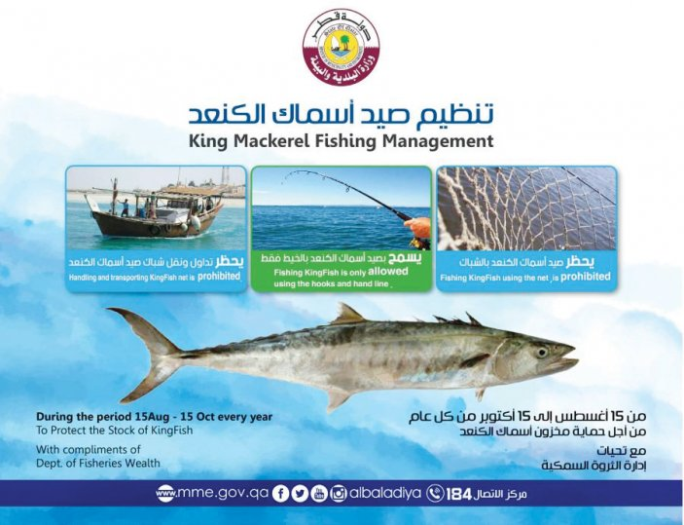
Econ 2675 – Environmental Economics
Chapter 12 Lecture - Common-Pool Resources: Commercially Valuable Fisheries

Slide 2
Biological Populations
Biological Populations belong to a class of renewable resources we will call interactive resources, wherein the size of the resource stock (population) is determined jointly by biological considerations and by actions taken by society.
The postharvest size of the population, in turn, determines the availability of resources for the future.
Thus, humanity’s actions affect the flow of these resources over time.
Because this flow is not purely a natural phenomenon, the rate of harvest has intertemporal effects.
Tomorrow’s harvesting choices are affected by today’s harvesting behavior.

Slide 3
Efficient Allocations
The Biological Dimension
  The Gordon-Schaefer model is a bioeconomic model applied in the fishing industry. It may be used to compute the maximum sustainable yield. It takes account of biological growth rates, carrying capacity, and total and marginal costs and revenues.
  The shape of the graphs on the next to slides show the range of population sizes where population growth leads to population increases and a range where population growth will lead to stock decreases.

Slide 4
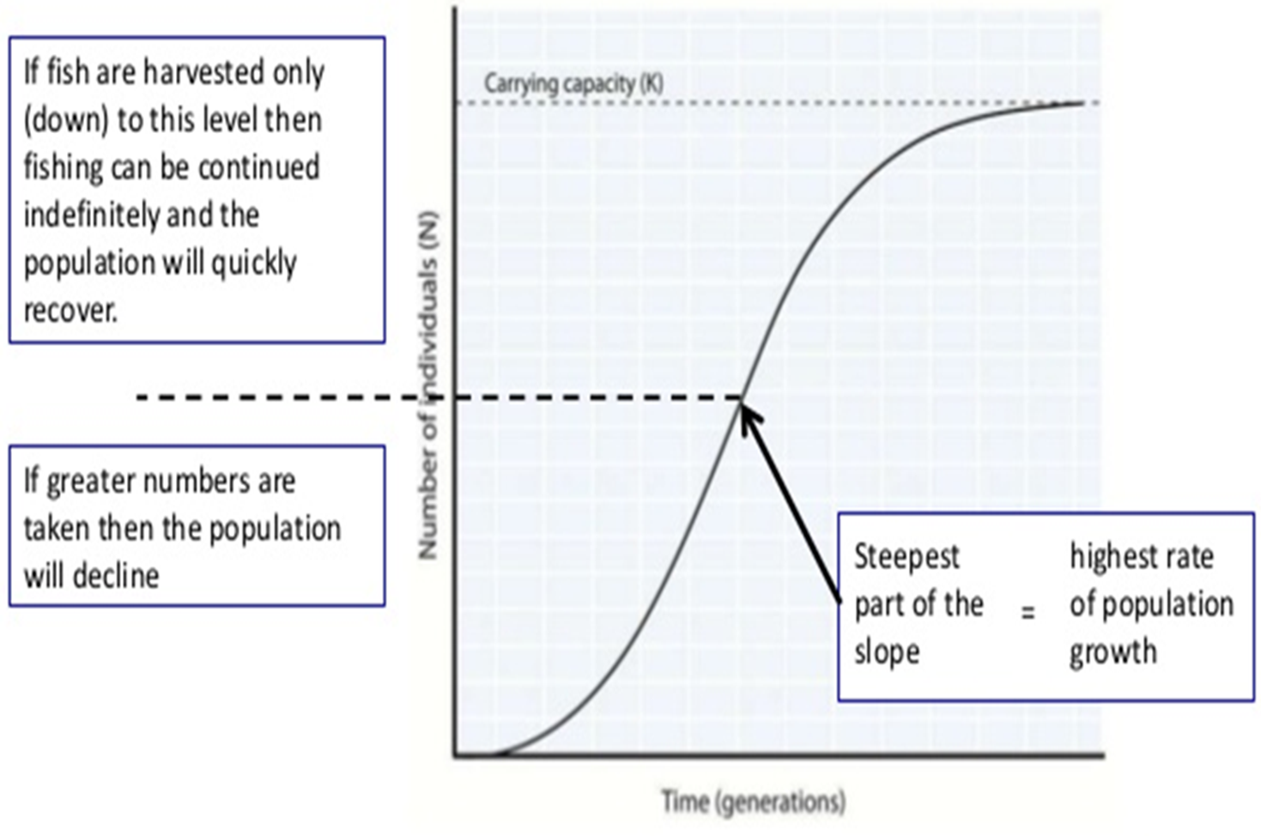
Population Size and Sustainable Fishing
https://images.app.goo.gl/jsy8y92PrWdJU7RZ7

Slide 5
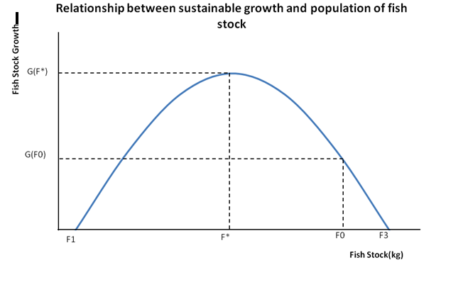

Slide 6
Efficient Allocations
Static-Efficient Sustainable Yield
The static-efficient sustainable yield is the catch level that, if maintained perpetually, would produce the largest annual net benefit.
Assumptions of the economic model are:
  The price of fish is constant and does not depend on the amount sold.
  The marginal cost of a unit of fishing effort is constant.
  The amount of fish caught per unit of effort expended is proportional to the size of the fish population.
The static-efficient sustainable yield allocation maximizes the constant net benefit.

Slide 7
Refer to the Following Three Videos for an Explanation of Fisheries Economics and Policies

Slide 8
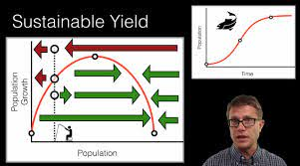
Fishing (Sustainable Yield)

Slide 9
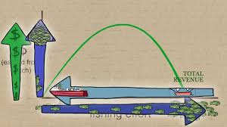
Fisheries Economics & Policy: Maximum Economic Yield

Slide 10
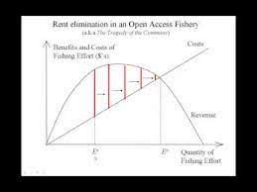
Rent Elimination in Open-Acess Fisheries

Slide 11
Efficient Sustainable Yield for a Fishery

Slide 12
Appropriability and Market Solutions
A sole owner of a fishery would have a well-defined property right to the fish and would want to maximize his or her profits.
  Profit maximization will lead to the static-efficient sustainable yield.
Ocean fisheries are typically open-access resources. Thus, no single fisherman can keep others from exploiting the fishery.

Slide 13
Appropriability and Market Solutions
Open-access creates two kinds of external costs:
  Contemporaneous external costs are the costs imposed on the current generation from overfishing. Too many resources (boats, fishermen, etc.) are committed to fishing.
  Intergenerational external costs are the costs imposed on the future generation from the exploitation of the stock today. Overfishing reduces stocks and thus future profits.
Unlimited access creates property rights that are not well defined.
With free-access, individual fishermen have no incentive to “save” the resource.

Slide 14
Public Policy Toward Fisheries
Raising the Real Cost of Fishing (restricting use of traps, for example).
  Raising the marginal cost of effort results in a lower harvest and higher stock sizes.
  While the policies may result in an efficient catch, they are inefficient because the efficient level of catch is not caught at the lowest possible cost.
  Technological innovations have lowered the cost of fishing, offsetting the increases imposed by regulations.

Slide 15
Effect of Regulation

Slide 16
Public Policy Toward Fisheries
Taxes
  Unlike regulations, the tax can lead to the static-efficient sustainable yield allocation because the tax revenues represent transfer costs and not real-resource costs.
  Transfer costs involve the transfer of resources from one part of society to another.
  For the individual fisherman, however, a tax still represents an increase in costs.

Slide 17
Public Policy Toward Fisheries
Catch Share Programs
    Individual Fishing Quotas (IFQs)
    Individual Transferable Quotas (ITQs): An ITQ program is a specific IFQ program where privileges can be transferred subsequent to initial allocations.
    Territorial Use Rights Fisheries (TURFs) which grant rights to a geographic area.
  ITQs have the following characteristics:
    The quotas entitle the holder to catch a specified volume of a specified type of fish.
    The total amount of fish authorized by the quotas should be equal to the efficient catch level for that fishery.
    The quotas should be freely transferable among fishermen

Slide 18
Catch-Shares in the United States by Fisheries Management Region
New England |  |  | Mid-Atlantic
• | Atlantic Sea Scallops IFQ (2010) |  | • | Surf Clam & Ocean Quahog ITQ (1990)
• | New England Multispecies Sectors (2010) |  | • | Golden Tilefish IFQ (2009)
South Atlantic |  |  | Pacific
• | Wreckfish ITQ(1991) |  | • | Pacific Sablefish Permit Stacking IFQ (2001)
 |  |  | • | Pacific Coast Groundfish Trawl Rationalization IFQ (2011)
North Pacific |  |  | Gulf of Mexico
• | Halibut & Sablefish IFQ (1995) |  | • | Red Snapper IFQ (2007)
• | Western Alaska CDQ (1992) |  | • | Grouper & Tilefish IFQ (2010)
• | Bering Sea AFA Pollock Cooperative (1999)
• | Groundfish (non-Pollock) Cooperatives (2008) |  | Atlantic Highly Migratory Species
• | Bering Sea King & Tanner Crab IFQ (2005) |  | • | Individual Bluefin Tuna Quota (2015)
• | Central Gulf of Alaska Rockfish Cooperative (2011)
Caribbean |  |  | Western Pacific
• | No catch share programs |  | • | No catch share programs
Source: NOAA 2017. Adapted from www.nmfs.noaa.gov/sfa/management/catch_shares/about/programs_by_region.html

Slide 19
Public Policy Toward Fisheries
  European Common Fisheries Policy
    The Common Fisheries Policy is the fisheries policy of the European Union.
    It sets total allowable catch TAC for member states. Each country receives a national quota based on a percentage of the TAC.
    E.U. member countries can trade these quotas with other E.U. countries.
  Territorial Use Rights Fisheries (TURFs) can allow access to a layer of the water column in a specific zone.
    More economically efficient use of fishery resource
    Improve the welfare of small fishing communities
    Particularly useful for stocks not migrating far

Slide 20
Public Policy Toward Fisheries
Aquaculture
  Aquaculture is the controlled raising and harvesting of fish. It is currently the fastest-growing animal food production sector.
    Fish farming involves cultivating fish over their lifetime, which can create environmental problems.
    Fish ranching involves holding fish in captivity for the first few years of their lives.
    Aquaculture works well for certain species.

Slide 21
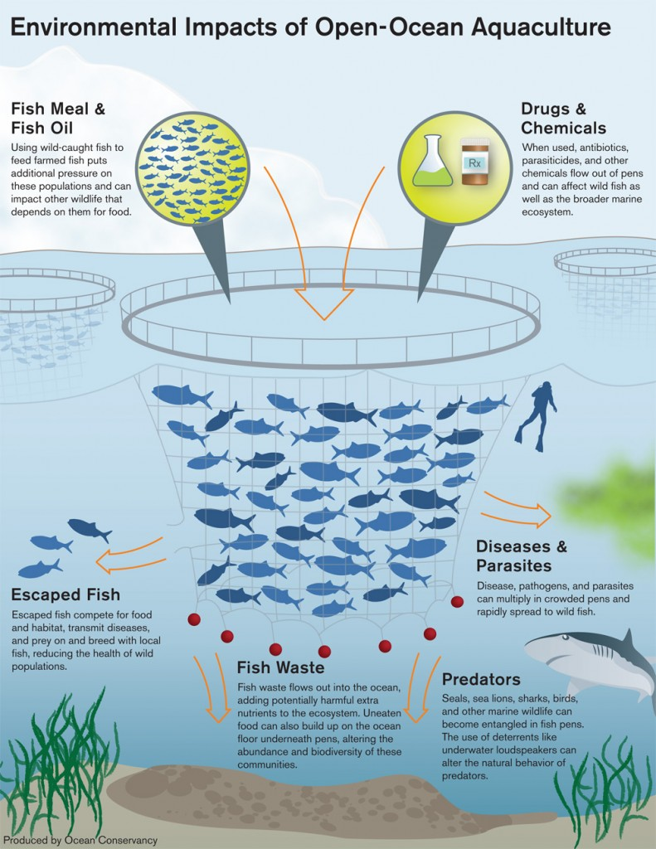

Slide 22
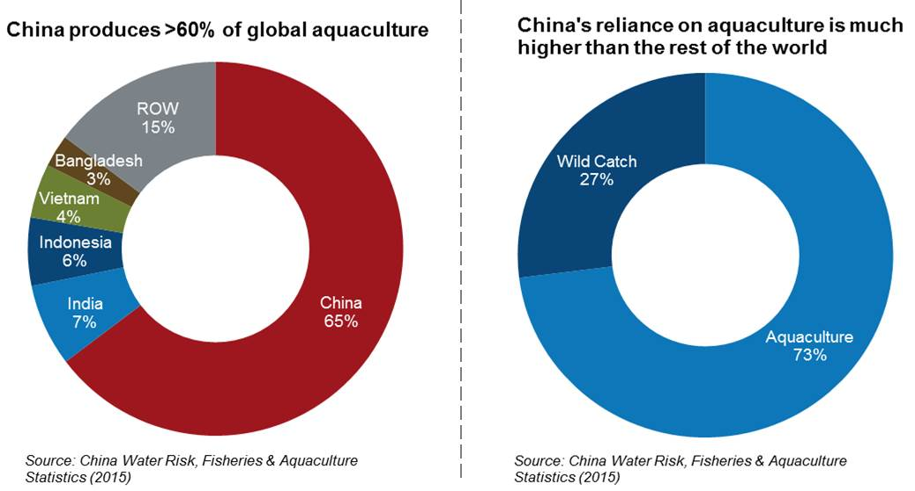
China’s Rising Share of Aquaculture

Slide 23
Public Policy Toward Fisheries
Subsidies and Buy Backs
  A management option to reduce overcapacity
    Payments used to buy out excess fishing capacity are useful subsidies, but if additional capacity seeps in over time, they are not as effective as other management measures.
Exclusive Economic Zones: The 200-Mile Limit
  The 200-Mile Exclusion Zone is an international policy solution that has been implemented.
    Countries bordering the sea now have ownership rights that extend 200 miles offshore. Within the 200-mile limit, the countries have exclusive jurisdiction.
    This ruling protects coastal fisheries, but not the open ocean

Slide 24
Public Policy Toward Fisheries
Marine Protected Areas and Marine Reserves
  Areas that prohibit harvesting and are protected from other threats such as pollution
    Marine protected areas are designated ocean areas within which human activity is restricted.
    Marine reserves protect individual species by preventing harvests within the reserve boundaries.

