Slide 1
Rare Earth Mining for Electric Vehicles
Alatheer Al Barwani
Abdulla Al Attiyah
Usman Ahmed
Fall 2025
Environmental Economics

Slide 2
Content
1
What are Rare Earth Elements
2
Why EV’s need them
3
Environmental Impacts
4
Economic Challenges
5
Solution and Policy Options
6
Conclusion

Slide 3
Rare Earth Elements
Rare Earth Elements Used in EV:
Permanent Magnet Motor Needs:
Neodymium (Nd) Praseodymium (Pr) Dysprosium (Dy)
Battery:
Lithium, Cobalt, Nickel
17 metallic elements
High magnetic + conductive properties
Essential for modern electronics
Critical for EV motors

Slide 4
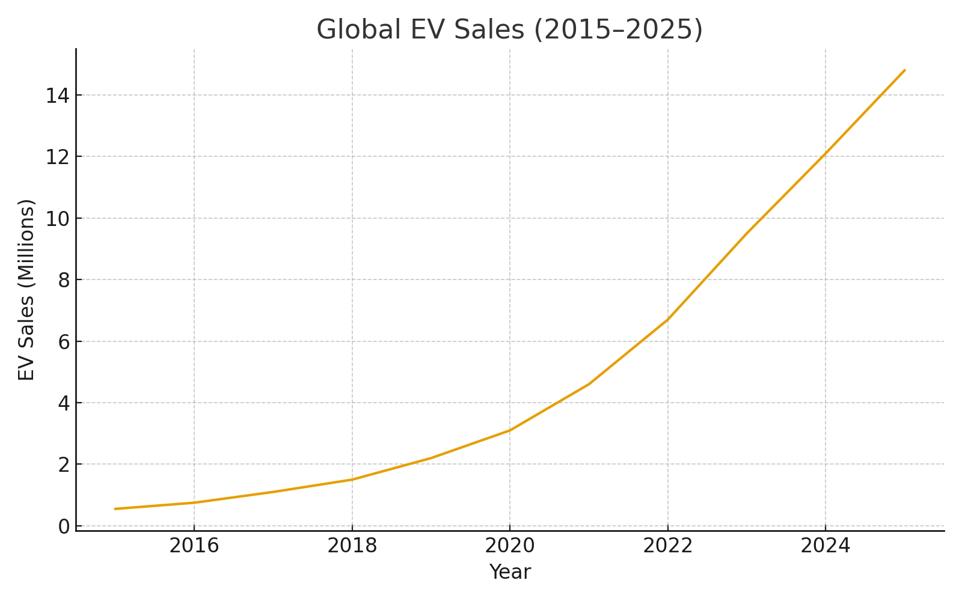
Rising Demand Driven by EV’s

Slide 5
Environmental Impacts
Major impacts of REE mining:
Toxic & radioactive waste
Water contamination
Deforestation & ecosystem loss

Slide 6
Toxic & Radioactive Waste
Mining produces radioactive tailings
Chemical leaching → toxic sludge lakes
Baotou (China): global case study of extreme pollution

Slide 7
Toxic & Radioactive Waste
How mining contaminates water:
Acid drainage
Fluoride & arsenic infiltration
Streams + farmlands impacted

Slide 8

Forests in Myanmar and Laos have been cleared for illegal mines, causing erosion, landslides, and river collapse.

Slide 9
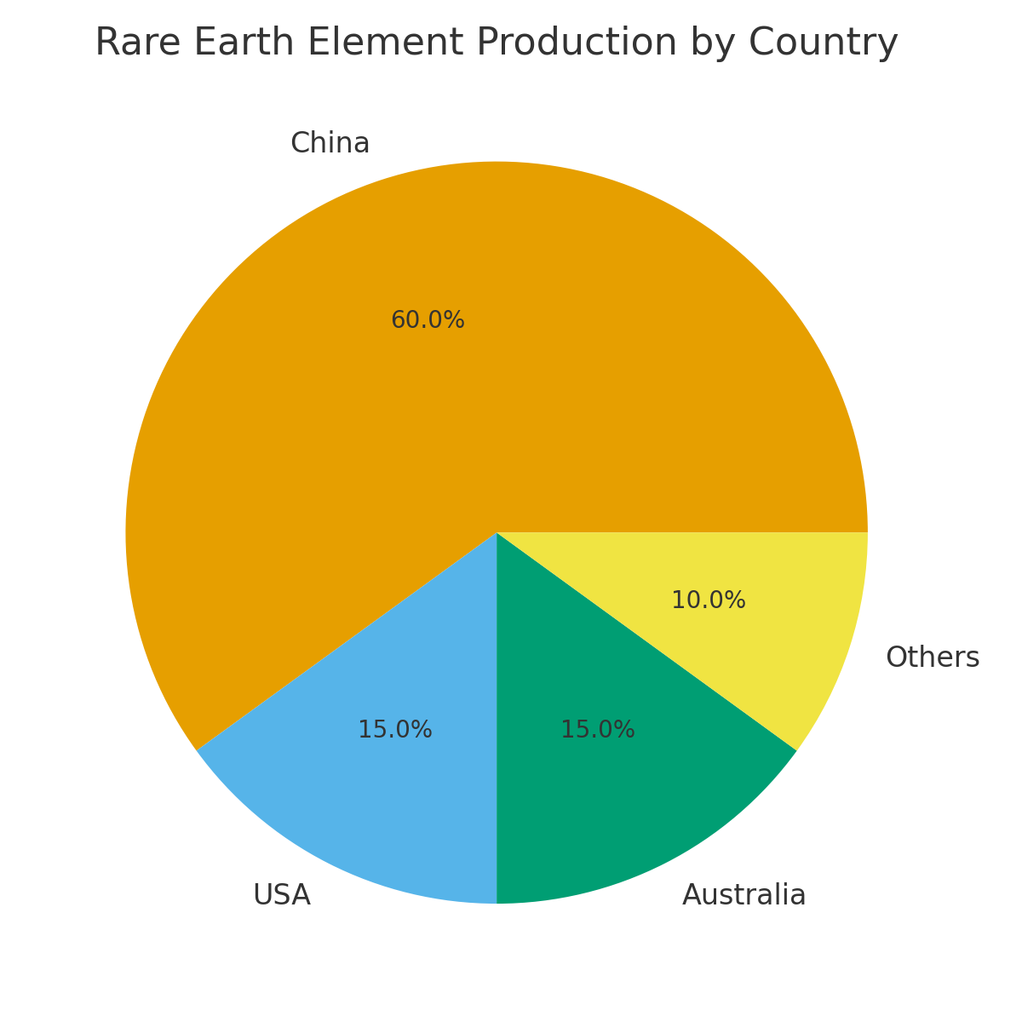
Geographic Concentration of REE Production
China controls ~60–70% of global rare earth mining
DRC controls ~70% of global cobalt
Creates supply chain vulnerabilities
Environmental regulations differ by country

Slide 10
A single bottleneck affects the entire EV industry
Key Risks:
Export restrictions
Price spikes
Political tensions
Production delays for EV manufacturers
When one country controls the most complex stage (refining), everyone else becomes dependent.

Slide 11
Pathways to a Sustainable EV Supply Chain
Improving the supply chain requires cleaner extraction, responsible sourcing, and innovations that reduce the need for rare earth elements.

Slide 12
Recycling Rare Earths
Magnet recycling reduces pressure on new mining
Lower waste and fewer chemicals used
Could reduce demand for newly mined REEs by 20–40%

Slide 13



Cleaner Extraction Methods
New processes like bioleaching and closed-loop separation limit chemical waste and reduce radioactive tailings.
These technologies make rare earth mining less destructive while still meeting rising demand.

Slide 14
Diversifying Supply Sources
New projects in Australia, Canada, Tanzania, and the U.S.
Higher environmental and labor standards in newer mines
Reduces dependence on a single country
Stabilizes long-term EV production

Slide 15
Conclusion
Electric vehicles are critical for decarbonization, but the sustainability of the transition depends on how we extract and use the materials behind them.

Slide 16
References
1. International Energy Agency (IEA). (2023). Critical Minerals Market Review 2023.
https://www.iea.org/reports/critical-minerals-market-review-2023
2. International Energy Agency (IEA). (2022). The Role of Critical Minerals in Clean Energy Transitions.
https://www.iea.org/reports/the-role-of-critical-minerals-in-clean-energy-transitions
3. US Geological Survey (USGS). (2024). Rare Earths Statistics and Information.
https://www.usgs.gov/centers/national-minerals-information-center/rare-earths-statistics-and-information
4. US Geological Survey (USGS). (2023). Cobalt Statistics and Information.
https://www.usgs.gov/centers/national-minerals-information-center/cobalt-statistics-and-information
5. BBC Future. (2015). The dystopian lake created by our tech lust.
https://www.bbc.com/future/article/20150402-the-worst-place-on-earth
6. Amnesty International. (2016). This Is What We Die For: Human Rights Abuses in Cobalt Supply Chains.
https://www.amnesty.org/en/documents/afr62/3183/2016/en/

Slide 17
Thank you

