Slide 1
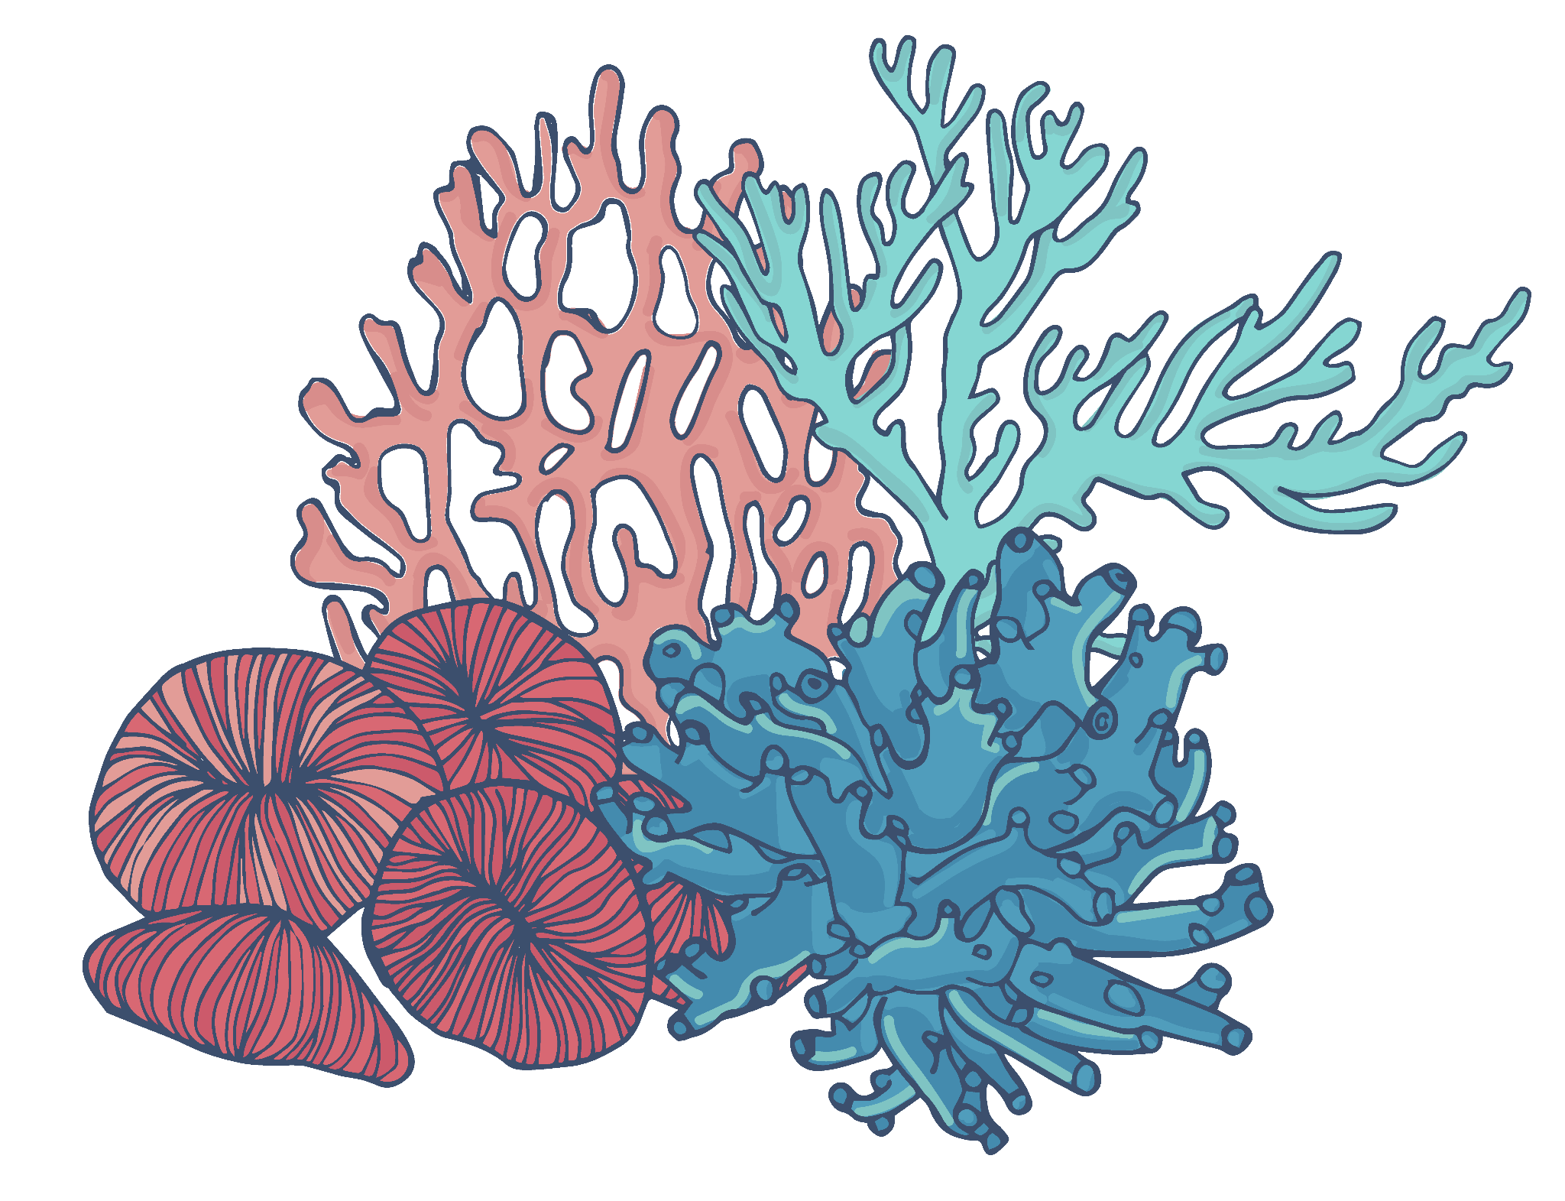
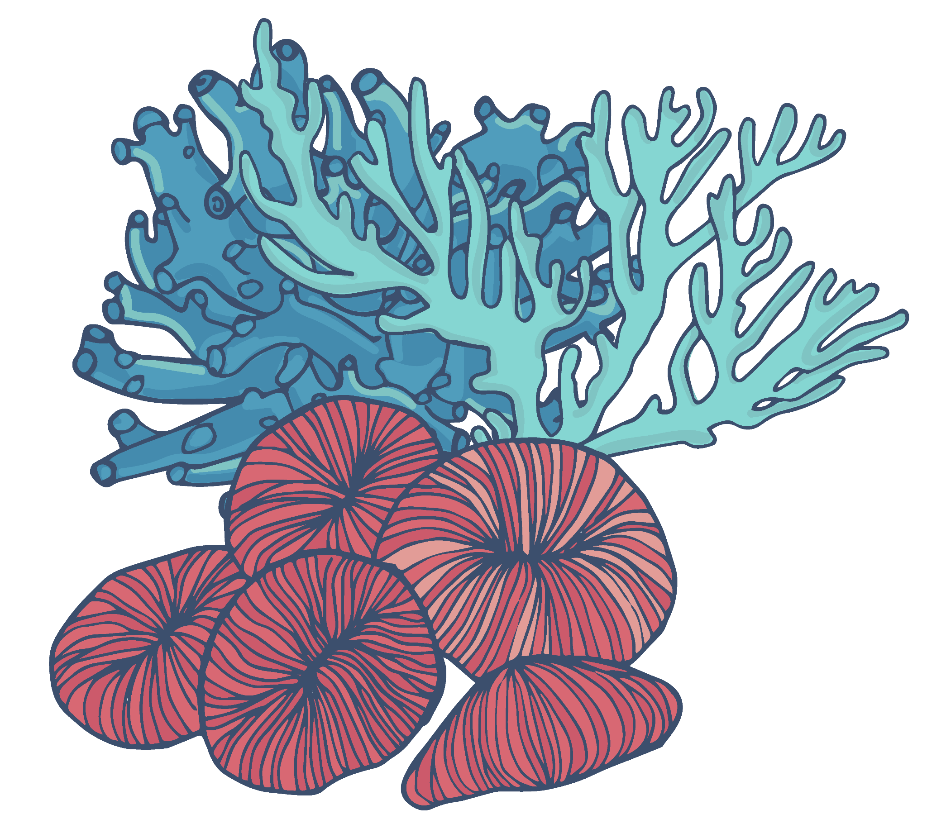
Coral Reef Degradation and Coastal Development in the Gulf
Laila Al-Hadad, Noof Al-Ibrahim, Dalal Al-Muftah

Slide 2
Gulf Corals Overview
From an economic perspective, this is a case of environmental externalities.
The Arabian Gulf is one of the hottest seas on Earth, with temperatures rising to lethal levels to most corals.
Corals in the Gulf can withstand summer heat and recover from extreme temperature rises.
The heat-tolerance has positive implications for the world’s coral populations to adapt to increasing water temperatures.
In the Gulf region, 35 million people benefit from coral reefs, with 16.5 million people highly dependent on reefs for their food or livelihood.
Reef-associated tourism in the Gulf region is valued at $1 billion annually.

Slide 3
The Problem & Causes
01
02
The Arabian Gulf coastal region is considered the most degraded marine ecosystem region in the world.
Only 8% of coral reefs are protected in the region.
Coral reefs are declining due to:
Coastal development
Rising sea temperatures
They intensify each other’s negative impacts, further accelerating coral decline.
Coral cover in the Gulf is in 2090 is estimated to be 75-100% less than it was between 2010 and 2019.

Slide 4
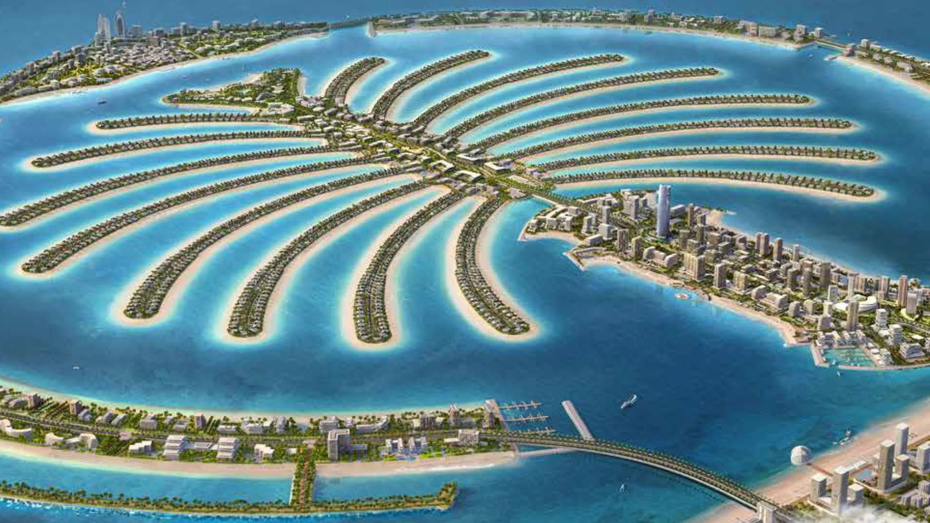
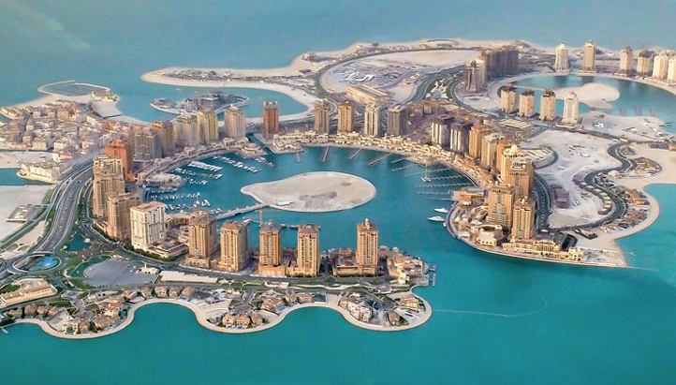
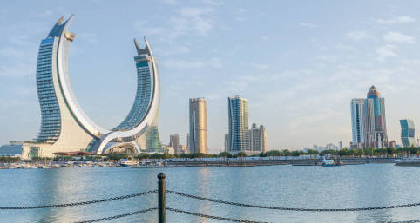
Coastal Development
More than 40% of the GCC coastline was under development in the last 20 years.
Coastal development negatively affects coral reefs through:
Dredging and land reclamation: Physically destroys shallow reefs, alters tides and water circulation, which slows coral growth.
Construction: introduces cement particles, heavy metals, and hydrocarbons that stress corals.
Desalination plants: release chemical residues back into coastal waters, leading to higher salinity, creating “dead zones,” where corals struggle to survive or recover.
Palm Jumeirah (UAE)
The Pearl (Qatar)
Lusail (Qatar)

Slide 5
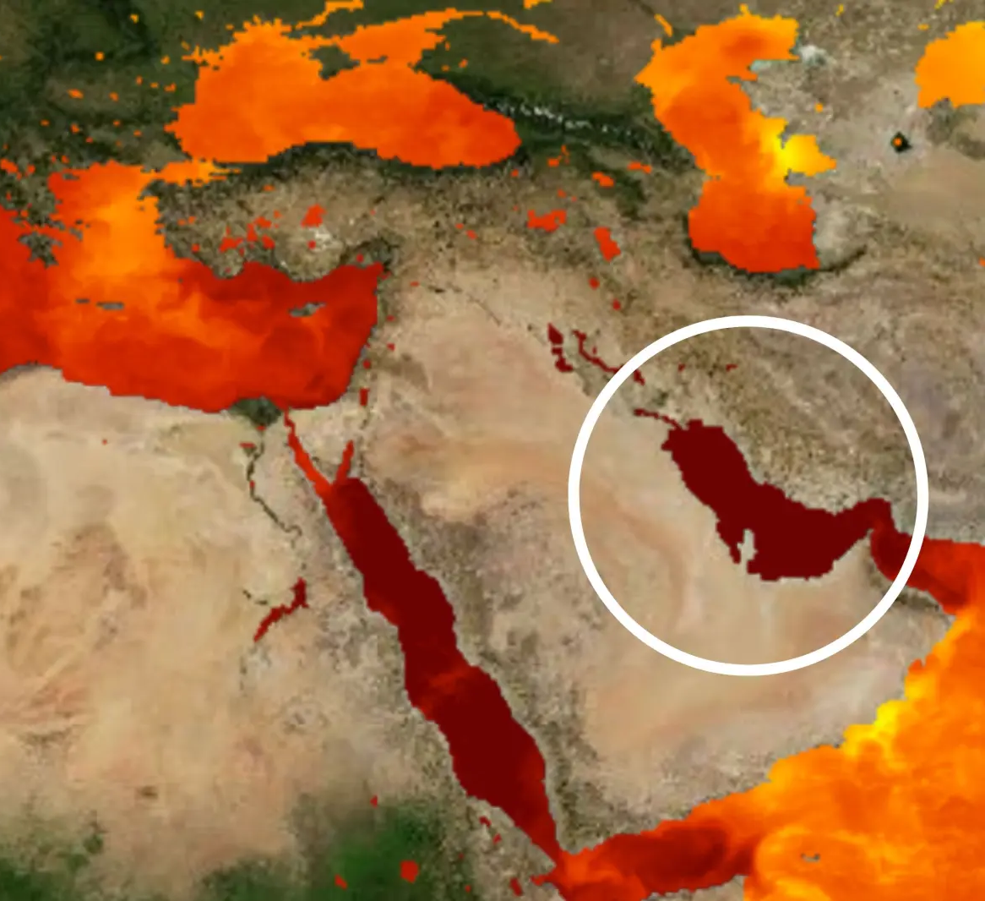
Rising Sea Temperatures
Sea-surface temperatures here reached around 36.5°C (98°F), which was one of the hottest ocean temperatures ever recorded.
The highest was in 2020 near Kuwait, when it reached almost 37.6°C (99.7°F).
With high levels of greenhouse gases, heating leads to oxygen depletion. This would:
Damage coastal habitats and increase fish mortality.
Increase harmful toxin-producing plankton which contaminate seafood.
Increase gov spending on artificial coastal protection.
This combination of extreme heat + coastal development result in severe declines in coral cover, reduced biodiversity, and slower coral recovery.
NASA SOTO map showing the temperature of the water on August 26, 2025.

Slide 6
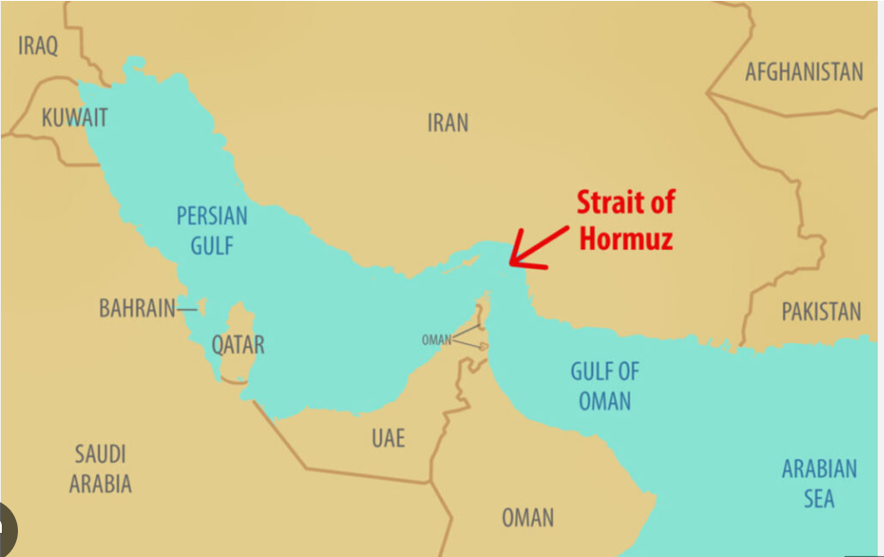
Geographical Landscape
Shallow, semi-enclosed basin
Avg depth ≈ 35 m
Only outlet: Strait of Hormuz, weak water exchange
Summer temps reach 35–36°C
High salinity ( around 42 psu)
Sediment + pollution stay trapped
Coastal changes leads to amplified impact on reefs

Slide 7
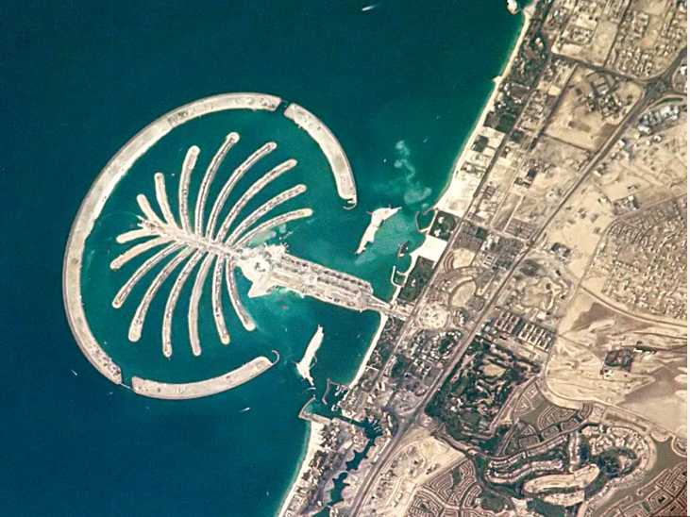
The UAE: Dubai’s Palm Jumeirah
Pre-development: Dubai coast had high coral cover (~42%), rich reef + seagrass habitats
Massive dredging & sand filling for the island
Sediment plumes buried corals + benthic habitats
Turbidity increased, reducing light for reefs
Formation of anoxic sediment pits, shift to sediment-tolerant species
Fragmentation of natural reef systems; replaced by artificial hard substrate

Slide 8
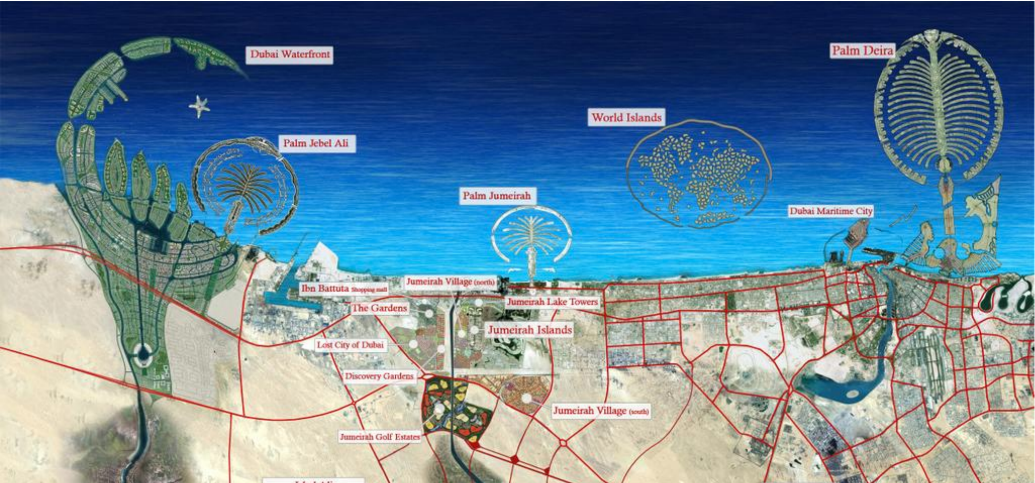

Slide 9
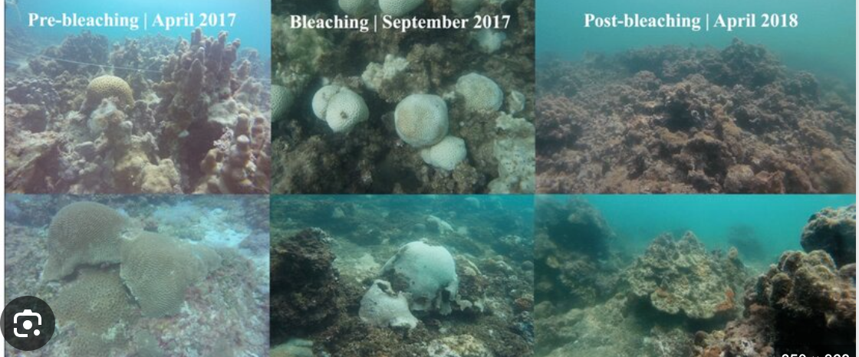
Bahrain: Fasht Al-Adhm and extreme reclamation
Since 1960s: >80% of coastline altered by reclamation
110 km² of new land added, 14% increase in Bahrain’s land area
Habitat losses (1985–1992):
10.2 km² seagrass lost
218,700 m² coral lost at Fasht Al-Adhm
After reclamation:
Reef flats buried or cut off
Sediment plumes + altered currents degrade water quality

Slide 10
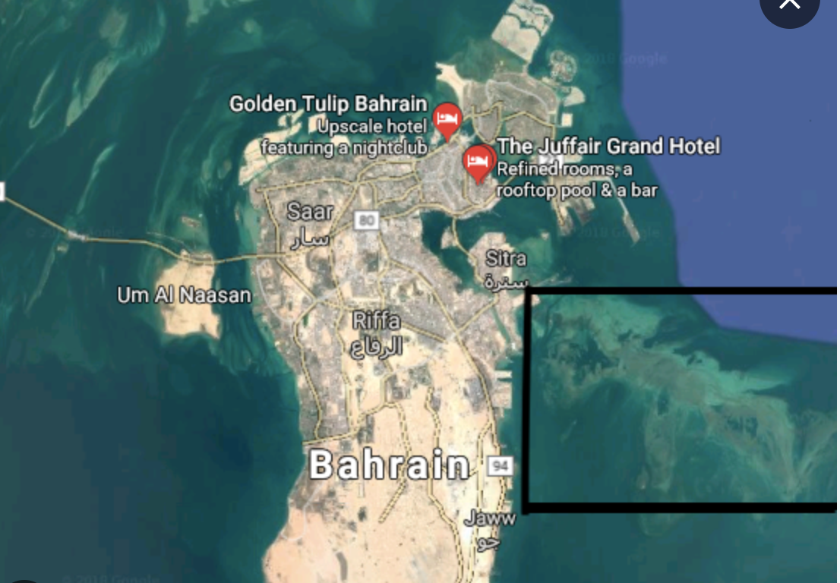
Mercury
Venus
Mars
Mercury is the closest planet to the Sun and the smallest of them all
Venus has a beautiful name and is the second planet from the Sun
Despite being red, Mars is actually a cold place. It’s full of iron oxide dust

Slide 11
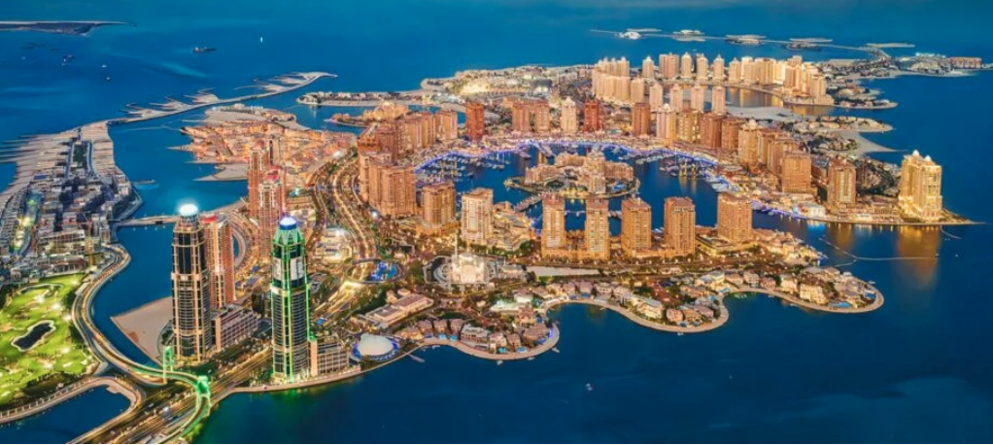
Qatar: A Peninsula Reshaping its
Coast
Altering embayments/channels further reduces water circulation
>70% of coastline modified by reclamation, dredging, construction
40-year analysis: industrialization + megaprojects reshaped Doha’s shoreline
Before: connected coral–seagrass–mangrove systems supporting fisheries
After: increased sediment, pollution, decline in reefs + seagrass + mangroves
>60% of commercial fish species overexploited, linked to habitat degradation

Slide 12
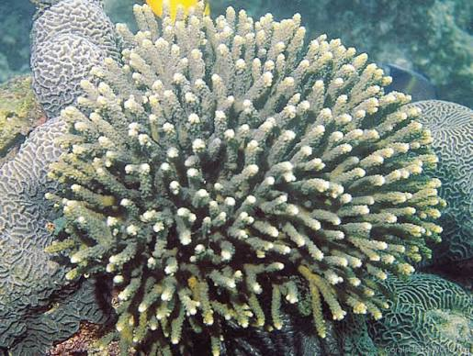
Conservation Solutions:
-MPAs (Marine Protected Areas) restricted zones, allowing ecosystem recovery
-Active coral restoration
-Solar-powered desalination plants: reverse osmosis
-Regional Organization Protection Marine Environment (ROPME)

Slide 13
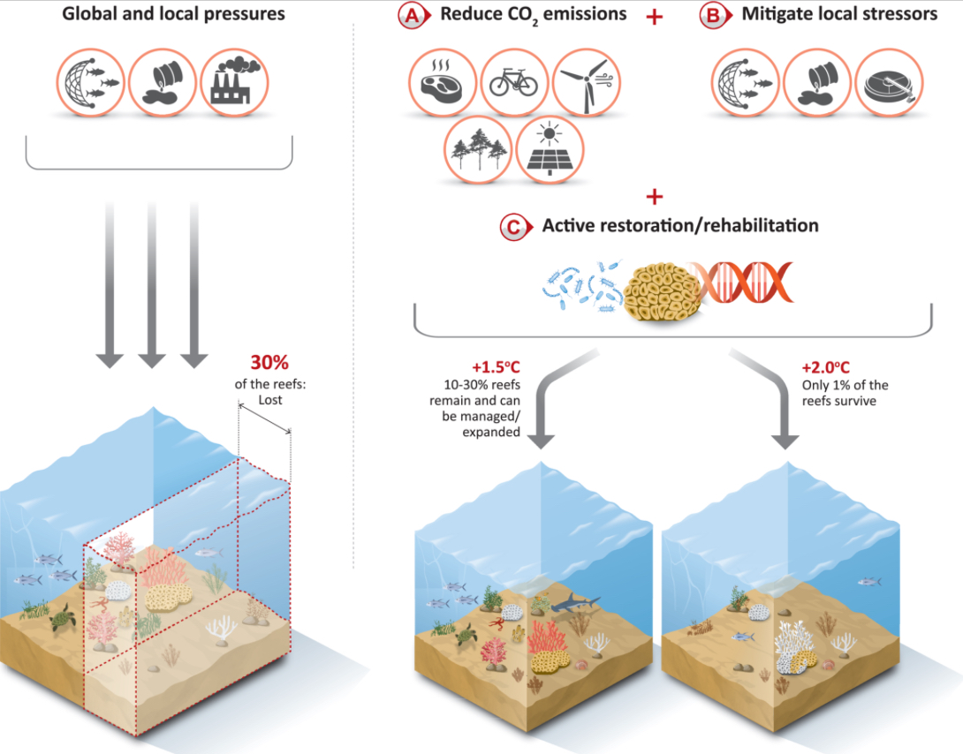
Policy tools
1- pollution charges
2- cap and trade systems
3-payments for ecosystem services

Slide 14
Economic Theory
Gordon-Schaefer model
No property rights = inefficient harvest. Open access fisheries= stock depletion & overcapitalization
Cost- benefit analysis
Mandatory EIAs shutdown projects destroying more economic value than they create

Slide 15
Establishing property rights through MPAs covering 30% of gulf waters
$29.8B
$34-37B
Without action- economic losses
With management-economic gains

Slide 16
Sources
Alosairi, Y., T. Kowalik, S. Shaw, and H. Al-Hoy. “World Record Extreme Sea Surface Temperatures in the Arabian Gulf during 2020.” Marine Pollution Bulletin 165 (2020). https://doi.org/10.1016/j.marpolbul.2020.111766.
Bai, Yuntao, Ruidi Hu, Lan Wang, and Delong Li. “Reduce Pollution, Establish Protected Areas, Manage Fisheries Properly? How to Protect Coral Reefs Based on Carbon Trading.” Frontiers in Marine Science 11. 2024). https://doi.org/10.3389/fmars.2024.1331045.
Coles, Steve L., and Bernhard M. Riegl. “Thermal Tolerances of Reef Corals in the Gulf: A Review of the Potential for Increasing Coral Survival and Adaptation to Climate Change through Assisted Translocation.” Marine Pollution Bulletin 72, no. 2 (2013): 323–332. https://doi.org/10.1016/j.marpolbul.2012.09.006.
D’Agostino, Daniele, Maryam Al-Memari, and John A. Burt. “Evolution of Desalination Research and Water Production in the Middle East: A Five-Decade Perspective.” Frontiers in Water 7. 2025. https://doi.org/10.3389/frwa.2025.1672360.
Lachkar, Z., Mehari, M., Paparella, F., and Burt, J. A. “Acceleration of Warming, Deoxygenation, and Acidification in the Arabian Gulf Driven by Weakening of Summer Winds.” Geophysical Research Letters 51, no. 24 (2024). https://doi.org/10.1029/2024GL109898.
Roy, A.D., Mohan, M., Althauser, A. et al. “Analyzing the Influence of Climate and Anthropogenic Development on Vegetation Cover in the Coastal Ecosystems of GCC”. Earth Syst Environ (2025). https://doi.org/10.1007/s41748-025-00625-y.
Thomson, Jess. “Sea Surface Temperatures Hit 97.7 °F: ‘One of the Highest’ Ever Recorded.” Newsweek, August 27, 2024. https://www.newsweek.com/sea-surface-temperatures-persian-gulf-record-breaking-climate-change.

Slide 17
Sources
World Resources Institute. “Coral Reefs: Persian Gulf and Gulf of Oman (Dashboard).” Resource Watch. Accessed November 17, 2025. https://resourcewatch.org/dashboards/coral-reefs-persian-gulf-and-gulf-of-oman.
Afzal, S., Sodoudi, S., Chowdhury, S., & Siddiqui, I. (2012). Impact of large-scale land reclamation on the physical and chemical characteristics of the near-shore environment: Case study of Dubai, UAE. Marine Pollution Bulletin, 64(8), 1580–1589. https://doi.org/10.1016/j.marpolbul.2012.07.036.
Al-Asfour, H. (2025, June 18). Marine desertification… Landfill threatens the environment and livelihoods of fishermen in Bahrain. Arab Reporters for Investigative Journalism. https://en.arij.net/marine-desertification/.
Amato, A., Ben Hamadou, R., Chatziefthimiou, A. D., Abdul Majid, S., Castro de la Mata, G., Ali, M., & Al-Thani, S. K. (2025). Qatar’s Ecology: An Assessment with Recommendations. Earthna Center for a Sustainable Future. https://www.earthna.qa/sites/default/files/publications/attachments/2025-04/Qatar%27s%20Ecology-An%20Assessment%20with%20Recommendations.pdf.
Fanning, L. M., Al-Naimi, M. N., Range, P., Ali, A.-S. M., Bouwmeester, J., Al-Jamali, F., Burt, J. A., & Ben-Hamadou, R. (2021). Applying the ecosystem services – EBM framework to sustainably manage Qatar’s coral reefs and seagrass beds. Ocean & Coastal Management, 205, 105566. https://doi.org/10.1016/j.ocecoaman.2021.105566.
Mansourmoghaddam, M., Ghafarian Malamiri, H. R., Rousta, I., Olafsson, H., & Zhang, H. (2022). Assessment of Palm Jumeirah Island’s construction effects on the surrounding water quality and surface temperatures during 2001–2020. Water, 14(4), 634. https://doi.org/10.3390/w14040634.
Naser, H. A. (2015). The role of environmental impact assessment in protecting coastal and marine environments in rapidly developing islands: The case of Bahrain, Arabian Gulf. Ocean & Coastal Management, 104, 159–169. https://doi.org/10.1016/j.ocecoaman.2014.12.009.

Slide 18
Sources
Paparella, F., D’Agostino, D., & Burt, J. A. (2022). Long-term, basin-scale salinity impacts from desalination in the Arabian/Persian Gulf. Scientific Reports, 12(1), 20549. https://doi.org/10.1038/s41598-022-25167-5.
Salahuddin, B. (2006). The marine environmental impacts of artificial island construction, Dubai, UAE (Master’s project). Nicholas School of the Environment and Earth Sciences, Duke University. https://hdl.handle.net/10161/104.
Ward, K. M., Bauman, A. G., Alshihi, R. M., & Feary, D. A. (2015). Current status of coral reefs in the United Arab Emirates: Distribution, extent, and community structure. Marine Pollution Bulletin, 105(1), 505–513. https://doi.org/10.1016/j.marpolbul.2015.10.005.
Zainal, K. (2012). The cumulative impacts of reclamation and dredging: An assessment of ecological and economic consequences. Bnature. https://bnature.info/wp-content/uploads/2022/09/Impacts-of-reclamation-and-dredging.pdf.

Slide 19
Sources
- Coral Reef Status in the ROPME Sea Area: Arabian/Persian Gulf, Gulf of" by Hamid Rezai, Simon P. Wilson et al.
- A decade of benthic changes on coral reefs in the Southern Persian/Arabian Gulf (2010–2020)
- The Growing Need for Sustainable Ecological Management of Marine Communities of the Persian Gulf
Towards more sustainable coastal development in the Arabian Gulf: Opportunities for ecological engineering in an urbanized seascape - ScienceDirect
Estimating and comparing the direct economic contributions of reef fisheries and tourism in the Asia-Pacific - ScienceDirect
Restoring Coral Reefs | NOAA Fisheries
Estimating the economic benefits and costs of highly‐protected marine protected areas - Davis - 2019 - Ecosphere - Wiley Online Library
The global costs and benefits of expanding Marine Protected Areas - ScienceDirect
Is the development of desalination compatible with sustainable development of the Arabian Gulf? - PubMed
Long-term, basin-scale salinity impacts from desalination in the Arabian/Persian Gulf | Scientific Reports
Counting the Value of the Sea: How Tourism Can Be Good for Coral Reefs and More
Coral Reef Loss: Economic Impact on Tourism, Fisheries & Coastal Protection

