Slide 1
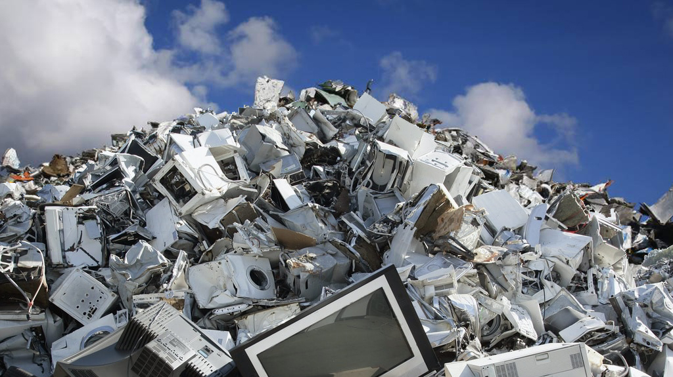
E-Waste Management
Gulzina Abdikarim & Iqra Nadeem

Slide 2
Table of contents
E-waste overview
Why is E-Waste a Major Concern?
Economic Dimensions of the E-Waste Crisis
Solutions
Case Study

Slide 3
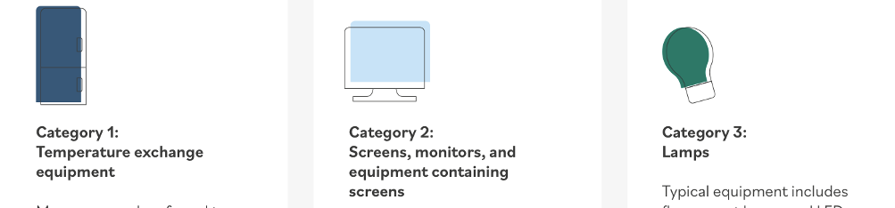

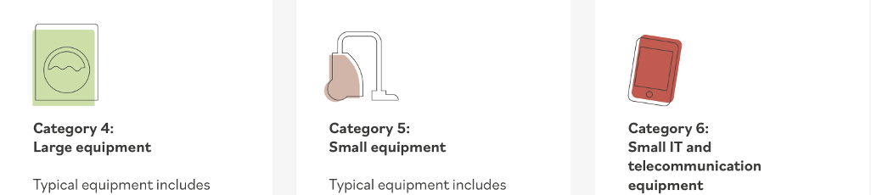
Global E-Waste
62 billion kg
7.8 kg/capita
generated globally in 2022
​
Annual growth rate: ~2.6 million tonnes per year ​
Only 22.3% was formally collected and recycled​
78% is undocumented → dumped, burned, or illegally traded​
Top producers: China, U.S., India
Middle East: Saudi Arabia
Category 1: Temperature exchange equipment
Category 2: Screens, monitors, and equipment containing screens
Category 3: Lamps
Category 4: Large equipment
Category 5: Small equipment
Category 6: Small IT and telecommunication equipment
Source:
Source: Global E-Waste Monitor 2024, UNITAR & ITU
Notes:
E-waste, or electronic waste, refers to outdated, discarded, or end-of-life electrical and electronic equipment (EEE).
57.4 million metric tons (MMT) generated globally in 2021, expected to reach 74 MMT by 2030.
Screens and monitors: 5.9 billion kg (25% recycled)
Small IT and telecommunication equipment: 4.6 billion kg (22% recycled)
This includes a wide range of devices such as computers, smartphones, televisions, and other electronic appliances that are no longer wanted or usable.

Slide 4
Regional E-waste Generation Per Capita & Recycling Rates (2022)
Regional Formal Collection and Recycling Rates
Europe leads with 42.8%
Oceania: 41.4%
Americas: 30%
Asia: 11.8%
Africa: 0.7%
Global average: 22.3%
Notes:
Shortened device lifespans due to rapid innovation and consumerism .
Surge in mobile and computer use since COVID-19 (remote work, online school) sustainability-14-00647-v2
.
Informal recycling in low-income countries uses acid burning, open incineration, illegal dumping → severe environmental damage

Slide 5
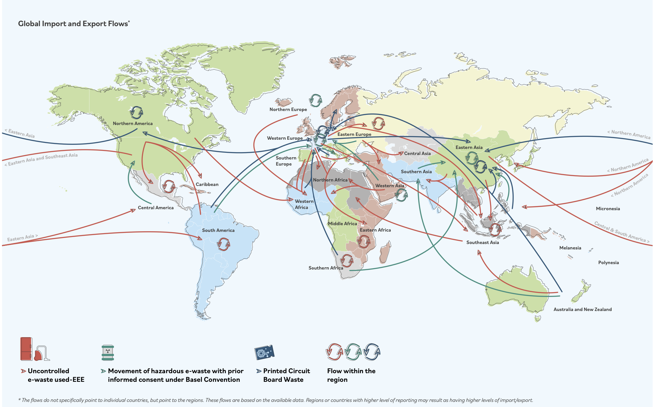
Why is E-Waste a Major Concern?
Rapid Growth and Inadequate Management
Hazardous Substances and Environmental Impact
Health Risks
Depletion and Loss of Valuable Materials
Climate Change Impact
Regulatory and Enforcement Challenges
Notes:
Shortened device lifespans due to rapid innovation and consumerism .
Surge in mobile and computer use since COVID-19 (remote work, online school)
.
Informal recycling in low-income countries uses acid burning, open incineration, illegal dumping → severe environmental damage

Slide 6
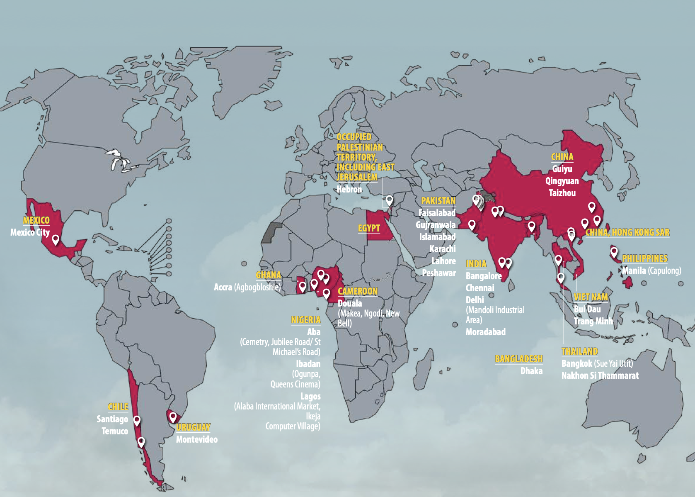
Economic Dimensions of the E-Waste Crisis
What makes e-waste economically costly?
Negative Externalities
Market Failure
Lost Economic Opportunity
Climate Change Impact
Rising Public Costs
Economic value of metals lost to landfills ($60 billion/year globally)
Locations of informal e-waste dismantling and recycling sites, WHO

Slide 7
Circular Economy Model reduces inefficiency
9R Framework of Circular Economy
Sustainable inputs
Extending Product Life Cycle
Sharing Production Systems
Product-Services Fusion (maintenance, repair)
Responsible Resource Use & Waste Management
Continuous Technological Advancement
Socio-Cultural Adaptability
Refuse
Make product redundant.
Rethink
Make the product use more intense.
Reduce
Increase efficiency in manufacturing.
Reuse
Reuse by another consumer.
Repair
Fix defective products.
Refurbish
Restore and update old products.
Remanufacture
Use parts in new products with the same function.
Repurpose
Use parts in new products with different functions.
Recycle
Process materials for reuse.
Recover
Incinerate with energy recovery

Slide 8
Urban Mining solves resource scarcity + externalities
Recovering metals from discarded electronics
Smartphones contain 100× more gold per ton than gold ore
Cheaper and more sustainable than virgin mining
Reduces global supply-chain risks
Supports green jobs and formal recycling industries
Recycling of e-waste prevented the extraction of 900 billion kg of ore and avoided 52 billion kg of CO2-equivalent emissions in 2022.

Slide 9
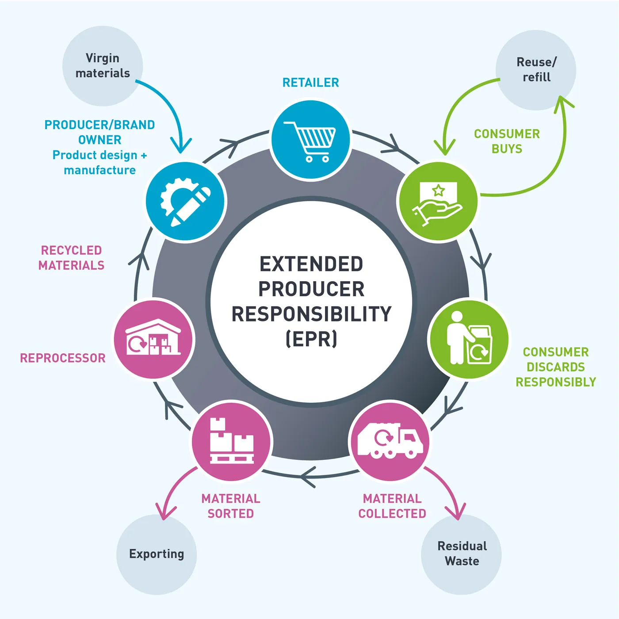
Extended Producer Responsibility (EPR) internalizes externalities
Product take-back
Economic and market-based instruments
a. Deposit refund
b. Advanced disposal fees
c. Material tax
d. Upstream combination tax/subsidy
Regulations and performance standards
Information-based instruments
Notes:
EPR is successful in:
EU (WEEE Directive)
Japan
South Korea
India & China (partial adoption

Slide 10
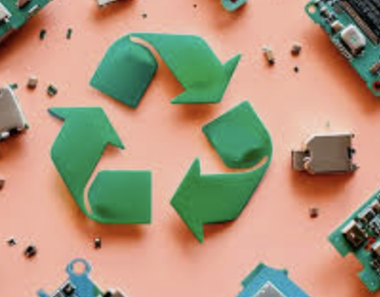
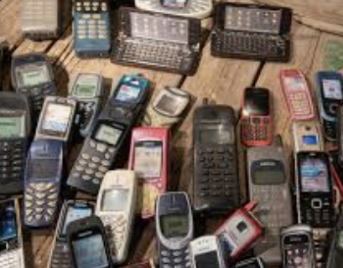
Role of Companies
Corporate Responsibility in E-Waste Reduction
Take-back and buy-back programs
Repair and replacement services
Product design for easier disassembly
Higher durability standards
Using recycled materials in new products
Supporting right-to-repair initiatives
Examples:
Apple: trade-in & material recovery robots
Dell: closed-loop recycling plastics
Fairphone: modular phone design

Slide 11
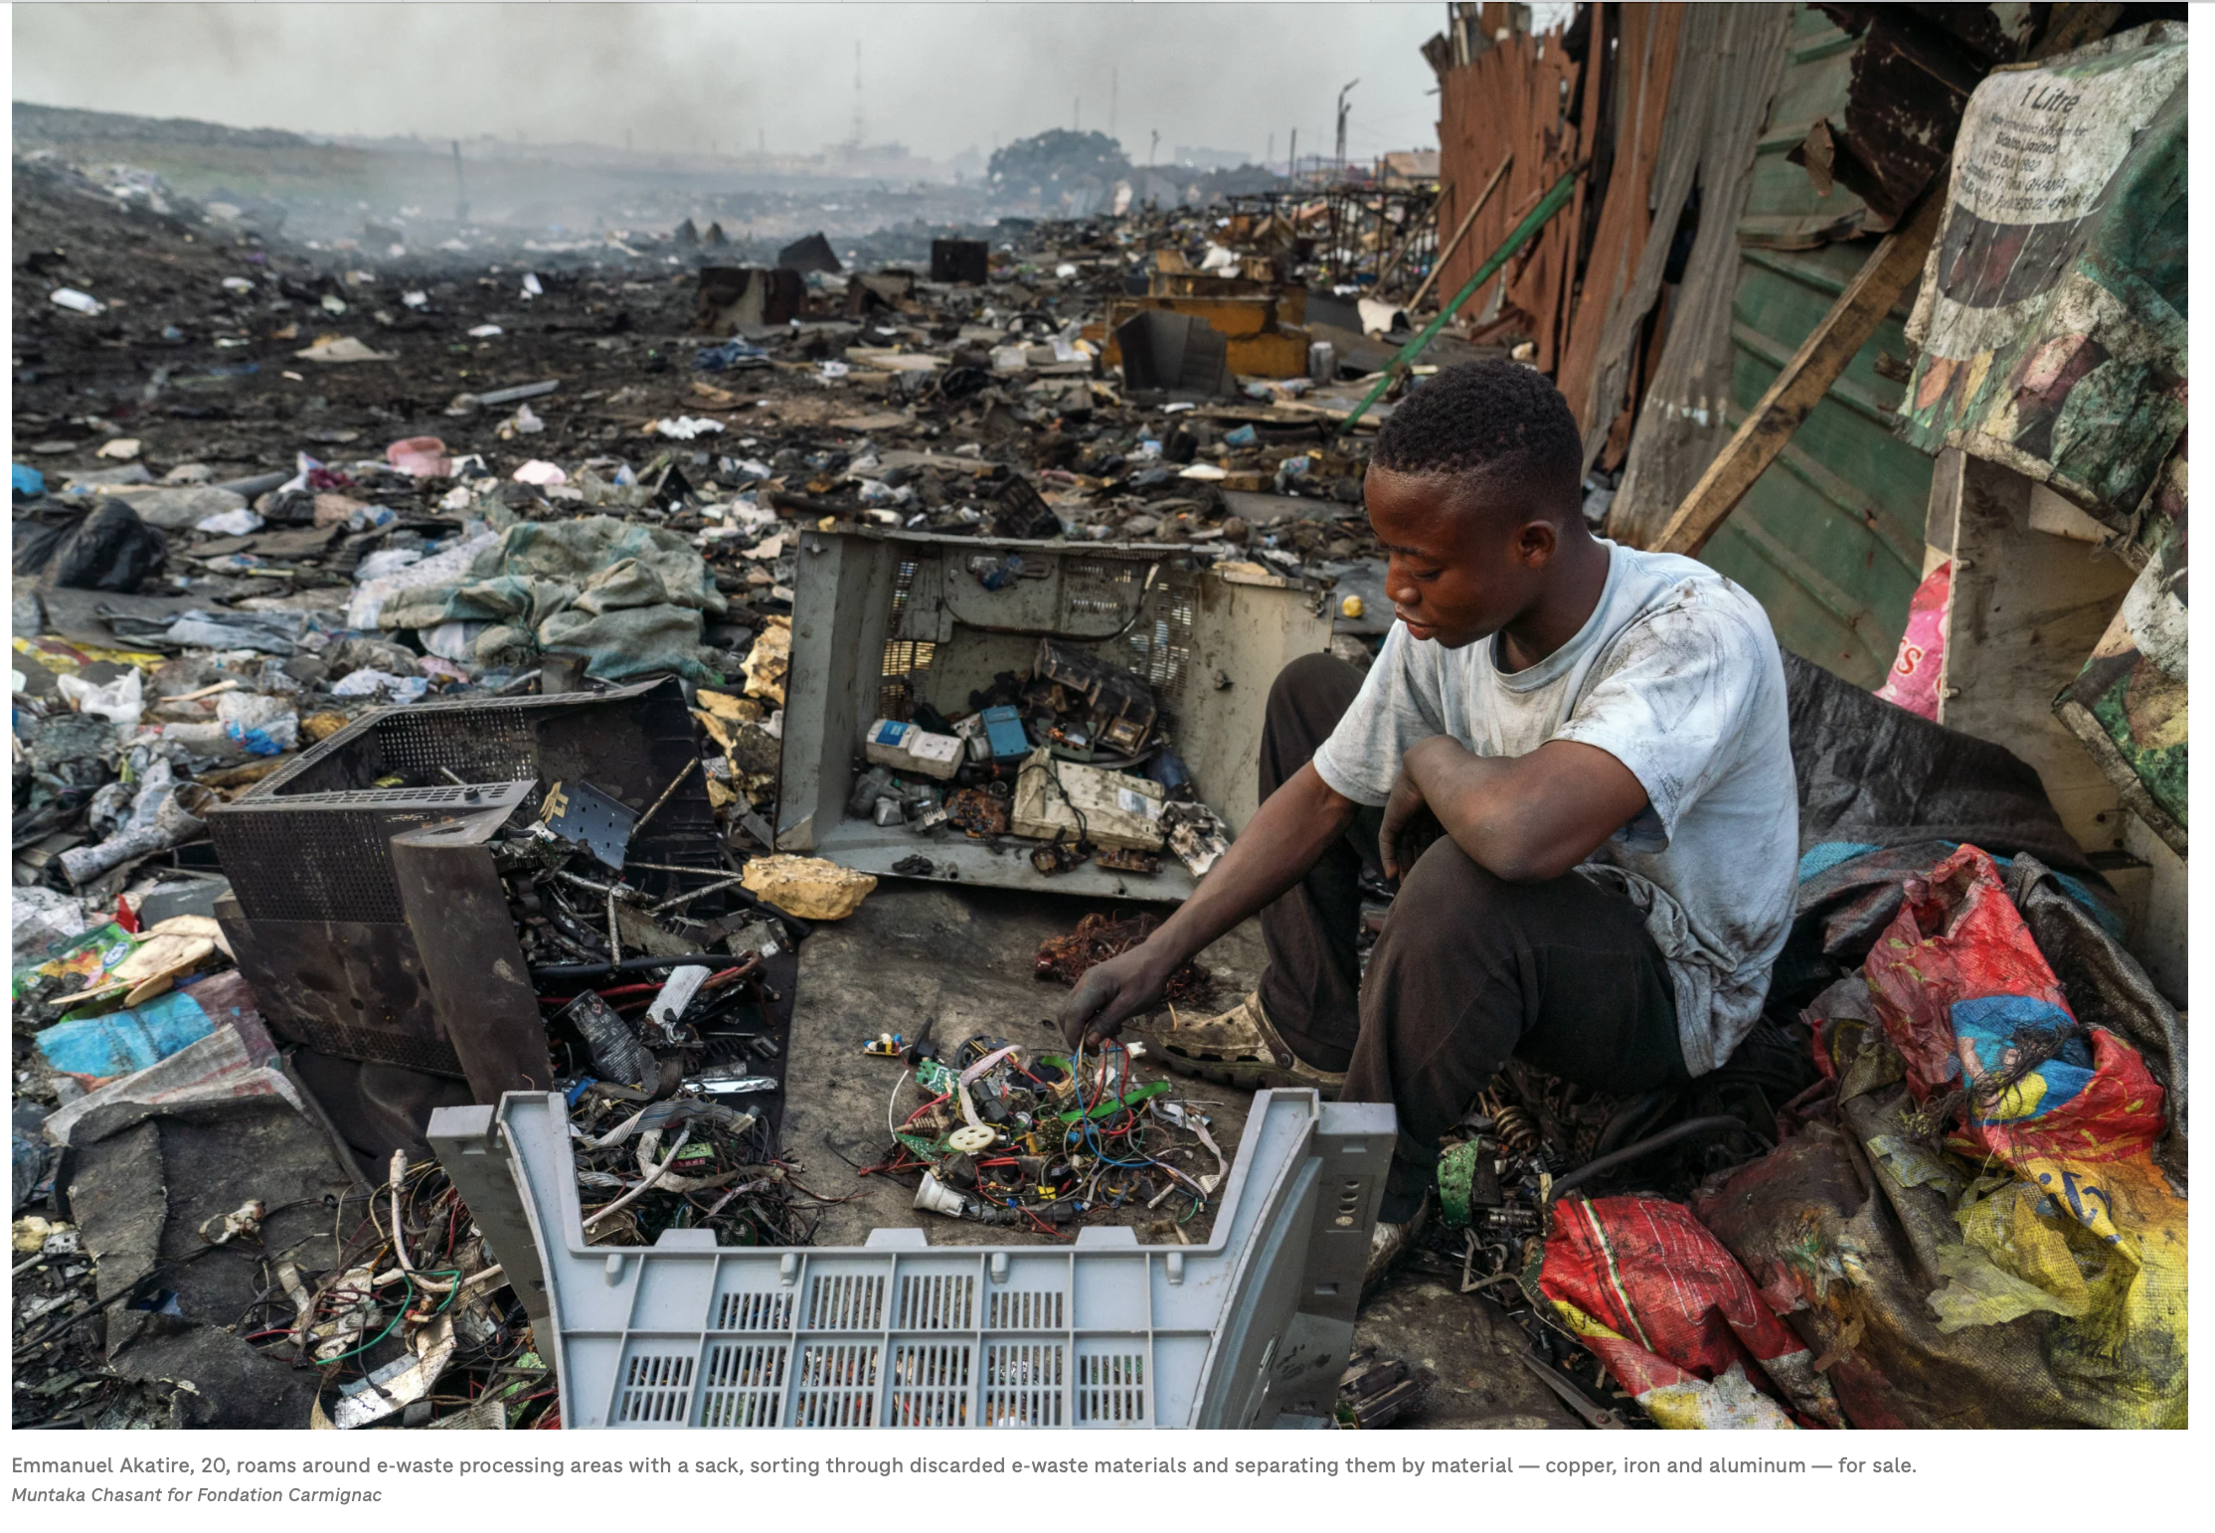
Transforming the Informal Sector reduces hidden social costs
Informal workers are essential but unprotected
Exposure to hazardous burning → chronic illness
Solutions:
Training + certification programs
Safety equipment
Small-scale community recycling hubs
Financial support during transition
Integration into formal labor systems

Slide 12
Support for Low- and Middle-Income Countries
Infrastructure investments for formal e-waste treatment
International financial and technical support for developing countries
Promote formalization of the informal recycling sector with training and safer technology

Slide 13
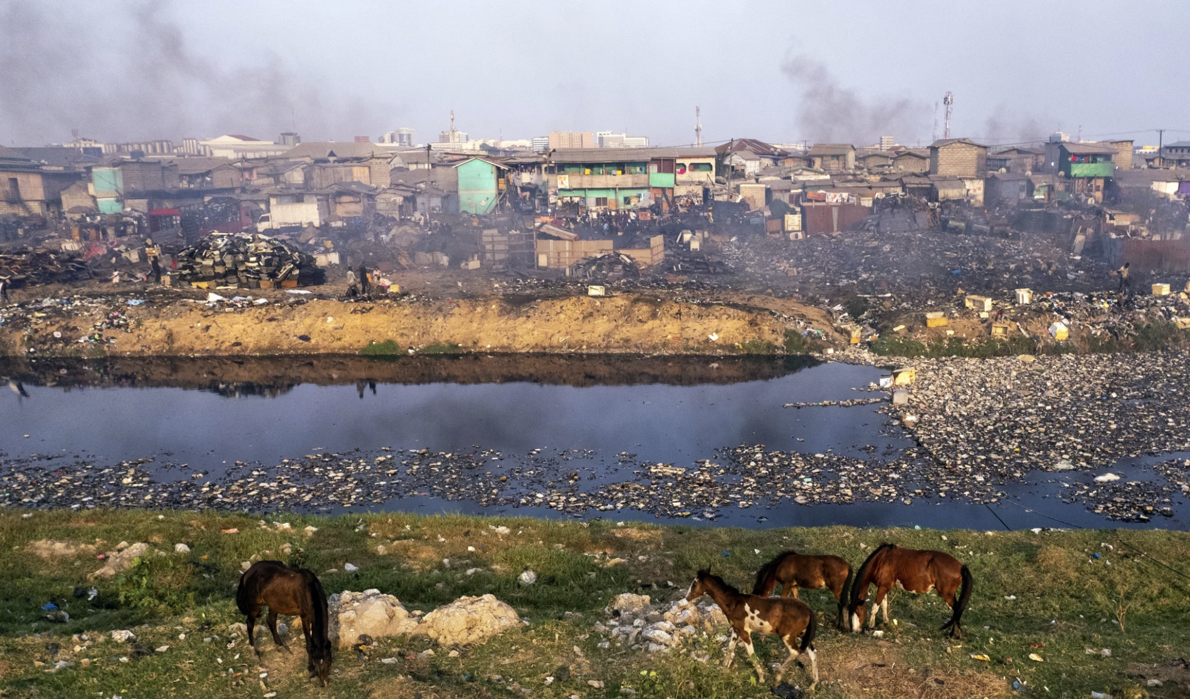
Case Study: Agbogbloshie, Ghana
Importer of large volumes of second-hand electronics
Burn wires and dismantle devices to recover metals
High exposure to: lead, mercury, toxins, polycyclic aromatic hydrocarbons
Health effects: respiratory illness, neurological damage, impaired child development
Soil & water contamination exceeds international safety standards
Demonstrates the global inequality of e-waste flows

Slide 14
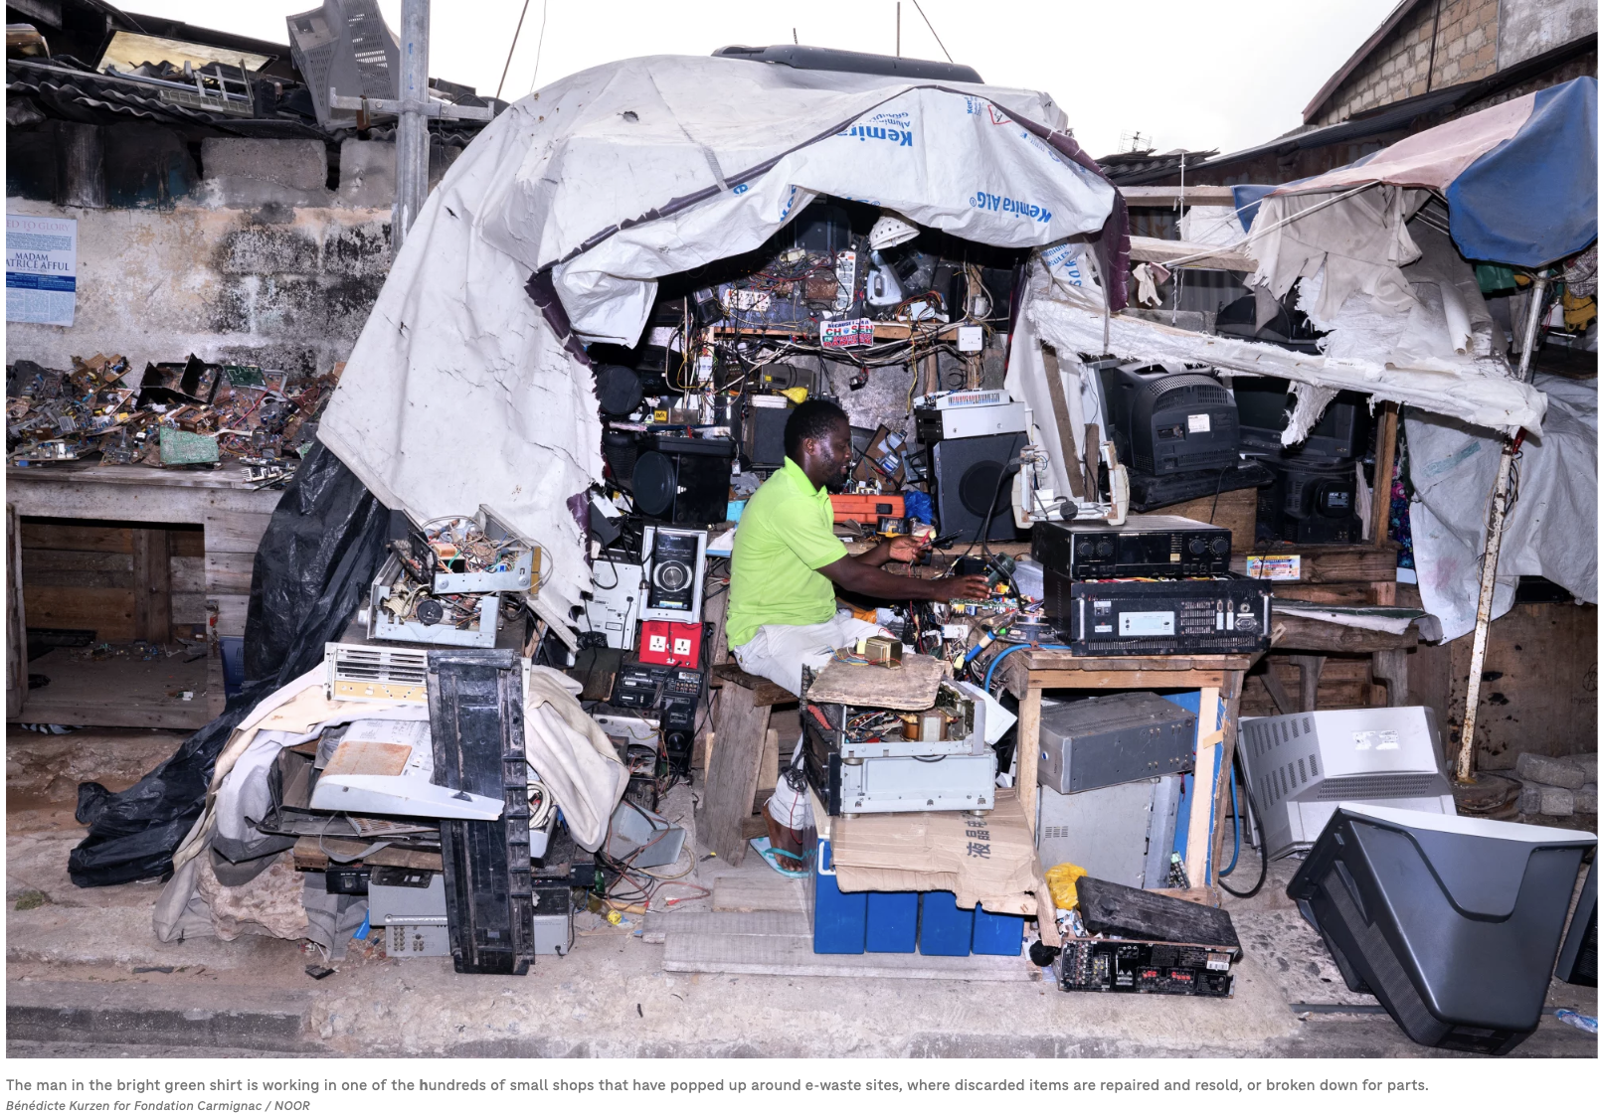

Slide 15
Policy Gaps & Enforcement Challenges
Weak or outdated legislation
Limited monitoring of electronic imports
Illegal transboundary movement of e-waste
Low investment in formal recycling infrastructure • Public awareness about disposal is minimal
Informal sector dominates → unsafe processing
Lack of coordination between policymakers, manufacturers & recyclers

Slide 16
References
World Health Organization. (n.d.). Electronic waste (e-waste).
https://www.who.int/news-room/fact-sheets/detail/electronic-waste-(e-waste)
World Health Organization. (2024). The growing environmental risks of e-waste. WHO IRIS Repository.
https://iris.who.int/server/api/core/bitstreams/1b1556ab-fbe1-4de2-890e-68af26c7e1c7/content
Geneva Environment Network. (n.d.). The growing environmental risks of e-waste.
https://www.genevaenvironmentnetwork.org/resources/updates/the-growing-environmental-risks-of-e-waste/
Chakrabarty, A., & Nandi, S. (2021). Electronic waste vulnerability: circular economy as a strategic solution. Clean Technologies and Environmental Policy, 23, 429–443. https://doi.org/10.1007/s10098-020-01976-y
Silver, M. (2024, October 5). Electronics, public health, and waste: Ghana’s phones and computers problem. NPR.
https://www.npr.org/sections/goats-and-soda/2024/10/05/g-s1-6411/electronics-public-health-waste-ghana-phones-computers
Baldé, C.P., E. D’Angelo, V. Luda, O. Deubzer, and R. Kuehr. Global Transboundary E-waste Flows Monitor - 2022. Bonn, Germany: United Nations Institute for Training and Research (UNITAR), 2022. https://ewastemonitor.info/wp-content/uploads/2024/12/GEM_2024_EN_11_NOV-web.pdf
Murthy, V., & Ramakrishna, S. (2020). A review on global e-waste management: Urban mining towards a sustainable future and circular economy. Sustainability, 12(24), 10492. https://doi.org/10.3390/su122410492
Baldé, C. P., et al. (2024). The Global E-Waste Monitor 2024. UNITAR & ITU. https://ewastemonitor.info/wp-content/uploads/2024/12/GEM_2024_EN_11_NOV-web.pdf
World Health Organization. (2024). The Growing Environmental Risks of E-Waste. WHO IRIS Repository. https://www.who.int/news-room/fact-sheets/detail/electronic-waste-%28e-waste%29
Geneva Environment Network. (n.d.). The Growing Environmental Risks of E-Waste. https://www.genevaenvironmentnetwork.org/resources/updates/the-growing-environmental-risks-of-e-waste/
Murthy, V., & Ramakrishna, S. (2020). A review on global e-waste management. Sustainability, 12(24). https://www.mdpi.com/2071-1050/14/2/647
Chakrabarty, A., & Nandi, S. (2021). Electronic waste vulnerability: circular economy as a strategic solution. https://link.springer.com/journal/10098/volumes-and-issues/23-2

