Slide 1
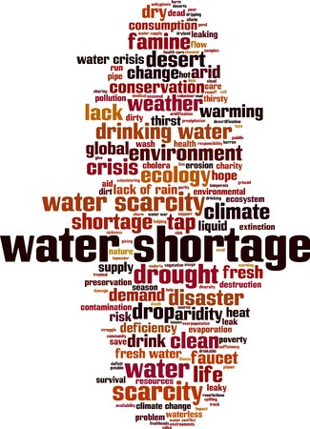
Econ 2675 – Environmental Economics Chapter 9 Lecture - Water: A Confluence of Renewable and Depletable Resources

Slide 2
The Potential for Water Scarcity
Surface water is a renewable resource consisting of rivers, lakes, and reservoirs.
Groundwater is water that collects underground in aquifers. Some aquifers are non-recharging and are thus nonrenewable resources.
In many parts of the world, excess demand for water is causing great stress, for example, fracking.
Groundwater levels have also been declining in many areas due to intensive pumping.
Water quality is also a growing problem. Excessive withdrawal from aquifers is a major cause of land subsidence.
Also a question of allocation.

Slide 3
The Hydrologic Cycle

Slide 4
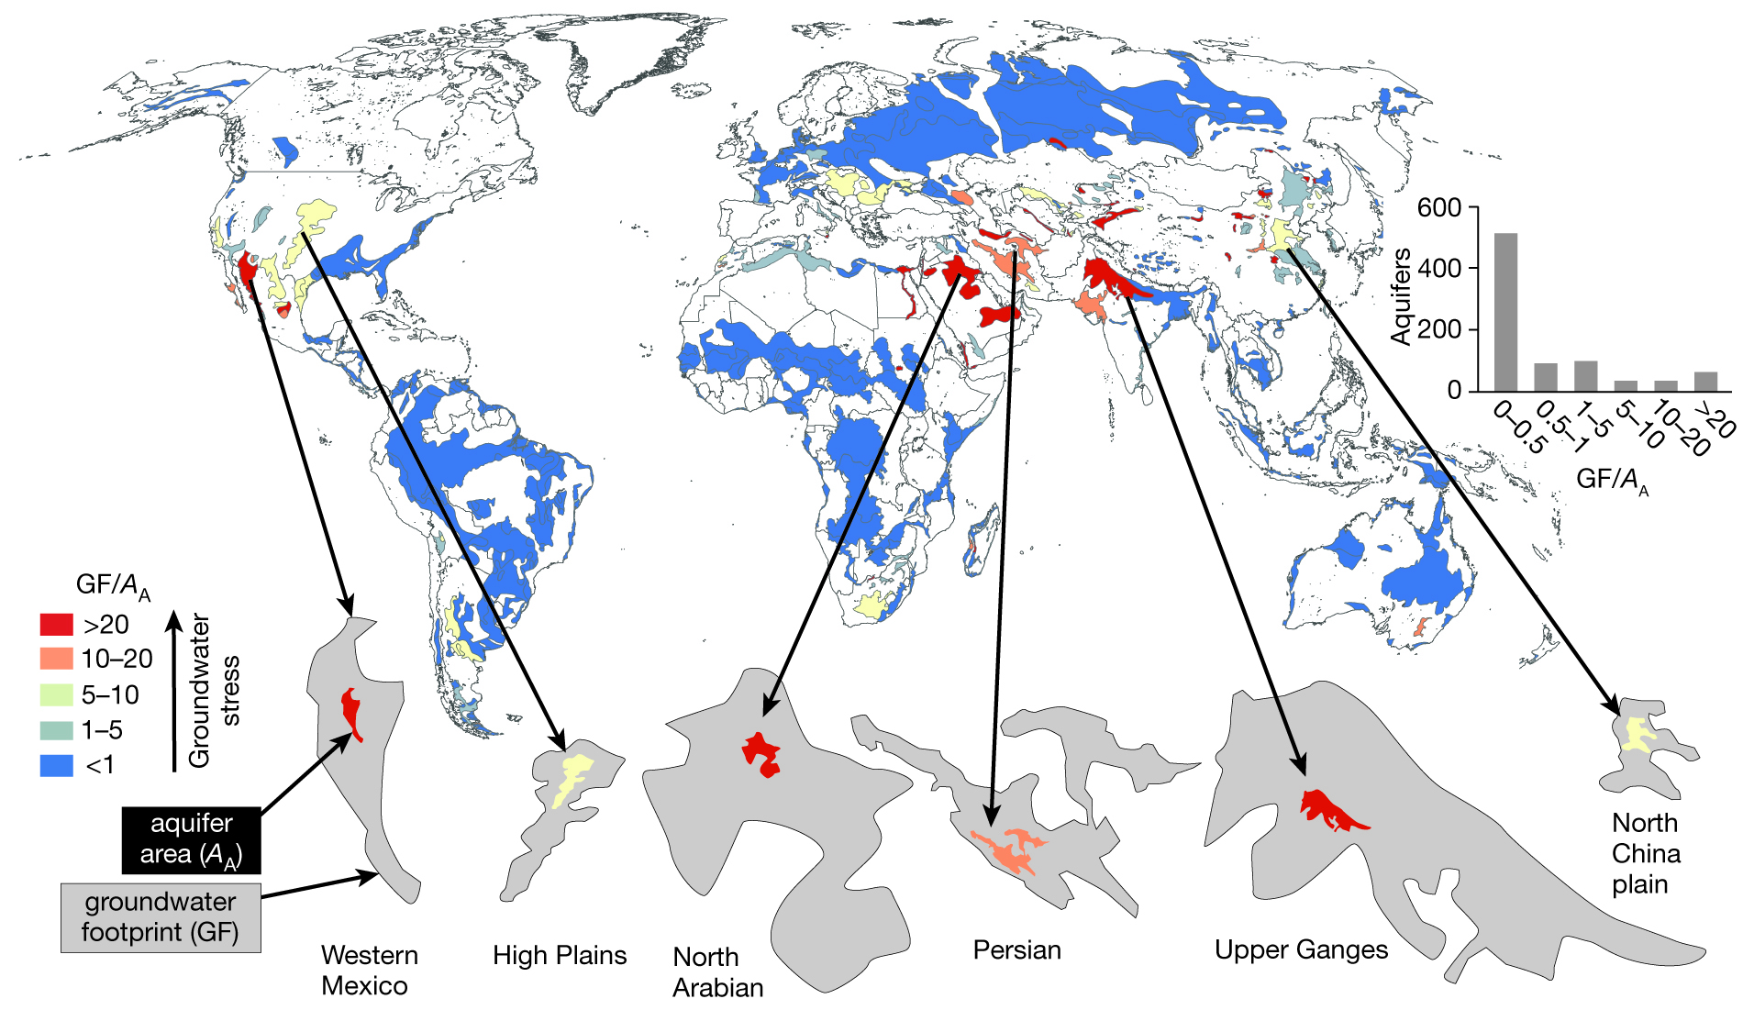
Degree to Which Aquifers Important for farming are Under Stress
Groundwater stress measures the ratio of groundwater withdrawal relative to its recharge rate over a given aquifer. Values above one indicate where unsustainable groundwater consumption could affect groundwater availability and groundwater-dependent ecosystems

Slide 5
The Efficient Allocation of Scarce Water
Surface Water
An efficient allocation of surface water must (1) strike a balance among a host of competing users and (2) supply an acceptable means of handling the year-to-year variability in water flow.
Efficiency in the presence of competing uses implies that the marginal net benefit should be equalized across all users.
If water were not scarce, scarcity rents would be zero.
Water is also a highly variable resource in terms of the timing of flows. Thus, a system must be able to deal with interannual variation in flows.

Slide 6
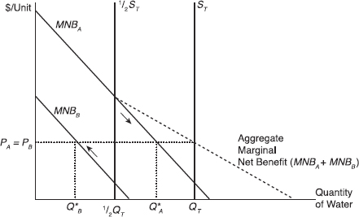
The Efficient Allocation of Scarce Water
Consider a water supply represented by S_{T}, where the amount of water available is Q_{T}. Suppose there are two different users represented by marginal net benefit curve A and marginal net benefit curve B. In this figure, A has higher demand (higher willingness to pay). The total (aggregate) marginal net benefit is the horizontal sum of the two demand curves.
What is the efficient allocation of water across these two users with different marginal values for water?

Slide 7
The Efficient Allocation of Scarce Water
Suppose instead, however, that the state or water authority decides, for equity or political reasons, to simply divide the available water equally between the two users, giving each an amount Q_{A} = Q_{B} = ½ Q_{T}. Is this efficient?
Suppose now the total water supply is equal to ½S_{T}. How should the lower water supply be efficiently allocated between the two users?

Slide 8
The Efficient Allocation of Scarce Water
Groundwater
For groundwater, there is a marginal user cost reflecting the intertemporal opportunity cost.
For groundwater sources for which withdrawals exceed recharge, the resource will be mined over time until it is depleted or until the marginal extraction cost reaches a prohibitive level.
In some regions, groundwater and surface water are not physically separate and management must consider the linkages.

Slide 9
The Current Allocation System
Riparian and Prior Appropriation Doctrines
Riparian rights allocate the right to use water to the owner of the land adjacent to the water.
The prior appropriation doctrine allows the transfer of water away from the stream for beneficial use (“use-it-or-lose-it”).
Water rights are usufructuary rights which are rights to use, not rights to own.

Slide 10
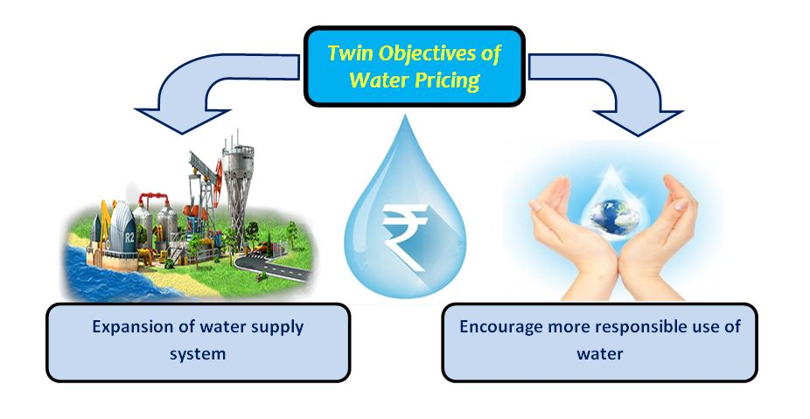
Remedies and Reforms: Water Prices
Municipal Water Pricing
Water conservation and various charge rate structure

Slide 12
Remedies and Reforms: Water Prices
Full Cost Recovery Pricing
Inefficient prices can be adjusted by allowing water utilities to earn more than a normal rate of return by charging a full cost recovery (FCR) price for water services.
The EU Water Framework Directive
Water Market: Sales, Leases, and Banks
Relaxing “use-it-or-lose-it” restriction would encourage conservation and allow water to move to higher valued uses by allowing owners to sell conserved water.
Water markets and water banks are being increasingly utilized to treat both inefficiencies and scarcity in the short term or on a long-term basis.

Slide 13
Remedies and Reforms: Water Prices
Water Market: Sales, Leases, and Banks (contd.)
Water Markets in Australia
Australia has eight mechanisms for trading water that include posted water markets, auctions, and the ‘water exchange’ which allows interstate trade and forward contracts.
Environmental Water Transaction
Attempts to protect instream water uses must confront two problems. First, the demand for instream rights will be inefficiently low. Second, their use to protect instream flows may not be considered “beneficial use.”

Slide 14
EXAMPLE 9.6 Moving Rivers or Desalting the Sea? Costly Remedies for Water Shortages
In most of northern China, freshwater is extremely scarce. China has been pursuing immense engineering projects in order to bring new water sources to this desperately dry, yet rapidly growing region. One three-phase project involves the diversion of water from the Yangzi River basin through hundreds of kilometers of canals and pipelines at extraordinary cost ($34 billion so far). The project is only partially complete. The other is a $4.1 billion power and desalination plant in the port city of Tianjin. The Beijing Power and Desalination Plant began operating in 2009. The capacity of the desalination plant will satisfy only a small portion of China’s demand for water.
As of 2013, water from the plant cost 8 yuan per cubic meter (about $1.30) to produce. Diverted water from the Yangzi is expected to cost about 10 yuan. Both of these are at least 60 percent higher than what households currently pay, though water rates are rising. Even if higher water prices were imposed on consumers, prices would be unlikely to cover the true cost of either source. Desalination is very energy intensive. In China, that energy comes mainly from burning dirty coal. Diverting water is not without external costs either. Diverting water deprives southern China of the water needed to combat drought. Developing scarcity in a crucial resource like water can force some tough choices!
Source: Removing salt from seawater might help slake some of northern China’s thirst, but it comes at a high price. Economist, February 9, 2013.

Slide 15
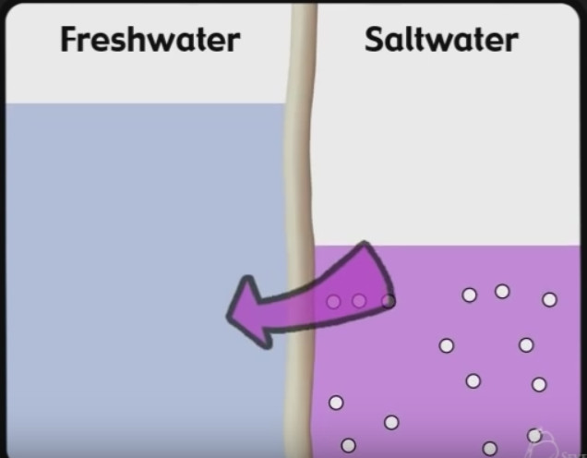
Remedies and Reforms: Water Prices
Desalination and Wastewater Recycling
Reverse osmosis: pumping seawater at high pressure through permeable membranes
Significantly reduced price of desalinized water due to technological advances in reverse osmosis, nanofiltration, and ultrafiltration methods

Slide 16
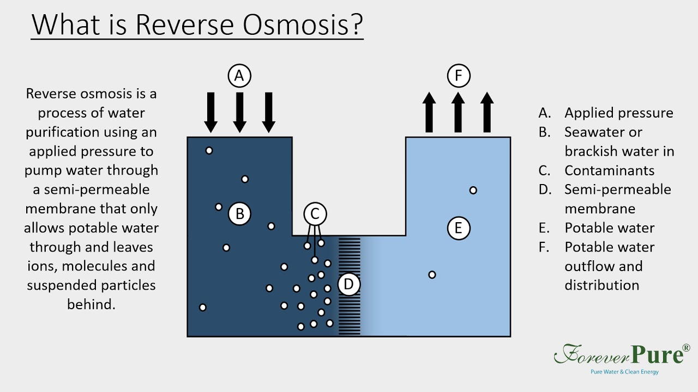

Slide 17
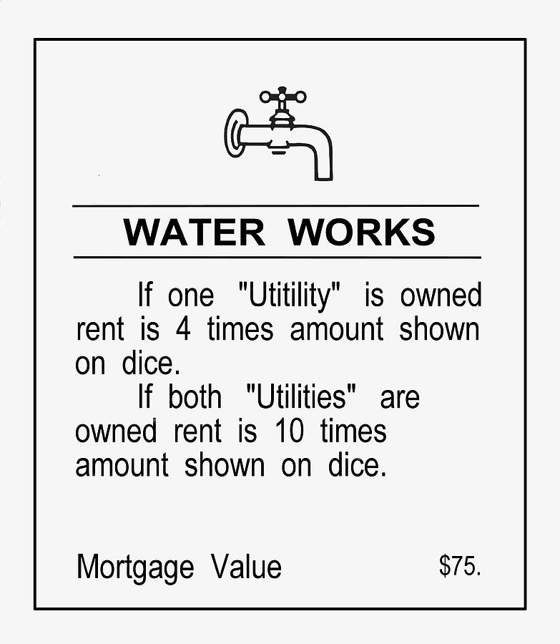
Remedies and Reforms: Water Prices
Privatization
Privatization of water supplies creates the possibility of monopoly power and excessive rates, but privatization of access rights does not.
Privatization of access rights only establishes specific quantified rights to use the publicly supplied water.

Slide 18
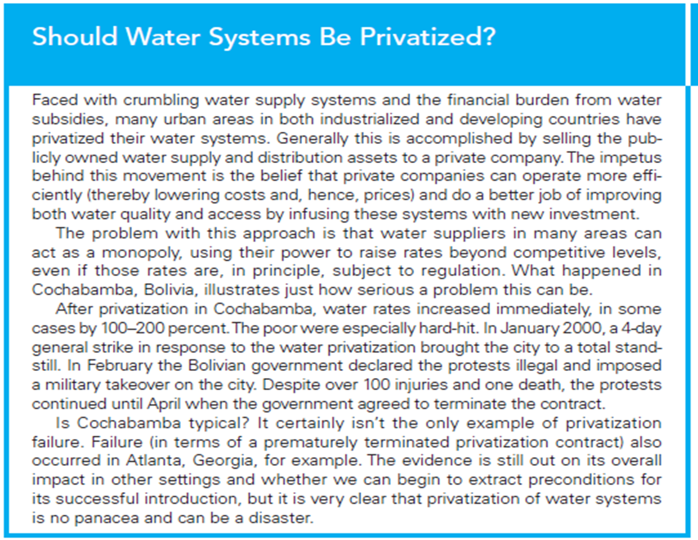

Slide 19
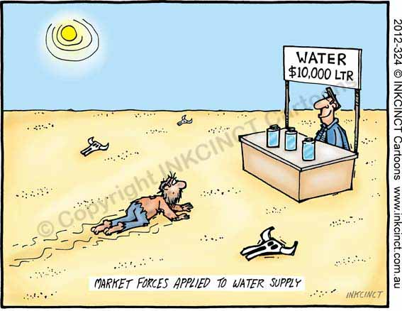

Slide 20

https://www.chicagotribune.com/la-fg-global-world-water-story.html

Slide 21
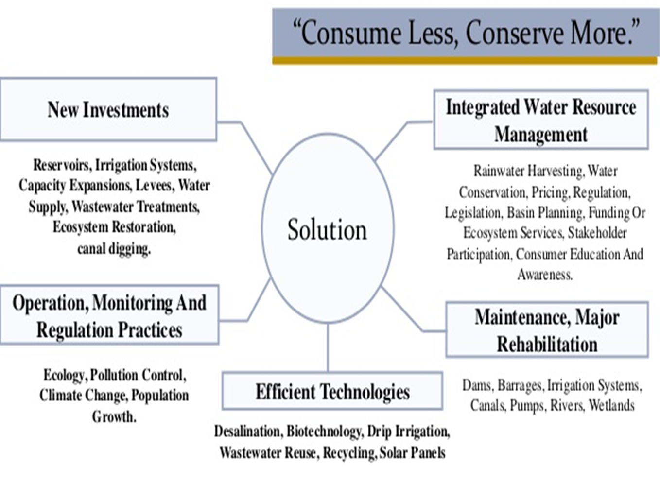

Slide 22
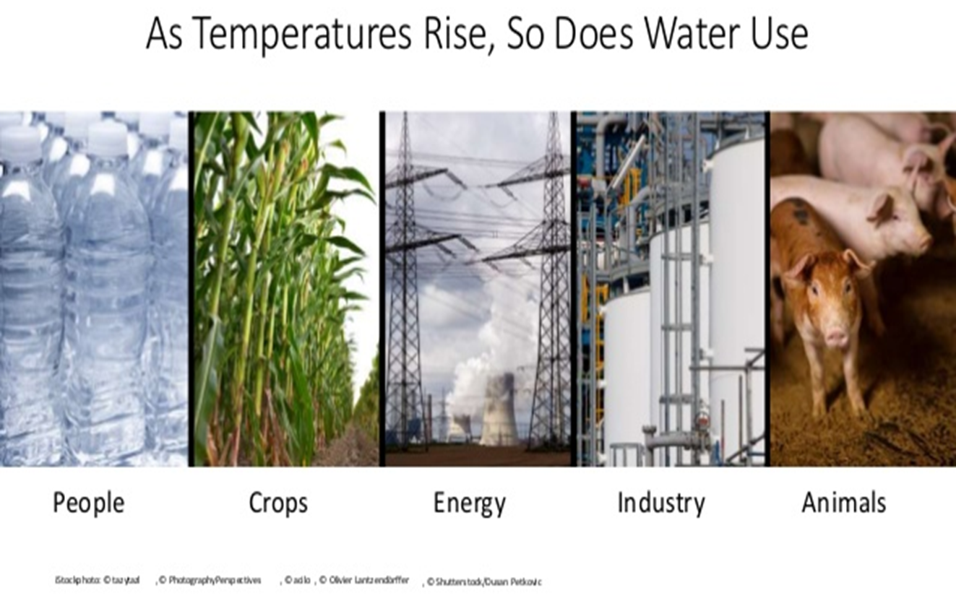

Slide 23
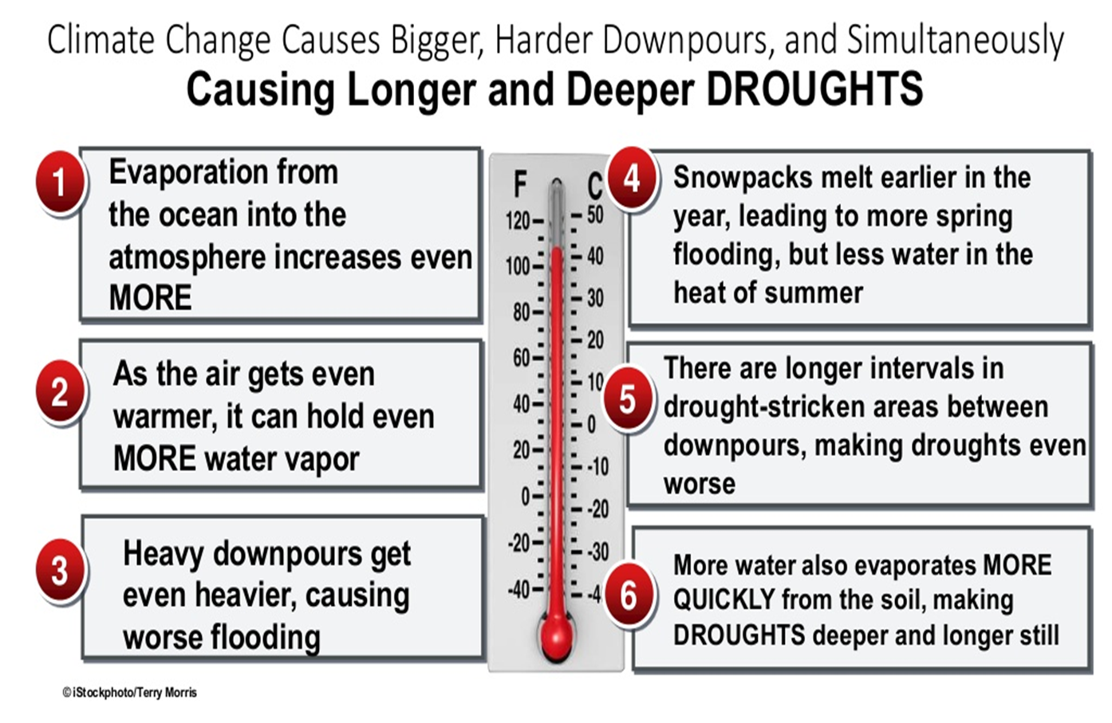

Slide 24


