Slide 1

Econ 2675 – Environmental Economics
Chapter 8 Lecture - Recyclable Resources: Minerals, Paper, Bottles, and E-waste

Slide 2
Minerals
Important in production processes
Effect of recycling will increase the size of the available resources.
Consider a resource with a stock of A.
With a recovery rate of a and an infinite time period, the amount made available by recycling will be A/(1-a). Can you prove?
If a = 0, the resource is nonrecyclable. The effect of recycling is to increase the availability of the resource.
The larger the value of a, the larger the value of resource flows.

Slide 3
An Efficient Allocation of
Recyclable Resources
Extraction and Disposal Cost
  Disposal costs rise with rising wealth and with increasing population densities.
  As land has become more scarce and thus, valuable, the burial of wastes is becoming increasingly expensive.
  Concerns over contamination of groundwater from buried waste has also made landfill disposal less attractive
  The composition-of-demand effect—as long as quality is not adversely affected, consumers will shift to materials made of recycled products if products made with virgin materials are more expensive.
  Recycling and actual market factor – Will there be a demand for the recycled products and what are price effects.
  Purity of the recycled products

Slide 4
An Efficient Allocation of
Recyclable Resources
Recycling: A Closer Look
Recycling increase and recycling rates are on the rise.
Transport, labor, processing costs, energy costs, and compliance cost with environmental regulation are usually significant and play a large role in overall recycling rates.
As recycling becomes more cost competitive, manufacturers rely more heavily on recycled inputs as well as product design.

Slide 5
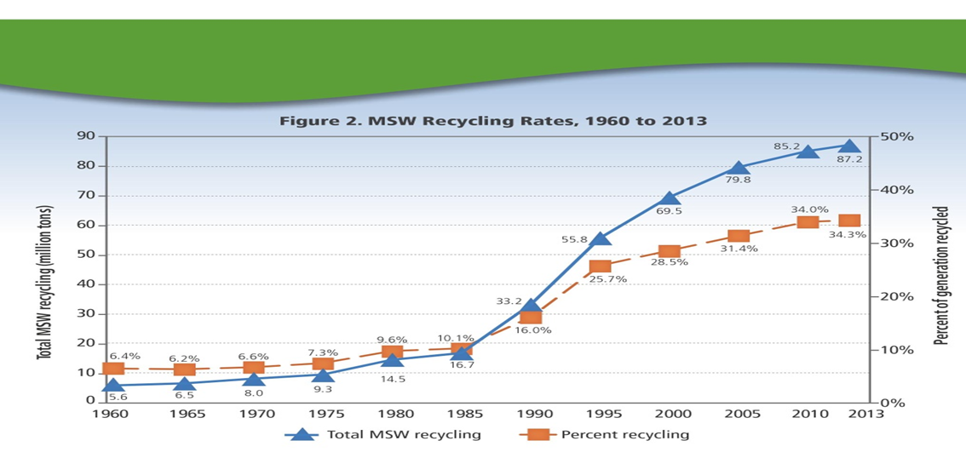
Municipal Solid-Waste Recycling Rates1960–2013

Slide 6
Situation in Qatar
The generation rate of household solid waste is estimated at 2.1-4.1 kilogram (kg) per capita per day in GCC countries, 1.2 in the US, and 4.1 in European Union countries, compared to 1.6 kg per person per day in Qatar.
Domestic solid waste usually consists of different proportions of organic matter (food waste, etc), paper, plastics, glass, metals, fabrics, bones, leather, home dust, etc. Domestic solid waste in Qatar is the second largest source of waste after construction waste.
https://thepeninsulaqatar.com/article/17/09/2018/Qatar-aims-to-recycle-15-of-solid-waste-by-2022
https://www.psa.gov.qa/en/nds1/pages/default.aspx#ManageEnvDev

Slide 7
An Efficient Allocation of
Recyclable Resources
Recycling and Ore Depletion
In terms of the switch point introduced earlier, if the resources can be recycled at a marginal cost lower than that of the substitute, the market will likely use the recyclable resource longer than it would the non-recyclable resource.
An efficient economic system will try to find a balance between the consumption of newly mined and recycled materials, between disposing of used products and recycling, and between imports and domestic production.

Slide 8
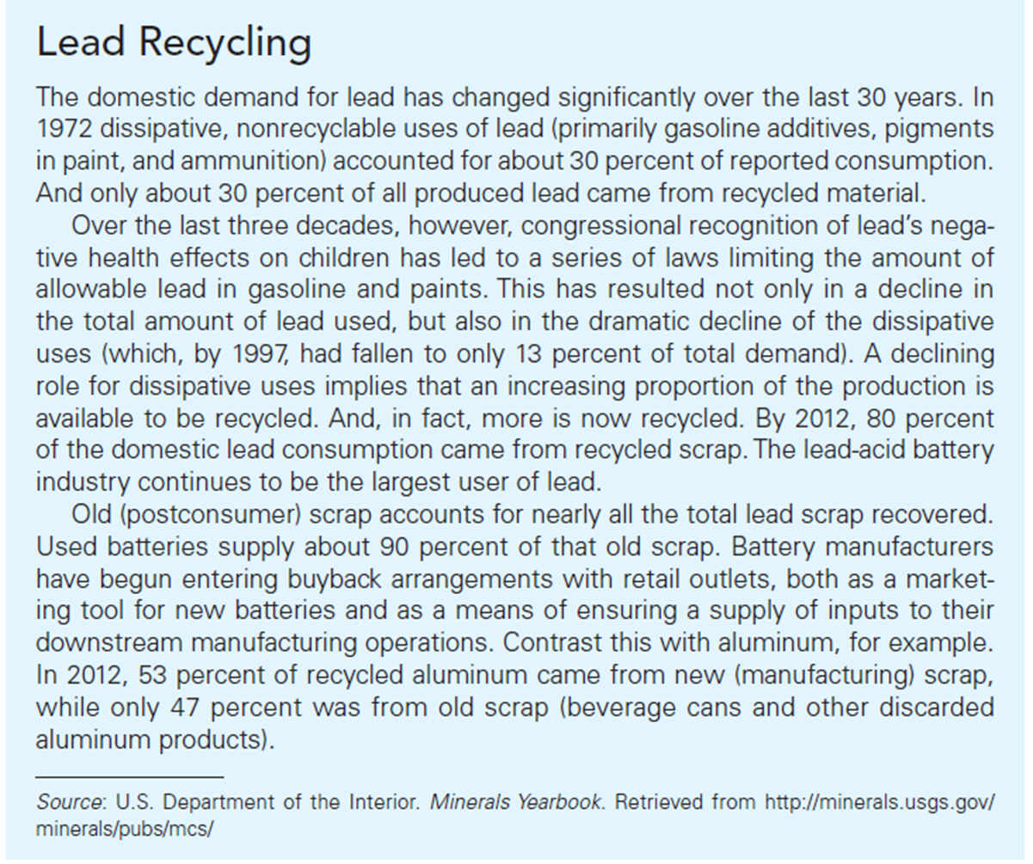

Slide 9
Factors Mitigating Resource Scarcity
Exploration and Discovery
  A profit-maximizing firm will continue to explore until the marginal discovery cost of exploration equals the marginal scarcity rent from a unit of the resource sold.
  The marginal scarcity rent equals the difference between the price received and the marginal cost of extraction.
  Income growth and population growth both cause demand for the resource to rise over time.
  Changes in scarcity rents will lead to different stimulations in exploration activities.

Slide 10
Factors Mitigating Resource Scarcity
Technological Progress
  Technological progress reduces the cost of the ore.
  Rising extraction costs stimulate the development of new technologies.
  The rate and type of technological progress are influenced by the degree of resource scarcity.

Slide 11
Factors Mitigating Resource Scarcity
Substitution
  Looking at isoquants we can illustrate the effect of substituting abundant resources for scarce resources.
  The more substitution possibilities, the smaller the impact resource scarcity will have on output.
  Some factors increase the likelihood of resource scarcity, while others mitigate the seriousness of scarcity.

Slide 12
Output Levels and the Possibilities for Input Substitution.

Slide 13
Market Imperfections
Disposal Cost and Efficiency
If an economic agent does not bear the full cost of disposal, the agent will be biased toward the use of virgin materials and away from recycling.
The avoided marginal cost of disposal is considered a marginal benefit from recycling. This amount must be included in recycling decisions
Both marginal disposal costs and the prices of recycled materials will affect the efficient level of recycling.

Slide 14
Market Imperfections
The Disposal Decision
  Recyclable waste comes from either new scrap or old scrap. New scrap is residual material from a production process while old scrap is recovered from used products.
  When the private marginal cost of disposal is lower than the marginal social cost, the market level of recycling is inefficient.

Slide 15
The Efficient Level of Recycling

Slide 16
Market Imperfections
Disposal Costs and the Scrap Market
  If consumers bear the true marginal disposal cost, more materials could be integrated into production process; price falls, and total consumption of inputs would increase as well as the use of recycled materials.
  Correct inclusion of disposal cost would increase the amount of recycling and extend the economic life for depletable and recyclable resources.
Corrective Public Policies include pay-as-you-throw (PAYT) trash disposal, curbside recycling, refundable deposits, Plastic Bag Bans and Fees, and taxes.
  Volume or user-pay pricing are disposal charges that reflect the true social cost of disposal.
A pre-implementation concern about volume pricing was that it might impose a hardship on poorer residents.

Slide 17
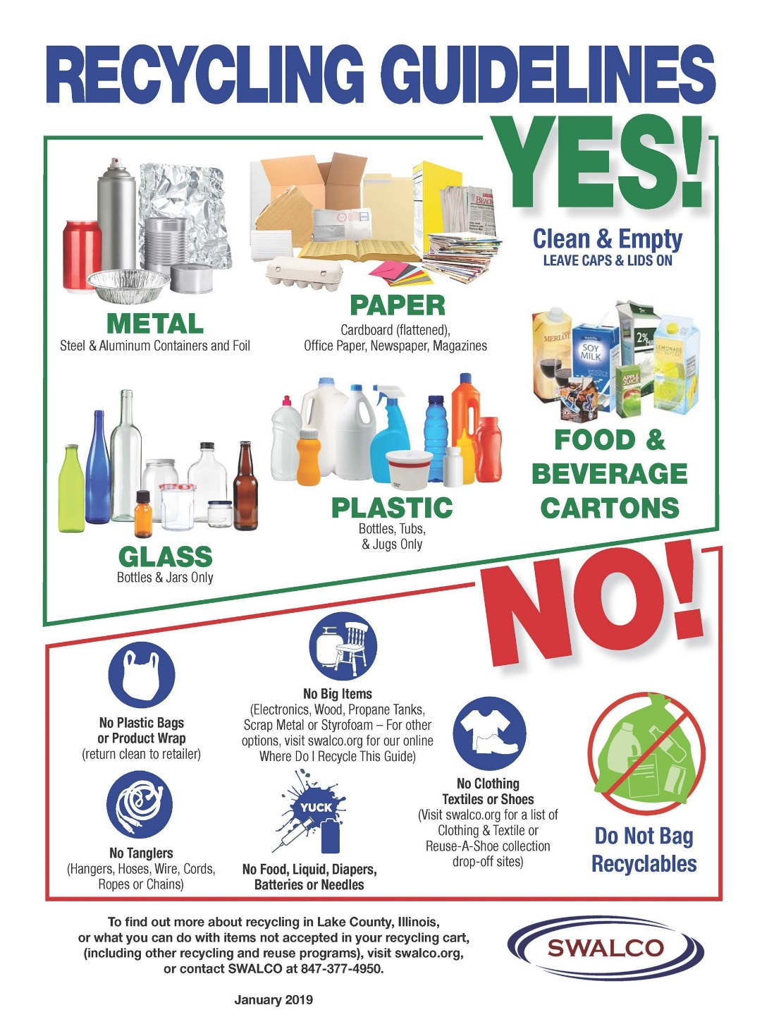
Market Imperfections
Curbside Recycling attempts to achieve an efficient balance between disposal and recycling, especially in combination with pay-as-you-throw trash disposal.
A refundable deposit system is typically designed to be an initial charge that reflects the cost of disposal and to provide a refund that encourages recycling and helps conserve virgin materials.

Slide 18
Market Imperfections
Advocates of Plastic Bag Bans and Fees claim that bans significantly reduce plastic bag waste which frequently ends up in storm drains and in oceans creating hazards for marine mammals, seabirds, and fish.
Opponents of Plastic Bag Bans and Fees argue that consumers will simply use more paper bags and those also have environmental impacts, as do cotton tote bags.
Taxing virgin materials and subsidizing recycling activities can also promote recycling.

Slide 19
Markets for Recycled Materials
Successful recycling programs depend to a large extent on the existence of markets (buyers) for recycled materials.
E-Waste
E-Waste (disposed electronics equipment)
  Regulations on consumers and manufacturer
    25 states enacted e-waste legislation.
  The Basel Convention
    Regulates the movement of electronic wastes across international boundaries.

Slide 20
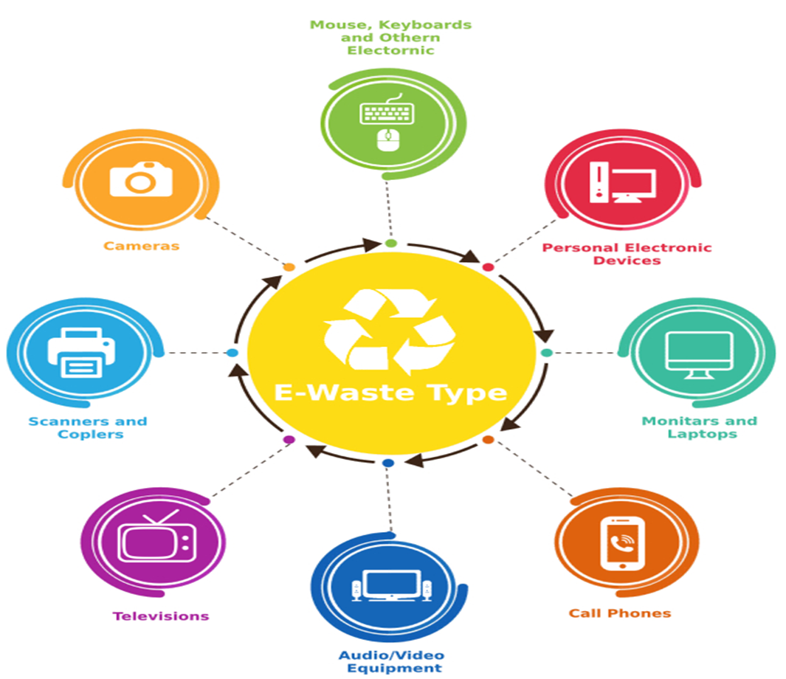

Slide 21
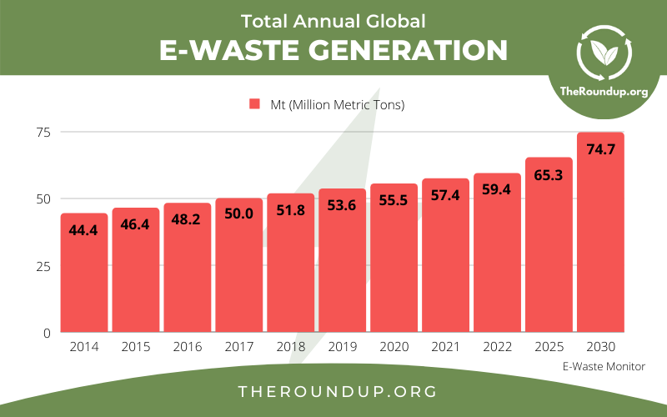

Slide 22
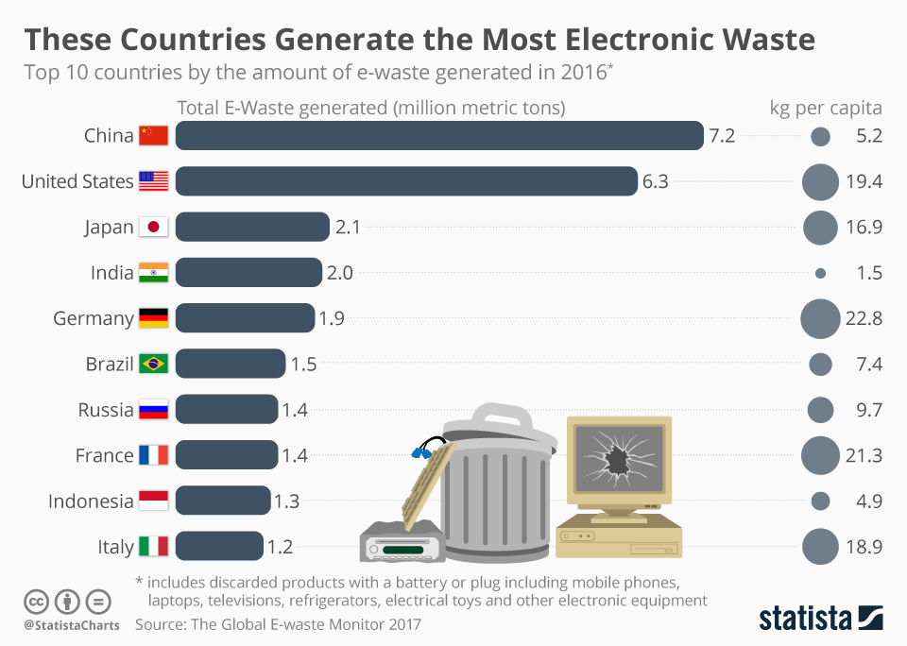
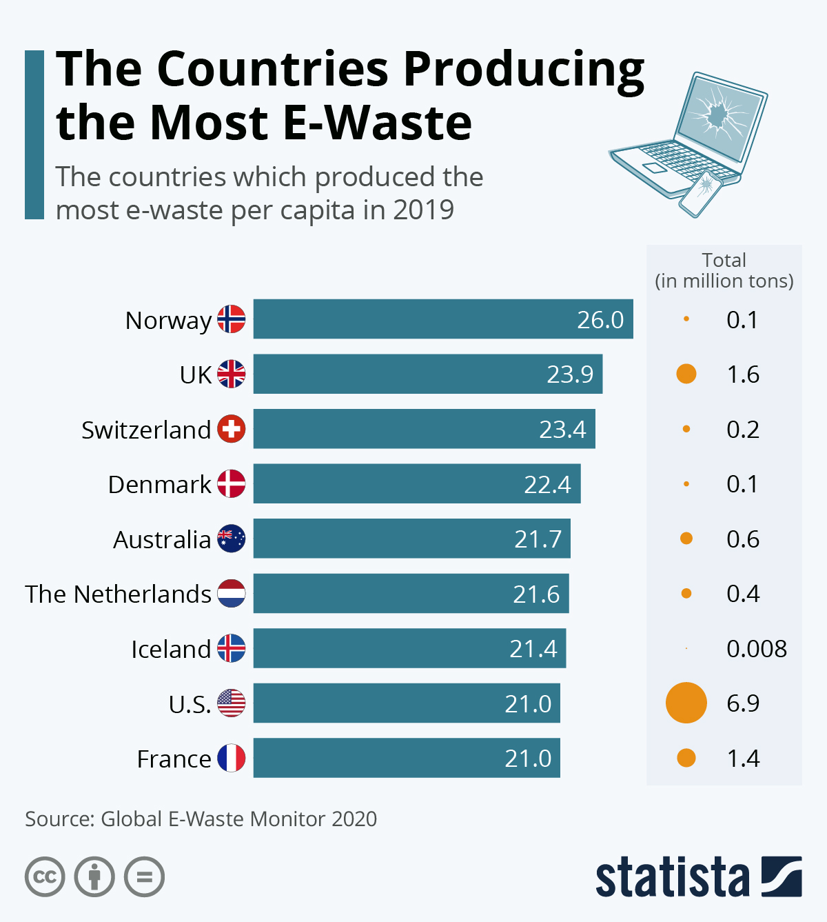

Slide 23
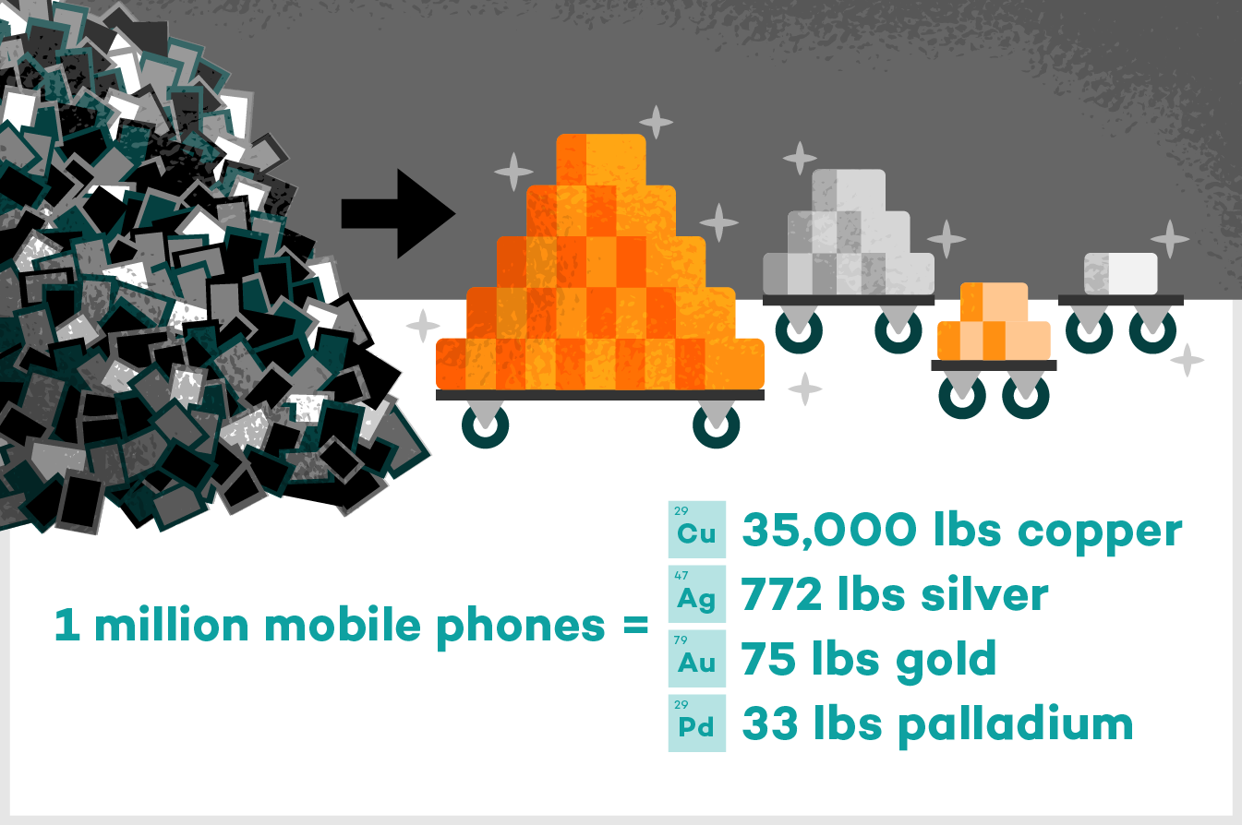

Slide 24

Pollution Damage
Non-internalized environmental damages from the use of virgin materials will also bias the market away from recycled materials. These might be damages from extraction or from processing.
Host fees are being used to address the issue siting of landfills. Host fees compensate the community that agrees to house the landfill.

