Slide 1
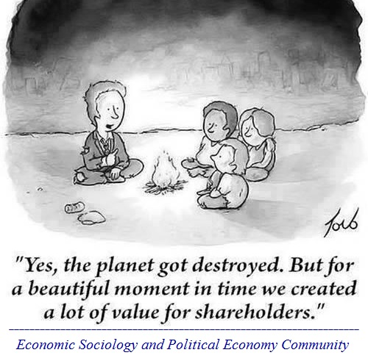
Econ 2675 – Environmental Economics Chapter 4 Lecture – Valuing the Environment: Methods
https://economicsociology.org/2016/11/26/corporate-governance-for-the-society-and-the-environment/

Slide 2
Why Value the Environment?
Many types of agencies depend on benefit-cost analyses for decision-making.
(USA) Natural resources damage assessments, such as for oil spills (National Oceanic and Atmospheric Administration);
(USA) For the designation of critical habitat under the Endangered Species Act (U.S. Fish and Wildlife Service);
(USA) Dam relicensing applications (The Federal Energy and Regulatory Commission).
(Qatar) Ministry of Municipality and Climate Change
https://www.mecc.gov.qa/en/home/

Slide 3
Valuation
Types of Values
Use Value: Use value reflects the willingness to pay (WTP) for direct use of the environmental resource. To use something simply requires one of the senses to be active (sight, sound, touch, taste or smell) All of these constitute some kind of use of natural resources and the environment. Both active use (consumptive) and passive use (non-consumptive).
Option Value: Option value is the willingness to pay for the future ability to use the environment. This is the value people place on having the option to use or ensuring something exists for potential future use. For example, what are your future plans?

Slide 4
Valuation
Nonuse or Passive-use Value: Nonuse value represents an individual’s willingness to pay to preserve a resource that he or she will never use. These values are often called existence values. This is a very different category of value and, of course, represents the most problematic as well as controversial with respect to monetization. These are less tangible values, but can be quite large.
Total Willingness to Pay (TWP):
Total Willingness to Pay = Use Value + Option Value + Nonuse Value

Slide 5
Valuation
Classifying Valuation Methods
Revealed preference method
Methods which are based on actual observable choices and from which actual resource values can be directly inferred
Stated preference method
Methods to elicit respondents’ willingness to pay when the value is not directly observable
Each method includes both indirect and direct techniques.

Slide 6
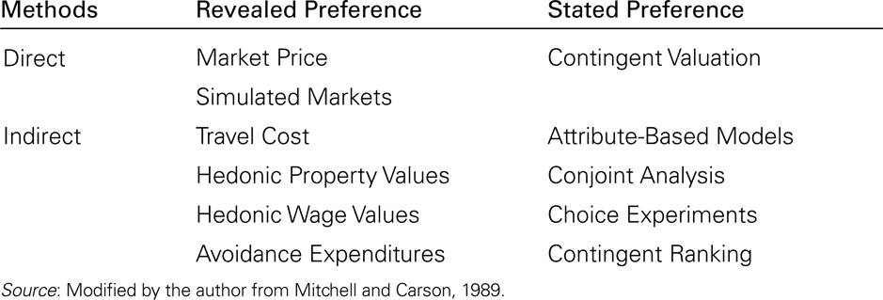
Economic Methods for Measuring Environmental and Resource Values

Slide 7
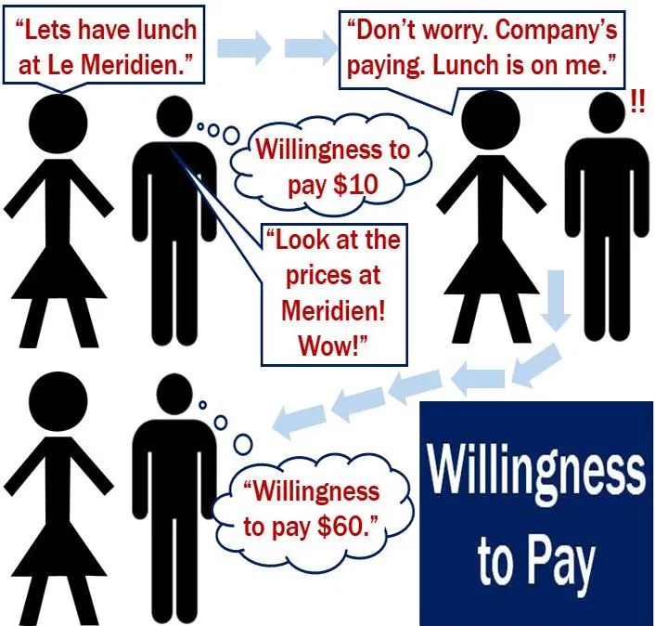
Valuation
Stated Preferences Methods
Contingent Valuation Method
It is to elicit people’s willingness-to-pay (WTP) in a hypothetical market
Major concerns include strategic bias, information bias, starting-point bias, hypothetical bias, and discrepancy between WTP and willingness-to-accept (WTA)

Slide 8
Potential Biases with Contingent Valuation
Strategic bias is the tendency to overstate or understate WTP in order to affect policy.
Information bias occurs when respondents are forced to evaluate goods/attributes for which they have little or no experience.
Starting point bias is the tendency for reference points for bidding games and payment card mechanisms to induce higher or lower responses.
Hypothetical bias is the tendency for hypothetical payments to differ from actual payments due to a difficulty in correctly picturing the situation.
A final source of bias addresses the gap between the willingness to pay to avoid damage and the willingness to accept compensation for damage.

Slide 9
Valuation
Attribute-based methods
Choice-based, conjoint analysis, choice experiments
Respondents are asked to choose among alternate bundles of goods. Each bundle has a set of attributes and the levels of each attribute vary across bundles. Since one of the attributes in each bundle is a price measure, willingness to pay can be identified.
Contingent ranking method
Respondents are given a set of hypothetical situations that differ in terms of the environmental amenity available (instead of a bundle of attributes) and are asked to rank-order them.

Slide 10
Consider an example ( Landry and Mires, 2017 working paper) that surveyed North Carolina residents on their preferences and willingness to pay for marine cultural heritage sites (e.g. shipwrecks). The choice experiment included 5 attributes including the preservation zone, the availability of public programs and whether or not their was a walking, virtual or driving trail. The table below reproduces the attributes and levels.
Attributes | Levels
Preservation Zone | Status Quo; 30 shipwrecks protected 38 more shipwrecks (68 total; 127% increase); 2,192 m² of bottomland 56 more shipwrecks (124 total; 313% increase); 13,498 m² of bottomland
Public Programs | No change Increase museum exhibits and provide educational workshops Increase museum exhibits and provide educational workshops, plus public television series about shipwrecks and creation of boating tours to shipwrecks
Walking Trail | Yes/ No
Virtual Trail | Yes/ No
Diving Trail | Yes/ No

Slide 11
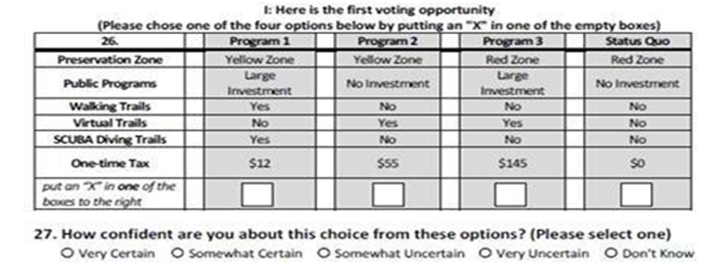

Slide 12
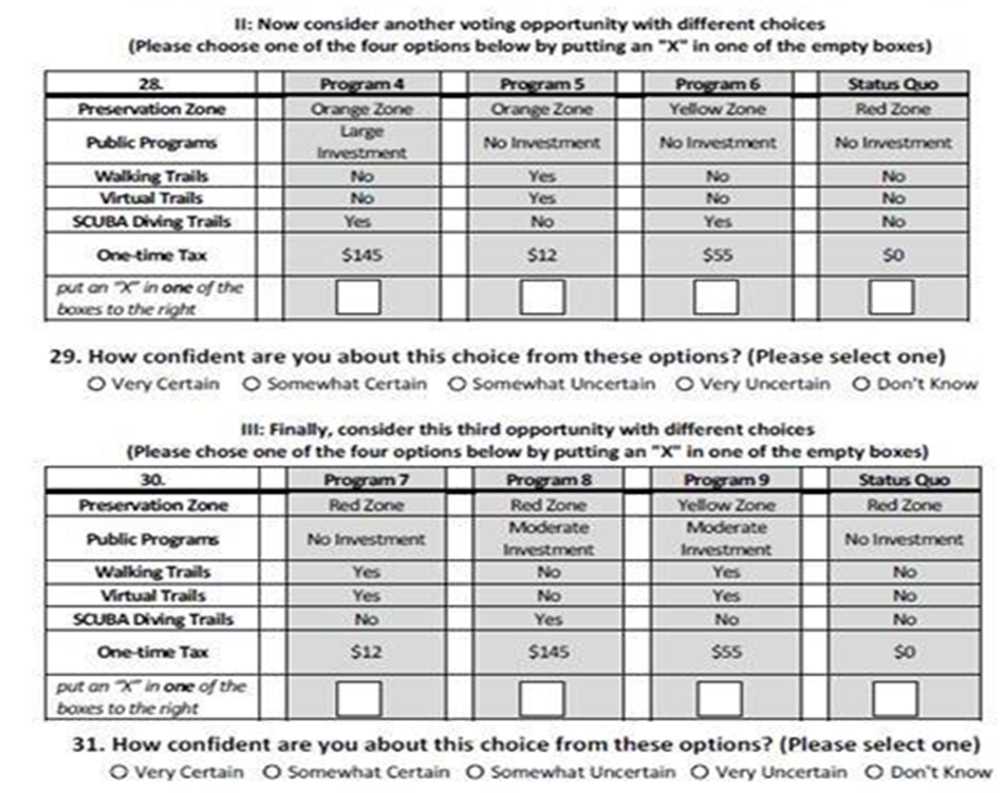

Slide 13
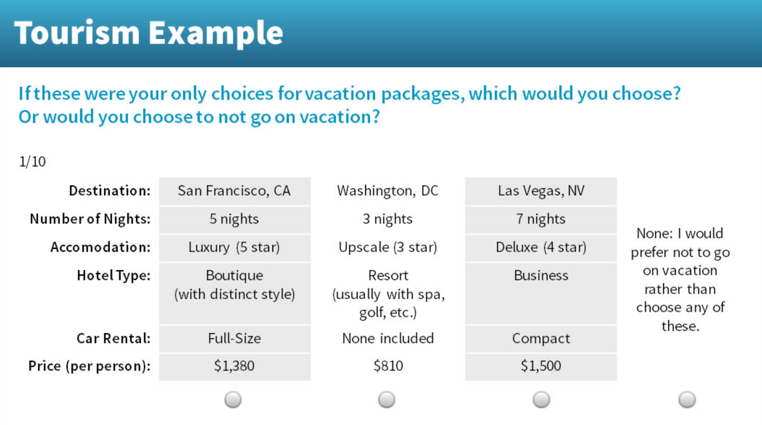

Slide 14
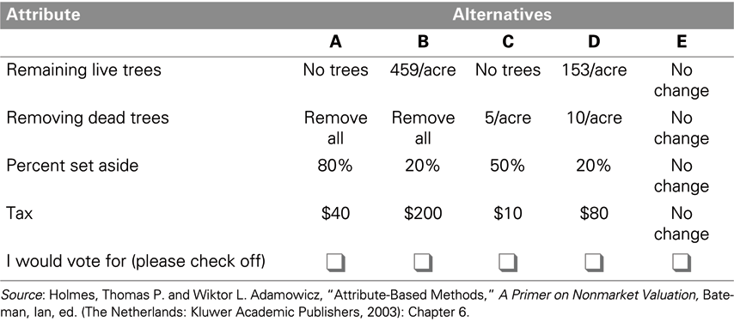
A Sample Conjoint Analysis Survey Question

Slide 15
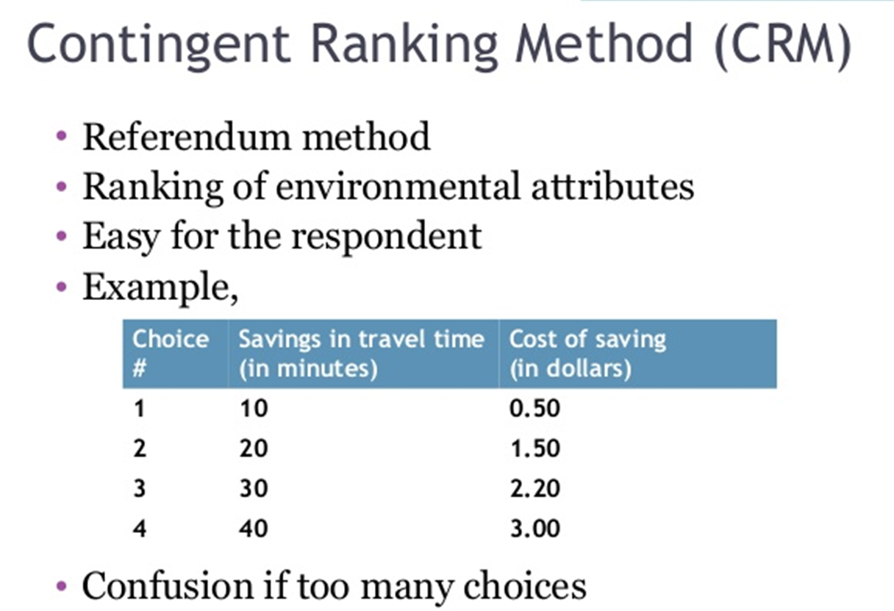

Slide 16
The Value of U.S. National Parks
In 2016, the National Park Service in the United States turned 100 years old. As federal budget deficits loom, there has been some talk of selling off some of these sites. What is the value of the National Park lands, waters and historic sites? According to the first ever comprehensive estimate, it is, at a minimum, valued at $92 Billion.
Haefele et al (2016) present the results of a survey of American households focused on estimating the total economic value (TEV) of national parks and programs. Previous studies have focused on the value of specific national park or monument sites, but none had attempted to estimate the value of all of these national treasures. The goal was to calculate total economic value; visitation values and passive use (or nonsue) values.
Using the population of all U.S. households from which to draw a sample, researchers used a mixed mode approach that utilized both mail and internet surveys with phone call reminders. Two rounds of surveys were implemented between 2013-2015.
In the survey, participants were asked whether protecting National Parks was important to them. Nearly 95% of the sample said they were, even if they did not visit them. 93.5% thought it was important to protect trails, parks and open spaces for current and future generations whether they use them or not. The language in these questions suggests bequest and passive use values. Only 6.2% thought the U.S. should sell off some National Parks. The survey also included question on respondents’ political point of view. The sample of respondents leaned to the conservative side of the aisle.
The stated preference survey design was a choice experiment in which respondents chose among bundles that included the size of cuts to programs as well as the percentages of lands sold. Choice experiments typically allow respondents to choose a status quo bundle for which the price is $0. In order to minimize hypothetical bias (respondents stating a higher willingness to pay than they would actually pay), the choice question was followed by reminders to consider their budgets. This “cheap talk” technique has been shown to significantly reduce hypothetical bias.
Respondents were asked their willingness to pay a specific amount of money to pay for the National Park Service Programs. The payment vehicle utilized was an increase in federal income tax for each of the next 10 years. As we have discussed in this chapter, protest responses must be omitted from the data since those answers do not represent willingness to pay, instead representing a scenario (usually payment vehicle) protest. Since the payment vehicle chosen was federal income tax, there was some initial concern that protest zeros would be problematic, however, only 7.5% of the responses were considered to be protests.

Slide 17
These household values were then multiplied by the total number of households in the population to determine the total economic value. In order to present a minimum bound (or very conservative estimate), they assumed that households that did not return a survey were willing to pay $0.
The final tally of $92 billion includes both use values for visitors and passive use or existence values, $62 billion of which (or two-thirds) is for the National Park Service lands and waters and historic sites, with $30 billion for programs. Of the $62 billion, they authors suggest that approximately half of that value is passive use value. Of course, these values do not even include the willingness to pay of the millions of international tourists that visit U.S. National Parks each year or those who hold passive us values for these locations. Thus, the $92 billion TEV also represents ”the minimum amount that U.S. households are willing to pay to avoid the loss of the NPS and its programs.”
According to one of the authors of the study, Limda Bilmes at Harvard Univesrity, the study shows that “Americans value the National Park Service at least 30 times more than the governments spends on them.” It is a happy 100th birthday indeed.
Source: Haefele, Michelle, John Loomis and Linda Bilmes. 2016. Total Economic Valuation of the National Park Service Lands and Programs: Results of a Survey of the American Public. Faculty Research Working Paper Series. RWP16-024. June.
Haefele, Michelle, John Loomis and Linda Bilmes. 2016. Total Economic Valuation of US National Park Service Estimated to be $92 Billion: Implications for Policy. The George Wright Forum 33(3): 335-345.

Slide 18
Using econometric analysis, the marginal willingness to pay (or implicit price) for each type of National Park or National Park Service program were estimated. These values are reproduced here.
Per-household total economic value (TEV) for the national park system and NPS programs
National Parks | Estimated value
Nature-focused national parks (79,096,632 acres) | $1,113.24
History-focused national parks (226 sites) | $874.72
Water-focused national parks (4,818,275 acres) | $977.93
Per household value for all national park acres/sites | $2,967.00
NPS Programs
Historic sites and buildings protected each year (2,000) | $316.31
Acres transferred to communities each year (2,700) | $98.41
National landmarks protected each year (114) | $347.98
Schoolchildren served by NPS educational programs (4.1 million) | $682.62
Per household value for all NPS programs | $1,445.00
Source: Table 4 in Haefele et al. (2016)

Slide 19
Valuation
Revealed Preferences Methods
Travel-Cost Method
Travel-cost models infer values of recreational resources by determining how much visitors spent getting to a site and then using this information to estimate a demand curve for that site.
Travel-cost models have been used to value national parks, mountain climbing, recreational fishing, and beaches. Travel-cost models have also been used to value loses.

Slide 20
Valuation
Hedonic property value and hedonic wage methods
These two approaches use regression analysis to infer environmental values from spending on goods which include those values.
Hedonic property value models use market data and then break down the house sales price into its components, including the house characteristics, the neighborhood characteristics, and environmental characteristics.
Hedonic wage approaches attempt to isolate the environmental risk component of wages, which serves to isolate the amount of compensation workers require in order to work in risky occupations.
http://www.ecosystemvaluation.org/hedonic_pricing.htm

Slide 21
Valuation
Benefit Transfer and Meta Analysis
Benefit transfer methods can take one of three forms: value transfers, benefit function transfers, or meta-analysis.
Meta-analysis takes empirical estimates from a sample of studies, statistically relates them to the characteristics of the studies, and calculates the degree to which the reported differences can be attributed to differences in location, subject matter, or methodology.

Slide 22
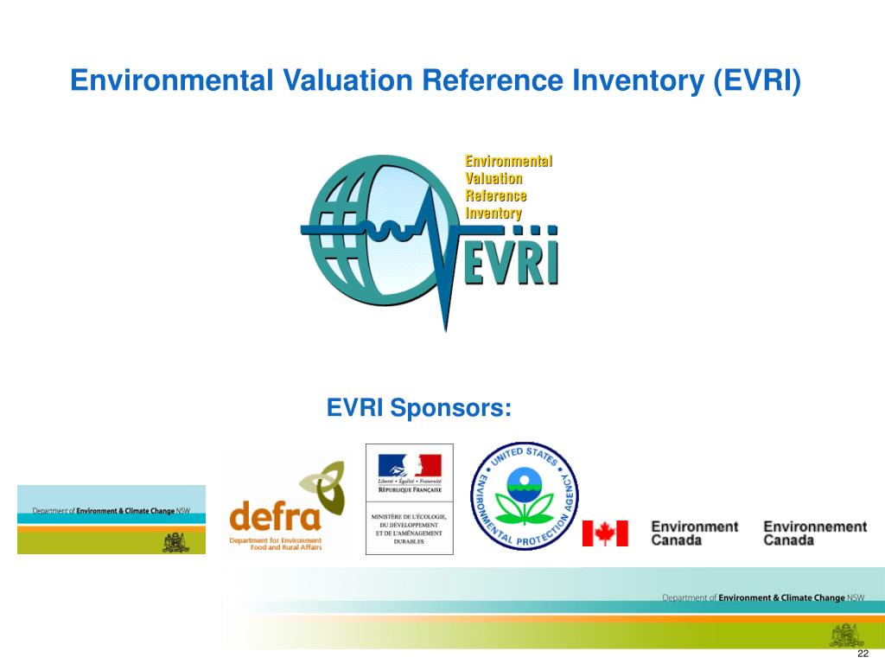
Valuation
Valuation Inventory Database https://www.evri.ca
The Environmental Valuation Reference Inventory (EVRI) is an online searchable database of empirical studies on the economic value of environmental benefits and human health effects.

Slide 23
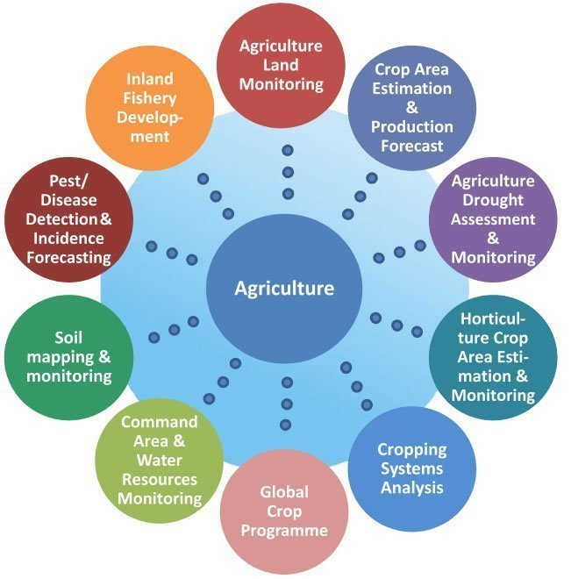
Valuation
Using Geographic Information Systems to Enhance Economic Valuation
Geographic Information Systems (GIS) are computerized mapping models and analysis tools. A GIS map is made up of layers such that many variables can be visualized simultaneously using overlays. GIS offers a powerful collection of tools for depicting and examining spatial relationships.

Slide 24
Valuation
Averting Expenditures
Methods are designed to reduce the damage caused by pollution by taking some kind of averting or defensive action.
Averting expenditures can provide a lower-bound estimate of the damage caused by pollution. They also cause a disproportionate hardship on poor households that cannot afford such coping expenditures.
Challenges
Aggregation: aggregation of estimated values into a total value that can be used in benefit-cost analysis.
Partial values: that most studies only capture a portion of the total value of an environmental good or service

Slide 25
Averting Expenditures Example
Suppose contaminated drinking water increases waterborne illness by 4 percent. If half the population avoids the contamination by some form of averting action such as using an alternate source of water, frequency of illness will drop to 2 percent. Only half the population is now exposed, thus reducing damages. However, the avoidance expenses must be included in the damage estimate.
Use of seat belts or smoke detectors measure the value of a “statistical life saved”
Purchases of bottled water measure the value of avoiding water pollution
Visits to the doctor or use of air conditioning measure the value of avoiding respiratory illnesses

Slide 26
Different Methods, Different Experts, Different Data

Slide 27
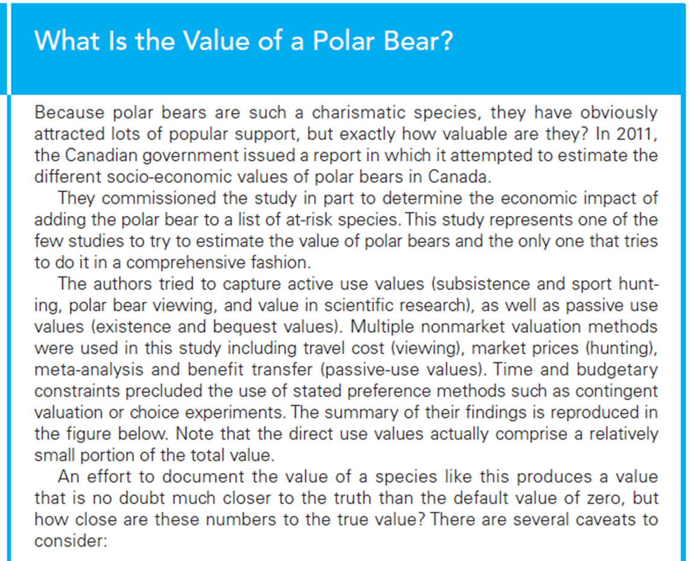

Slide 28
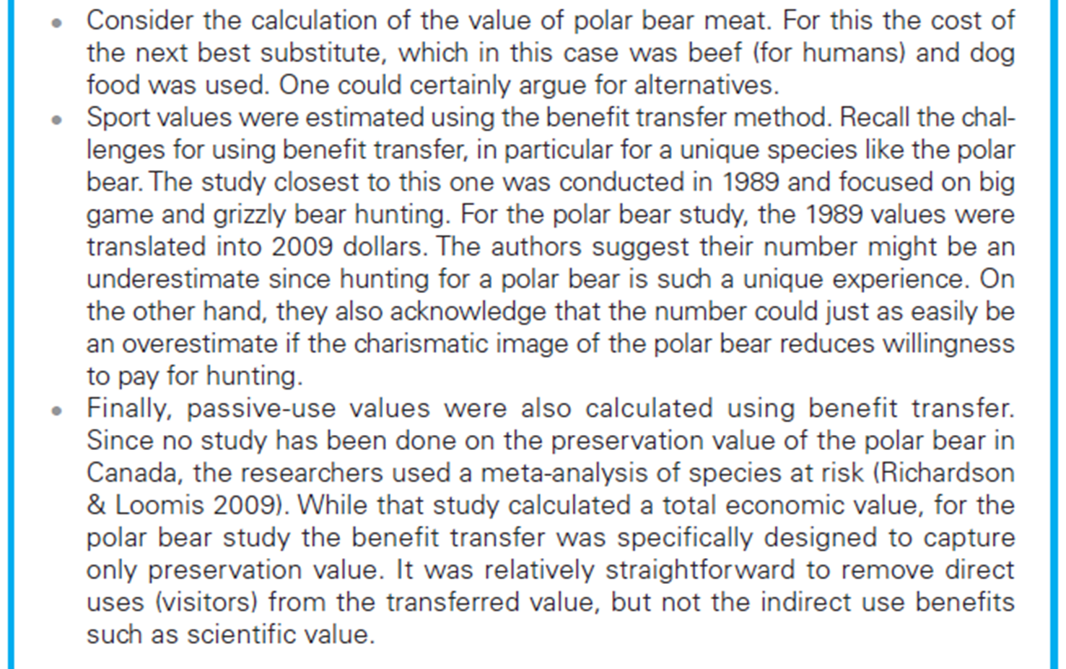

Slide 29
Monetary Values Associated with Polar Bears in Canada, by Value Category (Aggregate Amounts for Canada)

Slide 30
Valuation
Valuing Human Life
Focusing on calculating the change in the probability of death resulting from a reduction in some environmental risk and then placing a value on that change.
Statistical life values across different studies using meta-analysis
Statistical life across different incomes

Slide 31
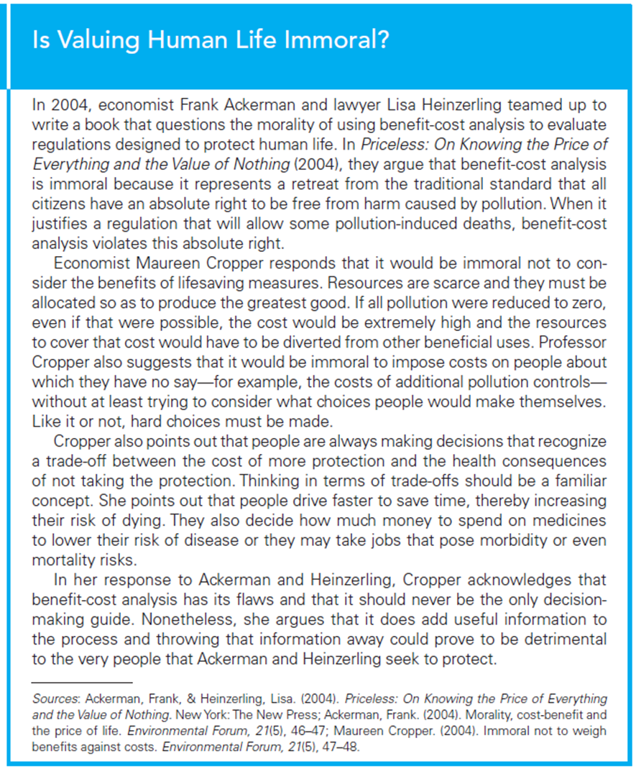

Slide 32
