Slide 1
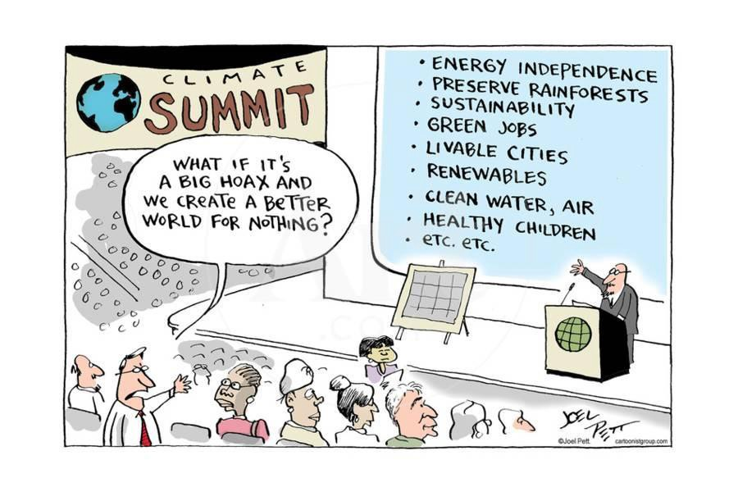
Econ 275 – Environmental Economics
Chapter 3 Lecture- Evaluating Trade-Offs: Benefit-Cost Analysis and Other Decision-Making Metrics

Slide 2
Normative Criteria for Decision Making
Benefit-cost analysis provides a method for determining whether or not an action should be supported.
Most simply, if the benefits exceed the costs, then the action should be supported.
Evaluating Predefined Options: Benefit-Cost Analysis
  Let B be the benefits from a proposed action and C be the costs. Our decision rule would then be:
    If B > C, support the action
    Otherwise, oppose the action

Slide 3
Normative Criteria for Decision Making
Total benefits are the value of total willingness to pay, which is the area under the market demand curve from the origin to the allocation of interest.
Opportunity cost is the net benefit lost when specific environmental services are forgone in the conversion to the new use.
Total cost is the sum of marginal opportunity costs, which is the area under the marginal cost curve.

Slide 4
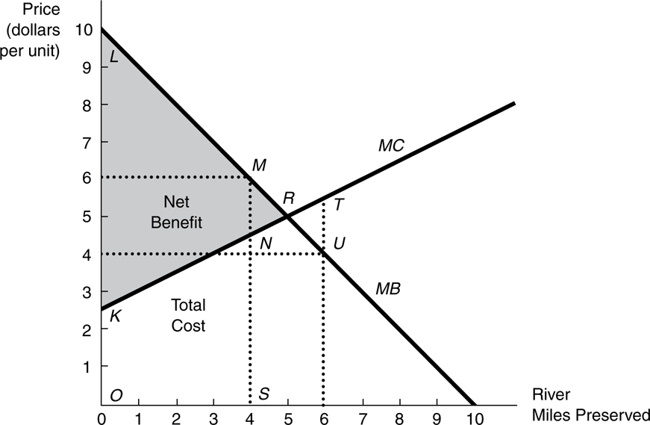
Normative Criteria for Decision Making
Consider the net benefits from preserving a stretch of river. Let’s suppose that we are considering preserving a four-mile stretch of river and that the benefits and costs of that action are reflected in the figure below. Should that stretch be preserved? Explain why or why not?
Compare 4 versus 5 versus 6 miles

Slide 5
Normative Criteria for Decision Making
Finding the Optimal Outcome
  Use benefit-cost analysis to identify ‘optimal’
  Carry out normative analysis
    Identify an optimal outcome
    Discern the divergences between actual and optimal outcomes
    Design appropriate policy solutions.
  Examples include depleted fisheries, landfills, and waste.
Relating Optimality to Efficiency
  An allocation of resources is said to satisfy the static efficiency criterion if the economic surplus from the use of those resources is maximized by that allocation.

Slide 6
Normative Criteria for Decision Making
  First Equimarginal Principle (the “Efficiency Equimarginal Principle”):
    Net benefits are maximized when the marginal benefits from an allocation equal the marginal costs.
  Pareto optimality:
    Allocations are said to be Pareto optimal if no other feasible allocation could benefit at least one person without any deleterious effects on some other person.

Slide 7
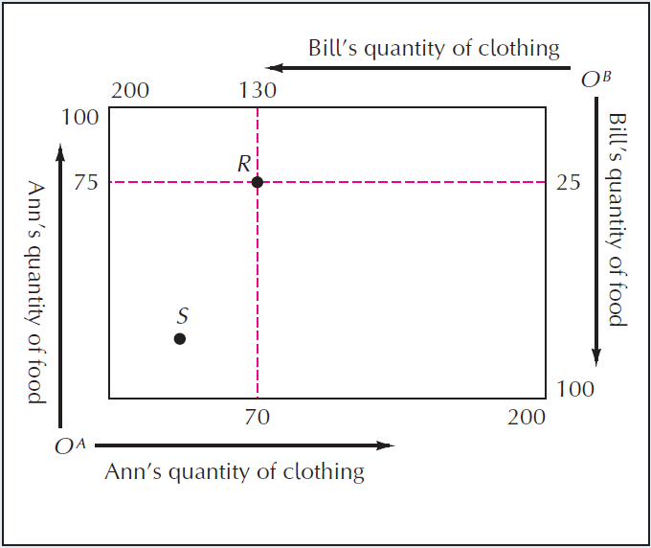
Pareto Optimality Explained
Simple economy in which there are only two consumers—Ann and Bill— and two goods, food and clothing.
  Allocation: an assignment of these total amounts between Ann and Bill.
  Initial endowments: the amounts of the two goods with which Ann and Bill begin each time period.

Slide 8
Edgeworth Exchange Box – Gains from Exchange
Edgeworth exchange box: a diagram used to analyze the general equilibrium of an exchange economy.

Slide 9
Further Gains from Exchange

Slide 10
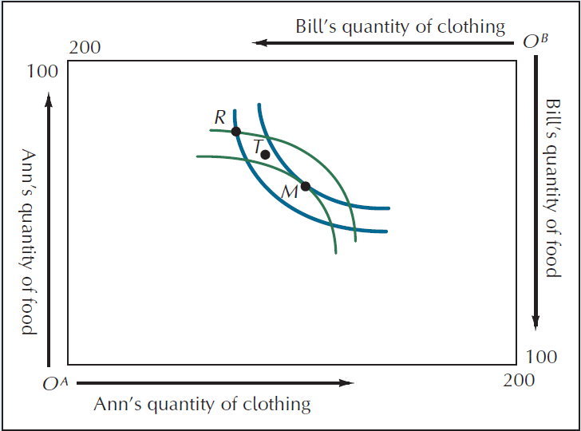
A Pareto-Optimal Allocation
Pareto optimal: the term used to describe situations in which it is impossible to make one person better off without making at least some others worse off.

Slide 11
Back to Normative Criteria for
Decision Making
Comparing Benefits and Costs Across Time
  Present Value of a one-time net benefit (B_{n}) received n years from now is
Where r is the interest rate and B₀ is the amount of net benefits received immediately

Slide 12
Normative Criteria for Decision Making
The present value of a stream of net benefit {B₀,…, B_{n}) received over a period of n years is
The process of calculating the present value is called discounting, and the rate r is referred to as the discount rate.
Where r is the interest rate and B₀ is the amount of net benefits received immediately.

Slide 13

Demonstrating Present Value Calculations

Slide 14
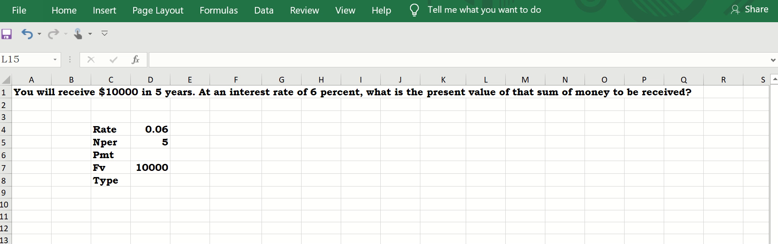
Calculating Present Value Using Excel

Slide 15
Normative Criteria for Decision Making
As looked at earlier, an allocation is efficient or has achieved static efficiency if the net benefit from the use of those resources is maximized by that allocation.
Thus, an efficient allocation will be achieved when marginal benefit and marginal cost are equal.
Dynamic Efficiency
  An allocation of resources across n time periods satisfies the dynamic efficiency criterion if it maximizes the present value of net benefits that could be received from all the possible ways of allocating those resources over the n periods.

Slide 16
Applying the Concepts
Pollution Control
  Benefits include, but are not limited to, reduced death rate, lower incidences of chronic bronchitis and other diseases, better visibility, improved agricultural productivity
  Costs include
    higher costs passed to consumers such as installing, operating, and maintaining pollution control equipment
    administrative costs such as designing, implementing, monitoring relevant policies.

Slide 17
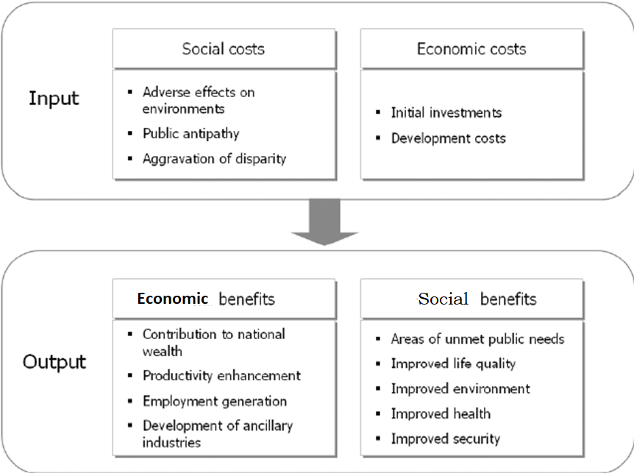

Slide 18
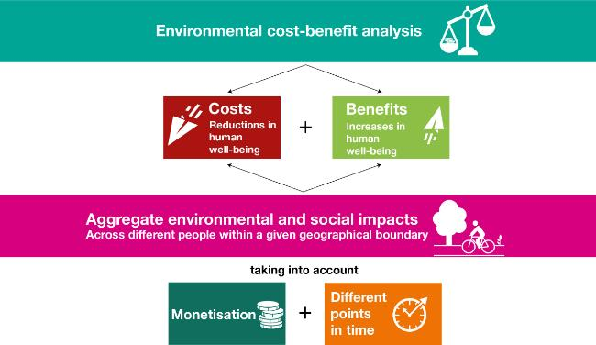

Slide 19
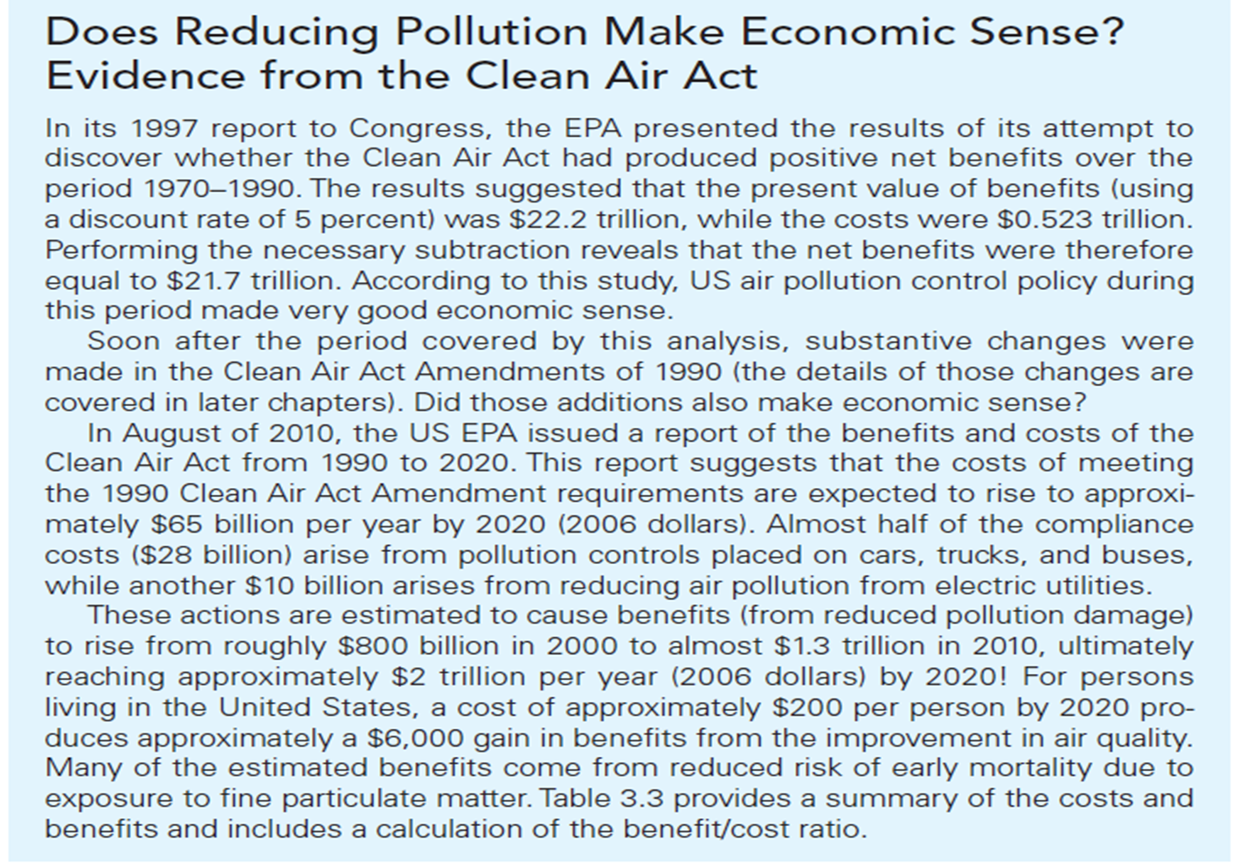

Slide 20
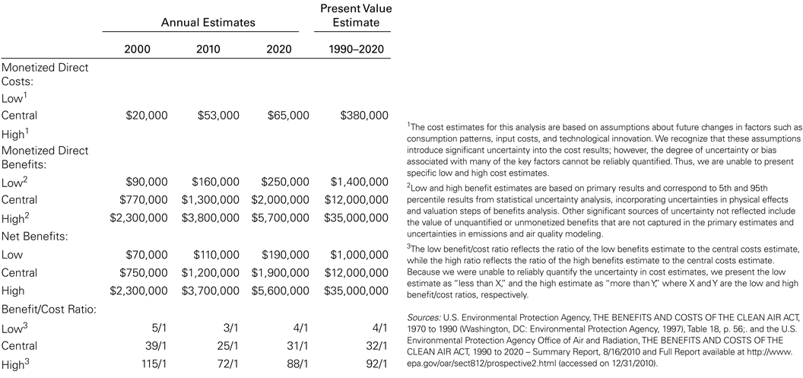
Summary Comparison of Benefits and Costs from the Clean Air Act 1990–2020 (Estimates in Million 2006$)

Slide 21
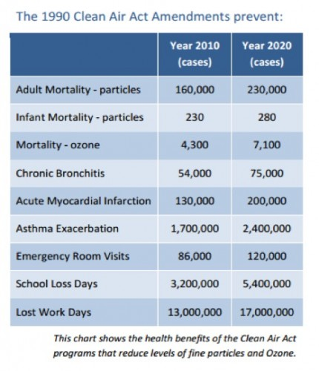

Slide 22
Applying the Concepts
Issues in Benefit Estimation
Primary versus secondary effects
  Consider both primary and secondary consequences while implementing environmental projects.
Accounting stance
  Who benefits? The accounting stance refers to the geographic scale at which the benefits are measured.
Aggregation
  Estimations of benefits and costs must be aggregated to some level.

Slide 23
Applying the Concepts
  With and without principle
    The “with and without” principle states that only those benefits that would result from the project should be counted, ignoring those that would have accrued anyway.
  Tangible versus intangible benefits
    Tangible benefits can reasonably be assigned a monetary value.
    Intangible benefits cannot be assigned a monetary value.

Slide 24
Applying the Concepts
Approaches to Cost Estimation
The survey approach
  Involves asking polluters about their control costs
The engineering approach
  Using engineering information to estimate the technologies available and the costs of purchasing and using those technologies
The combined approach
    Combining both survey and engineering approaches

Slide 25

Applying the Concepts
  The Treatment of Risk
  A dominant policy is one which confers the higher net benefits in every outcome.
  The expected value of net benefits is the sum over the possible outcomes of the present value of net benefits of that outcome weighted by its probability of occurrence. The policy selected should be the one with the highest expected present value of net benefits.
  The evaluation of irreversible decisions requires extra caution.

Slide 26
Applying the Concepts
Distribution of Benefits and Costs
  Economic impact analysis
    A broad characterization of who gains and who loses from a given policy
  Equity analysis
    Impacts on disadvantaged groups or sub-populations
Choosing the Discount Rate
  The appropriate rate to use will depend on the nature and expected lifetime of the project, who is doing the financing, and the level of risk.

Slide 27
Divergence of Social and Private Discount Rates
Risk-Free Cost of Capital
  The rate of return is earned when there is absolutely no risk of earning more or less than the expected return.
Risk Premium
  It is the amount required to compensate capital owners for potential differences between expected and actual returns.
Time Preference
  It affects both private and social discount rates, as well as across countries.

Slide 28
Divergence of Social and Private
Discount Rates
Difference between Private and Social Discount Rates
  Difference in social and private risk premiums
    The risk-free cost of capital is the rate of return earned when there is absolutely no risk of earning more or less than the expected return.
    The risk premium is an additional cost of capital required to compensate the owners of this capital when the expected and actual returns may differ.
  Difference in underlying rates of time preference

Slide 29
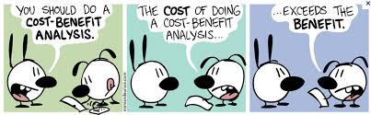
Divergence of Social and Private
Discount Rates
A Critical Appraisal
  When correctly implemented, benefit-cost analysis is a very useful tool in decision making.
  Concerns exist on the reliability of benefit-cost analysis when benefits or costs are difficult or impossible to quantify.

Slide 30
Cost-Effective Analysis
Second Equimarginal Principle (the Cost-Effectiveness Equimarginal Principle):
  The least-cost means of achieving an environmental target will have been achieved when the marginal costs of all possible means of achievement are equal.
  In the case of pollution control, cost-effectiveness can be used to find the least-cost means of meeting a particular standard and its associated cost.

Slide 31
Pollution Damages
People have a willingness to pay to avoid damages caused by pollution
We examine the Marginal Damages – additional damage caused by additional units of pollution (or higher ambient or surrounding concentrations)
Marginal Damages tend to rise exponentially
  A little pollution causes little or no damage
  A safe ‘threshold’ level of emissions without damages may exist
  At higher concentrations, damages increase at an increasing rate
  For some, highly toxic pollutants, any emissions may cause large damages

Slide 32
Marginal Damages: Explain Why?
Location Matters
  Damages may be higher in urban areas than rural areas
Knowledge Matters
  The more you know about the impacts of pollution, the more you are willing to pay to avoid it
Tastes and Preferences Matter
  If my child has asthma, I may be willing to pay more to reduce pollution
Ability to Pay Matters
  Pollution damages may be lower in low income areas

Slide 33
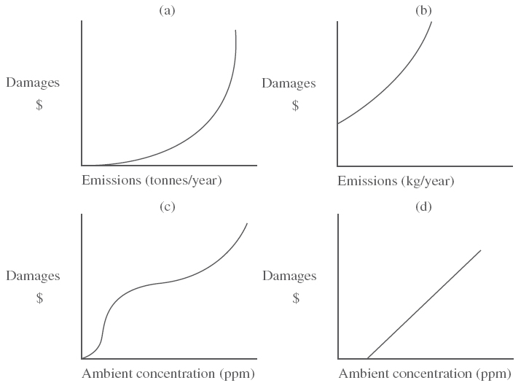
Representative Marginal Damage Functions
Ambient Concentration: Measure of environmental quality indicating the amount of pollutants found per unit volume in different environmental media.

Slide 34
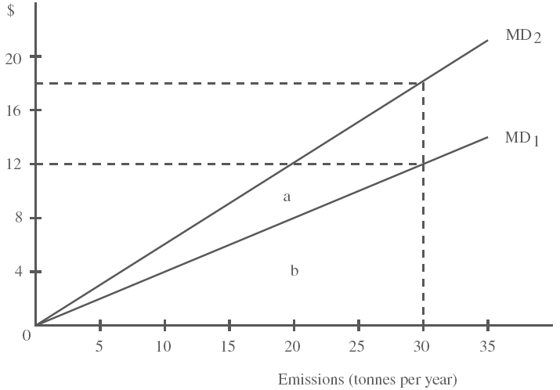
Marginal versus Total Damages
Area b on the graph represents the Total Damages for curve MD₁.
Area a + b on the graph represents the Total Damages for curve MD₂
Which curve might represent an urban area and which might represent a rural area? Explain why.

Slide 35
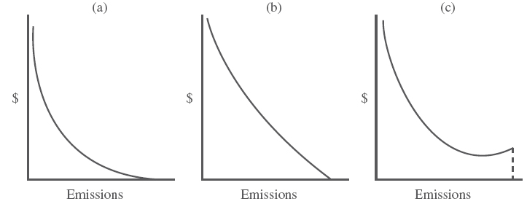
Abatement Costs
The Marginal Abatement Cost (MAC) Curve
  The cost of abating the next unit of emissions
  Rises exponentially as the amount of emissions to be abated increases
  The more pollution you abate, the higher the cost of abating the next unit of emissions because you have already abated the lowest cost units

Slide 36
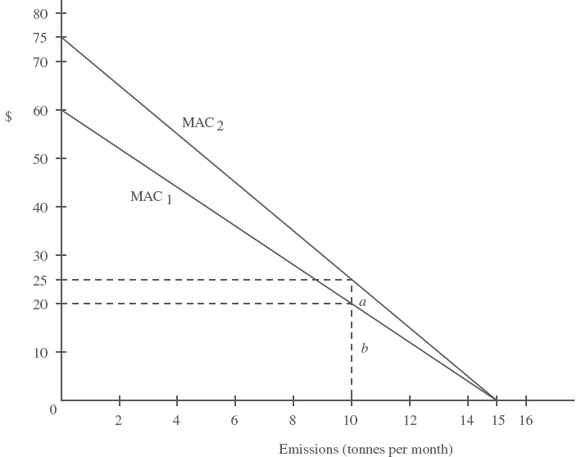
Marginal versus Total Abatement Costs
The area under the Marginal Abatement Cost curve represents the Total Abatement Cost
If technology to reduce abatement improves, the MAC curve will shift lower (MAC₁ versus MAC₂)

Slide 37
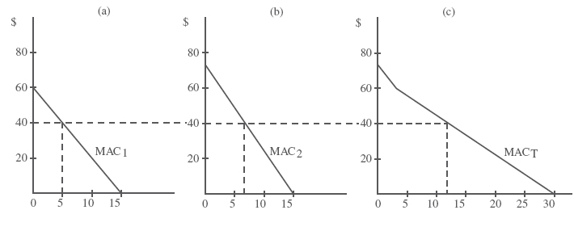
Aggregate Abatement Cost Functions
To aggregate marginal abatement costs, individual functions must be added horizontally to yield the lowest possible aggregate abatement costs

Slide 38
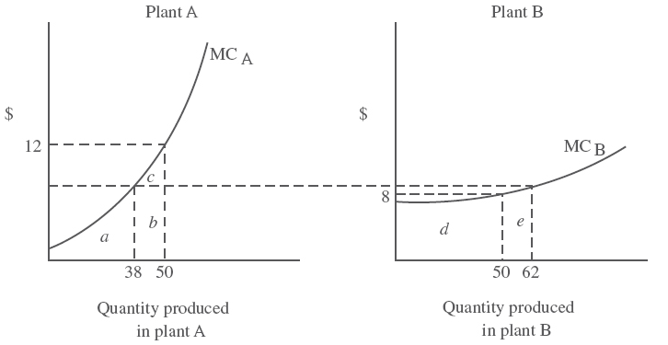
Equimarginal Principle
The equimarginal principle requires that the total production be distributed among sources so that their marginal cost of production are equalized

Slide 39
Equimarginal Principle
An aggregate MAC function (such as for several firms or factories) will always represent the minimum MAC achievable
The aggregate level of emissions will be distributed among different sources in a way that equalizes MAC
Under the equimarginal principle, abate the cheapest unit of pollution first, no matter which factory emits it

Slide 40
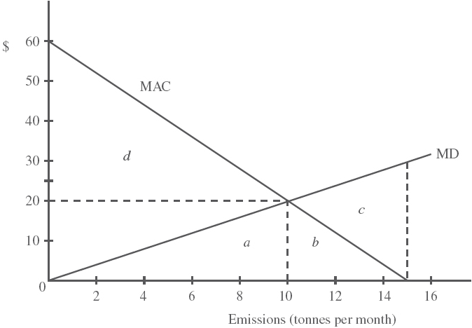
The Socially Efficient Level of Emissions
The socially efficient level of emissions is found where the MAC and the MD functions are equated

Slide 41
Proving Social Efficiency Yields the Lowest Social Cost
Total social costs [the total costs of damages (area a) plus the total costs of abatement (area b)] are minimized at the level of emissions where MAC=MD (At 10 units of emissions)
If emissions levels are higher or lower than the efficient level, the sum of the total costs of damages plus the total costs of abatement is higher than at the efficient level
For example, at 15 units of emission, total social costs equal total damages (a + b + c). There are no abatement costs at this point, but the damages to society are very high. Emissions that cause high damages can be abated at low cost, improving social welfare

Slide 42
Impact Analysis
An impact analysis attempts to quantify the consequences of various actions.
  A pure impact analysis does not convert all consequences into a one-dimensional measure, such as dollars, to ensure comparability.
  Also, impact analysis does not necessarily attempt to optimize.
  Impact analysis places a large amount of relatively undigested information at the disposal of the policy-maker.
Impact analysis is useful when the data needed for either a benefit-cost analysis or a cost-effectiveness analysis is unavailable.

Slide 43
Impact Analysis
Economic Efficiency and equitable distribution of cost and benefits must be taken into account when government introduces programs and policies.
Three Types of Distributional Impacts of Programs and Policies
  -Proportional. A program takes equal proportions of everyone’s income to achieve net benefit.
  -Regressive. A program provides individuals with high incomes a higher net benefit over lower income individuals based on proportion of income used.
  -Progressive. A program provides net benefits that represent a higher proportion of the lower income-person’s income than it does the rich persons income.
  Considering how a program or policy will distribute aggregates through a population is necessary to address the fairness of that plan.

Slide 44
Future Uncertainty
Uncertainty may exist when anticipating future values of benefits and costs.
For example we are uncertain when and where an earthquake may strike. Therefore it is hard to estimate how much we extra we should spend today to make buildings strong to withstand an earthquake that may or may not occur in our lifetimes
Probabilities can be created based on previous data or expert advice to help gauge the likelihood of future occurrences to better understand the risks involved.

Slide 45
Future Uncertainty
Scenario Analysis
We may want to create future scenarios to address uncertainty
For example, calculating a benefit-cost analysis of reducing CO2 emissions to lessen the greenhouse effect requires estimations of future energy saving technologies. As a result, scenarios can be presented based on “slow,” “moderate,” or “fast” advancement rate. Economic Efficiency and equitable distribution of cost and benefits must be taken into account when government introduces programs and policies.

Slide 46
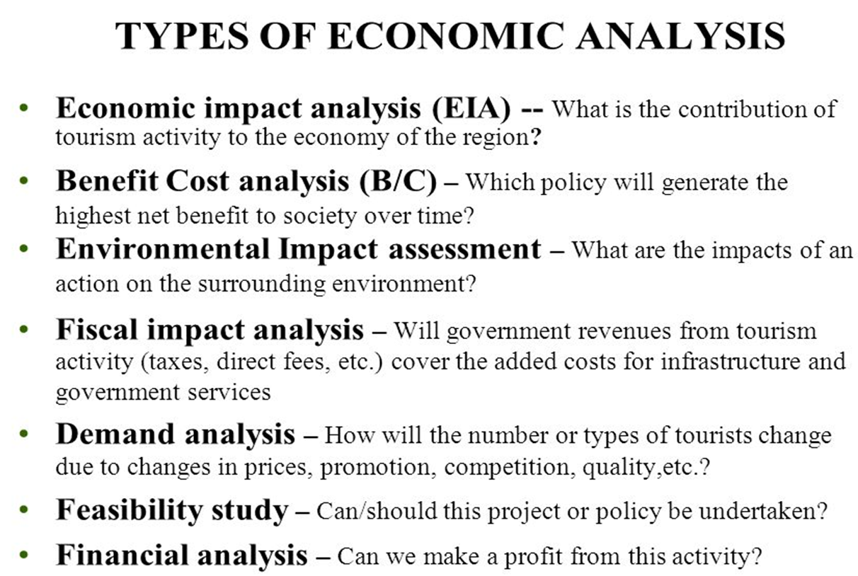

Slide 47
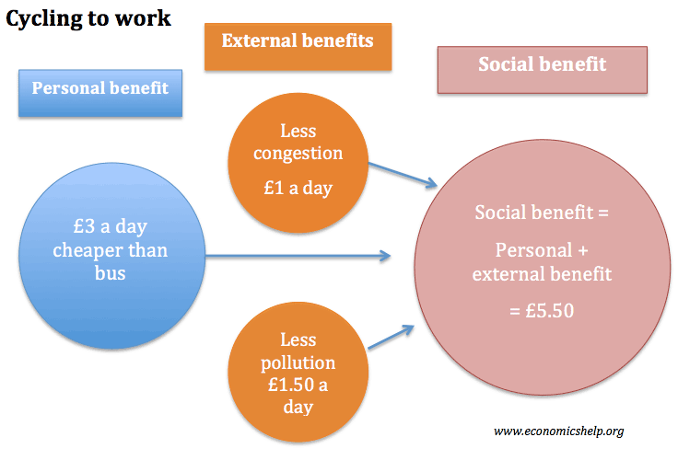
Looking at Benefits

Slide 48
