Slide 1

Econ 2675 – Environmental Economics
Chapter 2 Lecture- The Economic Approach: Property Rights, Externalities, and Environmental Problems

Slide 2
The Human–Environment Relationship
The Environment as an Asset
The environment is an asset that provides the economy with resources and acts as a receptacle for the economy’s waste.
The environment is a closed system, as defined by the first and second laws of thermodynamics.
  First law of thermodynamics—energy and matter can neither be created nor destroyed.
  Second law of thermodynamics - Known popularly as the entropy law. No conversion from one form of energy to another is completely efficient and that the consumption of energy is an irreversible process.
Closed system vs. open system
  Closed system: A system where there are no inputs and no outputs of energy and matter from outside the system
  Open system: A system which imports or exports energy or matter from outside

Slide 3
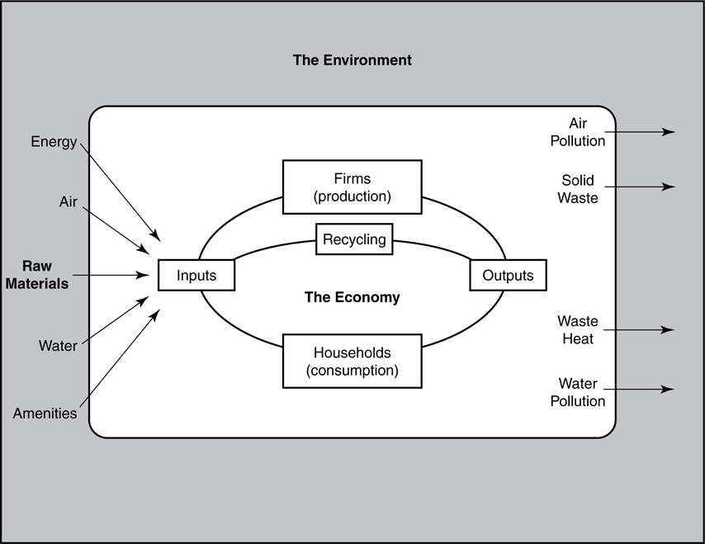
The Economic System and the Environment

Slide 4
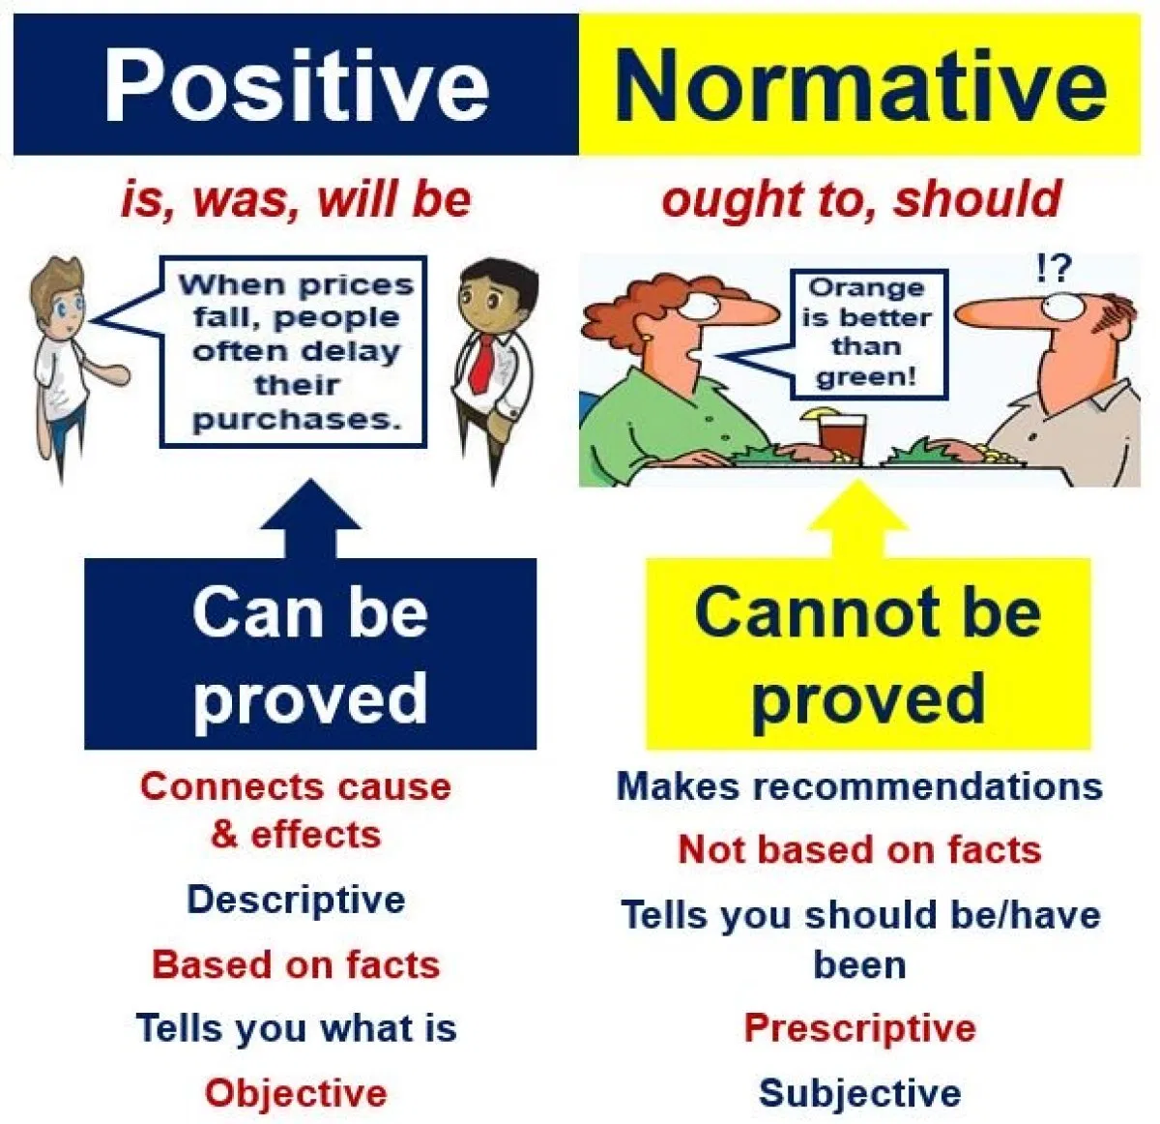
The Human–Environment Relationship
The Economic Approach
1. Positive economics attempts to describe what is.
2. Normative economics deals with what ought to be.
We can give some examples of both positive and normative economics. How about normative decision-making to prevent or mitigate climate change.

Slide 5
Environmental Problems and Economic Efficiency
Consumer surplus (once again)
  Consumer surplus is the value that consumers receive from an allocation minus what it costs them to obtain it.
  Consumer surplus is measured as the area under the demand curve minus the consumer’s cost.
Static Efficiency
  Economic surplus is the sum of consumer’s surplus plus producer’s surplus.
  An allocation of resources is said to satisfy the static efficiency criterion if the economic surplus derived from those resources is maximized by that allocation.

Slide 6
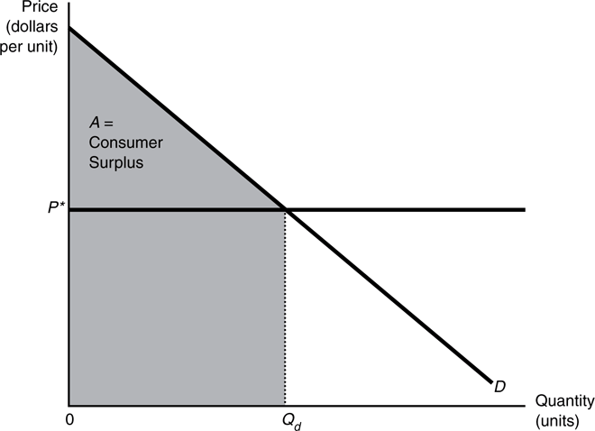
The Consumer’s Choice

Slide 7
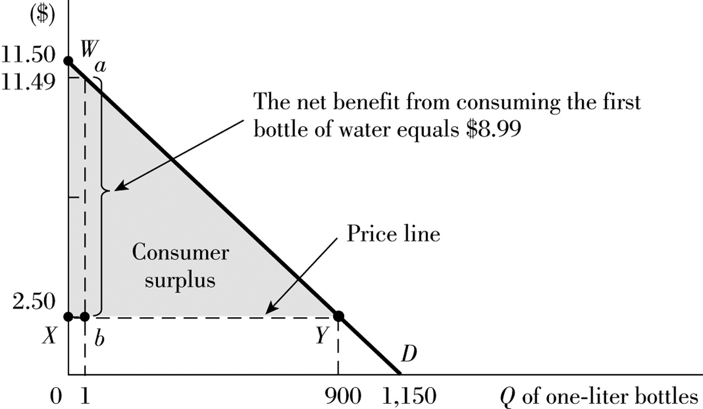
Consumer Surplus
Bottled Water Market
$11.50-$2.50=$9.00
CS = ($9.00 x 900)/2 =$4,050

Slide 8
Environmental Problems and Economic Efficiency
  Producer surplus (once again)
    Producer surplus is the difference between the amount that a seller receives minus what the seller would be willing to accept for the good.
    Given price P*, the seller maximizes his or her own producer surplus by choosing to sell Q_{s} units.
    The producer surplus is designated by area B, the area under the price line that lies over the marginal cost curve, bounded from the left by the vertical axis and the right by the quantity of the good.

Slide 9
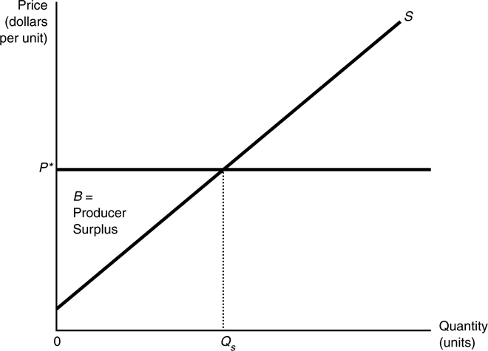
The Producer’s Choice

Slide 10
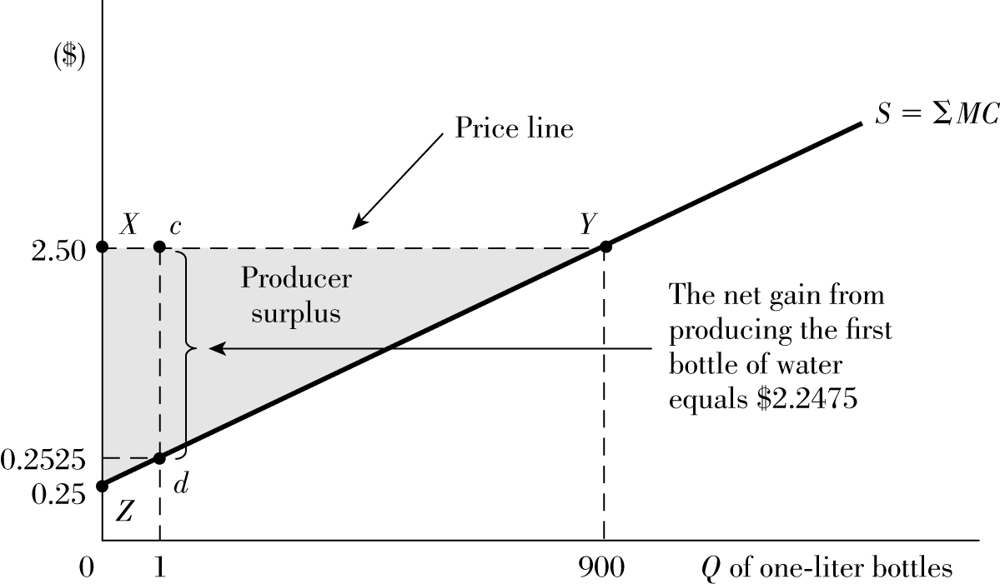
Producer Surplus
Bottled Water Market
PS = ($2.25 x 900)/2 =$1,012.50

Slide 11
Property Rights
In economics, property rights refers to a bundle of entitlements defining the owner’s rights, privileges, and limitations for use of the resource.
Property Rights and Efficient Market Allocations
  Either individuals or the state can capture the property rights.
Efficient Property Right Structures
  Exclusivity—All the benefits and costs should only accrue to the owner.
  Transferability—Property rights should be transferred to others.
  Enforceability—Property rights should be secure from seizure or encroachment.

Slide 12
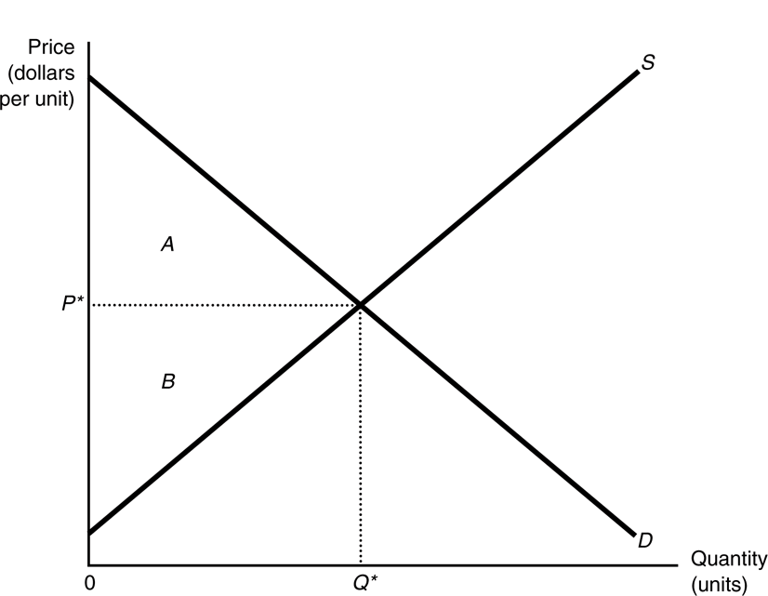
Market Equilibrium

Slide 13
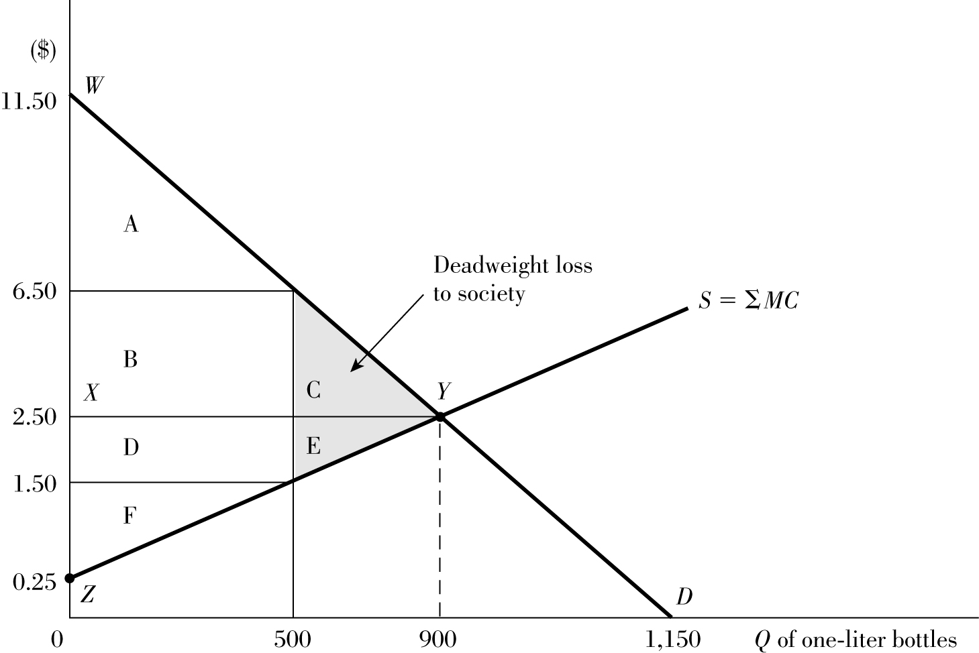
DWL of Price Regulated above P_{E}
Bottled Water Market
Policy forces price to $6.50
DWL = (C + E) = ($5.00 x 400)/2 = $1,000

Slide 14
Property Rights
In a system with well-defined property rights, static efficiency is achieved. Self-interested parties make choices that are efficient from society’s point of view.
In the short run, producer surplus is equal to profit plus fixed cost.
The area under the marginal cost curve is total variable cost.
In the long run, producer surplus is equal to profit plus rent.

Slide 15
Property Rights
Rent is the return to scarce inputs owned by the producer under perfect competition. Long-run profit equals zero and producer surplus equals rent (remember that economic profit is not the same as accounting profit).
Scarcity rents are the returns that persist in the long-run competitive equilibrium. It is the producer surplus, which persists in the long-run competitive equilibrium.

Slide 16
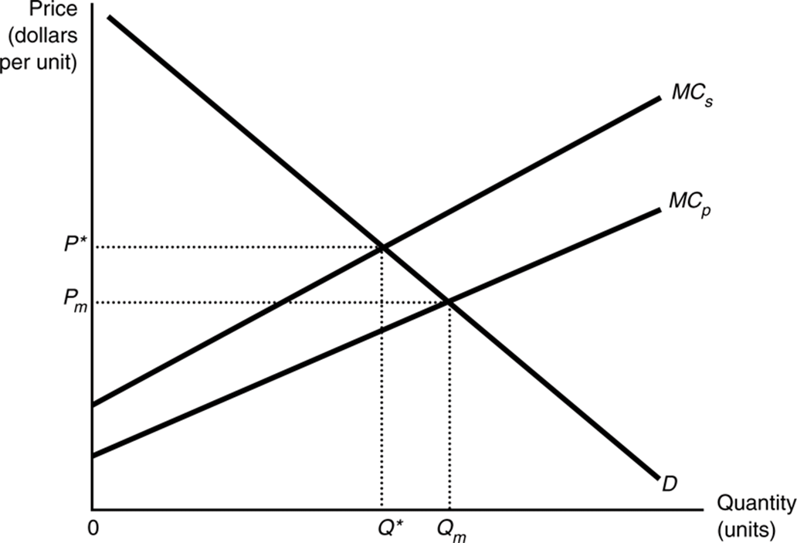
Externalities as a Source of Market Failure
  Externalities exist whenever the welfare of some agent depends not only on his or her activities, but also on activities under the control of some other agent.
The Market for Steel

Slide 17

Externalities as a Source of Market Failure
  The output of the commodity is too large.
  Too much pollution is produced.
  The prices of products responsible for pollution are too low.
  As long as the costs are external, no incentives to search for ways to yield less pollution per unit of output are introduced by the market.
  Recycling and reuse of the polluting substances are discouraged due to the cheap external cost.

Slide 18
Externalities as a Source of Market Failure
Types of Externalities
    External cost (external diseconomy) - It imposes costs on a third party.
    External benefit (external economy) - It imposes benefits on a third party.
  Pecuniary externalities
      It exists when the external effect comes from altered prices.
      Example: an influx of city-dwellers buying second homes in a rural area can drive up house prices, making it difficult for young people in the area to get onto the property ladder.

Slide 19
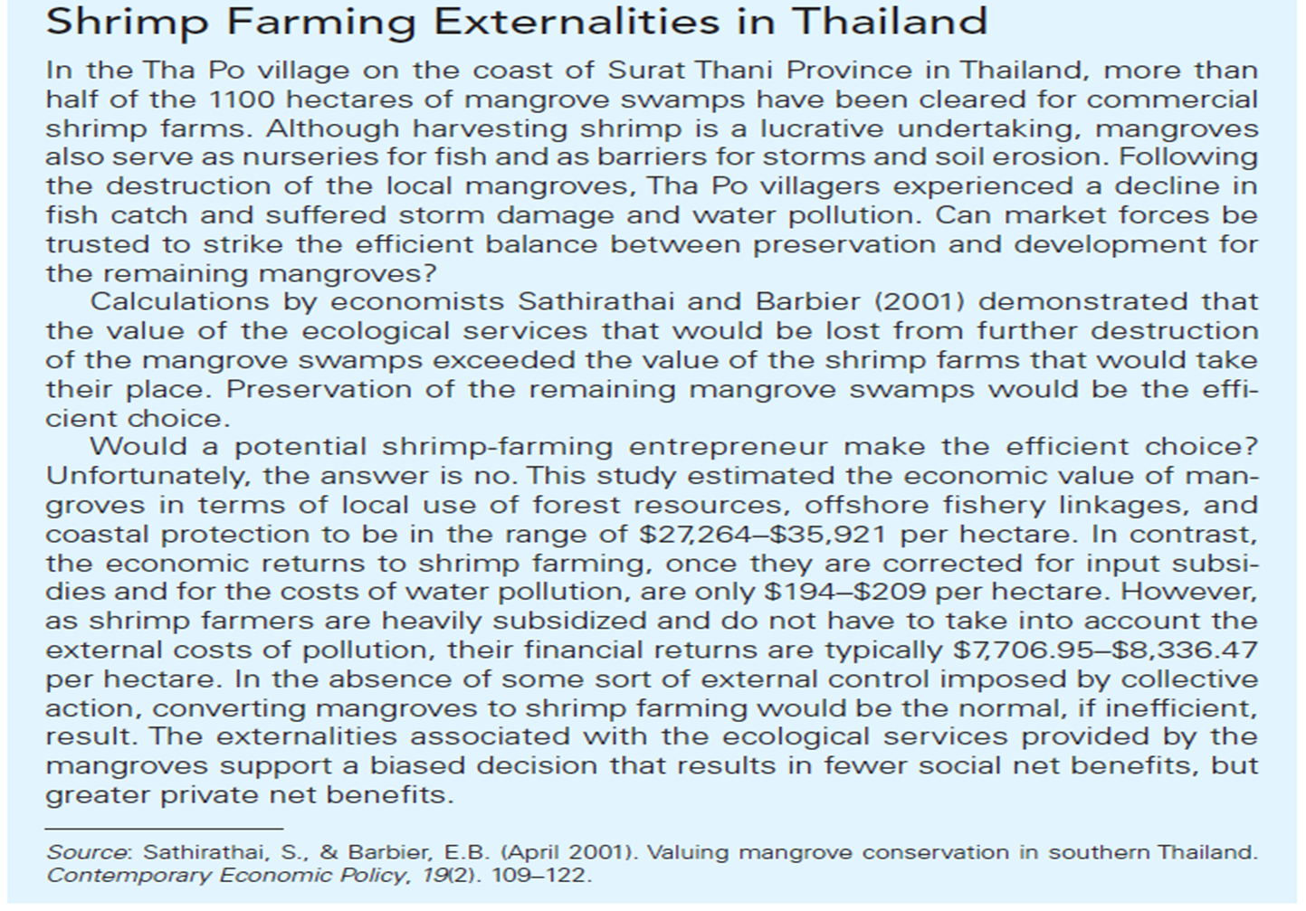

Slide 20
Externalities as a Source of Market Failure
Perverse Incentives Arising from Property Right Structures
  State-property regimes
    Governments own and control property.
  Common-property regimes
    Property is jointly owned and managed by a specific group.
  Res nullius or open access regimes
    No one owns or exercises control over the resources.

Slide 21
Externalities as a Source of Market Failure
Open-access resources and “tragedy of the commons”
“Common-pool” resources are shared resources characterized by nonexclusivity and divisibility.
  Nonexclusivity implies that resources can be exploited by anyone.
  Divisibility means that the capture of part of the resource by one group subtracts it from the amount available to the other groups.

Slide 22
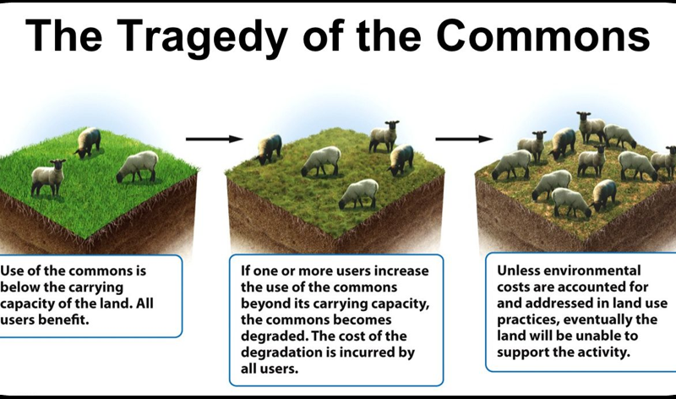

Slide 23
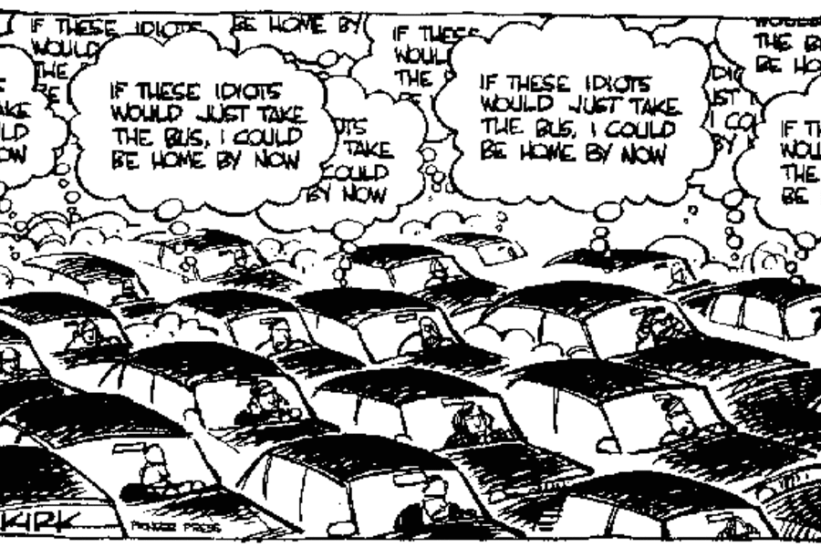

Slide 24
Externalities as a Source of Market Failure
Public Goods - both consumptively indivisible and nonexcludable.
  Nonexcludability refers to a circumstance where, once the resource is provided, even those who fail to pay for it cannot be excluded from enjoying the benefits it confers.
  Consumption is said to be indivisible when one person’s consumption of a good does not diminish the amount available for others.
  Examples include charming landscape, clean air, etc.
  It also includes Biological diversity or the amount of genetic variation among individuals within a single species and the number of species in a community.

Slide 25
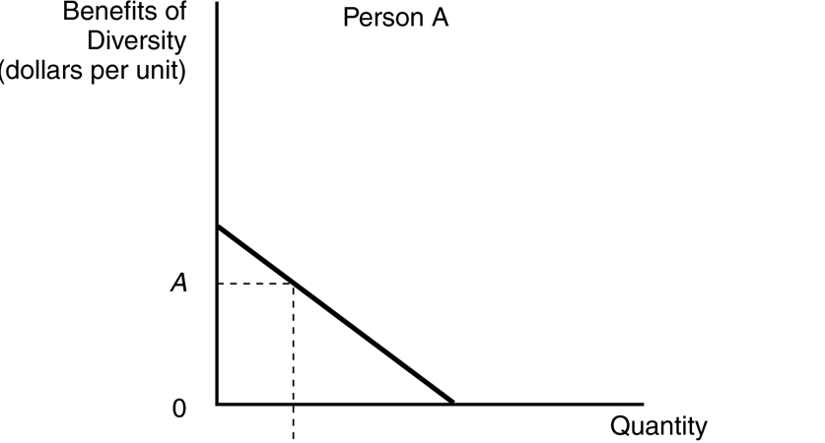
Efficient Provision of Public Goods (1 of 3)

Slide 26
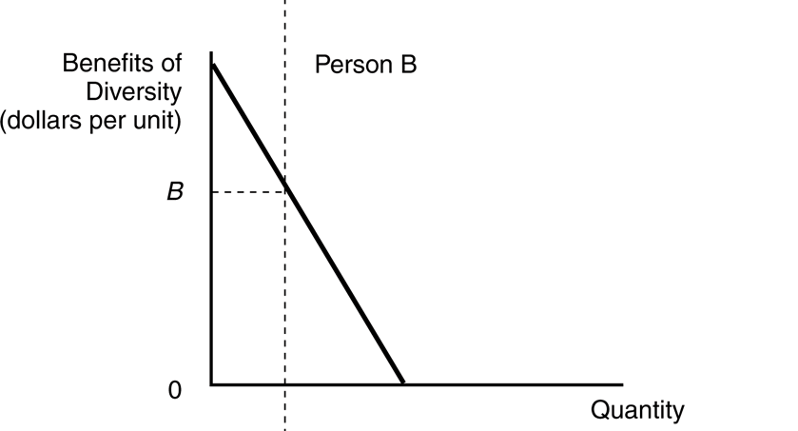
Efficient Provision of Public Goods (2 of 3)

Slide 27
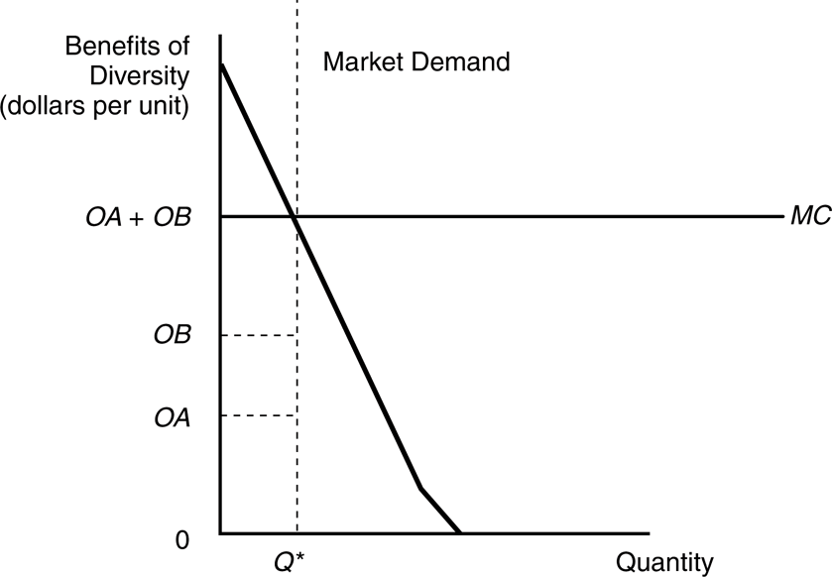
Efficient Provision of Public Goods (3 of 3)

Slide 28
Externalities as a Source of Market Failure
With Public Goods we have:
  Efficient level of diversity
  The efficient allocation maximizes economic surplus, which is represented geometrically by the portion of the area under the market demand curve that lies above the constant marginal cost curve.
  The allocation that maximizes economic surplus is Q*, the allocation where the demand curve meets the marginal cost curve.

Slide 29
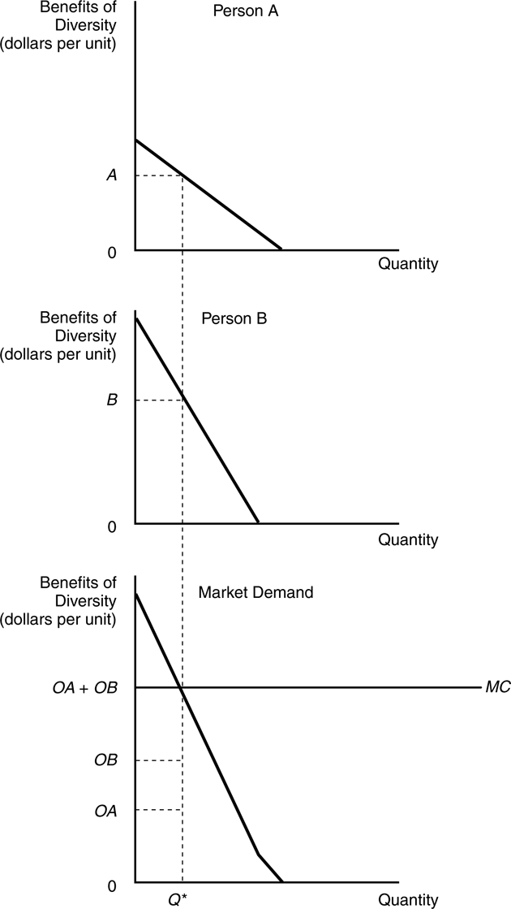
Efficient Provision of Public Goods

Slide 30
Externalities as a Source of Market Failure
Imperfect Market Structures
  Monopoly: when product is sold by a single seller
    Monopolies will supply too little of a good at too high a price.
    At the monopoly output, marginal benefits are greater than marginal costs. Net benefits are not maximized and there is a deadweight loss.
  We may have cartel - a group of producers who form a collusive agreement to gain monopoly power.

Slide 31
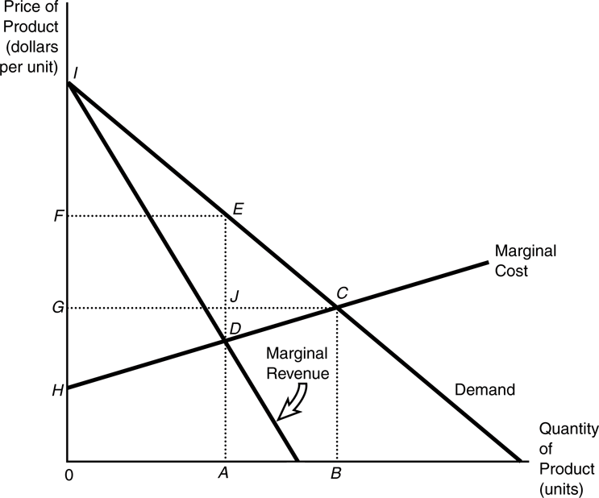
Monopoly and Inefficiency

Slide 32
Factors that Contribute to Inefficient Allocation
A free rider is someone who derives benefits from a commodity without contributing to its supply.
Asymmetric Information
  It refers to a situation where one or more parties have much more information than the others.
  Asymmetric information creates problems for the market when it results in a decision-maker knowing too little to make an efficient choice.
Government Failure
  Rent seeking: the use of resources in lobbying and other activities directed at securing protective legislation.
    Examples include agricultural producers seeking price supports and consumer groups seeking subsidies.

Slide 33
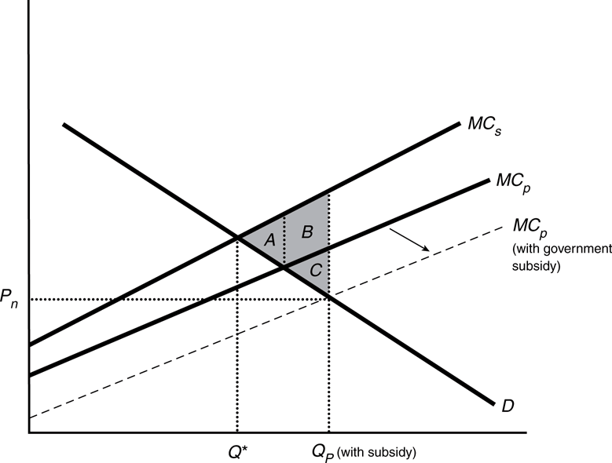
The Market for Steel With a
Government Subsidy
Without subsidy, due to external cost, deadweight loss is A
With subsidy, a deadweight lost of A + B + C

Slide 34
Deadweight Loss (DWL)
Society’s welfare can be captured through the sum of Consumer Surplus and Producer Surplus
Comparing these measures before and after a market disturbance helps quantify how society is affected by that disturbance through Deadweight Loss (DWL)
DWL is the net loss of consumer and producer surplus due to an allocatively inefficient market event

Slide 35
The Pursuit of Efficiency
Private Resolution Through Negotiation—the Coase Theorem
  The courts: property rules and liability rules
    Not well-defined property rights corrected by courts
The Coase Theorem
  When negotiation costs are negligible and affected parties can freely negotiate, the entitlement can be allocated by the courts to either party and an efficient allocation will result. Only the distribution of costs and benefits among the effective parties is changed.
https://www.youtube.com/watch?reload=9&v=BcGoPQe3-ls

Slide 36
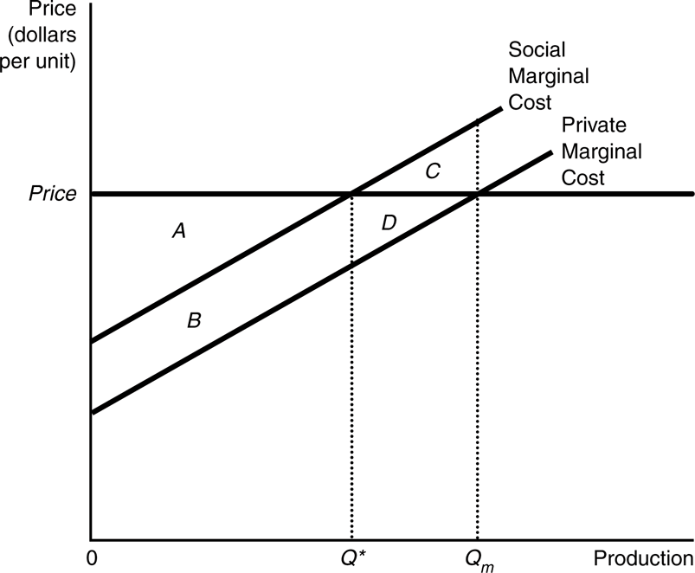
Efficient Output with Pollution Damage
A downstream firm hurt by an upstream polluter could negotiate or bribe the upstream polluter to reduce pollution. A resort, for example, may be willing to pay C + D. They would experience damage reduction from the decrease in production from Qm to Q*.
Let’s assume that the bribe is equal to this amount. Would the steel company be willing to reduce production to the desired level?
If they refused the bribe, their producer surplus would be A + B + D. If they accepted the bribe, their producer surplus would be A + B plus the bribe, so their total return would be A + B + C + D. Clearly, they are better off by C if they accept the bribe.
Society as a whole is better off by amount C as well since the economic surplus from Qm is A – C and the economic surplus for Q* is A.

Slide 37
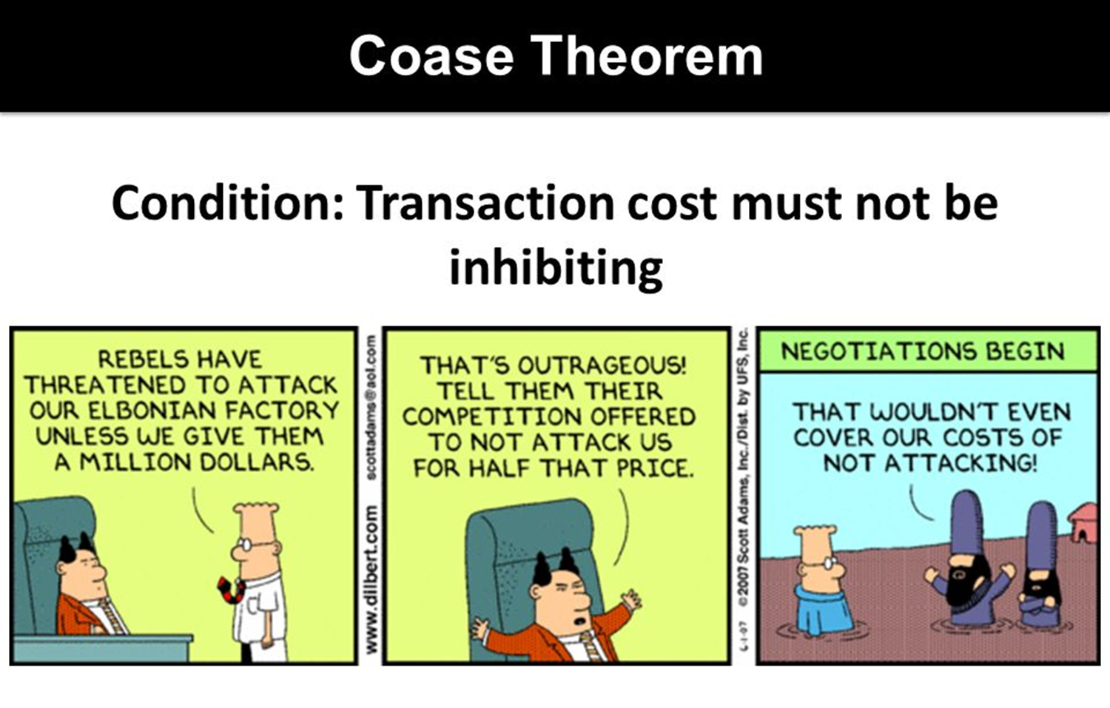

Slide 38
The Pursuit of Efficiency
Legislative and Executive Regulation
  Several forms taken to permit flexibility and reduce damage.
    Including taxes and regulatory laws, payments, labeling
    A Simple Question
Government has constantly been facing challenges from economic activities. Can government respond or will rent seeking prevent efficient political solutions?

Slide 39
A Simple Question
Five fishermen live in a village and have no other employment or income earning possibilities besides fishing. They each own a boat that is suitable for fishing, but does not have any resale value. Fish are worth $5 per pound and the marginal cost of operating the boat is $500 per month. They all fish in a river next to the village, and they have determined that when there are more of them out there on the river fishing, they each catch less fish per month according to the following schedule:
Boats Fish Caught per Boat (pounds)
1 200
2 190
3 175
4 155
5 130
If each fisherman acts in his own best interest, will he continue to operate his boat each month? If so, how much income will he earn per month?
If the fishermen band together and act as a group, how many boats will they choose to operate? If income is divided evenly, how much will each fisherman make?

Slide 40
The Coase Theorem: here is a simple bargaining example.
There is a factory that is dumping toxic waste into a river where a resort is located downstream. At the moment the factory is not filtering the water that it dumps into the river. There is a filter it could install that would remove a significant amount of the toxic elements from the water before it is dumped in the river. The factory and the resort have each assessed the situation and come up with the following data:
Gains to: No Factory Factory with filter Factory with no filter
Factory $0/day $700/day $800/day
Resort $400/day $250/day $100/day
If the factory is given ownership of the river, what choice will it make? How much would the resort be willing to pay to get the factory to make another choice? Will the factory accept?
If the resort is given ownership of the river, what choice will it make? How much would the factory be wiling to pay to get the resort to make another choice? Will the resort accept?

