Slide 1
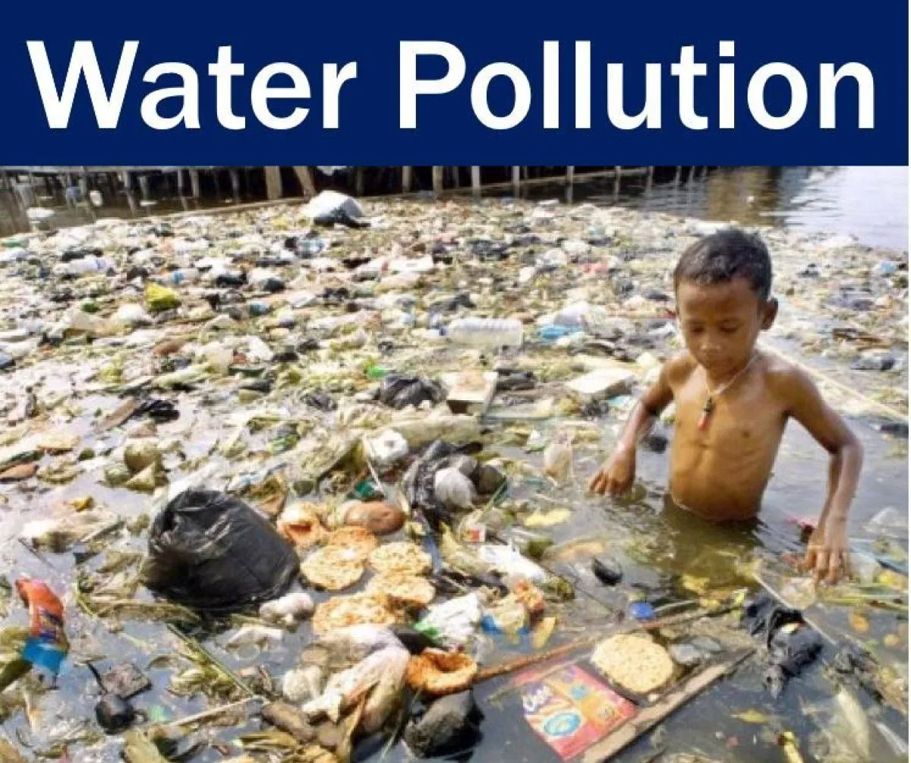
Econ 275 – Environmental Economics
Chapter 18 Lecture – Water Pollution

Slide 2
Nature of Water Pollution Problems
Types of Waste-Receiving Water
  There are two general types of water bodies at risk of contamination from pollution.
    Surface water includes rivers, lakes, and oceans. Historically, clean-up policies have focused on surface water.
    Groundwater is subsurface water.
    Both groundwater and surface water are used for irrigation and drinking.
    Surface water also provides additional benefits such as recreation and wildlife.

Slide 3
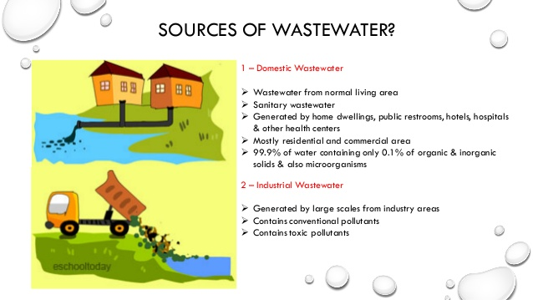
Nature of Water Pollution Problems
Water sources have been treated as common property. Thus, they have been used as a cheap place to dump municipal sewage and industrial waste.
Groundwater and surface water require different water policies.

Slide 4
Nature of Water Pollution Problems
Sources of Contamination
  Point source pollution is discharged into surface water at a specific location through a drainage pipe or ditch.
    The primary point sources are industries and municipalities. Point sources are relatively easy to monitor and predict.
  Nonpoint source pollution is runoff that comes from a variety of sources and includes agricultural and urban runoff.
    Nonpoint sources are much more difficult to control due to the unpredictability and uncertainty associated with the exact source.

Slide 5
Nature of Water Pollution Problems
  Rivers and lakes: The primary point sources are industries and municipalities. The primary nonpoint sources involve agricultural activity of different forms.
    The contamination of groundwater usually comes from the migration of harmful substances.
  Ocean Pollution: The primary sources of ocean pollution are oil spills and ocean dumping.
    Though not uncommon, oil spills have decreased since 1970.
    Dumped materials include sewage and sewage sludge, unwanted chemicals, trace materials, and radioactive materials

Slide 6
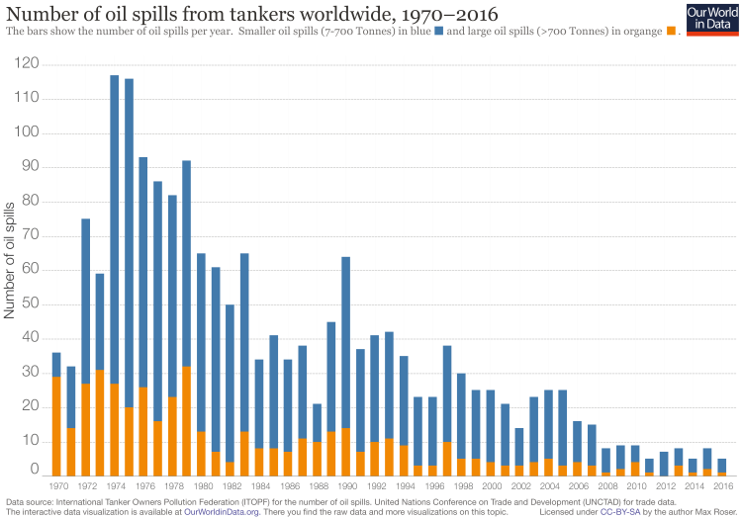

Slide 7
Types of Pollutants
Fund Pollutants - These pollutants can be assimilated by water sources if the absorptive capacity of the lake or river is high relative to the discharge.
  Degradable wastes will break down in the water. This process uses oxygen.
  Large amounts of degradable pollutants can consume enough oxygen to turn an aerobic stream into an anaerobic stream.
  Without oxygen, aquatic lifeforms will die.
  Controlling the waste load requires monitoring the ambient conditions in the watercourse and monitoring the magnitude of emissions.

Slide 8
Types of Pollutants
Dissolved oxygen (DO) is the measure used to monitor ambient conditions.
Biochemical oxygen demand (BOD) is the measure of oxygen demand placed on a stream by any particular volume of effluent.
Oxygen sags represent locations along the stream where the DO is lower than at other points.
Policy options could focus on a general BOD reduction target (emission permit or emission charge).
Ambient control programs (ambient permits or ambient charges) would be aimed at reaching a particular DO target at the oxygen sags.

Slide 9
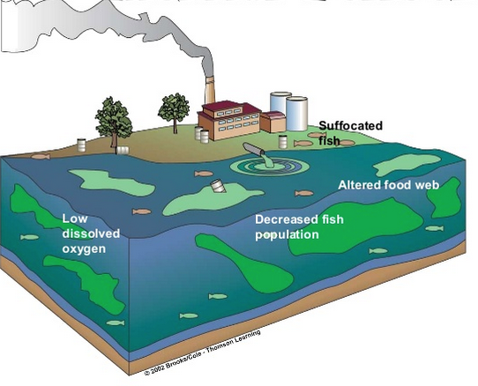
Thermal Pollution
Thermal pollution stems from the injection of heat into a watercourse. Usually this is in the form of used coolant water. Raising the temperature of the water reduces DO.

Slide 10
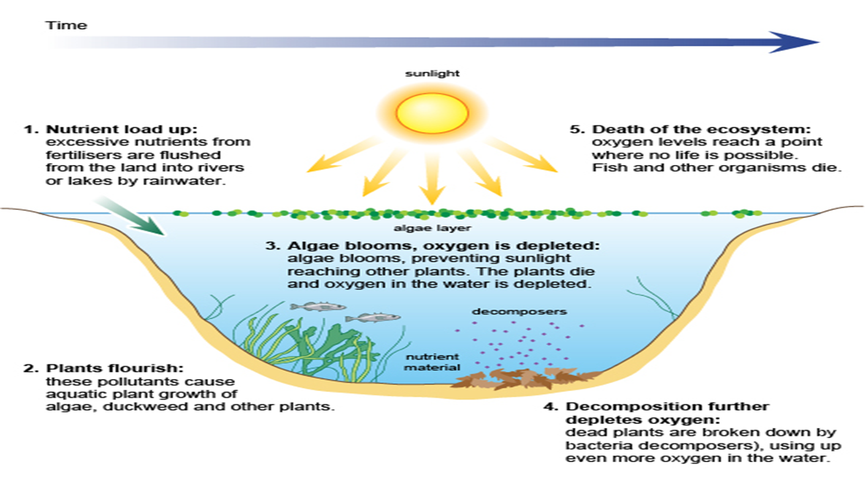
Eutrophication
Plant nutrients such as nitrogen and phosphorous cause algae growth. Too many nutrients in a stream or water body can cause eutrophication.

Slide 11
Types of Pollutants
Stock pollutants - those for which the environment has no absorptive capacity.
One example of the effect of stock pollutants is the numerous fish consumption advisories due to mercury contamination of fish.
Medicinal waste is a more recent worry as drugs such as birth control and antidepressants have been found in fish tissue.
These accumulating pollutants are extremely problematic because they are difficult to monitor.
Persistent pollutants are pollutants that accumulate because they break down so slowly that they can travel long distances in water without changing structure.

Slide 12
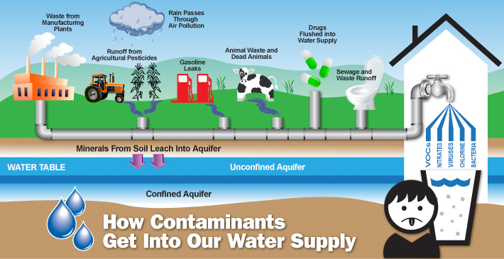
https://zirionk.wordpress.com/2015/07/27/water-contaminants-and-its-sources/

Slide 13
Some Example of Traditional Water Pollution Control Policy in the USA
  The Water Quality Act of 1965 set ambient water quality standards for interstate watercourses. States were required to file implementation plans.
  The Clean Water Act of 1965 sets out two goals: “that the discharge of pollutants into navigable waters be eliminated by 1985”; and “that wherever attainable, an interim goal of water be achieved by June 1, 1983.”
  The 1972 Amendments to the Clean Water Act set two stages for meeting the standards.
  The 1977 Amendments to the Clean Water Act distinguished between conventional and toxic pollutants.

Slide 14
Traditional Water Pollution Control Policy
  Nonpoint Sources
    Nonpoint source pollution control was not covered by the Clean Water Act. This type of pollution was seen as a state responsibility.
    The reauthorization of the Clean Water Act in 1987 provided funding for a program to help states control runoff, but the states held responsibility for nonpoint source pollution control.
  The TMDL Program
    A Total Maximum Daily Load is a calculation of the maximum amount of a pollutant that a water body can receive and still meet water-quality standards as well as an allocation of that amount to the pollutant’s resources.
    Since the late 1980s efforts focused on nonpoint sources. Voluntary programs and cost-sharing programs with landowners are the most common tools.

Slide 15
Traditional Water Pollution Control Policy
The Safe Drinking Water Act
  The Safe Drinking Water Act of 1974 provides more stringent standards for drinking water.
  The primary regulations set maximum allowable concentrations for bacteria, turbidity, and chemical contaminants.
  Secondary standards for odor and aesthetics were also set. Approximately 60,000 public water systems are subject to these standards.

Slide 16
Traditional Water Pollution Control Policy
Ocean Pollution
  Oil Spills
    The Clean Water Act prohibits discharges of “harmful quantities” of oil into navigable waters.
  Ocean Dumping
    It is covered by the Marine Protection Research and Sanctuaries Act of 1972.
  Ocean Trash
    Few laws governing ocean trash except for explicit dumping.
Looking at Some Data
Maps and Statistics Ocean Pollution
Marine and Ocean Pollution Statistics and Facts 2020

Slide 17
Efficiency and Cost-Effectiveness
The efficient allocation of uncontaminated water requires marginal benefits to be equalized across all uses. However, if return flows are contaminated, this can alter the efficient allocation.
The figure on the next slide demonstrates the effect of return flow contamination on the efficient allocation in the case of two users: an upper basin user and a downstream lower basin user.

Slide 18
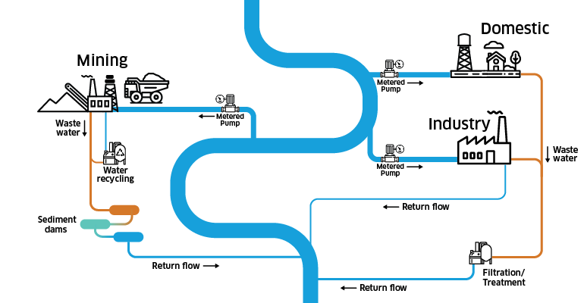
Return Flows Explained
https://www.mdba.gov.au/managing-water/return-flows

Slide 19
Economic Efficiency When Return Flows are Contaminated
If the two users have identical marginal net benefits for uncontaminated water, the two users should receive equal amounts of water. However, subtracting the effect of contaminated return flows from the upper basin marginal net benefit function (MBUB´) (internalizing this externality) changes the efficient allocation to one with unequal sharing. In particular, more water would be allocated to the lower basin user (QLB´) and less to the upper basin user (QUB´).

Slide 20
Efficiency and Cost-Effectiveness
Ambient Standards and the Zero-Discharge Goal
  The shift from ambient standards to a zero discharge goal was problematic.
    The feasibility of meeting such a goal is small and thus enforcement is a problem.
    For some pollutants, such a high cost might be justified. However, the zero discharge goal does not distinguish among pollutant types.

Slide 21
Efficiency and Cost-Effectiveness
National Effluent Standards
  Enforcement Problems
    Cost-effectiveness would require individual standards for each source, but the EPA chose general standards for broad categories of sources.
  Allocating Control Responsibility
    Studies have shown that uniform standards do not closely approximate the least-cost allocation.

Slide 22
Efficiency and Cost-Effectiveness
Municipal Waste Treatment Subsidies
  The Allocation of Funds
    States are now required to establish project priorities and target funds to the most significant needs.
  Operation and Maintenance
    Operation and maintenance costs would be paid by the municipality. This type of program provides incentives to build expensive plants.
    States are now required to establish project priorities and target funds to the most significant needs.
  Capital Costs
    Local areas need to be more careful with capital costs.

Slide 23
Efficiency and Cost-Effectiveness
Pretreatment Standards - regulate the quality of wastewater flowing into the waste treatment plants.
Point Source Pollution - any single identifiable source of pollution from which pollutants are discharged, such as a pipe, ditch, ship or factory smokestack.
Nonpoint Source Pollution
  Nonpoint source pollution has become a significant part of the total water quality problem.
  More intensive controls have been placed on point sources as an attempt to compensate for nonpoint sources.
  Studies suggest that some nonpoint sources could be controlled at low costs, especially with policies aimed at reducing nitrogen use.

Slide 24
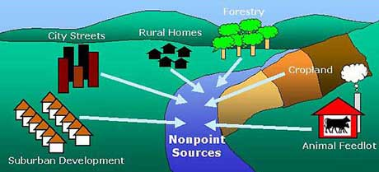
More Nonpoint Source Pollution Examples

Slide 25
Efficiency and Cost-Effectiveness
Watershed-Based Trading
  Trading for water pollution control involves point source polluters meeting water quality standards by purchasing reductions from other sources with lower marginal abatement cost.
  The trading program can bring large economic benefits from cheaper and faster clean up.

Slide 26
Potential Cost Savings with Trading across Point and Nonpoint Sources
Initial cleanup of PS of 50% at point d
No cleanup of NPS
Seek increase of 10%. Cheaper to cleanup NPS (Oabc < defg)
May result in source trading until MCs are equalized.

Slide 27
Efficiency and Cost-Effectiveness
  Water Quality, Watershed-Based Trading, and GIS
    Land use change significantly affects watershed health. Agricultural and urban runoff into rivers, streams, and estuaries is the largest contributor to water pollution.
    Digital land use maps can be used to examine the relationship between land use and water quality.

Slide 28
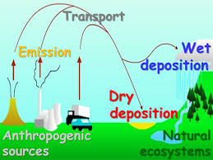
Efficiency and Cost-Effectiveness
Atmospheric Deposition of Pollution
  Wet deposition refers to pollutants that travel to the ground with rainfall.
  Dry deposition occurs when pollutants become too heavy and fall to the ground.
https://www.srs.fs.usda.gov/airqualityportal/critical_loads/atmospheric_deposition.php

Slide 29
Efficiency and Cost-Effectiveness
The European Experience
  In Europe, economic incentives such as effluent charges play a much larger role.
Developing Country Experience
  Noncompliance and lack of infrastructure has hampered many water pollution control programs.
  Water pollution is complicated by poverty.

Slide 30
Efficiency and Cost-Effectiveness
Oil Spills—Tankers and Off-shore Drilling
  Legal solutions have very high administrative costs and take enormous amounts of time.
  Vessel owners will choose the level of precaution that equates the marginal cost of additional precaution with the marginal expected penalty

Slide 31
Oil Spill Liability

Slide 32
Efficiency and Cost-Effectiveness
An Overall Assessment
  The use of cost-effective policies would reduce costs substantially while not affecting the benefits.
  Economic incentives would also facilitate change better than technology-based standards that are rigid.
  The possibilities of using marketable permits for water pollution control are being explored for many bodies of water in the U.S.
  Economic incentives put pressure on sources to find better ways to control pollution.

