Slide 1

Econ 275 – Environmental Economics
Chapter 16 Lecture - Mobile-Source Air Pollution

Slide 2
Subsidies and Externalities
Implicit Subsidies
  Social costs of transportation tend to rise with miles driven. Private costs (insurance) do not reflect these increases.
  The marginal private cost of driving an additional mile is zero with respect to road construction and maintenance.
  Employee parking or other free parking is an implicit subsidy that creates a bias toward automobile travel.

Slide 3
Subsidies and Externalities
Externalities
  The social cost of accidents rises with miles driven.
  Road congestion is also an externality. Marginal private costs will not equal marginal social costs if traffic volume is above the efficient level. Marginal private costs and marginal social costs diverge as traffic increases to the capacity of the roadway.
  Exhaust from cars also causes high levels of pollution inside the cars following.

Slide 4
Congestion Inefficiency
V_{e} = efficient volume MSC = MSB
V_{p} = actual volume MPC = MSB
Deadweight loss = ACD

Slide 5
Subsidies and Externalities
Consequences
  The implicit subsidies and non-internalized external costs result in transport costs that are too low.
  The results include too many vehicles using the road, too many trips taken, too many miles driven, and too much pollution. Low costs also cause demand for alternative modes of transportation to be inefficiently low.

Slide 6
Policy toward Mobile Sources
Lead Phaseout Program
  EPA also regulates lead and other fuel additives used in gasoline to reduce the amount of airborne lead.
Fuel Economy Standards–the U.S. Approach
  The Corporate Average Fuel Economy program requires each automaker to meet government-set miles-per-gallon targets for all its car and light truck fleets sold in the U.S.
Gas Guzzler Tax
  The Gas Guzzler Tax is levied on cars that do not meet fuel economy standards.
  This tax aims at reducing the production and consumption of fuel inefficient vehicles.

Slide 7
Policy toward Mobile Sources
Fuel Economy Standards in the European Union
  The E.U. has tackled the externalities from fuel consumption primarily through gas taxes and has some of the highest gas taxes in the world.
  The E.U. also combines standards with very high fuel taxes, which creates a larger demand for small cars (Anderson et al., 2011).
  E.U. countries also tax diesel at lower rates than gasoline and as such diesel’s share of passenger cars has grown significantly.
  The European Union standards are set to rise annually from the 2012 standard of 45 mpg (Anderson et al., 2011).
  The Netherlands, Norway, Germany, and Sweden used differential tax rates to encourage consumers to purchase (manufacturers to produce) low-emitting cars before subsequent regulations required all cars to be low emitting.

Slide 8
Policy toward Mobile Sources
Fuel Economy Standards in Other Countries
  Japan has the most stringent standards with different standards for diesel and gasoline vehicles.
  China sets fuel consumption standards that are based on weight.

Slide 9
Policy toward Mobile Sources
External Benefits of Fuel Economy Standards
  Fuel economy standards create positive externalities.
  First, fuel efficiency also lowers emissions.
  Lower carbon dioxide emissions as well as reduced dependence on foreign fuels are both positive externalities that result from better fuel efficiency.
Alternative Fuels and Vehicles
  Alternative Fuels
    In the USA, the Clean Air Act Amendments of 1990 required nonattainment areas to use cleaner-burning fuels.
    Mandated sales quotas for clean vehicles are also being used
Road Pricing
  Fuel Taxes
    The figure on the next slide presents the current fuel taxes by country. How much higher current fuel taxes would have to be in order to internalize the full social cost of road transport is the central issue. The increases are sizable.

Slide 10
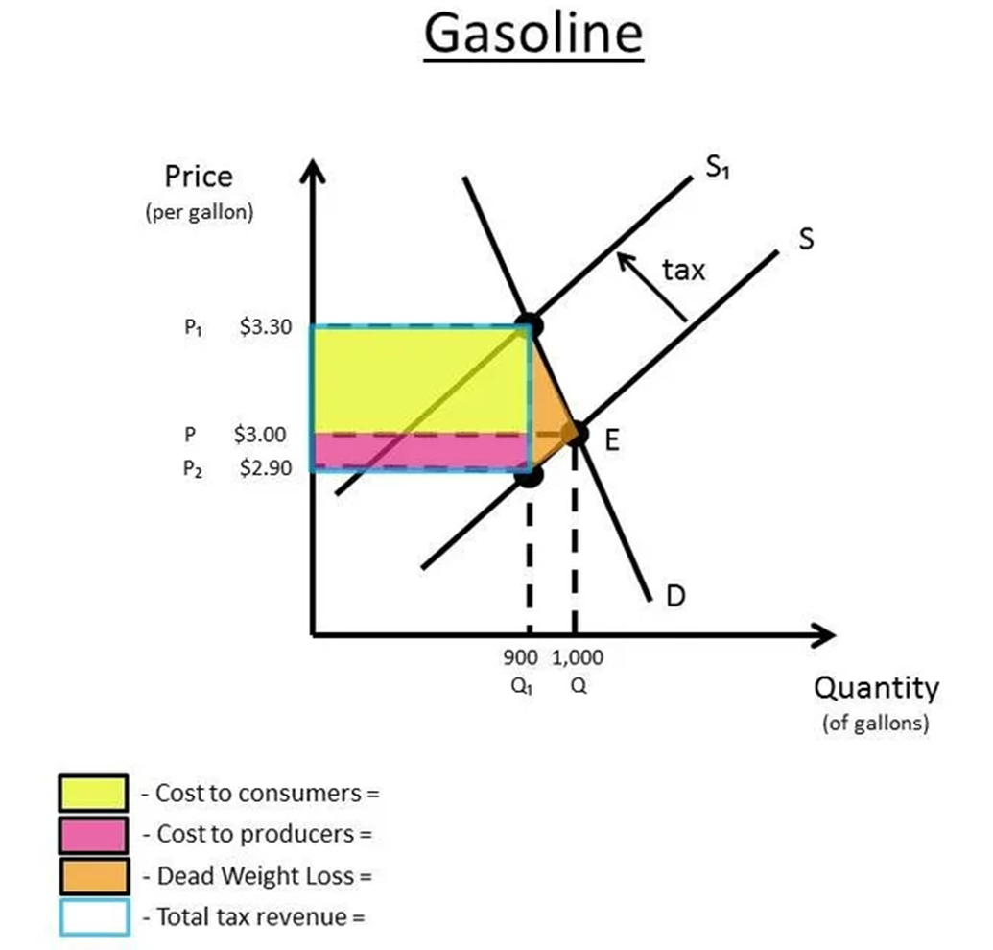
Gasoline Tax

Slide 11
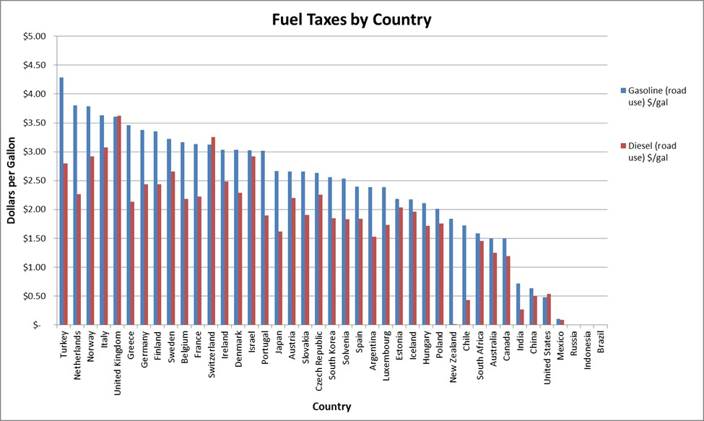
2016 Fuel Taxes in Selected Countries

Slide 12
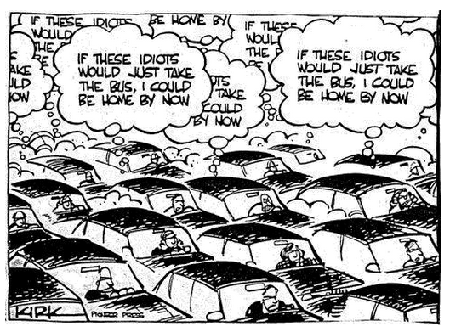
Policy toward Mobile Sources
  Congestion Pricing
    Congestion pricing would involve charging fees or higher prices to use more congested highways and roads. In Singapore, for example, electronic peak-hour pricing is used.

Slide 13
Zonal Mobile-Source Pollution-Control Strategies: Singapore
Singapore has one of the most comprehensive strategies to control vehicle pollution in the world. In addition to imposing very high vehicle-registration fees, this approach also includes the following:
Central Business District parking fees that are higher during normal business hours than during the evenings and on weekends.
An area-licensing scheme that requires the display of an area-specific purchased vehicle license in order to gain entry to restricted downtown zones during restricted hours. These licenses are expensive and penalties for not displaying them when required are very steep.
Electronic peak-hour pricing on roadways. These charges, which are deducted automatically using a “smart card” technology, vary by roadway and by time of day. Conditions are reviewed and charges are adjusted every 3 months.
An option for people to purchase an “off-peak” car. Identified by a distinctive red license plate that is welded to the vehicle, these vehicles can only be used during off-peak periods. Owners of these vehicles pay much lower registration fees and road taxes.
Limiting the number of new vehicles that can be registered each year. In order to ensure that they can register a new car, potential buyers must first secure one of the fixed number of licenses by submitting a winning financial bid.
An excellent mass-transit system that provides a viable alternative to automobile travel.
Has the program been effective? Apparently, it has been quite effective in two rather different ways. First, it has provided a significant amount of revenue for the government, which the government can use to reduce more burdensome taxes. (The revenues go into the General Treasury; they are not earmarked for the transport sector.) Second, it has caused a large reduction in traffic-related pollution in the affected areas. The overall levels of carbon monoxide, lead, sulfur dioxide, and nitrogen dioxide are now all within the human-health guidelines established by both the World Health Organization and the US Environmental Protection Agency.
Source: Chia, N. C., & Phang, S.-Y. (2001). Motor vehicle taxes as an environmental management instrument: The case of Singapore. Environmental Economics and Policy Studies, 4(2), 67–93.

Slide 14
Policy toward Mobile Sources
Private Toll Roads
  Another new policy is to allow construction of new private toll roads where tolls are set high enough to recover all the costs.
Parking Cash-Outs
  Removal of parking subsidies, bus-only lanes, and carpool lanes are other options for reducing congestion externalities.
Bike Sharing Programs
  Urban bike sharing programs have emerged in cities and are growing in popularity.
  Common pricing for these bike share programs involves a membership fee plus pricing based on the rental time used.

Slide 15
Policy toward Mobile Sources
Pricing Public Transport
  In the absence of congestion, public transportation fees should equal the marginal cost of the service minus a subsidy that reflects the external benefits of taking public transportation. If not, however, fares should also include a congestion charge.
Feebates
  Feebates combine taxes on purchases of new high-emitting vehicles with subsidies for new low-emitting vehicles.
Tax Credits for Electric Vehicles
  Tax credits subsidize the purchase of electric vehicles.
  Consumers who purchase electric vehicles not only receive a tax credit but also pay less in gasoline and emit fewer greenhouse gases, both of which have external benefits.

Slide 16
Policy toward Mobile Sources
Pay-as-You-Drive (PAYD) Insurance
  Pay-as-you-drive insurance could also help internalize the externalities associated with driving.
Accelerated Retirement Strategies
  This policy could be to encourage the retirement of heavily polluting vehicles either by subsidizing retirement or making it more expensive to keep with higher registration fees.

