Slide 1
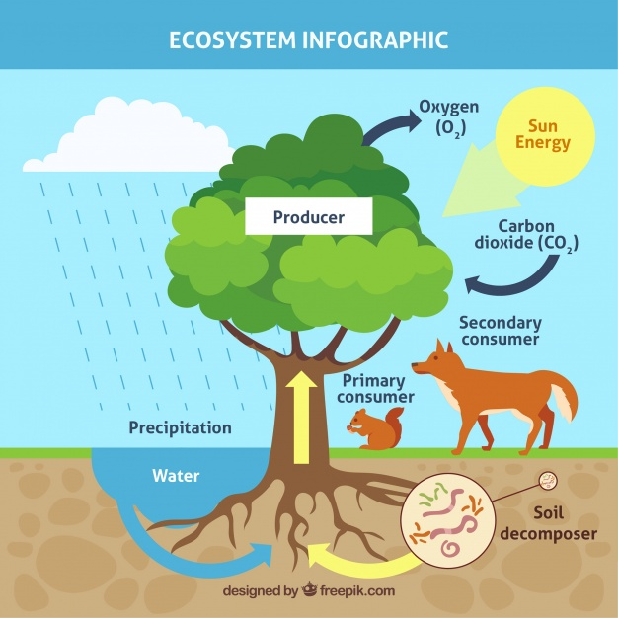
Econ 2675 – Environmental Economics Chapter 13 Lecture - Ecosystem Goods and Services: Nature’s Threatened Bounty

Slide 2
The State of Ecosystem Services
Millennium Ecosystem Assessment
Ecosystems have changed rapidly in the last 50 years.
Many of the changes to ecosystems have been at the expense of ecosystem health.
If degradation continues, it will be difficult to achieve many of the U.N. Millennium Development Goals.
Significant changes in institutions and policies are required to reverse the degradation.

Slide 3
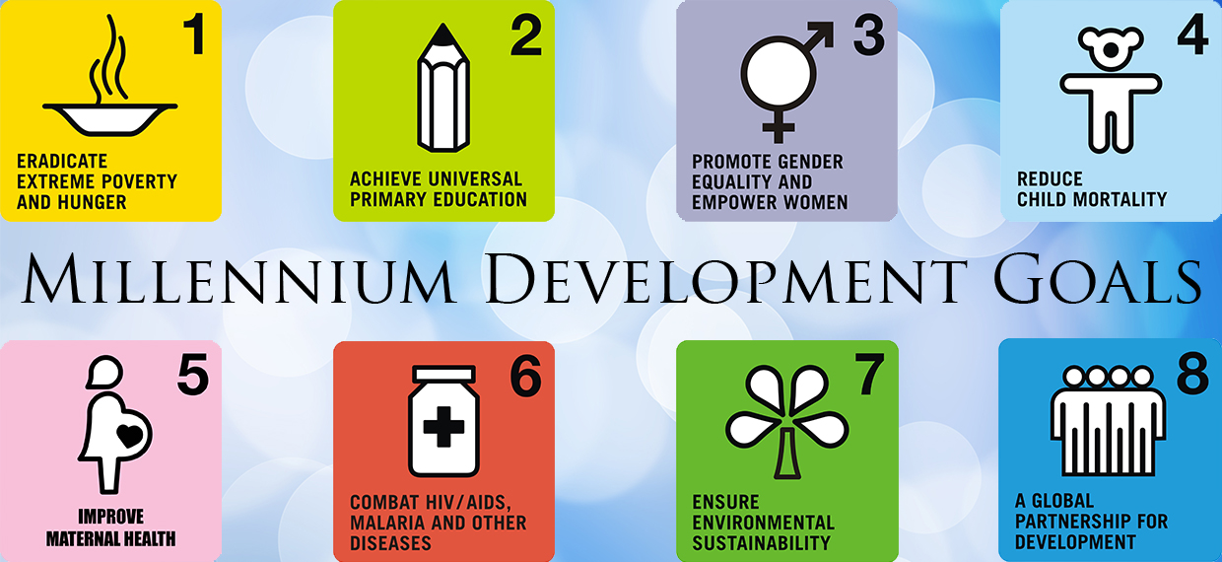

Slide 4
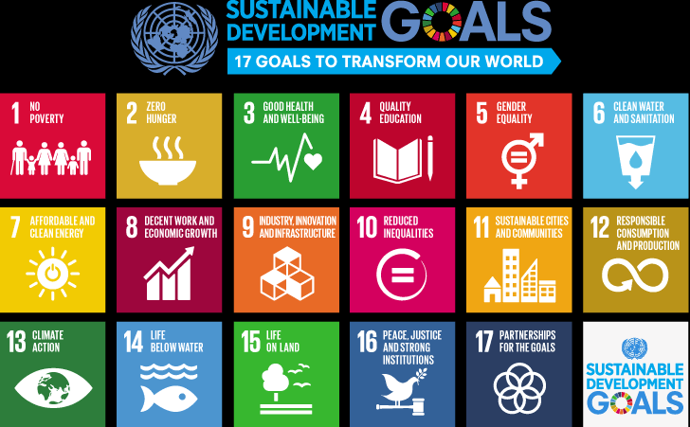

Slide 5
The State of Ecosystem Services
The Economics of Ecosystems and Biodiversity report
Examines the costs of inaction on the decline of biodiversity worldwide
Finds that by 2050 under several “business as usual” scenarios an additional 11 percent of remaining biodiversity could be lost, 40 percent of low-impact agriculture could be converted to intensive agriculture, and 60 percent of coral reefs could be gone by 2030.
http://www.teebweb.org/

Slide 6
Economic Analysis of Ecosystem Services
Economic analysis is helpful both in identifying sources of economic degradation and in evaluating possible approaches to maintain and restore these services.
Valuing service flows can also be useful in benefit cost analysis.
Commonly used methods:
Revealed preference methods
Stated preference methods
Adjusted market prices
Avoidance costs (averting expenditure)
Production function methods
Damage costs avoided

Slide 7
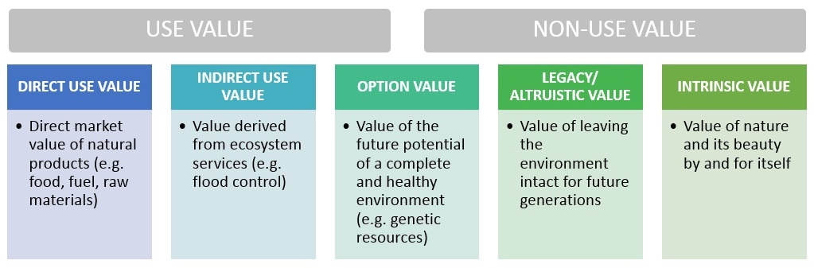

Slide 8
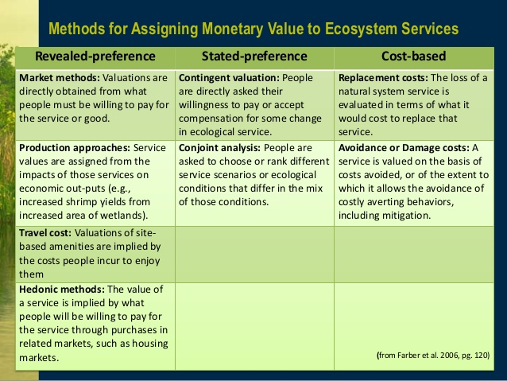
https://www.slideshare.net/maggiewinslow/ecosystem-service-valuation-winslow

Slide 9
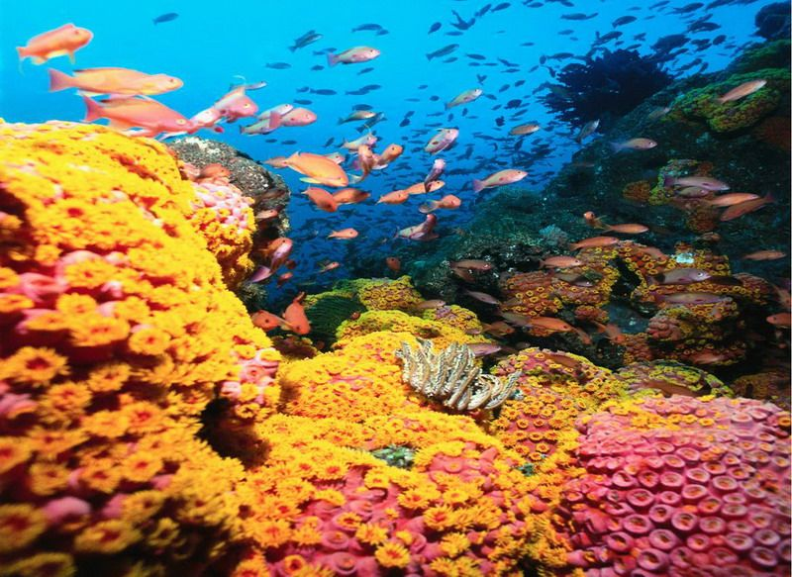
Coral Reefs
Coral reefs are an integral part of an extensive and vital landscape of coastal ecosystems.
Some of the threat to coral reefs is due to pollution, overfishing, climate change (specifically, rising water temperatures).
http://www.qatarmarine.net/diving-environment/marine-ecology/coral-reef-facts/

Slide 10
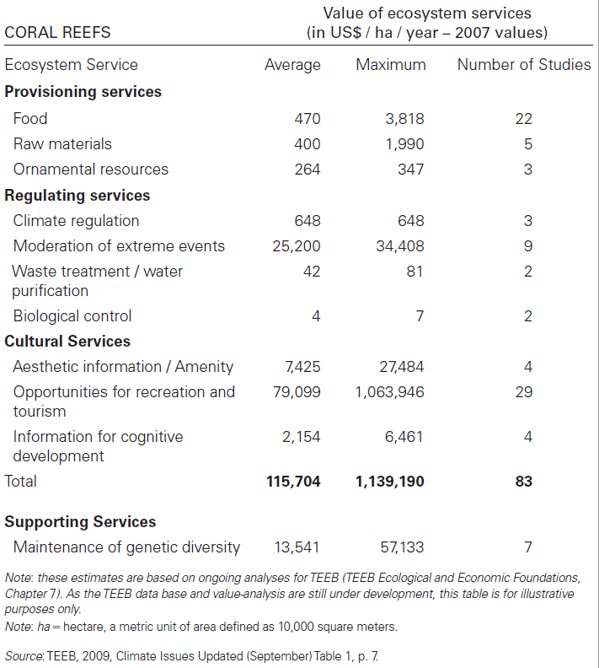
Benefits from ecosystem services in coral reef ecosystems

Slide 11
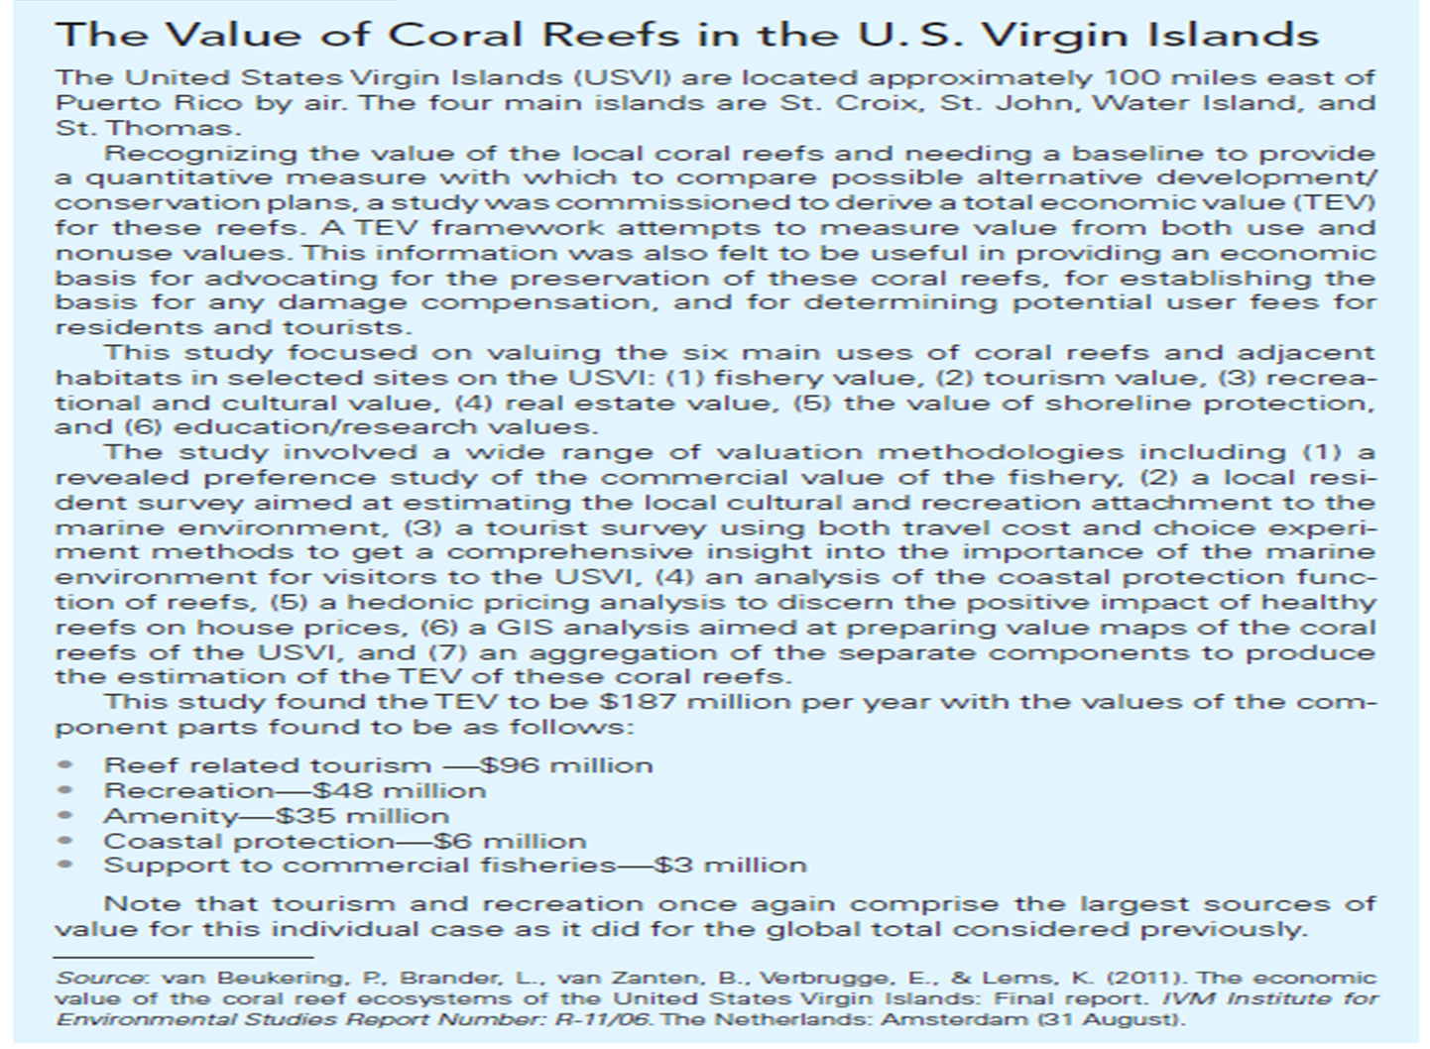

Slide 12
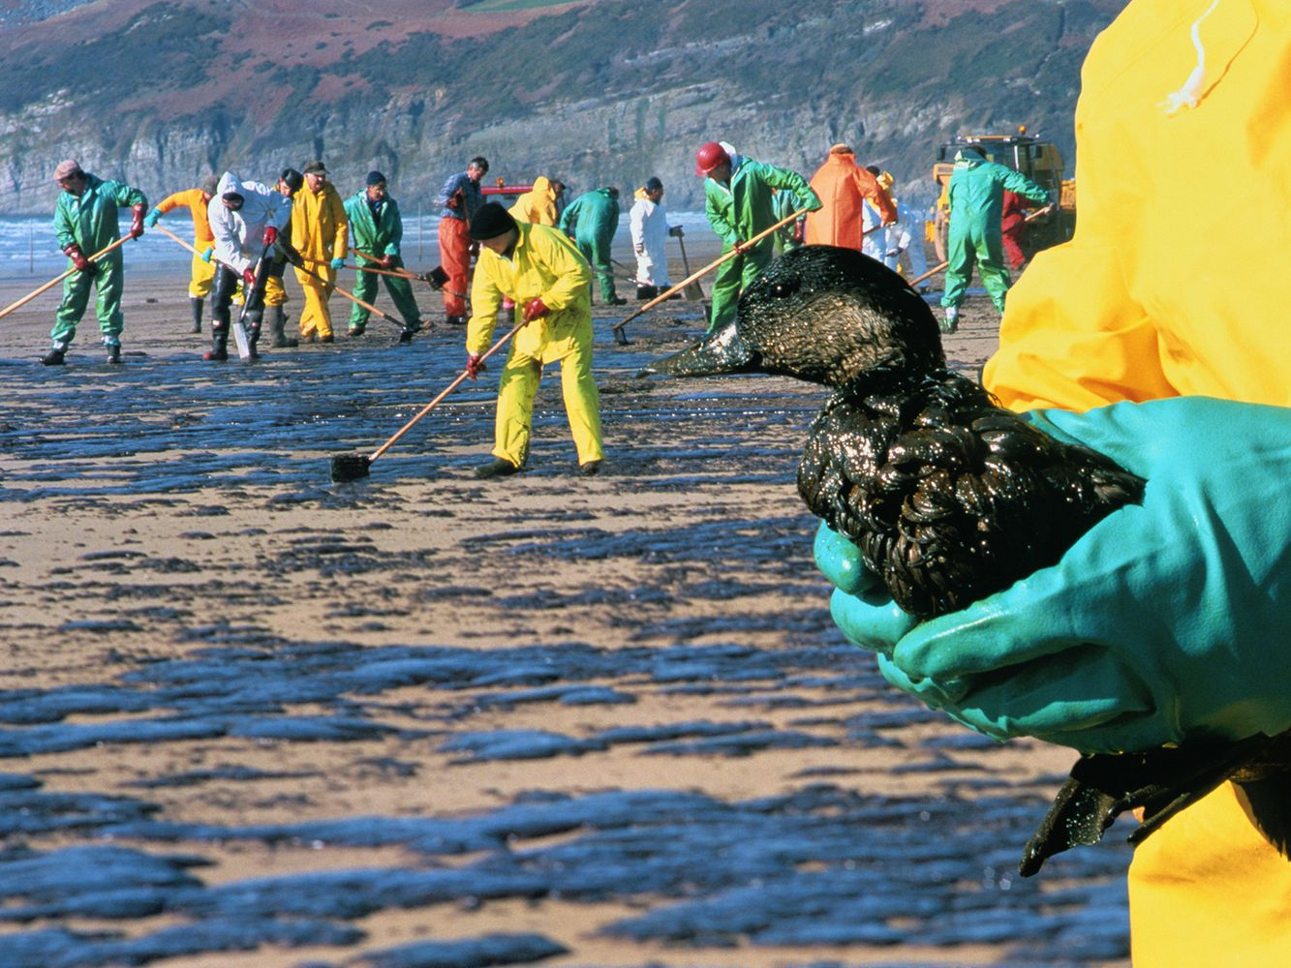
Demonstrating the Value of Ecosystem Services
Damage Assessments: Loss of Ecosystem Services
Oil spills: Through a process known as the Natural Resources Damage Assessment, trustees of the affected ecosystem must attempt to quantify the extent of damages caused by a spill in order to seek compensation from the responsible parties.

Slide 13
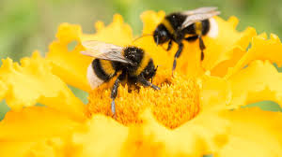
Demonstrating the Value of Ecosystem Services
Valuing Supporting Services: Pollination
Pollination services supplied by bees is a valuable ecosystem service with multiple benefits
Aiding in genetic diversity
Ecosystem resilience and nutrient cycling
Increasing the productivity of agricultural crops
Many valuable agricultural crops rely on bees for pollination.
https://royalsocietypublishing.org/doi/10.1098/rspb.2020.0922

Slide 14
Demonstrating the Value of Ecosystem Services
Valuing Supporting Services: Forests and Coastal Ecosystems
Valuation methods have been used extensively to value forest ecosystem services, coastal and marine ecosystem services, and biodiversity.
Quantifying the benefits of these services can provide an empirical foundation for decision-making and priority setting.

Slide 15
Demonstrating the Value of Ecosystem Services
Challenges and Innovation in Ecosystem Valuation
In order for valuations to be useful, their derivations must be based upon consistent methodologies.
Achieving this kind of consistency requires precise definitions of the services, as well as agreement of how these services contribute to value.
It also requires that the valuation procedures avoid double counting.

Slide 16
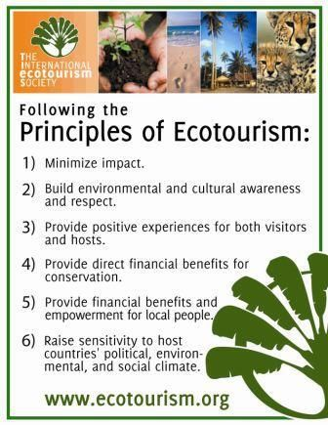
Ecotourism
Ecotourism is defined as: Environmentally responsible travel to natural areas, in order to enjoy and appreciate nature (and accompanying cultural features, both past and present) that promotes conservation, has a low visitor impact and provides for beneficially active socio-economic involvement of local peoples (Nature Conservancy and the World Conservation Union).

Slide 17
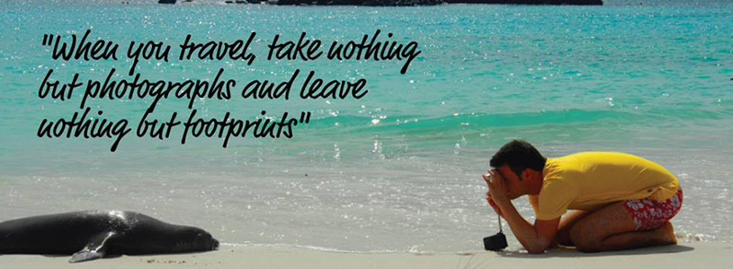
5. Galapagos Islands
In 1978, the Galapagos Islands were declared the first ever Natural World Heritage Site due to the amazing and unique fauna that call the archipelago home
6. Antarctica
Antarctica remains one of the least-touched places on Earth for obvious reasons — you can only even reach the landmass during the summer.
7. Iceland
Iceland has recently become a top tourist destination as it lures visitors in with its remote beauty. The country is the cleanest energy consumer in the world.
8. Amazon Rainforest
The Amazon has already suffered extremely from climate change and the encroachment of man, but some areas around the huge forest are aiming to change that by having native become guides to lead tourists around the forests in ways that are sustainable and even promote the health of the ecosystem.

Slide 18
8 Incredible Eco-Friendly Destinations In The World
Costa Rica - The country undoubtedly most associated with ecotourism, Costa Rica has made a name for itself as a travel destination because of its well-protected natural beauty.
Norway - Norway might not be a place that first comes to mind when thinking of ecotourism, but the country’s culture of trying to live sustainably has influenced its travel industry extensively — especially in the Norwegian Fjords.
Kenya - Kenya is one of the prime destinations to take an African safari due to its grasslands full of animals such as giraffes, lions, and rhinos.
Palau - Palau, an island nation in the western Pacific that is part of Micronesia, is known more for its oceans than for its land.

Slide 19
Galapagos Islands - In 1978, the Galapagos Islands were declared the first ever Natural World Heritage Site due to the amazing and unique fauna that call the archipelago home.
Antarctica - Antarctica remains one of the least-touched places on Earth for obvious reasons — you can only even reach the landmass during the summer.
Iceland - Iceland has recently become a top tourist destination as it lures visitors in with its remote beauty.
Amazon Rainforest - The Amazon has already suffered extremely from climate change and the encroachment of man, but some areas around the huge forest are aiming to change that by having native become guides to lead tourists around the forests in ways that are sustainable and even promote the health of the ecosystem

Slide 20
The Special Problem of Protecting Endangered Species
Economists have developed programs that attempt to reduce habitat fragmentation:
Conservation Banking
The Agglomeration Bonus
Safe Harbor Agreements
Conservation Banking
A conservation bank is a parcel of land containing natural-resource values that are conserved and managed, in perpetuity, through a conservation easement held by an entity responsible for enforcing the terms of the easement.

Slide 21
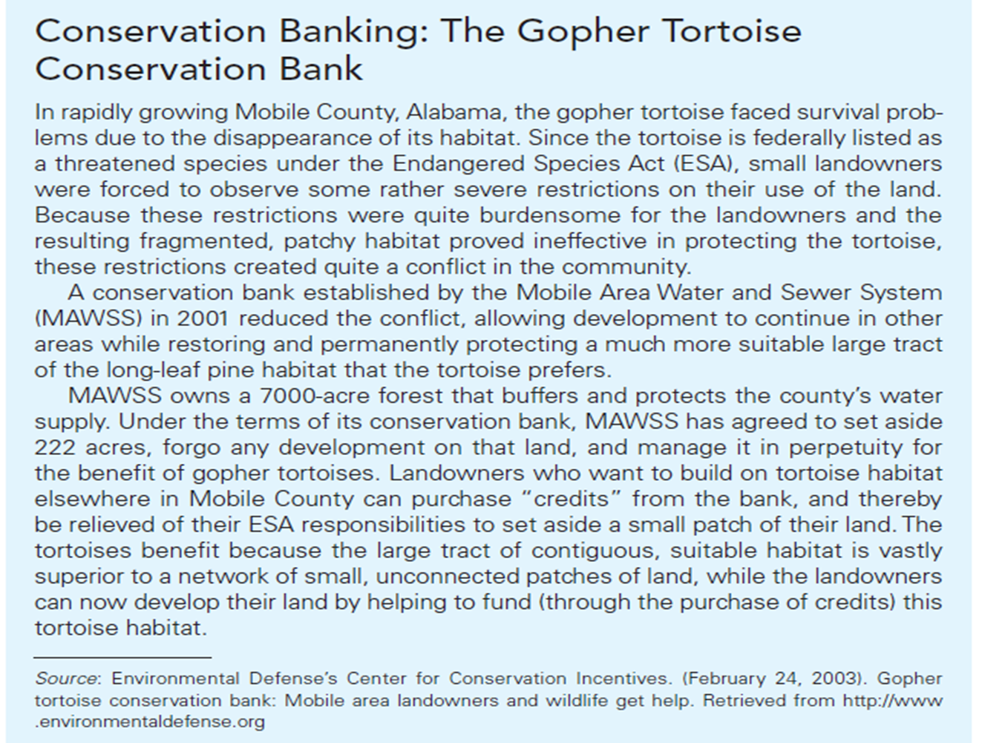

Slide 22
The Special Problem of Protecting Endangered Species
The Agglomeration Bonus
It is a voluntary incentive mechanism that is designed to protect endangered species and biodiversity by reuniting fragmented habitat across private land in a manner that minimizes landowner resistance.
Safe Harbor Agreements
Any landowner who agrees to carry out activities expected to benefit an endangered species is guaranteed that no added Endangered Species Act restrictions will be imposed as a result.

Slide 23
Moving Forward
In practice developing innovative mechanisms like payments for ecosystem services or carbon sequestration credits is challenging, especially in developing countries.
Performing economic analysis on ecosystem is a new subfield, and it is experiencing some growing pains, but early successes and new innovations indicate that its future is promising.

Slide 24
