Slide 1
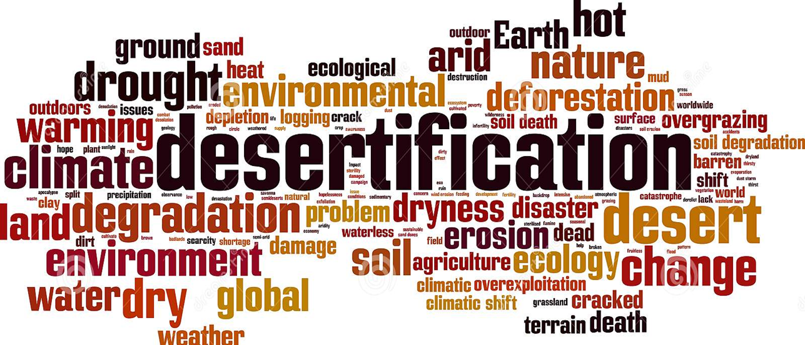
Econ 2675 – Environmental Economics Chapter 10 Lecture - A Locationally Fixed, Multipurpose Resource: Land

Slide 2
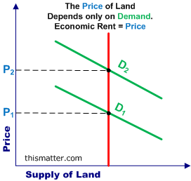
Economic Rent

Slide 3
The Economics of Land Allocation
Land Use
In general, markets tend to allocate land to its highest valued use.
The diagram on the next slide exhibits the relationship between net benefits and location to market places for three types of land uses.
A bid rent function expresses the maximum net benefit per acre that could be achieved by that land use as a function of the distance from the center.

Slide 4
The Allocation of Land

Slide 5
The Economics of Land Allocation
Land Use conversion
Conversion occurs whenever the underlying bid rent function shifts.
The U.S. and other countries has experienced rapid increase in urban land area over time.
Main sources of land conversion include:
Increasing urbanization and rapid industrialization
Rising productivity of the agricultural land

Slide 6
The Economics of Land Allocation
Agricultural Land: A Closer Look
Irrigated acreage has been rising.
The value if agricultural land should increase with the increased prices of food.
Corn and ethanol
Irrigated land faces challenges in growth.
Limited replenish water supply
Contamination of water
The Rise of Organic Food
The markets have not only been affected by shifts in agricultural land use, they have also been affected by the type of agricultural being practiced.
Organic cropland is the fastest growing sector.

Slide 7
Sources of Inefficient Use and Conversion
Sprawl and Leapfrogging
Sprawl occurs when land use in a particular area is inefficiently dispersed.
Leapfrogging refers to a situation in which new development continues not on the very edge of the current development, but further out.
The Public Infrastructure Problem: Inefficiently low internalized can create inefficient favors over more distant locations, such as low marginal cost of driving and free parking.

Slide 8
Sources of Inefficient Use and Conversion
Incompatible Land Uses
One traditional remedy is zoning
Zoning involves land use restrictions enacted via an ordinance by local government to create districts (zones) that establish permitted and special land uses.
One limitation of zoning is that it promotes urban sprawl.
Undervaluing Environmental Amenities
Net benefits from positive externalities may be undervalued by land owners. How does this affect the MB curves for the land?
One remedy involves direct protection of the assets by regulation or statute

Slide 9
Sources of Inefficient Use and Conversion
The Influence of Taxes on Land-Use Conversion
Taxes can create incentives to convert land from one use to another, even when such conversions would not be efficient.
The Property Tax Problem
A property tax has two components: the tax rate and the tax base. The tax base is determined by either the market value or an assessor.
When this tax does not reflect the current activity’s use funded by the revenue from that tax, a bias can be created against land-intensive activities.
Considering the estate tax, tax-driven liquidity might dominate land conversion, instead of efficiency consideration

Slide 10
Sources of Inefficient Use and Conversion
Special Problems in Developing Countries
Insecure Property Rights
Lack of clear property rights can introduce both efficiency and equity problems.
The Poverty Problem
Poverty may constrain choices of sustainable use of land.
Government Failure
It occurs when the public policies have the effect of distorting land use allocation.

Slide 11
Innovative Market-Based Policy Remedies
Conservation Easements
It is a legal agreement between a landowner and private or public agency that limits uses of the land in order to protect its conservation value.
Conservation easements can be either sold or donated.
It allows the bundle of rights to be treated as separable transferable units.
Land Trusts
A conservation land trust is a nonprofit organization that actively works to conserve land using a variety of means.
A community land trust focuses on using land for housing and community service, rather than land conservation.

Slide 12
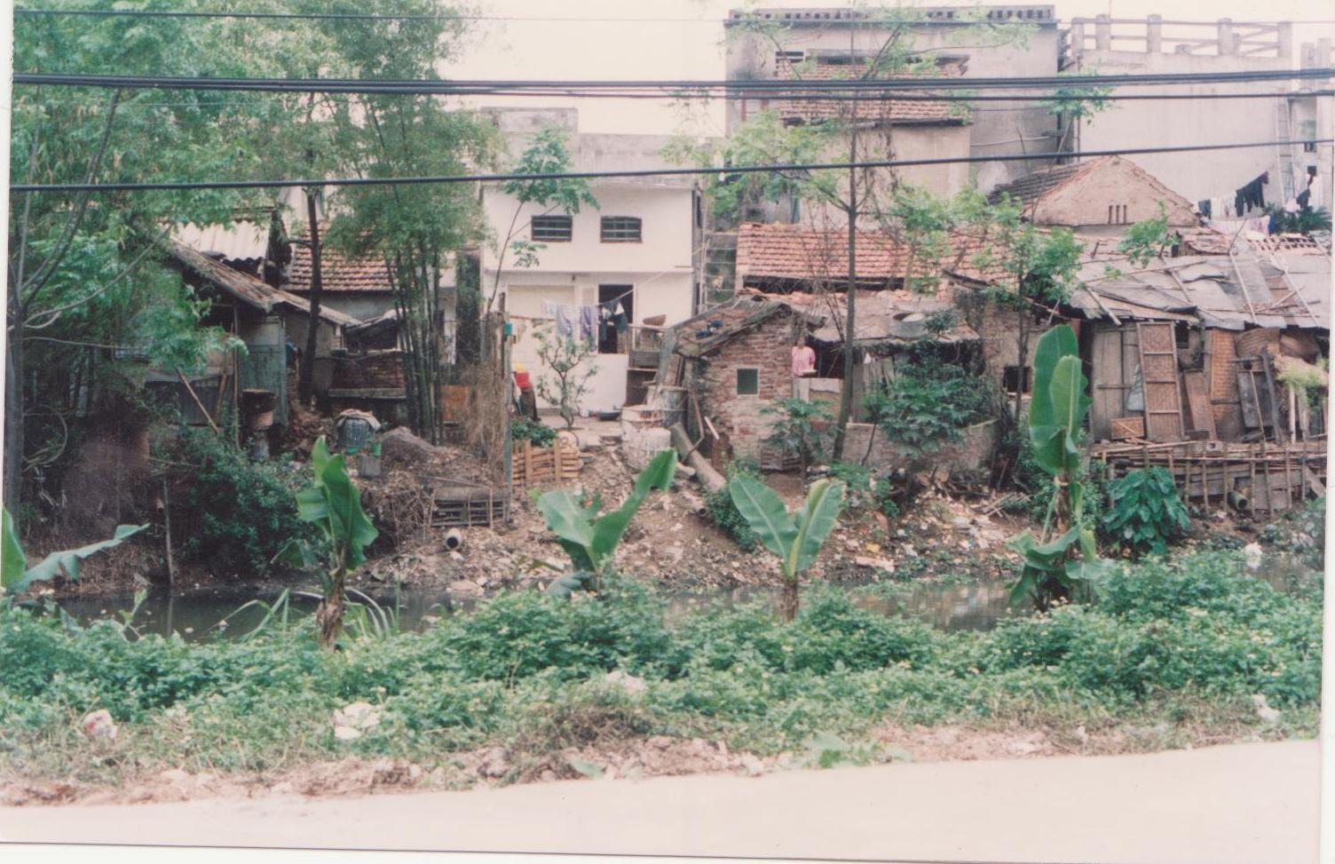
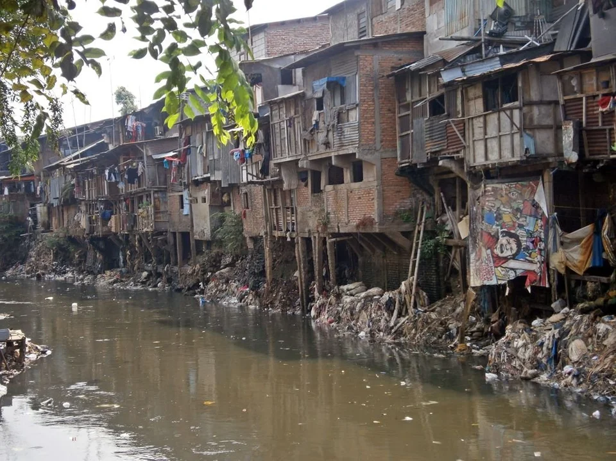
Environmental Problems of Modern Cities

