Slide 1

Environmental Impact of Land Mining in Ukraine
Presented by
Mariia Sorokina

Slide 2

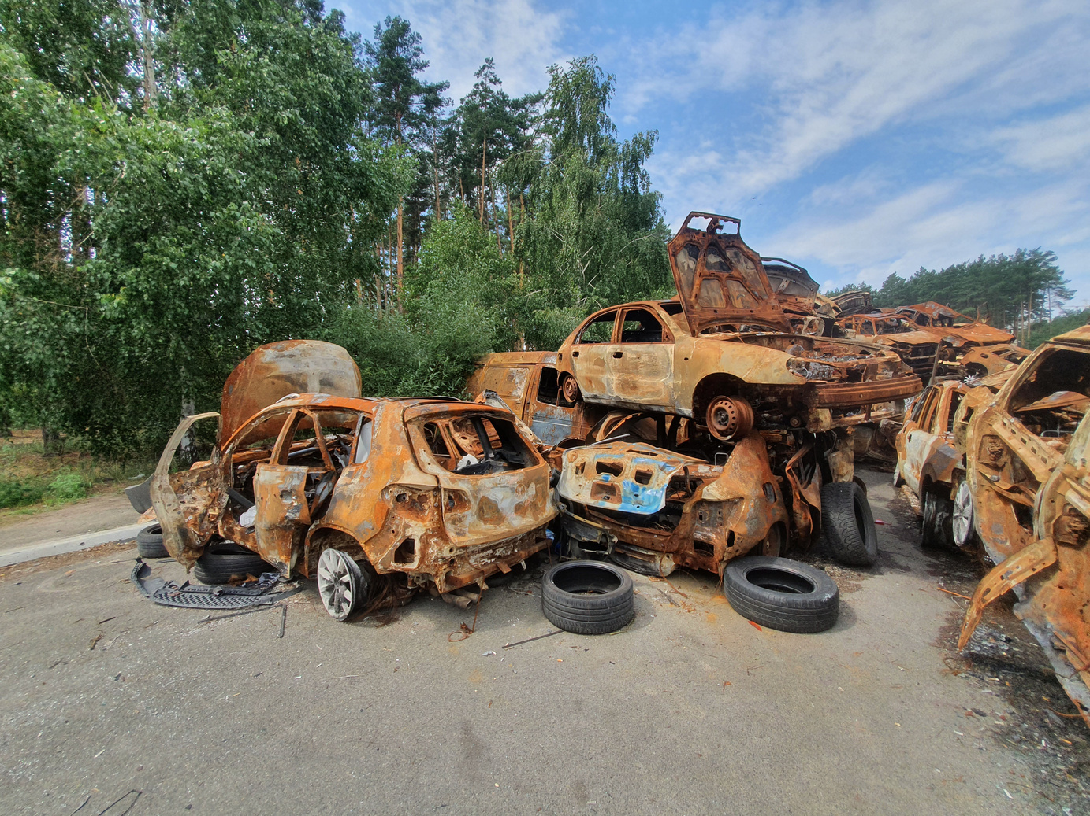
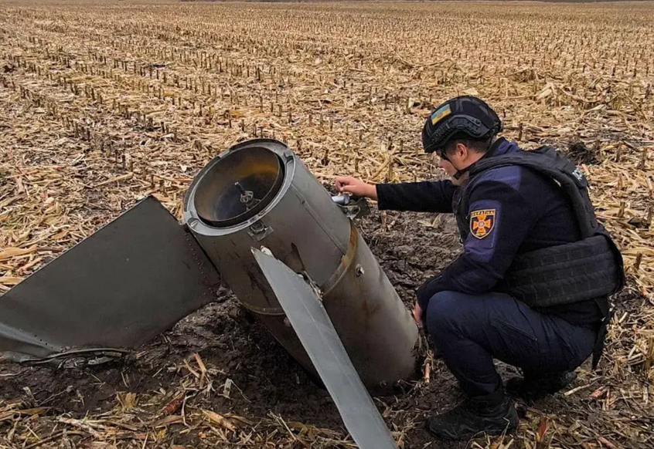
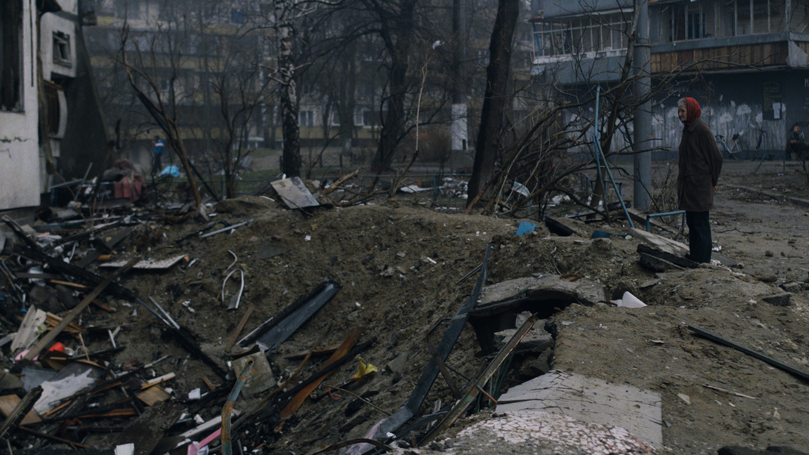
Beyond human losses and infrastructure damage, the war in Ukraine has severely harmed the environment
The war has resulted in:
  soil and water contamination
  destruction of ecosystems
  pollution from shelling
  contamination of Ukraine’s territory with mines and unexploded ordnance

Slide 3


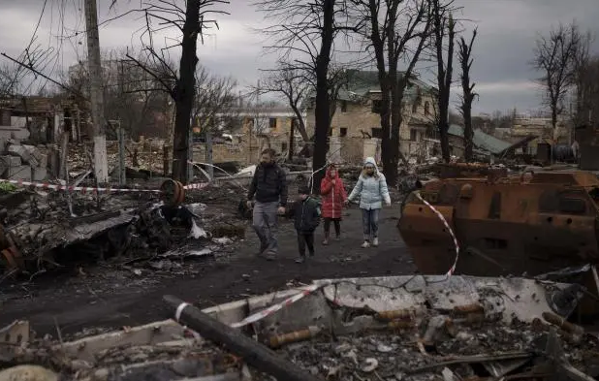
Ukraine is now the most mined country in the world
Landmines outlive wars, leaving people, land, and nature trapped in danger:
  137,058 km² contaminated by mines/UXO (≈ 20% of Ukraine’s territory)
  6+ million people live in or near contaminated areas
  800+ casualties documented from unexploded ordnance
  36,942 km² cleared
Interactive map of demining activities in Ukraine

Slide 4
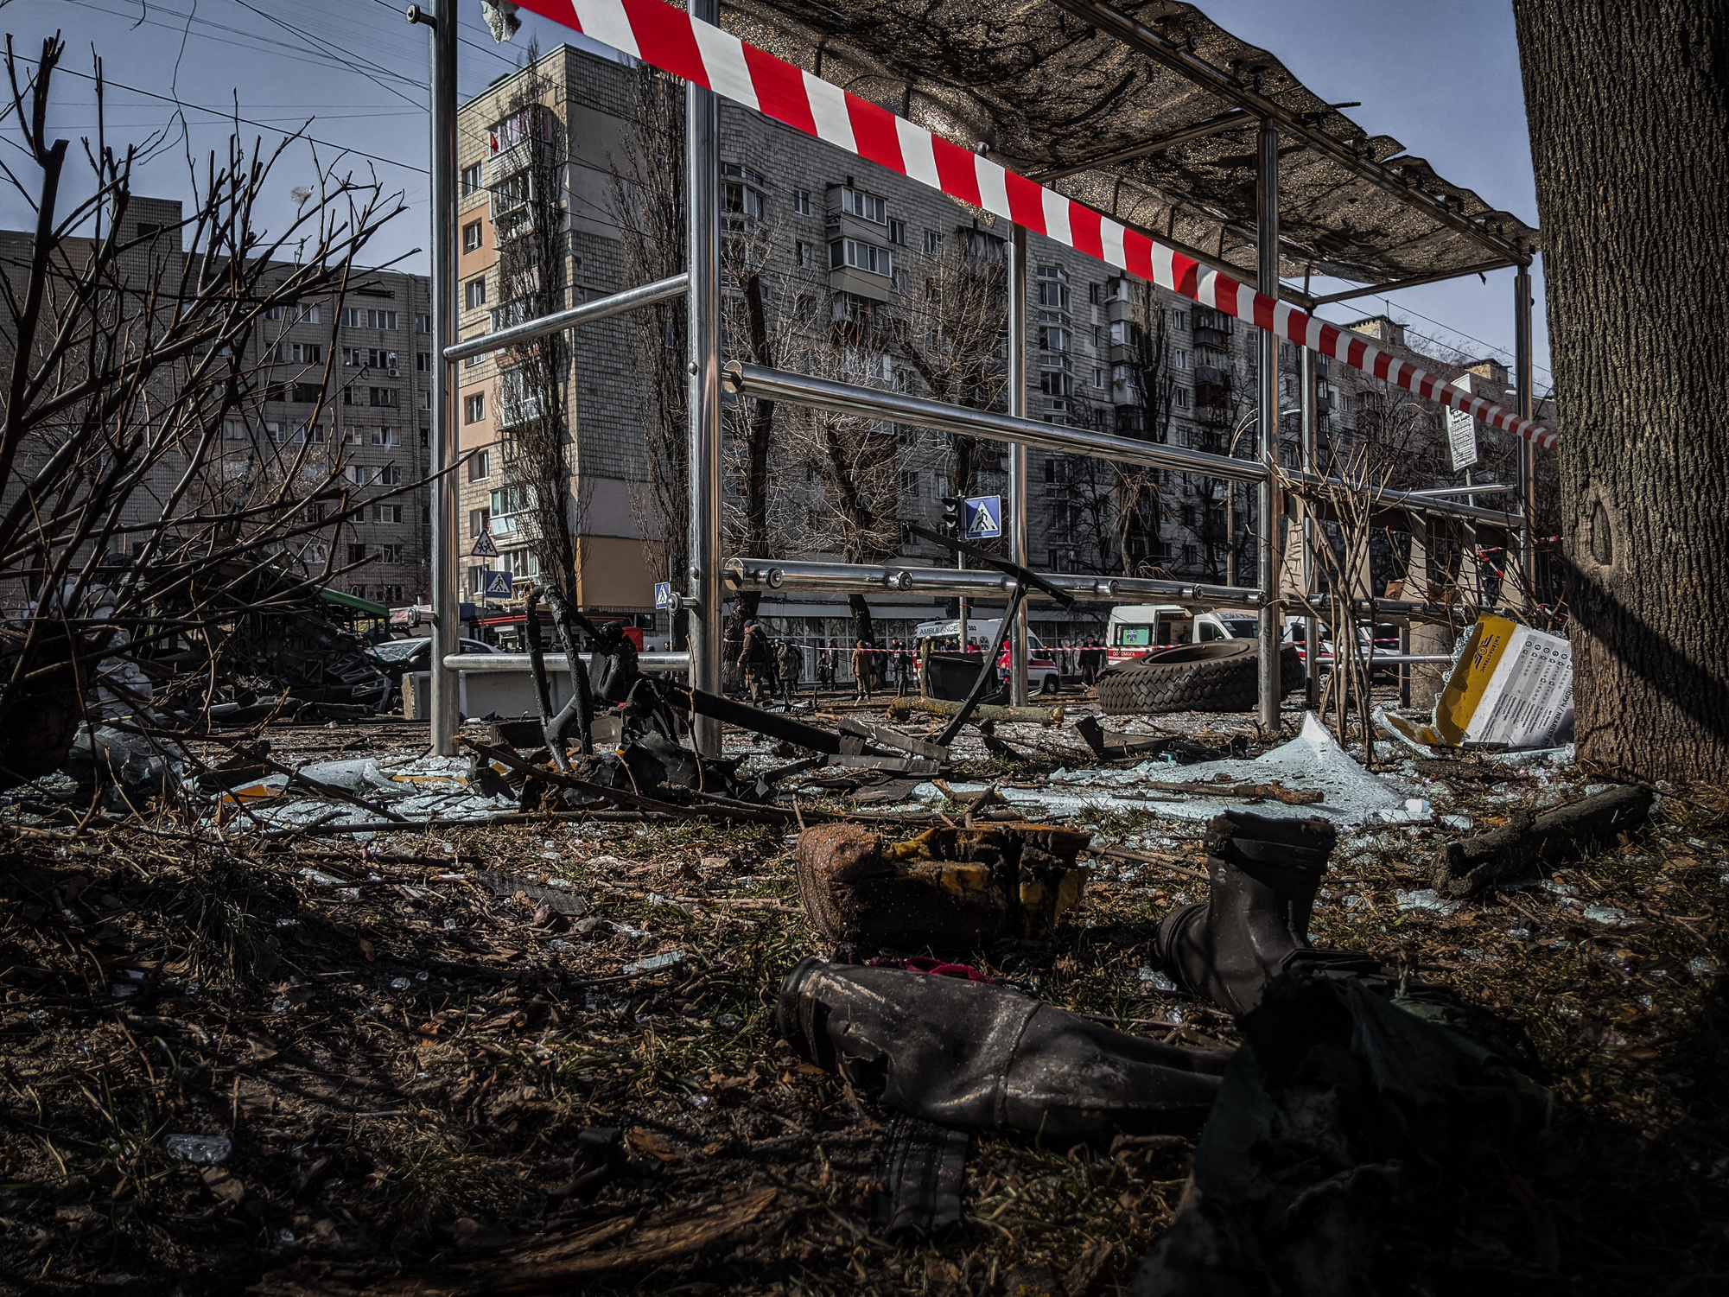
Landmines severely damage the environment and threaten sustainable development
Key Environmental Problems:
  access denial – land becomes unsafe for farming, water, or conservation
  loss of biodiversity – wildlife and plants are being destroyed, natural habitats are disappearing
  micro-relief disruption – mining leads to soil cratering, compaction, and erosion
  chemical contamination – toxic explosives and heavy metals pollute soil and water
  loss of productivity – agricultural land degrades, reducing food security

Slide 5
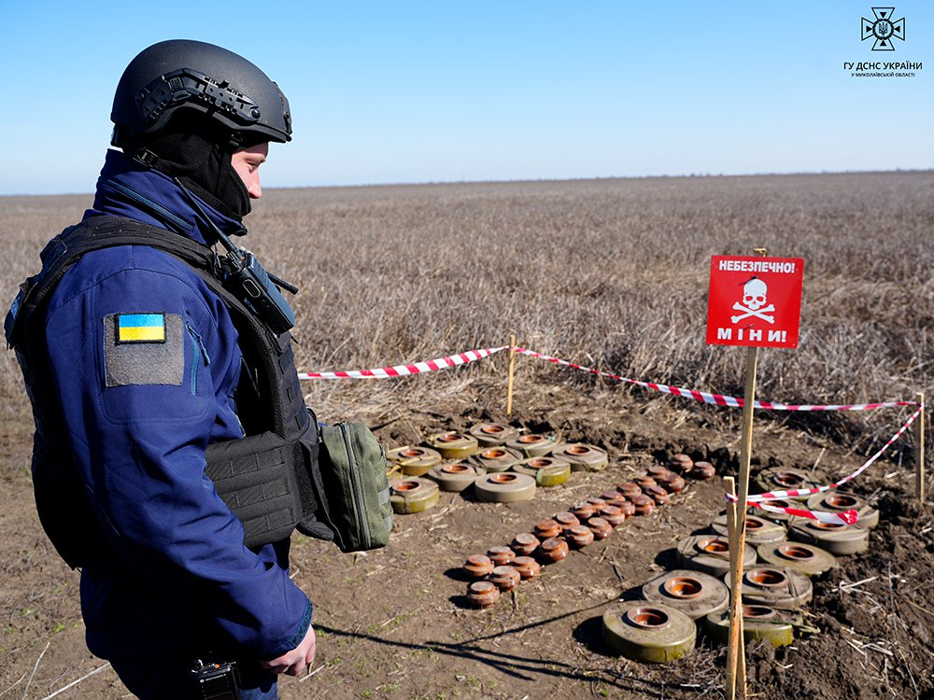
Landmines in Ukraine led to a long-term ecological disaster
The Ukraine War Environmental Consequences Work Group has identified the main negative impacts of landmines in Ukraine:
  sheer scale of contamination (26–33% of Ukraine’s land contaminated), demining can take up to 750 years
  loss of fertile farmland (~30% of arable land inaccessible) and tourism regions
  spread of invasive species
  damage to protected areas
  unique crises like marine mines in the Black Sea and the Kakhovka dam disaster, which created buried and waterborne minefields

Slide 6
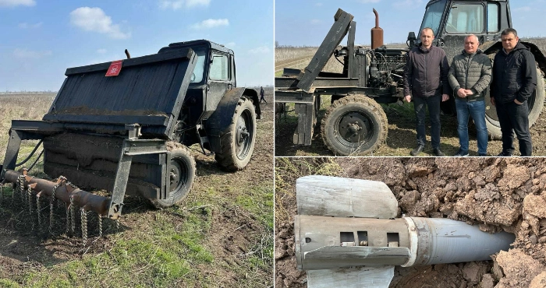
Ukraine’s partial shutdown of key agricultural/rural economic activity harms global food security
Unmanned tractor for mine detection: farmers in Mykolaiv region are restoring fields
Approximately 28,000 km² of farmland has been abandoned due to landmines and warfare
Wheat production has fallen by ~41%, coarse grain by ~37% from 2021–22 to 2024–25

Slide 7
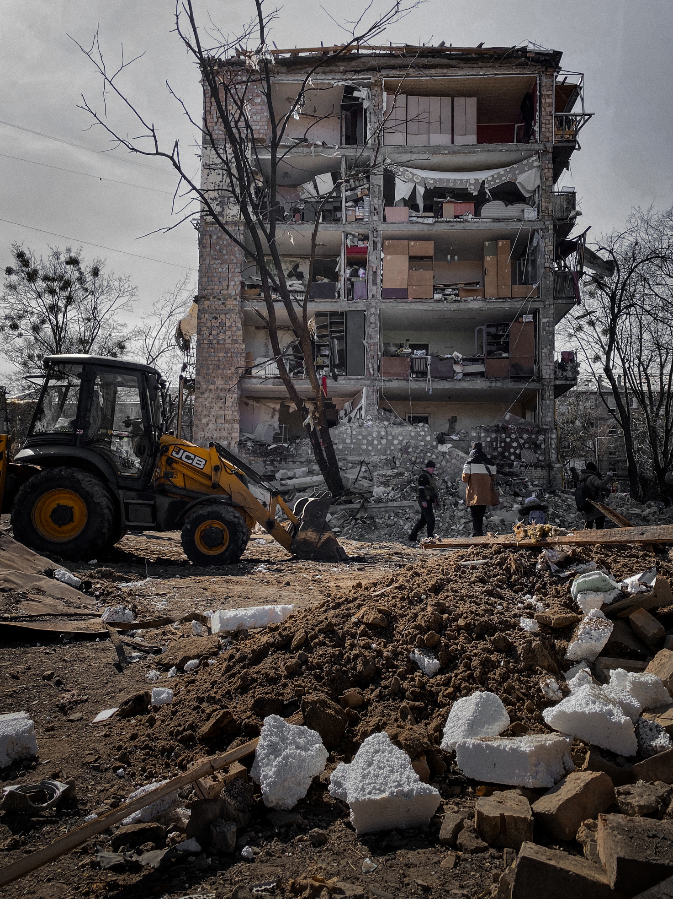
Landmining has negative economic impact
The Tony Blair Institute for Global Change conducted an assessment of the resulting economic losses:
  mines and ERW reduce Ukraine’s GDP by $11.2B annually (≈5.6% of 2021 GDP)
  economic output in affected regions (Kharkiv, Mykolaiv, Sumy, Chernihiv) is down by over 20%
  exports fall by about $8.9B each year, mainly due to disrupted agricultural trade
  regional tax revenues decline by $1.1B annually as activity slows in mined areas

Slide 8
Ukraine has been addressing the landmine problem through fieldwork, policy measures, and international cooperation
  the Ukrainian government approved a National Mine Action Strategy until 2033
  Demine Ukraine, a national mine action platform was developed by Ukraine’s Ministry of Economy
  over the last year, the scope of humanitarian mine clearance has increased by nearly 50%, and 36,942 km² have been cleared in the past two years
  the UNDP in Ukraine is leading a five-year mine action project

Slide 9

However, Ukraine faces immense challenges in its demining efforts
  landmines, IEDs, and booby-traps affect vast areas
  ongoing fighting and occupied areas prevent safe demining
  bureaucracy and slow adoption of standards hinder demining efforts
  few certified deminers and limited tools are available
  heavy reliance on international aid leaves programs underfunded

Slide 10
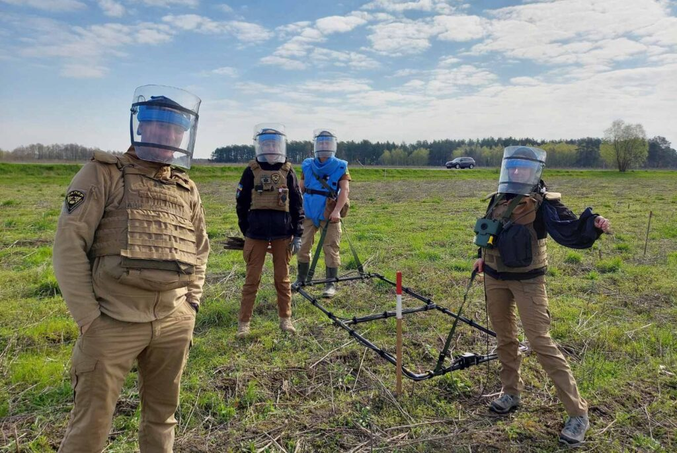
At the same time, Ukraine’s urgent demining needs drive technological innovation
  Ministry of Defense develops a modern testing ground for new demining technologies
  artificial intelligence and machine learning are used for automatic minefield recognition and planning
  satellite and aerial imagery is utilized to map contaminated areas more accurately
  Palantir AIP platform integrates economic, human, and geographic data to prioritize areas for clearance

Slide 11


Conclusions
  landmines and explosive remnants severely threaten Ukraine’s environment, agriculture, and economy
  millions of people remain at risk, with thousands of square kilometers contaminated and ongoing civilian casualties
  Ukraine’s response combines national strategy, innovative technologies, and broad international collaboration
  demining will be a long-term, resource-intensive process requiring continued innovation, coordination, and funding

Slide 12
Bibliography
BBC News Ukraine. “How Many People Died in the Flooding in Kherson Region: Everything We Know so Far - BBC News Ukraine,” June 8, 2023. https://www.bbc.com/ukrainian/news-65838691.
Berhe, A. A. “The Contribution of Landmines to Land Degradation.” Land Degradation & Development 18, no. 1 (January 2007): 1–15. https://doi.org/10.1002/ldr.754.
Demine.gov.ua. “Demine Ukraine,” 2024. https://demine.gov.ua/en.
Demine Ukraine. “Palantir Will Help Ukraine Clear Mines Using AI: A Pilot Project Has Already Been Launched in the Kharkiv Region.” Demine.gov.ua, 2024. https://demine.gov.ua/news/palantir-dopomozhe-ukraini-rozminovuvaty-terytorii-z-vykorystanniam-shi-pilot-uzhe-zapustyly-na-kharkivshchyni.
Institute.global. “From Economic Recovery to Global Food Security: The Urgent Need to Demine Ukraine.” Tony Blair Institute, September 10, 2024. https://institute.global/insights/geopolitics-and-security/the-urgent-need-to-demine-ukraine.
Mod.gov.ua. “Ministry of Defense Initiates Creation of Testing Ground for New AI-Based Demining Technologies | Ministry of Defense News,” February 11, 2025. https://mod.gov.ua/news/minoboroni-inicziyuye-stvorennya-poligonu-dlya-testuvannya-novih-tehnologij-rozminuvannya-z-vikoristannyam-sh-i.
Mod.gov.ua. “Over the Year, the Scope of Humanitarian Demining in Ukraine Has Increased by 50% | MoD News,” June 13, 2025. https://mod.gov.ua/en/news/over-the-year-the-scope-of-humanitarian-demining-in-ukraine-has-increased-by-50.
On the approval of the National Mine Action Strategy for the period up to 2033 and the approval of the operational plan of measures for its implementation in 2024–2026 (n.d.). https://www.kmu.gov.ua/npas/pro-skhvalennia-natsionalnoi-stratehii-protyminnoi-diialnosti-na-period-do-2033-roku-ta-zatverdzhennia-t280624
Ukraine War Environmental Consequences Work Group – Seeking solutions through information sharing about the environmental impacts of the war. UWEC Work Group. “Обережно, міни: що означає замінування територій для довкілля? – Ukraine War Environmental Consequences Work Group,” November 18, 2024. https://uwecworkgroup.info/uk/danger-mines-the-terrible-environmental-and-human-cost-of-ukraines-minefields/.
Ukrainian Energy. “Humanitarian Demining in Ukraine: A 30-Year Problem.” Ukrainian Energy. Ukrainian Energy, 2025. https://ua-energy.org/uk/posts/humanitarne-rozminuvannia-ukrainy-problema-na-30-rokiv.
UN News. “‘It Is an Elephant’: Ukraine’s Unexploded Mine Problem,” June 5, 2025. https://news.un.org/en/story/2025/06/1164121.
UNDP. “Mine Action Project in Ukraine,” 2025. https://www.undp.org/uk/ukraine/projects/proyekt-protyminnoyi-diyalnosti-v-ukrayini.
Unn.ua. “In the Kyiv Region, a Farmer Found Fragments of an S-300 Missile in the Middle of a Field.,” 2025. https://unn.ua/news/na-kyivshchyni-fermer-posered-polia-znaishov-ulamky-rakety-s-300.
Yulia Vinnik. “Unmanned Tractor for Mine Detection: How Farmers in Mykolaiv Region Are Restoring Fields after the Russians.” Rayon.in.ua, April 11, 2024.
https://bashtanka.rayon.in.ua/topics/695698-traktor-bezpilotnik-dlya-poshuku-min-yak-agrarii-mikolaivshchini-vidnovlyuyut-polya-pislya-rosiyan.

