Slide 1
Syria’s Most Serious Environmental Concern: Drought
By Yasser Sakbani
Notes:
Good [afternoon], everyone.
My presentation is about Syria’s most serious environmental concern: drought.
I chose this issue because it is not just an environmental problem، but one that has deeply shaped Syria’s economy, rural society, and even its political stability.

Slide 2
Introduction
Why focus on Syria?
Drought as recurring, severe issue
Impact beyond environment → economy, migration, conflict
Notes:
Syria faces many environmental challenges, but drought stands out as the most urgent after climate change.
Agriculture employed about 17% of the labor force pre-war and fed over half the population.
Drought has a multiplier effect: it damages food supply, rural livelihoods, and increases migration pressure.

Slide 3
Background
Semi-arid climate
Rainfall highly variable
Agriculture ≈ 25% of pre-war GDP
Rural population dependence on water resources
Notes:
Syria’s climate is semi-arid, which means that rainfall is naturally limited and very uneven.
Before the war, agriculture made up about 25% of Syria’s GDP, so the economy relied heavily on farming.
Millions of Syrians in rural areas depended directly on rain-fed agriculture and livestock herding.
This heavy dependence meant that even small shifts in rainfall could have big consequences for food production and rural livelihoods.

Slide 4
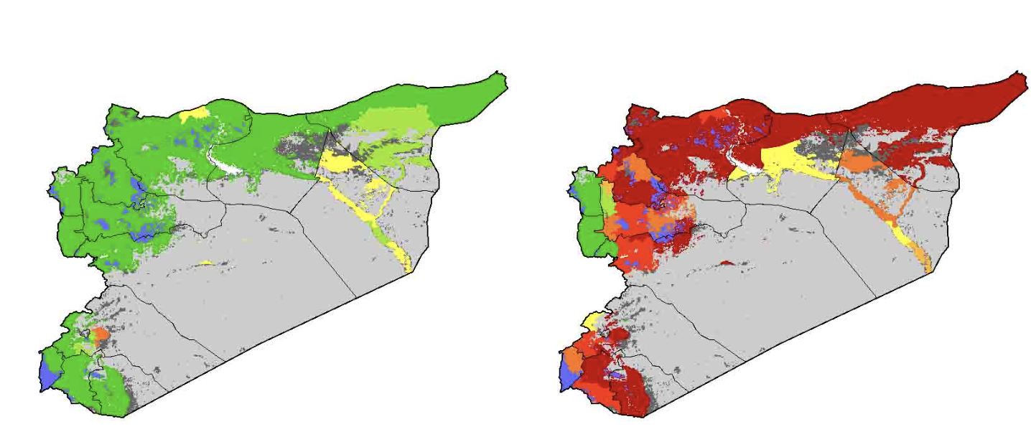
Left map: Syria’s land cover before severe drought
Right map: Land degradation and drought impact
Northeast “breadbasket” region hit hardest
Large areas of green (productive) → turned red (degraded)
Loss of agricultural land = collapse of wheat and barley
Notes:
This map is one of the clearest visual representations of how drought transformed Syria’s landscape.
On the left side, you see areas of fertile and cultivated land in green, especially in the northeast, Syria’s agricultural heartland.
On the right side, those same regions are marked in red, showing land degradation and severe drought impact.
Notice how the northeast, often called Syria’s “breadbasket,” was hit hardest. This region normally produces most of Syria’s wheat — but during the drought, harvests fell by almost half.
The loss of farmland didn’t just mean less food; it meant rural families lost their entire source of income, which forced many to migrate into cities.
This map helps us visualize the scale of environmental change and why the drought was such a turning point for Syria’s economy and society.

Slide 5
The Drought Crisis (2006–2010)
Worst drought in 40 years
Rainfall ↓ 50% in northeast ‘breadbasket’
Wheat and barley crops collapsed
1.3 million people severely affected
Notes:
Rainfall dropped by up to 66% in some northeastern governorates.
Wheat harvests fell from 4 million tons in 2006 to 2.1 million tons in 2008.
Livestock herds declined by nearly 80% in the hardest-hit provinces.
Around 1.3 million people were severely affected, and 800,000 lost their income entirely.

Slide 6
Consequences of the Drought
Crop failures → food insecurity
Livestock herds decimated
Rural → urban migration (~1.5 million displaced)
Exacerbated social & political tensions pre-2011
Notes:
Food prices doubled in many rural markets between 2007 and 2009.
An estimated 1.5 million rural residents migrated to urban areas, straining services in Aleppo, Damascus, and Homs.
Malnutrition rates among children in the northeast rose from 2% to 12% between 2007–2009.
The drought worsened economic inequality and deepened resentment toward the state

Slide 7
Current Situation
Ongoing water scarcity
Conflict damaged irrigation systems
Climate change intensifying extremes
Dependency on rain-fed agriculture persists
Notes:
By 2020, over 50% of irrigation infrastructure had been damaged or destroyed by the conflict.
Groundwater extraction has exceeded sustainable recharge rates, with aquifers dropping by 20–30 meters in some areas.
Syria now imports much of its wheat; in 2021, 1.5 million tons were imported to meet domestic demand.
Climate change projections suggest drought frequency will increase by 25% by mid-century in the Fertile Crescent

Slide 8
Government & Policy Response (Pre-war)
Limited investment in sustainable irrigation
Over-reliance on groundwater extraction
Weak drought preparedness policies
Aid distribution criticized as politicized
Notes:
The government subsidized wheat and cotton, leading to over-cultivation and unsustainable water use.
Between 1990–2007, groundwater extraction increased by over 50% due to unchecked well drilling.
Drought policies were reactive, emergency aid rather than long-term planning.
Aid distribution was criticized: 2009 UN reports showed only 40% of targeted rural households received support.

Slide 9
International and Humanitarian Response
FAO & UNDP drought resilience projects
NGO-led water and irrigation programs
Post-2011: humanitarian relief dominates
Recent focus: early-warning systems + adaptation
Notes:
FAO and UNDP invested in drought-resilient seeds and small-scale irrigation projects.
WFP provided food aid to 150,000 households in northeast Syria by 2010.
After 2011, humanitarian efforts shifted, in 2022, over 12 million Syrians were food insecure, the highest ever.
Recent focus is on building early warning systems and water recycling projects in safer regions.

Slide 10

Challenges to Addressing Drought
Conflict and political instability
Infrastructure destruction
Lack of institutional capacity
Regional water-sharing disputes (Euphrates, Tigris)
Notes:
As of 2021, 70% of Syrians lacked reliable access to safe drinking water (UN OCHA).
Power shortages mean many pumping stations cannot function.
Regional conflict: Turkey controls much of the Euphrates flow, and in 2020 reduced releases by 60%, hitting northeast Syria hardest.
Without regional cooperation, water scarcity will worsen regardless of local reforms.

Slide 11
Conclusion
Drought = Syria’s most serious environmental concern
Affects food, economy, migration, stability
Solutions require: Sustainable water management, International cooperation, Stronger local institutions
Notes:
Drought is Syria’s most serious environmental challenge because of its cascading impacts.
It devastated food systems, displaced communities, and fueled existing grievances.
Solutions require:
Sustainable water management (drip irrigation, aquifer protection).
International cooperation over shared rivers.
Stronger institutions that can implement long-term adaptation plans.

Slide 12
References
Gleick, 2014 – Water, drought & conflict in Syria
Kelley et al., 2015 – Climate change in Fertile Crescent
FAO, 2010 – Syrian drought response plan
UN OCHA – Humanitarian response in Syria
De Châtel, 2014 – Drought & Syrian uprising
Notes:
I drew on both academic sources and reports from international organizations.
Key studies highlight the drought’s impact on migration, food security, and conflict risk.
These include Gleick (2014), Kelley et al. (2015), FAO’s 2010 drought response plan, UN OCHA reports, and De Châtel (2014).

