Slide 1
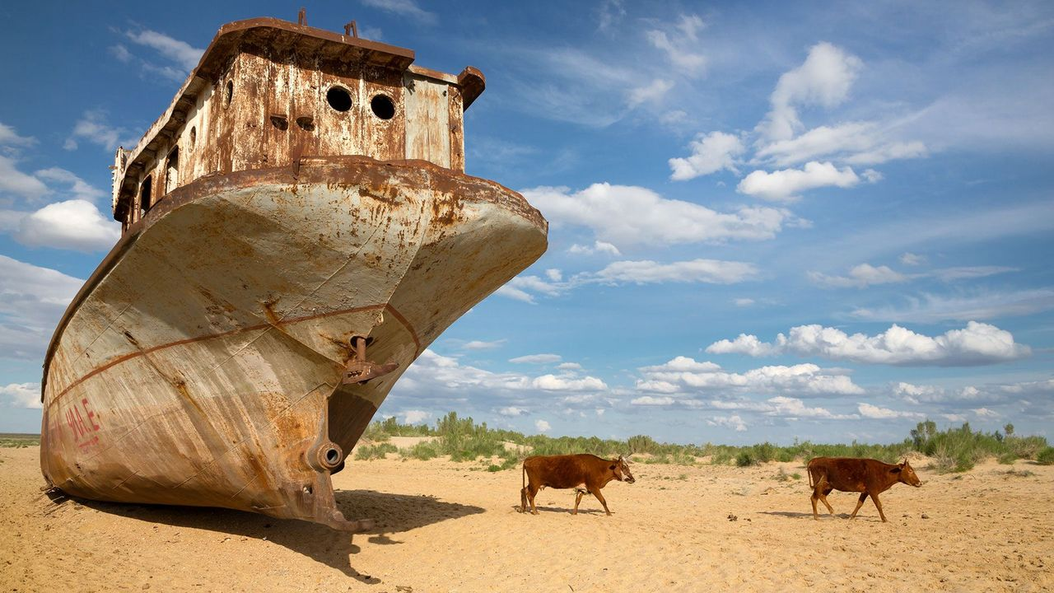
Aral Sea
The Aral Sea Disaster: Uzbekistan’s Defining Environmental Crisis
ECON 2675
Notes:
Today we will examine the Aral Sea disaster, one of the most severe man-made environmental collapses in modern history. We will focus on Uzbekistan, where the consequences are most visible, and interpret the crisis through environmental economics: distorted incentives, externalities, inefficient allocation of resources, and long-run welfare losses. In my analysis I will connect ecological outcomes directly to economic frameworks

Slide 2
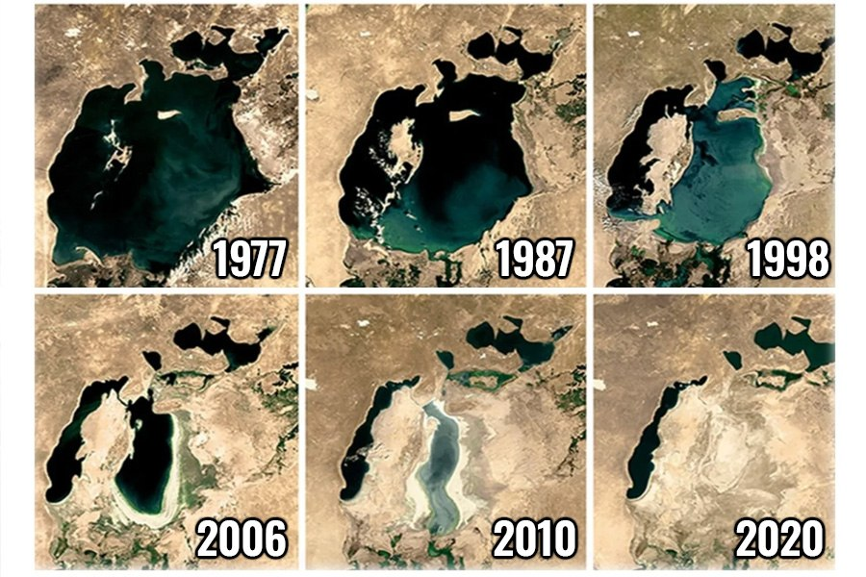
Introduction
Aral Sea (1960): 68,000 km², 1,100 km³ volume
By 2010: lost 90% of volume, 85% surface area
Classic case of resource misallocation
Soviet “white gold” cotton strategy
Amu Darya & Syr Darya rivers diverted: >90% inflow loss
Water price = $0 → open-access exploitation
Notes:
In the 1960s, the Aral Sea covered 68,000 square kilometers, with a water volume of around 1,100 cubic kilometers. By 2010, it had lost nearly 90% of its water. This isn’t simply environmental change; it’s the result of human choices. Economically, it illustrates resource misallocation — water was reallocated to maximize cotton output without accounting for its full opportunity cost. The result was an ecological and economic collapse.
The Soviet Union prioritized cotton, known as ‘white gold,’ for hard currency exports. To irrigate massive cotton fields, the Amu Darya and Syr Darya rivers were diverted, reducing inflows to the Aral Sea by over 90%. Water was priced at zero, treated as a free good. Without pricing or property rights, demand was unconstrained. Marginal benefits were considered, but marginal costs — environmental, social, and long-term economic — were ignored.

Slide 3
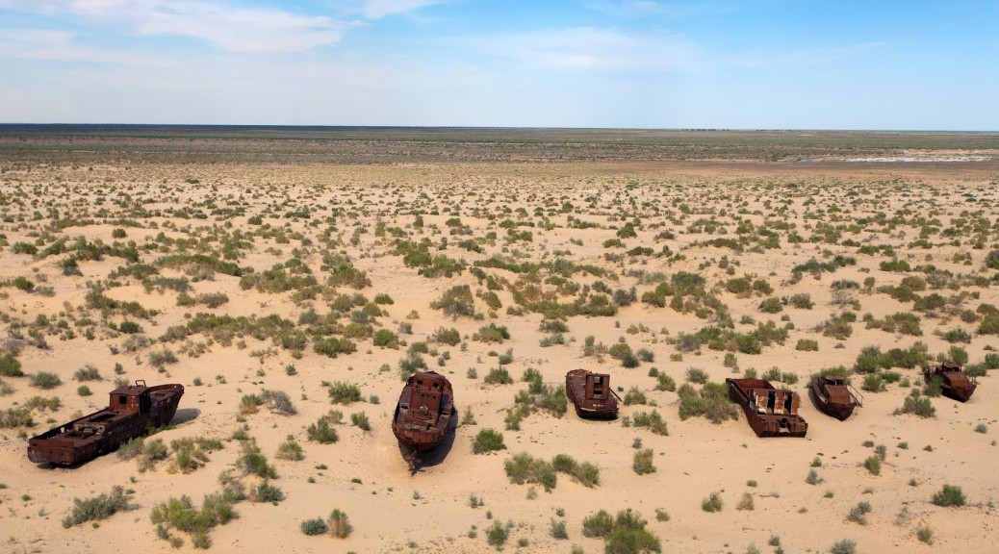
Scale of
Disaster
Surface area shrank 68,000 → 6,800 km²
Aralkum Desert: 54,000 km² exposed seabed
Regional climate impact: +1–2°C avg temp rise
Notes:
The scale of the Aral Sea’s disaster is best understood through the economic concept of irreversibility. In environmental economics, irreversibility refers to changes that cannot be undone, or can only be reversed at prohibitive cost. The sea’s surface shrank from 68,000 square kilometers to just 6,800, and the exposed seabed — now called the Aralkum Desert — covers 54,000 km². This desertification releases toxic dust and altered regional climate patterns, raising average temperatures by 1–2°C. Once this process began, the sunk investments in irrigation infrastructure and cotton production locked Uzbekistan into a path dependency. Path dependence means that past decisions constrain future options, even when those decisions become clearly inefficient. The Aral Sea disaster exemplifies this: the initial diversion of rivers created a system where returning to the original state is economically and physically impossible.

Slide 4
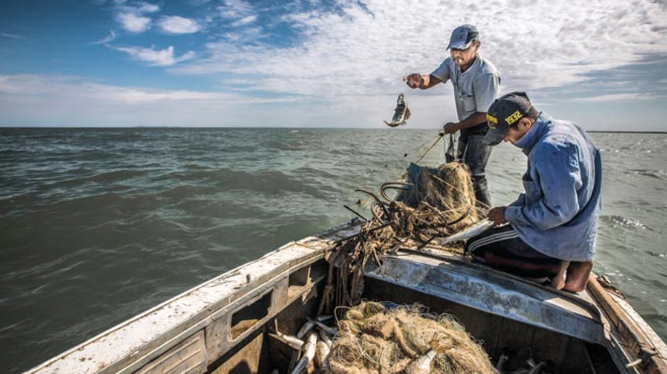
Fisheries output: 40,000 tons/year → 0 by 1980s
Ecological Impacts
Impact 1:
Impact 2:
Soil salinity: >50% irrigated land degraded
Impact 3:
Biodiversity collapse: 24 fish species extinct
Notes:
Ecosystem services are the benefits humans derive from natural systems, such as fisheries, fertile soils, and biodiversity. In the 1960s, the Aral Sea supported a fishing industry producing 40,000 tons annually. By the 1980s, this renewable resource collapsed to zero. Over half of irrigated land in Uzbekistan is now degraded by salinity, reducing productivity. At least 24 fish species have gone extinct. These losses are examples of services that had economic value but were not priced in markets. Economists refer to this as the absence of shadow pricing — the implicit value of resources not captured by market transactions. Because fish stocks, soil fertility, and biodiversity were treated as “free,” their depletion was invisible in cotton’s cost accounting. The Aral case thus demonstrates how ignoring non-market values results in policies that look profitable but, in reality, destroy long-term wealth.

Slide 5

Human & Economic Impacts
Impact 1:
Public health: TB rates 3× higher, infant mortality ↑
Impact 2:
Economic loss: est. $110 billion (World Bank)
Impact 3:
Cotton yields: ↓ 30% due to soil salinity
Notes:
The human and economic costs of the Aral Sea disaster illustrate the concept of negative externalities. Externalities occur when the actions of one group impose costs or benefits on others that are not reflected in market prices. In this case, cotton production generated profits for the state, but the costs were externalized onto communities. Public health collapsed: tuberculosis rates in the region are three times higher than the national average, and infant mortality rose. Dust storms carry pesticides and salt, causing chronic respiratory illness and cancer. Economically, the World Bank estimates losses of over $110 billion. Even cotton itself — the supposed beneficiary of the policy — saw yields decline by about 30% due to salinity. If we calculate the social cost of cotton — the private costs of production plus the external costs in health, lost productivity, and environmental damage — cotton cultivation becomes irrational. This makes the Aral Sea a classic illustration of how ignoring externalities distorts policy and undermines welfare.

Slide 6
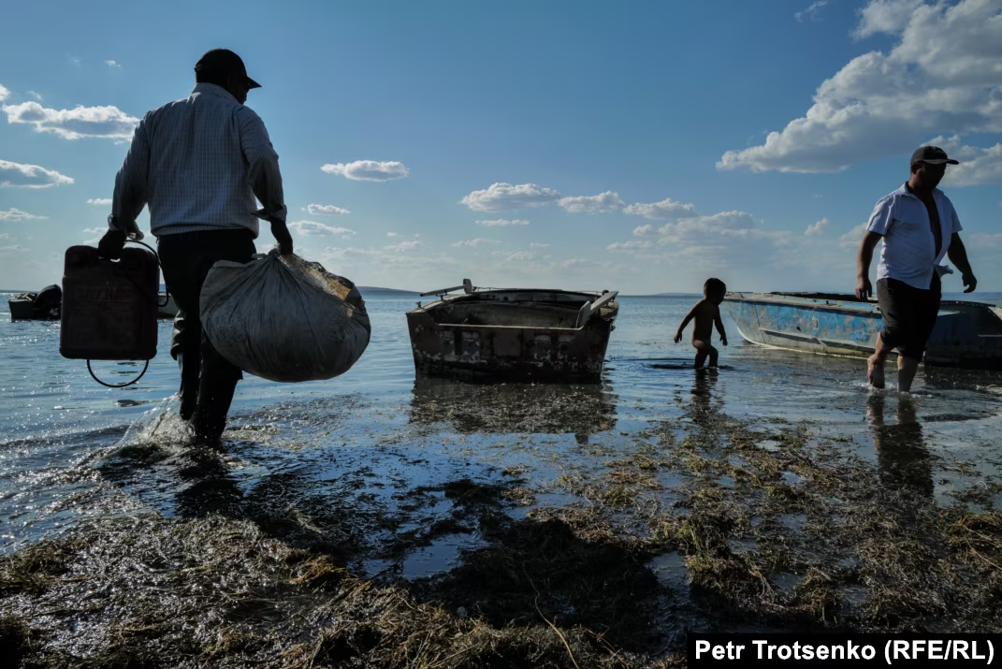
Current Responses (Uzbekistan)
Afforestation: 1.5M ha planted on Aralkum Desert
Irrigation reform: drip irrigation pilot <10% fields
International aid: $300M World Bank Aral Basin Program
Notes:
Responses to the Aral Sea disaster can be seen as efforts to deal with hidden costs, or what economists call externalities. For decades, cotton farming brought revenue to the state, but the health problems, soil damage, and dust storms were costs carried by local people. Farmers didn’t pay for the water they used or for the long-term harm caused, so the real cost of cotton was far higher than what appeared on paper.
Today, Uzbekistan is trying to bring those hidden costs back into the decision-making process. Planting about 1.5 million hectares of saxaul trees on the Aralkum seabed is one way to reduce the health and economic losses from toxic dust storms. This is like a policy to partially “internalize” the externality — it doesn’t erase the damage, but it cuts the ongoing social cost. Small-scale drip irrigation projects, now covering under 10% of farmland, aim to use water more efficiently, which is another way of correcting the original misallocation of resources. International partners like the World Bank have invested over $300 million in the Aral Sea Basin Program, reflecting the idea that the benefits of fixing the problem are shared regionally and globally.

Slide 7
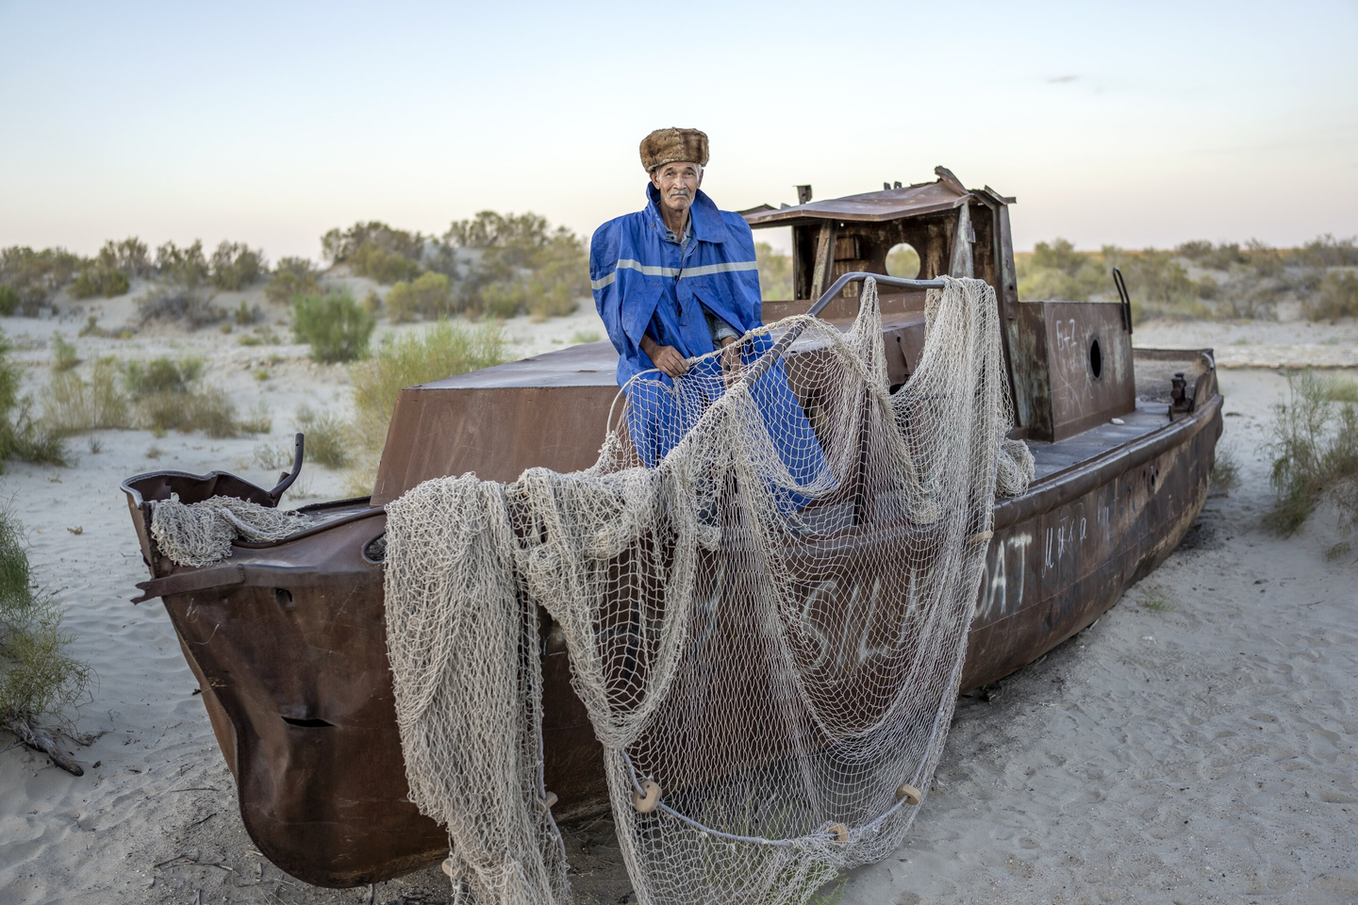

Partial Successes & Limits
Kok-Aral Dam (Kazakhstan): +20% water, fisheries revived
Uzbekistan progress: mitigation only
Full restoration infeasible: sunk costs too high
Notes:
Kazakhstan has managed some recovery with the Kok-Aral Dam, which raised water levels in the North Aral by about 20% and allowed fishing to return. This shows that targeted investments can bring real economic and social benefits, at least on a smaller scale. In Uzbekistan, however, the picture is different. Most efforts focus not on bringing the sea back but on softer measures — planting trees on the dry seabed to hold down dust or supporting health programs in affected regions.
Why is full restoration not on the table? One reason is the problem of sunk costs. In economics, sunk costs are expenses that have already been made and cannot be recovered — things like billions spent on irrigation canals, pumping stations, and the entire cotton supply chain. Because these systems are already in place, there is both financial and political pressure to keep using them, even if they are inefficient in the long run. In other words, the past investment “locks in” today’s decisions.
Another reason is opportunity cost. Opportunity cost refers to the benefits we give up when choosing one option over another. For Uzbekistan, pouring scarce resources into trying to refill the sea would mean not using that money for other needs, such as modernizing irrigation, improving healthcare, or investing in education. From a welfare perspective, the gains from those alternatives are likely higher than the limited benefits of large-scale restoration.
This is why most experts see mitigation — reducing dust storms, protecting public health, and improving water efficiency — as the rational economic path forward. The tragedy of the Aral Sea is undeniable, but from an economic standpoint, allocating resources to adaptation yields more value for society than chasing an unrealistic return to the past.

Slide 8
Economics Lens
Concept 1:
Negative externalities: social cost > private cost
Concept 2:
Tragedy of commons: no river governance → overuse
Concept 3:
Growth trade-off: GDP gains vs. $110B long-run loss
Notes:
The Aral Sea disaster can be understood through several key ideas in environmental economics. The first is the problem of negative externalities. An externality is a cost or benefit that spills over onto people who were not part of the original decision. In this case, cotton farming generated income for the state, but the damage — from collapsing fisheries to toxic dust storms and widespread health problems — fell on local communities. Because these costs were not included in the price of cotton, production kept expanding even though it was socially damaging.
A second idea is the tragedy of the commons. The Amu Darya and Syr Darya are rivers shared across different Soviet republics, with no strong system of joint management. Each region tried to maximize its own water withdrawals to meet cotton quotas. Individually, this was rational; collectively, it drained the rivers and destroyed the sea. The tragedy of the commons describes this exact dynamic: when a shared resource is open to all, overuse is almost inevitable unless there are rules or agreements in place.
Finally, the Aral Sea shows the trade-off between short-term growth and long-term welfare. Cotton exports did raise GDP figures in the short term, helping the Soviet economy. But the long-term losses, estimated at over $110 billion, outweighed those gains many times over. This demonstrates the importance of sustainable development — the idea that growth should account for environmental and social costs so that future welfare is not sacrificed for temporary increases in production.
Together, these three concepts — negative externalities, the tragedy of the commons, and the trade-off between growth and welfare — make the Aral Sea disaster an example of what happens when economic planning ignores sustainability.

Slide 9
If the true social costs of cotton production in Uzbekistan had been fully priced in from the beginning — including health impacts, ecosystem losses, and long-term economic damage — would cotton still have been grown at the scale it was?
Notes:
If the full social costs of cotton production in Uzbekistan had been counted from the start — not just the revenue but also the damage to health, the loss of fisheries, soil salinization, and the eventual $110 billion in long-run losses — it’s very unlikely cotton would have been grown at that scale. In economic terms, the social cost of production would have been far higher than the private benefit. Cotton only looked profitable because the hidden costs were shifted onto the environment and local communities.
That doesn’t mean cotton would have disappeared entirely. With proper pricing of water, regulations on chemical use, or compensation schemes, cotton might have been grown on a smaller, more sustainable scale. But the vast monoculture system — where two major rivers were essentially drained — would have failed a basic cost–benefit test.
The larger lesson is that economies need ways to bring those hidden costs into decision-making early on. Tools like pollution taxes, water pricing, or payment for ecosystem services are ways to prevent the kind of distorted incentives that fueled the Aral Sea collapse.

Slide 10
Aral Sea
The Aral Sea Disaster: Uzbekistan’s Defining Environmental Crisis
THANK YOU!
Notes:
Today we will examine the Aral Sea disaster, one of the most severe man-made environmental collapses in modern history. We will focus on Uzbekistan, where the consequences are most visible, and interpret the crisis through environmental economics: distorted incentives, externalities, inefficient allocation of resources, and long-run welfare losses. In my analysis I will connect ecological outcomes directly to economic frameworks

