Slide 1


South Africa’s Water Crisis: An Environmental Economics Perspective
Haala Qamar
Environmental Economics
September 23, 2025

Slide 2
Introduction
South Africa is a semi-arid country with limited freshwater resources
Average annual rainfall: 495 mm (global average = 1033 mm)
Water demand projected to exceed supply by 17% by 2030
The crisis is national, not local — affecting major cities and rural towns alike
Root causes go beyond drought → infrastructure, governance, inequality

Slide 3

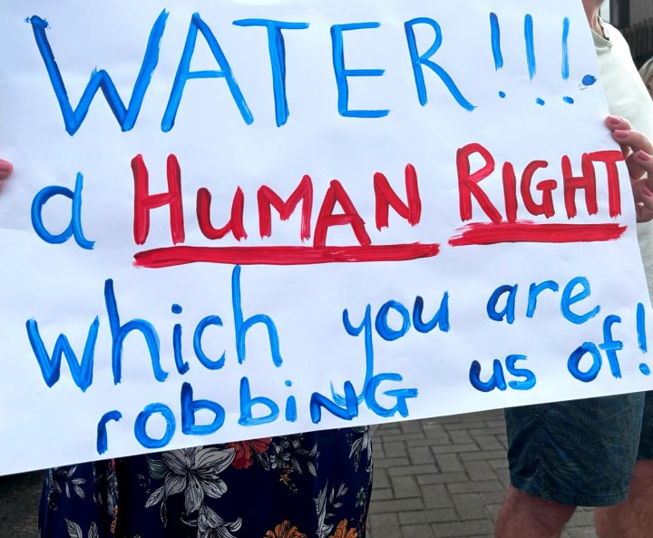
Scope of the Crisis
40% of municipal water lost before reaching users
>50% of wastewater plants in critical/poor condition
EPI 2024: South Africa ranks 50th in wastewater management
Blog voice: “This is not a Joburg issue. It is a national emergency.”

Slide 4
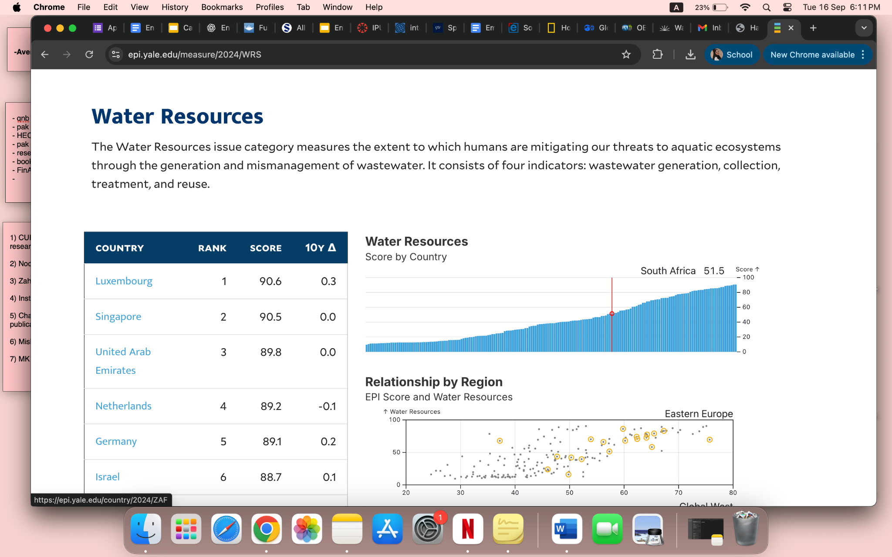
Water Resources (Wastewater Management)
South Africa ranks 50th globally in wastewater generation, collection, treatment, and reuse (EPI 2024). This reflects moderate progress, but significant gaps remain in protecting aquatic ecosystems.

Slide 5
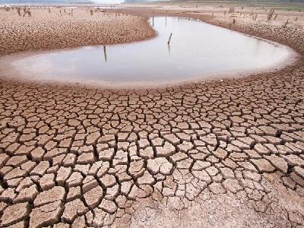
Causes of Water Scarcity
Aging infrastructure: leaking pipes, poor maintenance
Governance failures & uneven investment: rural areas and small towns
Urbanization: rapid population growth pushes demand beyond supply
Pollution: sewage mismanagement, and mining contamination
Physical conditions & climate variability: erratic rainfall, more frequent droughts

Slide 6
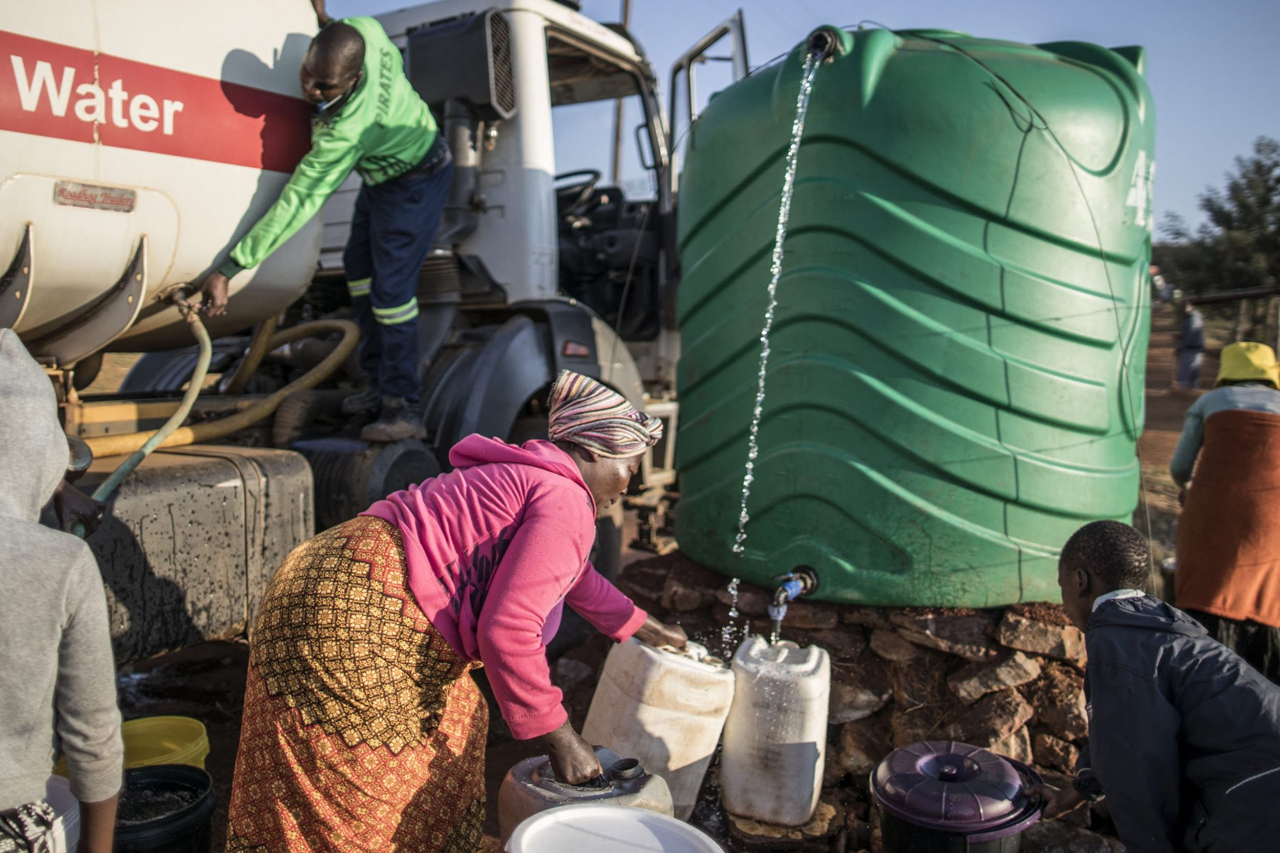
Economic & Social Impacts
Agriculture: maize, wine, citrus production at risk
Industry & mining: water-intensive → productivity losses
Households: rationing, rolling cuts, reliance on tankers
EPI Unsafe Drinking Water Score: 25.2 → higher burden of disease from unsafe water.
Blog voice: “Without water, there is no daily life, no hygiene, no health, no trust in leadership.”

Slide 7
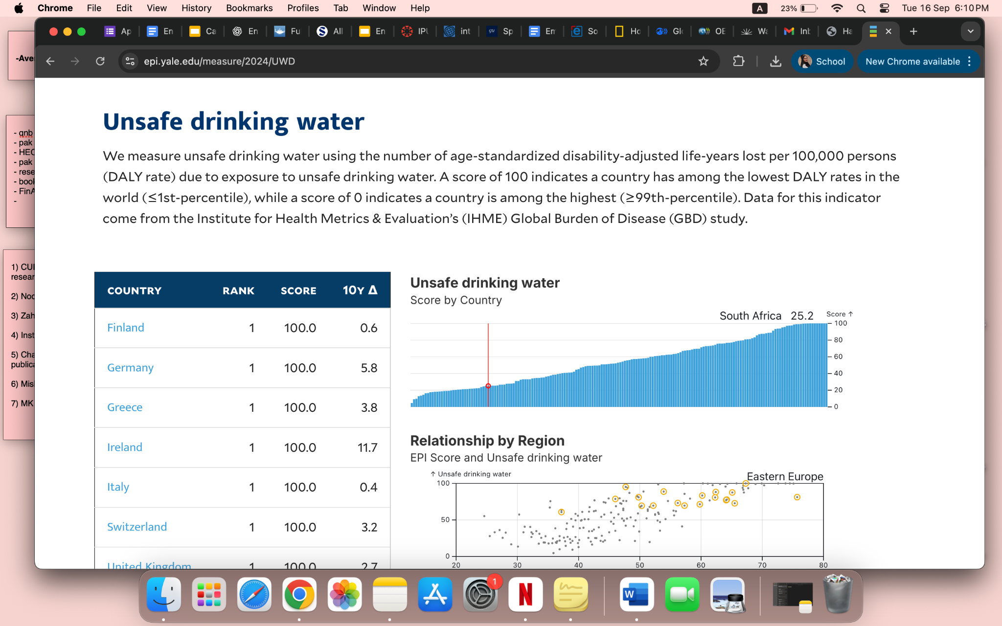
Unsafe Drinking Water
South Africa scores 25.2 for unsafe drinking water (EPI 2024), showing a higher health burden from waterborne disease compared to many countries. Unsafe water directly contributes to illness and inequality.

Slide 8
Current Responses
National Water Resource Strategy (latest: 2023)
Emergency drought relief & restrictions
Small desalination & groundwater tapping
Limited progress in treated wastewater reuse
Reality on the ground: residents face years of intermittent water cuts

Slide 9
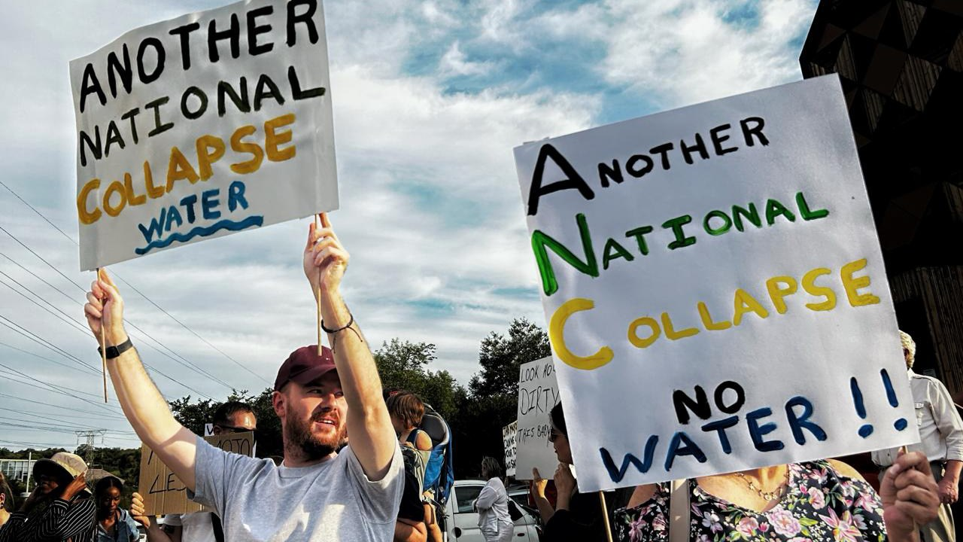
Policy & Implementation Challenges
Underfunded + delayed infrastructure upgrades
Corruption undermines trust
Corporatization of water (cost recovery > access)
Unequal access: wealthy suburbs vs. poor communities
Blog voice: “Miss one payment, and your supply is cut instantly. Yet when Joburg Water fails, urgency vanishes.”

Slide 10
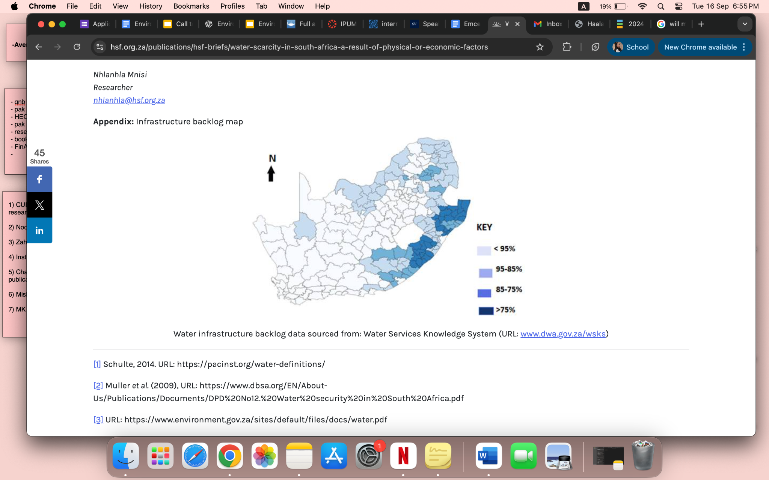
Economics Based Solutions
Circular economy: wastewater recycling, water reuse
Large-scale infrastructure modernization
Public-private partnerships with strong accountability

Slide 11
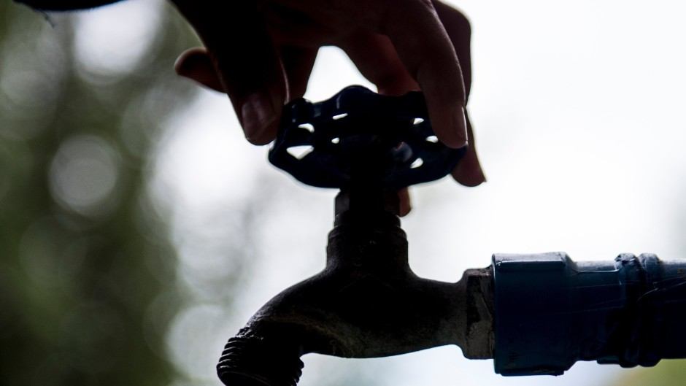
Conclusions
Water crisis = national emergency, not city-specific
Impacts economy, health, equity, and trust in democracy
Current responses reactive & fragmented
Solutions must combine:
Infrastructure investment
Strong governance + anti-corruption
Equitable access policies

Slide 12
Sources
eNCA. 2024. South Africa’s water crisis is a national emergency, not a local problem. eNCA. https://www.enca.com (accessed September 15, 2025).
Environmental Performance Index (EPI). 2024. 2024 Environmental Performance Index. Yale Center for Environmental Law & Policy. https://epi.yale.edu (accessed September 15, 2025).
Hedden, Steve, and Jakkie Cilliers. 2014. Parched Prospects: The Emerging Water Crisis in South Africa. Institute for Security Studies Paper 11. Pretoria: ISS. https://issafrica.org/research/papers/parched-prospects-the-emerging-water-crisis-in-south-africa.
Makhulu, Anne-Maria, and Amogelang Motha. 2022. “On patience and the burden of waiting: ‘Water cuts’ and local experiences in Makhanda, South Africa.” Journal of Southern African Studies 48 (6): 1097–1114. https://doi.org/10.1080/03057070.2022.2078084.
Sibanda, Lisemelo, and Busani Ngwenya. 2023. “Water scarcity in South Africa: A result of physical or economic factors?” South African Journal of Science 119 (7/8): 1–5. https://doi.org/10.17159/sajs.2023/15478.

