Slide 1
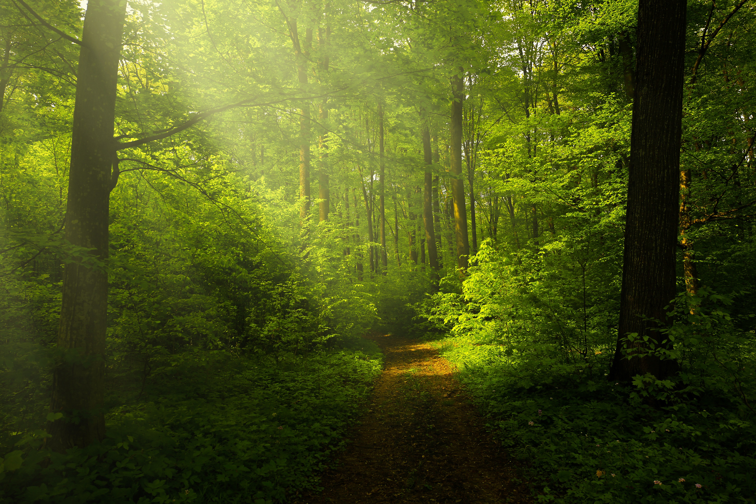
Deforestation & Forest Degradation in the DRC
JESSICA ORNELLA NETT
ECON-2675-70: ENVIRONMENTAL ECONOMICS FALL 2025
SEPTEMBER 16, 2025

Slide 2
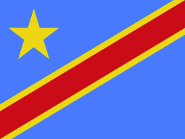
TABLE OF CONTENT
I. About DRC
II. The problem
III. Consequences
III. Solutions implemented
IV. Challenges
V. Why is it important?
VI. What can be done?

Slide 3
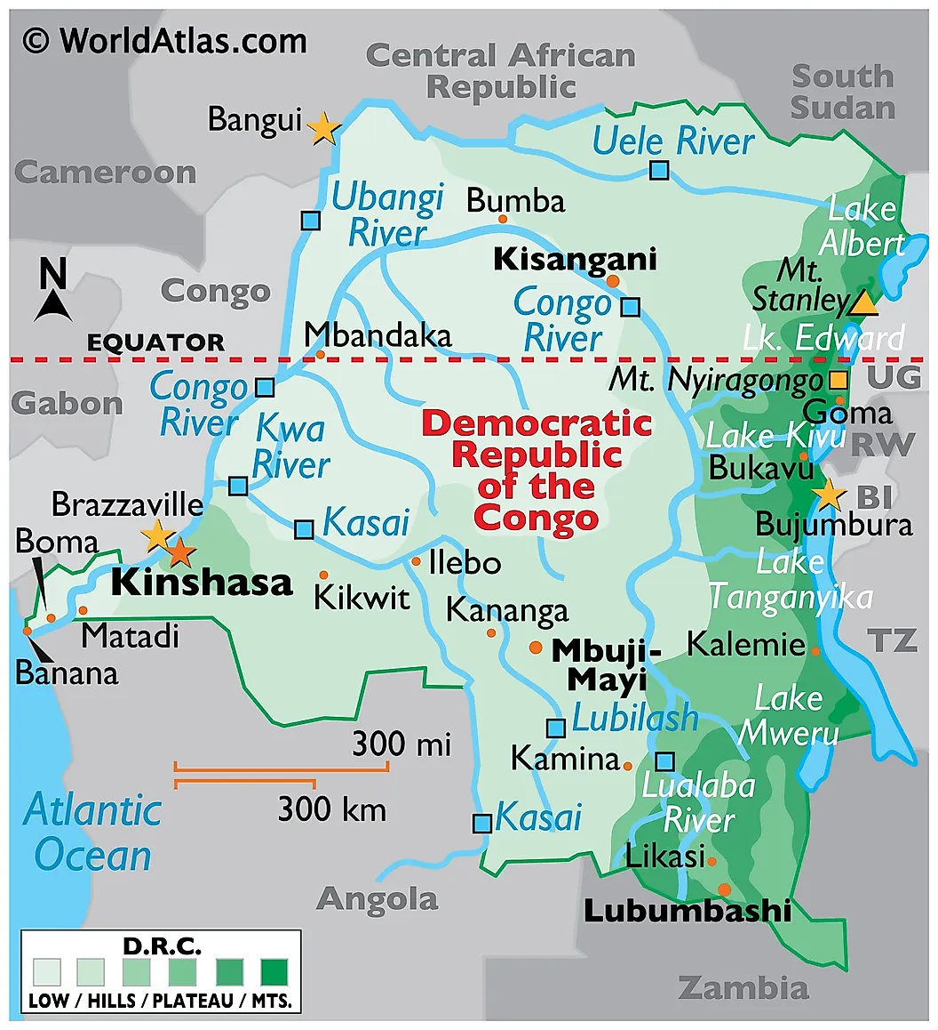
ABOUT DRC
Central African Country
GDP: 70.75 Billion USD (World Bank, 2024)
161th economy on the Legatum Prosperity Index (Legatum Prosperity Index, 2023)
11th country with the most Population below the poverty line (Index Mundi, 2020)
2nd largest tropical rain forest (World Bank, 2018)
83.9 % of death are due to lower respiratory issues (WHO, 2021)
9th most polluted country worldwide (Air Quality Life Index, 2024)
Most polluted country in Africa (Air Quality Life Index, 2024)
109,276,265 individuals (World Bank, 2024)

Slide 4
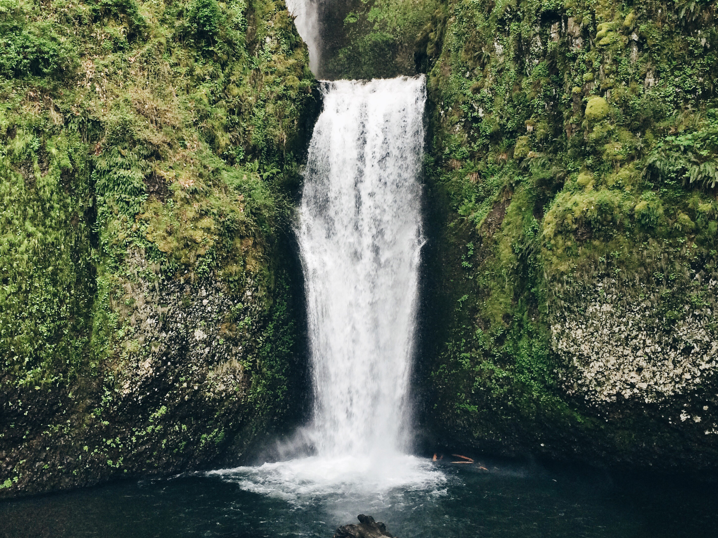
THE PROBLEM
The lack of alternatives to woodfuel results not only in time-consuming labor and illness related to air pollution, but also in a steady degradation of DRC’s forests, threatening the integrity of the world’s second largest rainforest. (World bank, 2022)
CAUSES OF DEFORESTATION IN DRC
Slash-and-burn agriculture
Industrial and illegal logging
Urban expansion
charcoal production

Slide 5
THE PROBLEM IN FIGURES
INDUSTRIAL AND illegal logging
SLASH-AND-BURN AGRICULTURE
90% of logging in the DRC is illegal or informal(Lawson , 2014)
42% of logging concessions not in order with the payment of their surface taxes. (Environmental Investigation Agency, 2024)
only 15% of companies compliant with their socioeconomic obligations to local communities
( Environmental Investigation Agency, 2024)
60% of deforestation in the country. (UN Environment program, 2024)
The agricultural sector employs over 60 per cent of Congolese and comprises 19.7 per cent of GDP. (International Trade Administration, 2024)

Slide 6
THE PROBLEM IN FIGURES
CHARCOAL PRODUCTION
URBAN EXPANSION
Only 3.7 % of the population in DRC had access to clean fuels and technologies for cooking in 2020.(World Bank, 2022)
90% of DRC’s population using charcoal to cook daily.(Guardian, 2022)
network expansion could cause a reduction of + 2 % in the existing forest resources (Li & al, 2014)
Population growth rate 3.2 % (WHO, 2022)

Slide 7
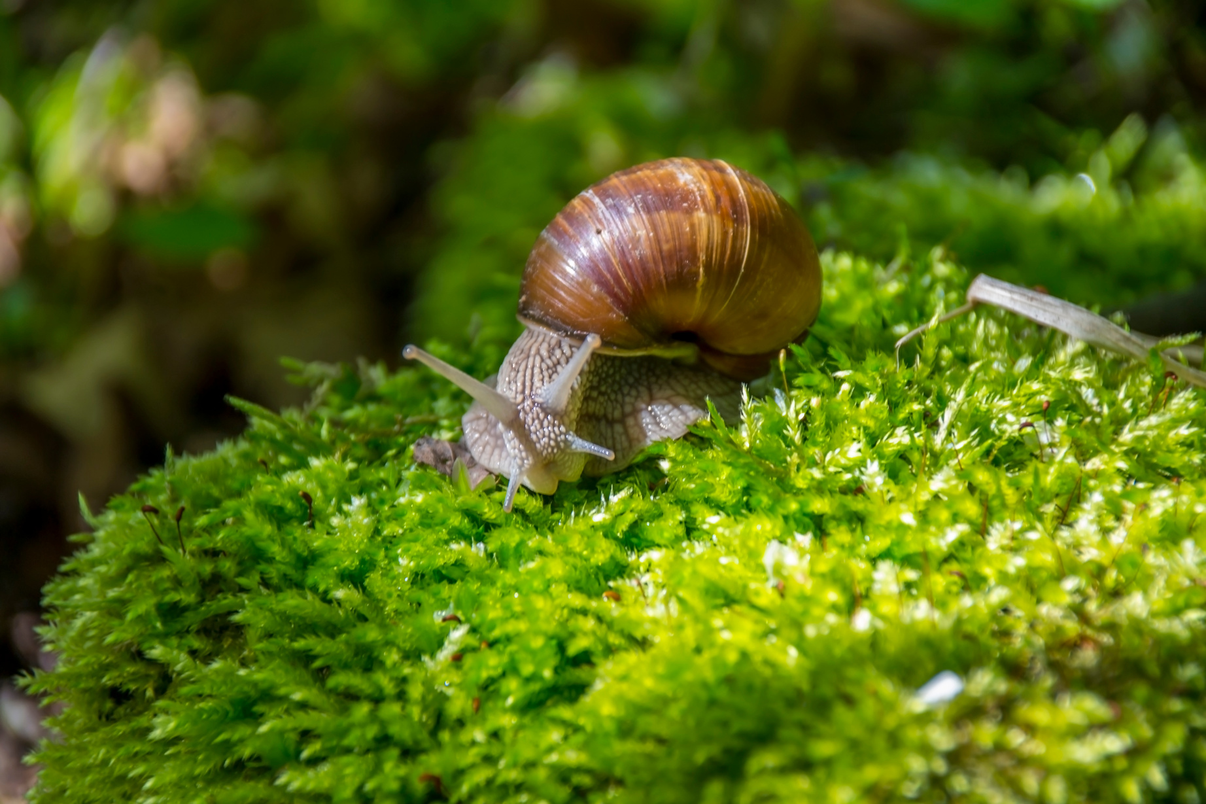
CONSEQUENCES
Loss of species and biodiversity
Increased greenhouse gas emissions
Reduced ability of forests to act as carbon sinks.
loss of resources
erosion
altered rainfall
Threat to indigenous peoples and their rights.

Slide 8
SOLUTIONS IMPLEMENTED -National Efforts
Direction de Reboisement et Horticulture(CRU, 2022)
NATIONAL FOREST MONITORING SYSTEM (NFMS) (FAO, 2020)
DRC’S Emission Reductions Program in the Mai Ndombe (World Bank, 2018)

Slide 9
SOLUTIONS IMPLEMENTED -International Efforts
Climate Investment Funds (World Bank, 2025)
FOREST INVESTMENT PROGRAM (FIP) (WORLD BANK, 2025)
WORLD BANK ’S FOREST CARBON PARTNERSHIP FACILITY CARBON FUND (WORLD BANK, 2018)

Slide 10
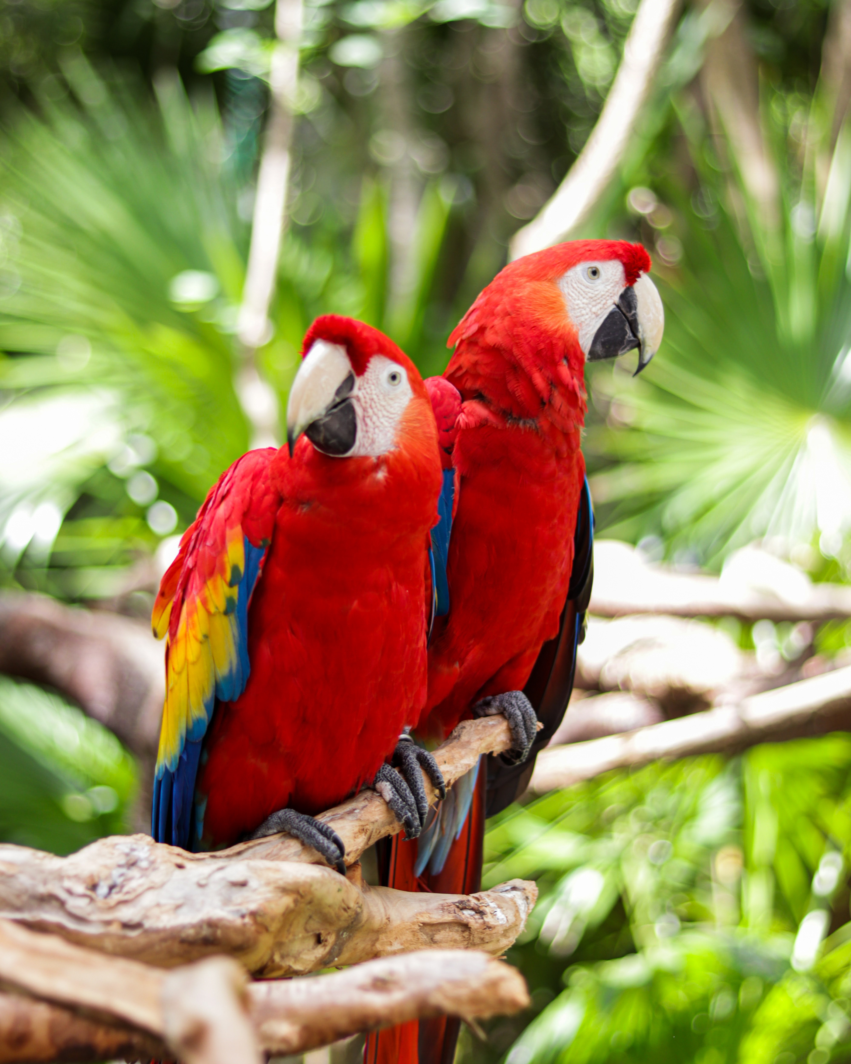
CHALLENGES
Corruption
Conflict
Land tenure issues
Local complinace
Illegal market
Economic necessity

Slide 11
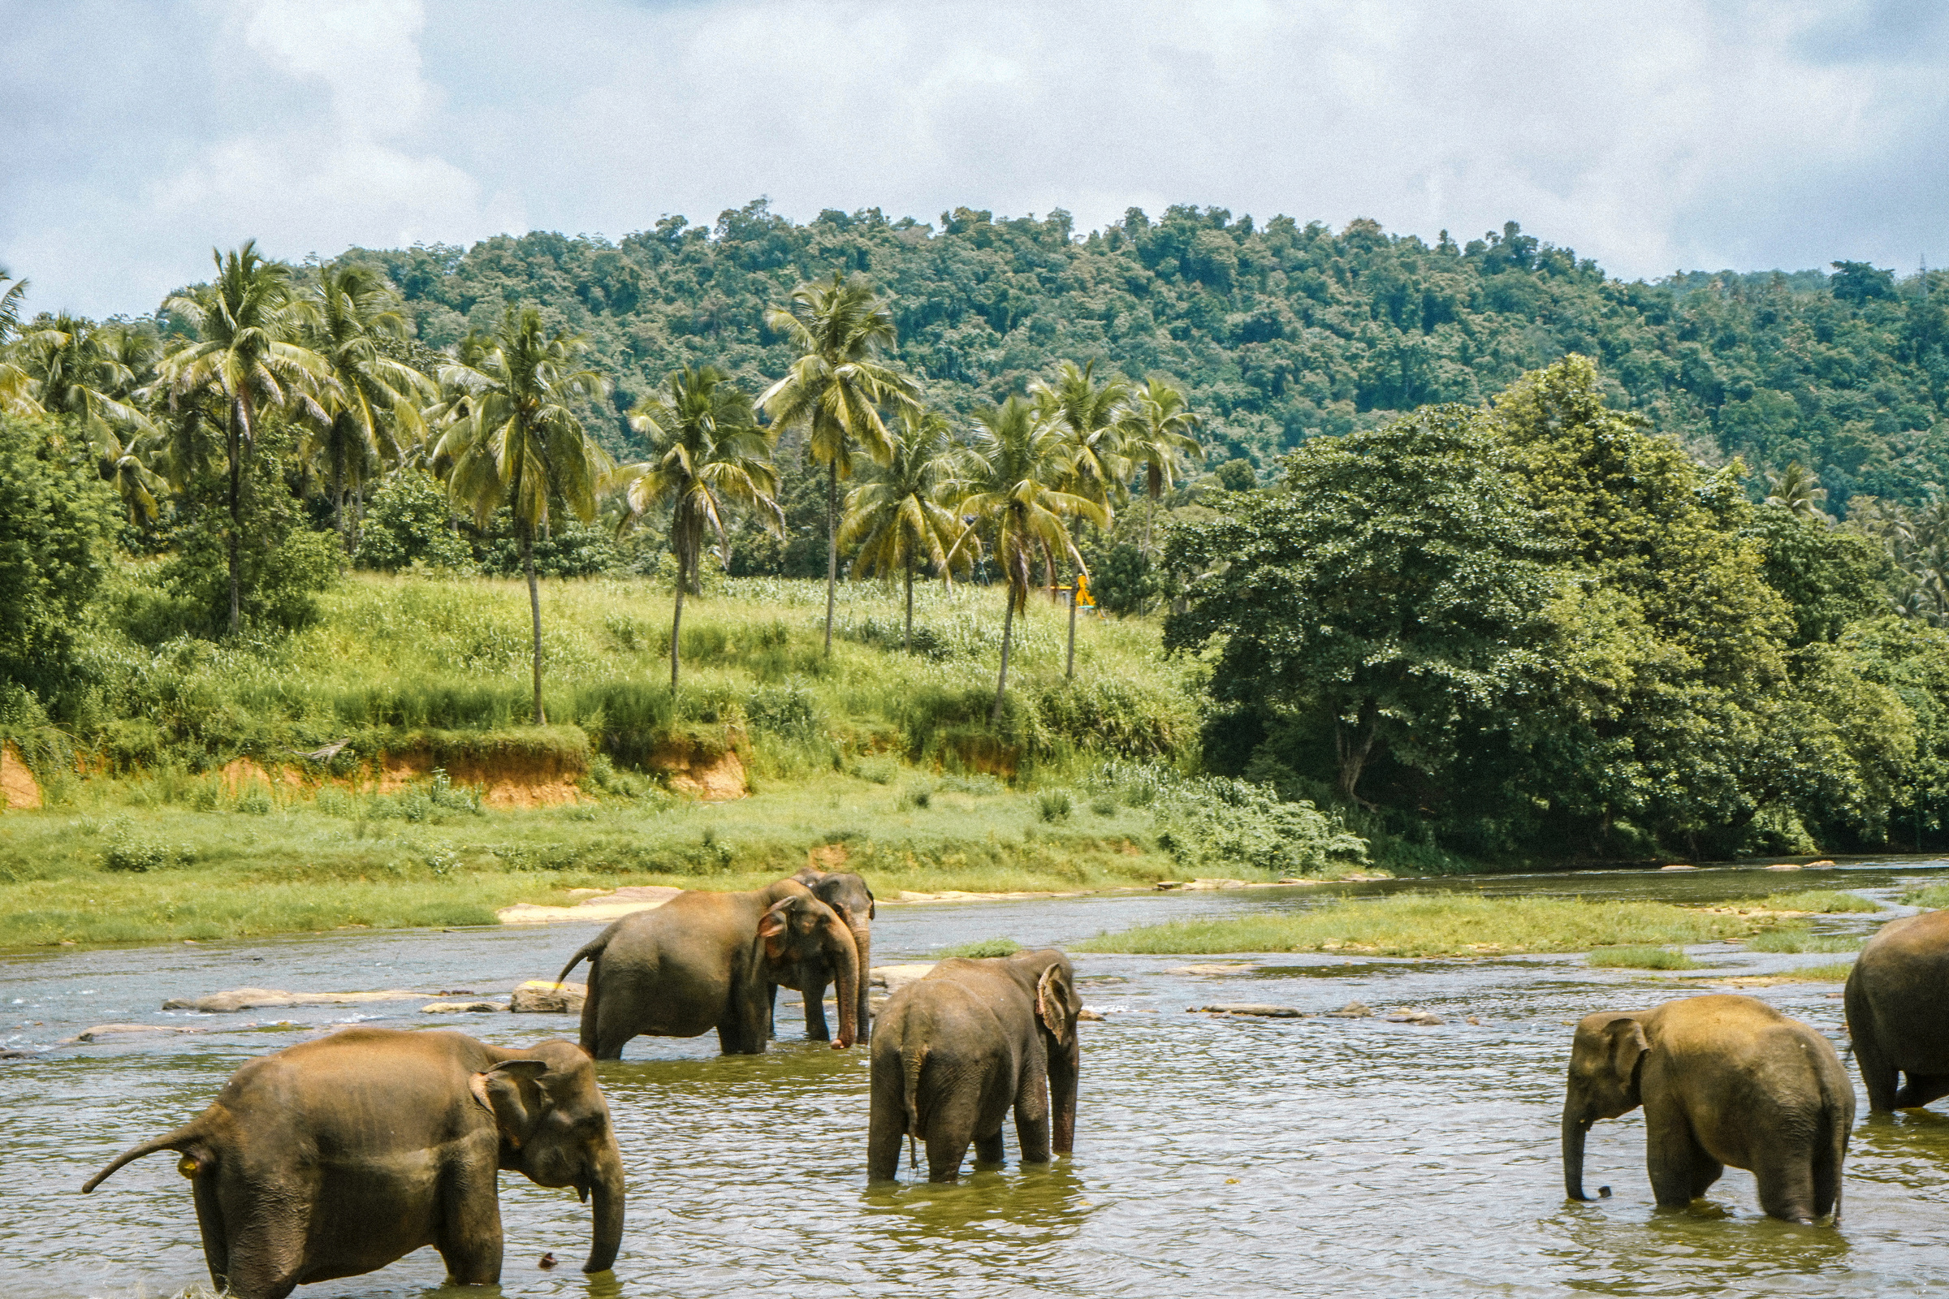
WHY IS IT IMPORTANT ?
Environmental reasons
The DRC’s Congo Basin rainforest acts as one of the world’s largest carbon sinks.
Reduce the effects of climate change.
Saving endangered species such as mountain gorillas, forest elephants, etc.
Economic Reasons
Dependence on the forest for fruits, bushmeat, etc (hunters)
Support ecotourism
Land degradation reduces soil fertility, lowering future agricultural productivity

Slide 12
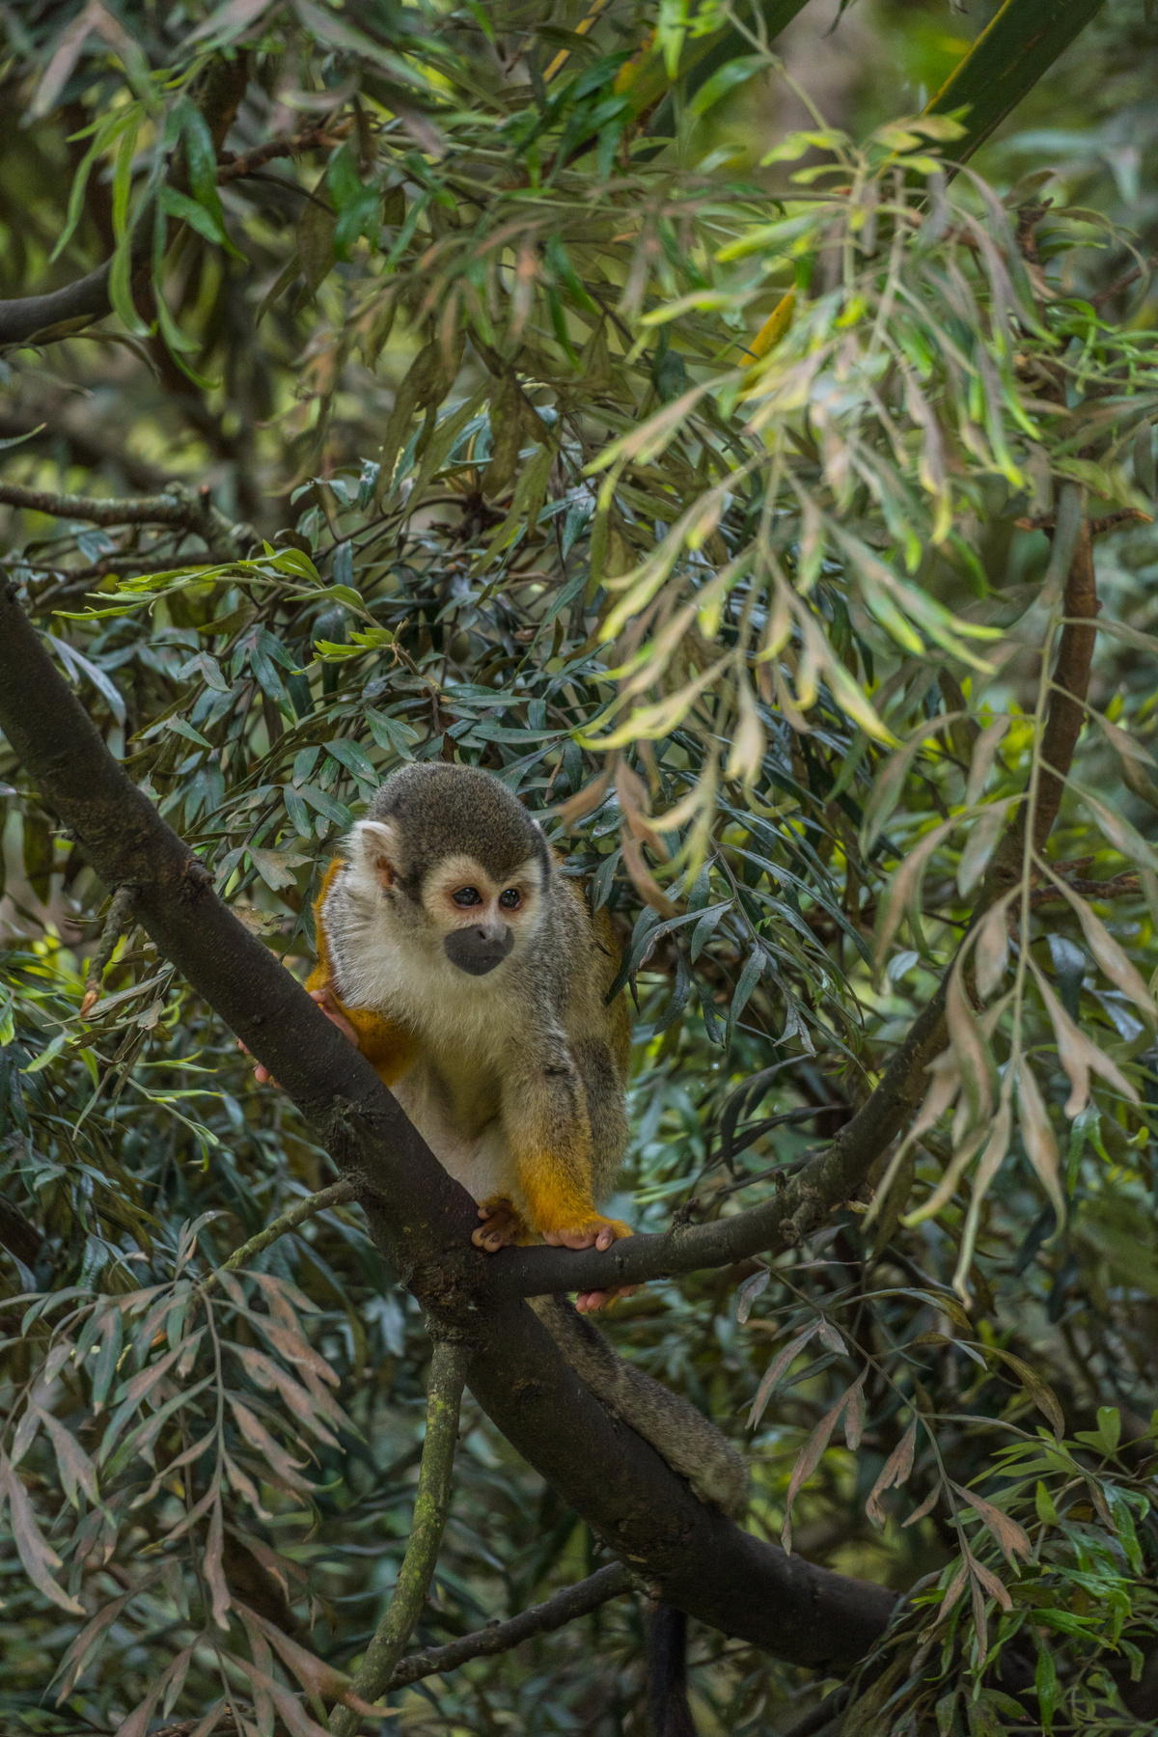
WHAT CAN BE DONE ?
Promote alternative livelihoods and energy
Secure land tenure and community rights
Stronger enforcement and policy coherence
More climate finance
Research and data

Slide 13
THANK YOU

Slide 14

SOURCES
Environmental Investigation Agency. DRC’s Logging Industry Marred by Systemic Illegalities. Press Release, March 24, 2022. https://eia.org/press-releases/drcs-logging-industry-marred-by-systemic-illegalities/.
Legatum Institute. The Legatum Prosperity Index: Rankings. Accessed September 16, 2025. https://index.prosperity.com/rankings.
Index Mundi. “Population Growth Rate by Country.” Accessed September 16, 2025. https://www.indexmundi.com/g/r.aspx?v=69.
World Bank. “In the Democratic Republic of Congo, People-Centered Solutions to Forest Degradation.” Feature Story, November 15, 2022. https://www.worldbank.org/en/news/feature/2022/11/15/in-the-democratic-republic-of-congo-people-centered-solutions-to-forest-degradation.
World Atlas. “Democratic Republic of the Congo Map.” Accessed September 16, 2025. https://www.worldatlas.com/maps/democratic-republic-of-the-congo.
World Bank. “Population, Total – Congo, Dem. Rep.” Accessed September 16, 2025. https://data.worldbank.org/indicator/SP.POP.TOTL?locations=CD.
United Nations Environment Programme (UNEP). “In the Heart of Africa, a Bold Experiment in Farming and Forest Conservation Unfolds.” UNEP Story, August 2021. https://www.unep.org/news-and-stories/story/heart-africa-bold-experiment-farming-and-forest-conservation-unfolds#:~:text=Azima%20Magonde%20Giston%20is%20walking,the%20world's%20worst%20hunger%20crises.187055.
Burke, Jason. “‘In 10 Years We Might Not Have Forests’: DRC Struggles to Halt Charcoal Trade – A Photo Essay.” The Guardian, July 20, 2022. http://theguardian.com/global-development/2022/jul/20/in-10-years-we-might-not-have-forests-drc-struggles-to-halt-charcoal-trade-a-photo-essay.
World Health Organization. “Congo, Dem. Rep.: Population Growth Rate.” WHO Data Portal, 2023. https://data.who.int/countries/180#:~:text=the%20Congo%2C%202023-,Population%20growth%20rate,percentage%20points%20change%20since%202022.
U.S. Department of Commerce, International Trade Administration. Democratic Republic of Congo – Agriculture. Country Commercial Guide, 2023. https://www.trade.gov/country-commercial-guides/democratic-republic-congo-agriculture.
Conflict Resolution Unit. “How the DRC Is Fighting Deforestation with an Eye on the Human Cost.” Accessed September 16, 2025. https://www.conflictresolutionunit.id/how-the-drc-is-fighting-deforestation-with-an-eye-on-the-human-cost/.
Food and Agriculture Organization of the United Nations. “Democratic Republic of the Congo Promotes Proactive Forest Loss Assessment with a Robust National Forest Monitoring System.” REDD+ News, September 23, 2020. https://www.fao.org/redd/news/detail/en/c/1309499/?utm_source=chatgpt.com
“By Country – AQLI: Democratic Republic of the Congo.” AQLI (Air Quality Life Index), EPIC, University of Chicago. Accessed September 16, 2025. https://aqli.epic.uchicago.edu/countryPage/Democratic%20Republic%20of%20the%20Congo
Li, M., De Pinto, A., Ulimwengu, J.M. et al. Impacts of Road Expansion on Deforestation and Biological Carbon Loss in the Democratic Republic of Congo. Environ Resource Econ 60, 433–469 (2015). https://doi.org/10.1007/s10640-014-9775-y

