Slide 1
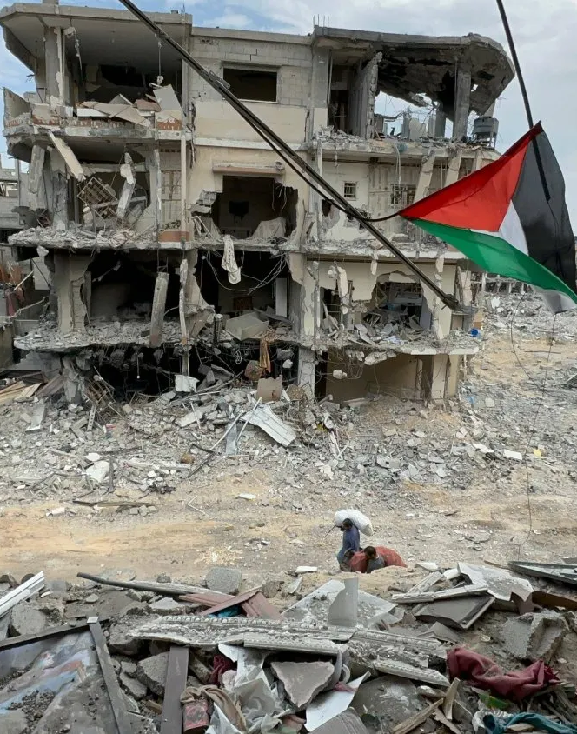
Warfare and the Environment
ECON 2675
By: Lena Muhsen

Slide 2
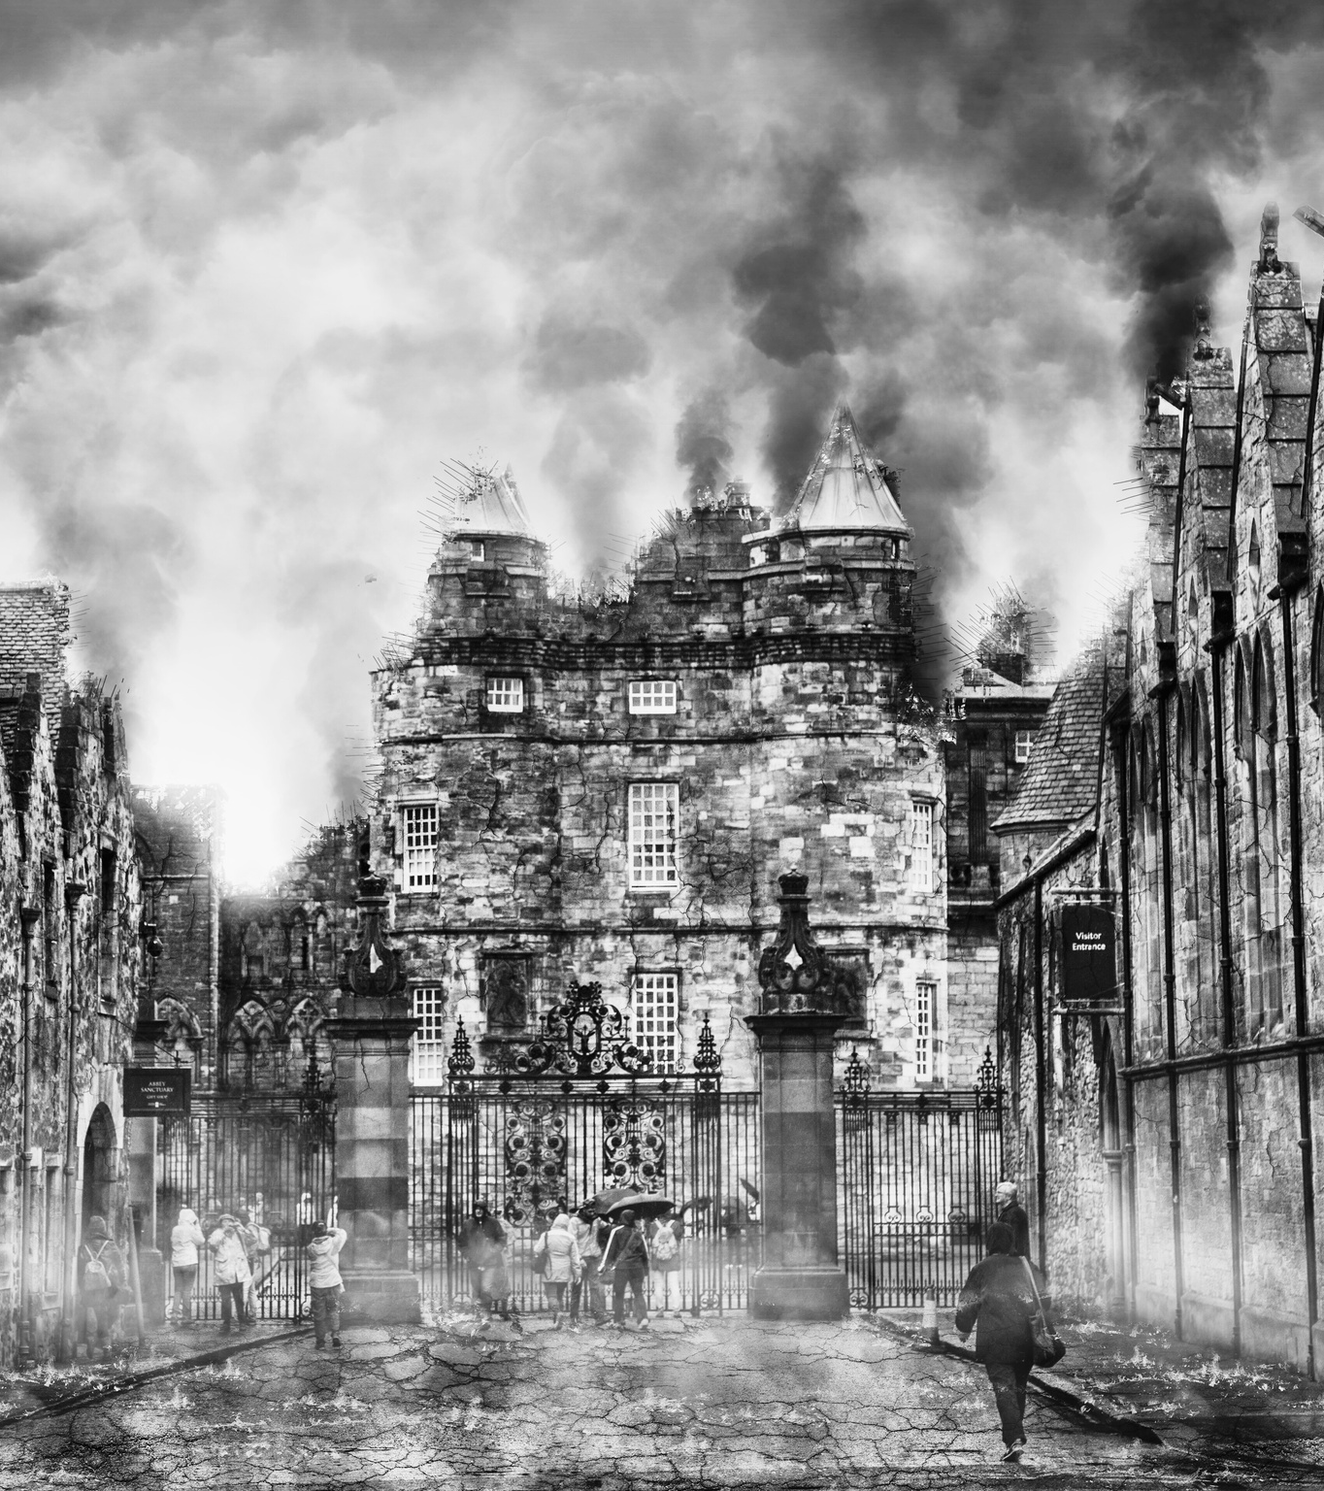
Overview
The environment is collateral damage during warfare between countries. Warfare between countries includes using modern weaponry that causes extensive and long-lasting harm to the environment. For example, the use of bombs (depending on the chemical) leaves effects that continue to harm the environment and biodiversity. However, despite several treaties to protect the environment and deter war between countries, the environment remains vulnerable to modern warfare. (J. Marvin Herndon, Mark Whiteside)

Slide 3
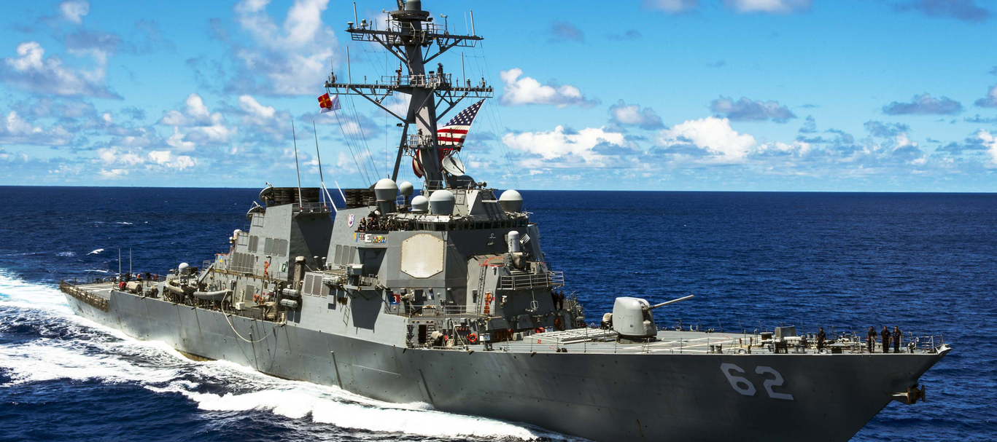
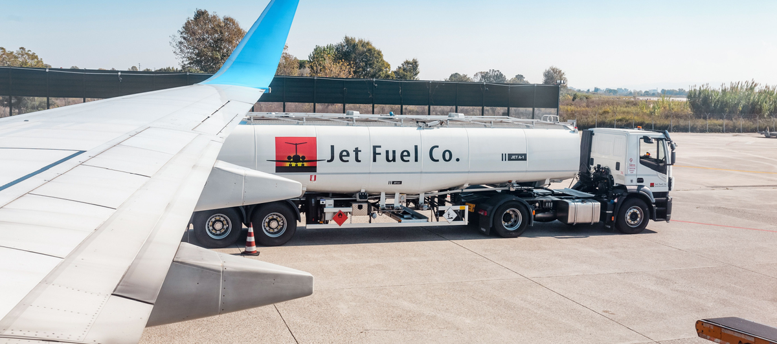
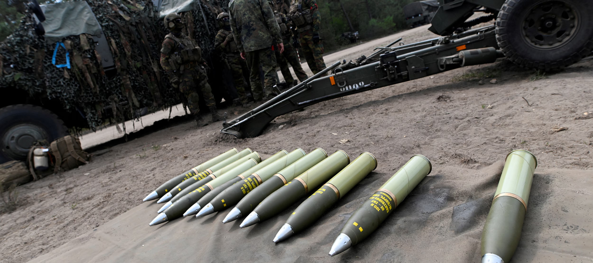
Warfare Impact on the Environment
The impact on the environment is not necessarily specific to wartime, although it increases during active war. The jet fuel and diesel needed for tanks and naval ships already harm the environment. Other examples, such as the production of weapons and ammunition, also produce major harmful chemicals.

Slide 4
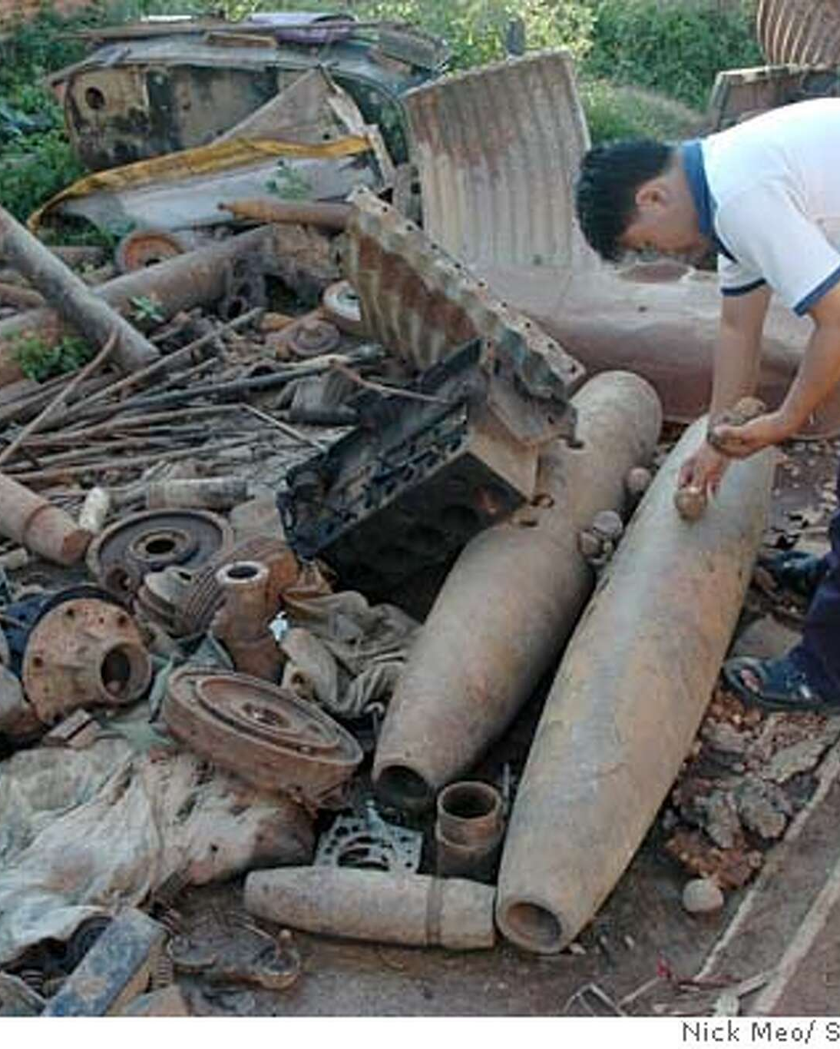
Immediate Impacts
Militaries consume enormous amounts of fossil fuels, which have a high carbon footprint.
Pollution particles introduced (greenhouse gases)
Harmful chemicals such as botulin and anthrax
The deliberate introduction of microorganisms lethal
Increase in nitrogen oxide emissions

Slide 5
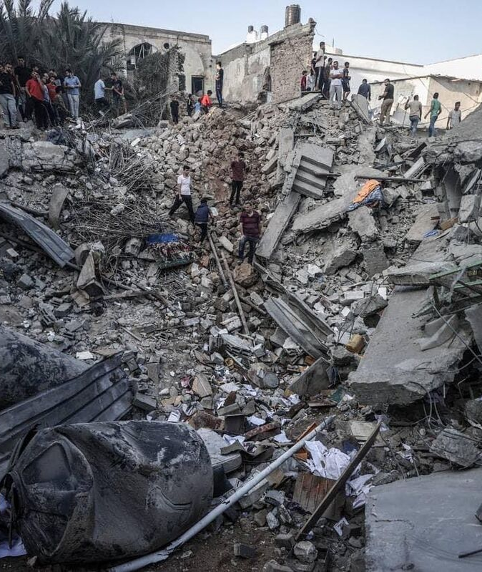
Long Term Harm
Surface heating due to pollution particles
Soil properties are altered
Biodiversity decreases as living creatures are injured/ die
environmental short-term impact
Legacy pollution

Slide 6
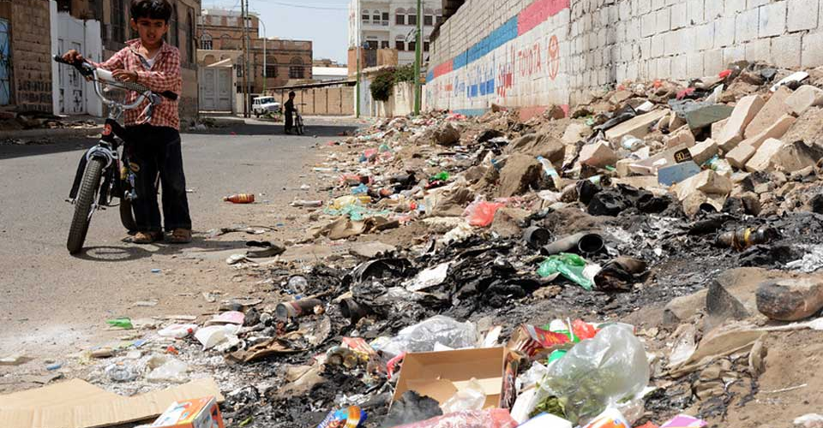
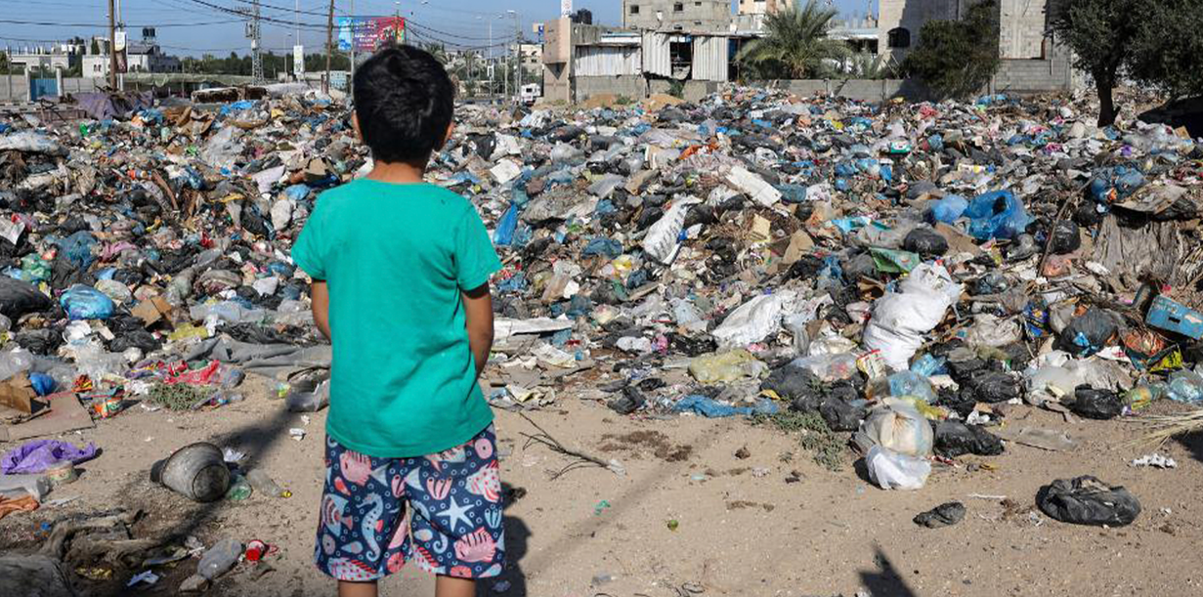
Post War Time Residue
Post-war residue impacts the environment as well as destroyed buildings, which represent a huge amount of difficult-to-recycle construction waste. A huge amount of demolition material and rubble from the wreckage of buildings during conflicts also traps harmful chemicals and materials that stay in the earth.

Slide 7
Immediately (Seconds to Minutes After Detonation)
Blast wave: Trees, vegetation, and wildlife are destroyed or severely injured.
Heat & fire: Ignition of plants, buildings, or forest fires. Soil is scorched.
Shockwave in water (if underwater): Kills fish and aquatic life instantly.
Short-Term (Hours to Weeks)
Air pollution, Water contamination, Wildlife displacement/death
Medium-Term (Months to Years)
Reduced biodiversity, human impact, chemical residues
Long-Term Environmental Impacts
legacy pollution,
eg: long term ecological damage in Iraq tactics such as oil well fires and Vietnam due to Agent Orange ,

Slide 8
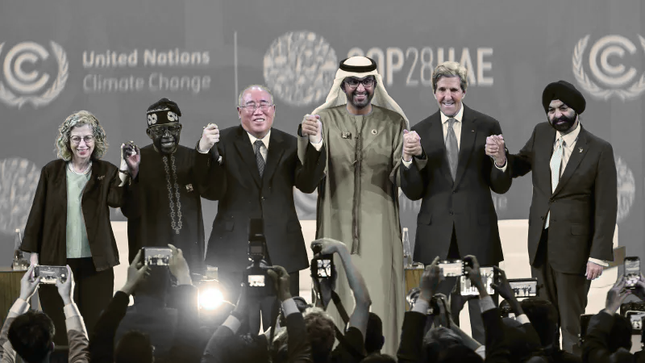
Actions to Mitigate
International case law on ecocide
The 2018 UN Report identified the fragmented nature of existing laws and called for a comprehensive legal framework to address issues like ecocide.
June 2021 Rome Statute amendment: include ecocide as a 5th international crime by creating a legal basis for prosecuting individuals responsible for significant environmental harm
France’s Climate & Resilience Act: Provisions to address environmental offenses, prosecution of those responsible
Ecuador’s Article 245 of the Penal Code: criminalizes crimes against the environment.
Vietnam’s Article 278 of the Penal Code: identifies ecocide as a crime against humanity

Slide 9
Actions to Mitigate
Environmental Protection in Armed Conflict (EPAC)
Environmental Monitoring in War Zones
Groups like the Conflict and Environment Observatory (CEOBS) raise awareness and pressure governments to adopt greener military practices.

Slide 10
References
Buuren, Sterre van, Thomas Fraise, and Benoît Pelopidas. “Existential Silos: The Compartmentalization of the Futures of Environmental Change and the Nuclear Threat.” Futures 173 (October 2025): 103671. https://doi.org/10.1016/j.futures.2025.103671.
Certini, Giacomo, Riccardo Scalenghe, and William I. Woods. “The Impact of Warfare on the Soil Environment.” Earth-Science Reviews 127 (December 2013): 1–15. https://doi.org/10.1016/j.earscirev.2013.08.009.
Herndon, J., and Mark Whiteside. “Global Environmental Warfare.” Advances in Social Sciences Research Journal 7 (May 2020): 411–22. https://doi.org/10.14738/assrj.74.8173.
Lawrence, Michael J., Holly L.J. Stemberger, Aaron J. Zolderdo, Daniel P. Struthers, and Steven J. Cooke. “The Effects of Modern War and Military Activities on Biodiversity and the Environment.” Environmental Reviews 23, no. 4 (2015): 443–60. https://doi.org/10.1139/er-2015-0039.
Mobaied, Samira, and Jean-Paul Rudant. “New Method for Environmental Monitoring in Armed Conflict Zones: A Case Study of Syria.” Environmental Monitoring and Assessment 191, no. 11 (2019): 643. https://doi.org/10.1007/s10661-019-7805-5.
Reuveny, Rafael, Andreea S Mihalache-O’Keef, and Quan Li. “The Effect of Warfare on the Environment.” Journal of Peace Research 47, no. 6 (2010): 749–61. https://doi.org/10.1177/0022343310382069.
Wirtu, Yohannes Desalegn, and Umer Abdela. “Impact of War on the Environment: Ecocide.” Frontiers in Environmental Science 13 (February 2025). https://doi.org/10.3389/fenvs.2025.1539520.

