Slide 1
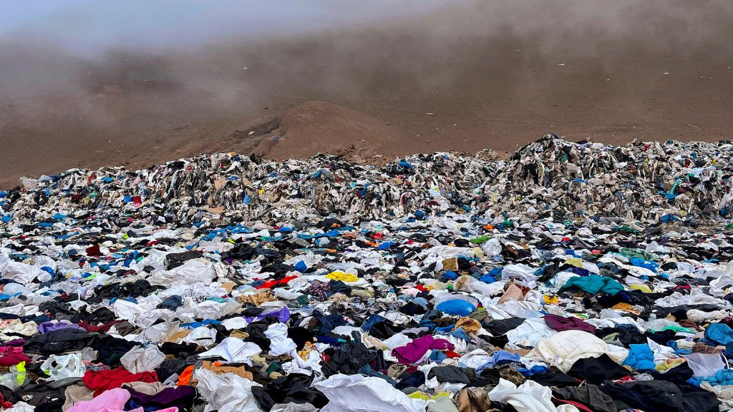
Chinas Most Pressing Environmental Concern: Fashion and Textile Pollution
Sadiq Melhim

Slide 2
Why is there Fashion Pollution in China (Ma 2025), (Mai 2019)
China is the world’s largest textile producer; dyeing/finishing are highly water‑ and chemical‑intensive.
Often‑cited estimates attribute ≈17–20% of industrial water pollution in China to textile dyeing & treatment (World Bank-cited).
Microfibers from synthetic fabrics and untreated dye effluent degrade rivers (Pearl & Yangtze systems) and coastal waters.
Fast fashion drives waste: ~23.3 Mt of waste textiles generated in 2023; only ~5.53 Mt utilized (≈24%) in China.

Slide 3
How Fashion Pollutes (Mai et al. 2019), (Xu et al. 2022)
Wet processing: scouring, bleaching, dyeing, printing, finishing → high‑COD/BOD wastewater with dyes, salts, auxiliaries and heavy metals.
Washing & wear: shedding of microfibers (polyester, nylon, acrylic) → persistent microplastic load in rivers and seas.
Solid waste: cutting scraps, defective goods, unsold inventory, and discarded clothing → low recycling due to blends/contaminants.
Air emissions & odors from solvents and finishing which is important but secondary focus here vs. water & waste.

Slide 4
Hotspots & Evidence in China (Mai et al. 2019)
Pearl River Delta: studies estimate tens of billions of microplastic particles/yr entering coastal waters
Yangtze River Basin: historical clusters of dyeing/finishing which concerns over hazardous discharges and ecosystem risks.
Past NGO investigations traced hazardous chemical releases from suppliers to major brands.
Local shutdowns & clean‑ups show progress but uneven compliance persists.

Slide 5
Impacts on People & Ecosystems ( Mai et al. 2019)
Toxicity: Certain azo dyes, auxiliaries, and finishing chemicals are carcinogenic or endocrine‑disrupting; bioaccumulation in sediments/biota.
Water quality: High color, COD, and salinity hinder drinking‑water treatment and damage riverine ecology and fisheries.
Microfibers act as pollutant vectors, adsorbing other toxics; ingestion documented across trophic levels.
Communities near dyeing hubs face nuisance odors, exposure risks, and degraded ecosystem services.

Slide 6
How China is Responding: Policy (Jinping 2020)
2015 ‘Water Ten Plan’ (Action Plan for Water Pollution Prevention): strict discharge limits; closure of ‘ten small’ highly polluting plants; monitoring & transparency push.
2021 Yangtze River Protection Law: restricts siting of high‑impact industries in key zones; basin‑wide protection framework.
Circular economy push: 2022 State Council guideline to boost textile recycling; pilot ‘zero‑waste’ cities & industrial parks.
Targets emerging to raise textile waste recycling rates toward 25% by 2025 and 30% by 2030 (implementation underway).

Slide 7
Industry & Market Responses (ZDHC 2024)
ZDHC ‘Roadmap to Zero’: MRSL & wastewater guidelines adopted by many China suppliers; high pass rates in tested facilities.
Brand‑driven detox & audit programs; upgrading of effluent treatment plants (ETPs) and color‑removal technologies.
R&D & pilots in fiber‑to‑fiber recycling; mechanical/chemical recycling challenged by blended fabrics and contaminants.
Data & transparency platforms (supplier wastewater disclosure) are expanding but still uneven.

Slide 8
Gaps & Ongoing Challenges (Ma 2025), (Mai et al. 2019)
Microfiber pollution is largely unregulated at source; WWTPs capture variably; households remain a major pathway.
Small/medium dyehouses face cost & capacity barriers to meet advanced ETP standards; periodic crackdowns vs. steady compliance.
Low utilization of post‑consumer textiles (~24% in 2023) due to sorting infrastructure, fiber blends, and low resale value.
Data transparency uneven across provinces; enforcement and public disclosure vary by basin/city.

Slide 9
What Should Be Done (Mai et al. 2019)
Tighten and harmonize dyehouse discharge monitoring with real‑time public dashboards in PRD/Yangtze clusters.
Scale closed‑loop & low‑liquor‑ratio dyeing; enforce MRSL compliance across tiers (including subcontractors).
Nationwide EPR for textiles: funded collection, sorting, and fiber‑to‑fiber capacity; design standards to reduce blends.
Microfiber controls: washer filters, fabric standards, and WWTP retrofits; invest in capture/retention research.
Consumer levers: durability labeling, repair/reuse incentives, and responsible procurement by large buyers.

Slide 10
Key References
2019 Ma, Y. (2025). China’s war on pollution: 10 years of the Water Ten Plan. China Water Risk. https://cwrrr.org/opinions/chinas-war-on-pollution-10-years-of-the-water-ten-plan/
Mai, L., You, S. N., He, H., Chen, H. S., Li, Y. X., Huang, C. Y., … & Zhou, Q. (2019). Riverine microplastic pollution in the Pearl River Delta, China: Are modeled estimates accurate? Environmental Science & Technology, 53(20), 11810–11817. https://doi.org/10.1021/acs.est.9b04838
Xu, Y., Li, H., & Wang, J. (2022). Current situation and construction of recycling system in China for post-consumer textile waste. Sustainability, 14(24), 16635. https://doi.org/10.3390/su142416635
Jinping, X. (2020). The governance of China IV. Beijing: Foreign Languages Press. (This is Xi Jinping’s official policy speeches volume, often cited as “Jinping, 2020.”)
Zero Discharge of Hazardous Chemicals (ZDHC). (2024). ZDHC wastewater guidelines, version 2.2. Roadmap to Zero. https://downloads.roadmaptozero.com/output/ZDHC-Wastewater-Guidelines

