Slide 1

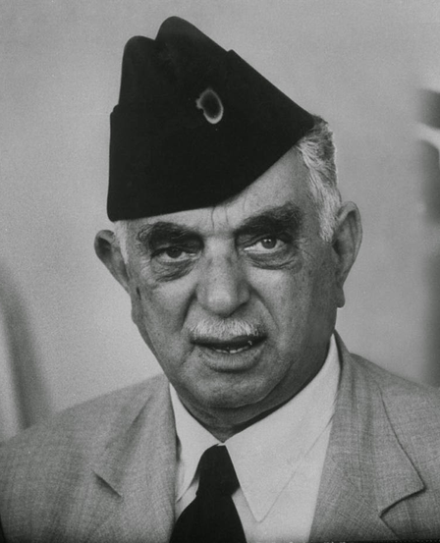

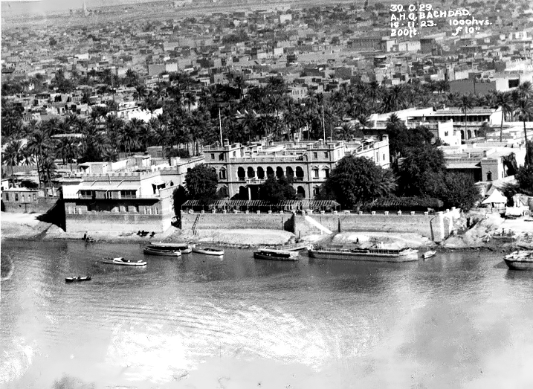


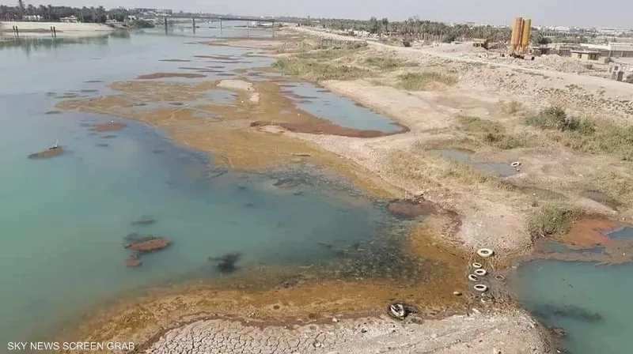
Iraq and the Water Crisis

Slide 2

Map of Presentation
1)Main Issue and Related Problems
2)Reasons for the Issue
Internal External
3)Current Policies
4) Solutions
Internal External

Slide 3
Main Issue: Water Scarcity:
💧 Lowest reserves in 80+ years
18 → 10 billion m³
Related Problems:
👥 Displacement
⚕️ Health Risks
✊ Political Instability
🌾 Food Security
🌍 Desertification

Slide 4
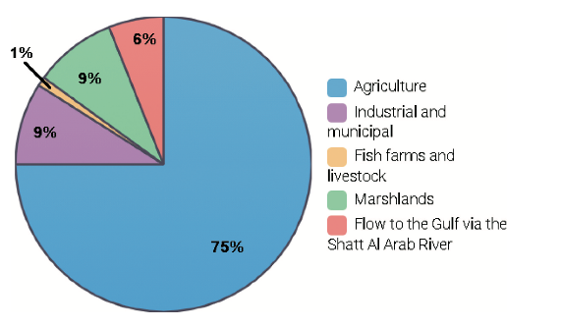
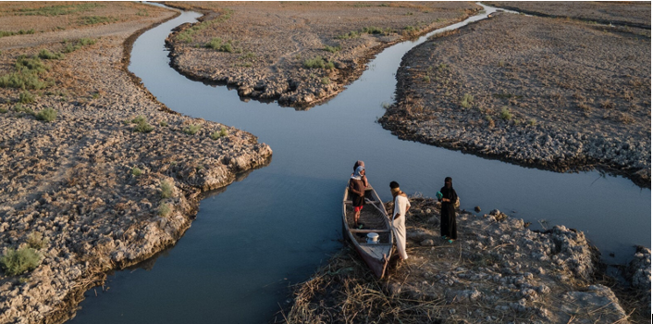
Reasons Behind Water Scarcity (Internal):
🚰 Poor irrigation infrastructure
🌱 Loss of seed variety
(Rubin and Denton 2023)

Slide 5
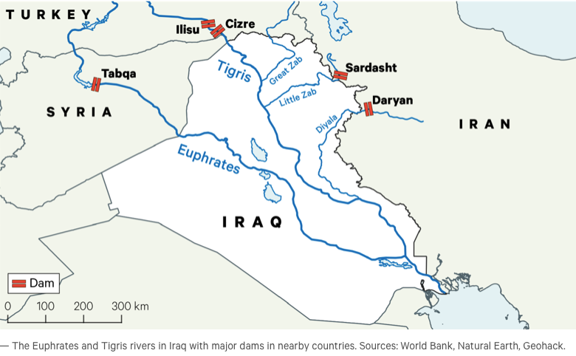
Reasons Behind Water Scarcity (External):
🌊 High dependence on rivers
Euphrates & Tigris: Turkey 71%, Iran 16.9%, Syria 4.1%, Iraq 8%
86% surface water, 14% groundwater
🏞️ Transboundary control (dams)
Turkey’s GAP (1980s–ongoing): 22 dams + 19 hydropower projects
Syria & Iran also have dams, but less influential

Slide 6
Government policies
💧 Desalination Projects (Basra, $4B – PowerChina, 2028)
Shatt al-Arab plant: 5,000 m³/hr
Al-Faw plant: 3,000 m³/hr
Al-Siba plant: 3,000 m³/hr
Abu Flous plant: 3,000 m³/hr
Safwan plant: 1,000 m³/hr
🌾 Centralized Agriculture
🌊 Water Agreements
Syria (1989): 58% Euphrates share
Turkey: temporary flow ↑ (oil-linked)
Criticized as election-driven
Amartya Sen
Poverty and Famines: An Essay on Entitlement and Deprivation (1981)
It is outdated and often not applied.

Slide 7
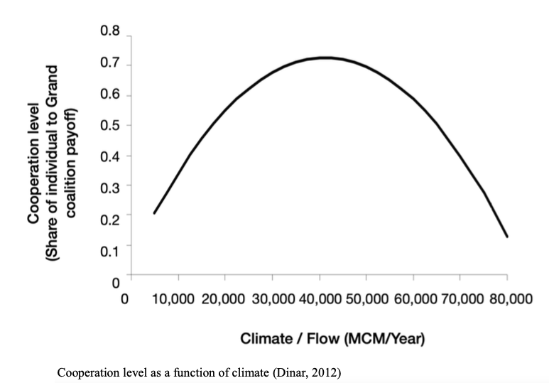
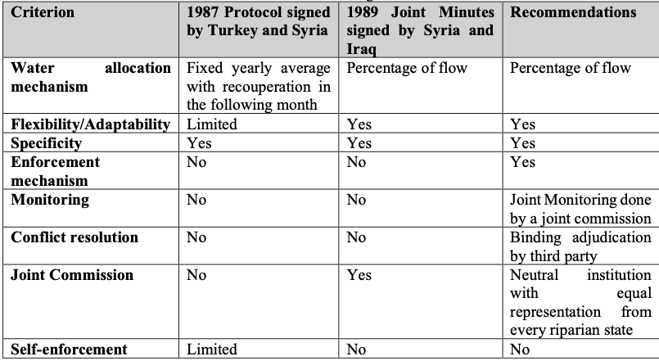
🌍 Solutions (External)
Improve water agreements with neighbors
Current treaties:
Syria–Iraq (1989): 58% Euphrates flow to Iraq, 42% to Syria
Syria–Turkey(1987): Syria receives 500 m³/sec from Turkey
(Grün 2024)

Slide 8
🏠 Solutions (Internal):
Improve irrigation – Farmer loans + efficient systems (gov’t loans pending, little progress).
Empower local initiatives – e.g., Gwez u Nakhl seed banks (Kurdistan, south Iraq, Lebanon).
Regenerative farming – Composting, cover crops, crop rotation (Enduring Harvest, Samawa Desert).

Slide 9
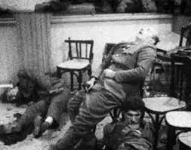

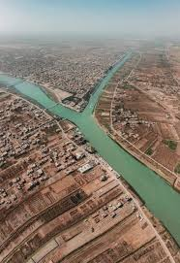



Slide 10
References:
Al-Shakeri, Hayder. 2024. Iraq’s Water Crisis: Dammed by Neighbours, Failed by Leaders | Chatham House – International Affairs Think Tank. August 14. https://www.chathamhouse.org/2025/08/iraqs-water-crisis-dammed-neighbours-failed-leaders.
Baghdad, Shafaq News. 2025. “Contaminated Rivers Raise Disease Risk in Iraq.” Shafaq News, September 4. https://shafaq.com/en/society/Contaminated-rivers-raise-disease-risk-in-Iraq.
Grün, Giulia. 2024. Transboundary Water Cooperation in the Euphrates Tigris River Basin – A Case Study. https://urn.kb.se/resolve?urn=urn:nbn:se:uu:diva-533734.
Jasim, Ansar, and Schluwa Sama. 2024. Imperialism and Iraq’s Agricultural System. June 17.
https://www.rosalux.de/en/news/id/52211/imperialism-and-iraqs-agricultural-system.
Salem, Amr. 2025. “PowerChina to Build $4 Billion Seawater Desalination Plant in Iraq.” Iraqi News, July 24. https://www.iraqinews.com/iraq/powerchina-to-build-4-billion-seawater-desalination-plant-in-iraq/.
Shamsulddin, Sarkawt. 2025. “Regenerative Farming in Iraq: Challenges, Opportunities, and Policy Recommendations.” Atlantic Council, August 7. https://www.atlanticcouncil.org/in-depth-research-reports/issue-brief/regenerative-farming-in-iraq-challenges-opportunities-and-policy-recommendations/.

