Slide 1
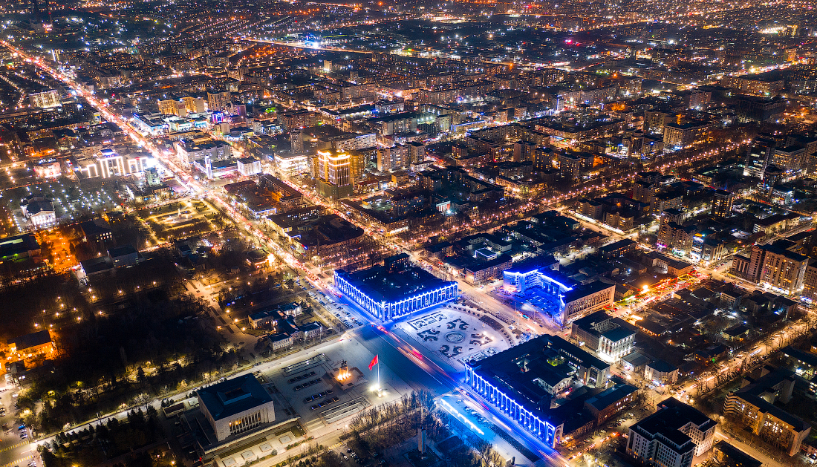
ECON -2675
Air Pollution in
Bishkek, Kyrgyzstan
Air Pollution in
Gulzina Abdikarim
Bishkek, Kyrgyzstan
ECON -2675
Gulzina Abdikarim

Slide 2
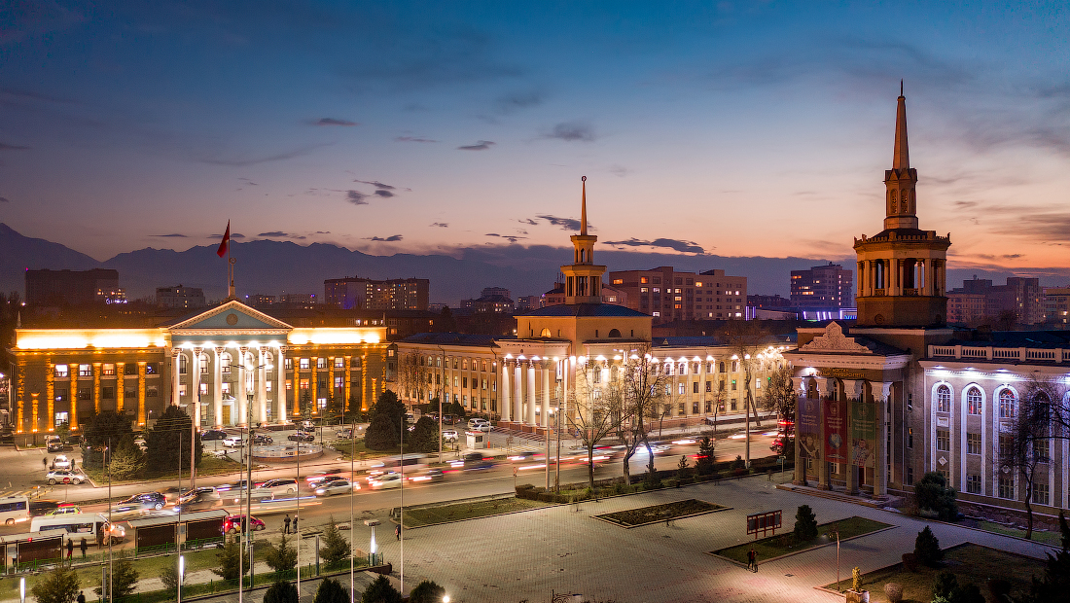
Table of Contents
Kyrgyz Republic
Air Pollution Overview
Causes of Air Pollution in Bishkek
Health Impacts
Measures Taken by the Government

Slide 3
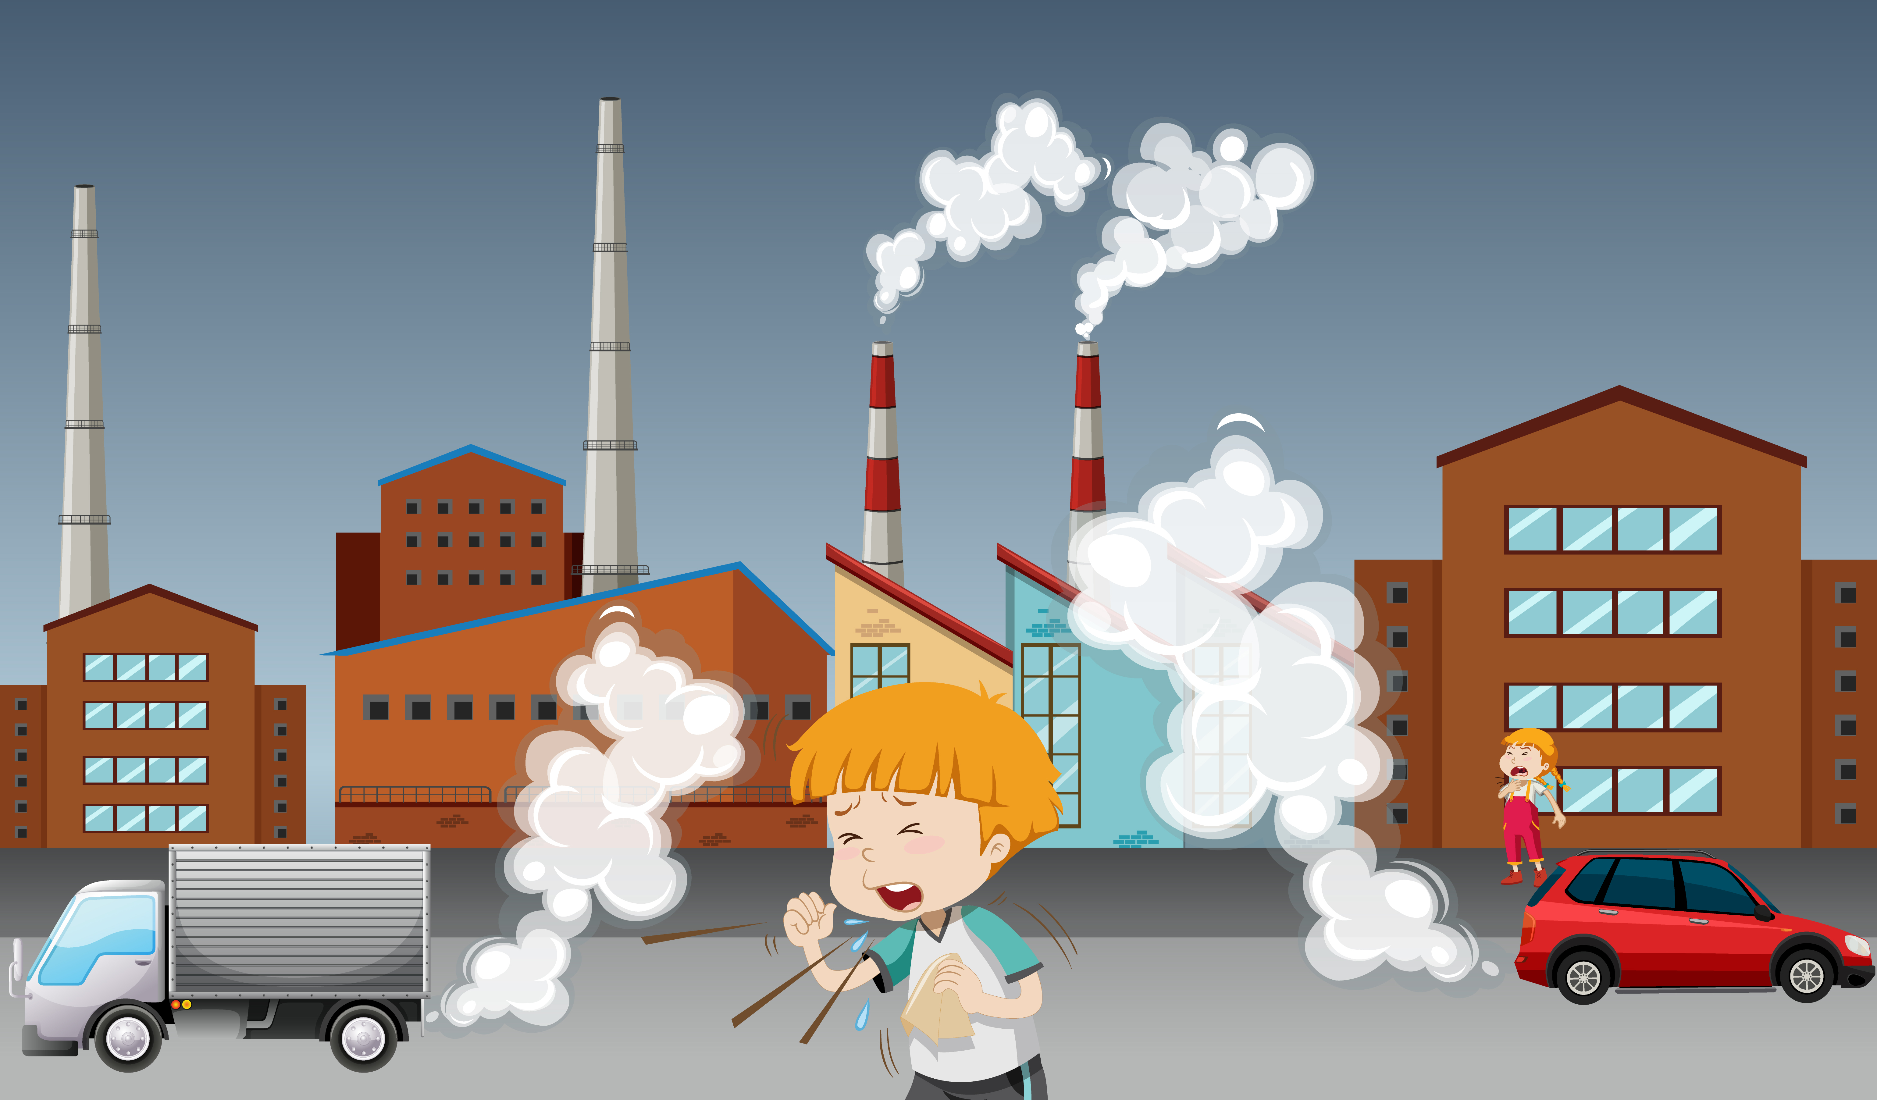
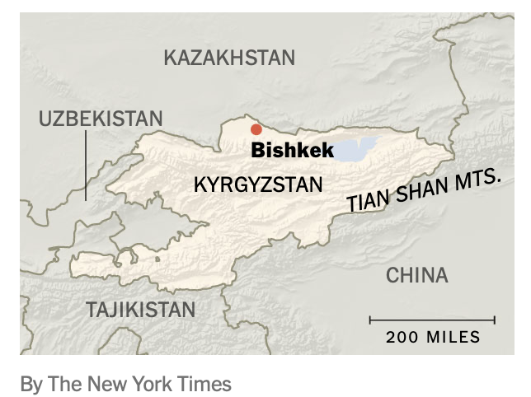
KYRGYZ REPUBLIC
Area: 199,951 sq km, 94 % of the country is covered by 88 mountains
Capital: Bishkek, Area 160sq km, Population - 1.02 million, altitude 800m
Population: 7,2 million
GDP per capita: $2,419.27
Languages: Kyrgyz, Russian
Life expectancy: 67 years (men), 76 years (women) The most vulnerable to climate change effects due to high mountain geography, a water-dependent economy, natural hazard exposure, and limited capacity to adapt or rebuild. (Source: World Bank, Debata, M. R. 2006)

Slide 4
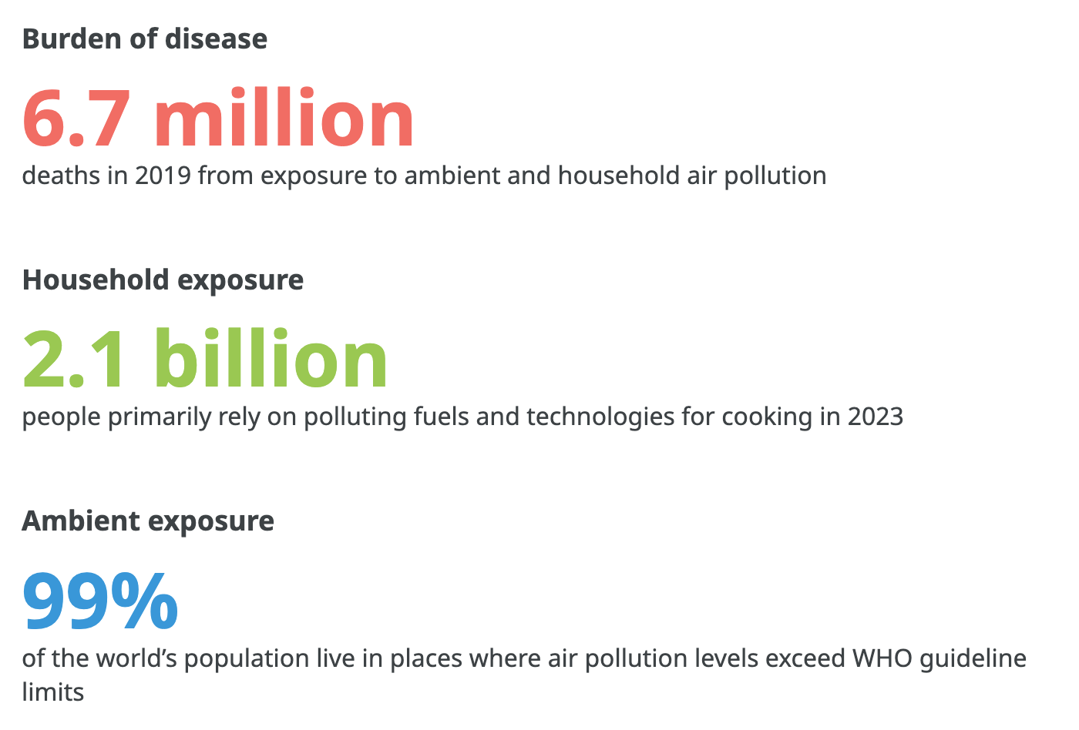
AIR POLLUTION
Air pollution is the contamination of the indoor or outdoor atmosphere by chemical, physical, or biological agents at concentrations that endanger human health, harm other living organisms, and damage the natural or built environment. Pollutants include particulate matter (PM2.5 and PM10), nitrogen oxides (NOx), sulfur dioxide (SO₂), ozone (O₃), carbon monoxide (CO) , and various volatile organic compounds (VOCs). (Gurjar, Molina, and Ojha 2010; WHO 2006)
Source: WHO 2023

Slide 5
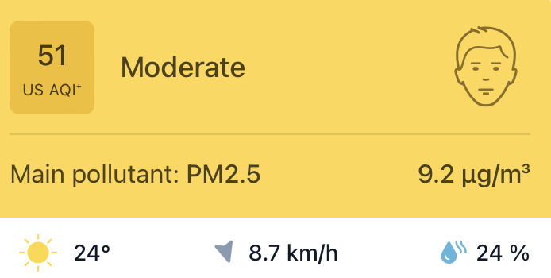
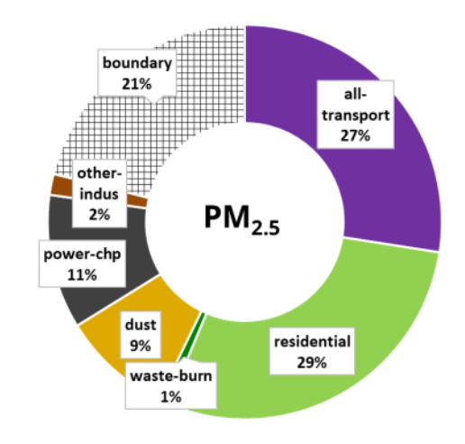
AIR QUALITY IN BISHKEK
Bishkek was among the worst global cities for air pollution in 2019
PM₂.₅ levels
Mid-Dec 2020: 184 µg/m³ (US AQI 234 – Very Unhealthy)
Early Dec 2020: “Hazardous” category
2019: 55.5–150.4 µg/m³ (Unhealthy)
April–Oct 2019: 12.1–35.4 µg/m³ (Moderate)
Annual mean < 10 µg/m³, 24-hr mean < 25 µg/m³ far exceeded the WHO guidelines
(Source: IQAir, 2020)
Sept 15, 2025
Sources (Guttikunda, Zlatev, Dammalapati, & Sahoo, 2022)
Notes:
The most significant environmental threat, even though there is no large-scale industrial pollution, Bishkek ranked at the top of the World ranking in 2019

Slide 6
Main Causes of Air Pollution in Bishkek
Motor Vehicles
Coal-fired Power Plants & Household Heating
Waste Burning and Landfill Fires
Geographic & Climatic Factors

Slide 7
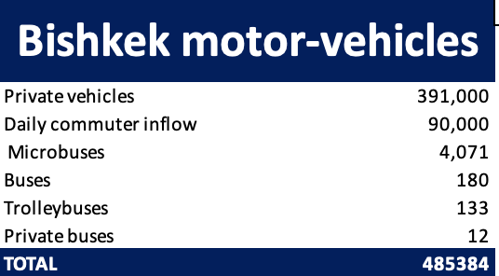
MOTOR VEHICLES
60-87% of outdoor air pollution is attributed to motor vehicles
Most vehicles are old, and run on low-quality fuel
Gasoline, some diesel, and a very few are hybrid used for vehicles
Vehicles do not undergo any technical inspections ( abolished in 2012 due to corruption concerns, but reintroduced again in 2021)
(Source: UNIDO, Health and Pollution Action Plan – Kyrgyz Republic, 2019)

Slide 8
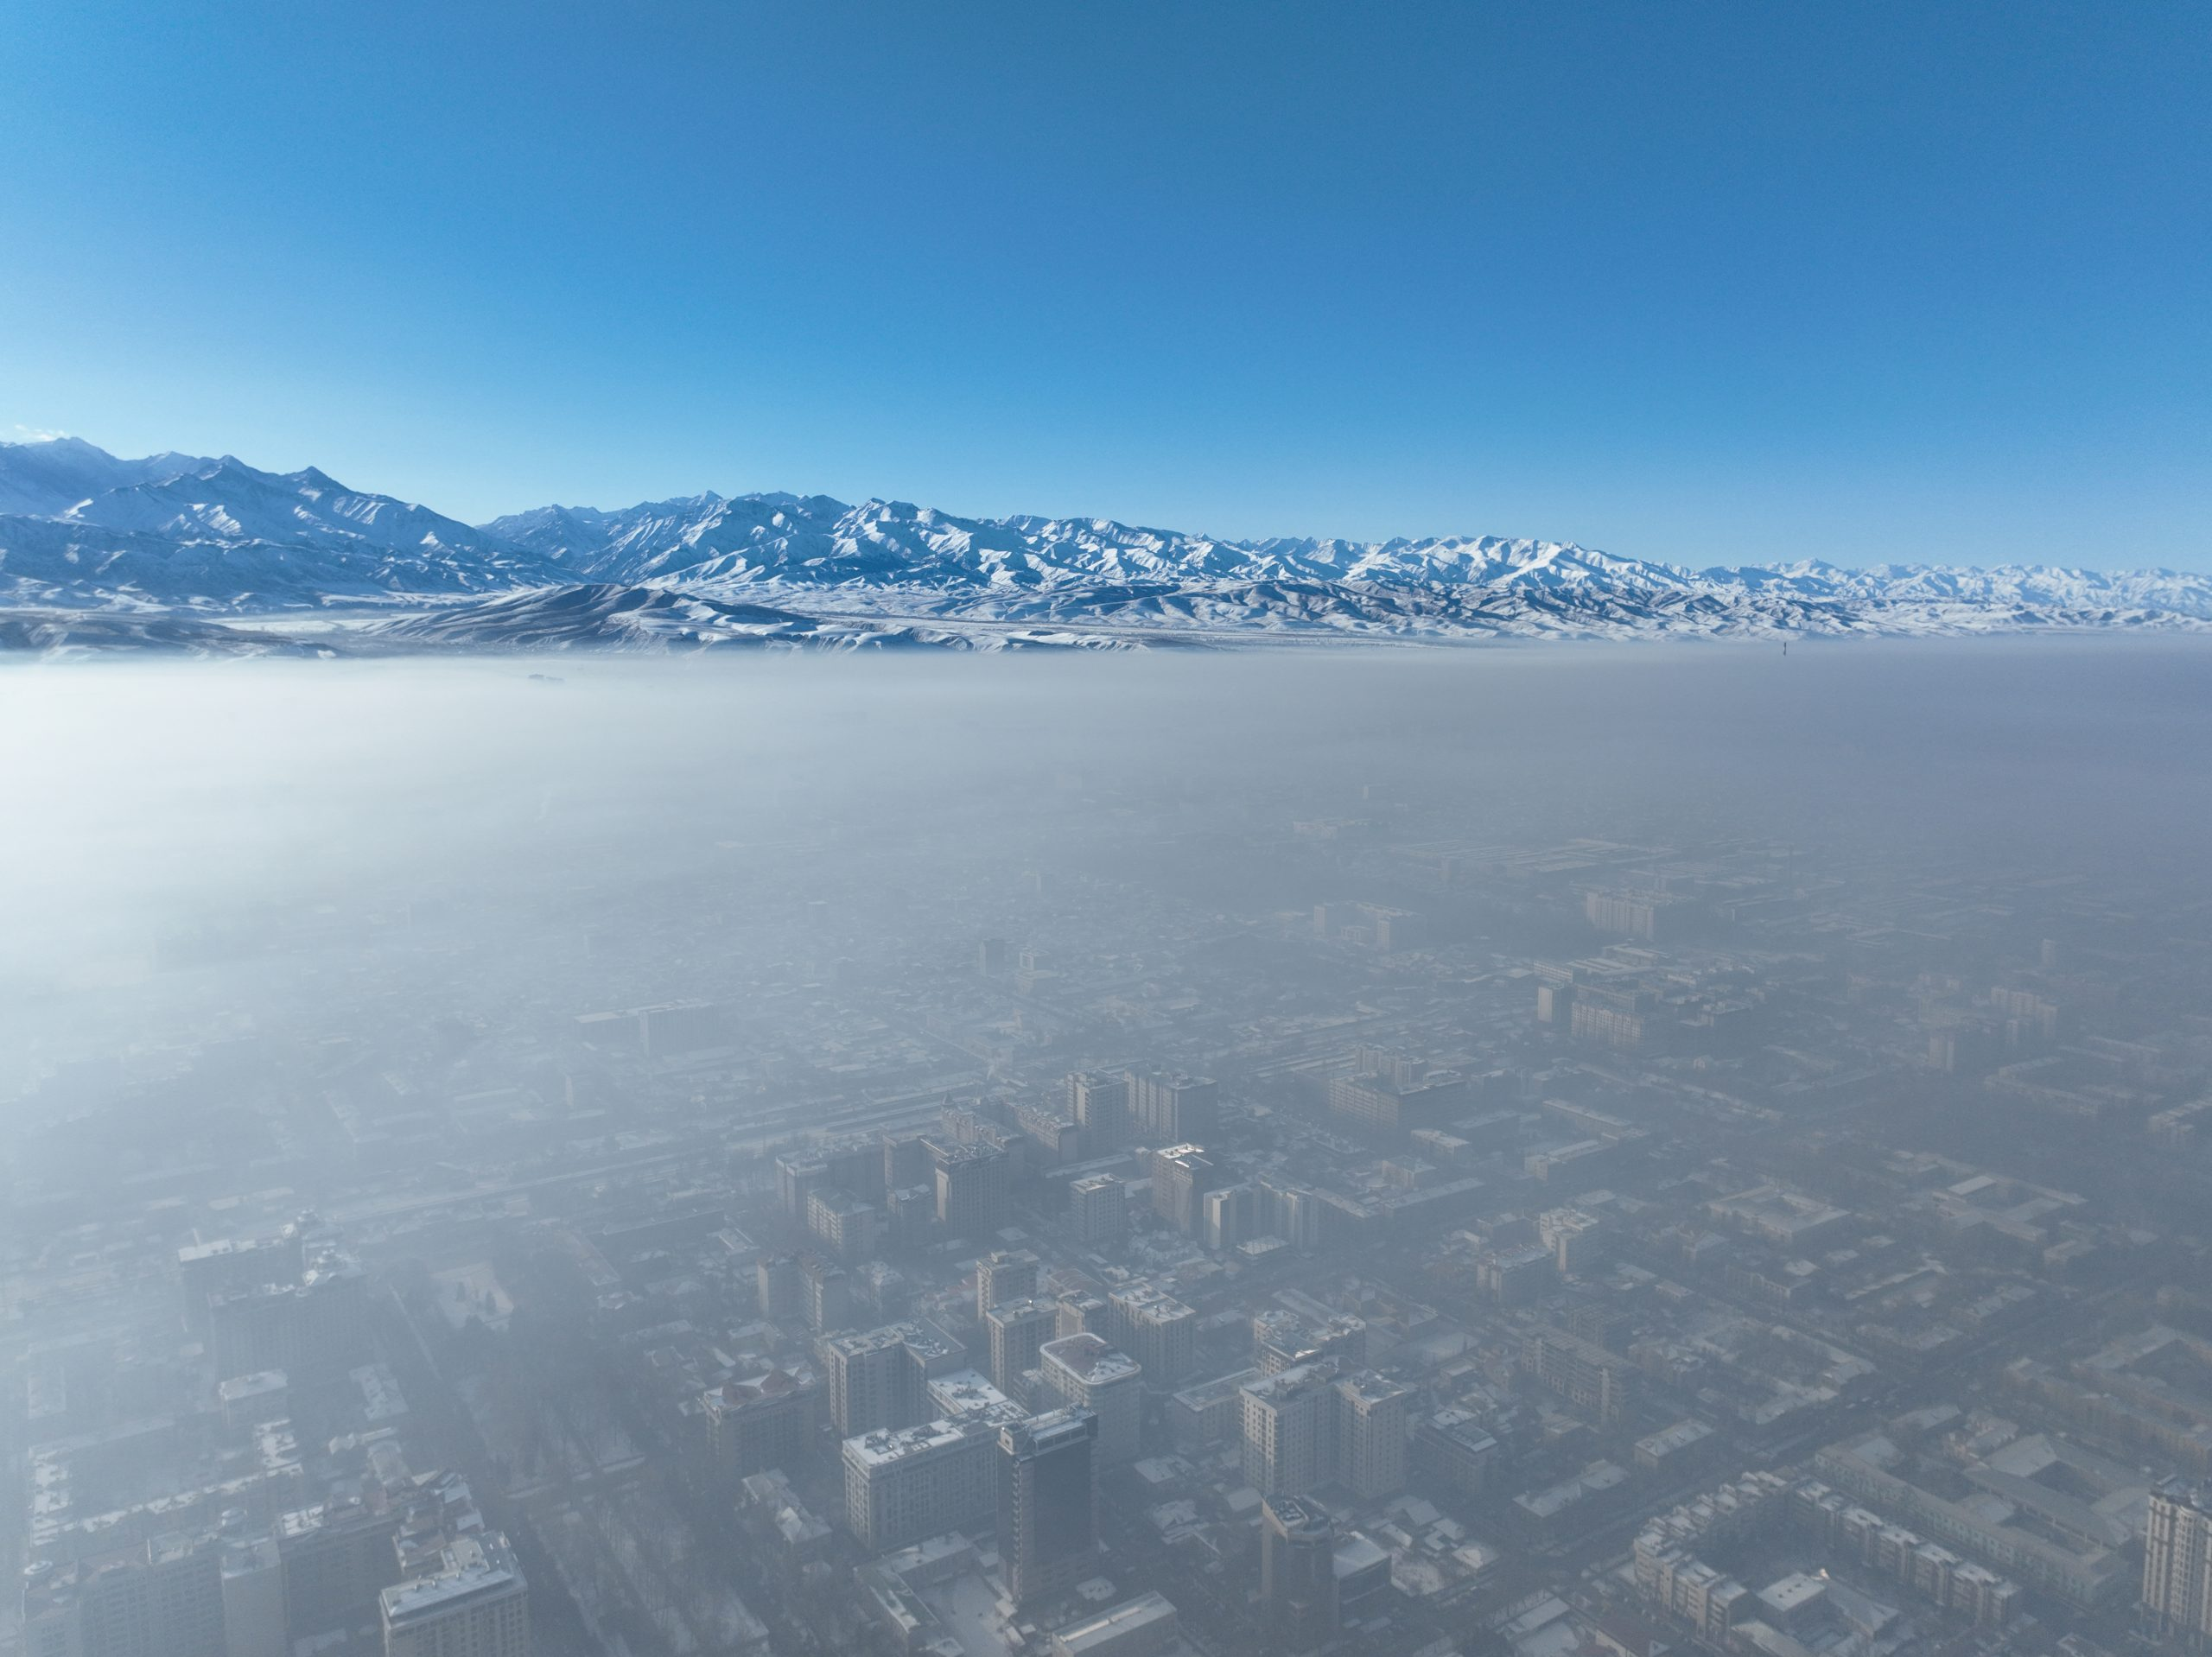
HEATING
Kyrgyzstan ranks 15th globally for coal resources, which explains why the main source of heating in cold winter seasons is not gas
Combined Heat and Power Station- large stationary emissions about 240,000 tons annually, 55% of SO2, 2.5 million tons of coal
Household heating - 40% of urban residents use coal-fired stoves or boilers in winter
Gazprom's programs promoted the use of natural gas, but it did not result in a big shift from coal
In January 2021, the local government called for the main heat and power plant to be converted from coal to natural gas, which is to be finalized in 2027.
CABAR.asia
https://www.youtube.com/watch?v=wrLZlEFid5I
Notes:
25% of people are below the poverty line favoring cheap coal over cleaner gas In Kyrgyzstan, four cities have district heating systems, with electric boilers being the primary
source of heat. However, the coal-powered DHC system in Bishkek, Kyrgyzstan, is
responsible for most of the city's air pollution during the winter months
During the St. Petersburg International Economic Forum in June 2024, Kyrgyzstan and Russian Gazprom signed long-term contracts to supply gas to Kyrgyzstan until 2040. According to Gazprom Kyrgyzstan, the full conversion to gas of the Bishkek power station was planned in October 2027

Slide 9
HOUSEHOLD WASTE & GEOGRAPHIC FACTORS
Open burning of household waste and periodic fires at the Bishkek landfill emit carcinogenic pollutants such as polycyclic aromatic hydrocarbons (PAHs).
Basin topography and frequent winter temperature inversions trap pollutants, preventing dispersion.
Climate change is increasing the number of inversion days, prolonging high-pollution episodes.

Slide 10
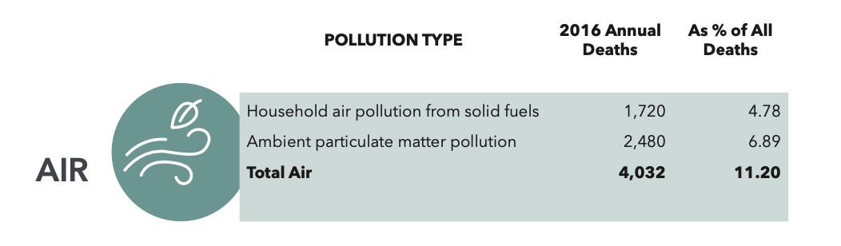
HEALTH IMPACTS
In 2019, 12% of the deaths were attributed to air pollution.
Yearly range remains 12–13% (4100-5000)
Health costs - $388million (6% of GNI) in 2015
Major diseases: stroke, ischemic heart disease, lung cancer, COPD, asthma
Children under 5 are highly vulnerable: 10% of deaths linked to pollution; impacts neurodevelopment and raises asthma/cancer risk
Notes:
In 2016 number of death was 33,475, 7% 4032 percent of all deaths from particulate matter. 80% of the pollution death was due to air pollution

Slide 11
GOVERNMENT MEASURES
Development Program 2018–2022 – “Unity, Trust, Creation” – short-term national plan embedding environmental protection and cleaner energy.
National Development Strategy 2018–2040 – long-term roadmap linking clean air with energy transition, transport reform, and sustainable growth.
Action Plan of the SAEPF on Ecological Improvement in Bishkek 2018–2022 – modernizes and expands the air-quality monitoring network and creates a sustainable transport strategy for the city.
Kyrgyzhydromet expansion – 50 PM₂.₅ sensors, one multi-pollutant station, and four new reference stations were installed.
Machine-learning forecasting system to predict PM₂.₅, NO₂, SO₂, and CO for early health alerts and policy
Seasonal electricity tariffs (low winter rates) make electric or heat-pump heating cheaper than coal.
Connection of homes to district heating and modernization of Bishkek’s CHP with higher stacks and better filtration of air

Slide 12
GOVERNMENT MEASURES
Energy-efficiency programs: building insulation incentives and enforcement of stricter building codes
Reintroduced mandatory vehicle inspections and maintenance to remove high-emission cars
Higher fuel-quality standards and restrictions on imports of old, polluting vehicles
Green public transport strategy with investments in electric/Euro-standard buses and safe cycling/walking networks.
Road paving and cleaning, suppression of landfill fires, and waste separation/recycling to cut dust and toxic smoke air
Enforced maximum allowable concentration (MAC) standards for PM₂.₅, NO₂, SO₂ and other pollutants from power plants81861
Support for clean-energy mandates, efficiency incentives, and combined heat-and-power modernization to

Slide 13
References
REFERENCES
Gurjar, B. R., Molina, L. T., & Ojha, C. S. P. (2010). Air Pollution: Health and Environmental Impacts. Boca Raton, FL: CRC Press.
World Health Organization. (2006). Air quality guidelines: Global update 2005. Copenhagen: WHO Regional Office for Europe. https://www.who.int/publications/i/item/WHO-SDE-PHE-OEH-06-02
UNDP and UNEP. 2022. Air Quality in Bishkek: Assessment of Emission Sources and Road Map. Bishkek, Kyrgyzstan: United Nations Development Programme & United Nations Environment Programme. https://www.undp.org/sites/g/files/zskgke326/files/2022-10/air_quality_in_bishkek_eng_1.pdf.
United Nations Industrial Development Organization (UNIDO). 2019. Health and Pollution Action Plan: Kyrgyz Republic. Vienna: UNIDO. Funded by the European Union and the United States Agency for International Development. Link
Isaev, Erkin, Boobek Ajikeev, Urmatbek Shamyrkanov, Kenjebek-uulu Kalnur, Karimov Maisalbek, and Roy C. Sidle. “Impact of Climate Change and Air Pollution Forecasting Using Machine Learning Techniques in Bishkek.” Aerosol and Air Quality Research 22, no. 3 (2022): 210336. https://doi.org/10.4209/aaqr.210336
Dzushupov, K. O., Buban, J. M. A., Aidaraliev, A. A., Ahmadi, A., Chahal, P., Ibrahim, M., Lin, X., & Kouwenhoven, M. B. N. (2022). Air pollution in Bishkek, Kyrgyzstan: Driving factors and state response. Public Health Challenges, 1(3), e22. https://doi.org/10.1002/puh2.22
Ness, J. E., Heath, G., & Ravi, V. (2022). An overview of policies influencing air pollution from the electricity sector in Central Asia (NREL/TP-7A40-81861). National Renewable Energy Laboratory. https://www.nrel.gov/docs/fy23osti/81861.pdf
Isajev, E., Ajikeev, B., Shamyrkanov, U., Kenjebek-uulu, K., Maisalbek, K., & Sidle, R. C. (2021). Impact of climate change and air pollution forecasting using machine learning techniques in Bishkek. Aerosol and Air Quality Research, 21(11), 210336. https://doi.org/10.4209/aaqr.210336
Debata, M. R. (2006). KYRGYZSTAN: A PROFILE. Himalayan and Central Asian Studies, 10(2), 140-145. Retrieved from https://proxy.library.georgetown.edu/login?url=https://www.proquest.com/scholarly-journals/kyrgyzstan-profile/docview/1317112071/se-2
The World Bank. (n.d.). People – Kyrgyz Republic. Data360. Retrieved [date you accessed it], from https://data360.worldbank.org/en/economy/KGZ?tab=People

Slide 14
ECON -2675
Thank You
Air Pollution in
Gulzina Abdikarim
Bishkek, Kyrgyzstan
ECON -2675

