Slide 1
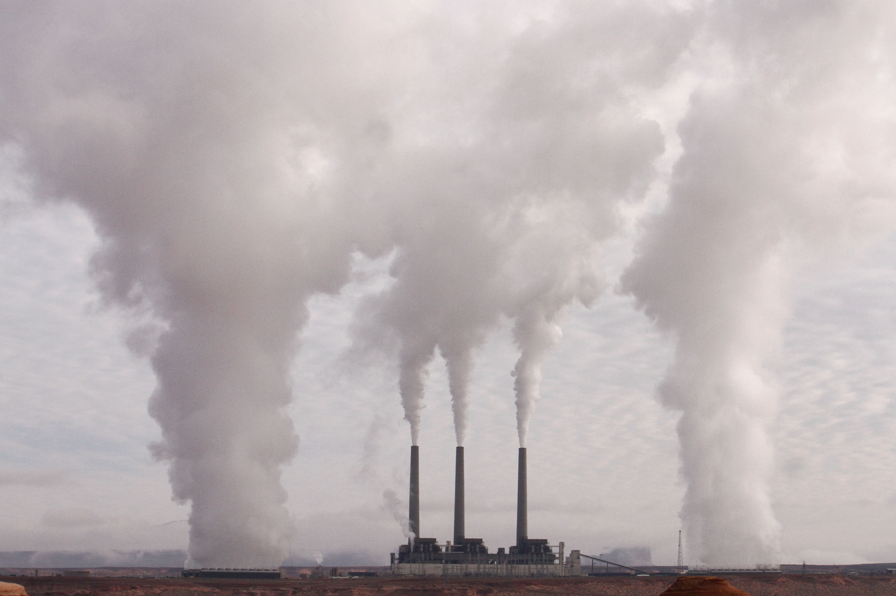

Ambient Air Pollution in France
Causes, Effects, and Solutions
September 16, 2025
Understanding the Impact and How We Can Help

Slide 2

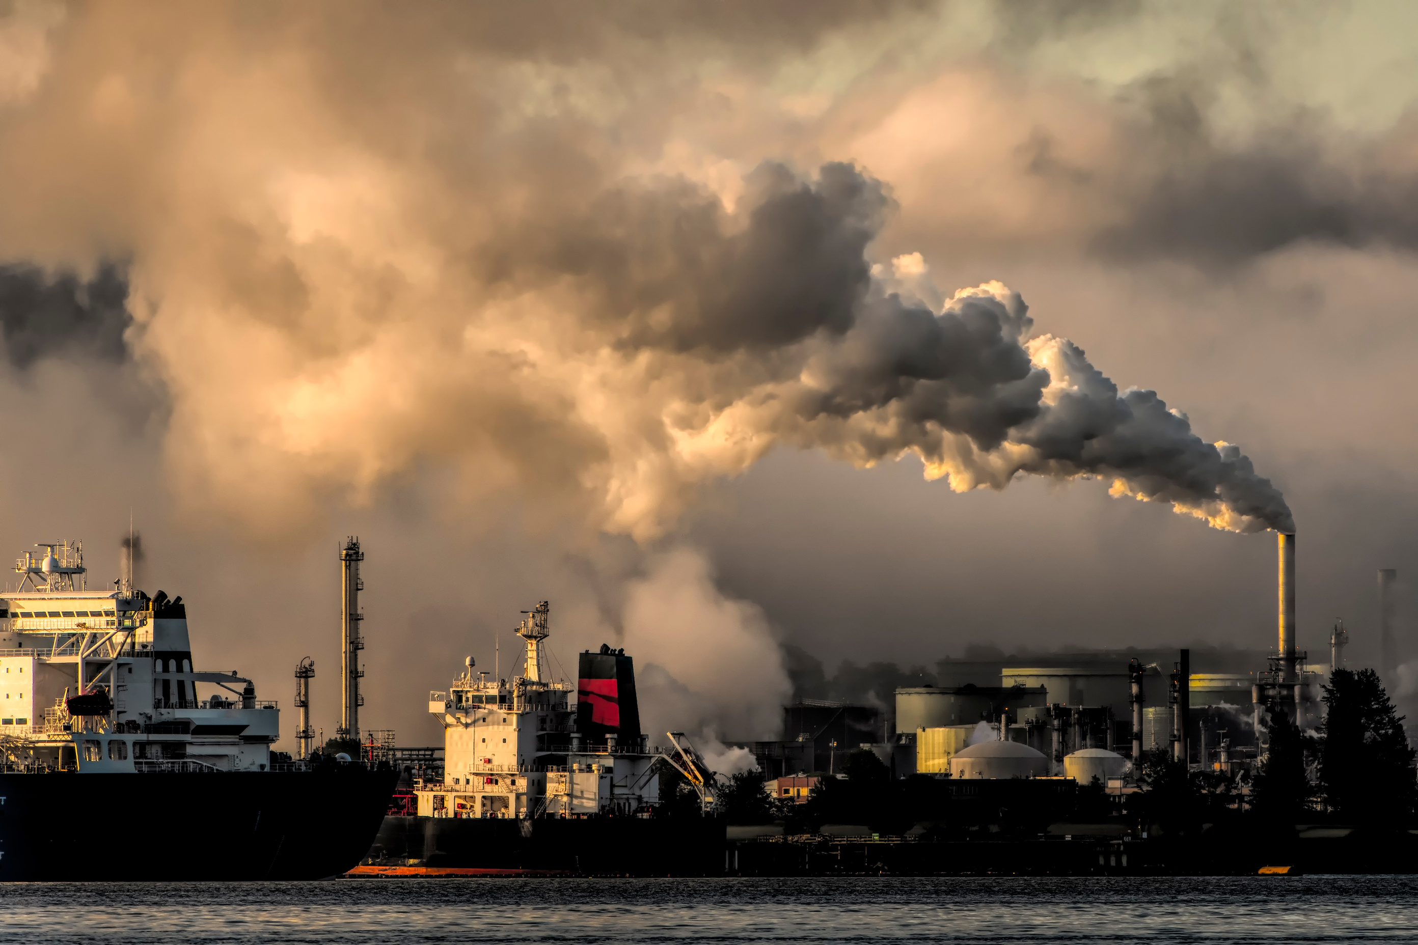
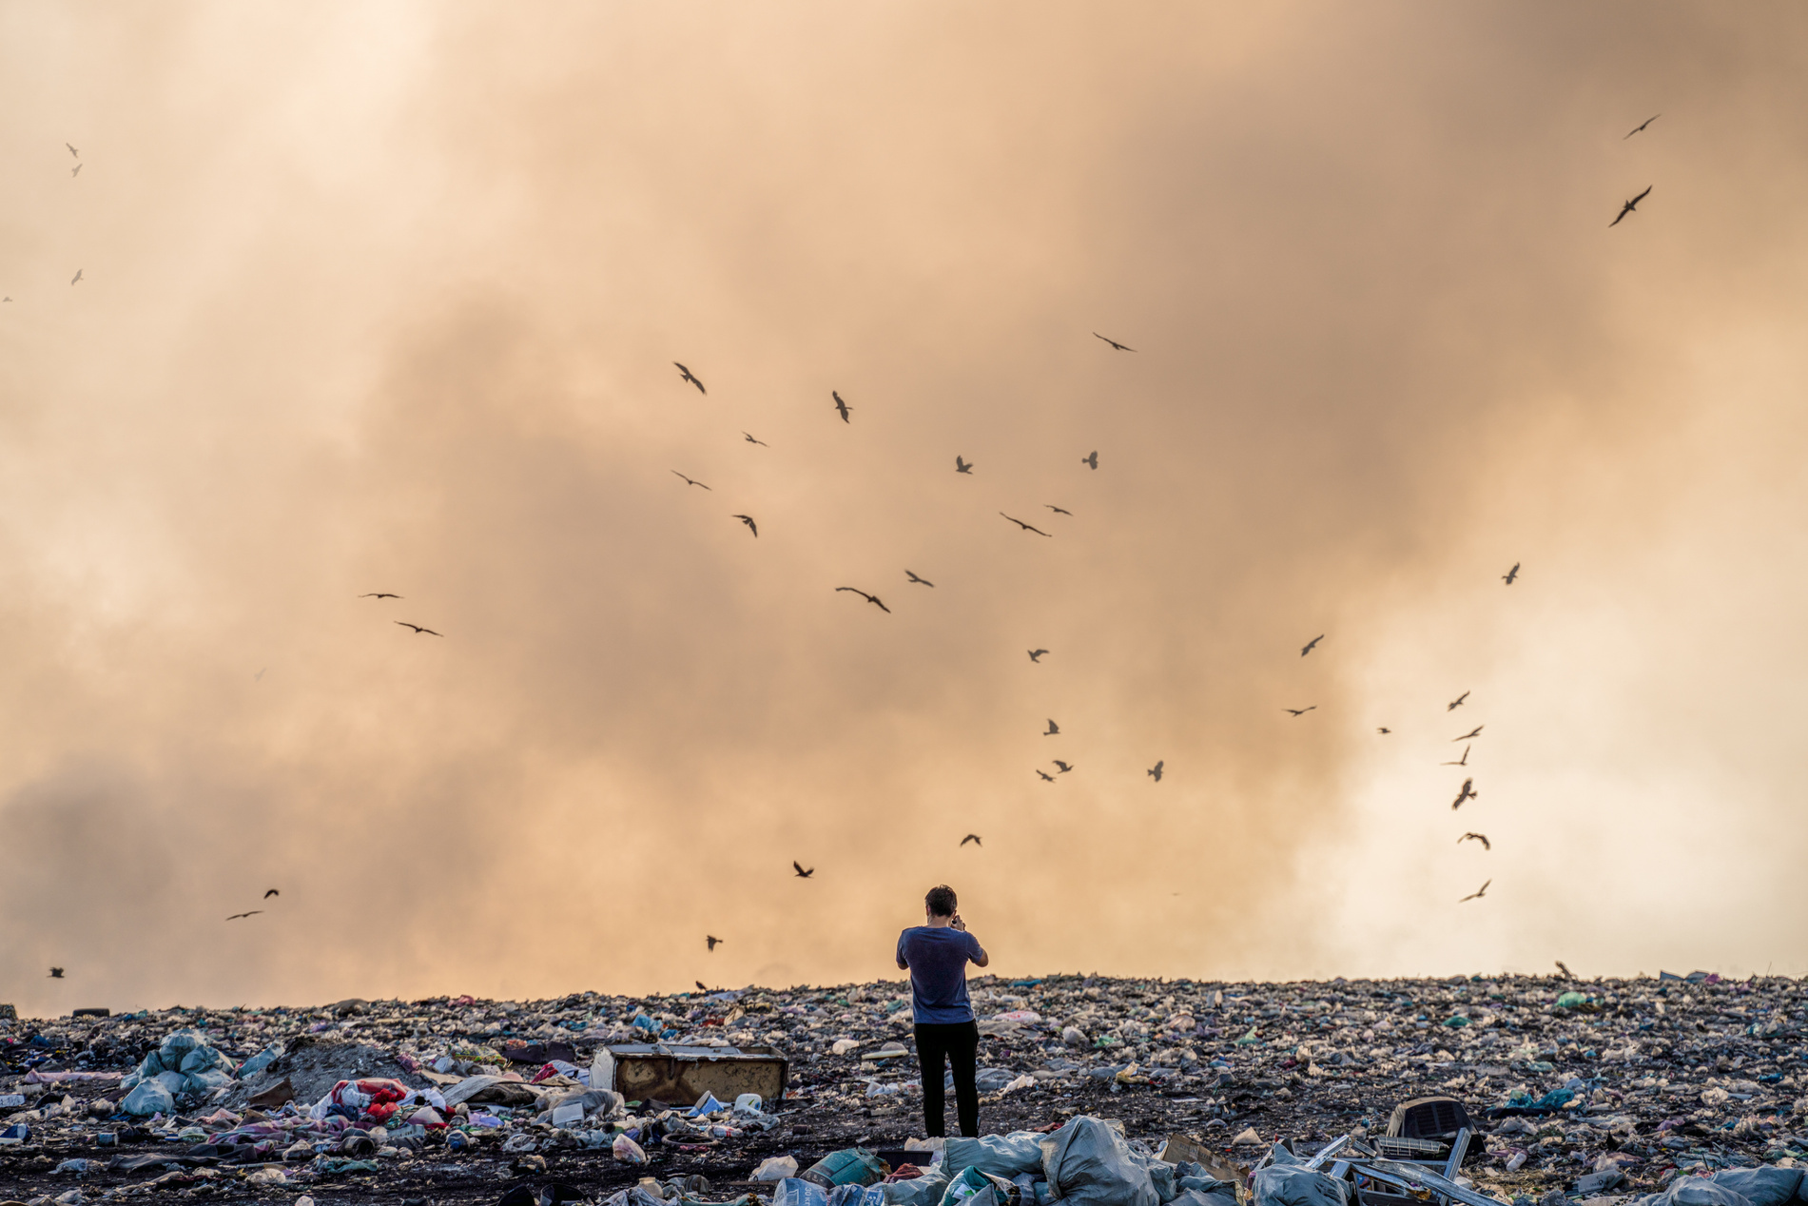
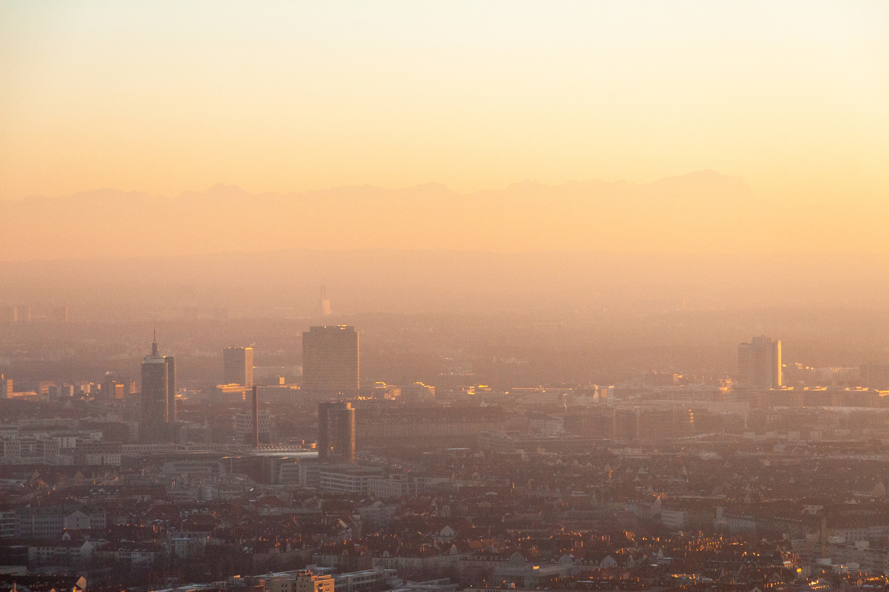
Liceria & Co.
What is Air Pollution?
Introduction
Ambient air pollution in France, NO2, PM2.5, and ultrafine particles from traffic and residential wood burning, is a major non-climate environmental health risk
Impacts are unequal, and authorities are responding with alerts and low-/limited-emission zones to cut exposure

Slide 3
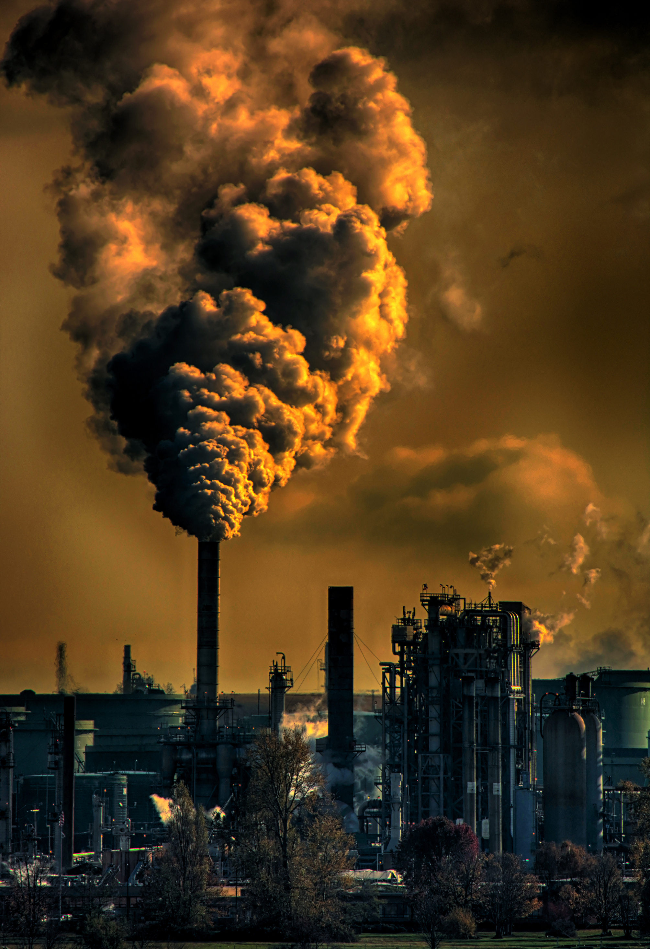
Paris Air-Quality Alerts: Do They Save Lives?
Paris operates an Air-Quality Alert (AQA) system for high-pollution episodes (Alari et al., 2021)
Study evaluates cause-specific premature mortality during alerts (Alari et al., 2021)
Findings inform timing of traffic restrictions and public health advisories (Alari et al., 2021)

Slide 4
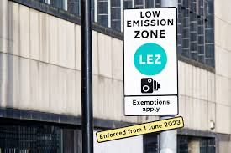
Designing LEZ for Health Gains (Greater Paris)
Modeled LEZ scenarios show reductions in NO₂/PM₂.₅ and related health gains (Host et al., 2020)
Broader zones and stricter standards yield larger benefits (Host et al., 2020)
Results help set ambition levels for Crit’Air restrictions (Host et al., 2020)
Natural Sources
Air pollution can occur naturally through events like wildfires, volcanic eruptions, and dust storms. Wildfires produce smoke and fine particulate matter, worsening air quality and respiratory conditions. Volcanic eruptions release sulfur dioxide and ash, leading to acid rain and climate effects. Dust storms lift fine particles into the air, causing visibility issues and respiratory hazards. While these sources are beyond human control, climate change and deforestation can intensify their impact.

Slide 5
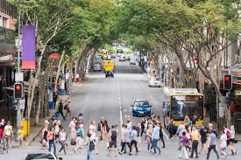
Liceria & Co.
Health-impact assessment across neighborhoods by deprivation (Moreno et al., 2022)
LEZ designs can reduce childhood asthma and premature adult mortality, with equity implications (Moreno et al., 2022)
Complementary investments (transit, active mobility) improve fairness (Moreno et al., 2022)
Equity Lens: Who Benefits From LEZ?

Slide 6
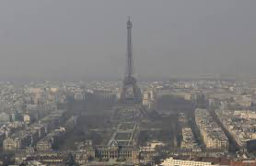
The Planet Under Threat
Source-apportioned oxidative potential of PM₁₀ highlights traffic and residential wood burning (Weber et al., 2021)
Toxicity is not just about mass; source matters for biological activity (Weber et al., 2021)
What Makes Paris PM Toxic? (Oxidative Potential)
Policy: target non-exhaust traffic (brake/tire) and wood-burning appliances (Weber et al., 2021)

Slide 7
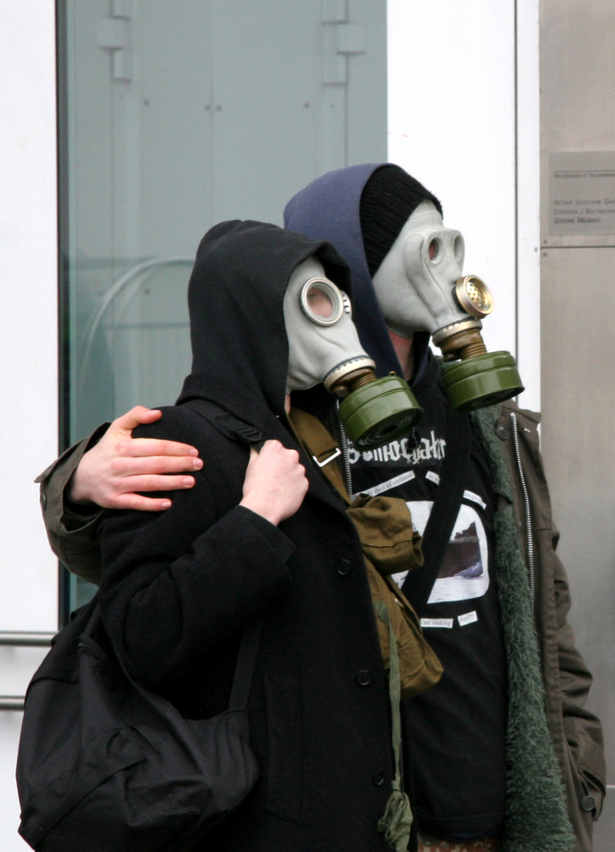
Ultrafine Particles (UFP) 2020–2022: A Rising Concern
The Cost of Air Pollution
Street-level monitoring shows UFP counts increased as activity rebounded post-lockdowns (Abbou et al., 2024)
UFP are numerous, penetrate deeply, and are not covered by mass-based limits (Abbou et al., 2024)
Implication: expand monitoring and address engine-out and non-exhaust UFP (Abbou et al., 2024)

Slide 8
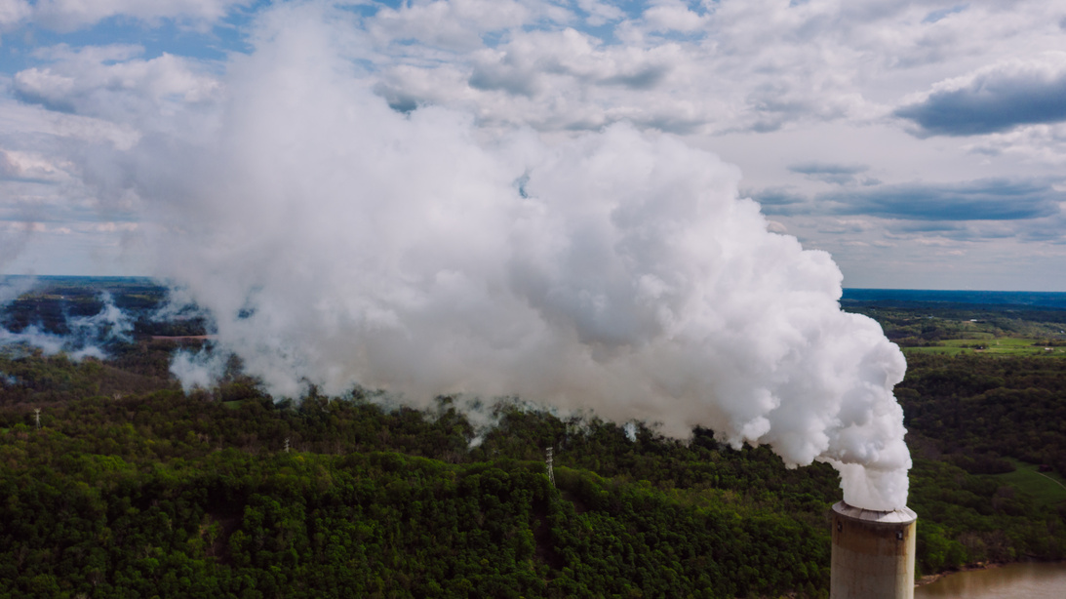
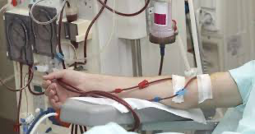
Liceria & Co.
Vulnerable Populations: Dialysis Cohort
Multi Pollutant Exposure
Nationwide cohort on dialysis shows higher mortality with multi-pollutant exposure (Hamroun et al., 2024)
Risks emerge from combined pollutants, not single-pollutant views (Hamroun et al., 2024)
Policy: multi-pollutant management and protection for high-risk groups (Hamroun et al., 2024)

Slide 9
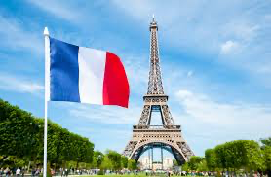
Personal Actions for a Cleaner Future
Episodes: Alerts with temporary traffic measures and targeted health guidance (Alari et al., 2021)
Structure: LEZ scale/criteria tuned for maximum health benefit (Host et al., 2020)
Equity: Pair LEZ with transit/active mobility to spread benefits fairly (Moreno et al., 2022)
Sources: Tackle wood burning and non-exhaust traffic toxicity (Weber et al., 2021)
New metrics: Add UFP monitoring and controls (Abbou et al., 2024)
Protection: Multi-pollutant management for vulnerable groups (Hamroun et al., 2024)
How France Is Addressing the Problem (Synthesis)

Slide 10
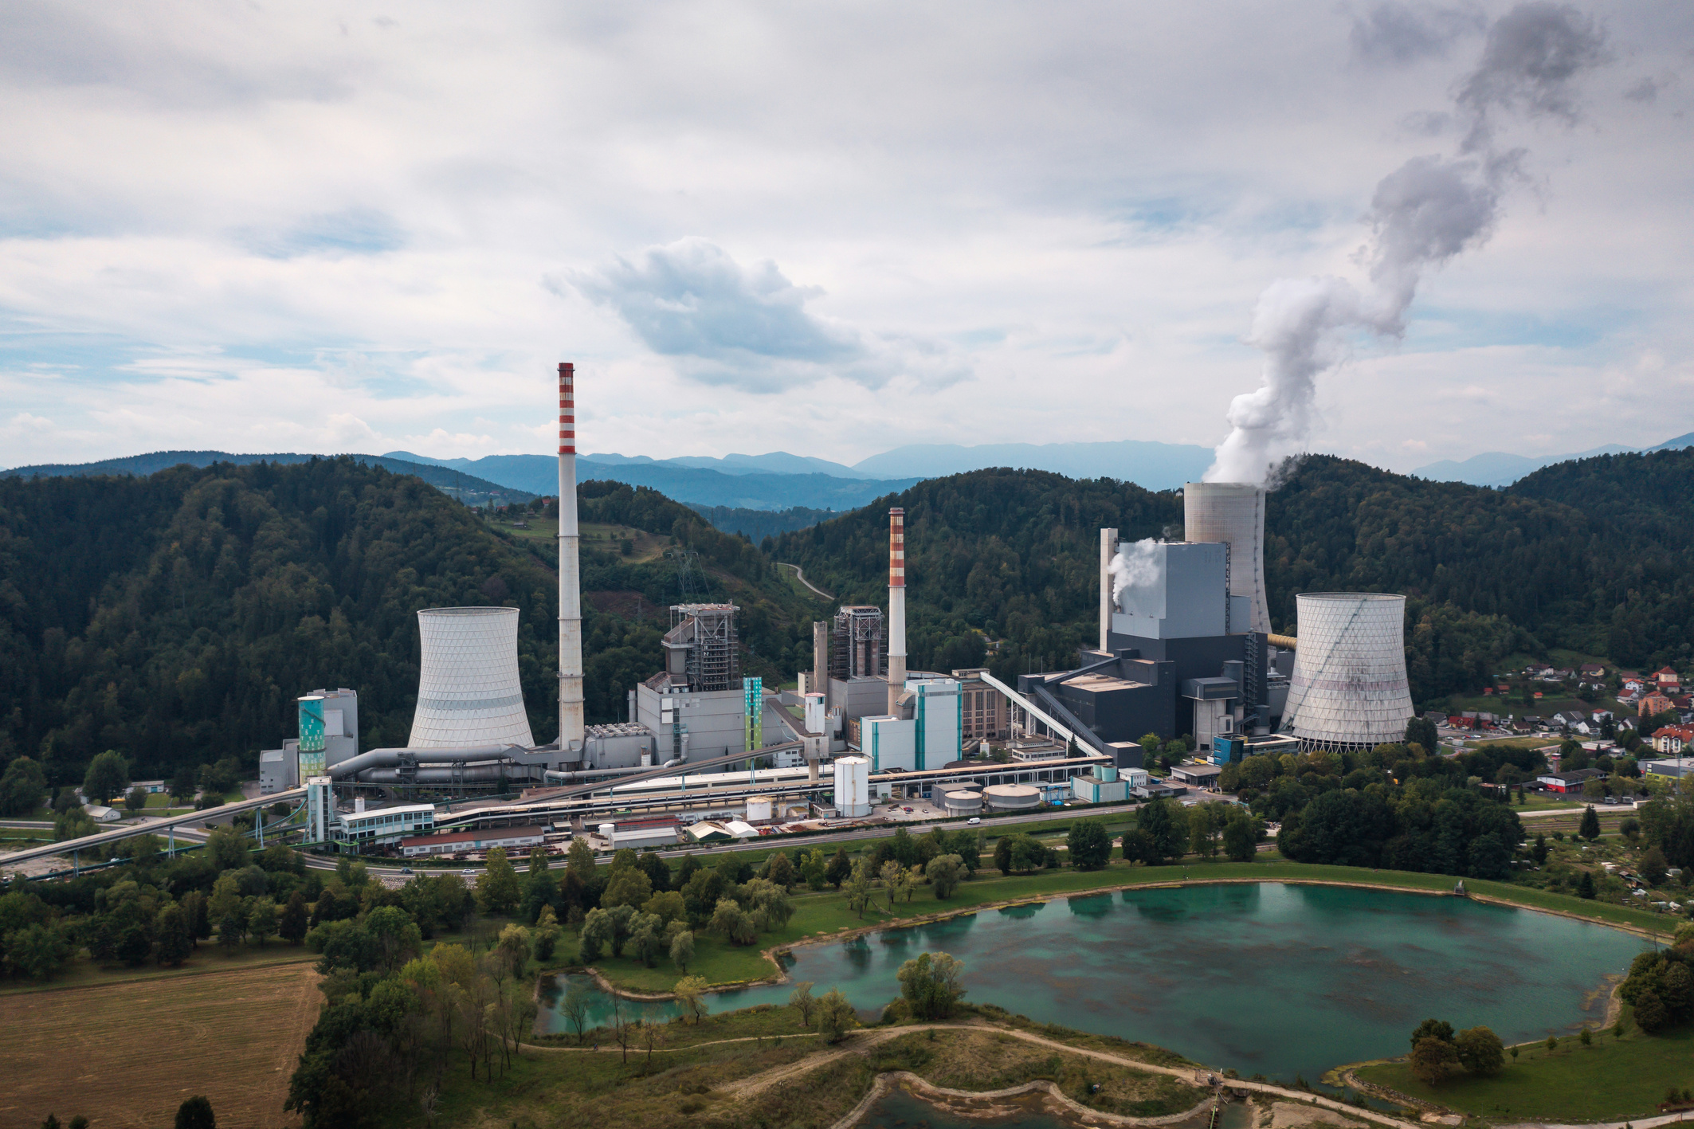
Real-World Impact
Liceria & Co.
Optimize alerts with rapid, evidence-based triggers (Alari et al., 2021)
Expand and tighten LEZ where modeling shows net health gains (Host et al., 2020)
Equity checks in every phase; invest in alternatives to driving (Moreno et al., 2022)
Seasonal wood-burning restrictions and appliance upgrades (Weber et al., 2021)
Pilot particle-number limits and UFP-oriented street measures (Abbou et al., 2024)
Prioritize high-risk patients in exposure-reduction programs (Hamroun et al., 2024)
Policy Roadmap: Near-Term Actions

Slide 11
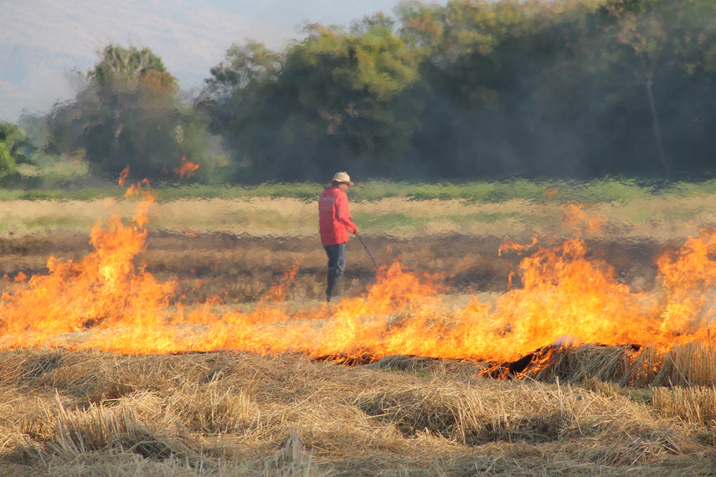
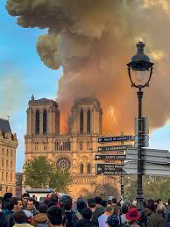
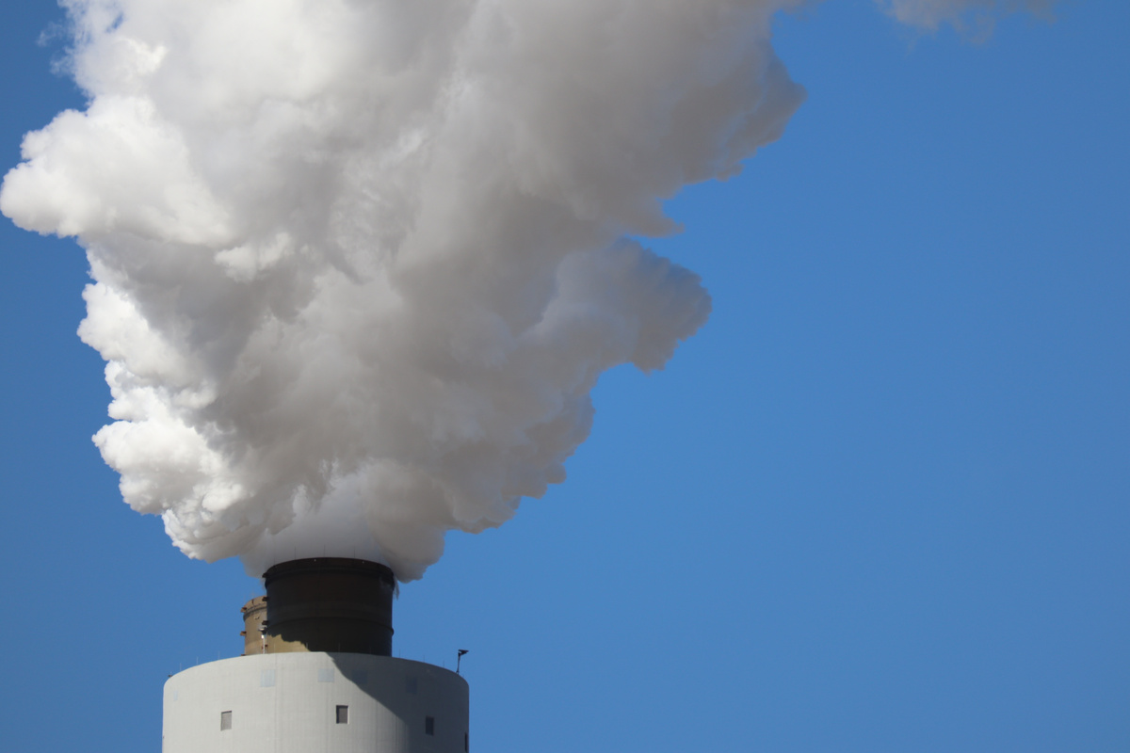
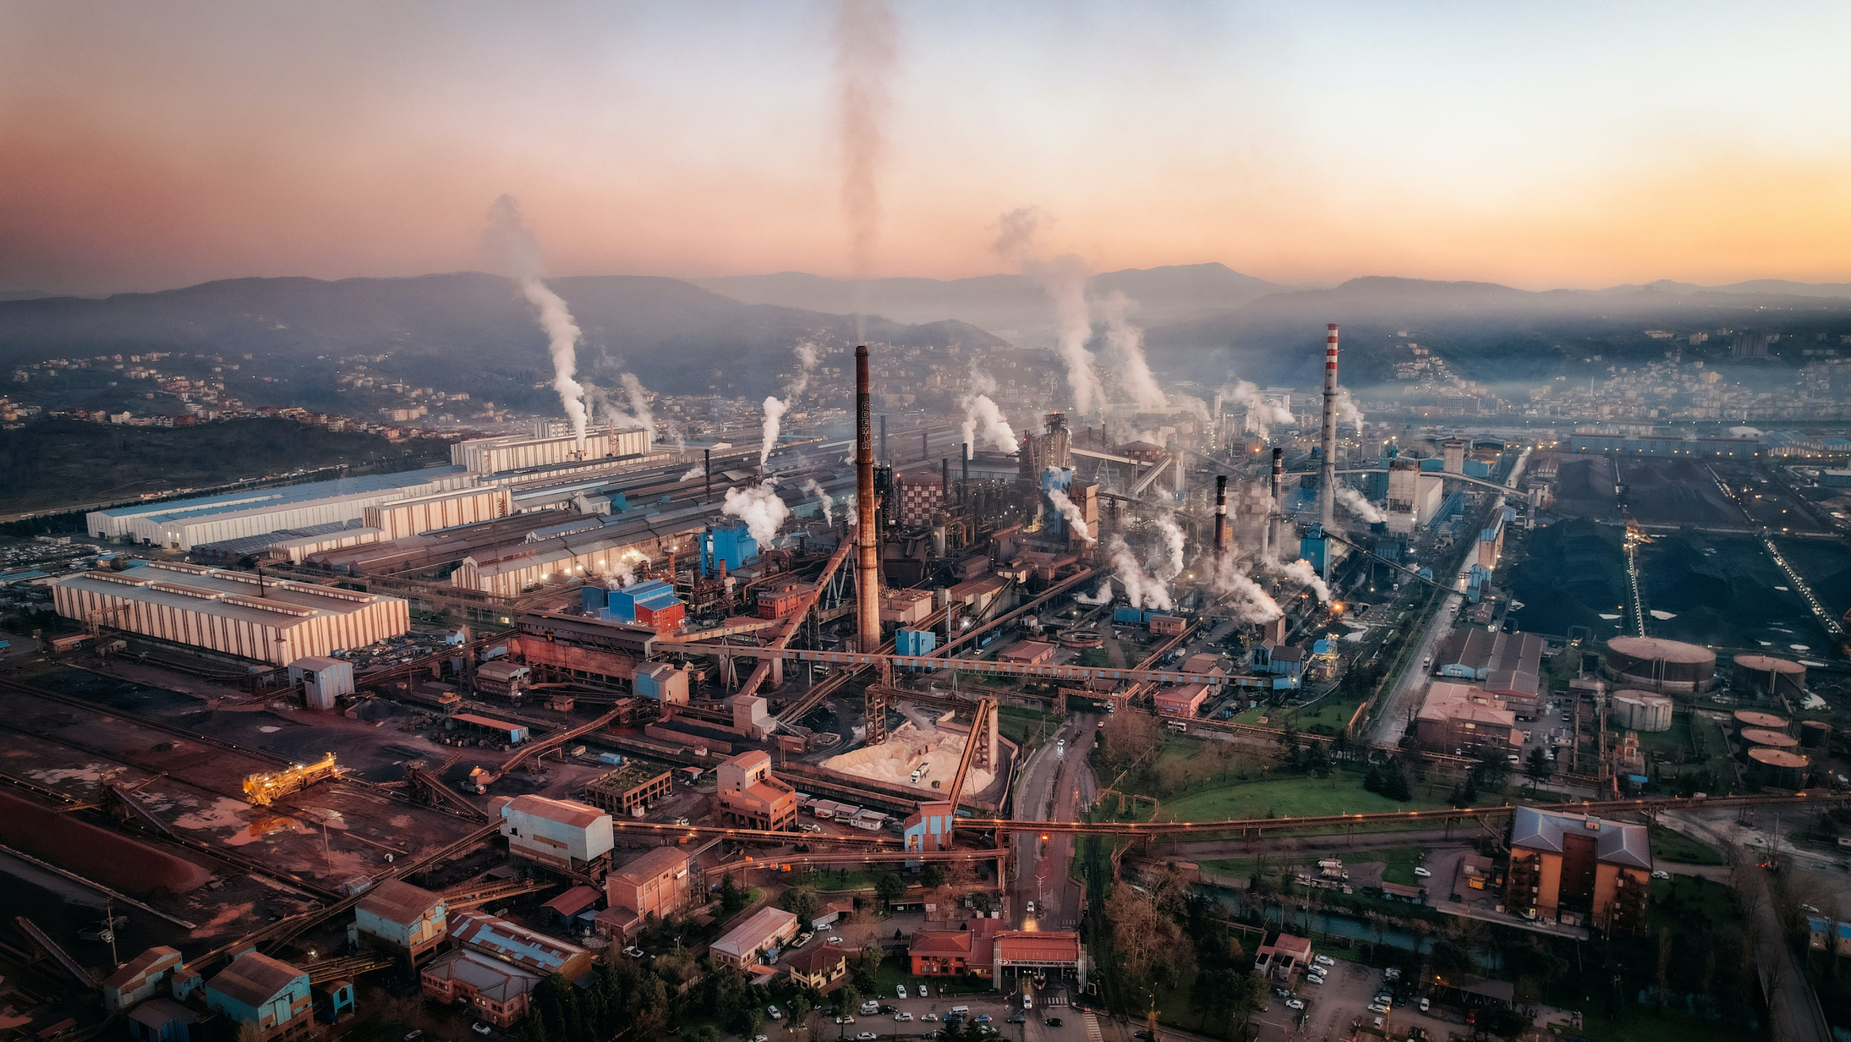
Liceria & Co.
What We Got
Conclusion
France’s ambient air pollution story, rooted in long-standing traffic and residential wood-burning sources with a post-lockdown rise in ultrafine particles, now shows unequal health harms and policy responses (alerts and low/limited emission zones), summing to persistent causes, clear effects, and targeted yet evolving controls

Slide 12
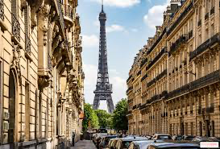
Alari, A. et al. (2021). Paris air-quality alerts and premature mortality. Environment International.
Host, S. et al. (2020). Health benefits from alternative LEZ designs in Greater Paris. Environmental Research.
Moreno, T. et al. (2022). Equity impacts of LEZ on NO₂/PM₂.₅ and health in Paris. Air Quality, Atmosphere & Health.
Weber, S. et al. (2021). Oxidative potential and source apportionment of Paris PM₁₀. Atmospheric Chemistry and Physics.
Abbou, R. et al. (2024). Trends in ultrafine particle counts in Paris, 2020–2022. Aerosol and Air Quality Research.
Hamroun, A. et al. (2024). Multi-pollutant exposure and mortality in a French dialysis cohort. Frontiers in Public Health.
Citations

Slide 13

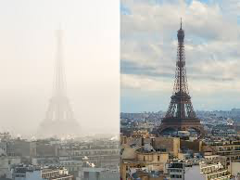
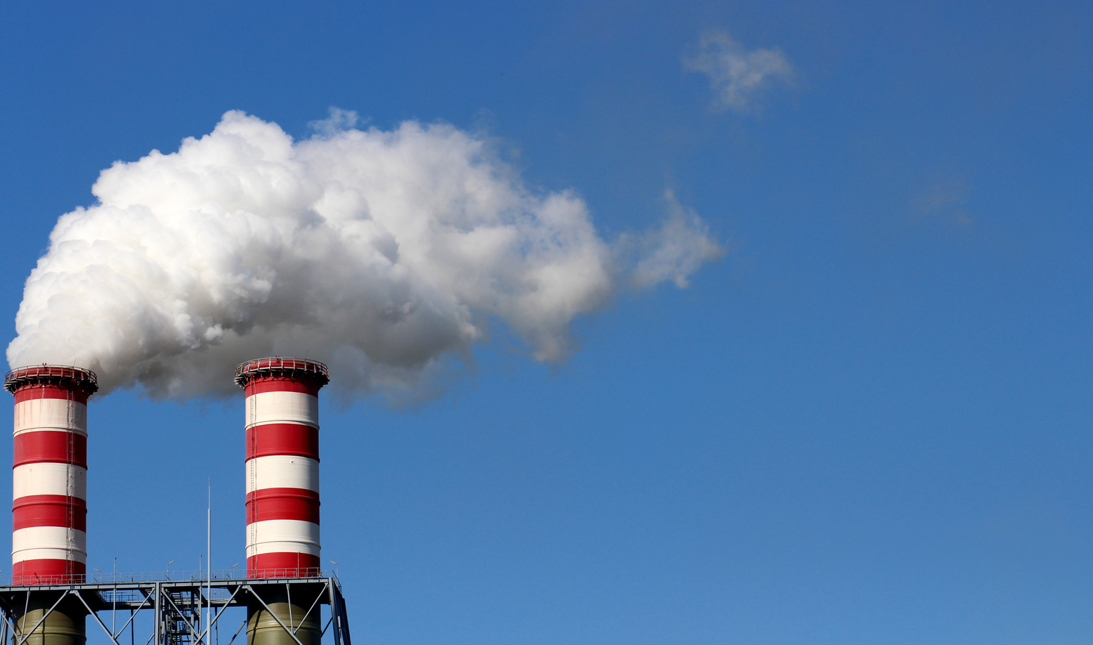
Liceria & Co.
Thank You

