Slide 1
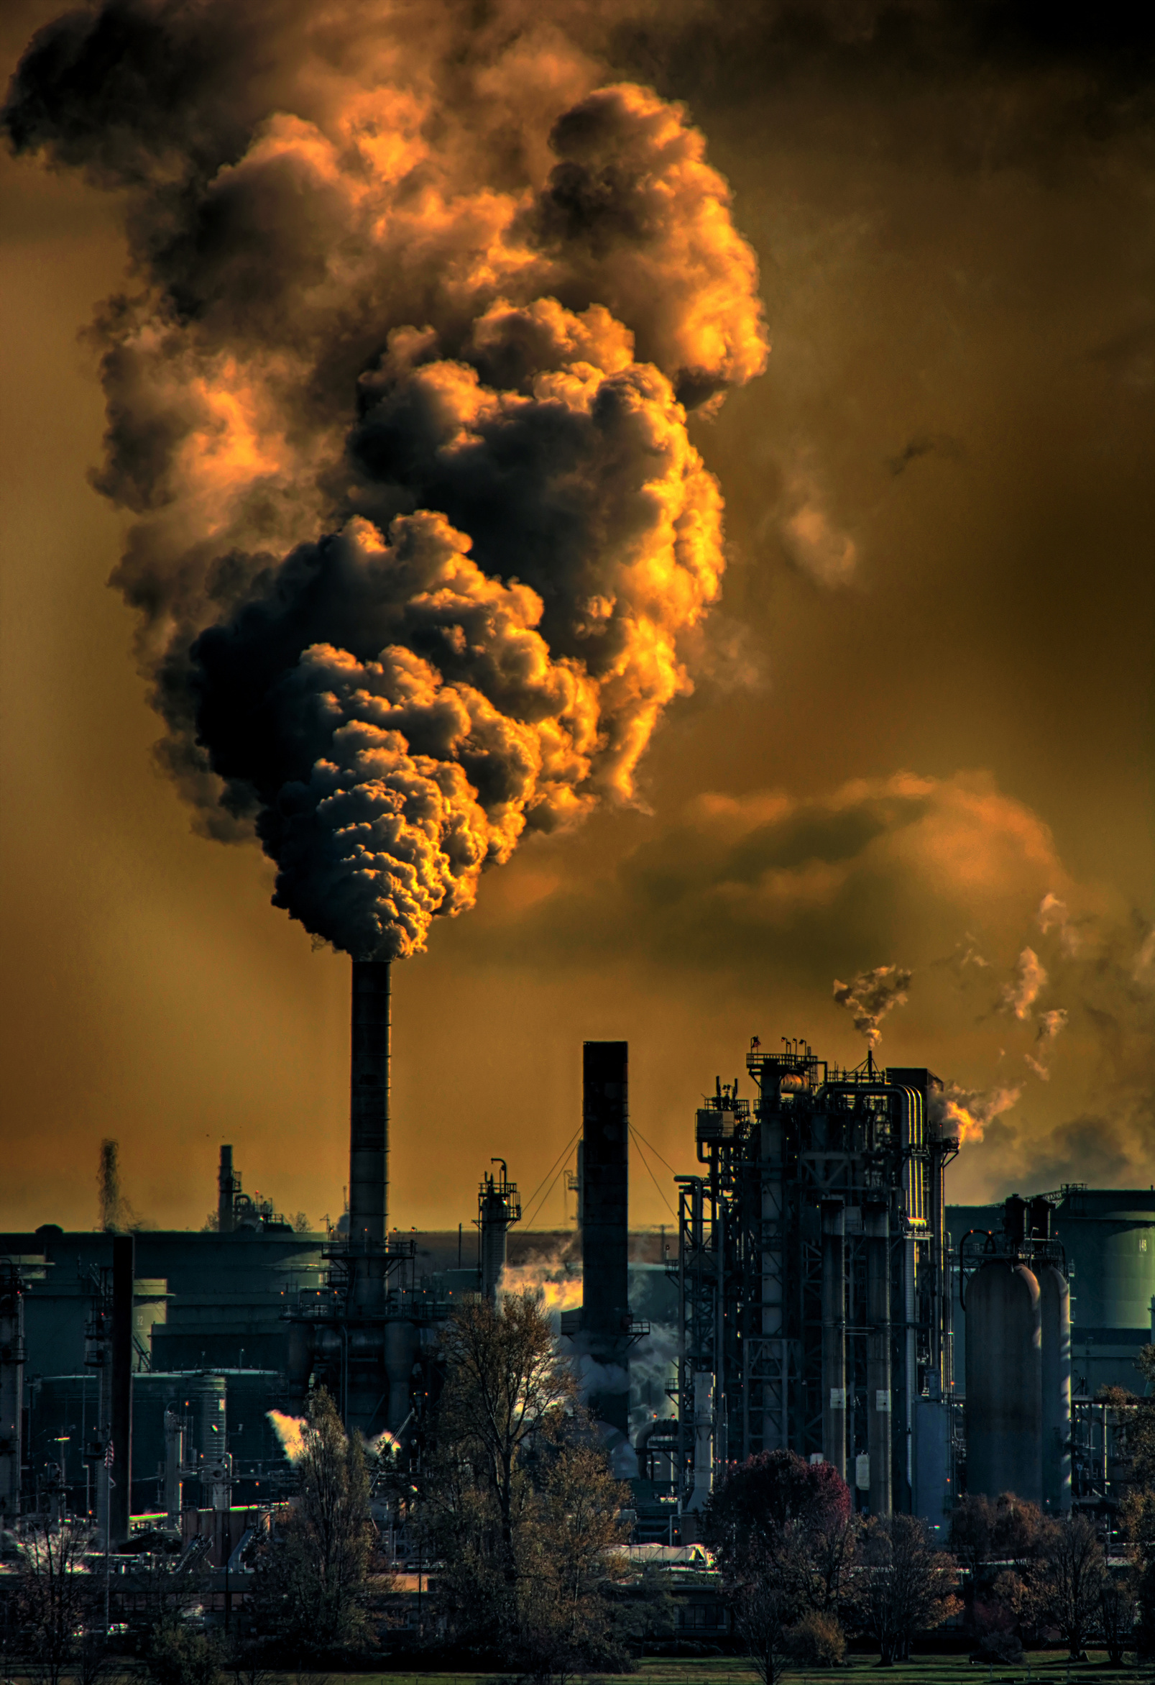

Alibek Zhanabergenov
15.09.2025
KAZAKHSTAN’S URBAN AIR POLLUTION
Notes:
Hello everyone. My name is Alibek , and today I will present on one of the most pressing environmental issues in Kazakhstan: urban air pollution. While climate change is often discussed, air pollution is the immediate crisis that affects the health, economy, and daily life of millions of Kazakh citizens.

Slide 2
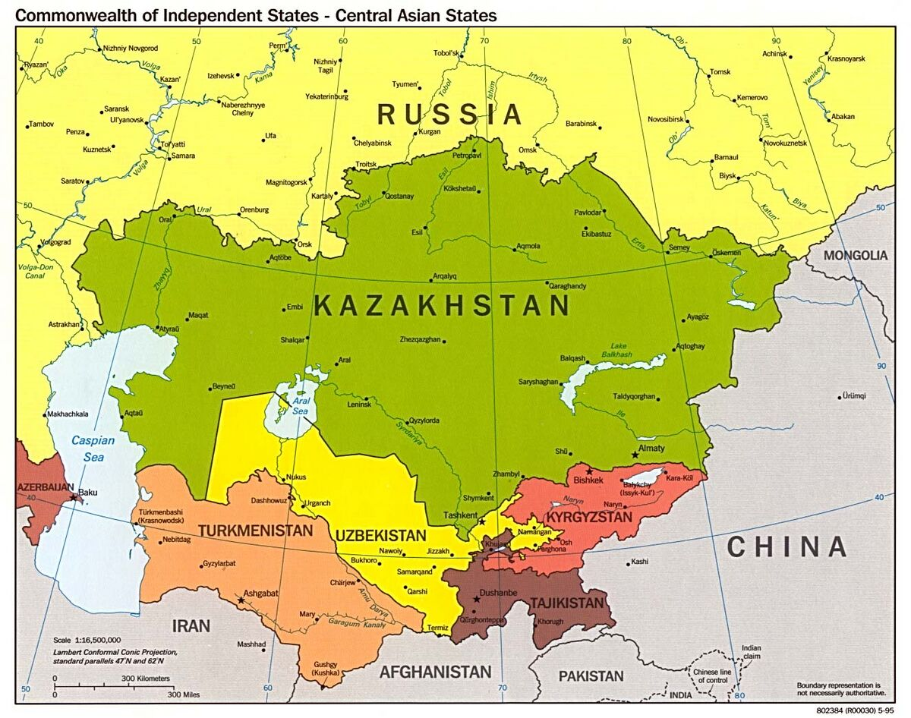
Global Environmental Challenge
Interconnected Crisis
Almaty’s smog is a local crisis with global lessons
Exceeds environmental carrying capacity
Notes:
Air pollution in Kazakhstan is not just a local problem. It’s part of the broader environmental challenges the world faces: climate change, water scarcity, and pollution are all interconnected. What happens in Almaty shows how quickly human activity can push a city beyond its environmental carrying capacity. So when we look at smog in Kazakhstan, we’re really looking at a small version of the global sustainability problem.

Slide 3
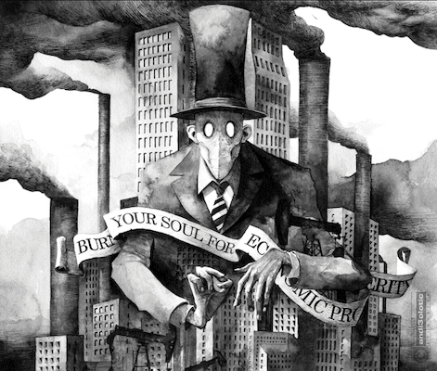
Pollution = Market Failure
Negative Externality: costs on society, not polluters
Private cost < Social cost = pervasive pollution
Example: coal power and cars, but harmful externalities
Notes:
From an economics perspective, air pollution is a negative externality. Polluters like coal plants or old cars pay for their fuel and maintenance, but they don’t pay for the hospital bills, lost productivity, or premature deaths caused by their emissions. This means the private cost of energy or transport is much lower than the true social cost. As a result, the market produces too much pollution. It’s also a kind of tragedy of the commons: when everyone drives their old car, the collective air quality suffers, and everyone pays the price.

Slide 4
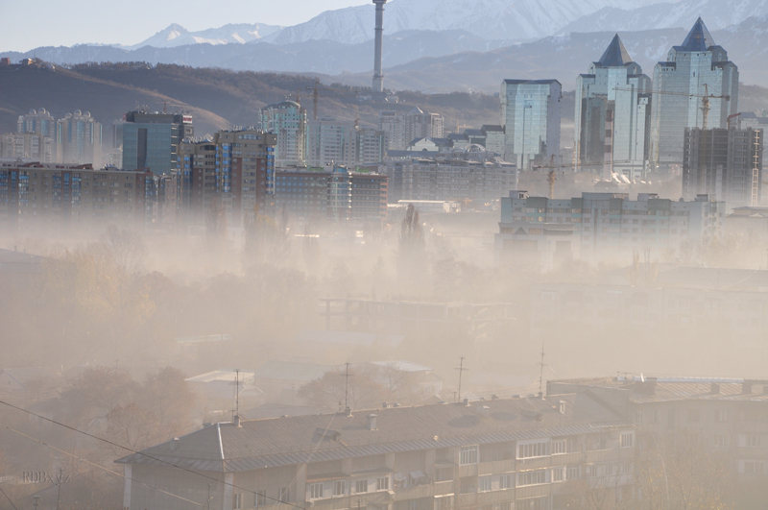
Why Air Pollution Matters
Major Health Risk (respiratory and heart diseases)
PM2.5 is far above the WHO guideline
Disproportionately impacts children and the elderly
Results in economic losses from reduced healthcare and productivity
Notes:
Air pollution is a major health risk. In Kazakhstan, exposure to PM2.5 particles is far above the World Health Organization guideline. This puts children, the elderly, and vulnerable groups at greater risk of asthma, heart disease, and even early death. It also carries heavy economic costs, including productivity loss and billions in healthcare spending.

Slide 5

Air pollution has several negative effects:
Health: More cases of heart disease and early mortality. Air pollution contributes to more than 10,000 premature deaths annually
Economic: Lost economic benefit from sick workers and additional spending on healthcare. It takes roughly $10.5 billion from the Kazakh economy
Societal: Reduced quality of life and emigration from the heavily polluted areas
Human and Economic Costs
Notes:
The costs of air pollution are staggering. More than 10,000 premature deaths every year in Kazakhstan are linked to poor air quality. The economic cost is estimated at over 10.5 billion dollars annually due to lost productivity and healthcare expenses. Beyond numbers, this reduces the quality of life and even drives people to leave polluted regions.

Slide 6
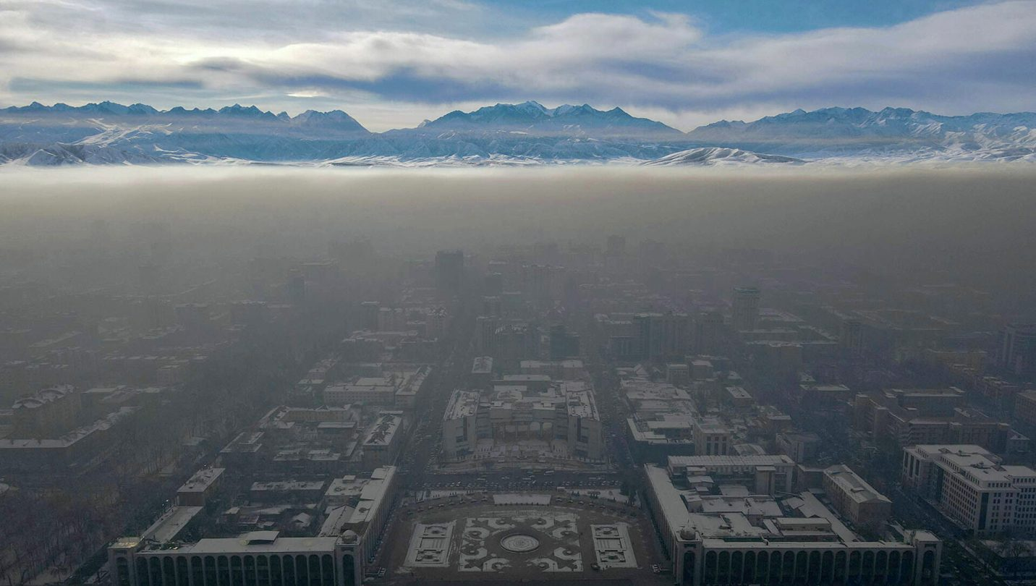
Air Quality Snapshot
PM2.5 concentration exceeds 6-17 times the World Health Organization‘s (WHO) standard (winter peaks)
Almaty: avg. 35 ug/m3 (annually)
Astana: avg. 22 ug/m3 (annually)
Almaty: 217 days/year above safe daily limit
Astana: 151 days/year above safe daily limit
Notes:
Here’s the data. WHO says the safe limit for PM₂.₅ is just 5 micrograms per cubic meter. In reality, Almaty averages around 35 and Astana around 22. That’s several times higher — and in winter, daily levels can be 10 to 17 times the safe limit. If we look at days over the safe daily threshold, Almaty exceeded it on 217 days a year — that’s about 60% of the time. Astana exceeded it on 151 days. These are not occasional spikes — this is a chronic, year-round problem, especially in the cold season.

Slide 7
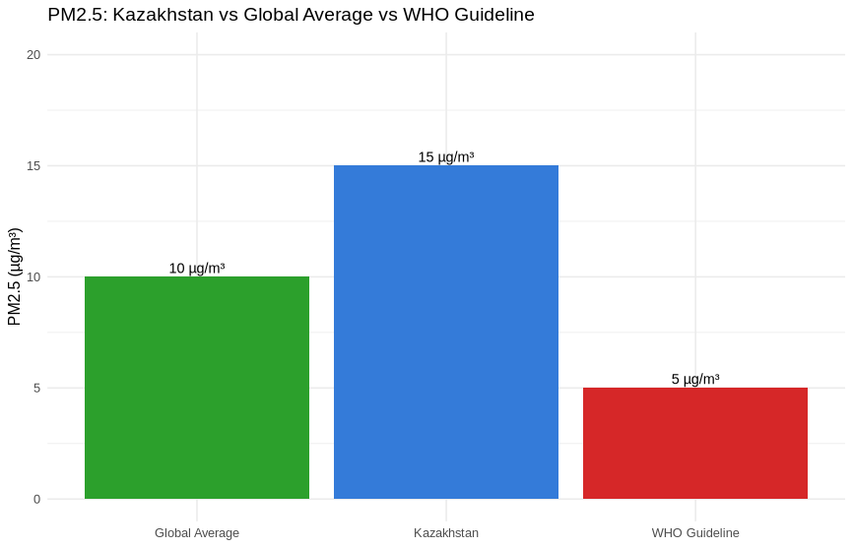
Chart #1

Slide 8
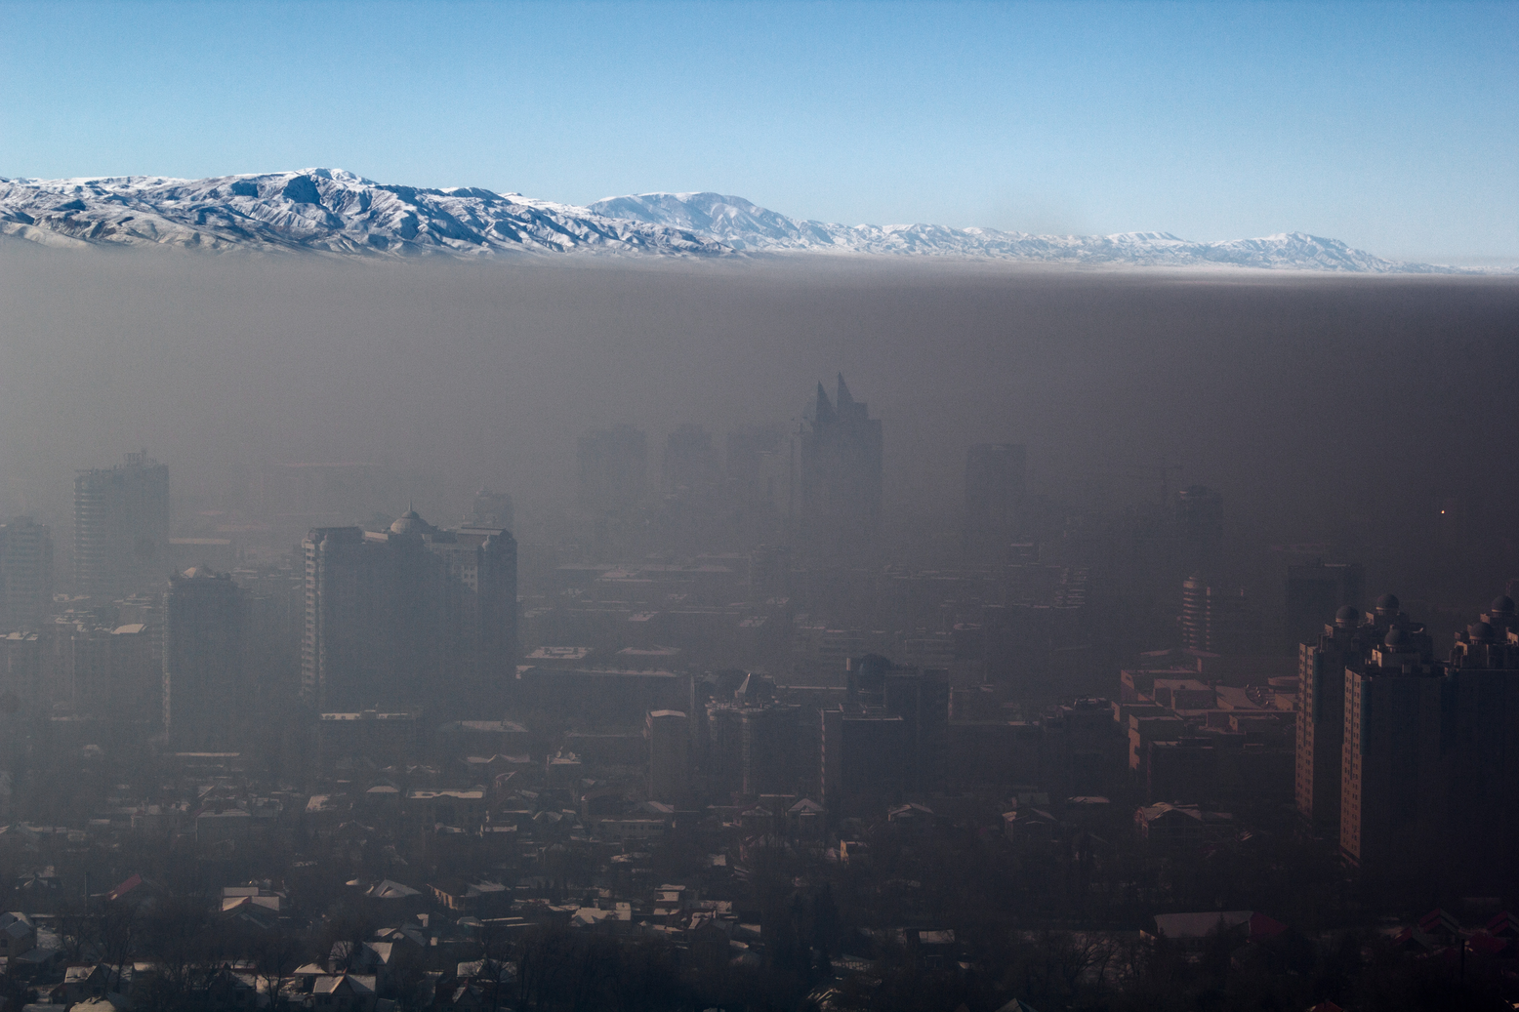

Almaty’s Pollution Sources
Coal-fired CHP plants
Household coal/low-quality fuel heating
Old vehicles and traffic congestion
Mountain basin traps polluted air
Notes:
Now, where does this pollution come from? First, coal-fired power plants — in Almaty, CHP-2 is infamous as one of the city’s single largest sources of PM₂.₅. Second, many households still burn coal or even raw waste for heating, especially in suburban districts. Third, old vehicles and traffic congestion release nitrogen dioxide and particulates into the air — Almaty actually records the highest NO₂ levels in Kazakhstan. Finally, the mountain basin effect means that once pollution is created, it stays trapped over the city. These four factors together explain why Almaty’s smog is so persistent, especially in winter.

Slide 9
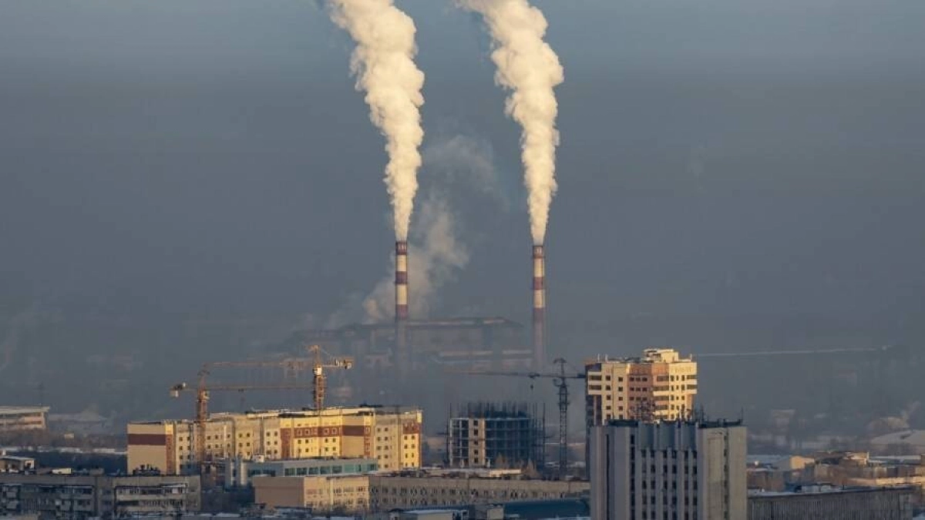
CHP-2 Plant in Almaty

Slide 10
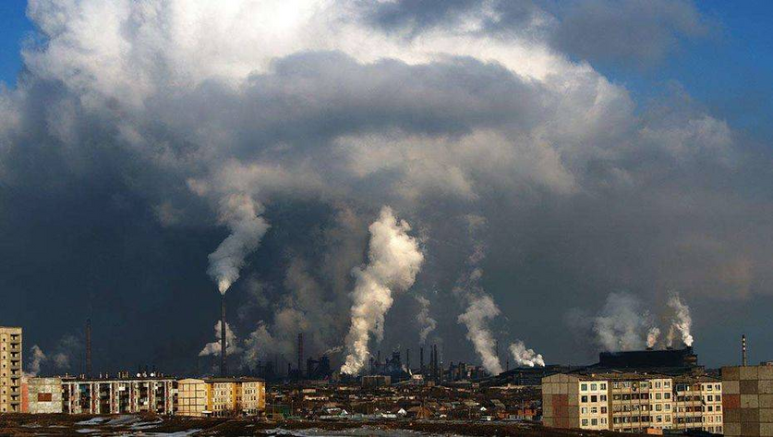
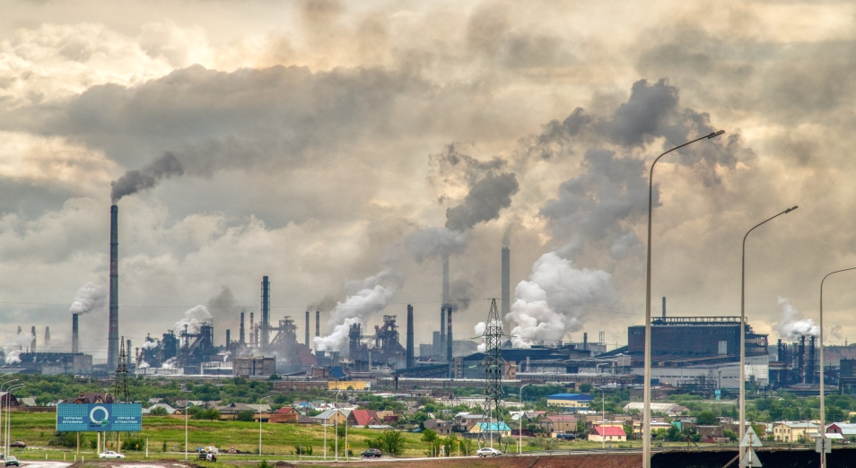
Temirtau (top left photo) – home to the largest steel plant, one of the biggest single polluters in the Central Asian region. It has caused over $4 billion in damages and 3000 premature deaths since the 1990s.
Karagandy (bottom right photo) is famous for its vast emissions from mining and smelting activities.
The emissions from these industrial giants have been linked to heavy health impacts.
Industrial Hotspots beyond Almaty
Notes:
Air pollution is not limited to Almaty. In Temirtau, home to the country’s largest steel plant, residents have witnessed black snow — snow literally falling covered in soot. Studies estimate pollution from this plant alone has caused about 3,000 premature deaths and nearly $4 billion in damages since the 1990s. Nearby Karaganda also suffers from high levels of emissions due to mining and smelting. And cities like Ust-Kamenogorsk and Shymkent are equally notorious for industrial air pollution. So this is not just a big city smog problem — it is also a legacy of Kazakhstan’s industrial structure.

Slide 11
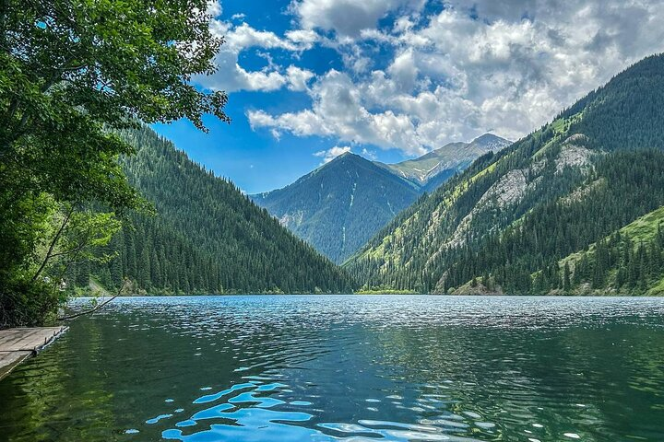
Why Action Makes Sense
Costs of action:
Modernizing CHP-2 (Almaty) and many other coal plants
Expanding the gas pipelines and renewables
Banning old cars and upgrading fuel standards
Benefits > Cost
Benefits of action:
reduces 8,000-10,000 premature deaths annually
$10 billion saved in healthcare and productivity
Higher life expectancy and more livable cities
Notes:
So why doesn’t the government just solve the pollution problem? Because abatement is costly. Converting Almaty’s CHP-2 from coal to gas costs hundreds of millions of dollars. Expanding gas pipelines, investing in renewables, and scrapping old vehicles all require large upfront spending.
But when we compare these costs to the benefits, the picture changes. Cleaner air could prevent 8,000 to 10,000 premature deaths every year. It could save Kazakhstan around $10.5 billion annually in healthcare costs and lost productivity. That’s more than the cost of modernization. In other words, the benefits outweigh the costs, making pollution control economically efficient as well as morally urgent

Slide 12
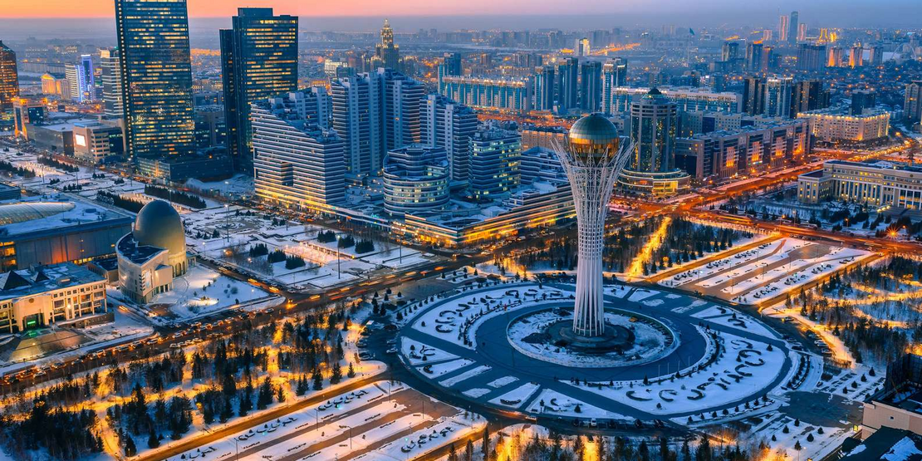
Policy Response from the Kazakh Government
The 2021 Environmental Code introduced stricter rules, requiring industries to use Best Available Techniques (BAT).
Integrated permits now link environmental performance with industrial operations.
Expansion of air quality monitoring stations across major cities.
The Carbon Emissions Trading System (ETS) indirectly supports cleaner fuels and efficiency
Notes:
Kazakhstan is not ignoring the issue. In 2021, the government adopted a new Ecological Code, which requires industries to implement Best Available Techniques and links their operating permits to environmental performance. More air quality monitoring stations have been installed in Almaty, Astana, and other big cities, so data is becoming more transparent. Kazakhstan also launched a carbon emissions trading system, which indirectly supports cleaner fuels and energy efficiency. And some gasification projects are underway: in Almaty, the notorious coal-fired CHP-2 is being converted to gas, and in Astana, the Saryarka pipeline is helping households shift from coal to cleaner heating. These are positive steps — but they’re still only the beginning

Slide 13
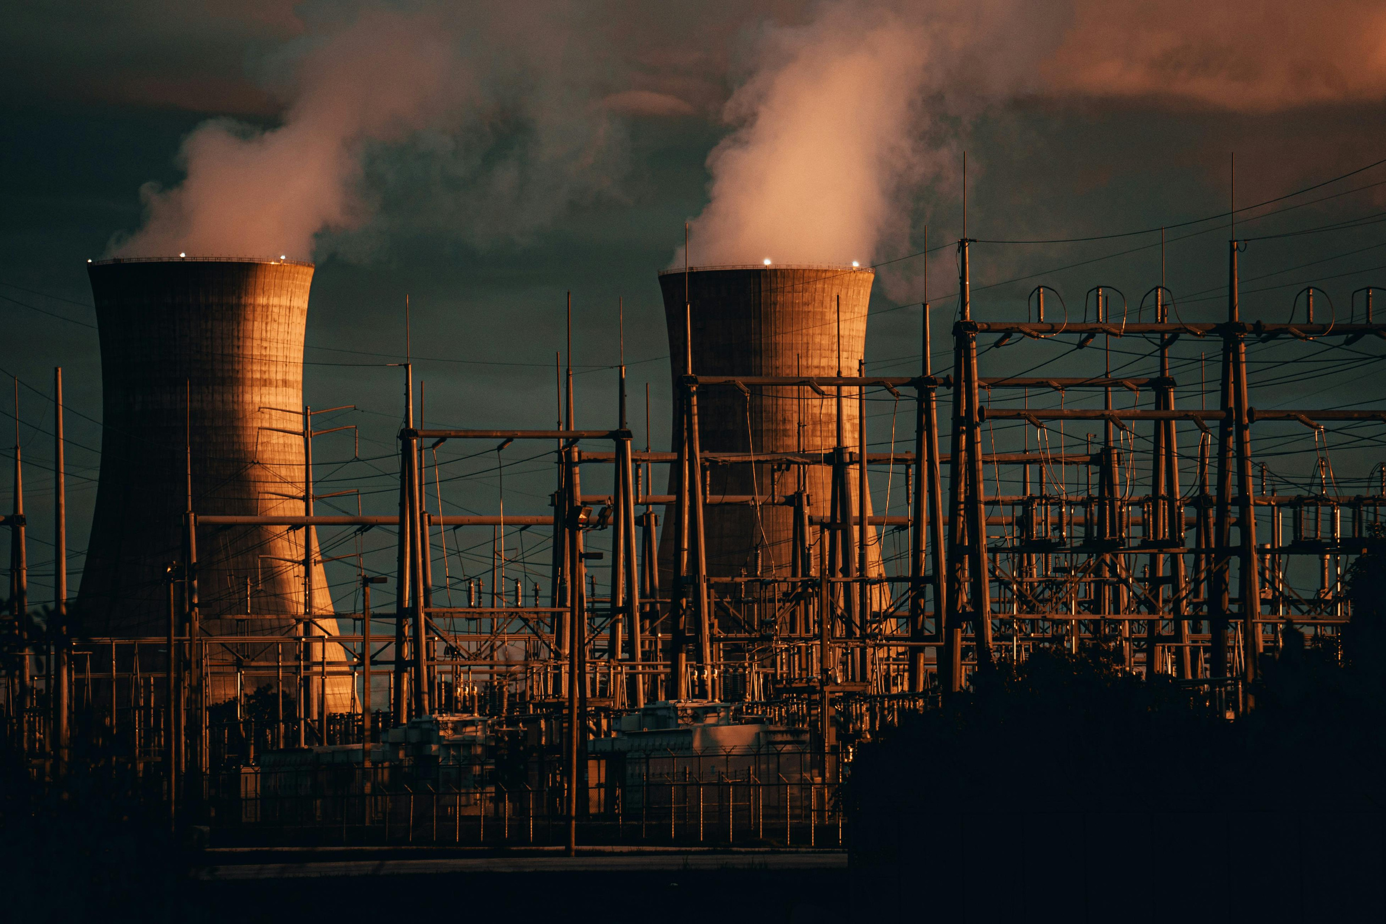
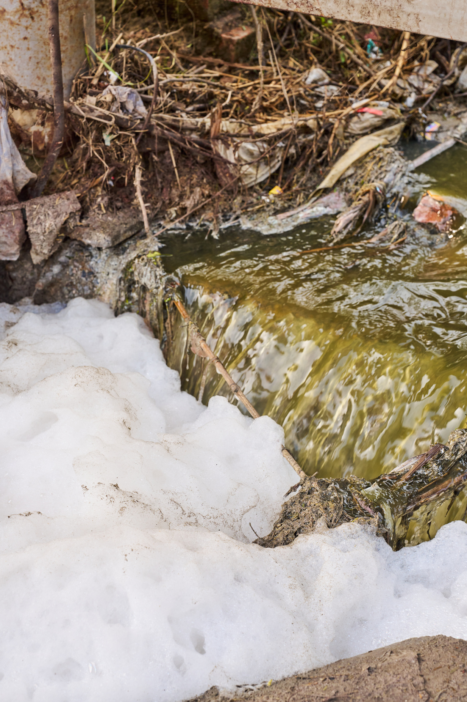
Remaining Challenges
Slow coal-to-gas transition. It leaves many households dependent on coal.
Industrial modernization is costly, with compliance remaining uneven.
An old vehicle fleet and poor fuel quality exacerbate urban pollution.
Monitoring gaps outside large cities unfortunately hide the true scale of pollution
Notes:
Despite progress, serious challenges remain. First, coal dependence is still high — many households and entire power stations burn coal. Second, the cost of modernization is enormous: billions are needed to upgrade CHP-2, expand gas pipelines, and replace old vehicles. Speaking of vehicles, the average age of cars in Kazakhstan is over 20 years, and poor fuel quality adds to the emissions problem. Enforcement is another barrier: even with more monitoring stations, industries often delay or avoid compliance. And finally, geography itself is an obstacle — Almaty’s mountain basin traps air, meaning even small emissions build up into severe smog. These challenges explain why solutions have been so slow, despite official policies.

Slide 14

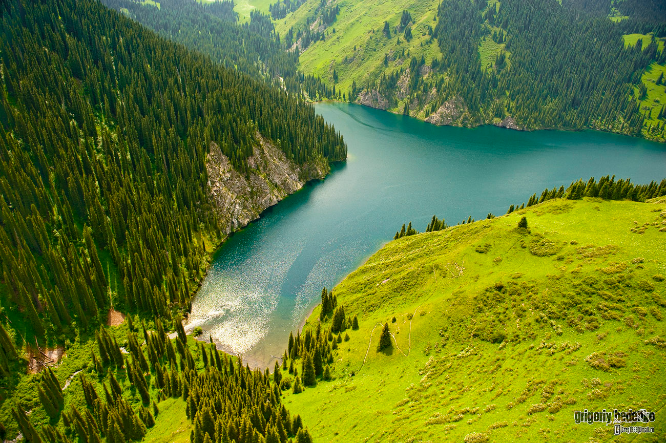
Alibek Zhanabergenov
15.09.2025
Thank You
Notes:
To conclude, Kazakhstan’s urban air pollution is not just an environmental nuisance — it is a serious public health crisis and an economic burden. Each year, thousands of premature deaths and billions in lost productivity show the cost of inaction.
We’ve seen that while the government has introduced policies — like the Ecological Code, gasification projects, and more monitoring — progress is held back by coal dependence, outdated vehicles, and weak enforcement.
This leaves Kazakhstan at a crossroads. Continue with business as usual, and cities like Almaty risk becoming permanently trapped in smog. Or take the transition path, following examples like Beijing, which managed to cut its pollution nearly in half in just a decade.
The lesson from environmental economics is clear: the benefits of action outweigh the costs. Cleaner air means healthier people, stronger productivity, and a more sustainable future for Kazakhstan

Slide 15
References
Asia Society. “ETS Status: Kazakhstan.” Asia Society, http://asiasociety.org/policy-institute/ets-status-kazakhstan. Accessed 16 September 2025.
IQAir. “2024 World Air Quality Report.” IQAir, IQAir, https://www.iqair.com/world-air-quality-report. Accessed 15 September 2025.
Kerimray, Aiymgul, et al. “Trends and Health Impacts of Major Urban Air Pollutants in Kazakhstan.” Journal of the Air & Waste Management Association, vol. 70, no. 11, 2020, pp. 1148–1164, https://www.tandfonline.com/doi/full/10.1080/10962247.2020.1813837.
Republic of Kazakhstan. Ecological Code of the Republic of Kazakhstan No. 400-VI (2021) – English Version. Biological Weapons Convention Implementation Support Unit, 2021. Ecological Code of the Republic of Kazakhstan No. 400-VI (2021) – English Version, https://bwcimplementation.org/sites/default/files/resource/KAZ_Ecological%20Code%20of%20the%20Republic%20of%20Kazakhstan_No.%20400-VI%20-%202021_EN.pdf.
Republic Of Kazakhstan. Environmental Code of the Republic of Kazakhstan. No. 400-VI, as Amended 2021. IEA, 2021. Environmental Code of the Republic of Kazakhstan. No. 400-VI, as Amended 2021, https://www.iea.org/policies/12917-environmental-code-of-the-republic-of-kazakhstan-400-vi-as-amended.
Samruk Kazyna. “Head of Samruk-Energy inspects modernization progress at Almaty CHP-2 and CHP-3.” Samruk-Energy, 13 September 2025, https://www.samruk-energy.kz/en/press-center/news/2339-head-of-samruk-energy-inspects-modernization-progress-at-almaty-chp-2-and-chp-3.
World Bank. “Kazakhstan Discusses Actions to Reduce Air Pollution with Partners.” World Bank, 2023, https://www.worldbank.org/en/news/press-release/2023/04/25/kazakhstan-discusses-actions-to-reduce-air-pollution-with-partners. Accessed 15 September 2025.
World Bank. “World Bank Document.” World Bank Document, https://documents1.worldbank.org/curated/en/099345012232191779/pdf/P1708700d2bd3a09093fa0cd27991d0662.pdf. Accessed 16 September 2025.

