Slide 1
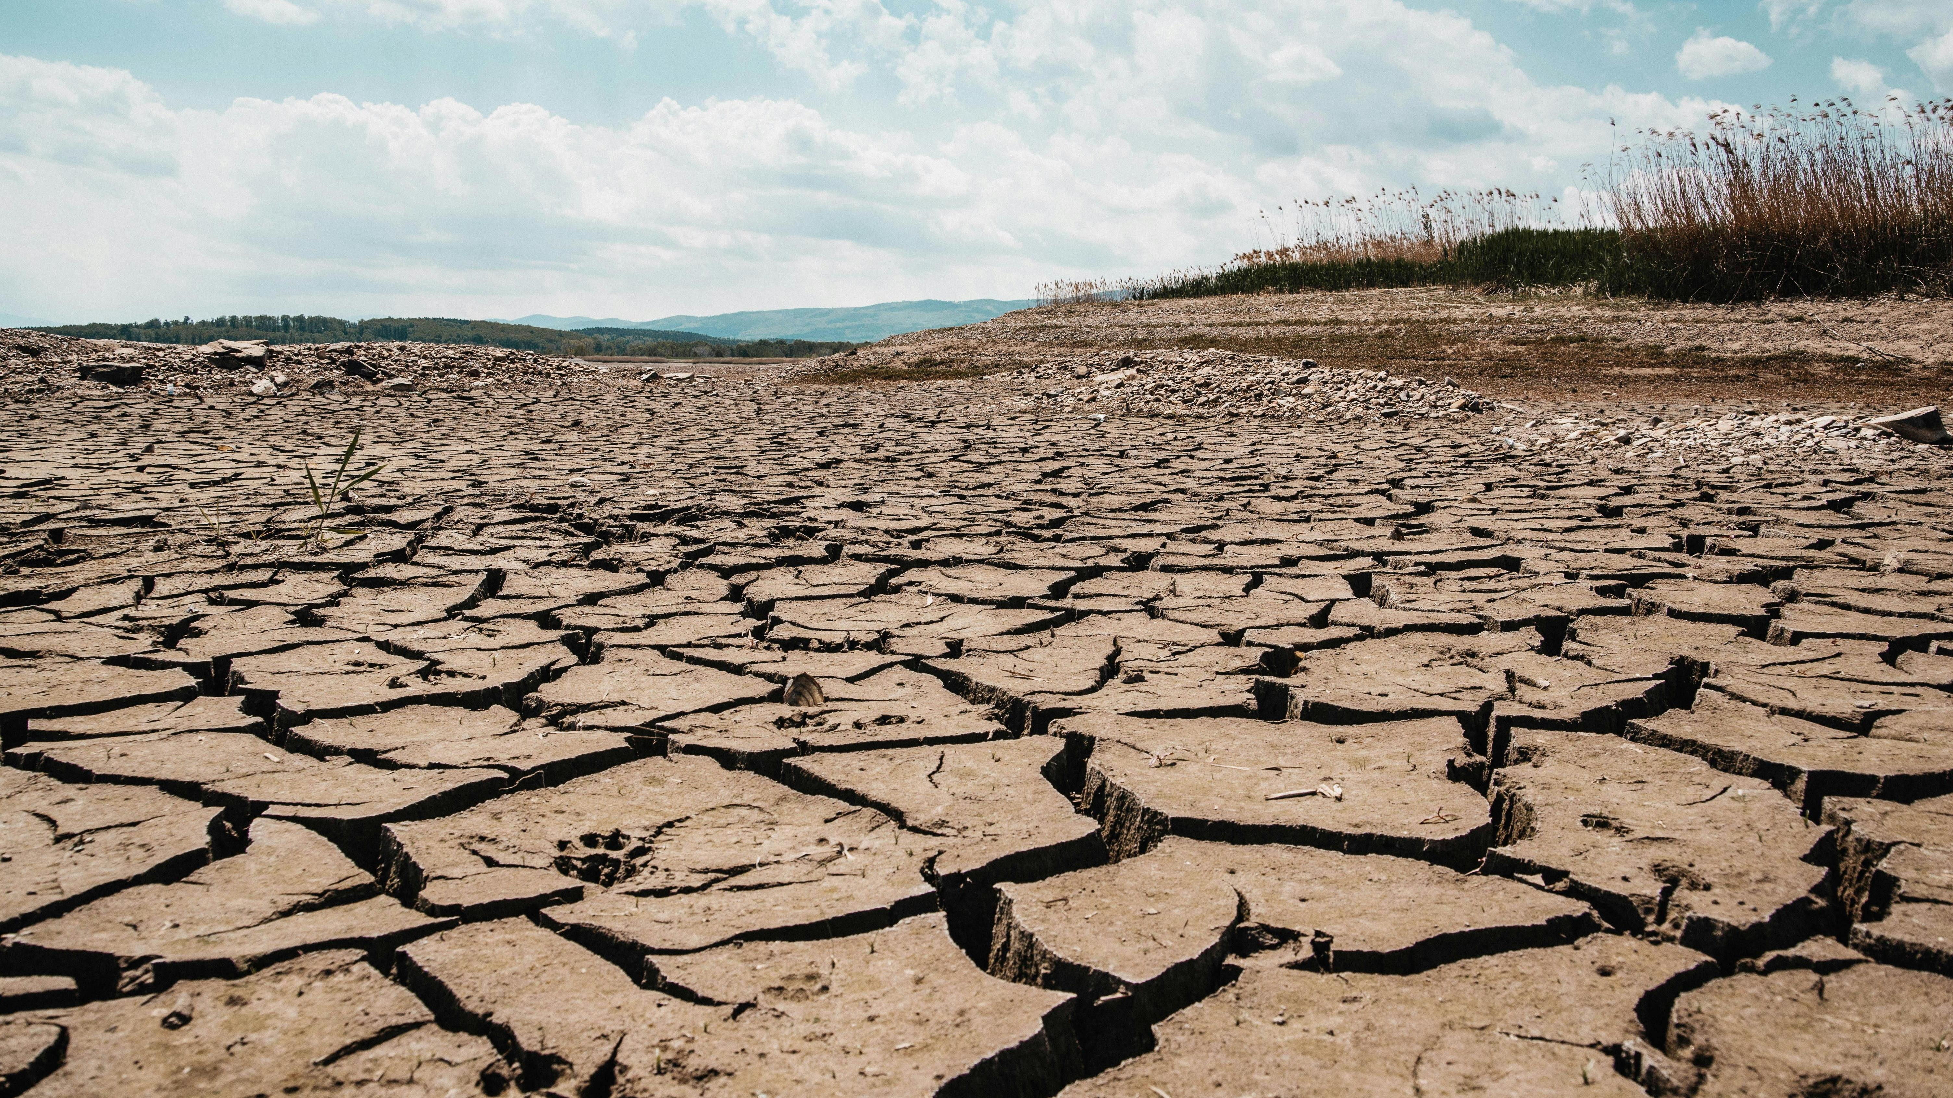
Water Scarcity: Jordan’s Ongoing Crisis
Presented by Shahd Enizah
(Mutaz Al-Alawi 2025)

Slide 2

Adenda
Overview
The Scale of the Problem
Drivers of Water Scarcity
Consequences
Government Response
Global Intervention
Challenges

Slide 3
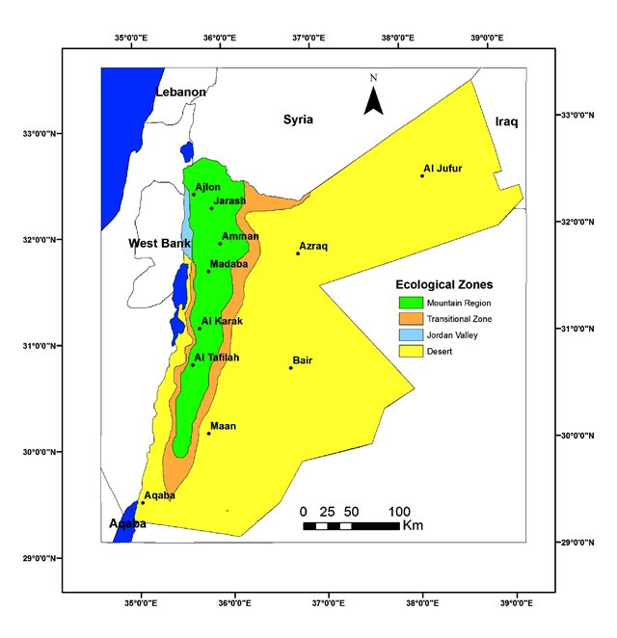
Borders Syria, Palestine, Iraq & Saudi Arabia.
Almost landlocked! Aqaba ; the northern arm of the Red Sea.
Mediterranean climate northwest, and desert climate in the south and east of Jordan.
Highly seasonal rainfall due to regional variation! {Valleys, highlands, Badia}.
11 million people, over 3.7 million of whom are refugees.
Precipitation levels between 300 mm and less than 100mm.
(Al-Sharif et al. 2020), (UNICEF 2022), ("The Climate of Jordan" 2023), (UNICEF 2023)
Notes:
Context/overview

Slide 4
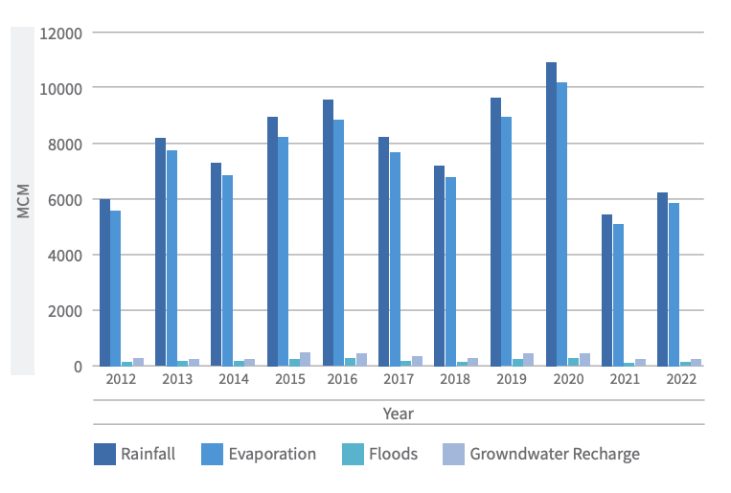
The second most water-scarce country in the world, with less than 100 m³ per capita.
Limited control over rivers! The Jordan River declined by 10% due to Israel’s diversion projects. Syria’s diversion projects & Yarmouk River.
Water needs exceed resources by more than 26 percent as of 2025.
Overexploitation of aquifers due to high demands! +37% in 2014.
Desi Aquifer with Saudi Arabia; fossil water (non-renewable).
Jordan’s Surface Water Budget (2012–2022)
(Ministry of Water and Irrigation 2022), (Fanack Water 2022), (Aviram, Hindi, and Abu Hammour 2020), (Ersan 2024), (Deutsche Rohstoffagentur 2017).
Notes:
Scale of the problem of water scarcity.

Slide 5
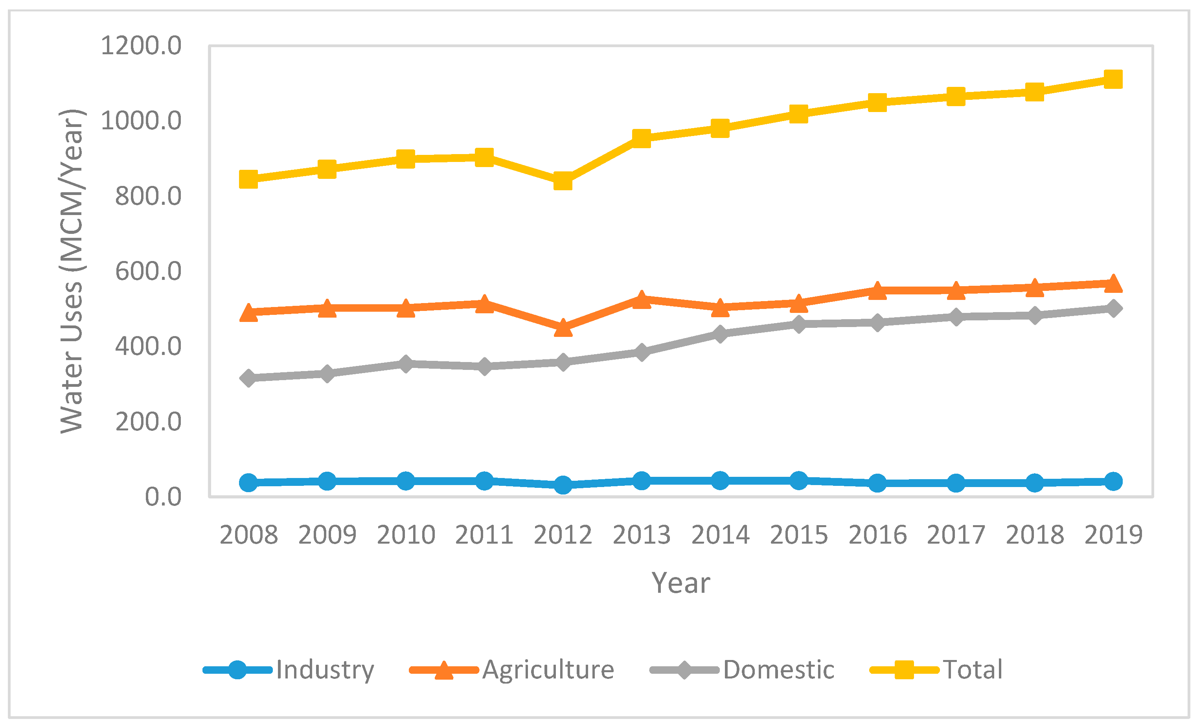
Agriculture uses ~ 43% in 2017). GDP contribution < 5%.
Syrian Crisis (1.6 M); from 160 m³ per capita to <100 m³.
Unpredictable rainfall events since the 80s due to climate change.
Exploitation of aquifers through illegal drilling.
Water Use Per Sector in Jordan
(Deutsche Rohstoffagentur 2017), (Al-Zoubi et al. 2018), (Moujahed et al. 2018)
Notes:
Main drivers of water scarcity: agriculture, refugees, and geopolitical tension.

Slide 6
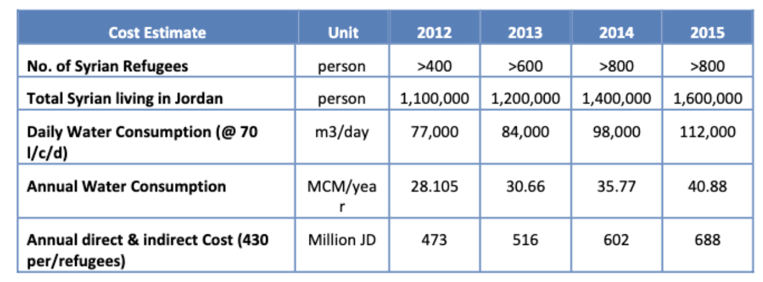
Cost of Syrian Refugees on the Water Sector (2015)
Jordan’s safe groundwater yield is ~275 MCM/year → refugees alone were adding ~15% extra demand.
Additional costs of approx. 970 million USD from refugees alone!
Access to the municipal water network is only 24 hours a week; less in rural areas!
Need to purchase desalinated water from Israel → $130 million USD for 200 MCM.
(Al-Kharabsheh et al. 2016), (Lieberman 2021)
Notes:
consequences

Slide 7
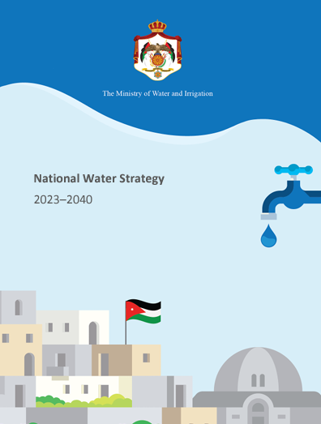
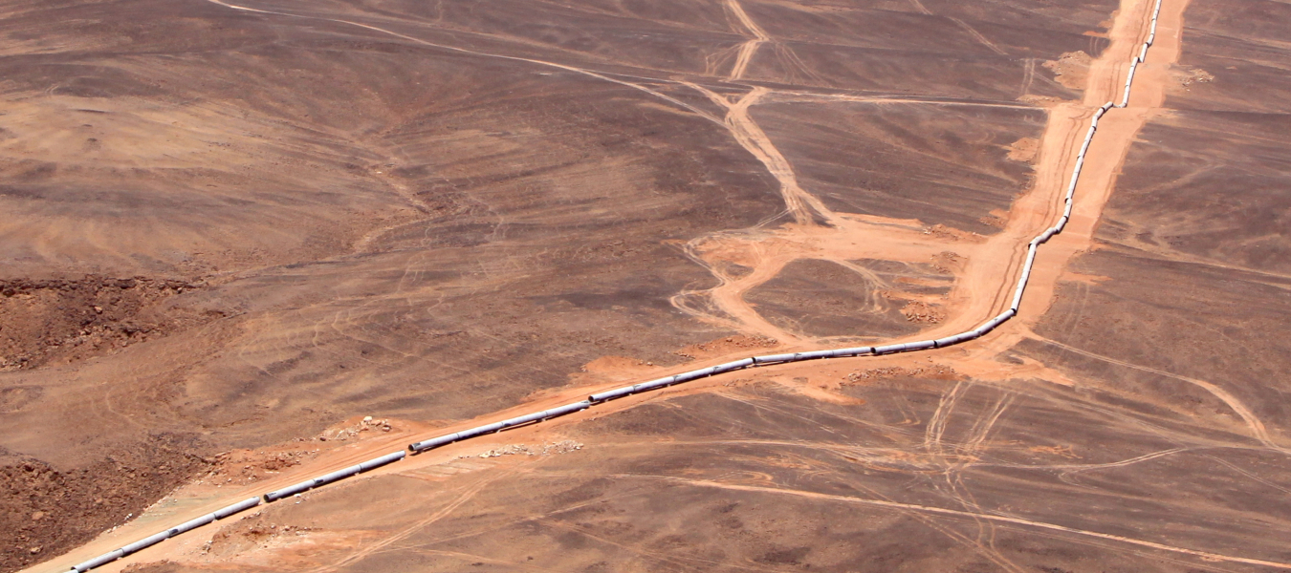
National Water Strategy 2023–2040 → cut non-revenue water by 25%.
Disi Water Conveyance Project (2013)
National Carrier / Aqaba–Amman Desalination & Conveyance Project
Wastewater Treatment & Reuse
(Al-Kharabsheh et al. 2016), (Lieberman 2021), (RWS-CCAF 2023).
Notes:
National response

Slide 8
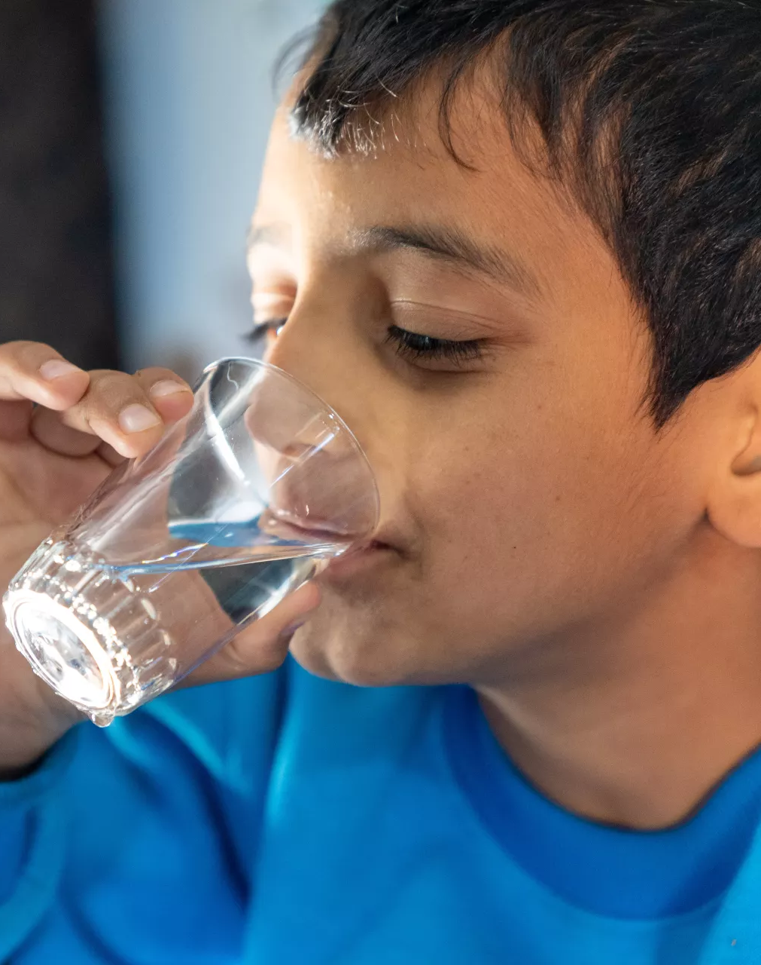
Japan International Cooperation Agency (JICA) grant of 8.7 million dollars.
GU-Q signed an agreement with JICA to enhance the capacity of Jordanian officials to design, manage, and oversee Public–Private Partnerships (PPPs). Offers policy & capacity building services!
Water Supply, Sanitation, and Hygiene WASH UNHCR
USAID Jordan Water Efficiency and Conservation
Israel–Jordan Water Sharing (1994 Treaty)
(Georgetown University 2023), (Ministry of Planning and International Cooperation 2025), (International Trade Administration 2024), (Peace Treaty between Israel and Jordan 1994), (MarketShare Associates 2022), (UNHCR 2023), (UNICEF 2023).
Notes:
Global intervention

Slide 9
Challenges
Political complications → Red–Dead Sea Conveyance
Biological Pollutants → 70% of freshwater sources are contaminated.
Continuous migrations of refugees → potential migrations from the Gaza Strip.
Desalination difficulties → financial & technical constraints.
(Al Sabaileh 2023), (Stoian 2023), (Ismail 2023)
Notes:
Challenges.

Slide 10
Thank you!
Full citations can be found here: https://docs.google.com/document/d/1vVeUNqR9Asc5OmRiGGm09cUfB3gaFguz2HtBy1MjcAM/edit?usp=sharing

