Slide 1

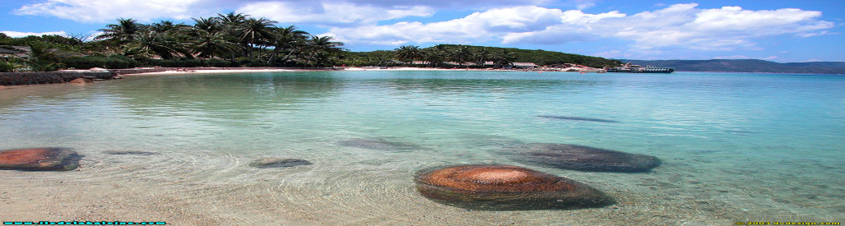
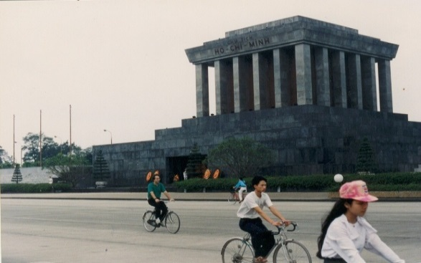
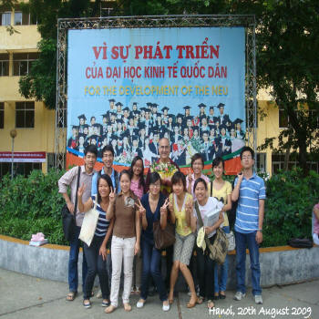
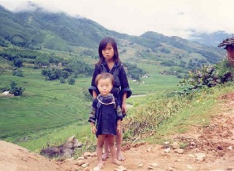
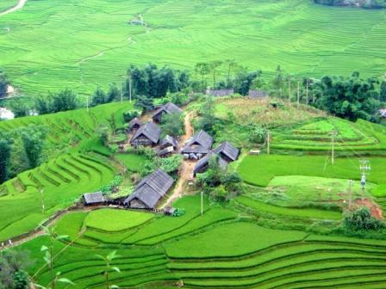
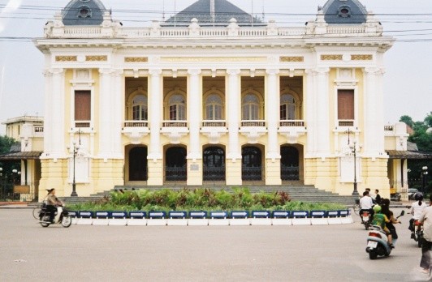


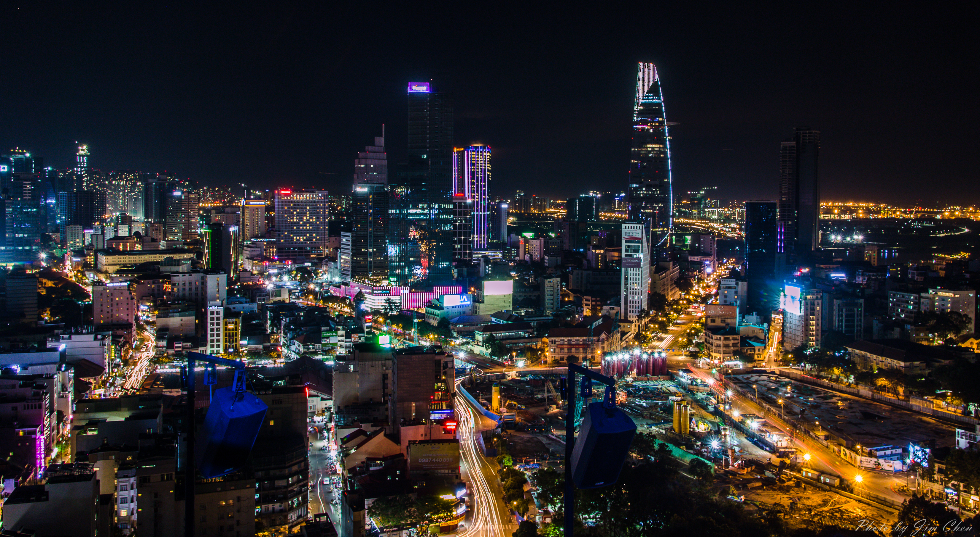
ECON 3077 – Economies of East Asia
VIETNAM: A COUNTRY, NOT A WAR

Slide 2
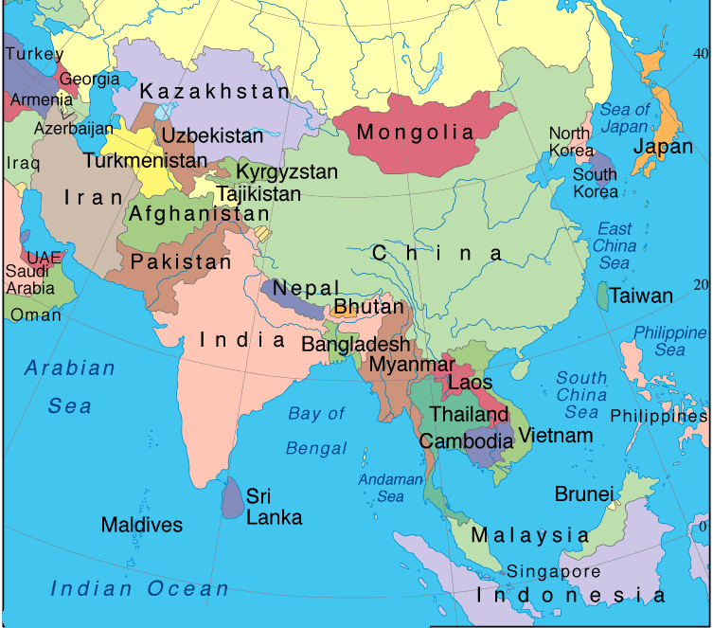
So Where is Vietnam?

Slide 3
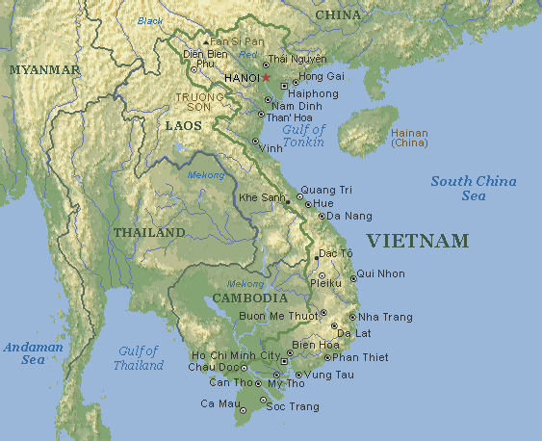

A Closer View
The five points of the star represent farmers, workers, intellectuals, youth and soldiers

Slide 4
Socialist Republic of Viet Nam
Independence, Freedom and Happiness
Total Area: 329,560 sq km (about 27 times the size of Qatar)
Type of Government: Communist
President of Vietnam: Lương Cường (October 2024)
Prime Minister of Vietnam: Phạm Minh Chính (April 2021)
General Secretary of Communist Party: Tô Lâm (January 2011)
Capital City: Hanoi
The current population of Vietnam (or Viet Nam) is 101.6 million
The population density in Vietnam is 314 per Km²
The total land area is 310,070 Km² (119,719 sq. miles)
40.4 % of the population is urban (2024)
The median age in Vietnam is 33.5 years (2025)
https://www.worldometers.info/demographics/vietnam-demographics/
https://www.populationpyramid.net/viet-nam/2021/
https://www.indexmundi.com/vietnam/demographics_profile.html
https://data.worldbank.org/indicator/SP.URB.TOTL.IN.ZS?locations=VN

Slide 5
Brief History
Communist forces of Ho Chi Minh force French out.
Struggle with French Colonialism
South officially integrated with the North under communist rule.
Pre 1945
1945
1954
1975
1976
1986
CPV implemented free market reforms known as Doi Moi
Independence
Democratic
Republic of
Vietnam
Southern
resistance
crumbles,
ending a 30-
year war

Slide 6
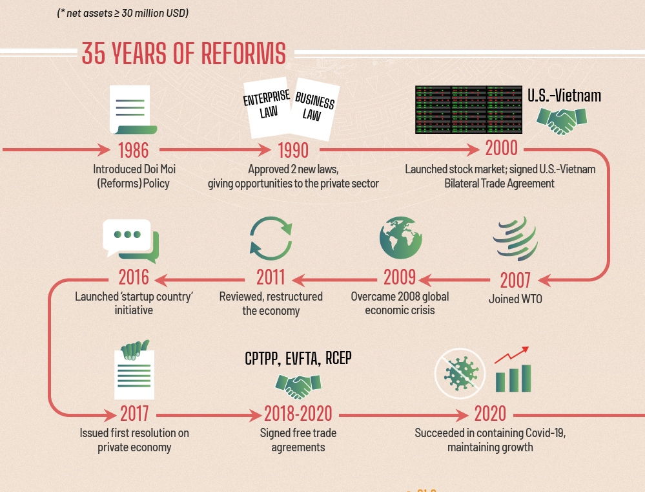
Major Eonomic-related Events: A Timeline Since Doi Moi
1986: Start of Doi Moi reform policy
1994: removal of US trade embargo after 30 years
2001: Application of the US-VN trade agreement
Aug 2013: 19th negotiation round of the TPP (12 countries)
1992: New constitution adopted with certain economic freedoms
1995: Full member of ASEAN
2007: 150th member of the WTO after 12 years of talks
March 2014: 7th negotiation round of the EU-VN FTA

Slide 7
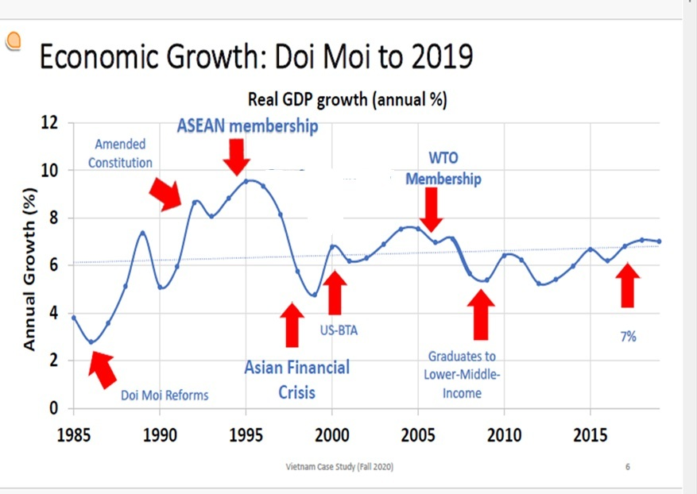

Slide 8
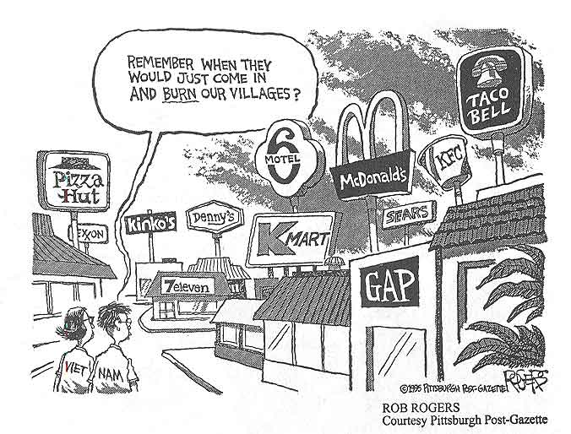
The Doi Moi Reform Further Examined
Vietnam has grown rapidly in the last 25 years, but the economy is still at the level of a less developed country.
Indicators on infrastructure, education, human development index … range a little above 1/3 of the lowest group in the world.
Vietnam has commitments on economic integration but the state system, education … still have more disparities in comparison with other countries in the world.
After more than thirty-seven years of doi moi, Vietnam has established the main elements of a “market-economy with socialist orientation.”

Slide 9

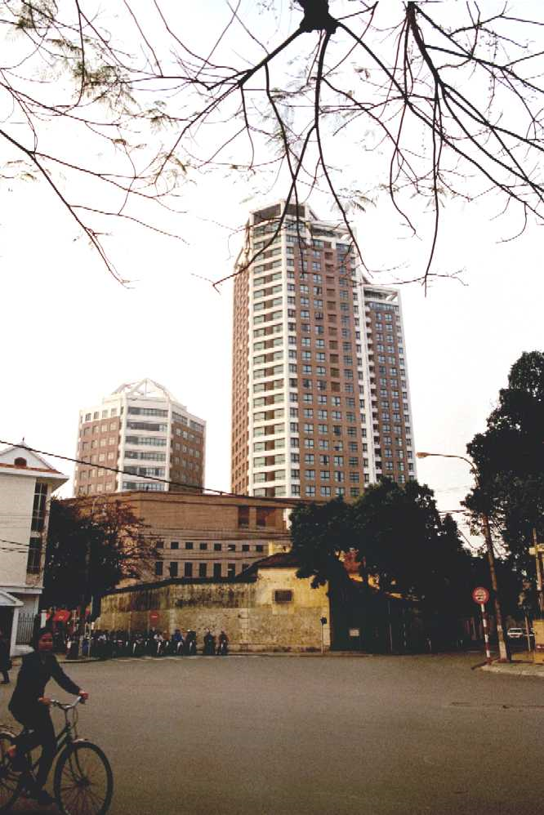

Slide 10
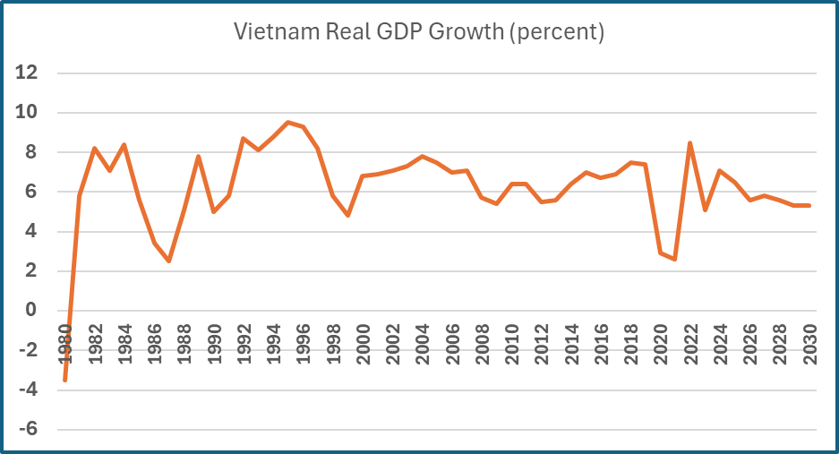
Major Economic Indicators
https://www.imf.org/external/datamapper/profile/VNM
http://www.tradingeconomics.com/vietnam/forecast
https://www.imf.org/external/datamapper/profile/VNM
Indicator Value
GDP Growth (Constant Prices, National Currency) | 5.5 %
GDP (Current Prices, National Currency) | VND 4,024,000.00 Billion.
GDP (Current Prices, US Dollars) | US$ 187.848 Billion
GDP Deflator | 149.954 (Index, Base Year as per country's accounts = 100)
GDP Per Capita (Constant Prices, National Currency) | VND 29,609,319.52 .
GDP Per Capita (Current Prices, National Currency) | VND 44,400,497.84 .
GDP Per Capita (Current Prices, US Dollars) | US$ 2,072.70
GDP (PPP), US Dollars | US$ 509.466 Billion
GDP Per Capita (PPP), US Dollars | US$ 5,621.41
GDP Share of World Total (PPP) | 0.476 %
Implied PPP Conversion Rate | 7,898.46
Investment (% of GDP) | 25.217 %
Gross National Savings (% of GDP) | 29.364 %
Inflation, Average Consumer Prices (Indexed to Year 2000) | 242.662 (Index, Base Year 2000 = 100)
Inflation (Average Consumer Price Change %) | 5.2 %
Inflation, End of Year (Indexed to Year 2000) | 249.065 (Index, Base Year 2000 = 100)
Inflation (End of Year Change %) | 5.3 %
Import Volume of All Items Including Goods and Services (Percent Change) | 17.148 %
Import Volumes of Goods Only (Percent Change) | 17.05 %
Export Volume of All Items Including Goods and Services (Percent Change) | 14.245 %
Export Volumes of Goods Only (Percent Change) | 14.406 %
Unemployment Rate (% of Labour Force) | 4.424 %
Population | 90.63 Million
General government revenue (National Currency) | VND 818,543.10 Billions.
General government revenue (% of GDP) | 20.342 %
General government total expenditure (National Currency) | VND 1,083,042.05 Billions.
General government total expenditure (% of GDP) | 26.915 %
Total Government Net Lending/ Borrowing (National Currency) | VND -264,498.95 Billions.
Total Government Net Lending/ Borrowing (% of GDP) | -6.573 %
General Government Structural Balance (National Currency) | VND -303,149.97 Billion.
Fiscal Year Gross Domestic Product, Current Prices | VND 4,024,000.00 Billions.
Current Account Balance (US Dollars) | US$ 7.79 Billion
Current Account Balance (% GDP) | 4.147 %

Slide 11
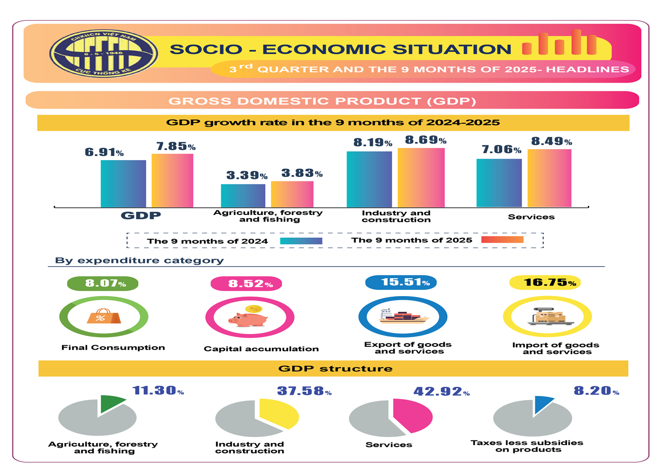
https://www.gso.gov.vn
https://www.nso.gov.vn/en/data-and-statistics/2025/10/infographic-on-the-socio-economic-situation-in-the-third-quarter-and-the-9-months-of-2025/

Slide 12
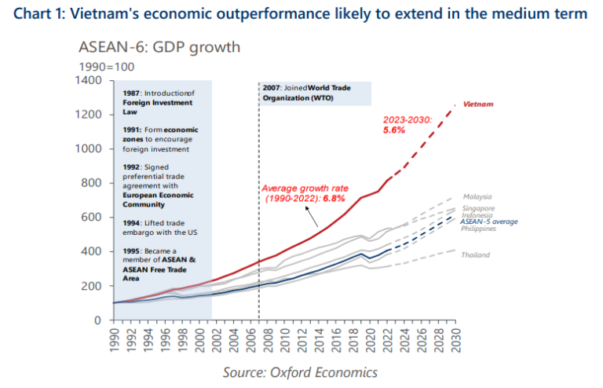

Slide 13
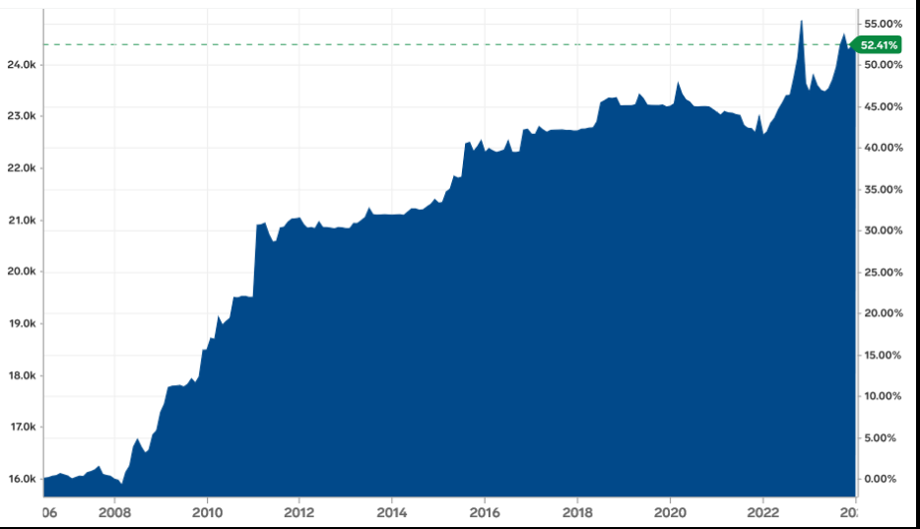
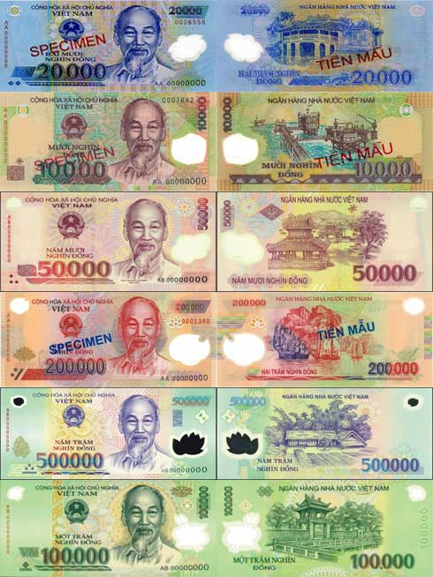
Vietnamese Dong Exchange Rate
https://www.xe.com/currencyconverter/convert/?Amount=1&From=USD&To=VND
$1.00 = 26,330 October 24, 2025

Slide 14
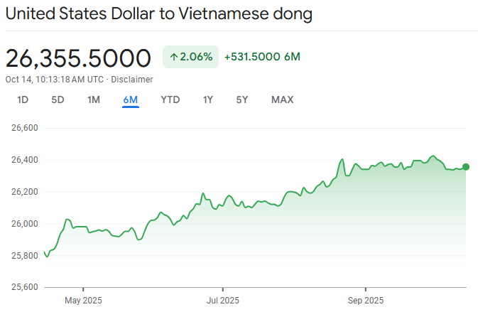

Slide 15
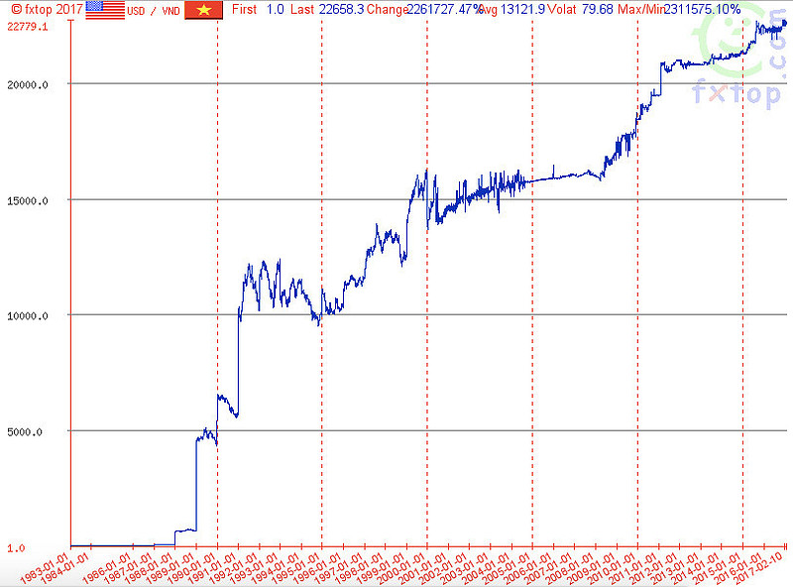
WHY SO LOW?
https://www.ebc.com/forex/why-is-vietnamese-currency-so-weak-key-factors-explained

Slide 16
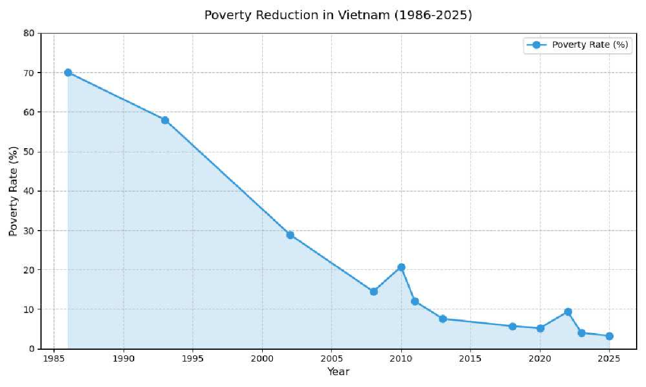
Poverty Levels
Poverty Reduction in Vietnam (1986-2025) The figure illustrates the poverty reduction rate in Vietnam from 1986 to 2025. The horizontal axis denotes years, whilst the vertical axis illustrates the poverty rate (%) over time. The graph illustrates a steep and sustained reduction in the poverty rate, decreasing from around 70% in the mid-1980s to under 10% by 2025. This fall signifies the government's effective implementation of economic development and poverty alleviation initiatives. The decade from 2000 to 2010 exhibits significant enhancement, indicative of the beneficial effects of support initiatives and investments in infrastructure, education, and healthcare.

Slide 17
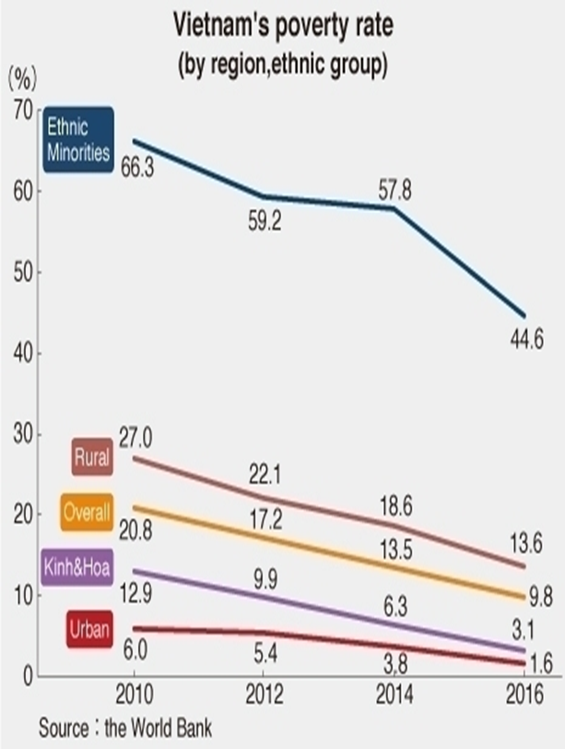

Slide 18
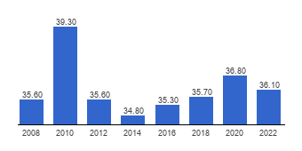
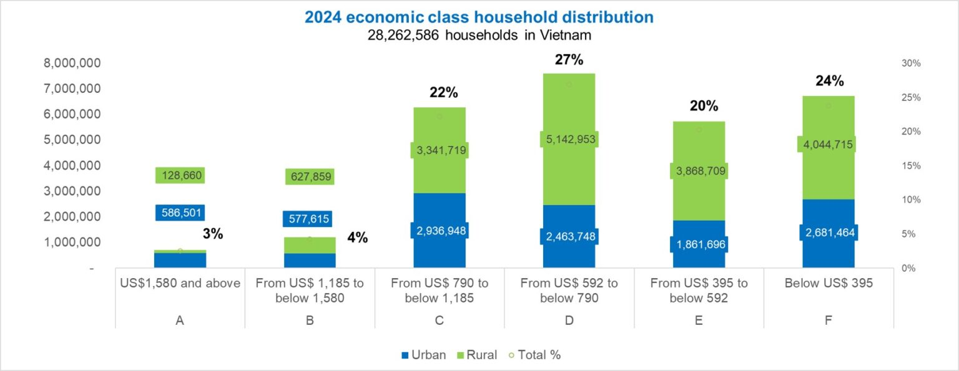
Income Inequality in Vietnam

Slide 19
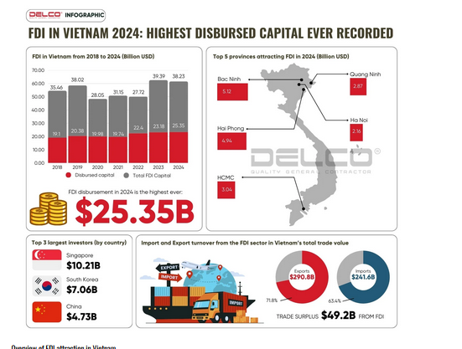
https://delco-construction.com/en/fdi-attraction-in-vietnam-2024/

Slide 20
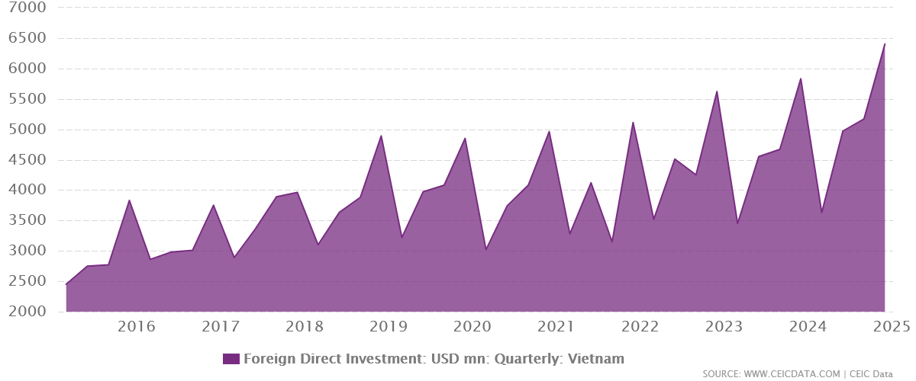
Foreign Direct Investment

Slide 21
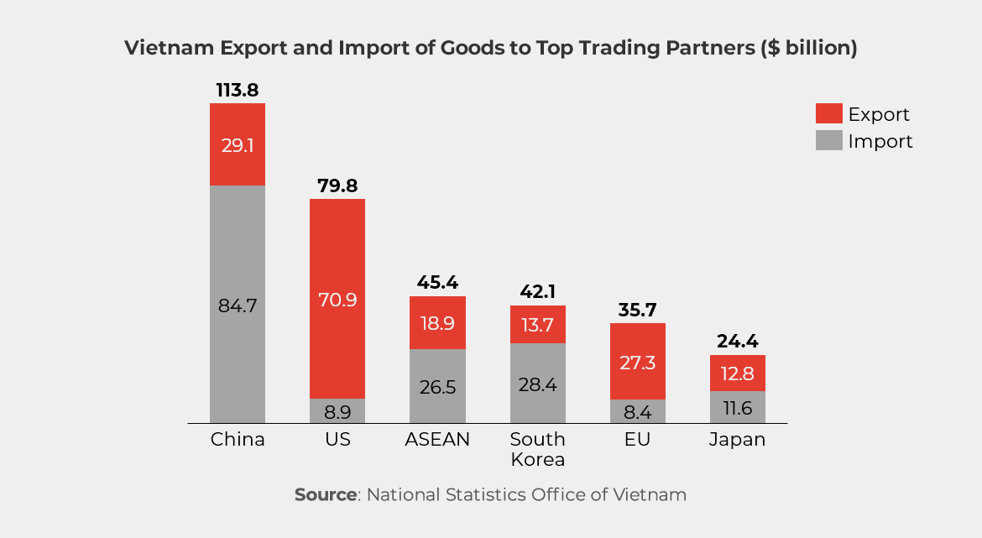
2024 Data

Slide 22
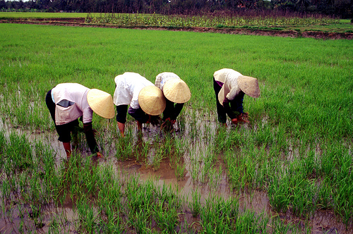


Vietnam’s Exports
US is Vietnam’ s largest export market.
Textiles and garments, Marine products and footwear.
Vietnam is now the world's second largest exporter of rice (volume) and coffee.
Crude oil is also exported.
Vietnam also generates substantial foreign exchange earnings from foreign tourists and labor exports in which Vietnamese workers work overseas

Slide 23
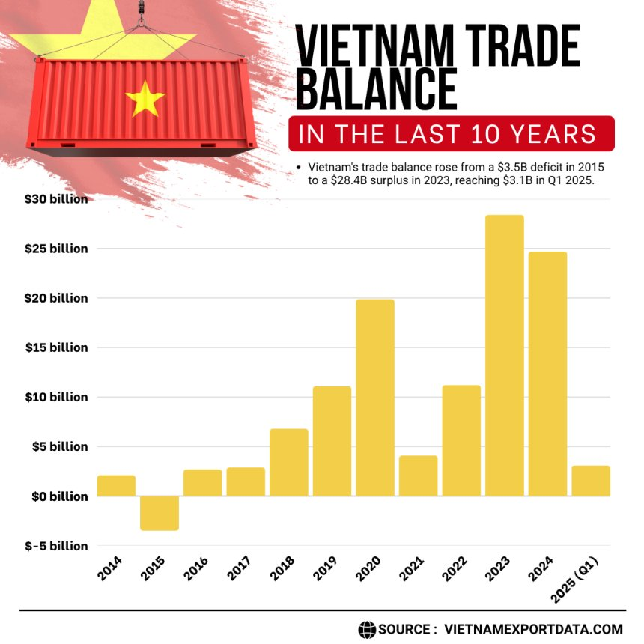
https://www.vietnamexportdata.com/blogs/vietnam-trade-balance-2024-25-latest-import-export-data

Slide 24
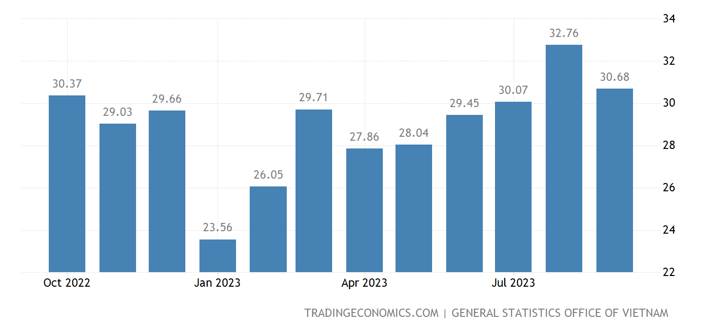
Vietnam’s Exports
  Exports
    In the last years, Vietnam's exports have doubled as competitive minimum wage and low costs of utilities boosted foreign direct investment in the manufacturing sector. Vietnam main exports are: telephones, mobile phones and parts thereof (21 percent of total shipments) and textiles (12 percent). Others include: computers and electrical products (12 percent); shoes and footwear (7 percent) and machinery, instruments and accessories (6 percent).
    Main export partners are: the United States (19 percent of the total exports), China (16 percent) and Japan (8 percent). Others include: South Korea (7 percent), Hong Kong (4 percent) and Netherlands (3 percent)
Millions of US$

Slide 25
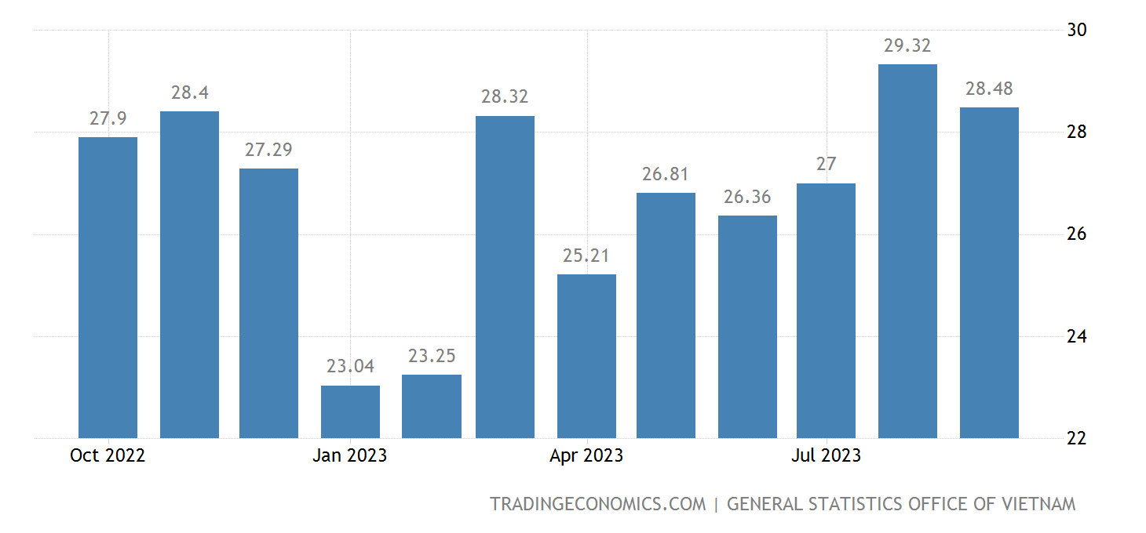
Vietnam’s Imports
  Imports
  Vietnam main imports are computers, electrical products and parts (18 percent of total imports) and machine, instruments and accessories (16 percent). Others include: telephones, mobile phones and parts thereof (8 percent); textile fabrics (5 percent) and iron and steel (4 percent). Main import partners are China (28 percent of the total imports) and South Korea (22 percent). Others include: Japan (8 percent), Taiwan (6 percent), Thailand (5 percent) and the United States (4 percent).
Millions of US$

Slide 26
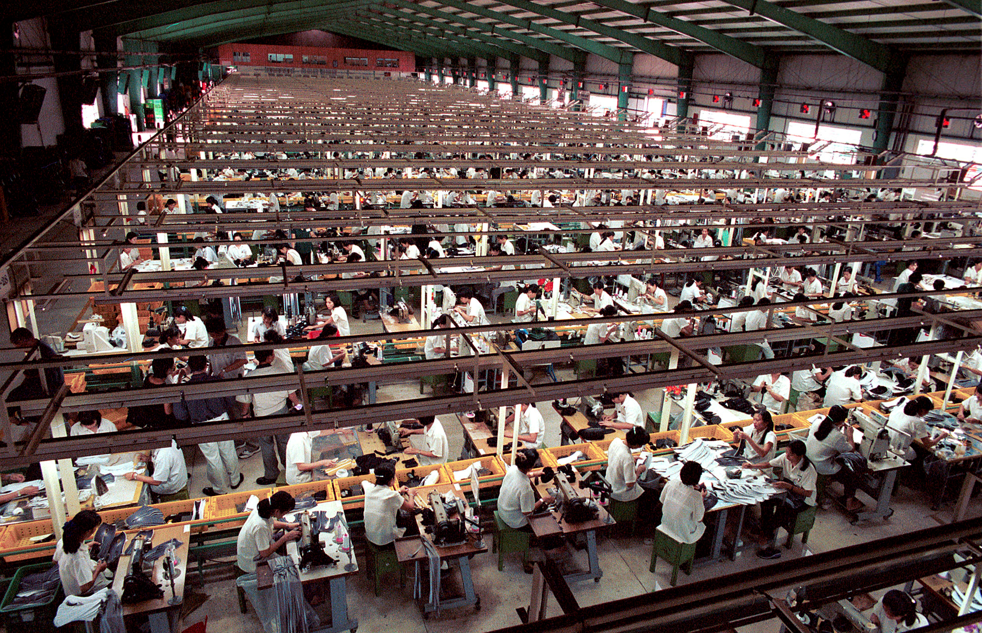

Slide 27
Vietnam’s Main Competitive
Strengths and Weakness
Strengths
  Low –cost labor
  Hard-working labor force
  High productivity in some sectors
  Relatively educated labor force
  Political Stability
  Abundant natural resources
  Overseas Vietnamese 4.5 million population (bringing inward remittances to the country)
Weaknesses
  Corruption
  Pace of reform
  Income disparity
  Education
  Health and Environment: H1NI, previously SARS, Bird Flu
  Indistinct principle and regulation
  Obsolete infrastructure
  Fluctuation of money market and exchange rate
  Lack of upstream industry

Slide 28
Commonly-known Strengths
An important domestic market of over 100 million inhabitants
Young and increasingly well-trained population (70% of the population age between 15 and 64) having potential for high value added jobs
Perfect location as a hub for South East Asia
One of the most dynamic economies among the Emerging Asia nations

Slide 29
Stable Socio-political Environment
Since the “Doi Moi” reform policy, the social, political and economic context has rapidly changed. It is mainly characterized by
  A higher openness of the economy and a gradual move towards regional global integration through a number of bilateral and multilateral trade agreements
  A multi-dimensional and multi-partner model that enables the country to develop the export-based economy
  A higher participation of most socio-economic agents/institutions (governmental vs. non-governmental) in the planning, implementation and monitoring of economic policies
  An encouragement of foreign investment as part of the country’s development strategy
http://www.theglobaleconomy.com/rankings/wb_political_stability/

Slide 30
Ongoing Structural Reforms
Numerous regulatory reforms to enhance international economic cooperation and to attract external financing
  Focus on foreign investors: return, risks, legal barriers, Investor protection
  Prior to joining the WTO, Vietnam has substantially reformed its legal system through revising a number of Laws and Codes:
    Labor Code, Land Law, Civil Code, Law on Securities, Law on Competition, Enterprise Law, and Investment Law
    Objective: making the investment environment more stable and transparent as well as to strengthen the enforcement of Laws
  The presence of foreign investors also helped the Vietnam’s legal environment more conform to international standards

Slide 31
Ongoing Structural Reforms
Since 1986, Vietnam has embarked a vast program of structural reforms with objectives of turning a centralized economy into a market-based economy with socialist orientation
  Abolishing agricultural collectives
  Removing price controls on almost all traded goods and services
  Encouraging the establishment of private businesses
  Opening up the domestic market to foreign investment, including foreign-owned enterprises
  Liberalizing gradually the banking sector so that interest rates are determined according to market conditions
  Developing and improving the efficiency of the domestic markets for goods/services and for capital (stock/bond markets)

Slide 32
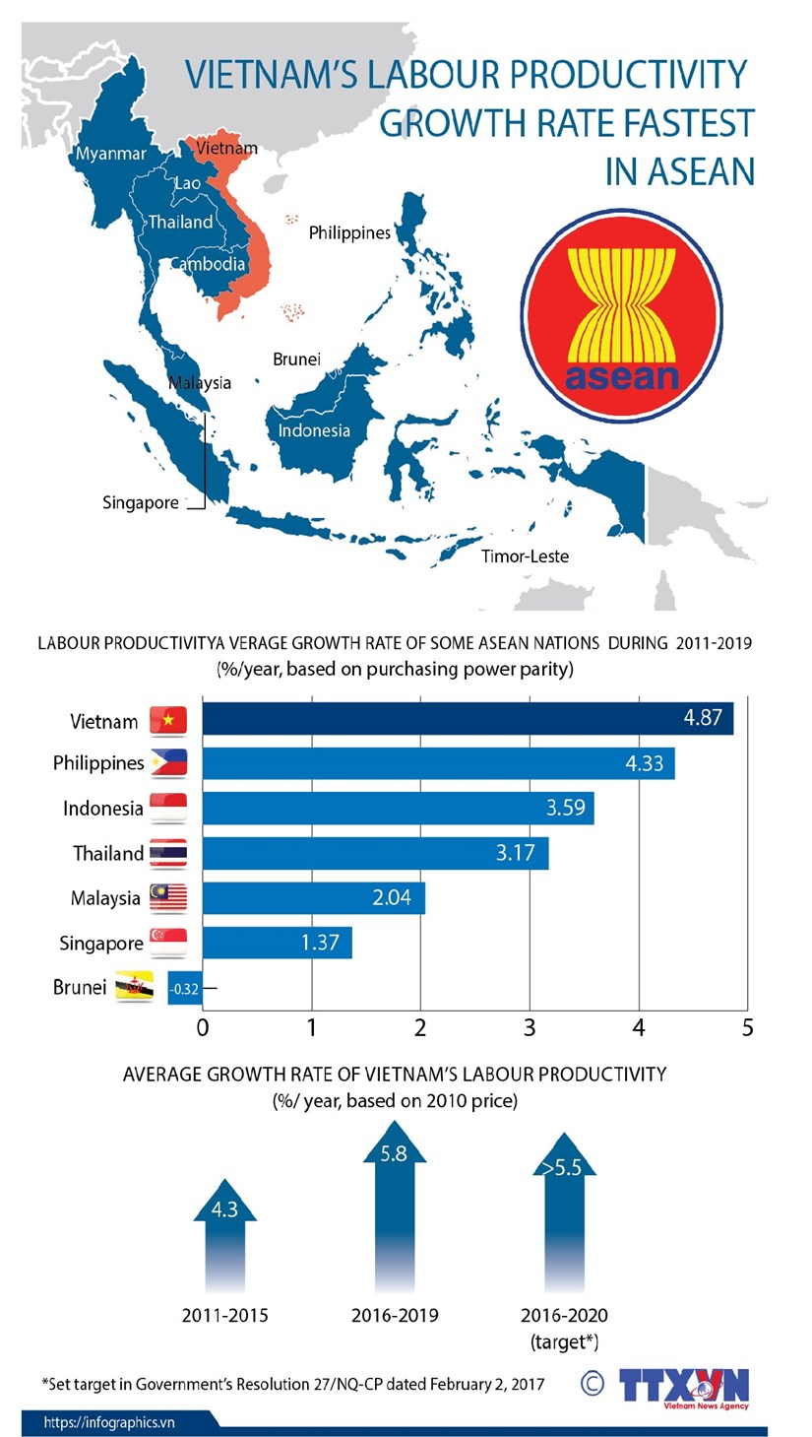
Labor Productivity Growth and Skills
https://en.vietnamplus.vn/vietnams-labour-productivity-growth-rate-fastest-in-asean/189017.vnp

Slide 33
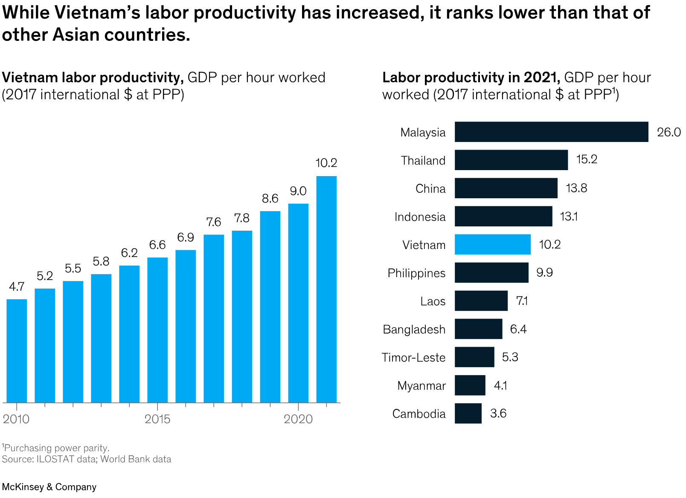

Slide 34
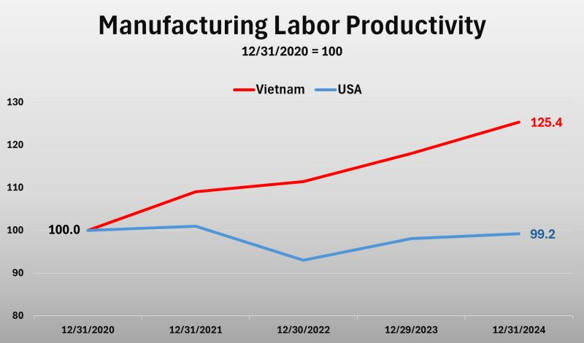

Slide 35
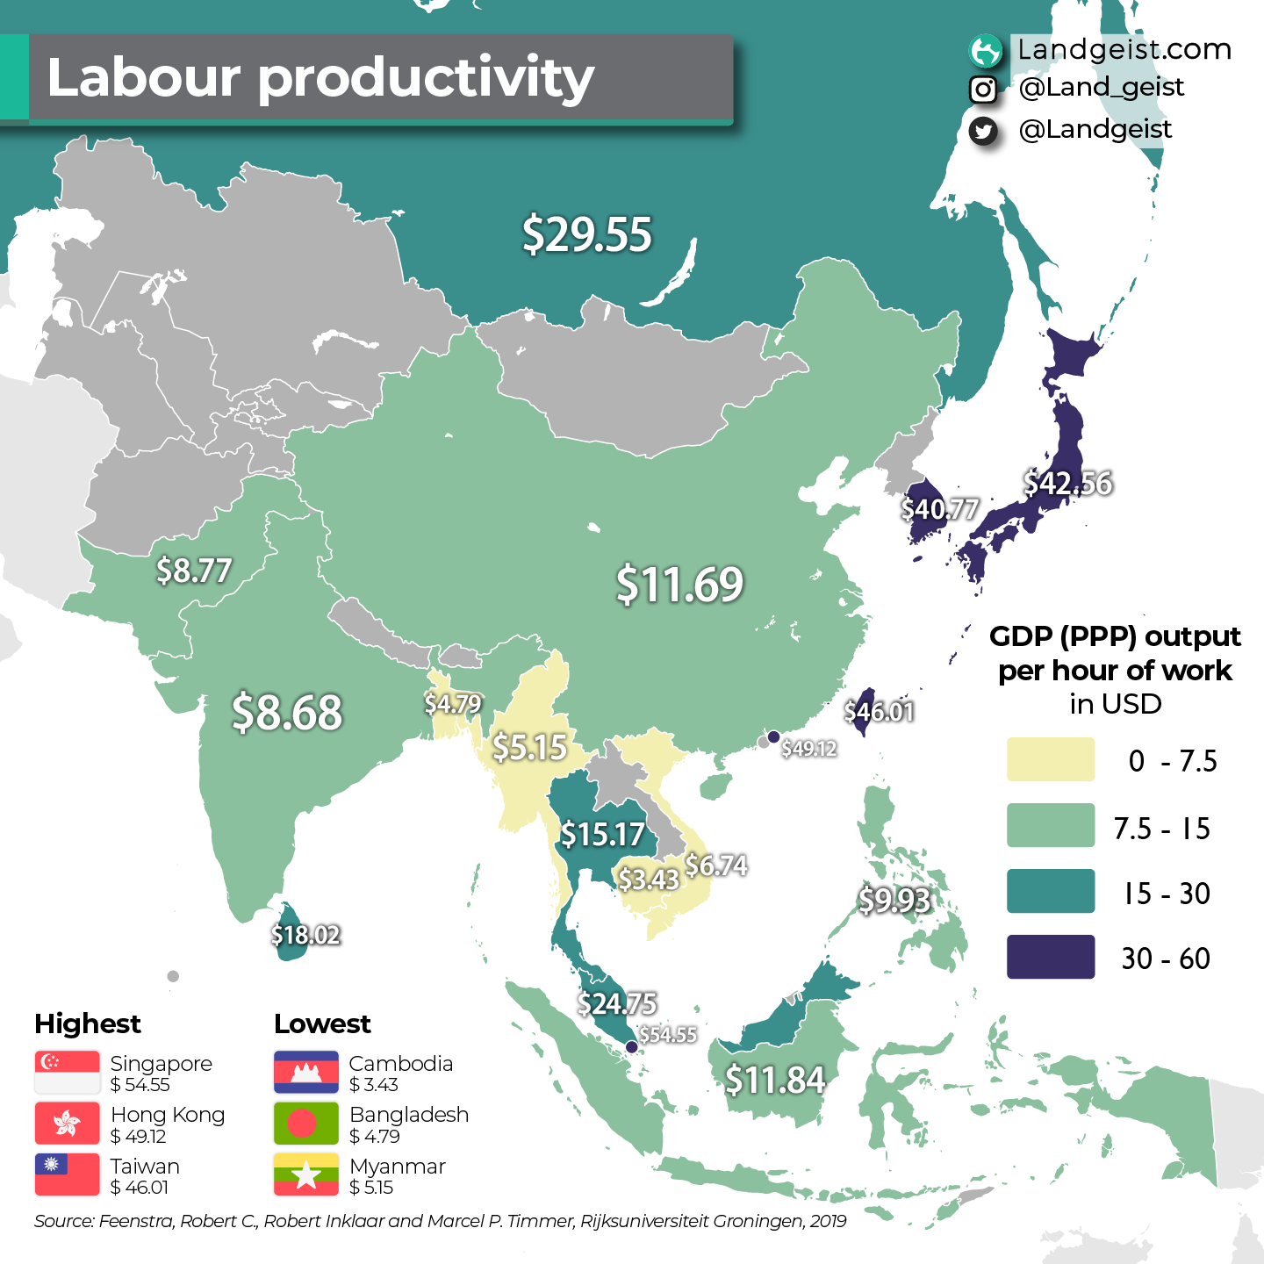

Slide 36
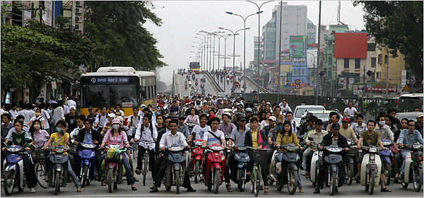
Environmental Problems
Vietnam is at the beginning of the industrialization process, but environmental damage is already severe:
  deforestation and erosion of soil – leads to flooding etc.
  water pollution due to rapid increase of aquaculture
  abuse of fertilizers, insecticides and herbicides, uncollected solid waste
  industrial pollution in urban regions, increased dust, and alarming increases of toxic gases are widespread.
Air quality in the cities is poor.

Slide 37
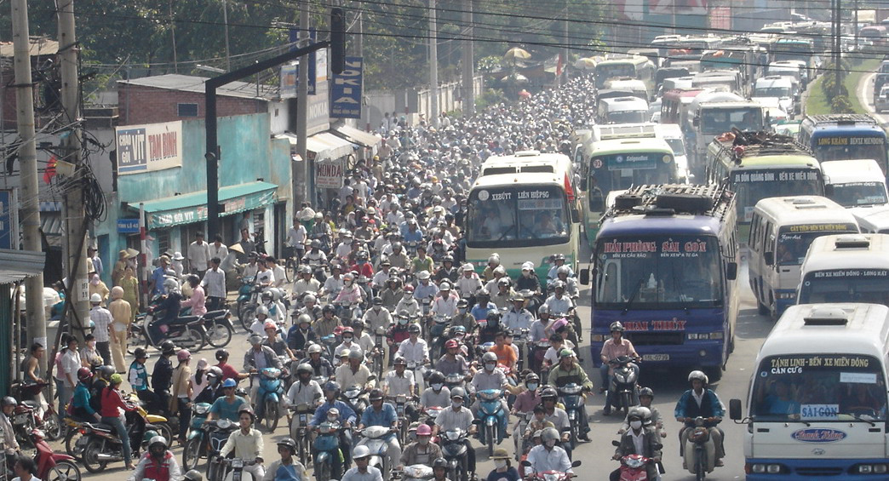
Good Thing it is Not Rush Hour!

Slide 38
Health Care System
Before 1975, Vietnam succeeded in establishing a three-tier (commune, local, and central) health care system
Health care was generally free in all public health care centers, but depending on one’s position in the political system, the quality of health care was drastically different.
Given the low GDP per capita, the performance of Vietnam’s health care system, measured by childhood mortality and life expectancy, has and is relatively good.
Between 2000 and 2023, the infant mortality rate declined from 19.1 per thousand to 14 per thousand.
https://data.worldbank.org/indicator/SP.DYN.IMRT.IN?locations=VN
Accordingly, life expectancy at birth increased from just over 60 (1975) to almost 75 today.
http://countryeconomy.com/demography/life-expectancy/vietnam

Slide 39
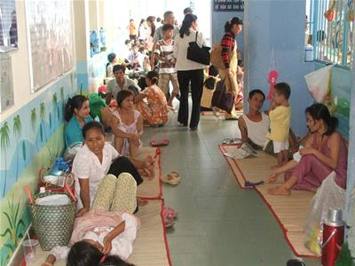
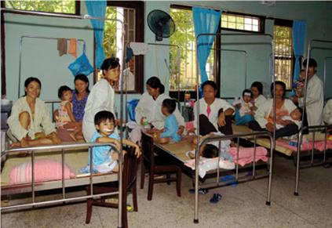
Health Care System
Public hospitals, especially well-known central clinics, are desperately over-crowded; two patients (or even more for children) must share a hospital bed, and family members must take care of the patients and must fight for reasonable service.
This imbalance between demand and supply provides fertile soil for bribery and abuse of power by the hospital staff.
Illness in Vietnam is one of the major causes of poverty or misery and is one of the most serious concerns of the population.

Slide 40
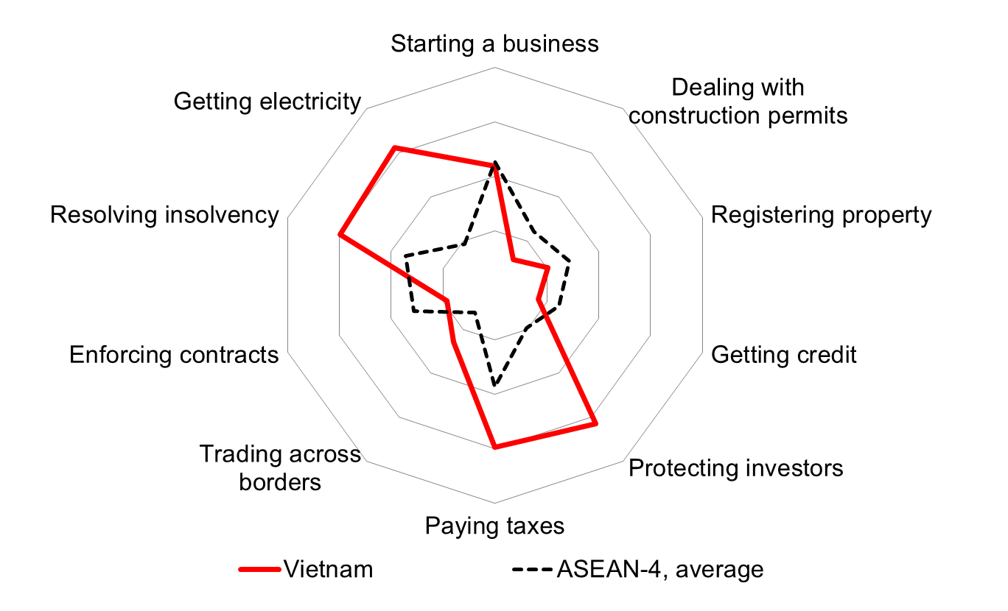
Longer-term Growth: Getting the Business Climate Right
https://www.state.gov/wp-content/uploads/2025/09/638719_2025-Vietnam-Investment-Climate-Statement.pdf
Adapted from World Bank Presentation

Slide 41
Long – Term Growth: Getting SOE
Reforms Right
As of late 2024, Vietnam had 671 state-owned enterprises (SOEs), and government plans suggest that the number will continue to decrease in 2025 due to ongoing restructuring
Key developments in Vietnam's SOE sector in 2025:
  Continued reduction: Government policy emphasizes equitization and divestment of state capital from non-strategic businesses. This restructuring aims to increase quality and efficiency rather than simply shrinking the sector.
  Transfer of control: In early 2025, 18 of the largest and most strategic SOEs—including PetroVietnam, Vietnam Airlines, and EVN—were moved under the direct management of the Ministry of Finance.
  New management law: A new Law on Management of State Capital took effect in July 2025, giving SOE managers more autonomy and business flexibility.
  Focus on strategic sectors: Despite the overall reduction, SOEs will continue to be a major force in key economic sectors such as energy, telecommunications, and finance.

Slide 42
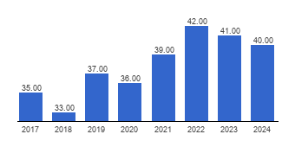
Corruption and Growth
Corruption long seen as a serious problem
A few troubling cross-country comparisons
https://www.transparency.org/country/#VNM
40/100 88/180 in 2025

Slide 43
Poverty and Inequality
Poverty remains concentrated among ethnic minorities. HOWEVER,
  Even ethnic minority poverty has improved significantly
  The situations of the 53 ethnic minority groups are diverse
  Observed pathways out of poverty for ethnic minorities are similar to rest of population
Adapted from World Bank Presentation

Slide 44
A Synthesis of Overall Performance
Vietnam has been recognized as one of Asia’s great success stories in terms of economic and social development over the last 20 years
  Vietnam economy has a robust and steady growth since 1990 (average growth rate of over 6% since 2000). China is the only Asian country that performed better
  The growth is relatively balanced, with industry and services sectors contributing about 40% each to GDP
  Trade openness and integration with the region and world has substantially increased (163.67% of GDP)
  Vietnam is among the most attractive countries in terms of external financing (FDI and portfolio equity)
  There is a certain level of resilience as extreme shocks (recent crises have not caused serious effects on economic and investment activity (good management of economic and financial openness)

Slide 45
Prospects
We will refer to World Bank (2023) Recent Developments and Prospects
Regardless of impressive achievements in economic growth and poverty reduction, Vietnam still has a long way to achiever its growth targets.
Question as to whether Vietnam can overcome the “middle-income trap” and reach the level of high-income economy.
The state in Vietnam is not immune to corruption, conflict of interests and abuse of power.
Transparency, openness, inclusive development have to be implemented.
If Vietnam continues its reform efforts, build-ups the right policies and appropriate institutions, Vietnam can overcome these obstacles and achieve the long desired targets.

Slide 46
Economic Integration is Not
Without Risk
Advantages
  A greater market for goods and services
  Companies will have better access to international capital markets for external financing
  Reduced cost of capital and international risk sharing
  Technology transfer (cleaner technology for a sustainable development)
Risks
  Vietnam companies may not be ready for dealing with challenges
    Vietnam has a low competitiveness level (labor-intensive economy), while main trading partners are productivity-driven economy (Chile, Mexico), or innovation-based economy (US, Canada, Japan, Singapore, Malaysia, Australia, New Zealand)
    Exports of low value added products

Slide 47
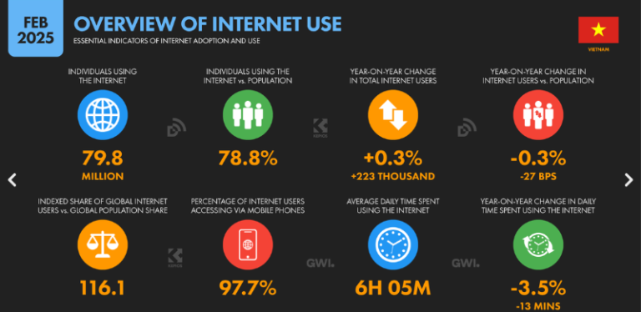
https://globalcio.com/longread/Digital-Strategies-of-Vietnam0/

Slide 48
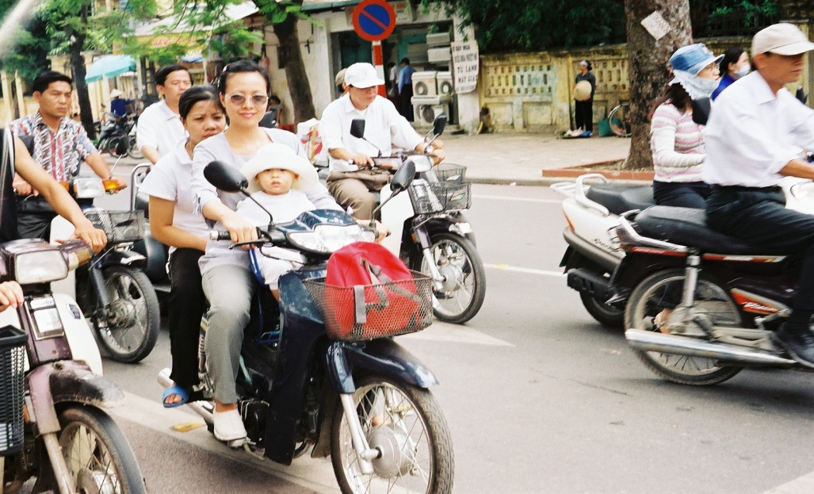
VIETNAM IS A COUNTRY, NOT A WAR
Vietnam has made remarkable progress over the past two decades in its transition to a market economy
Vietnam is a nation at peace concerned with improving the living standard of its people.
Discussion of Vietnam should focus on the positive developments of the last twenty years as it is an important study of economic development, transition economics and institutional change.

Slide 49

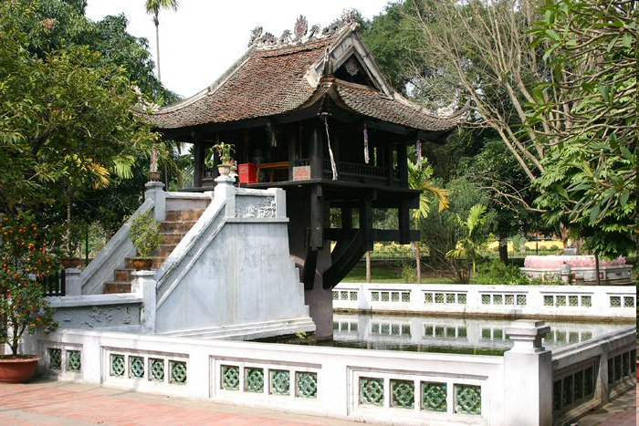
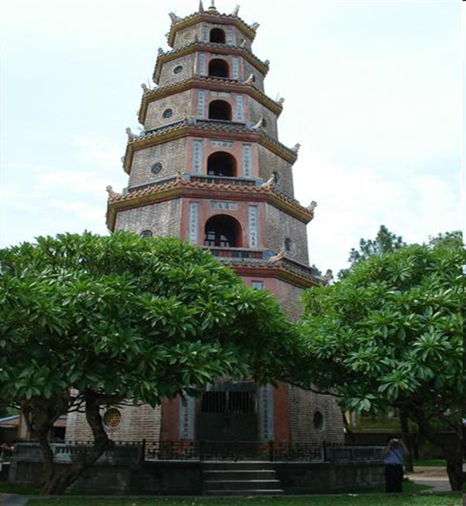
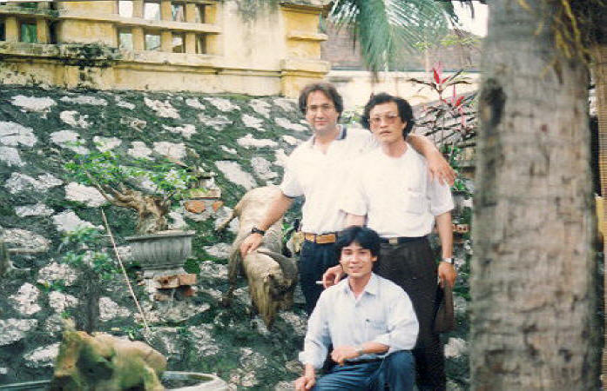
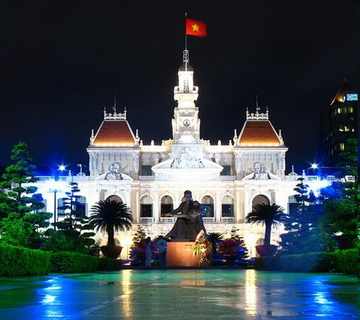
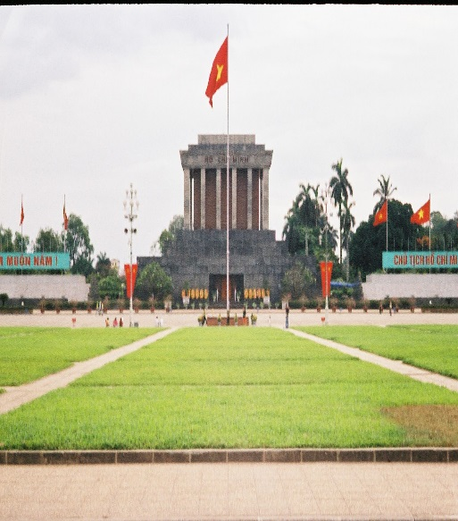
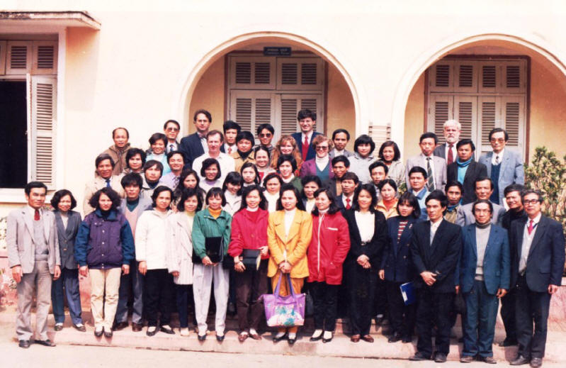

Slide 50


Slide 51

China – Vietnam Relationship
https://thediplomat.com/2025/07/why-vietnam-will-not-balance-against-china/

Slide 52

South China Sea

Slide 53

Oil and Gas

Slide 54

https://timesofindia.indiatimes.com/blogs/toi-edit-page/crossing-a-red-line-chinese-transgressions-in-south-china-sea-need-strong-pushback/

Slide 55


Slide 56

Thoughts?

