Slide 1
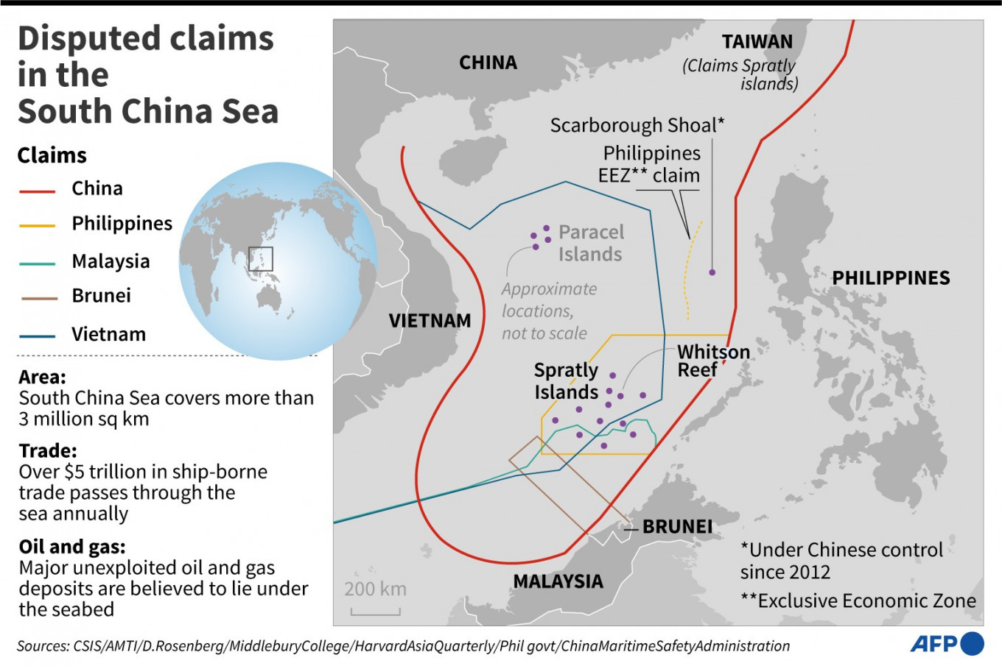
Disputes in the South China Sea and East China Sea

Slide 2
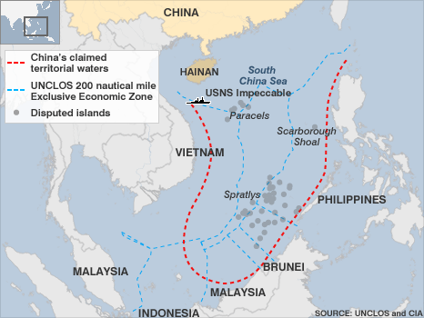

Slide 3
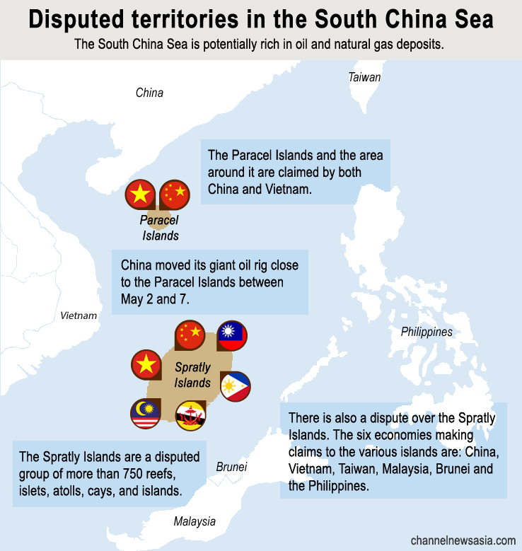

Slide 4
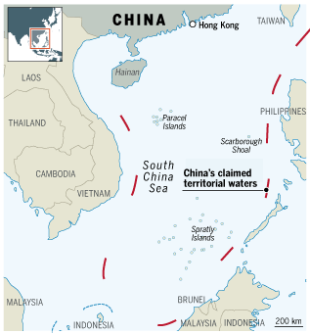
China’s Nine-Dash Line

Slide 5
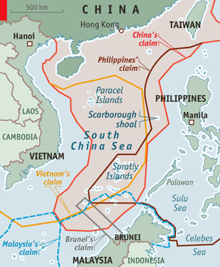
Competing Claims

Slide 6
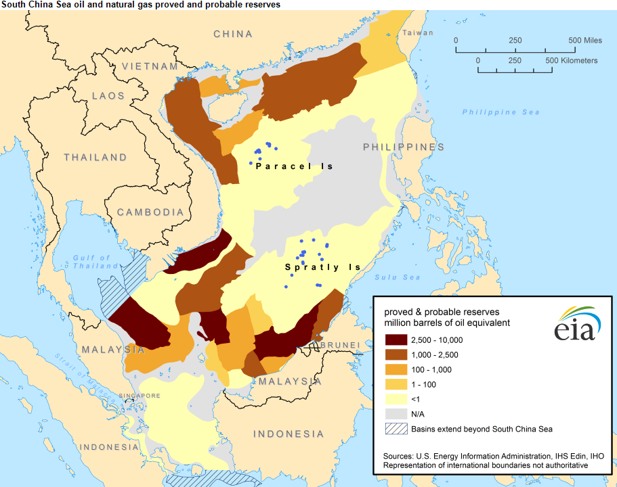
Oil and Gas

Slide 7
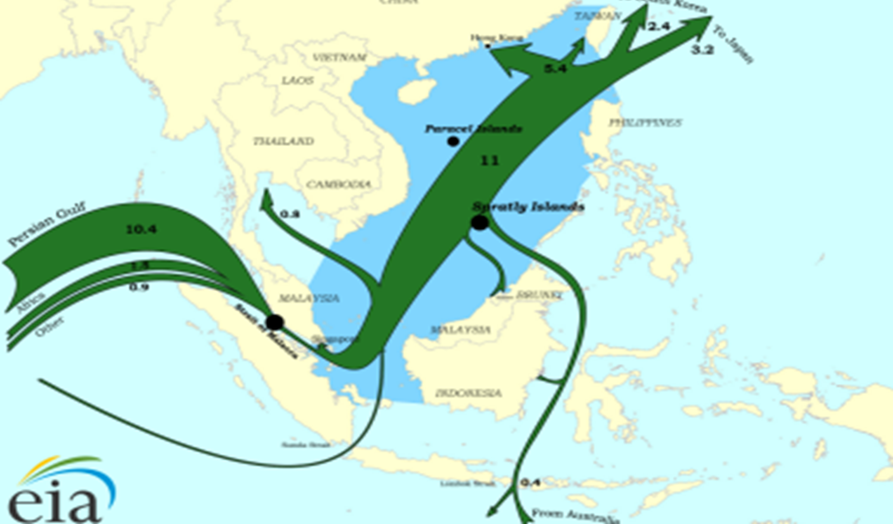
Oil Trade

Slide 8
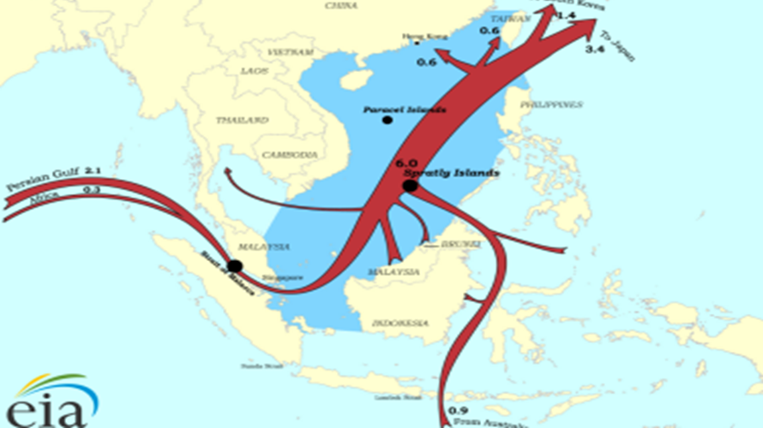
Natural Gas Trade

Slide 9
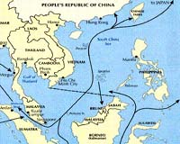
Trade Routes

Slide 10
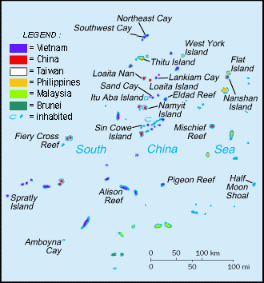
Spratly Islands Disputes

Slide 11
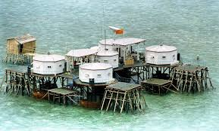
Mischief Reef Chinese “Naval Base”
1990s

Slide 12
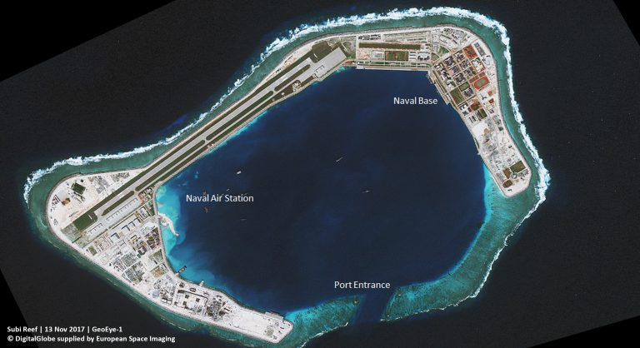
2020’s

Slide 13
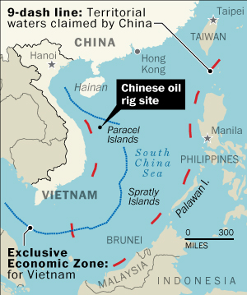
Paracel Island Disputes and Chinese Oil Rig 2014

Slide 14
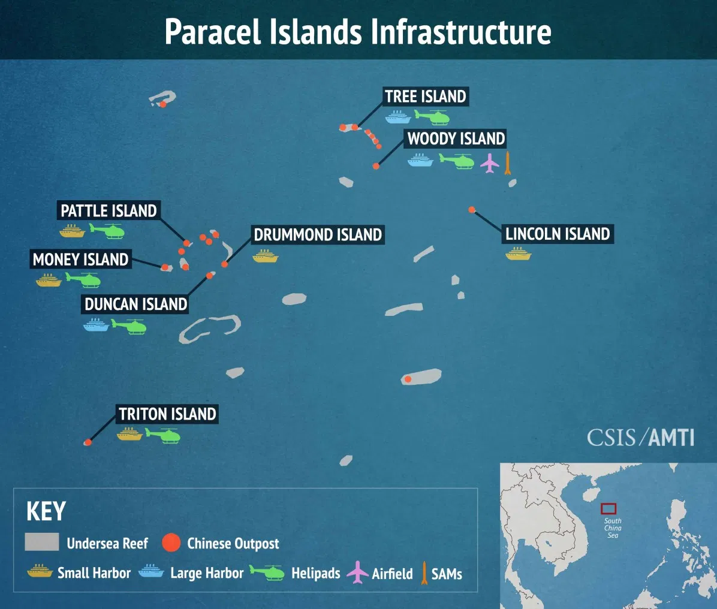

Slide 15
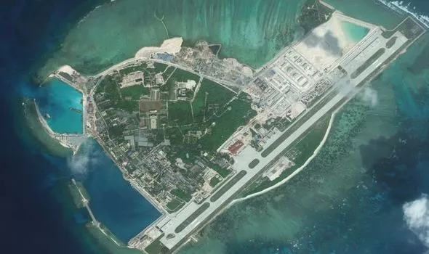
The Chinese Navy has managed to harvest 1.5 tonnes of vegetables on its largest military base in the Paracel Islands - a disputed archipelago in the South China Sea.

Slide 16
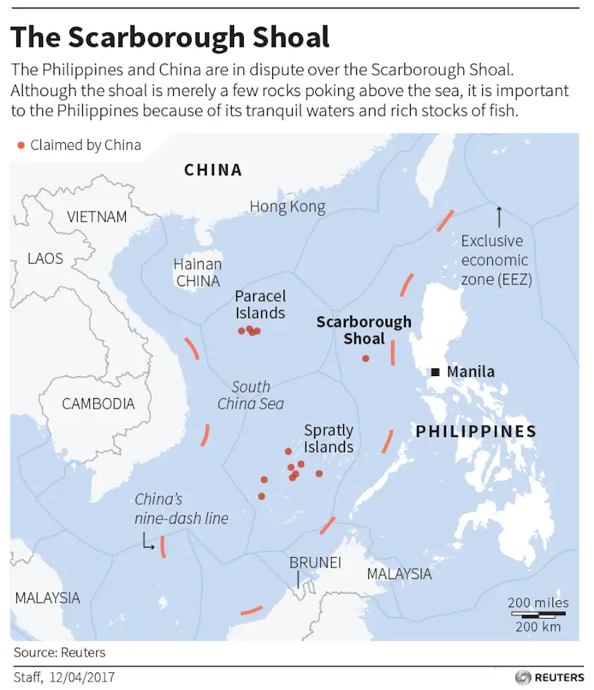
https://www.aljazeera.com/news/2023/9/26/what-set-off-the-latest-south-china-sea-row-between-china-and-philippines

Slide 17
UN Convention on the Law of the Sea (UNCLOS) 1982
12 mile limit from a nation’s coast: legal jurisdiction for the nation
200 miles form a nation’s coast Exclusive economic rights for the nation
Dispute resolution mechanism
Direct talks between the parties.
If they fail:
submission of the dispute to the International Tribunal for the Law of the Sea
adjudication by the International Court of Justice
submission to binding international arbitration procedures
submission to special arbitration tribunals with expertise in specific types of disputes. All of these procedures involve binding third-party settlement
Exceptions for cases involving national sovereignty. Parties submit their dispute to a conciliation commission; results are non-binding.

Slide 18
Permanent Court of Arbitration (PCA) in The Hague
Philippines versus China
https://www.lawfareblog.com/tribunal-issues-landmark-ruling-south-china-sea-arbitration

Slide 19
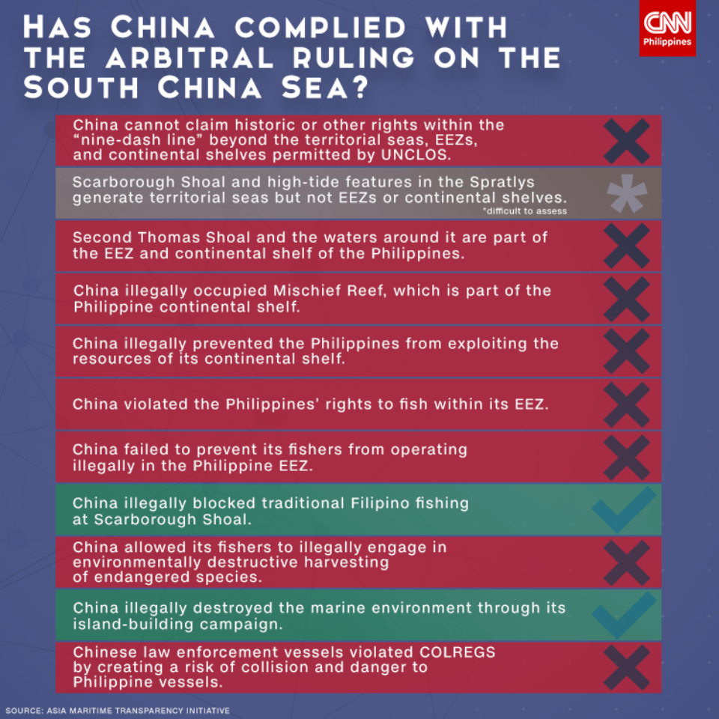
Philippines versus China

Slide 20
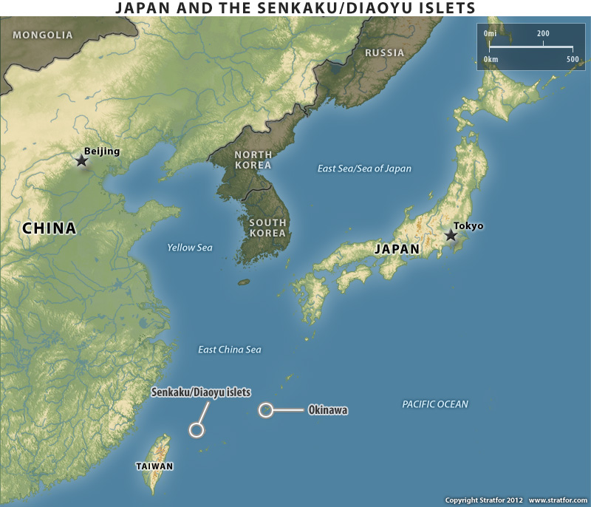
Dispute Between Japan and China Senkaku/Diaoyu Islands

Slide 21
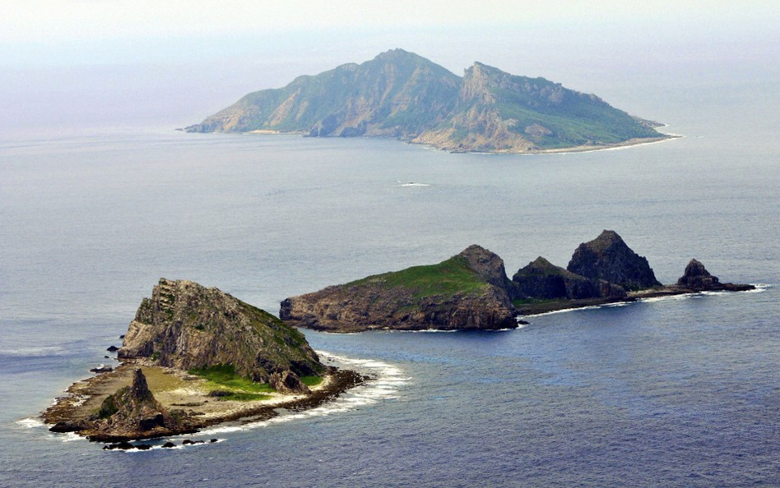
Japan Ministry of Foreign Affairs
https://www.mofa.go.jp/index.html

Slide 22
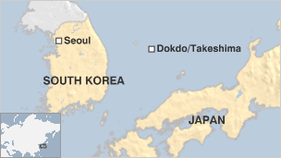
South Korea and Japan Dispute Dokdo/Takeshima Islands
https://www.lowyinstitute.org/the-interpreter/islands-ire-south-korea-japan-dispute

Slide 23
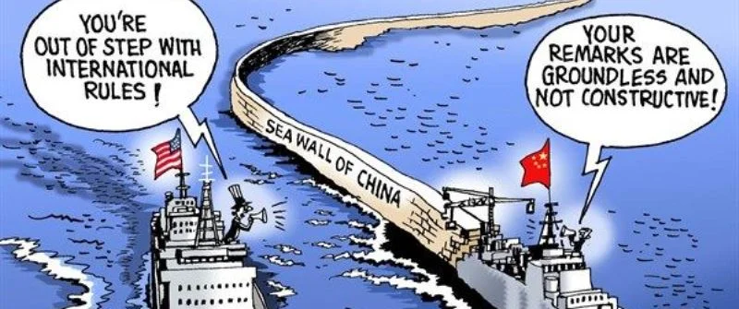

Slide 24
