Slide 1
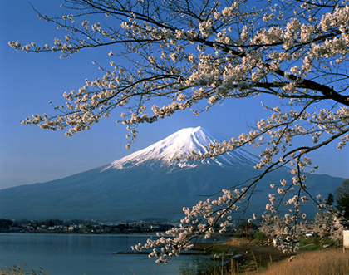
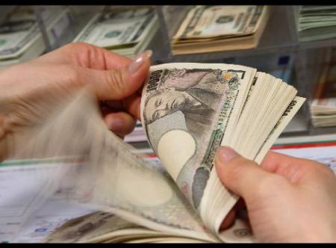
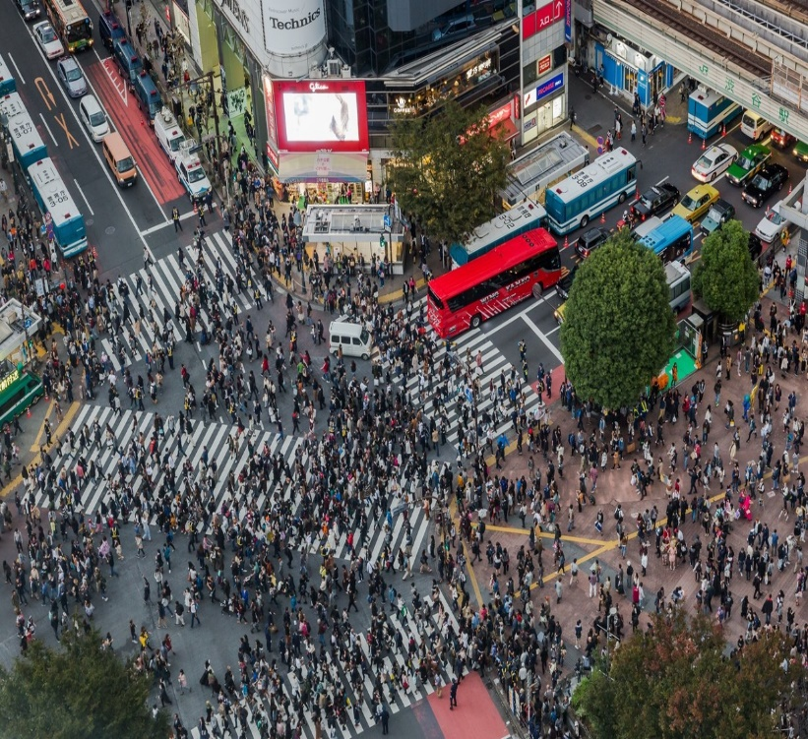
THE ECONOMY OF JAPAN
日本
経
済

Slide 2


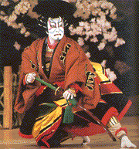
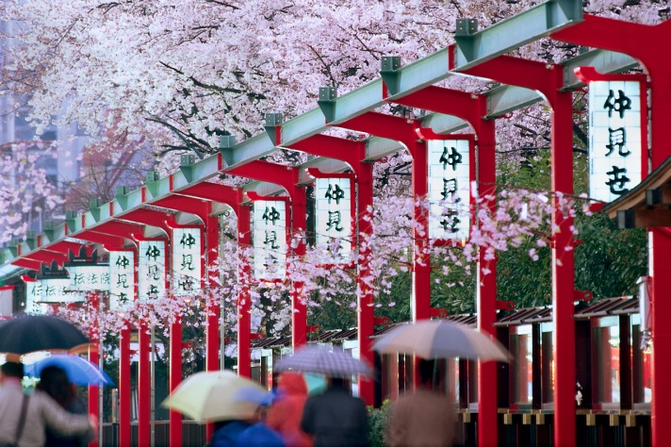
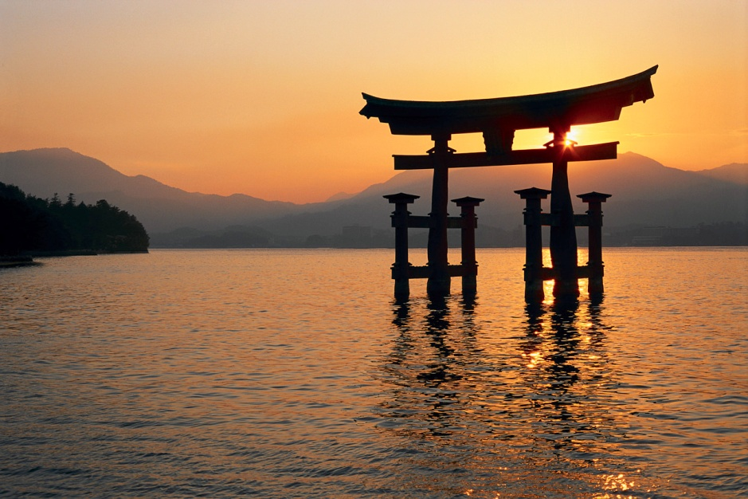
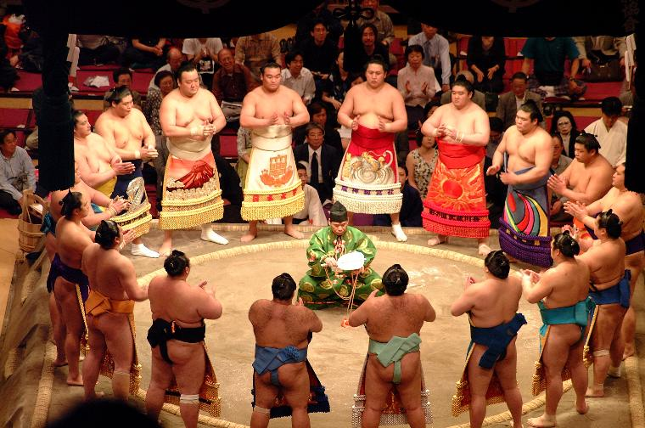
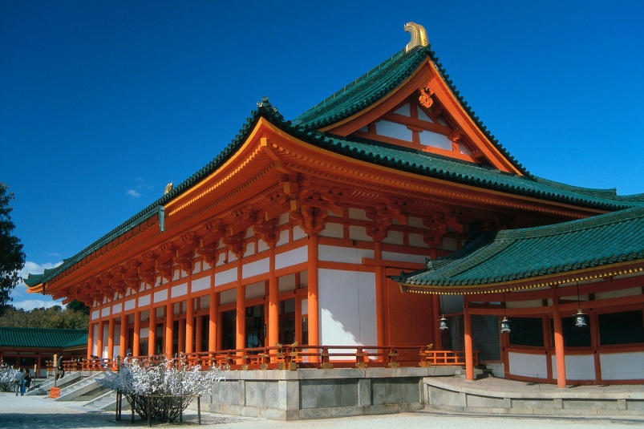


Traditional Japan
Source: Web Japan & Japanese Consulate General, San Francisco
Notes:
6

Slide 3



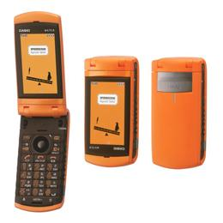
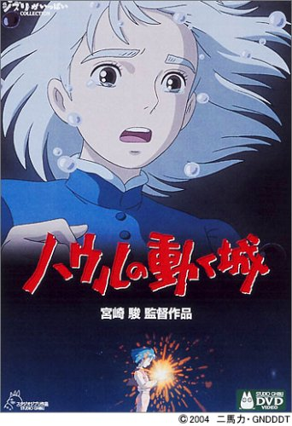
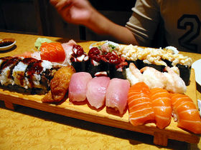

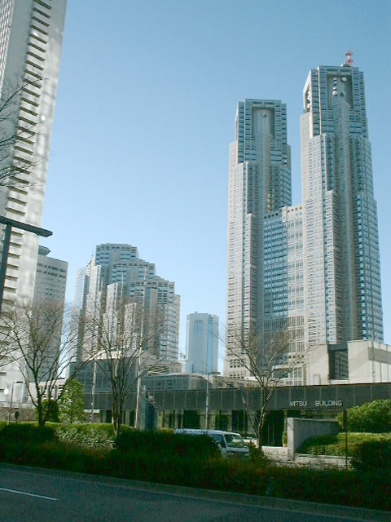
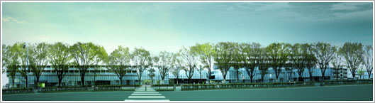

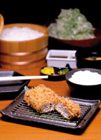
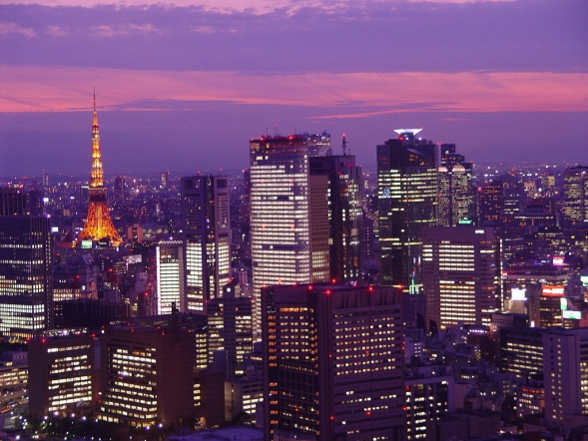
Contemporary Japan
Tokyo Disneyland
Puffy
“Cool Japan”
Japanimation
“KAWAII”
Hello Kitty
Notes:
6

Slide 4
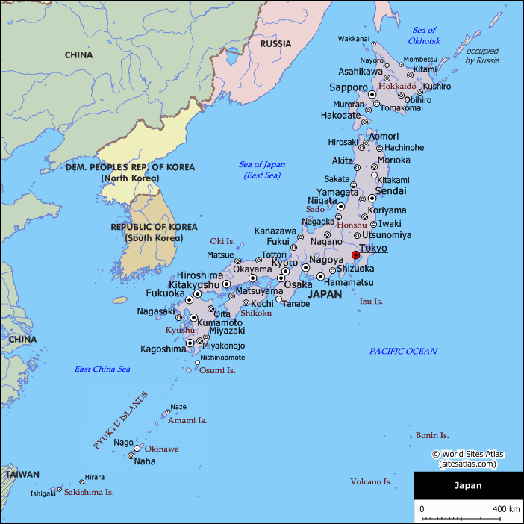

Slide 5
Looking at Some of the Basics Geography
Four main islands:
Hokkaido (N)
Honshu (main island) – Tokyo, Mt. Fuji, Osaka, Hiroshima
Shikoku – Rural
Kyushu (SW) – Fukuoka, Kagoshima, Nagasaki
Most of the population is in Honshu, between the Kanto (Tokyo-Yokohama-Kawasaki) in the east and the Kansai (Kobe-Osaka-Kyoto) in the west
Tokyo – Yokohama has almost 25% of the population (over 33 million)
Close to 80% of the land is mountainous
Japan is poor in natural resources and flat arable land. it depends on imports, for example, for 99.5% of its petroleum

Slide 6
Various Social Statistics
Japan Population (as of 3/8/2024) | 122,840,824
Next UN Estimate (July 1, 2024) | 122,631,432
Births per Day | 2,233
Deaths per Day | 4,327
Migrations per Day | 274
Net Change per Day | -1,821
Population Change Since Jan. 1 | -122,007
http://worldpopulationreview.com/countries/japan-population/

Slide 7
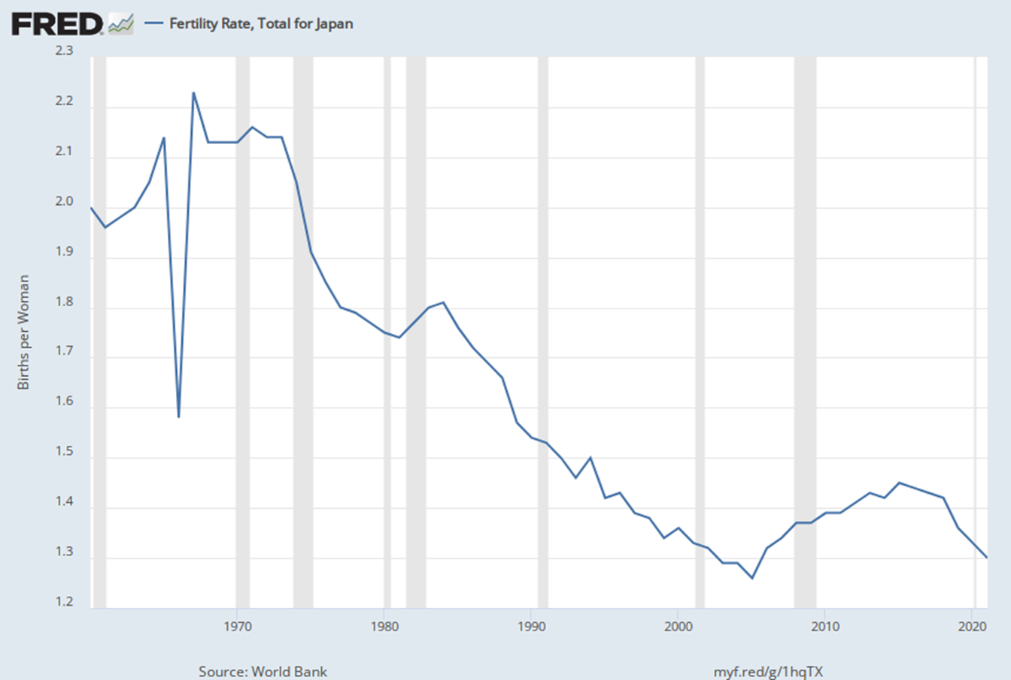
Girls born in [1966] became known as ‘Fire Horse Women’ and are reputed to be dangerous, headstrong and generally bad luck for any husband. In 1966, a baby’s sex couldn’t be reliably detected before birth; hence there was a large increase of induced abortions and a sharp decrease in the birth rate in 1966

Slide 8
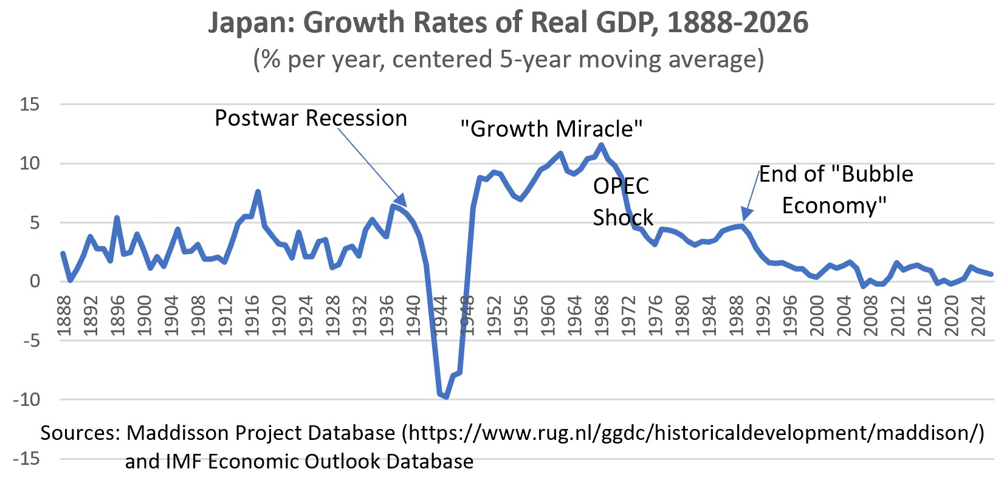
Japan GDP Growth Rate Long-Term

Slide 9
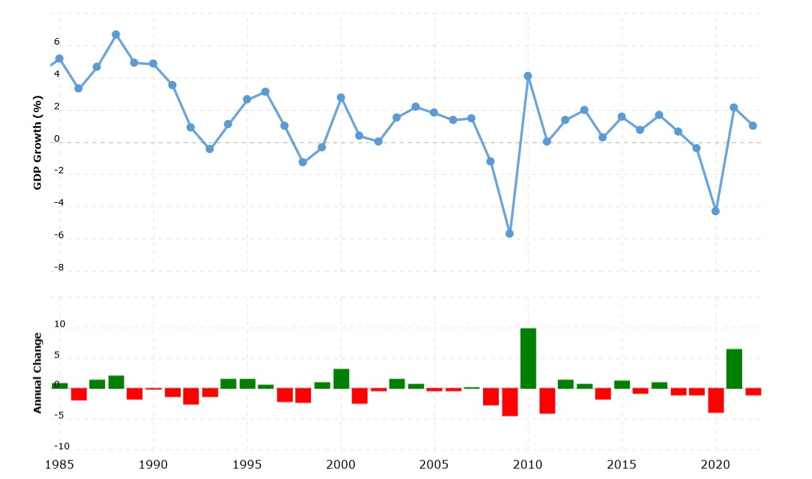
Japan GDP Growth Rate Recent

Slide 10
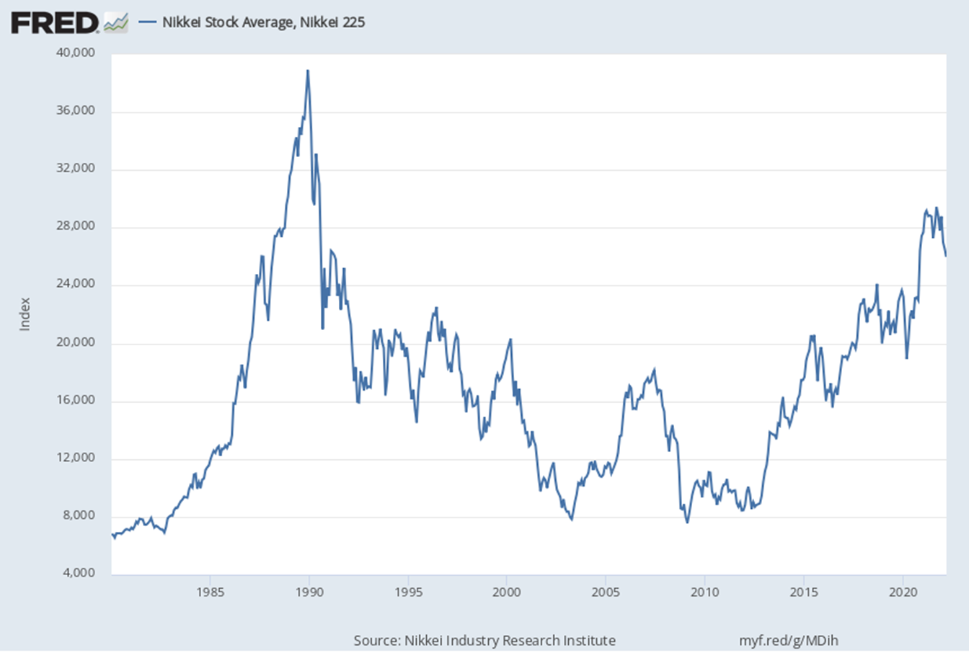

Slide 11
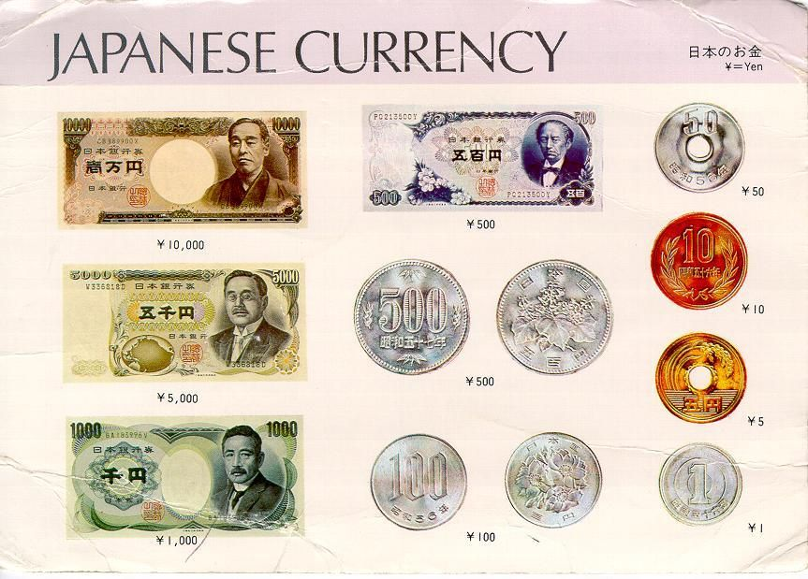

Slide 12
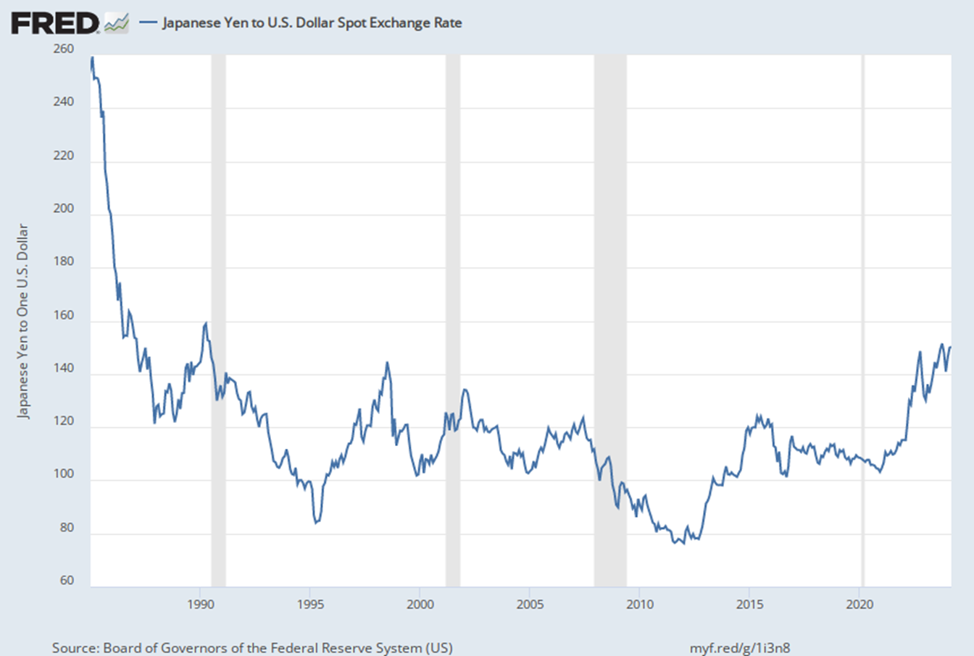
Yen/Dollar Exchange Rate
https://www.xe.com/currencyconverter/convert/?Amount=1&From=USD&To=JPY

Slide 13
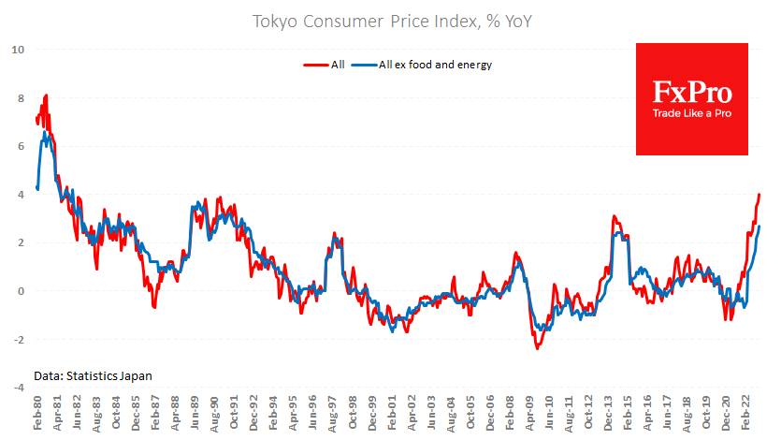
Japan Inflation Rate
https://ycharts.com/indicators/japan_inflation_rate

Slide 14
Japan’s Top 10 Exports - 2022
From 2018 to 2022, the overall value of Japanese exported goods rose by 1.2% from $738.2 billion. Based on the average exchange rate for 2022, the Japanese yen fell by -19.1% against the US dollar since 2018 and declined by -19.8% from 2021 to 2022. Japan’s weaker local currency made exports paid for in stronger US dollars relatively less expensive in 2022 starting from the stronger US dollar.
Given Japan’s population of 125.2 million people, its total $747.3 billion in 2022 exported products translates to roughly $6,000 for every resident in the East Asian island nation. That per-capita dollar amount is about the same as one year earlier in 2021.
Machinery including computers: US$142 billion (19% of total exports)
Vehicles: $135.4 billion (18.1%)
Electrical machinery, equipment: $113.4 billion (15.2%)
Optical, technical, medical apparatus: $38.8 billion (5.2%)
Iron, steel: $35.1 billion (4.7%)
Plastics, plastic articles: $27 billion (3.6%)
Mineral fuels including oil: $18.2 billion (2.4%)
Gems, precious metals: $17.5 billion (2.3%)
Organic chemicals: $17.3 billion (2.3%)
Other chemical goods: $14.3 billion (1.9%)
https://www.worldstopexports.com/japans-top-10-exports/

Slide 15
Japan’s Top 10 Imports - 2022
Japan’s imports totaled US$897.7 billion worth of products in 2022. That dollar amount reflects a 19.8% increase from $749.1 billion for 2018. Year over year, the overall value of goods imported into Japan grew by 16% compared to $773.7 billion during 2021. Given Japan’s population of 125.2 million people, its total $897.7 billion worth of 2022 imports translates to $7,200 in yearly product demand from every person in the densely populated Asian island country. That per-capita dollar amount exceeds the average $6,100 one year earlier in 2021.
Japan’s Top 10 Imports
Mineral fuels including oil: US$253.3 billion (28.2% of total imports)
Electrical machinery, equipment: $120 billion (13.4%)
Machinery including computers: $71.8 billion (8%)
Pharmaceuticals: $39.2 billion (4.4%)
Ores, slag, ash: $31.7 billion (3.5%)
Optical, technical, medical apparatus: $27.9 billion (3.1%)
Vehicles: $22.1 billion (2.5%)
Gems, precious metals: $20.4 billion (2.3%)
Organic chemicals: $18.3 billion (2%)
Plastics, plastic articles: $18.2 billion (2%)
https://www.worldstopexports.com/japans-top-10-imports/

Slide 16
Japan’s Top Import Partners
Below is a list of Japan’s top 15 trade partners that imported the most Japanese shipments by dollar value during 2021. Also shown is each import country’s percentage share of total Japanese exports.
China: US$144.7 billion (19.4% of total Japanese exports)
United States: $139.5 billion (18.7%)
Sout Korea: $54.3 billion (7.3%)
Taiwan: $52.3 billion (7%)
Hong Kong: $33.2 billion (4.4%)
Thailand: $32.5 billion (4.3%)
Singapore: $22.4 billion (3%)
Germany: $19.6 billion (2.6%)
Vietnam: $18.6 billion (2.5%)
Australia: $16.53 billion (2.2%) https://www.worldstopexports.com/japans-top-import-partners/
Malaysia: $16.48 billion (2.2%)
Indonesia: $15 billion (2%)
India: $13.9 billion (1.9%)
Netherlands: $12.4 billion (1.7%)
Philippines: $12.2 billion (1.6%)

Slide 17
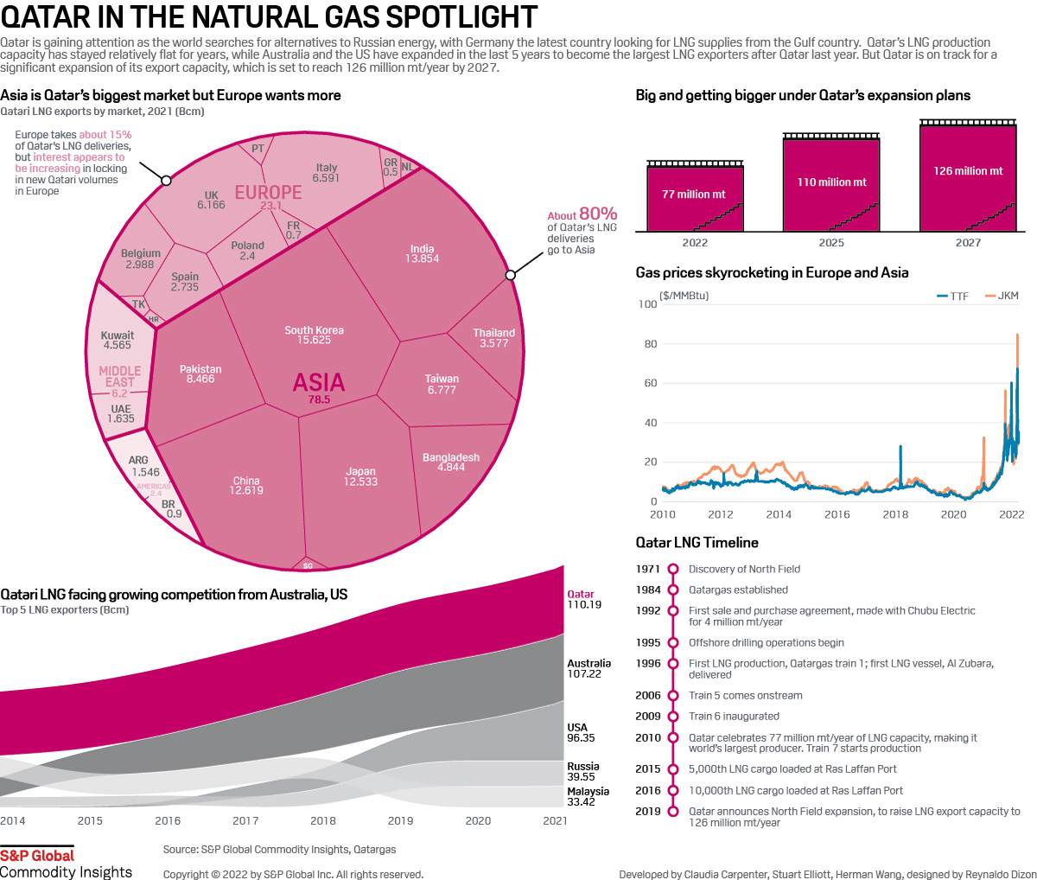

Slide 18
THE “BUBBLE” ECONOMY

Slide 19
Bubble Economy (How “Bubbly” Was It?) 1985 -1990
Asset Price Inflation
Stocks - Nikkei hit high of 38,915 on Dec. 31 1989. Keep in mind it did not hit 10,000 until after 1985.
Land and Real Estate Prices – Prices more than doubled from 1987 to 1990.
Real Estate inflation more pronounced in larger cites
Consumer prices not significantly affected
Rapid economic growth

Slide 20
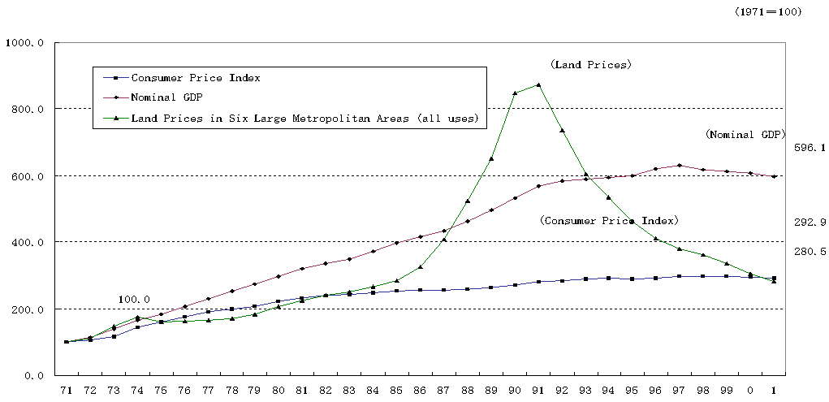
Land Prices

Slide 21
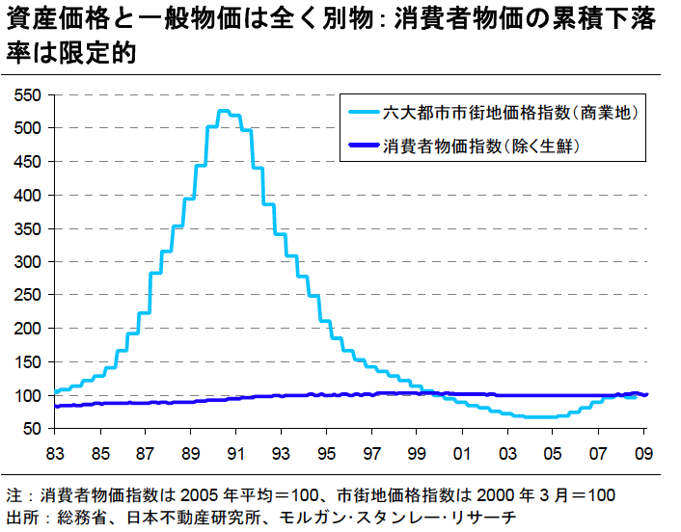
Japanese Urban Real Estate Prices
vs Consumer Price Index Inflation
⬅ 18 years! ➔
Commercial Real Estate
—6 largest cities—
CPI (inflation)

Slide 22
Looking at the Causes of the Bubble
Background
Strong growth in 1980’s and stronger consumer confidence
Financial Deregulation throughout 1980’s.
End of deficit spending by government
Main-bank relationships
Problem with trade deficits (led to Plaza Accord)
Expansionary monetary policy to counter Plaza Accord
Management poised for strong growth
Reaganomics (high interest rates in US)
Belief that Japan was becoming an economic superpower

Slide 23
The Low Cost of Borrowing
Interest rates were effectively 0%
Firms over borrowed
Projects that earned a mere 0% were approved
Banks over lent
Collateral or track records were enough – expectation that asset prices would always rise
Asset prices proved unrealistic
Projects didn’t earn 0% ex post
Banks eventually, however couldn’t collect on their loans

Slide 24
Proportion of Loans to Small Firms

Slide 25
Proportion of Loans to Real Estate Developers

Slide 27
Other Causes of the Bubble
Malfunctioned “Safety Net”
Bank of Japan (BOJ)
Ministry of Finance (MOF)
“Discretionary Guidance”
Inefficient Monitoring of Banking System
Some Reinforcing Factors
Cross-holding share in Keiretsu system
Expansion of real estate companies (Jusen)

Slide 28
Prolonged Aftermath
Impacts
Longest recession in post-war period.
Non-performing Loans
Major Bank Failures and Mergers
Causes of prolonged slowdown
Delay in recognizing problems and in responses
Uncoordinated Actions
Covered Problems
Overprotected banks
Inefficient corporate governance and structure

Slide 29
Lasting Dilemmas
Monetary policy doesn’t work
Interest rates can’t be pushed below 0%
But prices are falling ==> real rates are positive
Banks (rightly) fear bad assets
Outstanding loans are shrinking
Little investment
“Liquidity Trap”
Fiscal policy is not working
Large government deficits

Slide 30
Japan’s Lost Decade (early 1990s-early 2000s): Why Did the Recession Last So Long?
Long adjustment after a large asset bubble
Non-performing loans (late policy response)
Japan’s economic system became obsolete (?)
Aging population and associated problems (pension, medical care, dissaving, etc)
Snowballing fiscal debt
People’s lack of confidence in the future
The China challenge (vs. “return to Japan”)
➔ Lack of political leadership to propose solutions, convince people, and implement actions

Slide 31
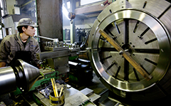

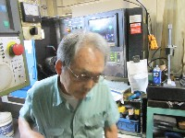
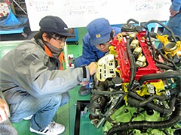
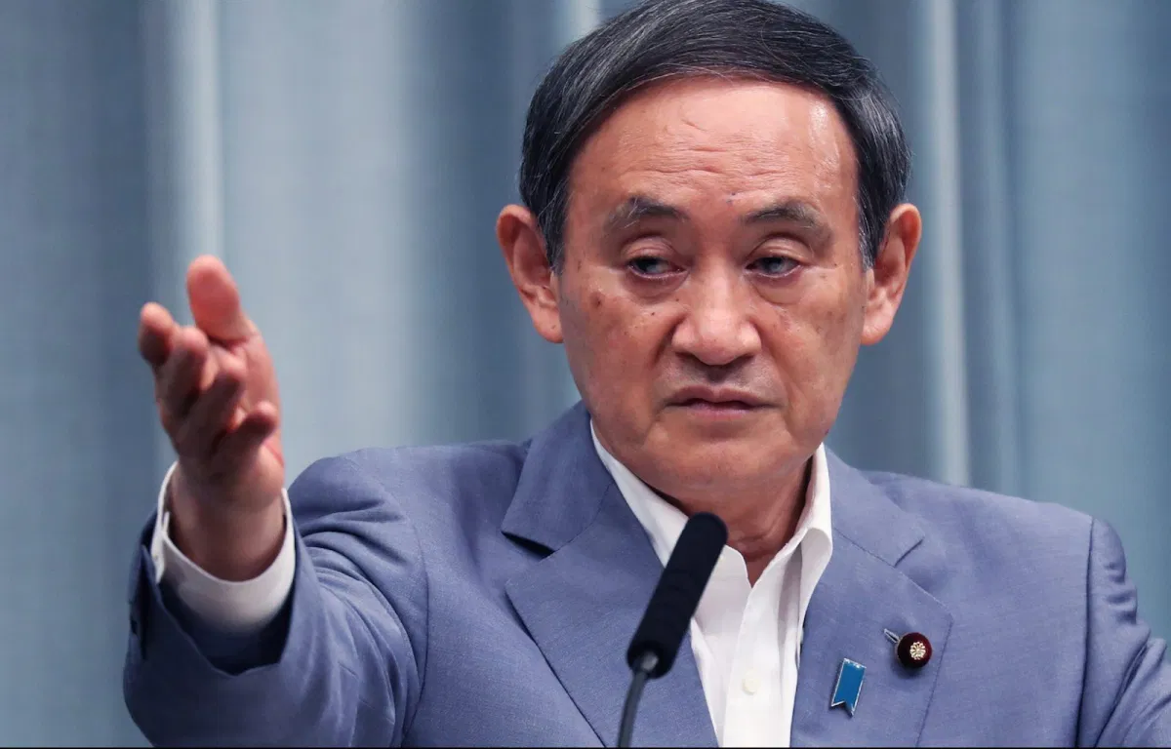
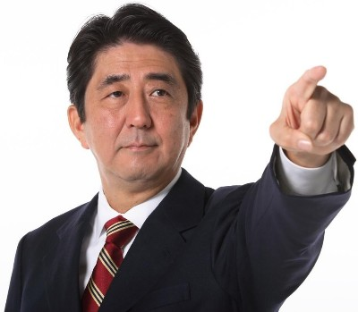
Current Economic Situation

Slide 32
LDP Government of Shinzo Abe
First Abe Cabinet (Sep.2006-Sep.2007) was unsuccessful.
Second Abe Cabinet (Dec.2012-) has the following features:
Active, quick and vigorous (compared with past PMs)
Politically conservative (critiques say “right wing”)
Aiming to revise constitution—instilling nationalism, officially approve military capability
Diplomatically active (foreign visits, top sales, coping with China & N. Korea, etc.)
Economic revival as top national priority (Abenomics)
High popular support + fragmented oppositions ➔ LDP won a landslide victory in Upper House election (July 21, 2013) and gain political free hand

Slide 33
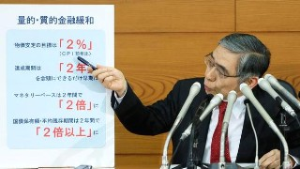
Three Arrows of Abenomics
To revive the economy, three “arrows” are mobilized.
1. Aggressive monetary policy (“New Dimension”)
- New BOJ Governor Haruhiko Kuroda (Mar.2013-)
- Dispel deflation mindset: inflation target of 2% within 2 years
- Monetary expansion with new asset purchases (REIT etc.); doubling monetary base & gov’t bond holding in 2 years
- Correction of high yen
2. Flexible (=active) fiscal policy
- Revive economy first, consolidate budget later
- Increase infrastructure investment
3. New growth strategy (proposed in steps; cabinet approval June 14, 2013)
- Japanese Economy Revitalization Headquarters (under it: Industrial Competitiveness Conference)
- 3 roadmaps and 3 plans (12 pillars – 37 items – 56 sub-items)

Slide 34
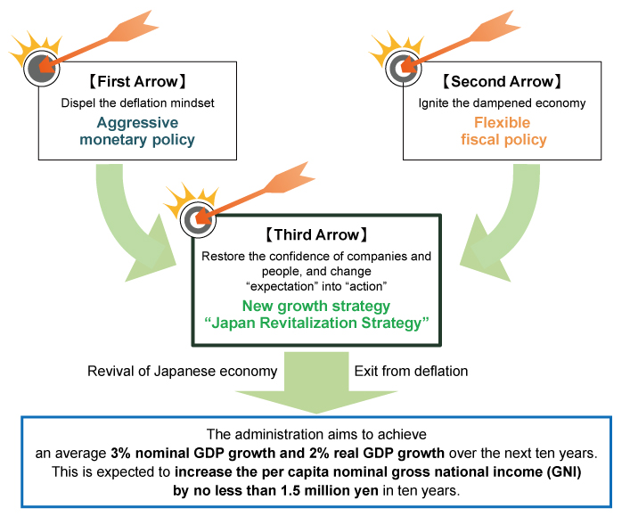
Overview of “Japan Revitalization Strategy”
[Three Prongs or “Arrows”]
The Abe administration will simultaneously implement the policy mix of the “three arrows” for reviving the Japanese economy: (1) Aggressive monetary policy; (2) Flexible fiscal policy; and (3) A growth strategy that encourages private sector investment

Slide 35
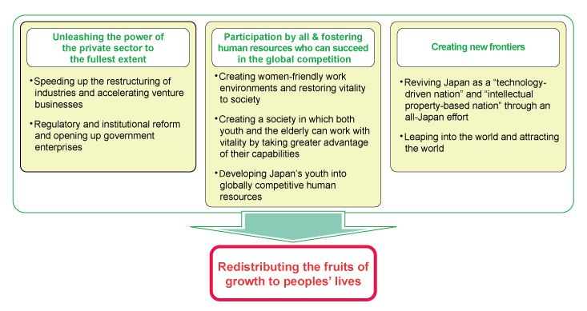
Roadmap to Growth
http://www.kantei.go.jp/foreign/96_abe/documents/2013/1200485_7321.html

Slide 36
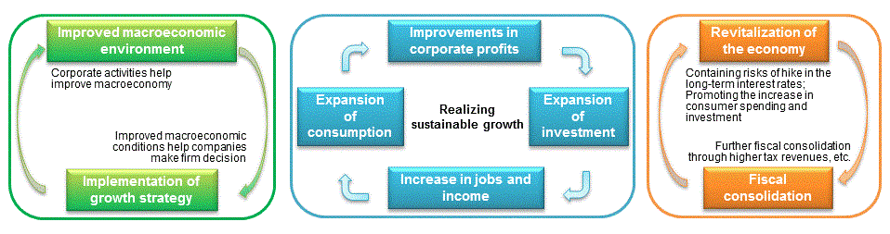
Three Positive Cycles

Slide 37
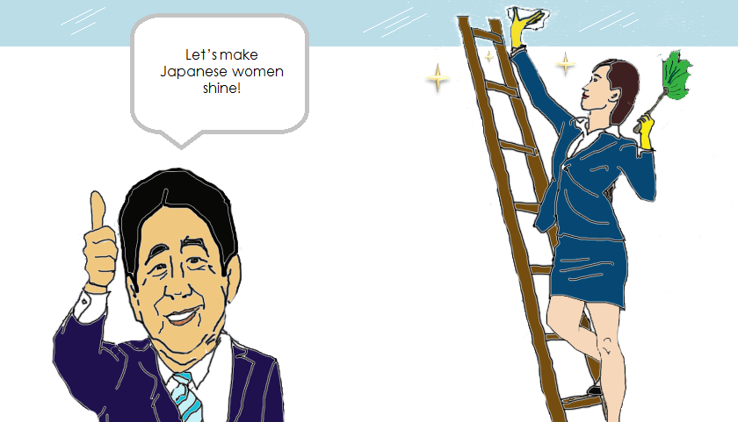
Womenomics
http://www.theperspective.se/?p=3194

Slide 38
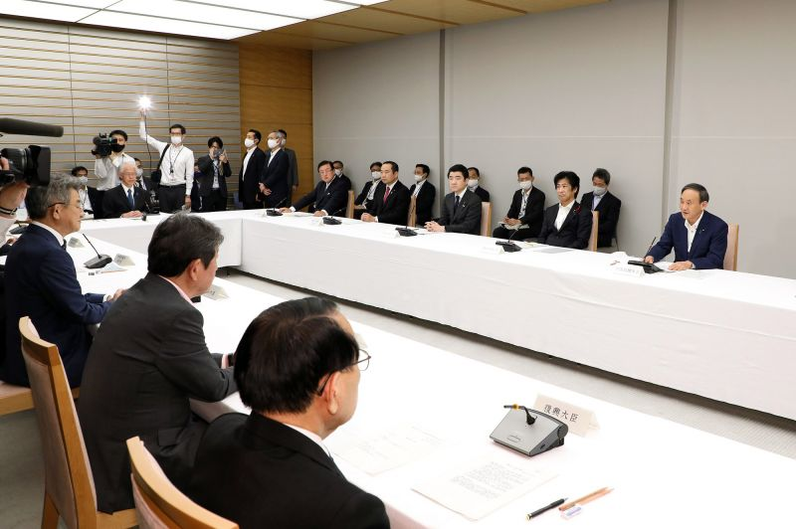
“Suganomics (Abenomics minus Yasukuni).””
In 2018, Suga helped spearhead an update to Japan’s visa system for foreign blue-collar workers to help sectors facing labor shortages, stating that he wanted interest on his part in using immigration Japan to be somewhere ‘where foreigners will want to work and live’.

Slide 39
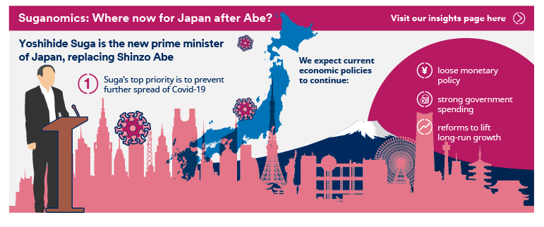
Suganomics

Slide 40
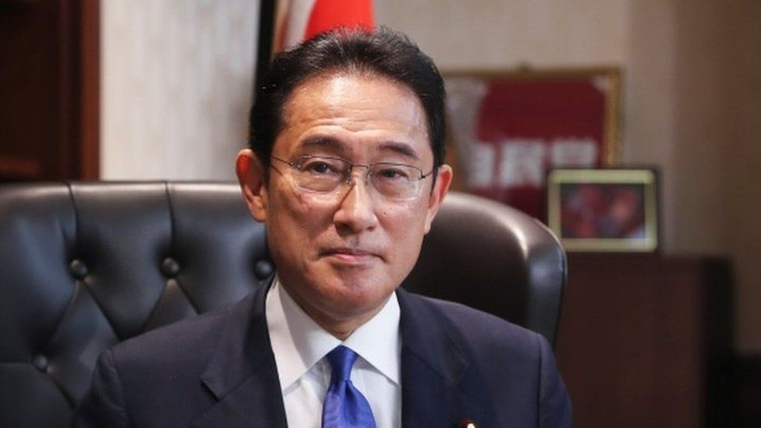
Japan’s New Prime Minister Fumio Kishida
Took office October 4, 2021.
Japan’s New Prime Minister Takes On Abenomics’ Legacy Fumio Kishida’s new populist measures look to shrink inequality and stir a sluggish economy.

Slide 41
１．Japan’s Economic Policy and Trend
◎ Goal: “New Form of Capitalism”
”market and state”, “public and private”
public-private collaboration as ”AND” not “OR”
To achieve better and sustainable “new form of capitalism”
https://www.fi.emb-japan.go.jp/files/100347461.pdf

Slide 42
Key Areas for “New Form of Capitalism”
１） Investment in Human Capital
２） Investment in Science, Technology and Innovation
３） Investment in Start-ups
４） Investment in Green and Digital

Slide 43
１）Investment in Human Capital
【Flow side】
Foster productivity growth and ensure wage rise In order to do so…
→Create social atmosphere for pay to rise
→Introduce tax incentives
【Stock side】
・Invest in vocational training, recurrent education, life long learning
→support labour mobility and job mobility
・Invest in shifting financial assets of individuals to investment
→”Doubling Asset-based Income Plan”

Slide 44
2） Investment in Science, Technology and Innovation
・Investment in R&D and capital investment by companies are far less than other major countries
・Articulate a national strategy to gain investment from companies
【Articulated four area】
Artificial intelligence (AI), quantum, biotechnology, decarbonization
・Strong incentives will be offered to companies that increase
R&D investment

Slide 45
３） Investment in Start-ups
To create an environment where young people can jump into start-ups
→ set of integrated measures required
１） The creation of start-up campuses
２） The drastic expansion of the SBIR system for start-ups
(SBIR=Small Business Research Initiative)
３） The attraction of overseas VC, combined
with public capital participation in overseas VC
４） The circulation of personal financial assets and long-term investment funds from institutions such as the GPIF into venture investment
(GPIF=Government Pension Investment Fund)

Slide 46
４）Investment in Green and Digital
・Utilize nuclear reactors with safety assurances in addition to renewable energy
・Promote digital transformation
・Achieve a society that facilitates the birth of
new services includes developing an environment for promotion of web3.0 - sometimes known as Web 3, is the concept of the next generation of the web, in which most users will be connected via a decentralized network and have access to their own data
8

Slide 47
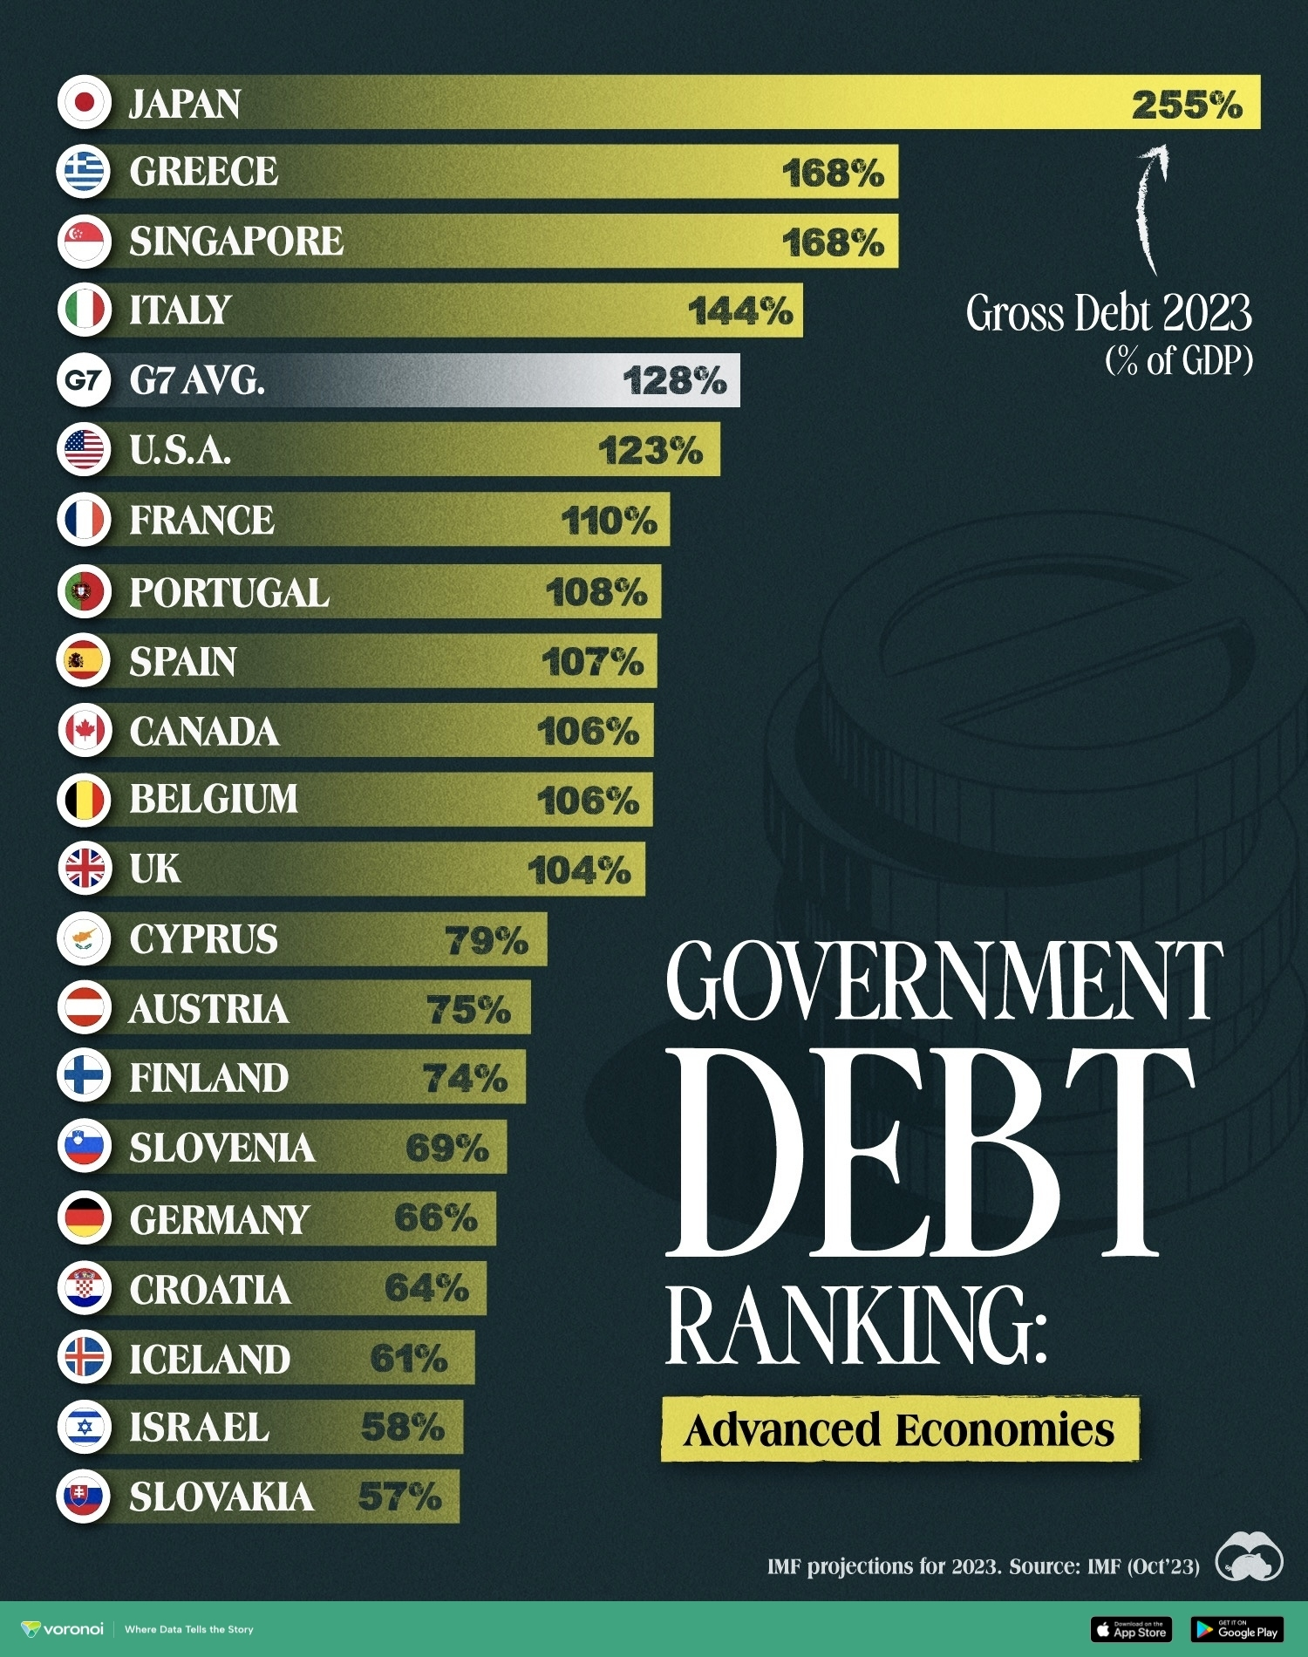
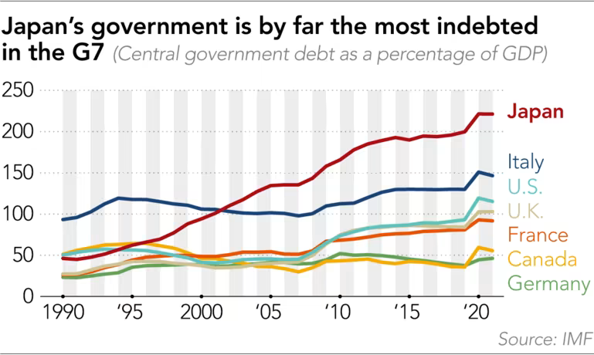
Problems to be Faced (Debt to GDP Ratio
Government Debt to GDP in Japan increased in 2020.

Slide 48
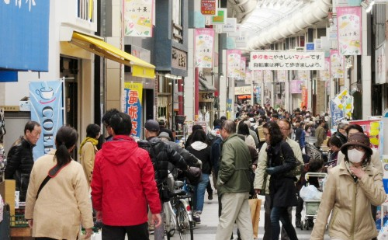
Aging, labor shortage & widening gaps
www.grips.ac.jp/teacher/oono/hp/lecture_J/lec_aging.pptx

Slide 49
Aging Society
Japanese society is rapidly aging because old people live longer and young people are not eager or able to marry and have babies.
Such trends are also visible in other countries, but Japan is the global leader in koreika (aging) and shoshika (producing fewer children).
Japanese population peaked around 2008 at 128 million, then began to decline gradually. Depopulation is expected to continue well into the future.
The share of working-age population (aged 16 to 64) started to decline much earlier, peaking at 70 percent around 1995, then falling to about 60 percent at present. This means fewer workers must support more retired people through higher tax burden and social security contributions.
Shrinking and aging population also means lackluster domestic demand, reduced saving, low growth, and skyrocketing medical and pension bills. Japanese society, once based on communal spirit and intra-family care for the young and the old, no longer functions that way.

Slide 50
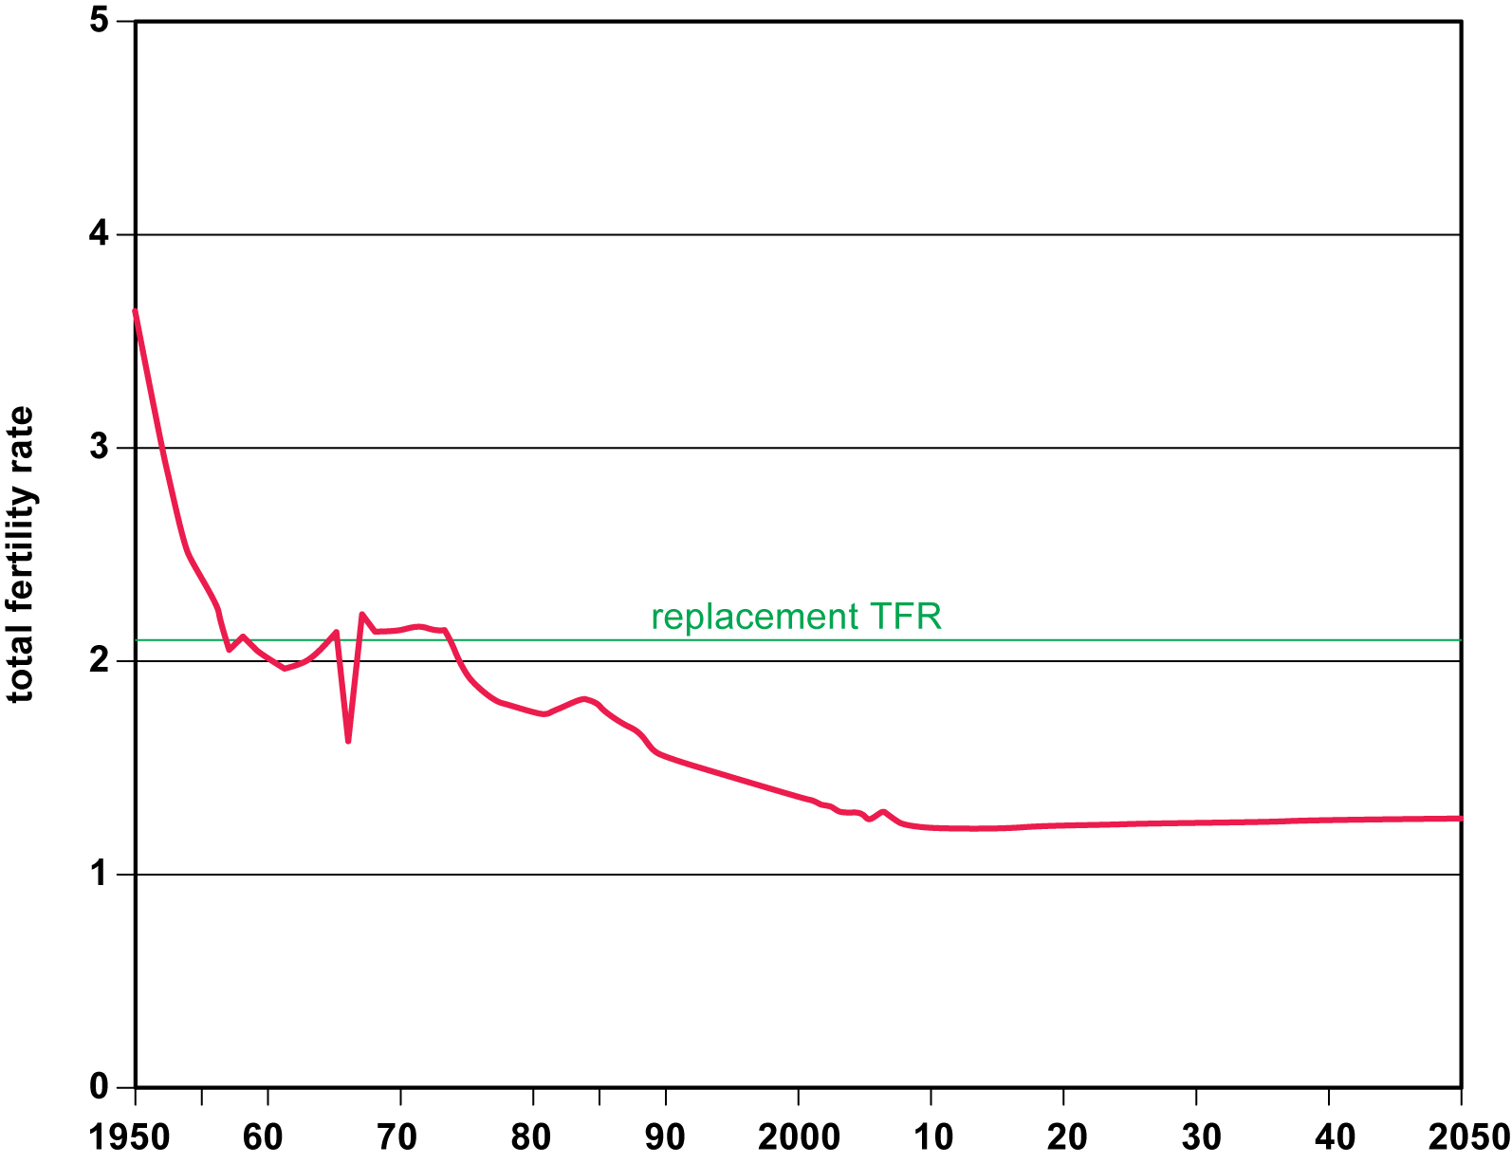
Social Issues – Japan Total Fertility Rate Projections

Slide 51
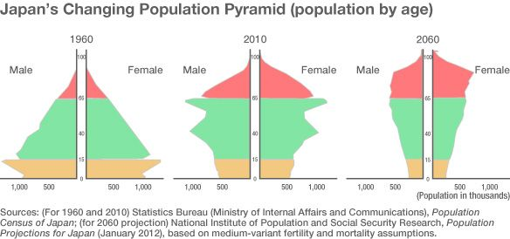
Japan Age Structure
https://www.nippon.com/en/in-depth/a01001/

Slide 52
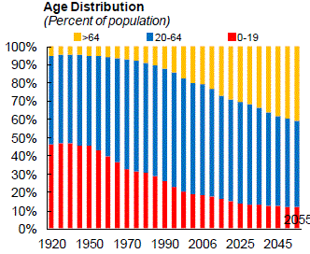

Slide 53
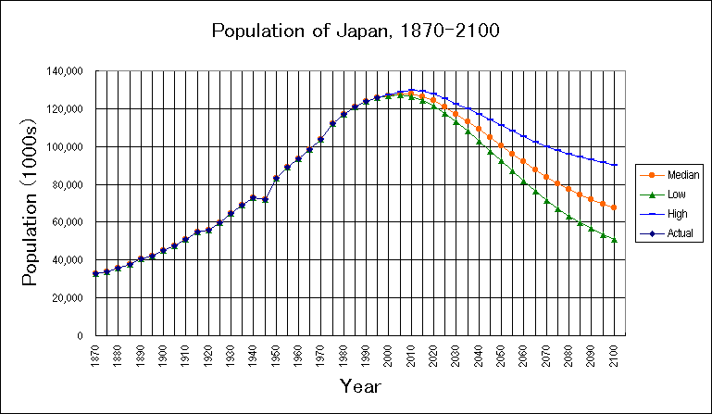
Possible Scenarios of Population Change in Japan

Slide 54
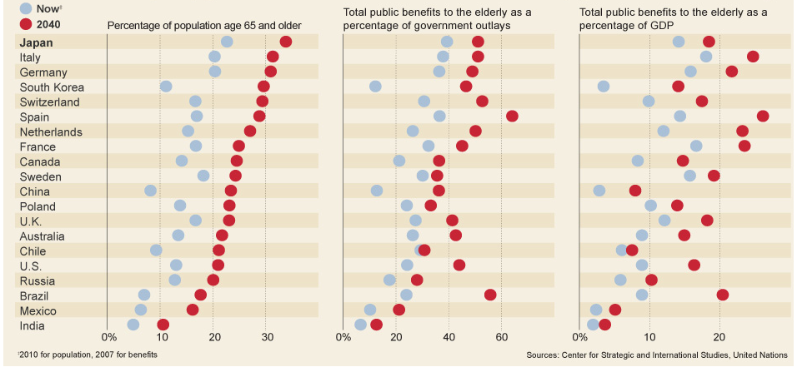
Japan: Consequences of an Aging Population

Slide 55

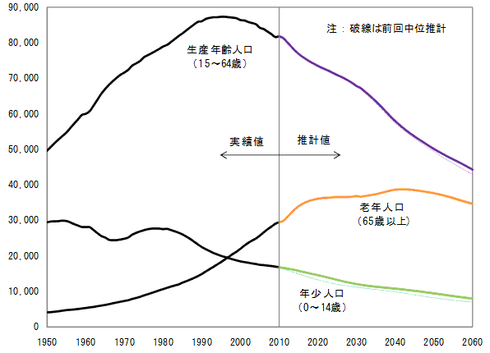
Young, Working & Old Population
Unit: thousand
Working age (15-64)
Actual
Forecast
Old (65 & above)
Young (0-14)
Source: National Institute of Population and Social Security Research.

Slide 56
Labor Shortage
Labor shortage has become apparent in recent years. The unemployment rate fell steadily from 5.1 percent in 2009 to 2.4 percent in 2019. Many businesses, especially small ones, find it difficult to recruit enough workers.
Labor shortage is widespread in all sectors, and especially acute in such service industries as construction, transportation, food catering, elderly care and childcare.
Scarcity of construction workers was aggravated by strong reconstruction demand in the aftermath of the Great East Japan Earthquake in 2011 and construction toward the Tokyo Olympics
Japan has traditionally accepted only a small number of foreign workers except those with highly professional skills or Japanese ethnic origin. However, the immigration policy now has to be reconsidered because labor shortage is a structural problem that is not likely to go away soon, and Japan must therefore rely heavily on foreign workers in the future.

Slide 57
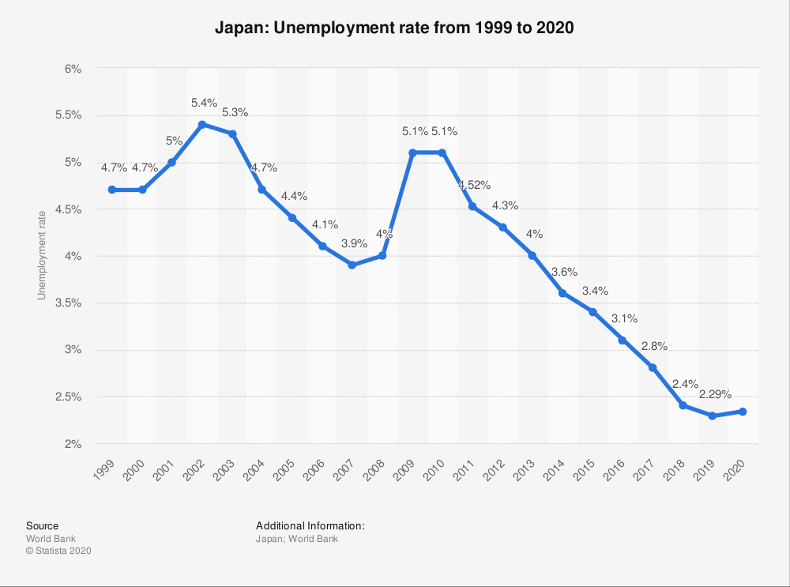
Japan’s unemployment rate increased to 2.8% in January 2022. The data reflected
the impact of the fast-spreading omicron variant on the labor market during the period. Meanwhile, the jobs-to applications ratio posted at a 21-month high of 1.20 in January. source: Ministry of Internal Affairs & Communications

Slide 58
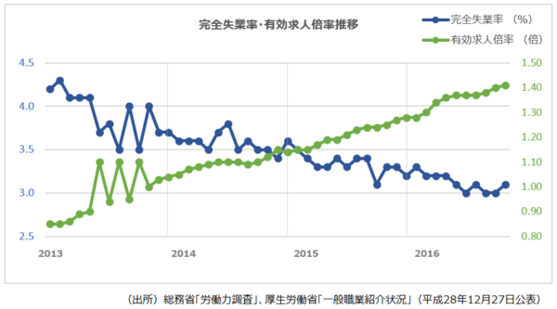
More Labor Demand, Less Workers Applying
%
Job offer/application ratio (right scale)
Unemployment rate (left scale)
Sources: Ministry of International Affairs & Communications, Labor Force Survey; Ministry of Health, Labor & Welfare, Situation of General Labor Matching (Dec.27, 2916)

Slide 59


Slide 60


Slide 61


Slide 62
Kasoka (Rural Depopulation)
A related problem is kasoka, or accelerated decline and aging of population in rural areas to the extent that basic transport, medical and commercial services are no longer rendered.
The problem of disappearing communities permeates in virtually all cities, towns and villages in rural Japan.
This is caused by migration of young people to large cities for education and job opportunities, in addition to gradual passing away of remaining senior citizens.
Revitalizing rural communities has become one of the top priorities of any Japanese administration (including Abenomics).

Slide 63
Hiseiki Koyo & Karoshi
Female workers and youths account for the bulk of non-regular workforce, who tend to be trapped in the second-rate status with little prospect of moving up to regular positions.
This generates long-term problems such as inability to marry for financial reasons, less production of children, low lifetime saving, continued poverty into old age and the next generation, and extreme hardship for single, divorced or widowed mothers.
Even seemingly protected regular workers are forced to work hard to keep their position under strong cost-cutting pressure. Unpaid overwork is a common practice, often leading to job-caused illness and karoshi (death and suicide).
In response, the Japanese government is promoting equality between regular and non-regular workers, urging wage increases and less working hours to company management, helping female labor to take up more jobs and high positions and, through all these, achieve better work-life balance for Japanese workers.

Slide 64


Slide 65
Japan Economic Survey 2024 by OECD
https://issuu.com/oecd.publishing/docs/cover-ppt-japan24-en_copy2

Slide 66


Slide 67

https://asiatimes.com/2023/12/japan-quietly-and-politely-hates-its-tourism-boom/

Slide 68





Slide 69



Slide 70


Slide 71


Slide 72


