Slide 1

The Chinese Economy

Slide 2
THE PEOPLE’S REPUBLIC OF CHINA
Notes:
1

Slide 3
Some Basics
Formal name: People's Republic of China (PRC)
Capital: Beijing
Head of State: President: Xi Jinping (assumed the post formally March 2013.
Government Type: Communist State
Land size: China has a landmass of 9,600,000 sq km, and is the third-largest country in the world, next only to Russia and Canada. Cultivated land is 130.04 million ha.
Border countries: Korea, Mongolia, Russia, Kazakhstan, Kyrgyzstan, Tadzhikistan, Afghanistan, Pakistan, India, Nepal, Bhutan, Myanmar, Laos and Vietnam.
Population ethnicity: 91.6 percent of Chinese people are Han. The non-Han population includes 55 ethnic minorities, of which the major groups are the Zhuang, Manchu, Hui, Miao, Uygur, Yi, Tujia, Mongolian, and Tibetan.
Population distribution: Most of the population of China lives in the middle and lower reaches of the Yellow River, Yangtze River and Pearl River valleys, and the Northeast Plain. In 2000 a "go-west" campaign was launched by the government to help its relatively backward western and central areas catch up with more affluent eastern China.

Slide 4
Population | 1,409,000,000 (2023 est.))
Age structure | 0-14 years: 17.29% (male 129,296,339/female 111,782,427) 15-24 years: 11.48% (male 86,129,841/female 73,876,148) 25-54 years: 46.81% (male 333,789,731/female 318,711,557) 55-64 years: 12.08% (male 84,827,645/female 83,557,507) 65 years and over: 12.34% (male 81,586,490/female 90,458,292) (2020 est.)
Median age | total: 38.4 years male: 37.5 years female: 39.4 years (2020 est.)
Population growth rate | 0.26% (2021 est.)
Birth rate | 11.3 births/1,000 population (2021 est.)
Death rate | 8.26 deaths/1,000 population (2021 est.)
https://www.indexmundi.com/china/demographics_profile.html

Slide 5
Infant mortality rate | Total: 11.15 deaths/1,000 live births male: 11.6 deaths/1,000 live births female: 10.64 deaths/1,000 live births (2021 est.)
Life expectancy at birth | Total population: 77.4 years (2024 est.) male: 74.23 years female: 78.62 years (2021 est.) https://www.macrotrends.net/countries/CHN/china/life-expectancy
Urbanization | urban population: 62.5% of total population (2021) rate of urbanization: 1.78% annual rate of change (2020-25 est.) note: data do not include Hong Kong and Macau
Major cities - population | Shanghai 23.741 million; BEIJING (capital) 20.384 million; Chongqing 13.332 million; Guangdong 12.458 million; Tianjin 11.21 million; Shenzhen 10.749 million (2015)
Sex ratio | at birth: 1.11 male(s)/female 0-14 years: 1.16 male(s)/female 15-24 years: 1.17 male(s)/female 25-54 years: 1.05 male(s)/female 55-64 years: 1.02 male(s)/female 65 years and over: 0.9 male(s)/female

Slide 6
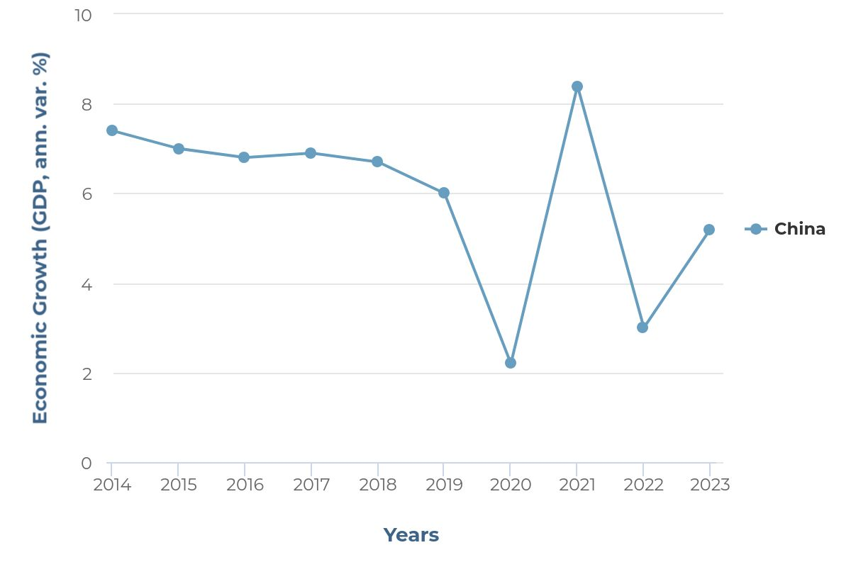
Economic Data (GDP Growth)
http://www.stats.gov.cn/english/
https://www.focus-economics.com/countries/china

Slide 7
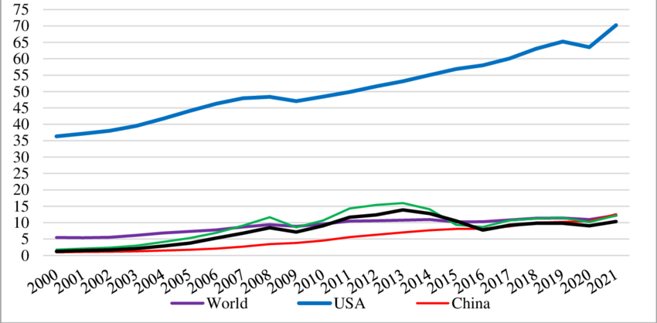
GDP per capita in the world (world average), the USA, China, Russia
https://www.researchgate.net/figure/GDP-per-capita-in-the-world-world-average-the-USA-China-Russia-and-Kazakhstan_fig1_372742265
https://www.worldometers.info/gdp/gdp-per-capita/

Slide 8
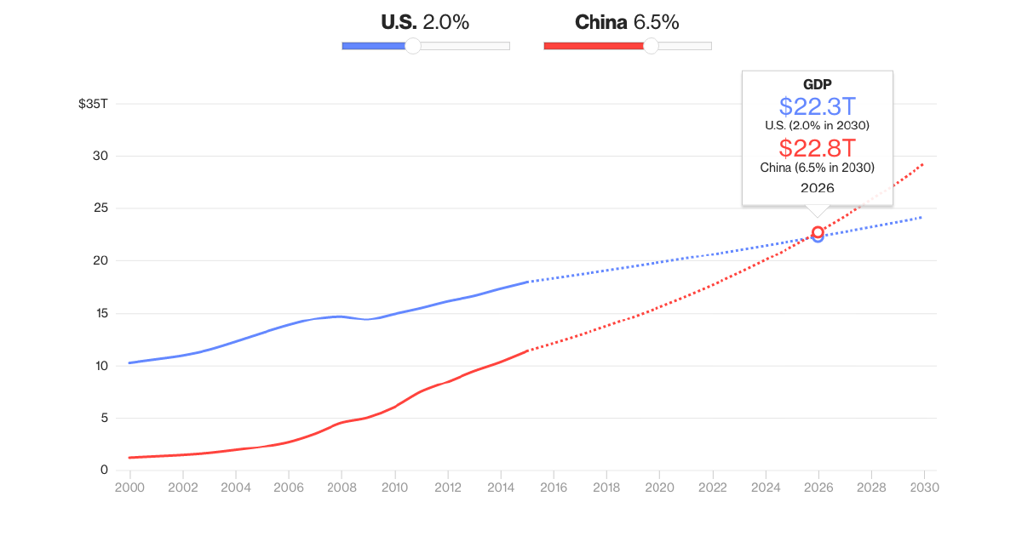
https://www.quora.com/Will-China-pass-the-US-in-GDP-any-time-soon-Why-or-why-not

Slide 9
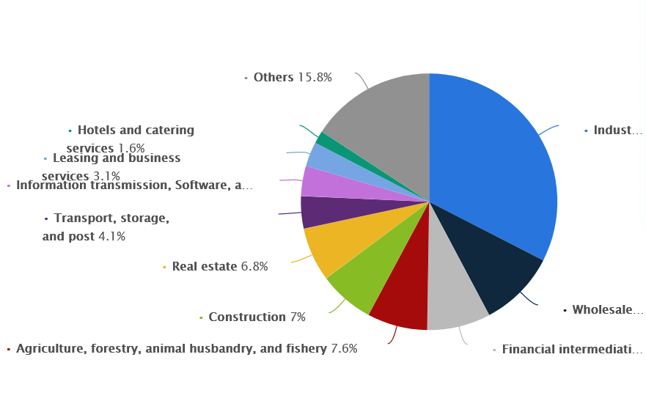
Sources of Growth

Slide 10
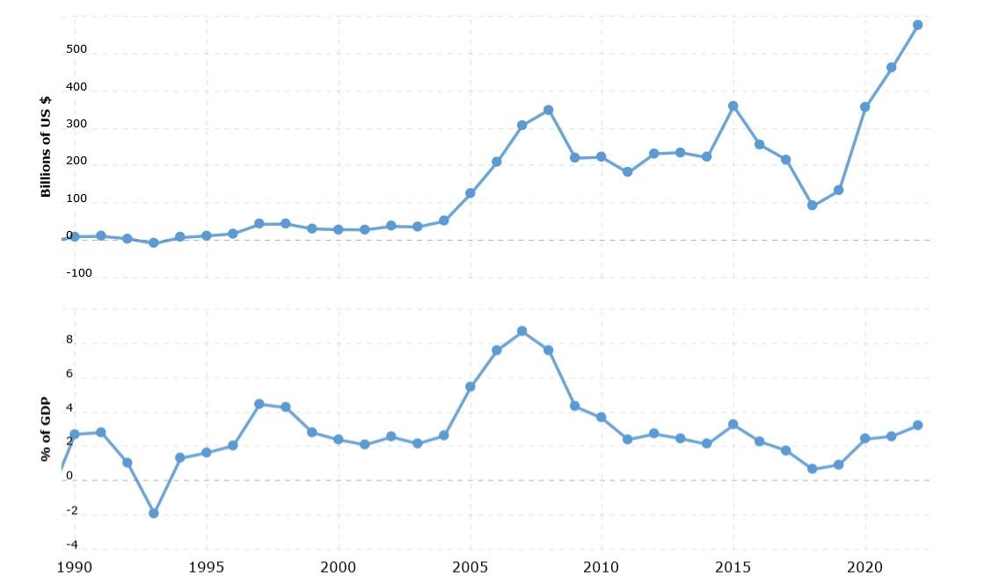
China’s Trade Balance
https://www.macrotrends.net/countries/CHN/china/trade-balance-deficit

Slide 11
China’s Top 10 Imports
The following product groups represent the highest dollar value in China’s import purchases during 2022. Also shown is the percentage share each product category represents in terms of overall imports into China.
Electrical machinery, equipment: US$644.7 billion (23.7% of total imports)
Mineral fuels including oil: $535.3 billion (19.7%)
Ores, slag, ash: $224.7 billion (8.3%)
Machinery including computers: $202.1 billion (7.4%)
Gems, precious metals: $103.7 billion (3.8%)
Optical, technical, medical apparatus: $82 billion (3%)
Vehicles: $80.8 billion (3%)
Plastics, plastic articles: $75.2 billion (2.8%)
Copper: $68.7 billion (2.5%)
Oil seeds: $68.6 billion (2.5%)
http://www.worldstopexports.com/chinas-top-10-imports/

Slide 12
China’s Top 10 Exports
The following export product groups categorize the highest dollar value in Chinese global shipments during 2022. Also shown is the percentage share each export category represents in terms of overall exports from China.
Electrical machinery, equipment: US$954.8 billion (26.6% of total exports)
Machinery including computers: $552 billion (15.4%)
Vehicles: $150.2 billion (4.2%)
Plastics, plastic articles: $143.5 billion (4%)
Furniture, bedding, lighting, signs, prefabricated buildings: $130.9 billion (3.6%)
Articles of iron or steel: $110.3 billion (3.1%)
Toys, games: $103.3 billion (2.9%)
Organic chemicals: $101.9 billion (2.8%)
Knit or crochet clothing, accessories: $90.9 billion (2.5%)
Iron, steel: $77.3 billion (2.2%)
http://www.worldstopexports.com/chinas-top-10-exports/

Slide 13
China’s Top Trading Partners
Below is a list highlighting 15 of China’s top trading partners in terms of export sales. That is, these countries imported the most Chinese shipments by dollar value during 2022. Also shown is each import country’s percentage of total Chinese exports.
United States: US$582.8 billion (16.2% of China’s total exports)
Hong Kong: $297.5 billion (8.3%)
Japan: $172.9 billion (4.8%)
South Korea: $162.6 billion (4.5%)
Vietnam: $147 billion (4.1%)
India: $118.5 billion (3.3%)
Netherlands: $117.7 billion (3.3%)
Germany: $116.2 billion (3.2%)
Malaysia: $93.7 billion (2.6%)
Taiwan: $81.6 billion (2.3%)
United Kingdom: $81.5 billion (2.3%)
Singapore: $81.2 billion (2.3%)
Australia: $78.8 billion (2.2%)
Thailand: $78.5 billion (2.2%)
Mexico: $77.5 billion (2.2%)

Slide 14
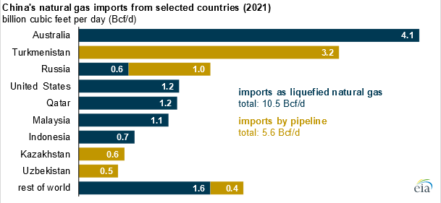

Slide 15
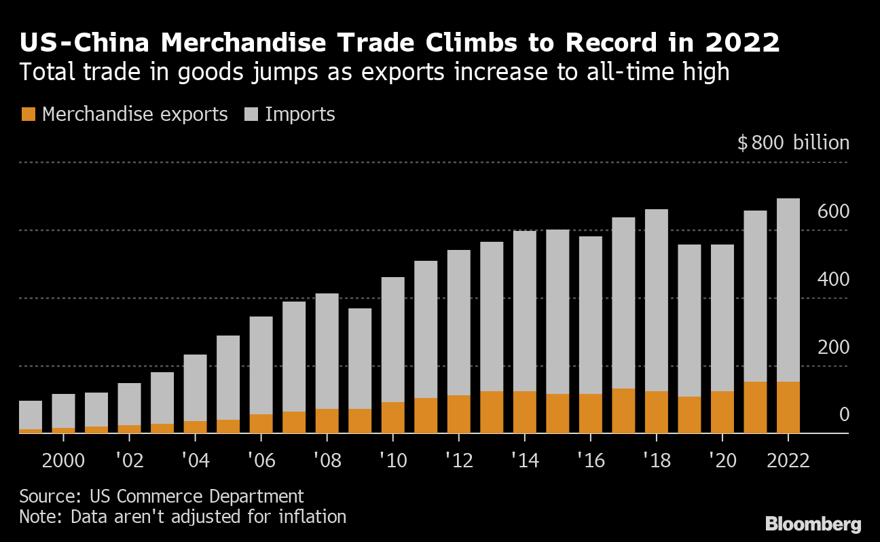

Slide 16
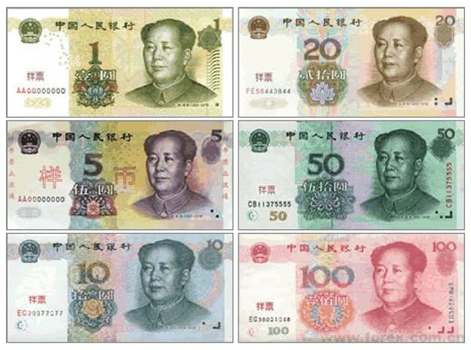
Currency and Exchange Rate
Chinese Currency – Renminbi (RMB)
Chinese yuan, also known as Renminbi, is used throughout in mainland China, while in Hong Kong and Macau, Hong Kong dollar and Macau pataca are respectively used. The basic unit of Renminbi is Yuan and the sign of Yuan is ￥

Slide 17
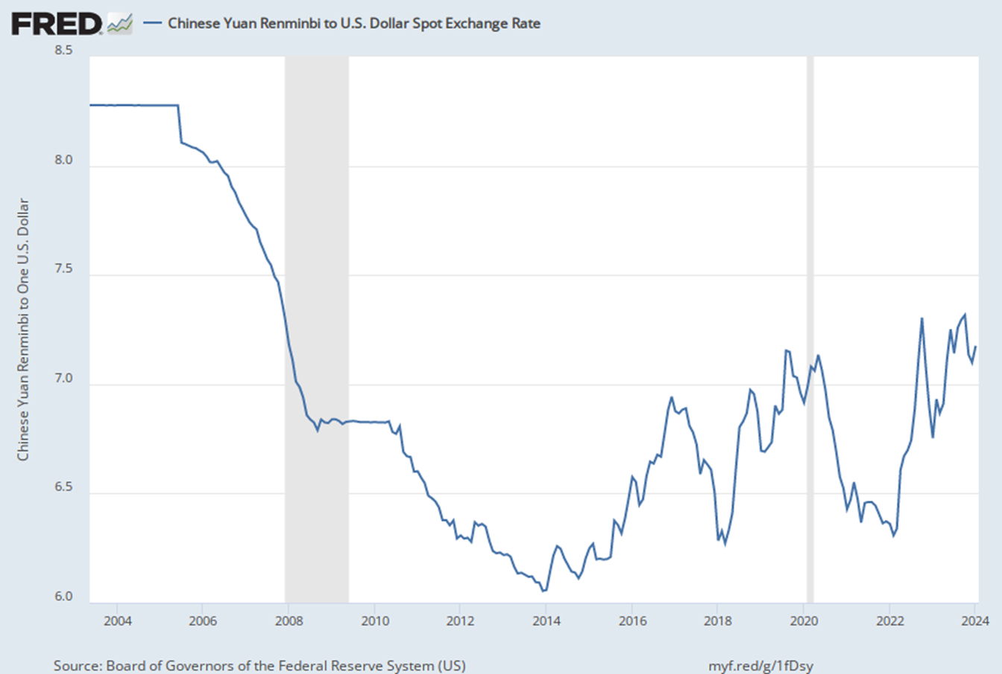
February 5 2024 USD/CNY close: 7.20
https://www.xe.com/currencycharts/?from=USD&to=CNY&view=10Y

Slide 18
Brief Look at the Chinese Economy Today
As discussed earlier, East Asia has been the fastest-growing region in the world over the past two and a half decades, the East Asian currency crisis of 1997-98 notwithstanding.
China is the fastest growing country in East Asia—approximately 9% p.a. since beginning of economic reform (1979) and close to 7% over the past five years.
Between 1979 and 2019, Chinese real GDP grew from $177 billion to $14.2 trillion (official exchange rate (2ndlargest GDP in the world) and real GDP per capita grew from $183 to more than $9000.
In 2020, growth rate slowed to 2.3% due to Covid-19.
In 2021, growth rebounded to 8.1 %
In 2023, growth slowed to 5.2 %

Slide 19
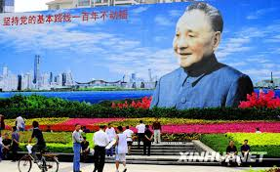
One of the main factors contributing to the growth of China is the Chinese reform program which began in 1978-9 with the re-introduction of markets.
China is still a socialist country, but one of the few to have made a successful transition from a centrally planned to a market economy
Over the past 40 or more years, China’s economy has experienced a profound transformation, with shares of GDP changing from agriculture to manufacturing.

Slide 20
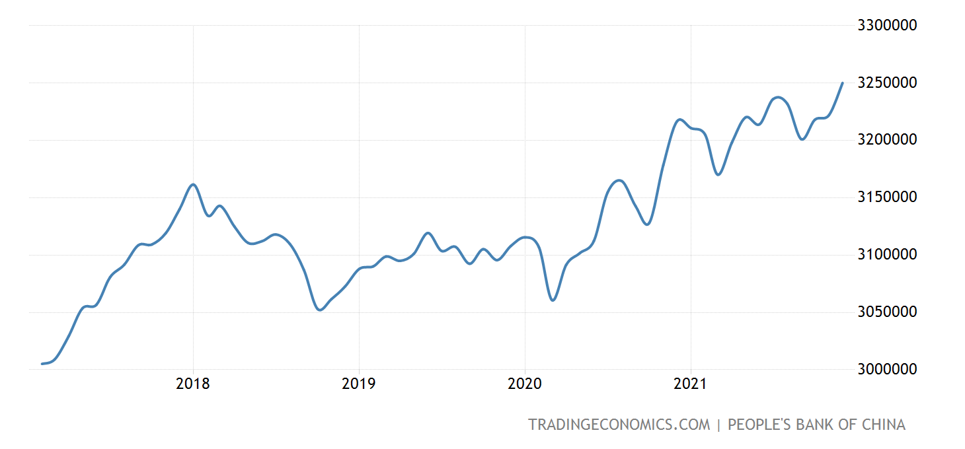
Another important structural transformation has seen the private (non-state) sector account for more or more of GDP
China’s trade has expanded faster than the economy and in 2012, China surpassed the U.S. to become the world’s biggest trading nation as measured by the sum of exports and imports of goods.
China's foreign exchange reserves at the end of December 2021 were USD 3.426 trillion.
Foreign direct investment (FDI) into the Chinese mainland, in actual use, expanded 14.9 percent year on year to a record high of 1.15 trillion yuan in 2021.
High-tech industries saw FDI inflows jump 17.1 percent from a year earlier, and cross-border investment in China's high-tech industries saw a year-on-year increase of 17.1 percent in 2021, outpacing the services sector that recorded a 16.7-percent jump during the same period, official data showed.
Foreign Exchange Reserves
https://tradingeconomics.com/china/foreign-exchange-reserves

Slide 21
Historical Background
1911
End of the Ch’ing Dynasty (1644-1911)
Instability, Revolts,
Invasions, and Civil War
1949
Mao’s Communist Victory
1950
Intervention in the Korean War (November)
Decay of Chinese-Soviet Relations
1966
1969
Soviet-Chinese Border Clashes
Cultural Revolution
1972
Nixon Plays the “China Card”
1976
Death of Mao
1978
“Market Reforms” Begin Slowly
2001
Joined WTO

Slide 25
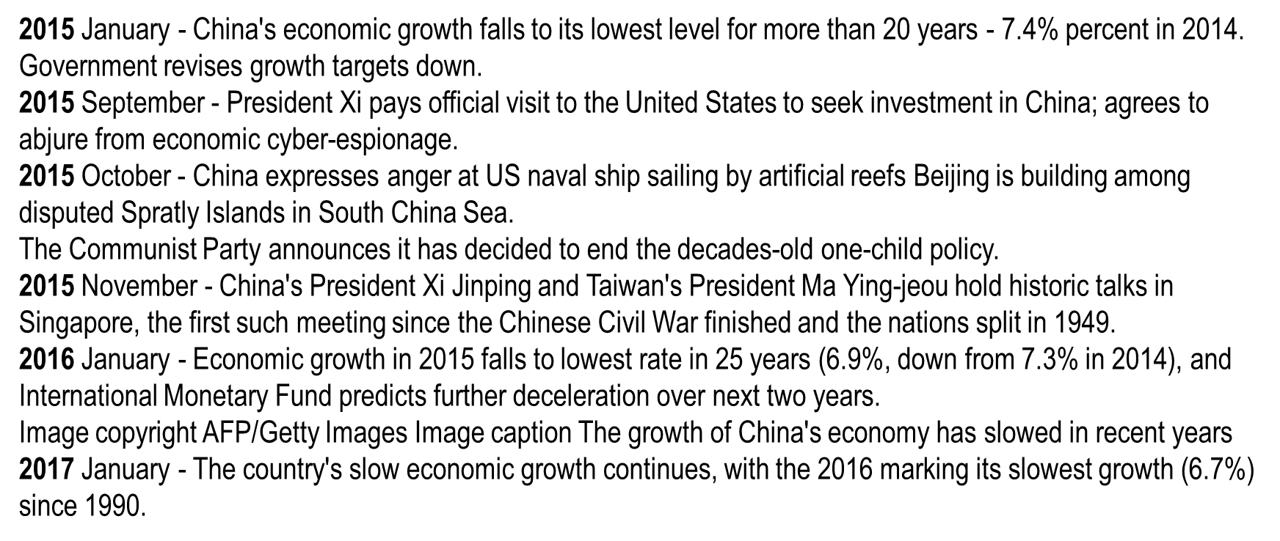

Slide 26
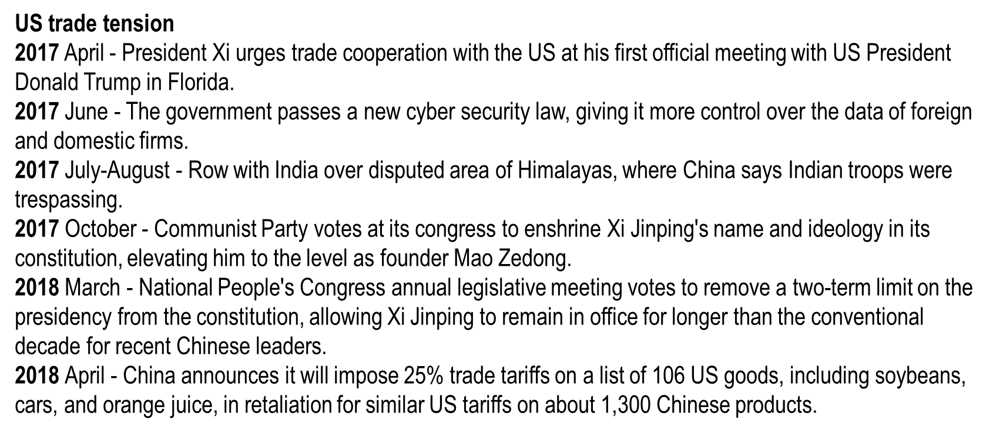
2019 June-July - Hong Kong sees anti-government and pro-democracy protests, involving violent clashes with police, against a proposal to allow extradition to mainland China.
2020 January - Outbreak of Covid-19 coronavirus in Hubei province spreads worldwide.
https://www.bbc.com/news/world-asia-pacific-13017882

Slide 27
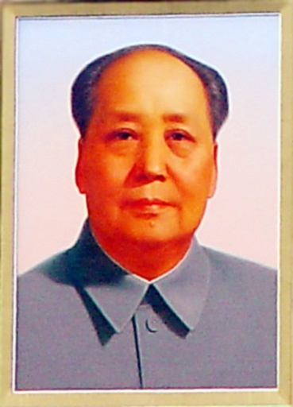
Chinese Socialism: The First Decade
Mao Zedong proclaims People’s Republic in 1949
Mao takes leadership as Chief of State
Initial tasks
collectivization of land
nationalization of industry
Followed typical (Stalinist) planned socialist model
heavy industry high priority, agriculture low priority
aggregate investment 20% - 25% of national product
85% industrial investment goes to heavy industry
8% state investment goes to agriculture
by end of Mao period, industry share in national output much higher than other countries at similar level of development
Notes:
4

Slide 28
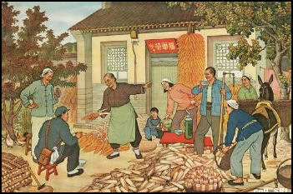
Collectivization of Agriculture
First step was redistribution of land from the landlords to the peasants
Major farming equipment provided by village authorities
Collectivization involved organizing households into large production teams
Finally led to the commune (after Great Leap Forward)
http://factsanddetails.com/china/cat2/sub5/item1079.html
Notes:
5

Slide 29
Nationalization of Industry
Slow and orderly transfer from private to state ownership
by 1956, 68% value of output by state owned enterprises (SOE) and 16% by jointly owned (state-private) enterprises
Planning mechanisms and priorities and enterprise management same as Soviet Union
Same problems
poor quality, shortages, inefficiency, etc.

Slide 30
Political and Economic Turmoil
Hundred Flowers Campaign (1956-7)
Mao unhappy with the Communist Part leadership
invites constructive criticism from intellectuals
reveals deep hostility
Great Leap Forward (1958-1960)
massive resurgence of ideology
last vestiges of rural private property eliminated
commune system established
attempt to initiate rapid growth and industrialization
economic disaster after years of solid growth
economy collapses and does not recover to 1958 level until 1963
The Great Leap Forward ( 大躍進) of the People's Republic of China (PRC) was an economic and social campaign by the Communist Party of China (CPC) from 1958 to 1961. The campaign was led by Mao Zedong and aimed to rapidly transform the country from an agrarian economy into a communist society through rapid industrialization and collectivization. The campaign caused the Great Chinese Famine.

Slide 31
The Rural People’s Commune
Created during the Great Leap Forward (1958-1960)
Individual households organized into production teams
Production teams combined to form brigades
Brigades combined into a commune
thousands of households in a commune
Communes were controlled by the county
County played major role in implementing the plans of the Ministry of Agriculture and Forestry
Notes:
6

Slide 32
Agricultural Reform
The principal-agent problem created a free-rider problem. The earnings of a commune member did not depend on how much he or she contributed. He could benefit from other members' efforts. Rational behaviour for an individual farmer who could not control output outcomes would be to minimise work input. In the end, it was a negative-sum game-a result of the prisoners' dilemma. Everyone was made worse off by free-riding.
The problem was made much worse by the political situation. Mao’s 'utopianism' dictated that the contribution of farmers to their communes should not be assessed only by their work contribution, but also by their 'revolutionary' spirit. Thus one could make no economic contribution to his commune, but was still rewarded with income, perhaps more than those who were not so 'revolutionary'. The son of a former landlord who was forced to work long hours would earn much less than a
'revolutionary' farmer would. To make the situation even worse, the communists decided at the beginning of rural collectivisation that the leaders of the communes must be 'poor and lower-middle peasants’. Those who seized power in the communes tended to have little experience in farming and management.
http://press-files.anu.edu.au/downloads/press/p212991/pdf/ch036.pdf

Slide 33
Recovery from the Great Leap
Communist Party exerts control
Mao removed as chief of state
Recovery from Great Leap emphasizes
less focus on output growth and more on quality and efficiency
more balanced economic development
modernization of agriculture
decentralization

Slide 34
The Cultural Revolution
Mao’s struggle to retake supreme leadership culminates in the Cultural Revolution
peaks from 1966 to 1969
more upheaval
lost generation of leadership as universities closed and students sent to the countryside
No increase in GDP from 1965 to 1970
Recovery from the Cultural Revolution
Led by Zhou Enlai
advocated moderate path of industrialization
engineered rapprochement with West, especially the US
Richard Nixon’s visit

Slide 35
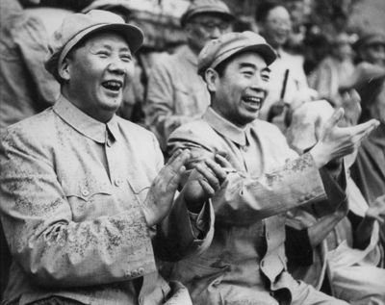
The End of the Stalinist Period
Both Zhou and Mao die in 1976
Gang of Four Trial
Mao’s wife and three others arrested and discredited
Stalinist thinking repudiated
political maneuverings end in 1978 with rise of Deng Xiaoping
reform period begins

Slide 36
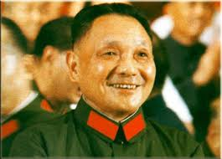
The Transition from a Centrally Planned Economy to a Market Economy
The meaning of transition
replacement of administrative allocation by market allocation
replacement of administered prices by market prices
DISCUSS PLEASE

Slide 37
Internal vs. External Processes
Undeniably, the market reform started by Deng Xiaoping in 1978 is a huge success. In a matter of two decades, China changed from an inward-looking, poor country into one of the largest exporters and fastest growing economy of the world.
To discuss and explain the success of the reform, one has to look into both internal and external processes of the reform. It is the interaction between the internal and external processes that enables the success of the reform.
Internal processes refer to the restructuring of the domestic economy and society made possible by a series of reform policy initiated by Deng.
External processes refer to economic and social processes in the East Asian region that accelerated the growth of China.

Slide 38
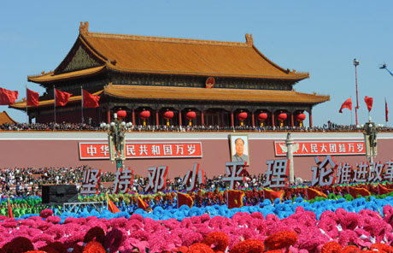
Internal Process of post-Mao reform
The post-Mao reform that began after 1978 can be roughly divided into three stages.
Rural Reform
Urban Reform
Marketization

Slide 39
Three Stages of Post Mao Reform
First stage: around 1978-1985:
At this stage, reform measures mostly concerned the rural area. Communes were dismantled and peasants got the “right of use” of small plots of land. They became free to manage their own land and sell their produce in the market.
It gave rise to rapid growth in agricultural productivity and improvement in peasants’ livelihood, as peasants’ got a lot more initiatives to work hard.
At the same time, local rural industries emerged in the form of township and village enterprises (TVEs) and in the form of factories run by foreign capital in special economic zones.

Slide 40
Second stage: around 1985-1989
Given the phenomenal success of rural reform, the Chinese leadership embarked on urban reform after the mid-1980s.
One important measure was to lessen state’s control over prices of commodities. This immediately triggered wild inflation and rampant corruption.
The hardship and popular resentment caused by inflation and corruption contributed to the escalation of discontent that finally led to the unrest in 1989.

Slide 41
Third stage: around 1990-present
After 1989, Chinese leaders not only tried to restore law and order, but also tried to redress the hyper-inflation in the late 1980s, which was thought to be a major cause of unrest.
It led to a series of macro-economic measures that tightened monetary supply in the early to mid-1990s. It led to the “soft-landing” of the economy.
But the urban market reform did not stop. More decentralization, marketization, and slackening of rules followed suit.

Slide 42
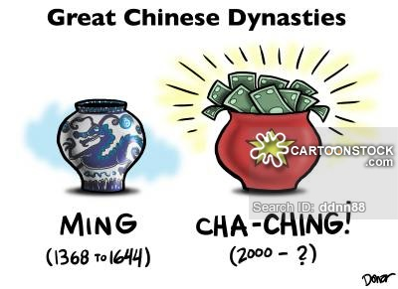
Major factors Contributing to the Success of the Reform
(1) China was not affected by the debt crisis that troubled many other developing as well as socialist countries in the early 1980s. As a result, autonomy of the Chinese government in regulating the economy remained intact. Chinese leaders can hence develop the reform strategy that fits China’s most, rather than enacting the formula prescribed by Western institutions (such as IMF and World Bank).

Slide 43
(2) China adopted a “trial and error” path of gradual reform, instead of the “shock therapy” method adopted by Russia and Eastern European countries
(3) Large percentage of Chinese population was rural. This huge rural population provided the coastal industries and TVEs with abundant supply of cheap labor.
But the above factors are insufficient in explaining China’s success. The following external factors have to be taken into account as well.

Slide 44
External Processes that Contributed to the Success of China’s Reform
Some argue that the rise of China is actually a continuation of the rise of East Asia (including Japan, South Korea, Taiwan, Hong Kong, and Singapore).
In the beginning, people thought that China was just another goose like the four tigers and other new tigers in Southeast Asia.
After a while, however, people began to realize that China is far from an ordinary goose. There are two distinct characteristics of China:

Slide 45
4. Size
The size of China (including its market size, size of the pool of talents, etc.) is much bigger than any other single economy in East Asia. Once it takes off, it becomes a huge magnet that drains the capital from other East Asian economies. Its highly competitive products, exported to the Western markets in huge amount, nearly squeezes many other export-oriented economies in the region out of business.

Slide 46
Additional Factors - Integration into Global Economy
Exports gave ready employment for freed up agricultural labor in labor intensive production in TVEs
allowed China to import modern technology
encouraged foreign direct investment which increased capital stock, access to modern technology, and efficient western management

Slide 47
Factor Markets: Labor
Historically, Chinese market impeded by administrative restraint on ability of workers to relocate
Mobility reduced further by lack of portability of benefits (housing, pensions, health insurance)
Experimentation on the margin, becoming widespread in new century. Driving forces:
Reform of government and SOEs
Continuing decline of agricultural work force
Emergence of private employers and shortages of senior managerial and technical skills (ADB 2003)
Mobility-enhancing developments in provision of social security, housing

Slide 48
Factor Markets: Labor
Cracks in the “iron rice bowl;” but true flexibility of labor practices might be over-stated by numbers
Pilot projects to standardize and modernize employment practices in 100 cities nationwide
Apparent transition from a system of guaranteed employment with little choice of employer, to one offering considerable choice of jobs with less security of long-term employment
"Iron rice bowl" (simplified Chinese: 铁饭碗; traditional Chinese: 鐵飯碗; pinyin: tiě fàn wǎn) is a Chinese term used to refer to an occupation with guaranteed job security, as well as steady income and benefits.

Slide 49
Factor Markets: Foreign Exchange
Strikingly successful achievement of reform – unification of the foreign exchange rate
Unified exchange rate since 1/94; stable at 8.3 to dollar for 15 years and now at about 6.9 Yuan to the dollar
Expected to appreciate
Interbank market in foreign exchange established 4/94
Current account convertibility since 12/96
Scope for establishing a more efficient foreign exchange market initially by widening intervention bands

Slide 50
Regional Development
These national level programs started with the Special Economic Zones for three cities in 1978, as part of China's economic reform, and were extended to the Economic and Technological Development Zones in 14 cities in 1984. In 2006, there are were 49 Development Zones and at present the number is 54.
SEZs and ETDZs exempted from most controls on foreign investment and private ownership
Result is much faster growth, especially in non-state sector
Regional disparities a major problem
Certain places (mostly coastal) targeted for faster transition
began in 1980 when four southern coastal sites were designated Special Economic Zones (SEZ)
Shantou, Shenzhen, Xiamen, Zhuhai
Hainan Island added in 1988
http://www.china.org.cn/english/SPORT-c/76751.htm

Slide 51
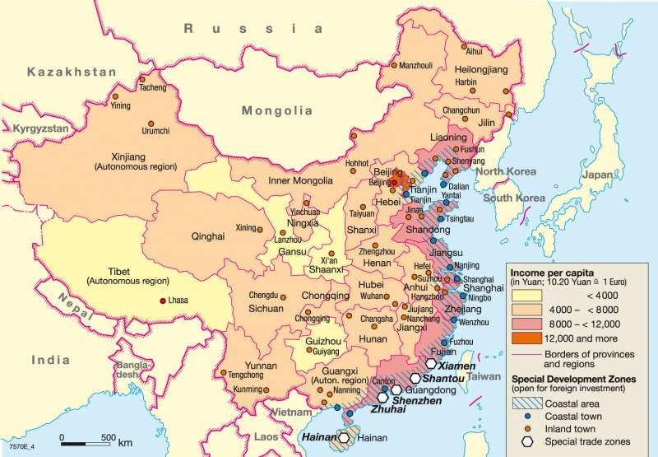
Notes:
27

Slide 52
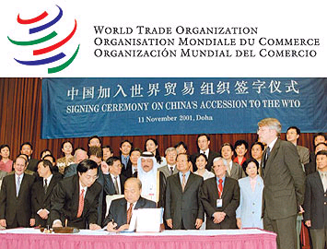
China and WTO
China’s effort to apply for membership of WTO redoubled over the 1990s, and it ended up in China’s accession into the organization in 2001. The followings are examples of what is changes have occurred under WTO:

Slide 53
Tariffs on agricultural products have declined drastically, US producers are now allowed to export bulk produces (wheat, rice, etc) to China.
2) Tariffs on imports of industrial goods have been reduced considerably, foreign companies have increasing rights to sell, distribute and market industrial goods without any Chinese middlemen. In particular, China has cut tariffs on imported automobiles from the 80-100 percent level in 2001 to less than 4 percent in 2019.
3) Foreign banks now allowed to carry on more activities in China.
4) The aftermath of the trade fight with the US.

Slide 54
Challenges
Legal system/rule of law
private property rights still lacking
business cannot turn to legal system to enforce contracts
self enforcement
protection from political elite
Corruption
Privatization
Managers of SOEs don’t want to give up power
SOEs continue to be a huge drain on economy
Agricultural reform
incomplete ownership of land
disincentive to improve land
reduces potential productivity of land

Slide 55
Challenges
Financial reform
near monopoly of state on banking
savings channeled to inefficient capital formation in SOEs
International finance
full convertibility
Trade relations
Continuing to meet the requirements of WTO
Improvement of trade relations with US, EU, Taiwan, other Asian countries

Slide 56
Challenges
Social safety net
current hodge-podge
not a immediate need as in other transitional economies
rural population to large extent self-sufficient
continued support of SOEs reduces urban unemployment problem
lack of political reform prevents the poor from having a voice
as SOEs privatized, unemployment will soar
rural population has much lower income and access to health care

Slide 57
Challenges
Regional policy
most growth from Special Economic Zones and Development Areas
huge income differential between coastal and interior provinces
Population policy
slowing population growth
slowing/preventing migration to cities
Macroeconomic policy
reform of tax structure
stabilization

Slide 58
Challenges
Environment - current issues:
Air pollution (greenhouse gases, sulfur dioxide particulates) from reliance on coal produces acid rain
water shortages, particularly in the north
water pollution from untreated wastes
Deforestation
estimated loss of one-fifth of agricultural land since 1949 to soil erosion and economic development
trade in endangered species
https://www.youtube.com/watch?v=2nFZaSbkf0U

Slide 59
Basic Education
1950: 20% over age 15 are literate
2007: 93.3% over age 15 are literate while 99% of 15-24 year olds are literate
2013, PISA (Program for International Student Assessment) international rankings of 15 year olds placed Shanghai students first in the world in mathematics, science and literacy
But in the latest 2015 study - with the addition of Beijing, Jiangsu, and Guangdong - the mainland Chinese entry saw all scores from the test for 15 year-olds drop and its ranking fall to 10th in science, sixth in maths, and 27th in reading – below the UK, which finished 22nd.

Slide 60
Health
1949: Average Life Expectancy of 35 years
2023 (est.): Average Life Expectancy of 77.40
But life expectancy would be much higher if respiratory illnesses (cigarettes, air pollution) could be reduced, water quality improved and food safety increased.
Improvements to public health should provide huge gains in life expectancy.

Slide 61
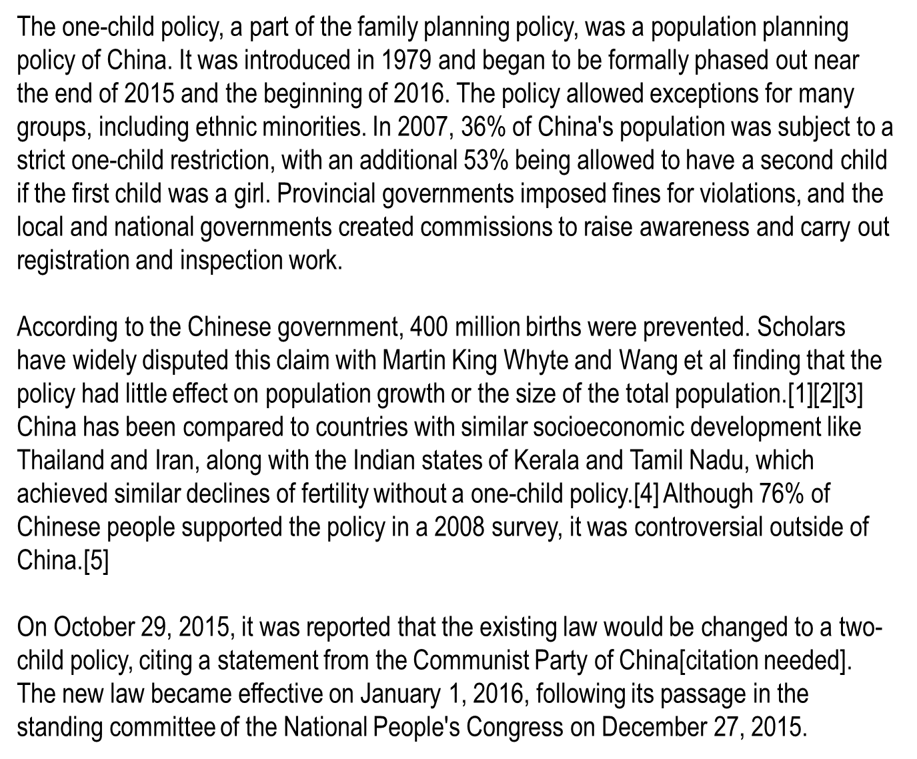
https://en.wikipedia.org/wiki/One-child_policy

Slide 62
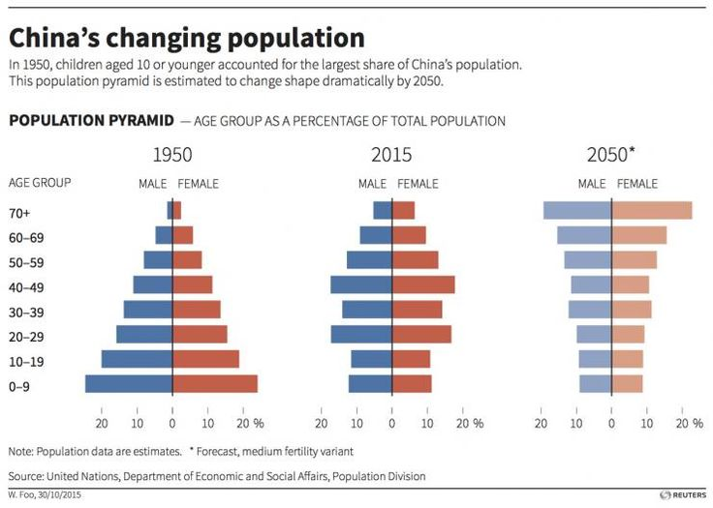
http://upload.wikimedia.org/wikipedia/commons/3/3e/China_Pop_Pyramid_Forecast.gif

Slide 63
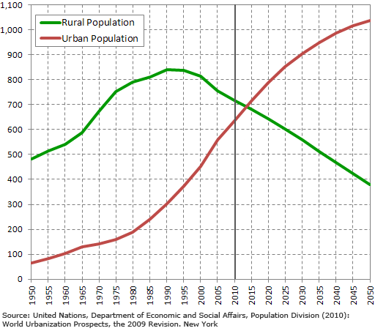
Where do all these people live?
http://www.worldometers.info/world-population/china-population/

Slide 64
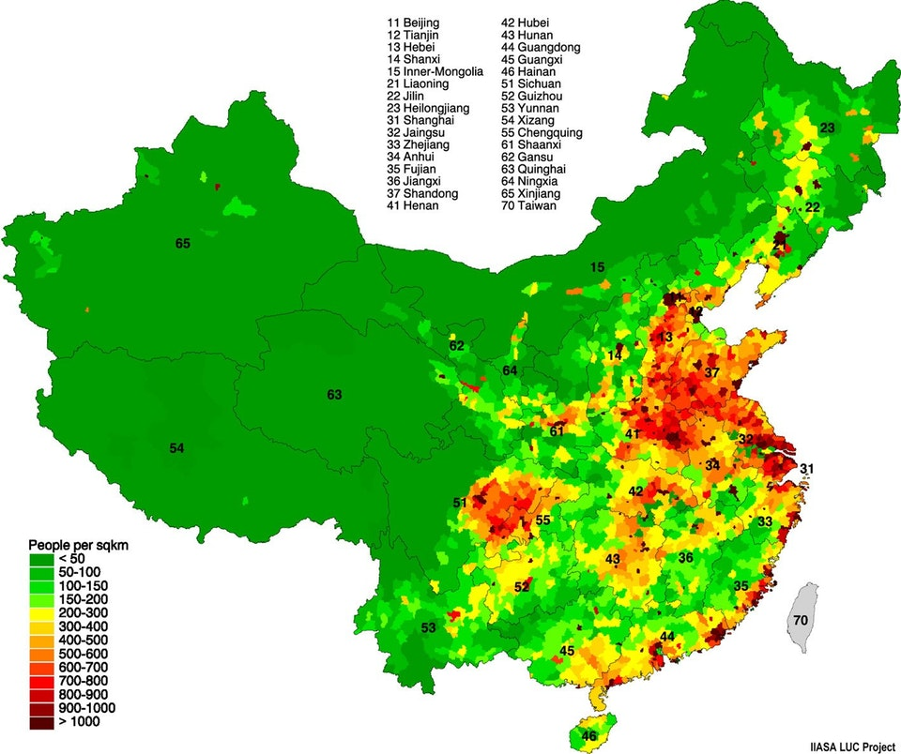
Where do all these people live? Population Density

Slide 65
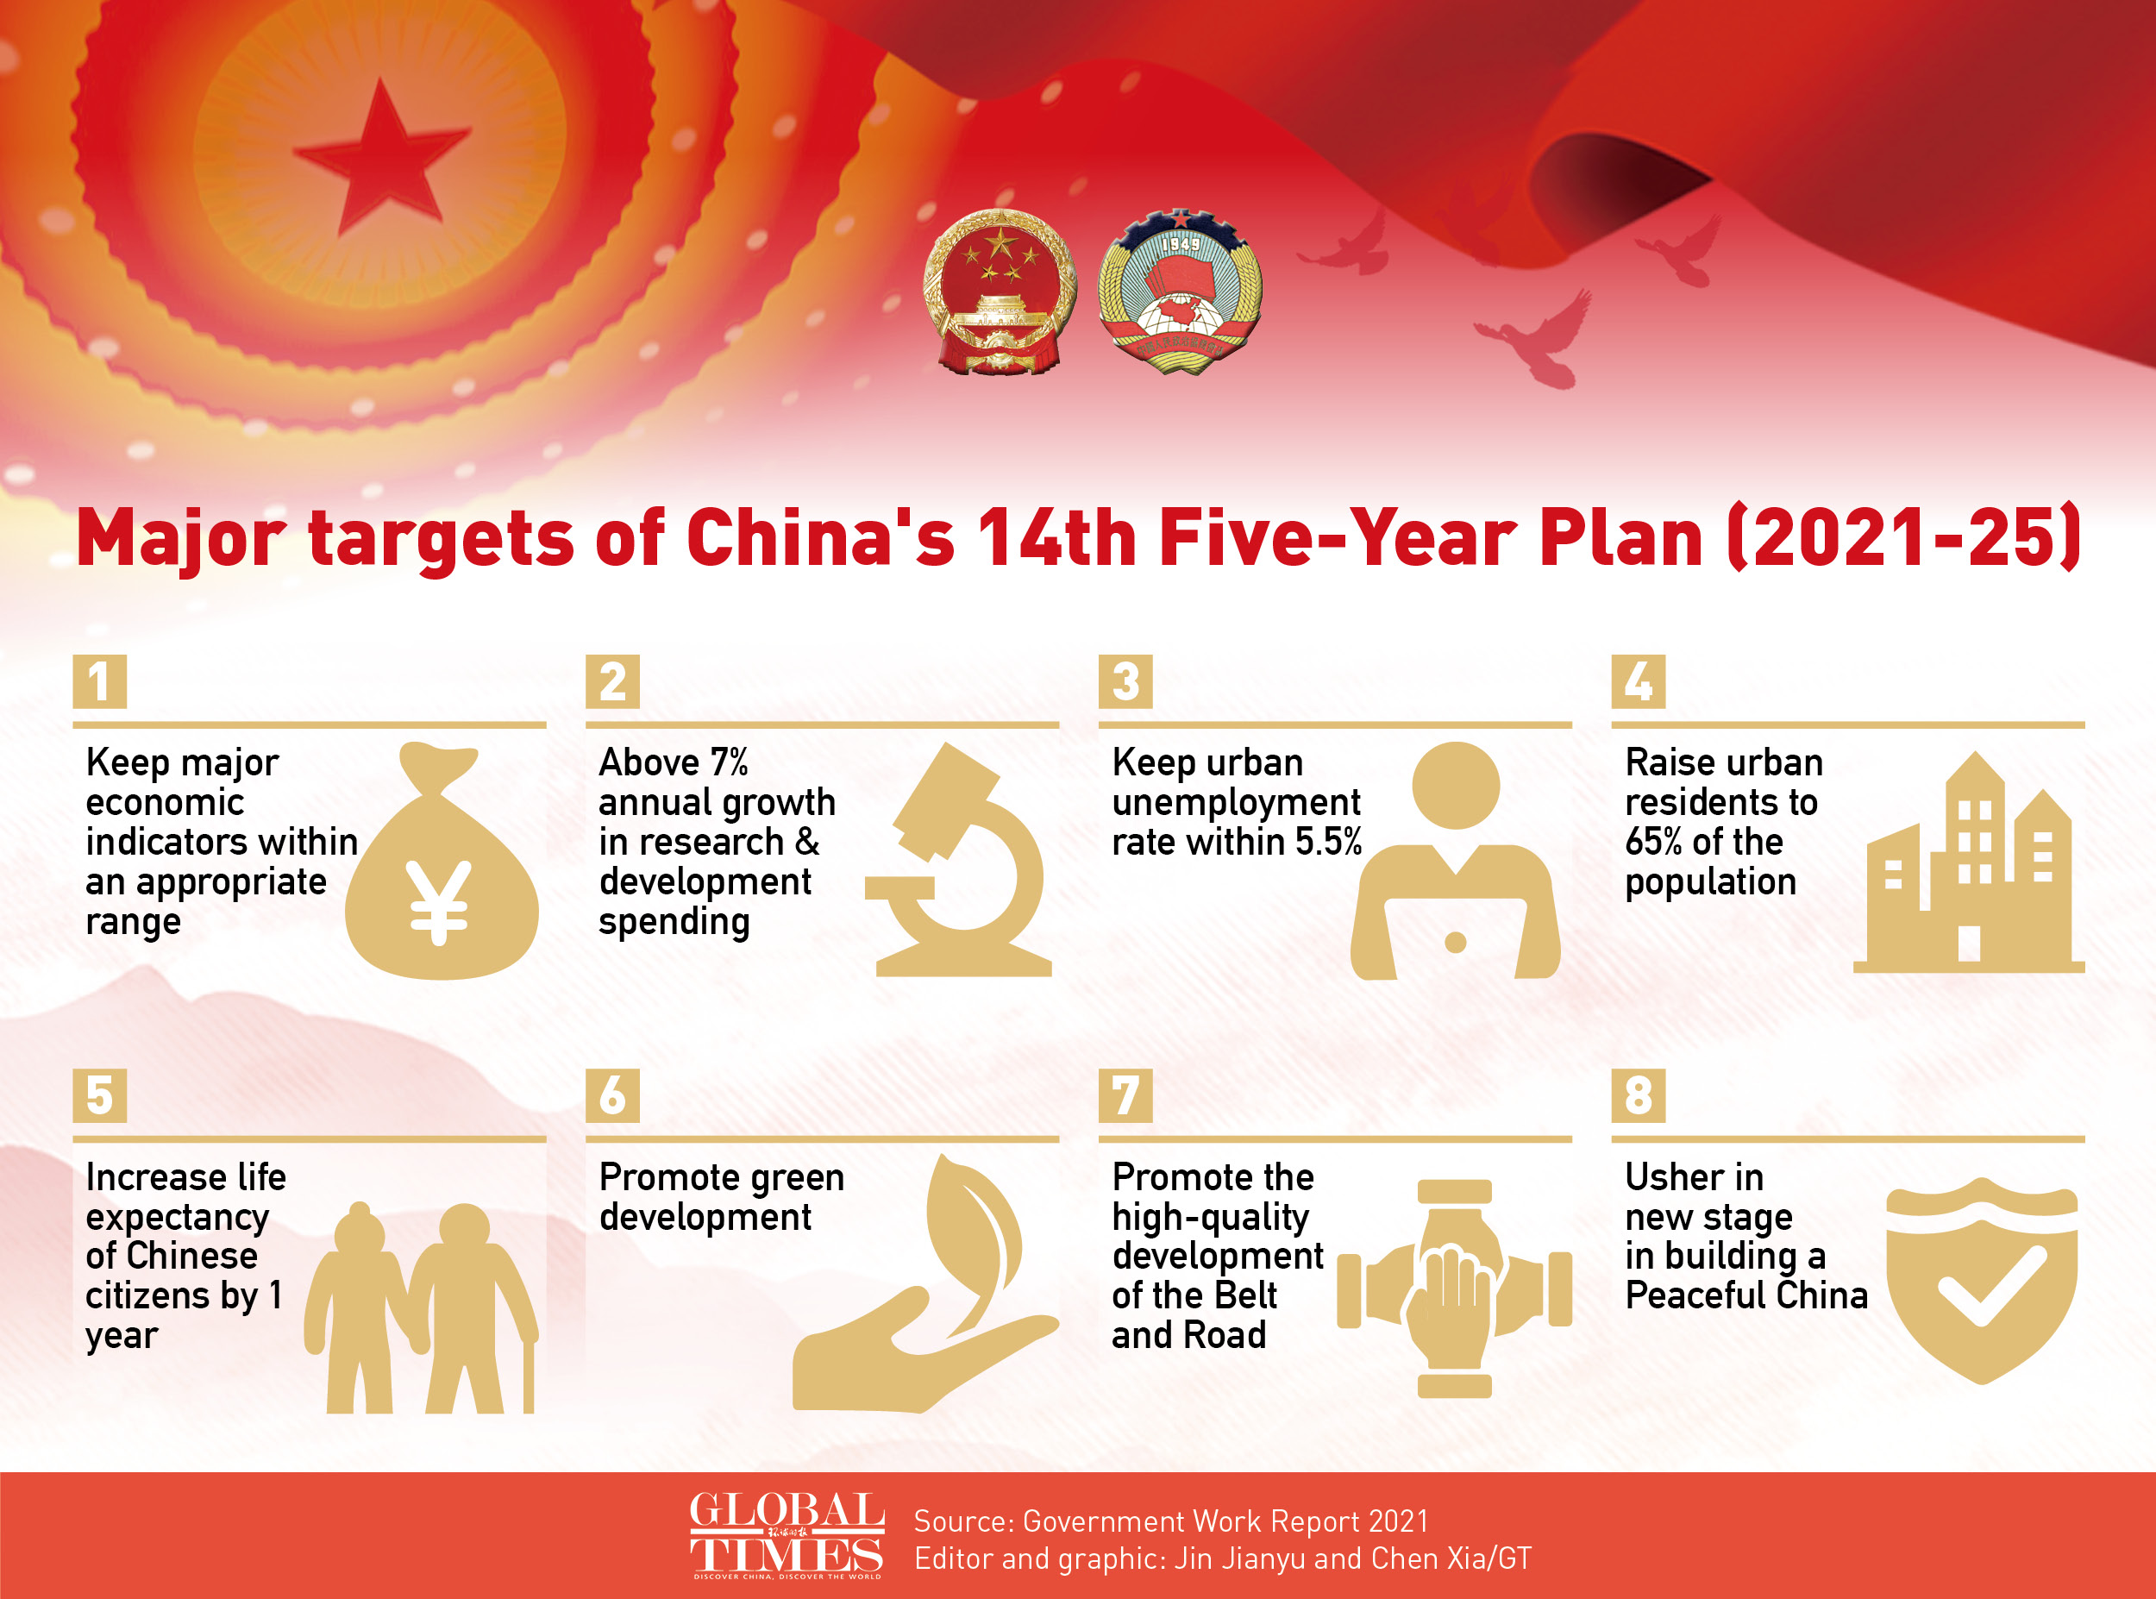

Slide 66
What Does China Need to Do?
Implement a NEW long term strategy for the next phase of development. The 12th Five Year Plan an excellent place to start. The IMF Report recommends that China seek to implement policies that:
Complete the transition to a market economy
Accelerate the pace of open innovation
Go green
Expand Individual Opportunities and Improve Social Services
Fiscal Reform
Become a responsible Global Player

Slide 67
1. Complete the Transition to a Market Economy
Implement structural reforms,
Strengthen the foundations for a market-based economy,
Redefine the role of government its relationship to markets and the private sector,
Reform and restructuring state enterprises, developing the private sector,
Promote competition,
Provide more intangible public goods and services like systems, rules,
Introduce modern corporate governance practices, e.g., separating ownership from management

Slide 68
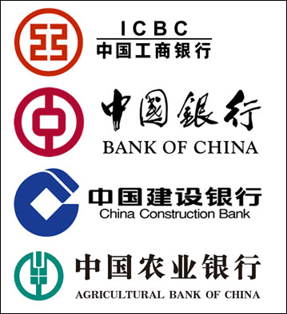
Financial sector reform:
Allow commercializing the banking system,
Allow interest rates to be set by market forces,
Deepening the capital market,
Developing the legal and supervisory infrastructure to ensure financial stability,
Build the credible foundations for the internationalization of China’s financial sector.

Slide 69
Labor market reform:
Ensure workers can move in response to market signals,
Introduce measures to increase labor force participation rates, and
Use social security instruments (pensions, health, and unemployment insurance).
Land reform:
Increase efficiency of land use,
Reform policies for acquisition of rural land for urban use, and
Reduce local government dependency on land-related revenues

Slide 70
Accelerating the Pace of Open Innovation
Needed: An open innovation system that fosters both Product and Process innovation
How? Increasing Chinese domestic R&D
By participating in global R&D
By establishing a research and development infrastructure via:
increase the technical and cognitive skills of university graduates,
build a few world-class research universities with strong links to industry, and
foster research parks, innovative cities.

Slide 71
3. Go green
Why ?
Increased efficiency,
Improve the level of well-being,
Sustain comparative advantage,
Achieve and sustain economies of scale, and
Sustain rapid growth.
How ?
Public education and awareness,
market incentives,
Regulations,
Public investments,
Industrial policy, and
Institutional development.

Slide 72
4. Expand Individual Opportunities and Improve Social Services
Expand opportunities and promote social security,
Facilitate equal access to jobs, finance, quality social services, and portable social security,
Help households manage employment, health, and age-related risks,
Increase labor mobility,
Manage the large rural-urban differences in access to jobs, key public services, and social protection.

Slide 73
4. Expand Individual Opportunities and Improve Social Services Con’t
Deliver more and better quality public services to under-served rural areas and migrant,
Restructure social security systems to ensure secure social safety nets
Mobilize all segments of society, public and private, government and social organizations, to share responsibilities in financing, delivering and monitoring the delivery of social services.

Slide 74
5. Fiscal Reform
Three key dimensions:
Mobilize additional fiscal resources to meet rising budgetary demands,
Reallocate spending toward social and environmental objectives
Ensure that budgetary resources available at different levels of government.
Note: fiscal reform as an essential prerequisite for many of the other reforms

Slide 75
6. Becoming a Global Player
Seek mutually beneficial relations with the world,
Use multilateral institutions and frameworks and open regionalism,
Intensify trade, investment, and financial links with the global economy,
Seize the benefit from further specialization, and diversification,
Integrate into the global financial system, which will involve opening the capital account,
Take steps toward internationalizing the RMB as a global reserve currency,
Help shape the global governance agenda such as:
climate change,
global financial stability,
effective international aid structure,
development in poor nations.

Slide 76
Will China Become A Democracy?
Tiananmen Square 1989
General Hypothesis:
Economic Development ---(+)---> Political Development
Optimists:
-- Seeds of Democracy Have Been Planted
Pessimists:
a) Low GNP per Capita
b) Exchange Economic Rewards for Political Silence
c) Peasants are Conservative Majority

Slide 77
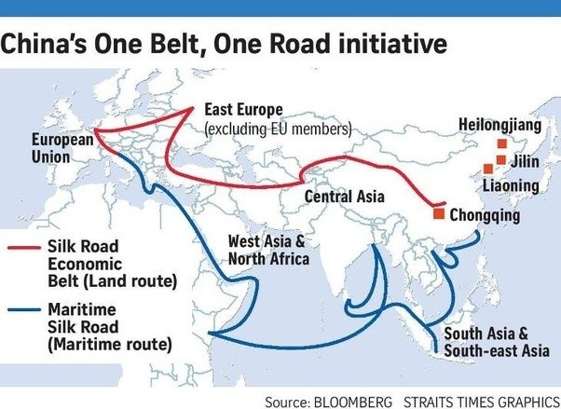
https://www.quora.com/What-is-One-Belt-One-Road-in-China

Slide 78
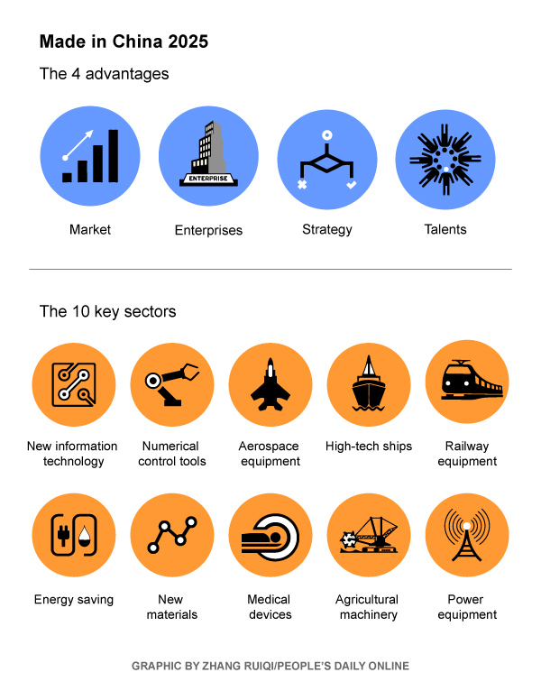
Made in China 2025

Slide 79
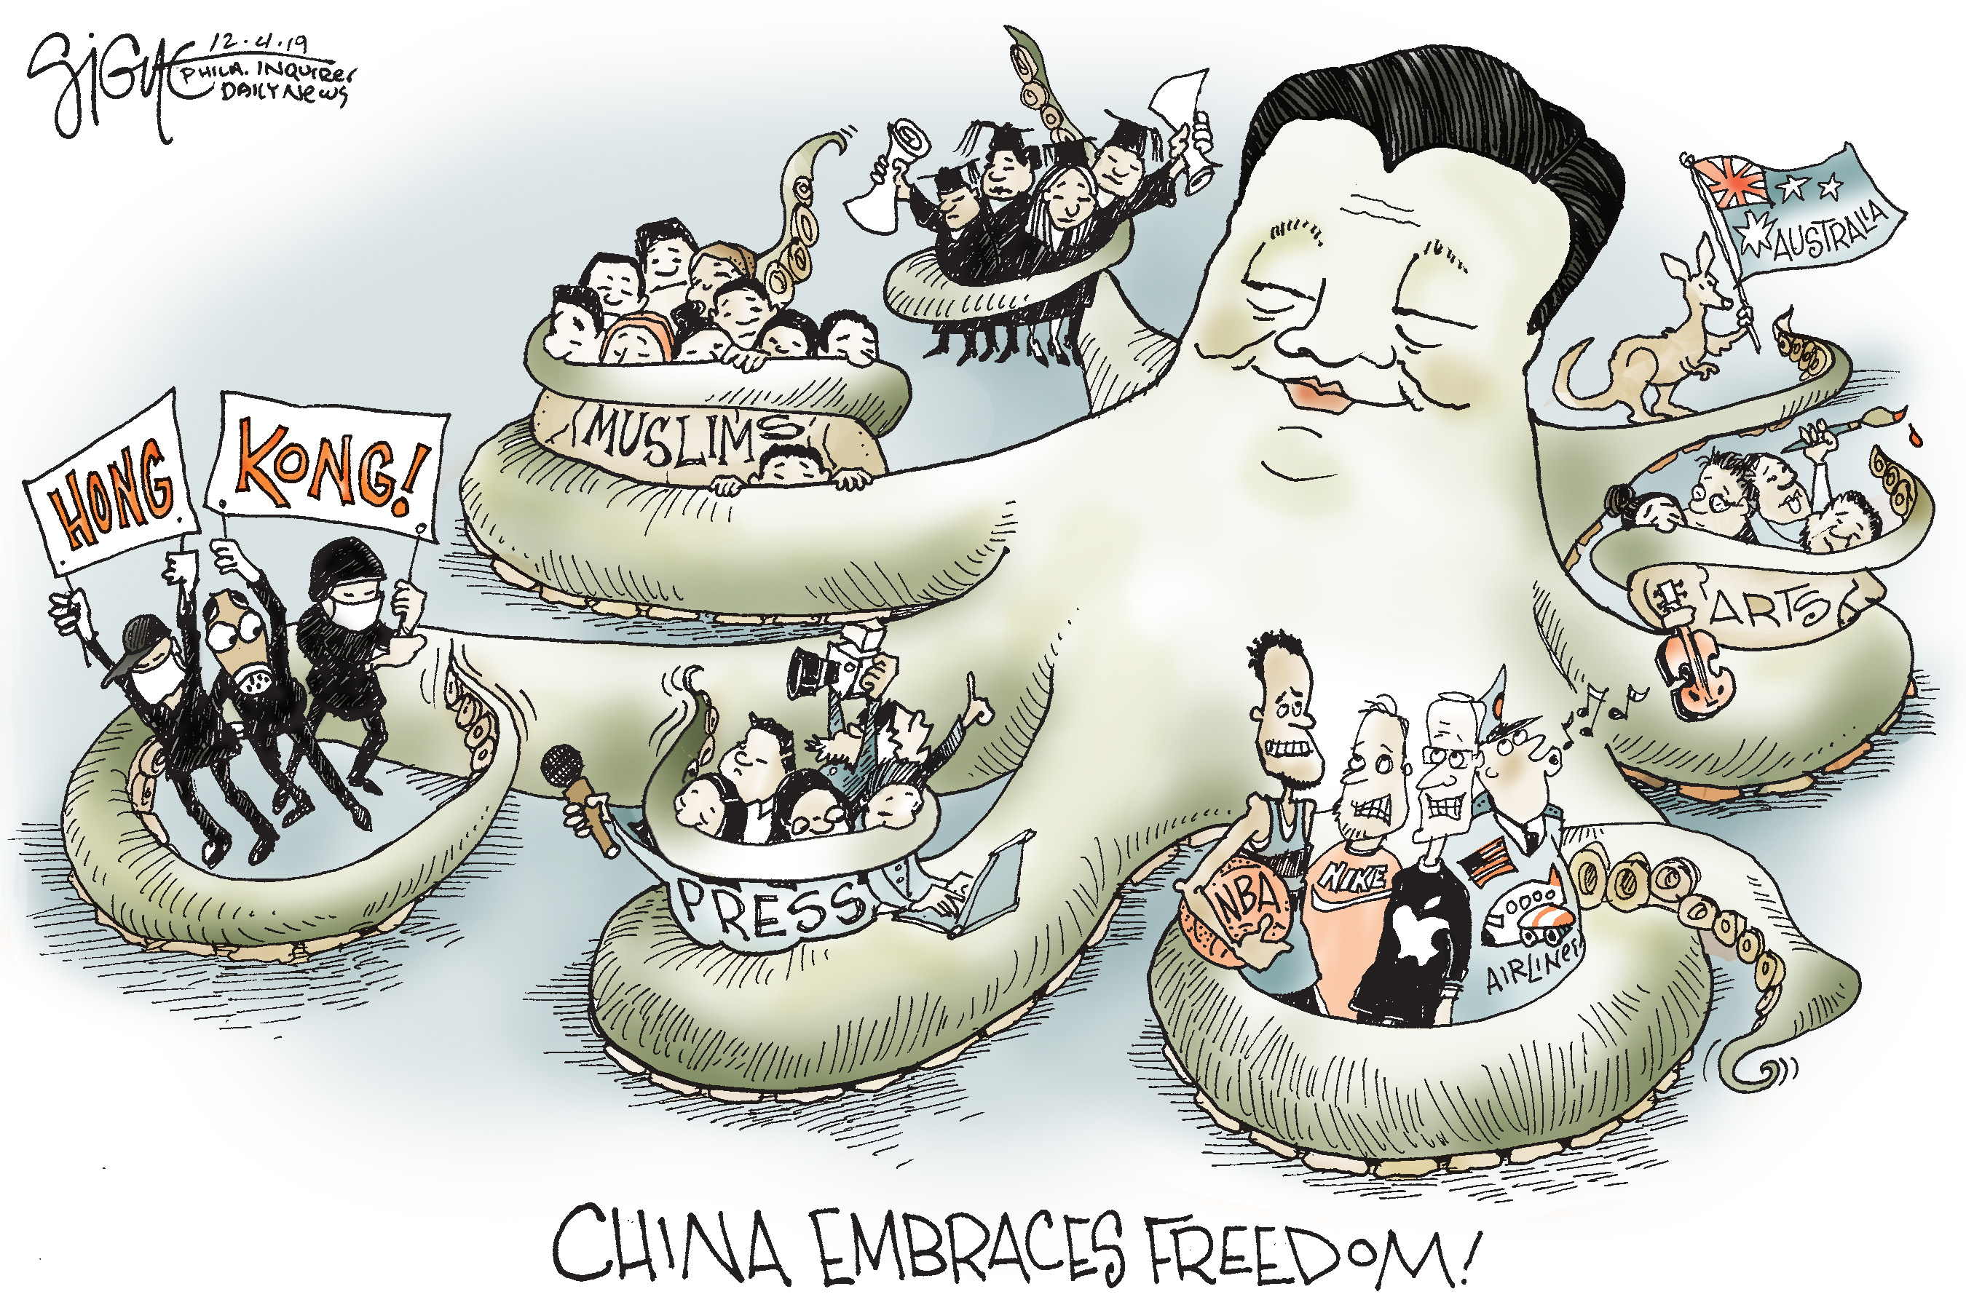

Slide 80
