Slide 1
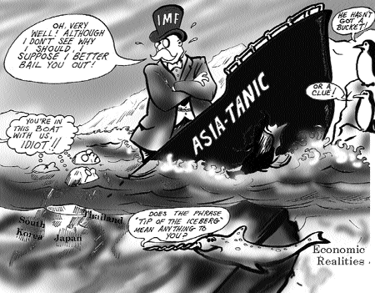
Economies of East Asia ECON 3077
The East Asian Crisis

Slide 2
The East Asian Crisis: Background
The Asian crisis is generally pegged at starting on July 2, 1997 with the devaluation of the Thai baht.
The sharp drop in the Thai currency was followed by speculation against the currencies of Malaysia, then of Indonesia and eventually of South Korea. Other economies including Singapore, the Philippines and Japan were also badly hurt by the crisis.
Main features of the crisis:
  Collapses in domestic asset markets
  Widespread bank failures
  Bankruptcies on the part of many firms

Slide 3
The East Asian Crisis: Thailand
In 1996, Thailand experienced an unsustainable investment boom
Trade deficit 8% of GDP
late l996 attack on the baht
Early 1997: collapse of finance companies and bank runs
July l997: collapse of the baht (first country in trouble)
Intervention of IMF
  high interest rates, credit crunch
  cut in budget deficit
Drop in demand, investment, consumption, etc
1998 Deep Recession
Decline in GDP -7 percent, industrial production -20%
Change of government.
Late l998, signs of stability at low level
Substantial recovery in 1999-2000

Slide 4
The East Asian Crisis: What Happened? (%change of GDP and Exchange Rates)
(%change of GDP

Slide 5
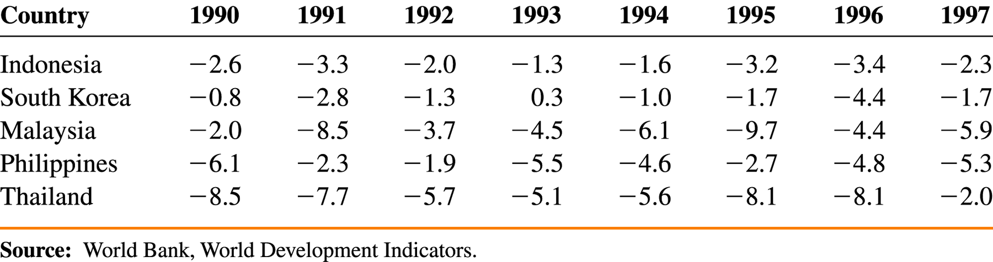
Current Account Deficits
East Asian (Current Account)/GDP

Slide 6
The East Asian Crisis: What Went Wrong?
The main issue
  Rapid growth suddenly collapsed in the entire region.
  Why were so many countries affected, but not all?
What were the Internal Issues?
What were the external forces?
Was it institutional (cronyism)?
Was it a business cycle swing?
Was it caused by international speculators?
Was it a loss of confidence (contagion)?
The Asian economic crisis happened quickly and with little warning. While the crisis has provoked a large number of studies, there is no consensus on its causes. – Some explanations are provided on the next slides.

Slide 7
The Failings of the Asian Model School
This school suggests that, while there may have been various immediate triggers
  a property price bubble
  macroeconomic mistakes (e.g., supporting for far too long a nominally fixed exchange rate)
  fall in the rate of growth of exports, or a regional contagion effect
  the underlying causes were structural and an integral part of the Asian model of capitalism.
The crisis manifested itself in the form of 'over-investment', misallocation of foreign capital inflows, and severe problems in the financial sector. The financial structure of the corporations and the banks, as well as other deficiencies of the state-guided or state-directed financial systems in Asian countries, made these economies very fragile.

Slide 8
Adverse External Factors
Many Asian political leaders blamed on the activities of foreign speculators.
Based on careful theoretical and empirical analyses, research show that it is entirely possible for a financial crisis to occur even when a country's fundamentals are totally sound. It may arise because of changes in investor sentiment or perceptions which may be triggered off entirely by external events such as changes in interest rates or equity prices in advanced countries.
Some models use the analogy of the classic panic-induced run on the bank to describe the financial crisis in East Asian countries.
Problem in Japanese economy

Slide 9
Financial Liberalization
This school ascribes the crisis to liberalisation of the global financial markets, and particularly to the deregulation of the capital account which many Asian countries had undertaken in the preceding period.
It is argued that the crisis occurred directly as a result of deregulation and liberalisation when the governments relinquished controls over the financial sector as well as corporate investment activities. This led to misallocation (towards, for example, the property sector) of investment as well as over-investment.

Slide 10
Evidence
(1) Fundamentals
It seems that all the affected countries prior to the crisis had for a long time enjoyed strong "fundamentals“: strong growth; low inflation; high domestic savings; healthy fiscal positions.
A significant blemish on the pre-crisis record was the current account balances in some of the affected countries.
Asian countries suffered to varying degrees from short-term imbalances such as overvalued exchange rates, as well as short term liabilities of the financial sector which exceeded the value of the central bank's reserves. The required some macroeconomic adjustments and restructuring of debts.

Slide 11
Evidence
(2) The Capital Supply Shock: It is widely agreed that the proximate cause of the crisis in Malaysia, Indonesia, Thailand and Korea was the capital supply shock - the sudden interruption and reversal of normal capital inflows into these countries.
(3) Structural Factors:
  Transparency: Because of the nature of the Asian corporations (involving extensive cross-subsidisation of subsidiaries) and their close, the markets did not have enough information about the true financial status of the corporations and the banks.
  Over-investment and misallocation of investment
  Chaebols in Korea

Slide 12
Evidence
(4) Financial Liberalisation: The typical corporation particularly in Japan, Korea, or Thailand is heavily geared, i.e. has a high ratio of debt to the equity capital of the shareholders. Such a corporate system became dysfunctional when the government a process of financial liberalisation. It permitted companies and banks to raise money abroad without the traditional supervision and control.
The East Asian crisis has sparked an intensive debate. Different authors emphasised different roles of fundamentals; the capital supply, structural factors and financial liberalisation in explaining the causes, onset, and evolution.

Slide 13
The Immediate Impact of the Slowdown During the late 1990s was Shortlived and Differed Across Countries
Growth rates of Real GDP
1996A1
1997A1
1998A1
1999A1
2000A1
2001A1
INDONESIA
8.0
4.5
-13.1
0.8
4.8
3.2
THAILAND
5.9
-1.5
-10.8
4.3
4.4
1.5
MALAYSIA
10.0
7.3
-7.4
6.1
8.3
0.3
KOREA
6.8
5.0
-6.7
10.9
8.8
2.6
HONG KONG
4.5
5.0
-5.3
3.0
10.5
-0.3
JAPAN
3.6
1.8
-1.0
0.7
2.2
-0.4
PHILIPPINES
5.7
5.2
-0.6
3.4
4.0
2.9
SINGAPORE
7.7
8.5
0.1
5.9
9.8
-2.9
PAKISTAN
2.9
1.8
3.1
4.1
3.9
3.7
TAIWAN
6.1
6.7
4.6
5.4
6.0
-2.2
SRI LANKA
3.8
6.4
4.7
4.3
6.0
BANGLADESH
5.0
5.3
5.0
5.4
6.0
4.7
INDIA
7.3
4.9
5.8
6.8
6.0
4.4
CHINA
9.6
8.8
7.8
7.1
8.0
7.3
UNITED STATES
3.6
4.4
4.3
4.1
4.1
1.0
Source: IMF, December 2001

Slide 14
The Recovery Happened– But There is Always the Question of Sustainability
Most East Asian economies have performed strongly since 1999.
Main factors behind the recovery include:
  Strong exports, partly due to depreciated exchange rate levels;
  Rebuilding of foreign reserves, partly because of collapsing imports in 1998;
  Fiscal deficits and low interest rates stimulating aggregate demand;
  Various structural reforms to strengthen the financial system; and
  Sustained foreign direct investment inflows.

Slide 15
Is there a Need to Reform the World’s
Financial “Architecture?”
The Asian crisis convinced nearly everyone of an urgent need for rethinking international monetary relations because of two reasons:
  The fact that the East Asian countries had few apparent problems before their crisis struck
  The apparent strength of contagion through the international capital markets

Slide 16
Ideas for Reforming Global Capitalism
Market-reinforcement
  transparency
    reserve transactions
    economic statistics
    foreign indebtedness
  regulation
    capital adequacy
    a global regulator
  reduce moral hazard
    curb the IMF
    bail in private lenders
    “orderly workouts”
System reinforcement
  guarantor for loans
  capital controls
    tax forex transactions
    control ST inflows
  “lender of last resort”
Regional mechanisms
  Currency swaps
  Surveillance
  Common currency or basket
  Asian Monetary Fund

