Slide 1

Economies of East Asia ECON 3077
The East Asian Miracle

Slide 2
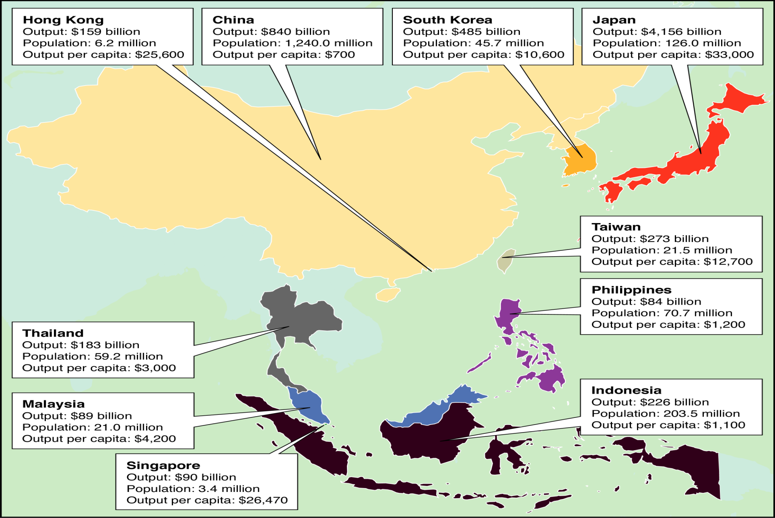
East Asia (1997)

Slide 3
What Went On In East Asia: From Miracle to Meltdown
From the perspective of international economics and business, the defining event of the l990s decade has been the miracle and meltdown of East Asian growth, just like the Latin American debt crisis was in the l980s and the oil shock in the l970s
What was the Latin American Debt Crisis?
What do we mean by the Oil Shock?
We will briefly look at the concept of economic growth

Slide 4
Traditional View of of Growth Process
Industry/manufacturing sector grows, creates employment, offers higher wages, and draws labour from agriculture and low-productivity jobs in rural areas
share of employment in agriculture ⇓
share of manufacturing and related services⇑
Productivity and farm size in agriculture ⇑
Larger rural market expands demand for industrial products

Slide 5
Economic Growth and Development
What is the difference?
development includes improvements across several dimensions
‘quality of life’: health, education, ‘human rights’ and political rights
income distribution
Development and freedom to exercise choices:
Per capita income growth necessary but not sufficient

Slide 6
The Basic Model of Economic Growth
Output or production (Q) is usually measured as Gross Domestic Product (GDP)
Q depends on quantities of factors of production and technology Q = f(K,L)
For economies to grow, however, factors of production must increase and/or there must be technical progress (productivity growth)
Q = Af(K.L)

Slide 7
Economists Look at Growth in Per Capita Output
Why do we emphasise per capita output/income?
If no technical progress, per capita output will grow only if:
Increase in per capita availability of factors of production
If capital stock per capita ⇑, output per capita ⇑, but we have the ‘law of diminishing returns’
Thus, as capital stock per capita ⇑, rate of growth of
per capita output falls
Can you give an example?

Slide 8
Output Per Capita (Y/L) and Capital Per Capita (K/L)
Y/L
If no technical progress, growth rate slows down
even if investment is maintained
*
*
K/L
1
2

Slide 9
Output Per capita (Y/L) and Capital per Capita (K/L)
Y/L
2
1
With technical progress,
growth can be maintained
This leads to the concept of Total Factor Productivity
K/L

Slide 10
Total Factor Productivity
Total Factor Productivity (TFP) = A = Y/f(K,L)
Basically, TFP is a ‘catch-all’ for anything that effects output other than K and L.
Workweek of labor and capital
Quality of labor and capital
Regulation
Infrastructure
Competition
Specialization
Innovation
Strategy (Entrepreneurial methods/new management techniques)

Slide 11
The Virtuous Circles of Economic Growth
Decline in Population Growth
Turn to Export Manufactures
High Saving and Investment
Declining Resource Costs
Increases in Scale of Production
Introduction of Technology

Slide 12
Development Strategies
Inward oriented
Outward oriented
‘socialist’
mixed
role of state
-small
role of state
- major

Slide 13
Inward Oriented Strategies: Emphasis on Domestic markets
Sources of growth:
Investment using domestic savings
labour released from agriculture provides workers for industry/manufacturing
technical progress, rely primarily on domestic innovations and ‘purchased’ foreign technology

Slide 14
Import Substitution
Development of domestic industry to substitute for imports
Trade barriers, subsidies, and exchange controls necessary to protect domestic producers: state intervention replaces market prices
Benefits: short-cut, coordination, synergies
Problems: low level of competition, “inappropriate” factor inputs, administrative costs, current account deficits, interest groups

Slide 15
Trade policy is Critical: Why?
Outward Oriented Strategies: Emphasis on Export Markets
export growth ⇒ funds to purchase foreign made capital goods and ‘embodied’ technology and other needed inputs
But trade policy is not the only important factor!

Slide 16
Export Orientation
Development based on exploitation of comparative advantages
Gradual diffusion of wealth to other sectors
Benefits: foreign exchange, competition, technology transfer
Problems: information, incomplete markets, market access, diffusion of benefits

Slide 17
East Asia and the Asian Miracle
The Asian Miracle
The four tigers: Hong Kong, Singapore, Korea, Taiwan
1970 - 1997 growth rates of 8%
Hong Kong and Singapore per capita output about equal to U.S.
Remaining Asian countries
High growth rates 1970 - 1997
Per capita output was low but rising rapidly

Slide 18
Output Growth in East Asian Countries, 1990 - 1997
1970-1997 (in percent)
*Data for other countries unreliable
Hong Kong 7.5
Singapore 8.2
Korea 8.4
Taiwan 8.3
Indonesia 6.8
Malaysia 7.4
Philippines 3.6
Thailand 7.5
China 9.1

Slide 19
East Asia: The Miracle
The East Asian Economic Miracle
Until 1997 the countries of East Asia had very high growth rates as was shown.
What were the ingredients for the success of the East Asian Miracle? (General Consensus)
High saving and investment rates
Strong emphasis on education
Stable macroeconomic environment
Free from high inflation or major economic slumps
High share of trade in GDP

Slide 20
Roots of East Asian Development: States or Markets?
Increasing consensus that growth has largely been export-led (although several countries exhibit periods of import substitution)
Disagreement about the relative role of state intervention and market signals.

Slide 21
The Economic Environment (Development)
Much of the East Asian success started from export-oriented strategies, benefiting from growth in the international economy since the 1950s.
Wave of FDI in Asia (“Flying Geese Pattern”)
Japan→4 Tigers→3 NIEs→China→ (?)
As each wave of development ensued it displaced exports of prior wave, compelling restructuring.
Internal causes: exchange rate appreciation, wage increases, …
Restructuring: labor intensive→capital intensive→knowledge

Slide 22
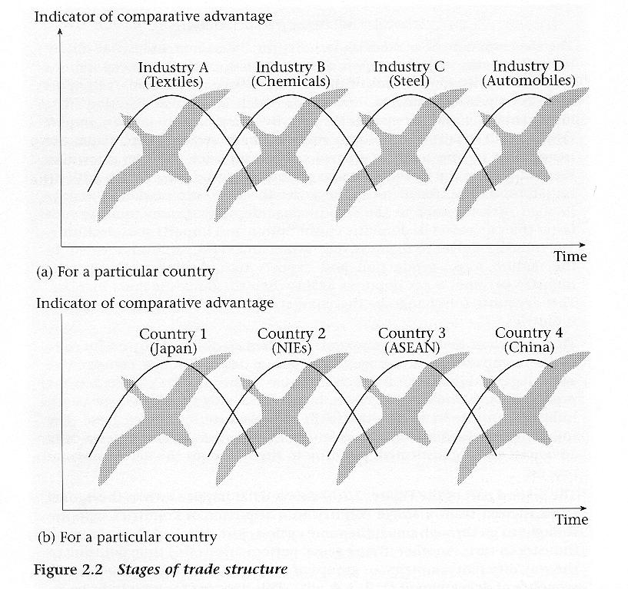
Flying Geese Model of Trade Structures in East Asia

Slide 23
“Asian Dynamism”
Geographic diffusion of industrialization
Within each country, industrialization proceeds from low-tech to high-tech
Clear order and structure (with a possibility of re-formation)
Specialization on comparative advantage
Requires successive stages of comparative advantage
Supported by export subsidies which are only given temporarily

Slide 24
Successive Stages of Comparative Advantage in East-Asian Trade Structure
1) Primary import-substitution: replace labour intensive manufacturing imports with domestically produced goods
2) Primary export-“substitution”: replace agricultural exports by labour-intensive manufacturing exports
3) Secondary import-substitution: production of intermediate and capital goods for domestic market
4) Secondary export-“substitution”: shift from labour-intensive to capital- and knowledge intensive production

Slide 27
The Development Ladder--Stages
Stage 1
Stage 2
Stage 3
Stage 4
Primary Products
Labor Intensive Manufactures
Hi Tech Manufactures
Services (high level)
Abundant cheap land and labor
Low Cost Labor
Capital Intensive, Technically Sophisticated Products
Domestic and International Services

Slide 28
The Stages of the Product Cycle Process 1950-65 1965-1980 1980-1995 1995-2010
China, Korea
Taiwan
Philippines
Malaysia
Indonesia
Thailand
Singapore
Laos
Cambodia
Myanmar
Stage 1
Thailand
Malaysia
China
Indonesia
Philippines
Indonesia
Philippines
Vietnam
Indonesia
Philippines
Vietnam
Thailand
China
Thailand
Malaysia
China
Stage 2
Taiwan
Singapore
Hong Kong
Korea
Japan
Japan
Hong Kong
Taiwan
Singapore
Hong Kong
Korea
Japan
Malaysia
Taiwan
Korea
Japan
Stage3
Stage 4
Japan* Singapore
Hong Kong

Slide 29
Fundamentalists and Assimilations
Economists attempting to understand the sources of East Asia’s growth tend to fall in 2 camps: Fundamentalists and Assimilationists.
Fundamentalists (e.g. Paul Krugman): Growth was mainly input driven. The efficient allocation of resources played a big part in the success story. Input driven growth is not sustainable because there are limits to efficient resource allocation and because incremental growth in inputs is subject to diminishing returns. What model can we use to explain this?
Assimilationists (e.g. Paul Romer): Growth was mainly driven by the acquisition and mastery of technology and the capacity to put ideas into practice. What model can we use to explain this?

Slide 30
Paul Krugman’s Classic Article on Asia
Summary:
Pundits point to the awesome growth of EastAsia's economies and fret that the West cannot compete. But there is nothing miraculous about the successes of Asia's "tigers." Their rise was fueled by mobilizing resources - increasing inputs of machinery, infrastructure, and education - just like that of the now-derided Soviet economy. Indeed, Singapore's boom is the virtual economic twin of Stalin's U.S.S.R. The growth rates of the newly industrialized countries of East Asia will also slow down. The lesson here for Western policymakers is that sustained growth requires efficiency gains, which come from making painful choices.

Slide 31
We Cannot Forget the Importance of Demographic Transition
Demography:
Changes in birth and death rates and life expectance ⇒ changes in population growth rate: low to high to low (even falling) – ‘demographic transition’
What are the Implications?

Slide 32
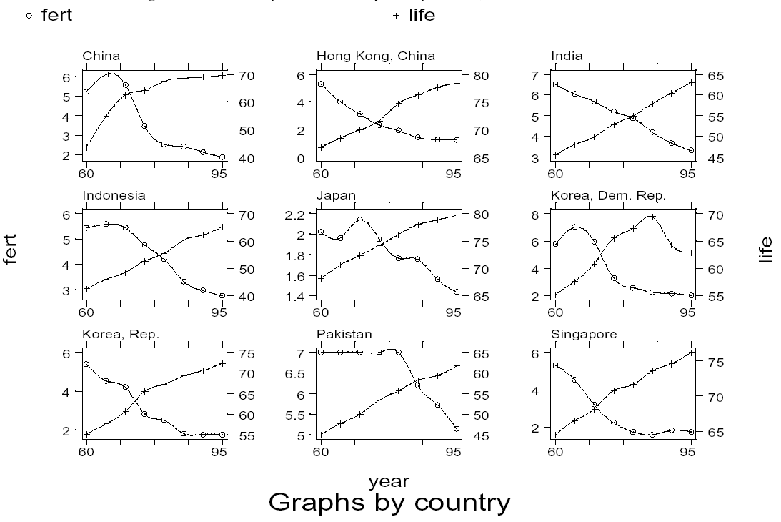
Transition: Some Asian Countries
Source: Todaro

Slide 33
The East Asian Miracle ~ Explanation According to the World Bank
“getting the fundamentals right”, with highly selective interventions”
Fundamental
Macroeconomic stability
High investments in human capital
Stable and secure financial systems
Limited price distortions
Agricultural development
Openness to foreign technology
Selective
Mild financial repression
Directed credit
Selective industrial promotion
Export-push trade policies

Slide 34
Causes of the Miracle: Public Policy (World Bank Report)
Rapid Accumulation (of human & physical capital)
Developing human capital
Primary and secondary education was emphasized
Tertiary education funds mostly for hard sciences
Female literacy→ more workers, lower fertility rates
Creating effective and secure financial systems
Increased savings: (including “forced” savings)
promoted by the integrity and accessibility of postal banks
Increased investment:
investment-friendly environment; creating infrastructure
easy credit through “financial repression”

Slide 35
Causes of the Miracle: Public Policy (World Bank Report)
Efficient Allocation of capital
Letting markets work: flexible labour markets
governments less responsive to organized labour
Productivity-driven wage rises, even downward
No minimum wage
emphasis on creating jobs; high employment levels
Assisting the market: credit for priority areas
Industrial policies: targeting winners
criteria: growth, productivity, spillover
Credit directed against strict performance criteria
“contests”, thru deliberative councils
Most subsidy small, but a signal to capital markets.

Slide 36
Causes of the Miracle: Public Policy (World Bank Report)
Technology catch-up and high productivity
actively seeking foreign technology
industrial policy promoted high-tech sectors
encouraging exports
other special features of East Asian growth
the principle of shared growth
macroeconomic stability
cooperative competition (led by technocratic elite)
business-friendly environment, led by private investment
state interventions addressed market failures
allocated by “contests”

Slide 37
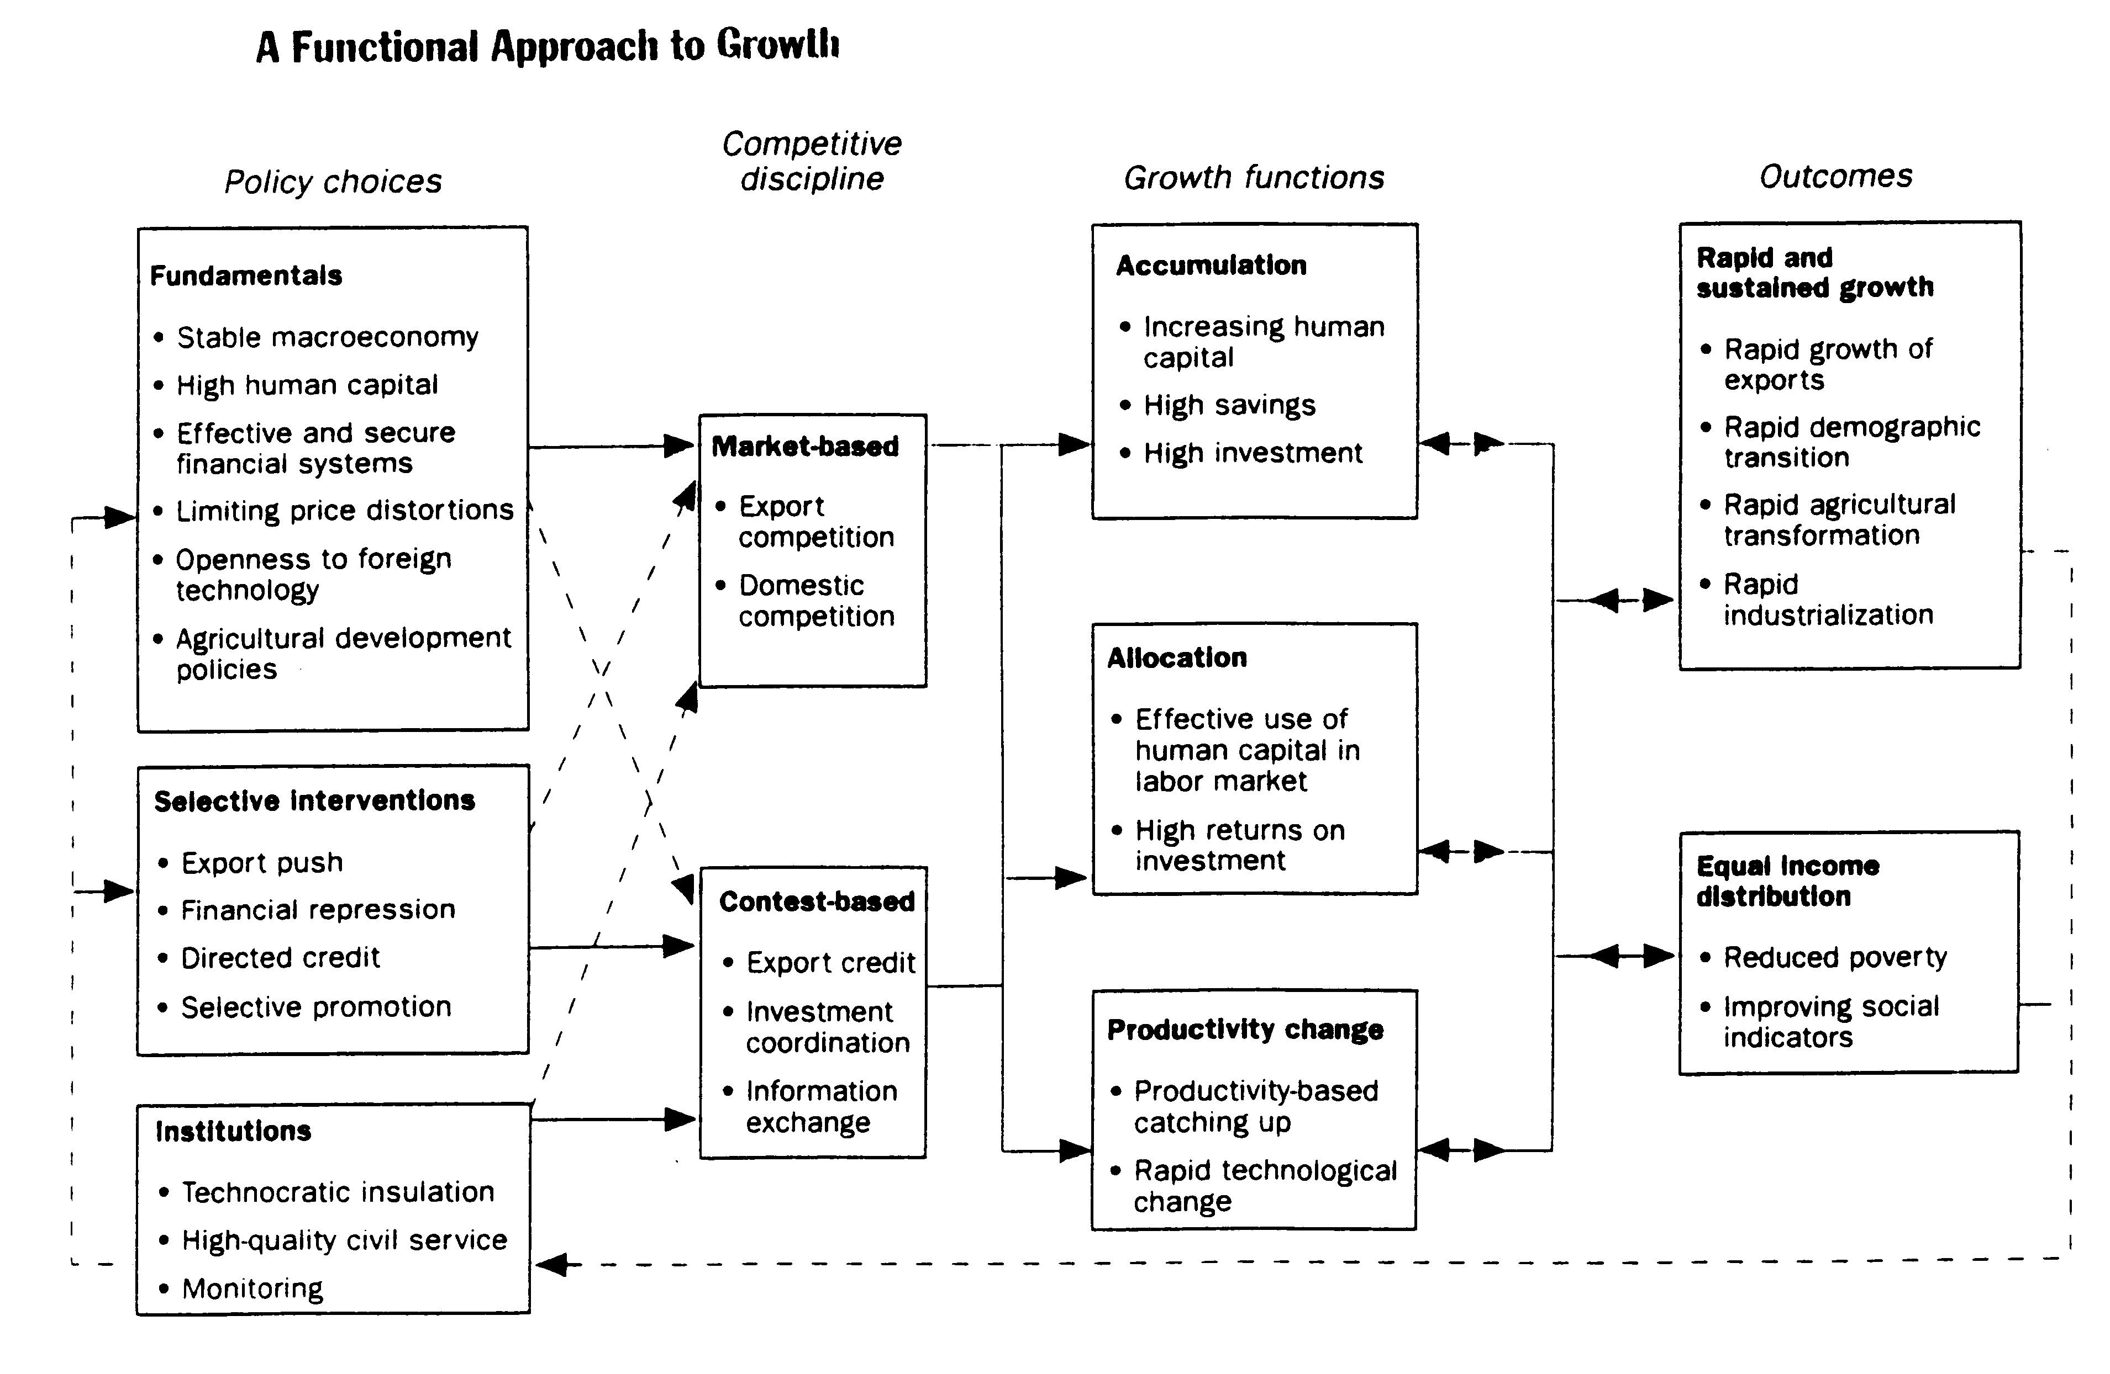
World Bank (1993), East Asian Miracle, Economic Growth and Public Policy, Washington D.C.

Slide 38
The Role of Policy
Macro Policies For Stability
Basic Government Services
Infrastructure investment
Education and technology
Environmental Policies
Legal Structure and Property Rights
Supervision of Banking System
Selective Industrial Policies

Slide 39
Investment and Technology: Role of Foreign Capital
Foreign direct investment (FDI)
International capital market and investment capital
Global sources of technical progress: technology transfer
What is the role of each?

Slide 40
Human Capital and Social Capital
Capital should include human capital, not only tangible objects
Also, there is evidence that social capital contributes to growth
What is meant by social capital?
http://www.nber.org/papers/w5470

Slide 41
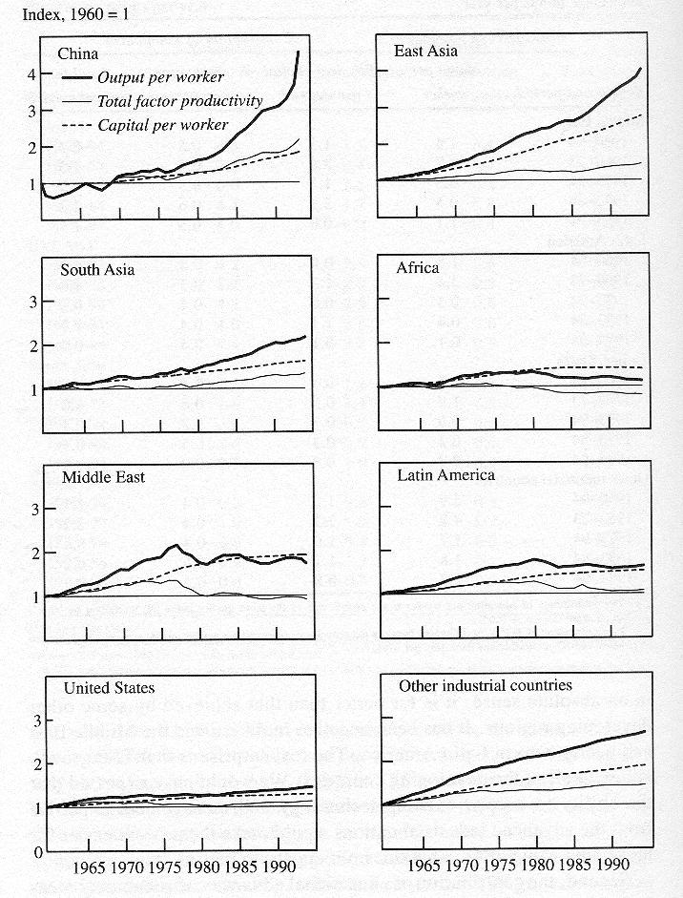
The Role of TFP

Slide 42
The Role of Government
East Asian countries adopted sound fundamental policies.
Control inflation
Manage internal and external debts
Resolve macroeconomic crises quickly
Invest in education
Maintain stable and secure financial systems
Limit price distortions
Open up to foreign trade and investment
Promote exports

Slide 43
The Role of Openness
An outward-oriented policy has long been seen as a centrepiece of East Asia’s economic success.
Integration into the world economy provides firms to access to a large variety of goods and services which embody new technologies.
It enables a country to adopt or adjust foreign technologies for domestic uses. By doing so, a country's productivity in imitation and innovation will be enhanced.
Exposure to international competition may bring about higher-quality products and alleviate duplication of R&D efforts.
More open economies can take advantage of larger markets, increasing their degree of efficiency (economies of scale) and their rates of growth.

Slide 44
Was East Asian Growth Miraculous?
Yes
Growth was very rapid (more than 7% p.a.)
A large productivity factor (4-5% p.a.)
Obvious shifts to advanced technology
No
Krugman--input based growth and diminishing returns
Not if we take into account the contribution of knowledge and the interaction between investment and technology

Slide 45
Was Government Policy Responsible for the East Asian Miracle?
No -- Neoclassical - Free Market
“Just get prices right” “Growth would have been even faster if reforms had enabled intervention to be reduced.”
Yes -- Revisionist, - State-Led
The Developmental State” “the existence of a state apparatus..that used its power to pursue the goals of military strength and national economic wealth.

Slide 46
Was Government Policy Responsible for the East Asian Miracle?
World Bank
“Fundamentally sound development policy was a major ingredient in achieving rapid growth:..Macro management, saving promotion policies, education, agricultural productivity, .. But these do not tell the whole story. Government intervened..targeting selected industries, promoting exports, low interest rates, protecting certain industries,.. ..rapid growth has at times benefited from careful policy intervention
..the promotion of specific industries generally did not work…. The fact that interventions were an element of some East Asian economies’ success does not mean that they should be attempted everywhere.”

Slide 47
Joseph Stiglitz on East Asia: Governments in East Asia recognised limitations of markets but confined the governments’ role to:
Ensure macroeconomic stability
Make markets more effective, for example, by regulating financial markets
Creating markets where they did not exist
Helping to direct investment to enhance growth and stability
Create atmosphere conducive to private investment and ensure political stability
http://dcmccornac.com/AEconEastAsiaSpring2024/articles/WhatILearnedStiglitz.pdf

Slide 48
