Slide 1

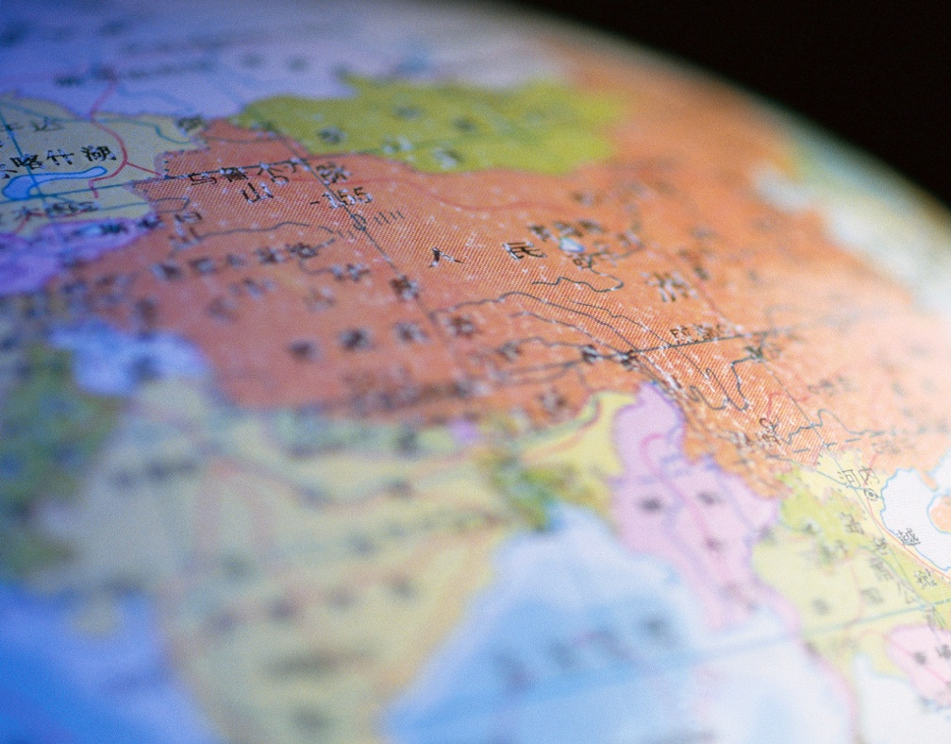
Economies of East Asia – ECON 3077
Please introduce yourself:
  Name
  Reason for choosing this course
  Prior knowledge/experience with East Asia
  Your particular interest in East Asia

Slide 2
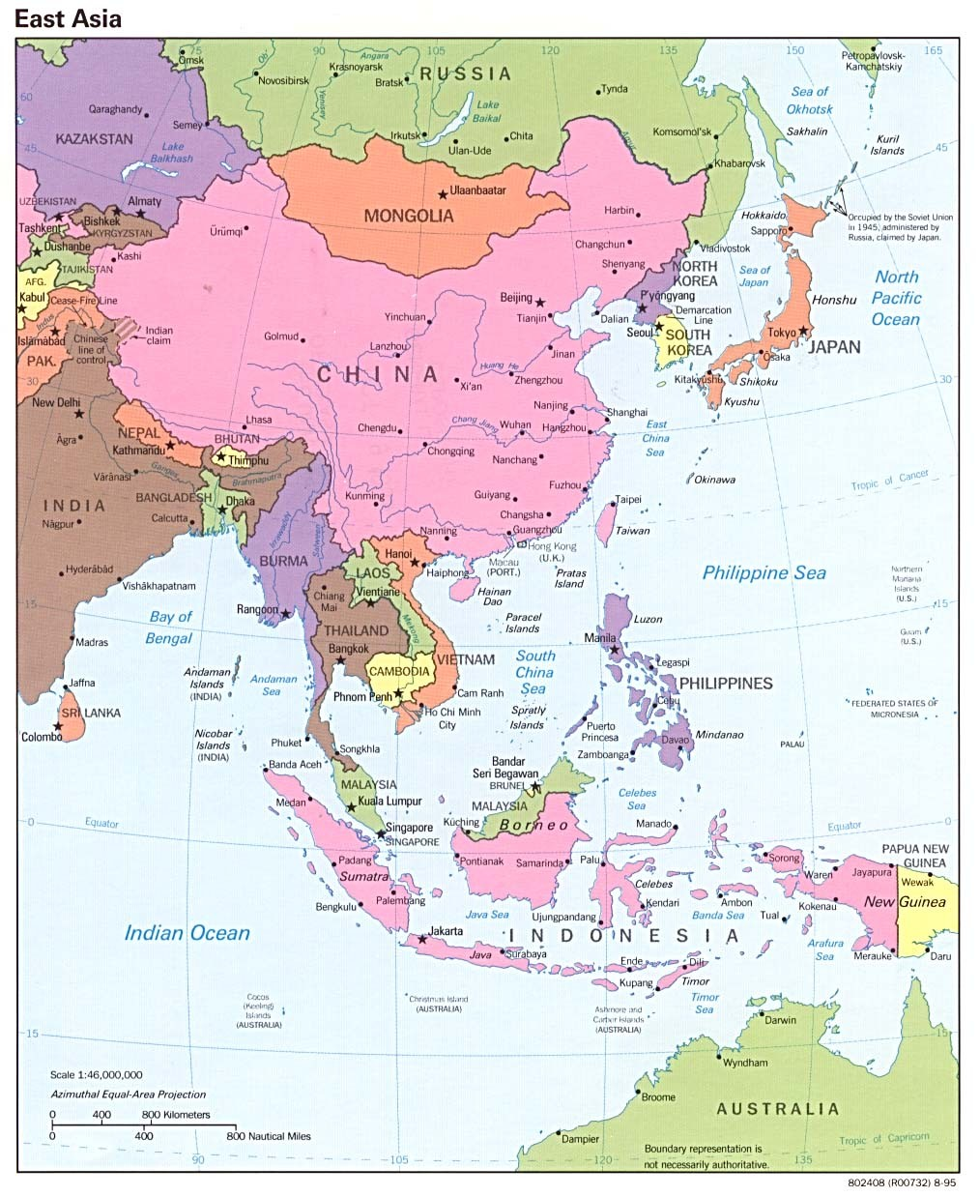
Where is East Asia?

Slide 3
What Countries Do We Include?
China (including Hong Kong*)
Cambodia
Japan
Republic of Korea (South Korea)*
Laos
Indonesia
Malaysia
Myanmar
North Korea
Philippines
Singapore*
Taiwan (Chinese Taipei)*
Thailand
Vietnam
*Used to be called the Tigers

Slide 4
Why Bother About East Asia?
The total population is approximately 2.2 billion people, combining East Asia (around 1.65 billion) and Southeast Asian countries (approximately 565 million). The majority of the population is in East Asia, primarily due to China's large population.
There is a need to understand the wide diversity of cultures - culture influence needs, political and security concerns as well as business practices
Rapid development for several decades - “Asian Miracle” and “Pacific Century”
Increasing economic and political importance - includes some of the world’s largest markets
Miracle disturbed by the Asian crisis in 1997
What about the future? Obvious need to understand developments in the region
Implications for world economic and political policy
https://www.worldometers.info/population/countries-in-asia-by-population/

Slide 5
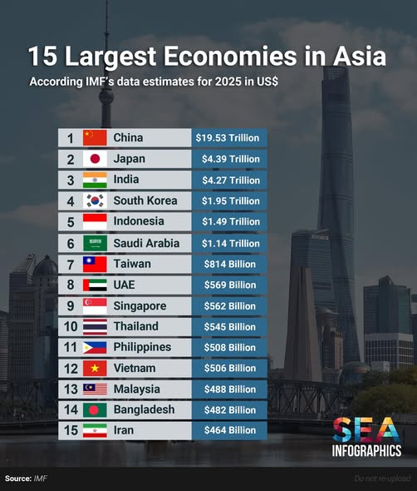

Slide 6
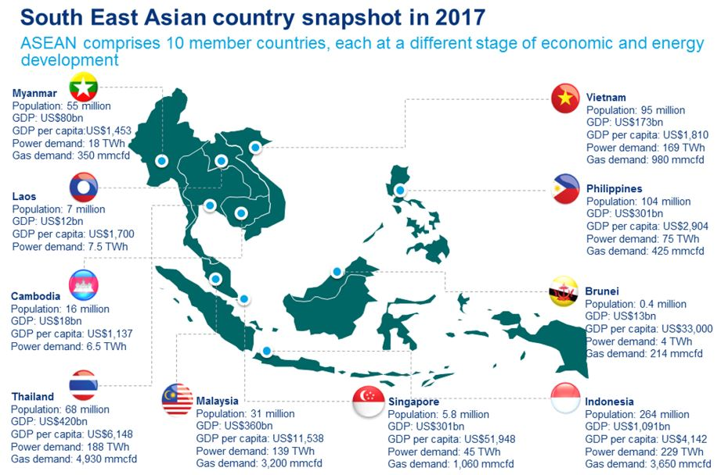

Slide 7
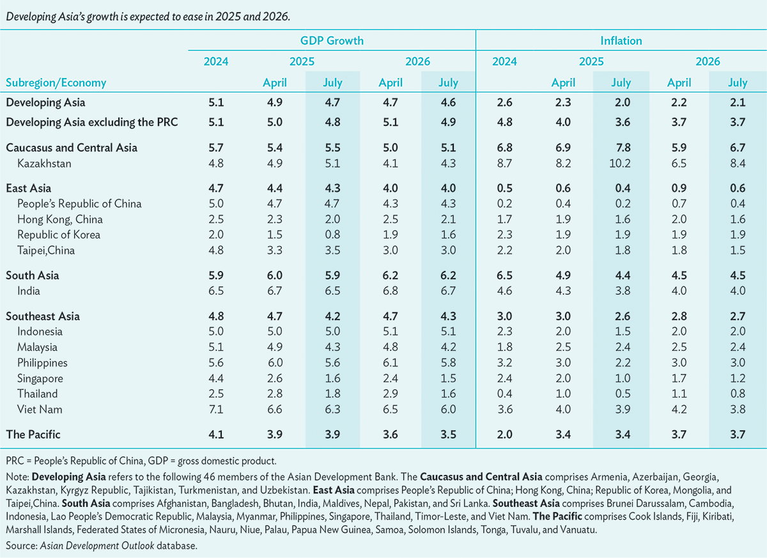
https://www.adb.org/outlook/editions/september-2025#east-asia

Slide 8
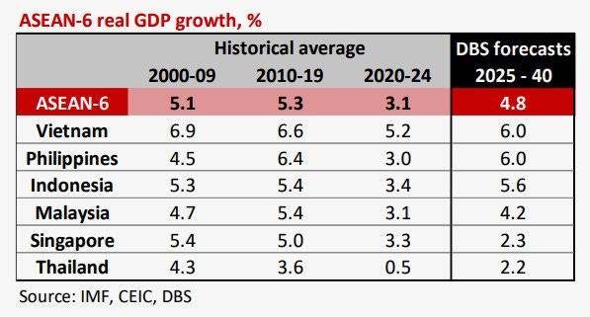

Slide 9
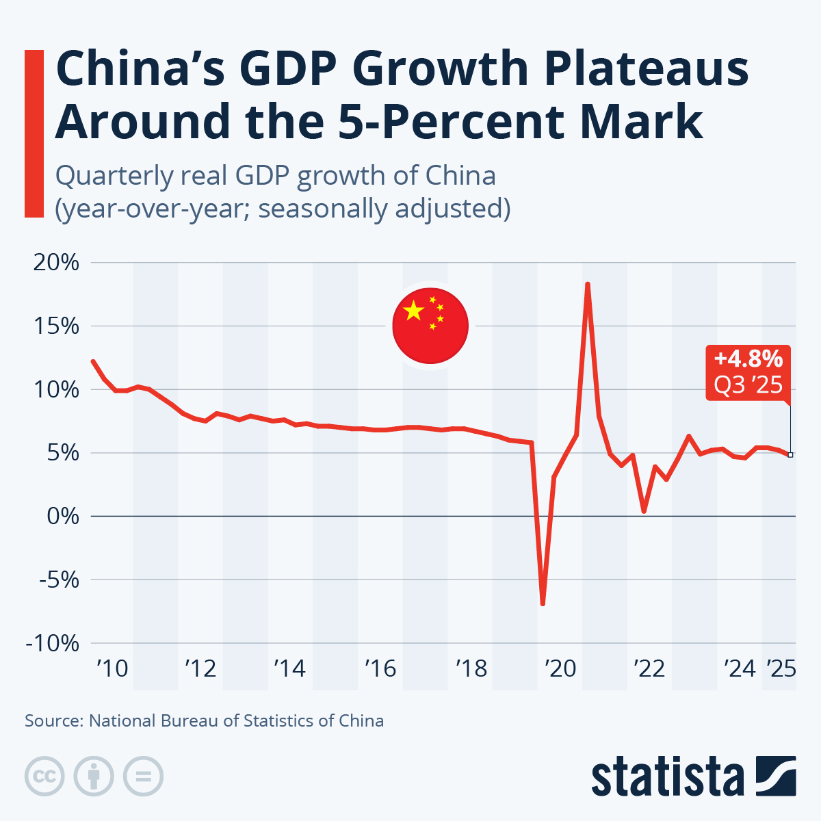

Slide 10
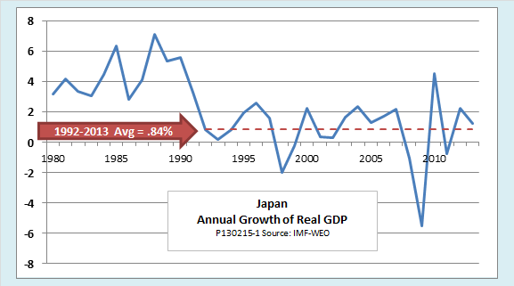
Japan’s Growth Over Time

Slide 11
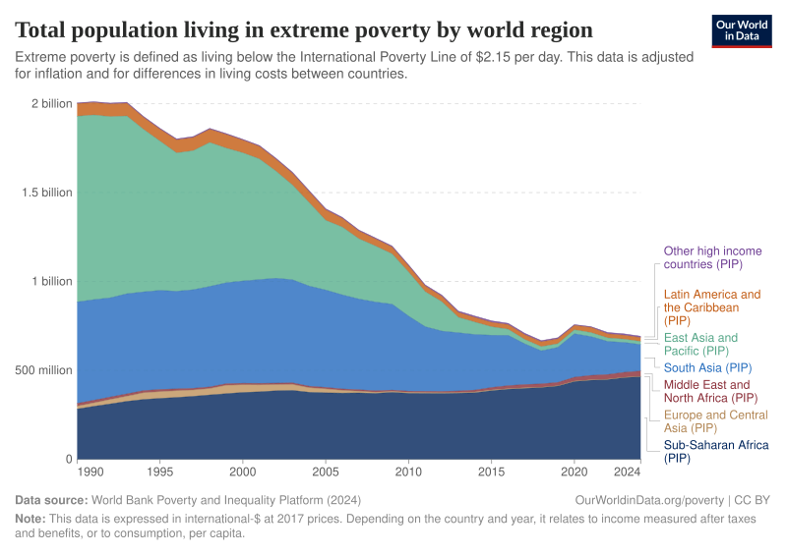
Poverty Reduction
https://ourworldindata.org/grapher/total-population-living-in-extreme-poverty-by-world-region

Slide 12
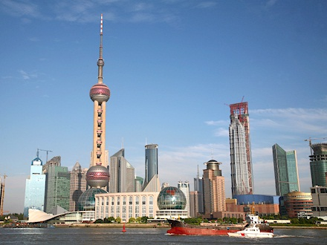
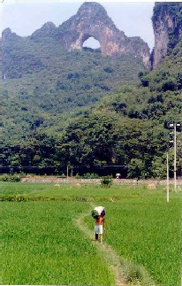
Population and Development Indicators for Asia Vary Greatly

Slide 13
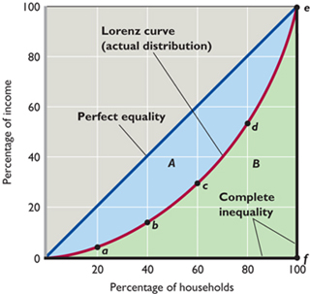
The Lorenz Curve
  The Gini coefficient is the ratio of the areas A/(A+B) in the figure above

Slide 14
The Gini Coefficient
To summarize inequality in a single number, some statistics were developed
The most popular one is the Gini coefficient
  The ratio of the areas A/(A+B)
  Larger Gini coefficient means larger inequality (note that the coefficient is between 0 and 1)
  Keep in mind, however, sometimes the value is based on 100 point scale.
Another popular approach is to compare the income of different fractions of the population; for example: ratio between income of the 20% richest and income of the 20% poorest

Slide 15
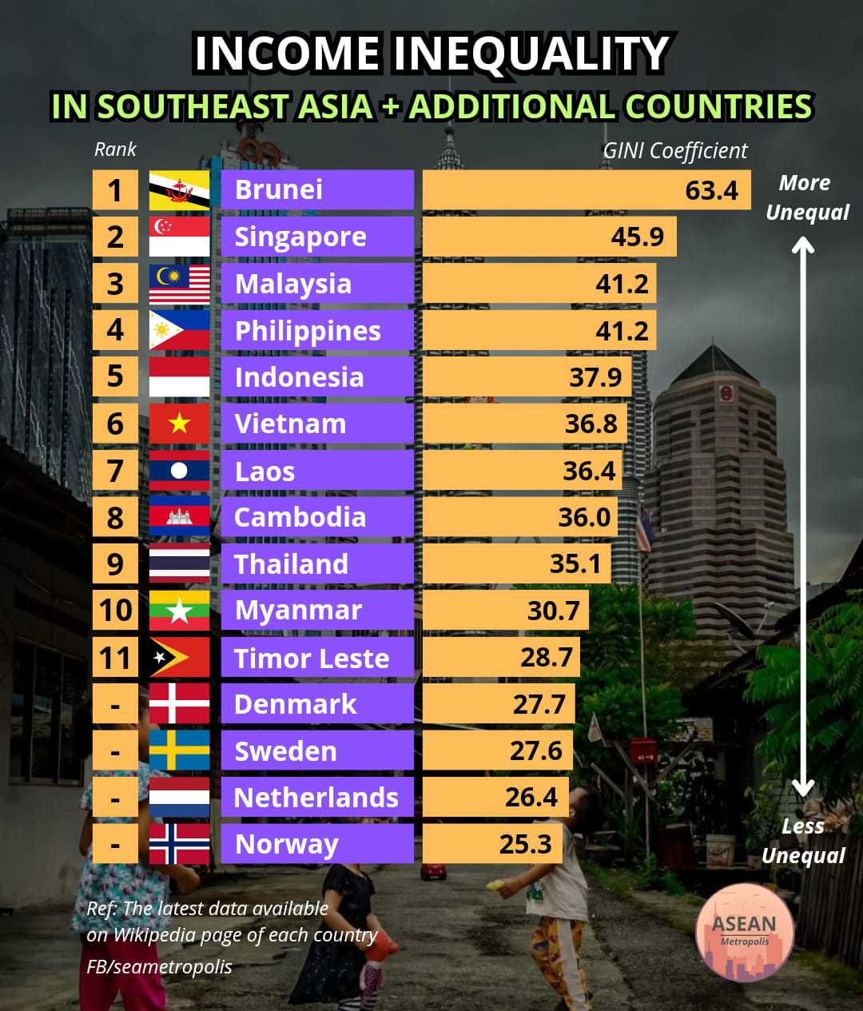
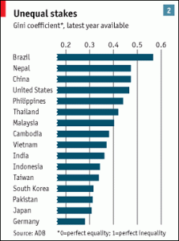
https://data.adb.org/dataset/gini-coefficient-asia-and-pacific

Slide 16
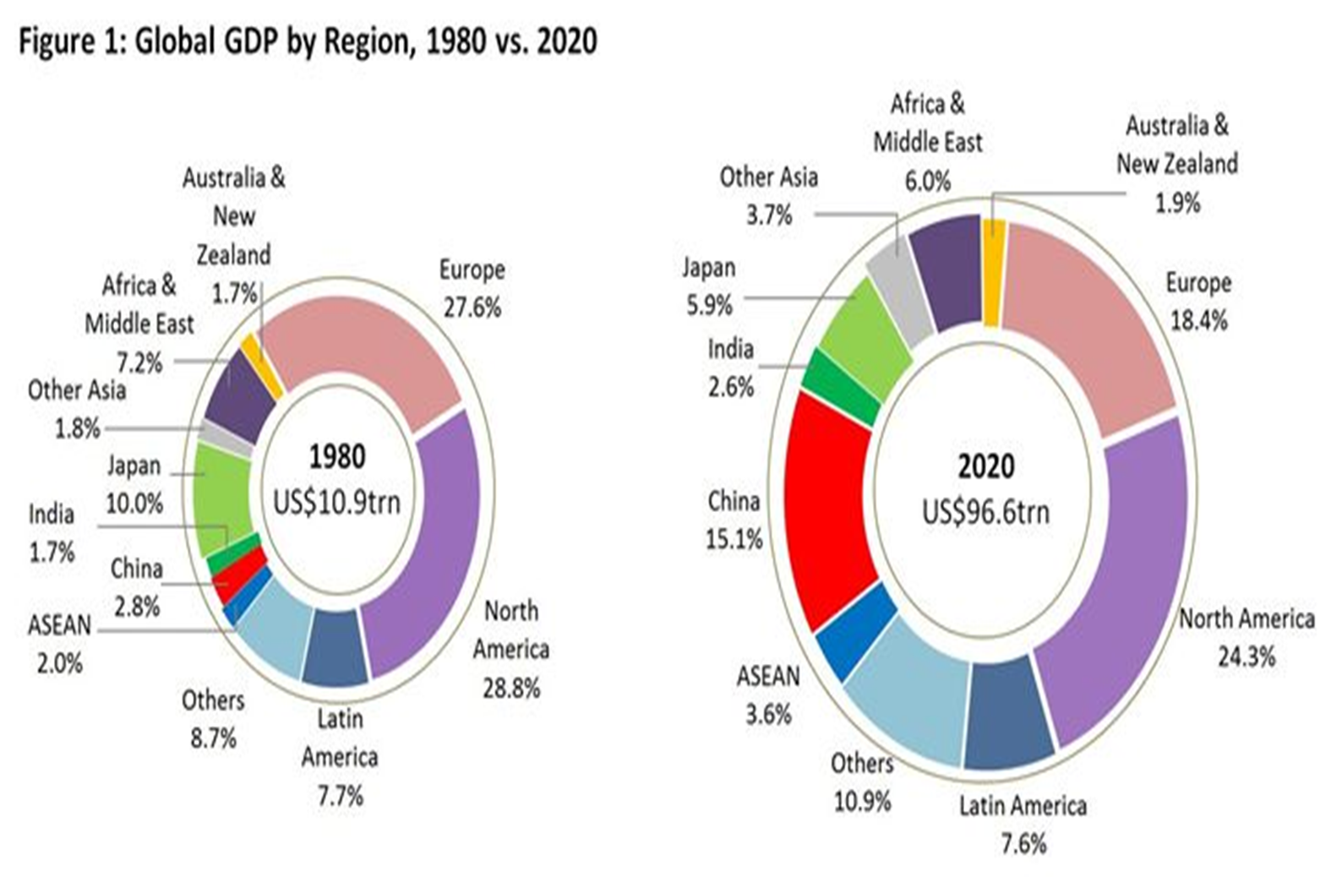

Slide 17
There is Diversity and Change in the Region
Some of the richest and most advanced economies, but also some very poor countries
  Speedy and the needy
The largest country (China), but also the smallest (Singapore)
Rapid changes during past decades
Some natural resource-rich, some natural resource-poor
In some population predominantly urban, in manufacturing/services, some, still predominantly rural, in agriculture
Still large differences in social structure (income distribution, health and education indicators)

Slide 18
Historical Background: Links, Similarities and Differences
Historical links in Asia go back many centuries
  Chinese and Indian cultural influences and links
  Trade links
Direct western colonial rule: South Asia, Southeast Asia (except Thailand)
    British, Dutch, French, Portuguese, Spanish-American
  Western domination : China, Thailand
  Japanese colonialism

Slide 19
Differences in the Political Environment
Political systems can vary from democratic to totalitarian
Democratic system - multiple centers of power, none of which is powerful enough to completely control decision making
Totalitarian system - political power is highly concentrated in a small elite group
GIVE EXAMPLES

Slide 20
Differences in Political Ideology
Political philosophy covers issues as government intervention, role of market forces and attitudes towards profit and risk
Ranges from capitalism to socialism
Capitalism - private ownership of business enterprises is encouraged
Socialism - public ownership of businesses is common, with substantial government regulations of the workings of a free market
GIVE EXAMPLES

Slide 21
Independence and Post-Independence
Nationalist movements: relatively peaceful vs revolutionary/violent
Communist movements in independence struggles
Regional conflicts
Political ideology and circumstances, and economic policy

Slide 22
Convergence in Economic Policies
Since late 1970s, process of economic policy liberalization – market oriented policies
Late 1980s-early 1990s, pace of liberalization accelerated
1997 crisis and aftermath
2001 on – rapid development in China, Vietnam
2008-9 How has the region weathered the financial crisis?
2020-2025 China’s role in the world.
Keep in mind that history, culture, structure, politics matter

Slide 23
Some Important Issues for East Asia
Maintaining regional peace and security
  South China Sea issues
Narrowing the gap between early developers and latecomers
Promoting globalization while mitigating its negative impacts
WTO, Economics Liberalization
Pollution
Political economy (Tariffs)
Human resource development institution building, governance for strengthening competitiveness
Population Decline
https://www.imf.org/en/Blogs/Articles/2025/10/16/asias-economic-growth-is-weathering-tariffs-and-uncertainty

Slide 24

"It doesn't matter whether the cat is black or white, as long as it catches mice."
Deng Xiaoping (Former Chinese Prime Minister)
What does the above statement mean?

